Slide 1
Slides For Roy HOLT

Slide 2
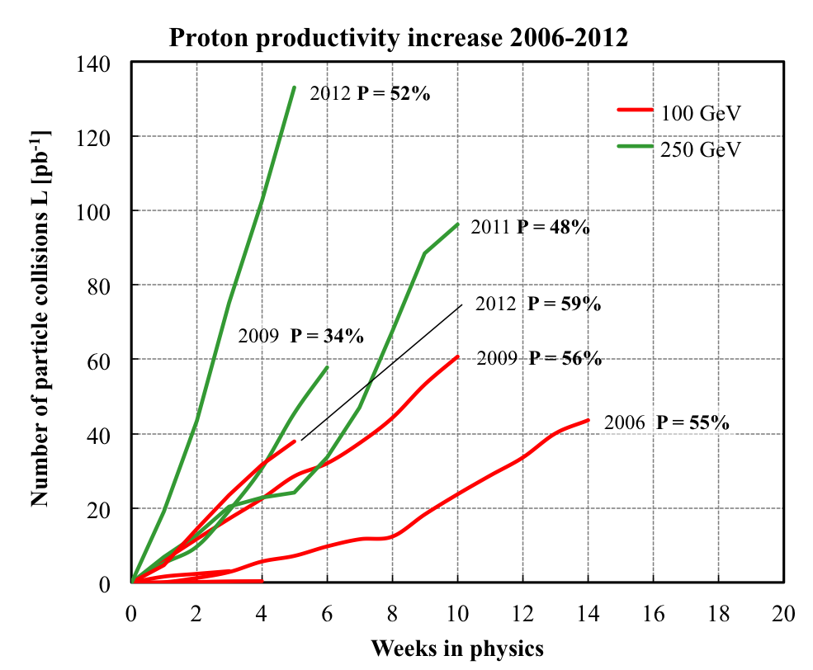
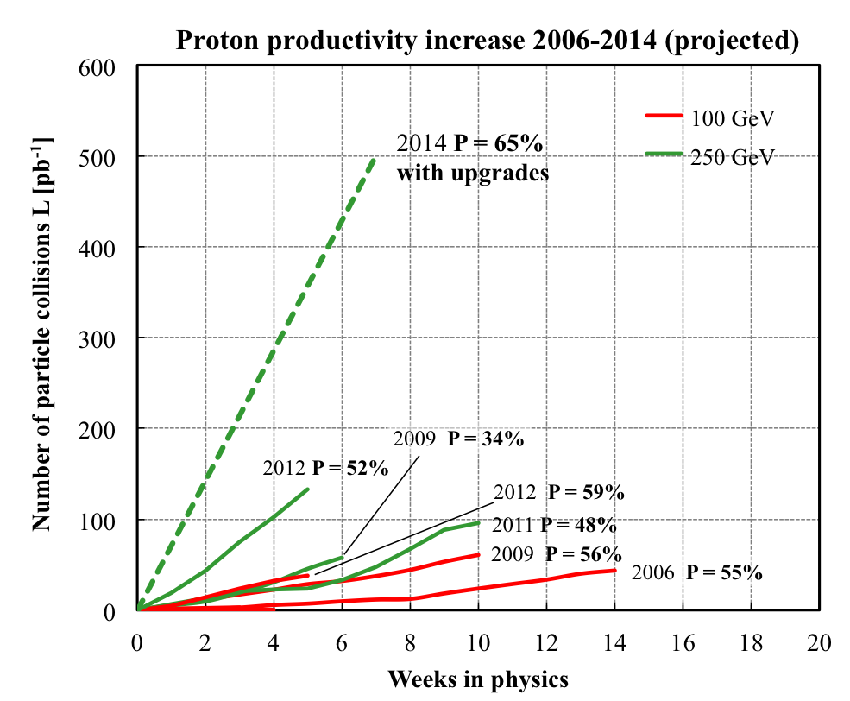
RHIC polarised pp performance
2012:
golden year for polarized
proton operation
100 GeV:
new records for L_{peak}, L_{avg}, P
255 GeV:
new records for L_{peak}, L_{avg}, P
highest E for pol. p beam
L_{avg}: +15%
P_{avg}: +8%
What will come:
increased Luminosity and
polarization through
OPPIS new polarized source
Electron lenses to
compensate beam-beam
effects
many smaller incremental
improvements
will make luminosity
hungry processes,
i.e. DY, easier accessible

Slide 3
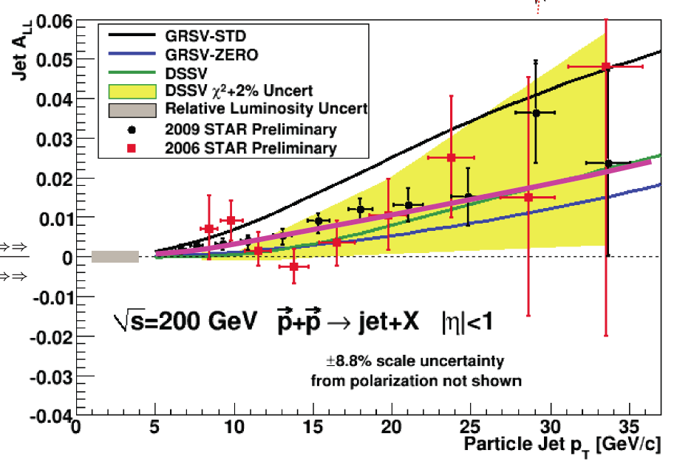

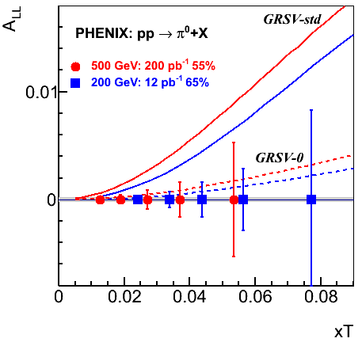
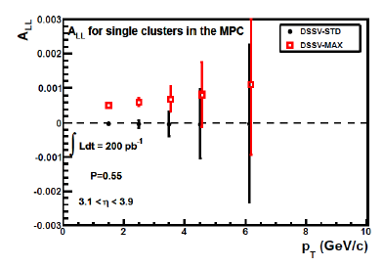

The Spin Structure of the Proton: ΔG
STATUS DIS + RHIC≤2006:
xΔg
Now:
RHIC
200 GeV
DIS
RHIC
500 GeV
forward η
After run-14 RHIC will have a nice set of high
statistics data to determine Δg(x) for x > 0.01
and has started measurements to explore Δg(x) at lower x
DSSV+STAR-Jets 2009
Run 2009 - 2014:
need to control systematics
very well for forward η

Slide 4

The way to Δq: W Production
u
W is maximally parity violating
→ W’s couple only to one parton helicity
large Δu and Δd result in large asymmetries
Complementarity to SIDIS:
No need for fragmentation functions
extremely clean theoretically
Very high Q² ~ M²_{W} ~ 6463 GeV²
Input
PHENIX
& STAR
data
in global
pQCD fit
uncertainty bands: Δχ² = 2%

Slide 5
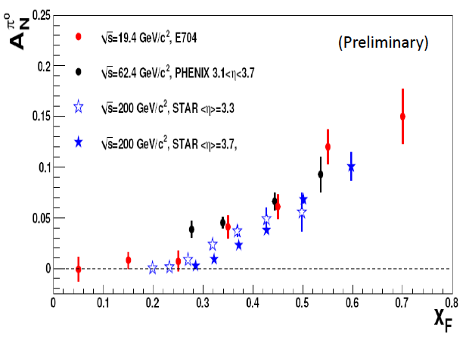
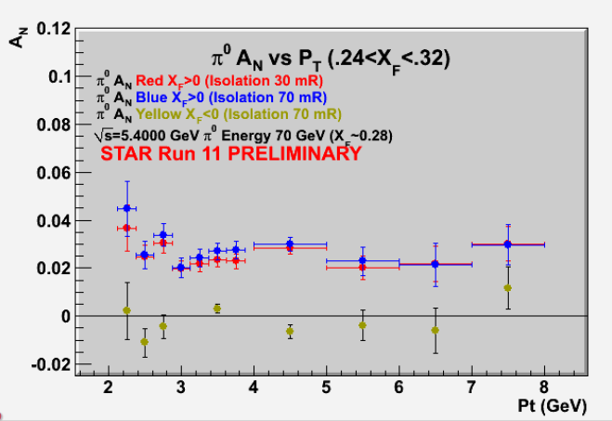
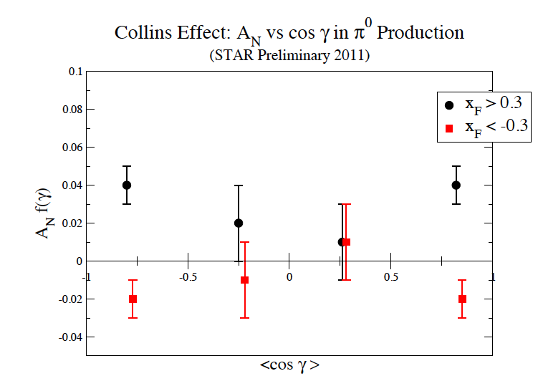
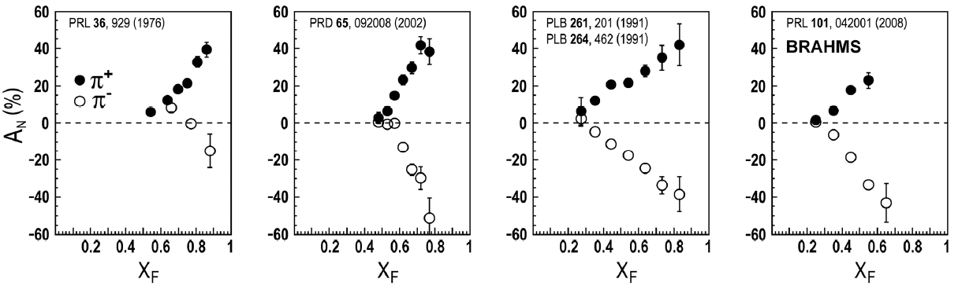
New puzzles in forward physics: large A_{N} at high √s
Big single spin asymmetries in pp !!
Naive pQCD (in a collinear picture)
predicts A_{N} ~ α_{s}m_{q}/sqrt(s) ~ 0
Do they survive at high √s ? YES
Is observed p_{t} dependence as expected
from p-QCD? NO
What is the underlying process?
Sivers / Twist-3 or Collins or ..
till now only hints
Left
Right
ANL ZGS
√s=4.9 GeV
BNL AGS
√s=6.6 GeV
FNAL
√s=19.4 GeV
BRAHMS@RHIC
√s=62.4 GeV
√s=500GeV
FPD:
Not jet corrected for
kinematic smearing

Slide 6
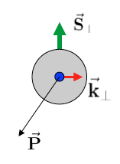
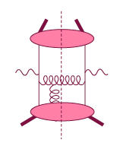
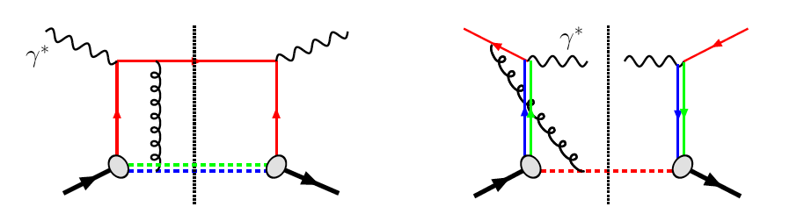
HP13: The sign change of the Sivers fct.
Intermediate Q_{T}
Q>>Q_{T}/p_{T}>>Λ_{QCD}
Transverse
momentum
dependent
Q>>Q_{T}>=Λ_{QCD}
Q>>p_{T}
Collinear/
twist-3
Q,Q_{T}>>Λ_{QCD}
p_{T}~Q
Efremov, Teryaev;
Qiu, Sterman
Sivers fct.
Q_{T}/P_{T}
Λ_{QCD}
<<
Q_{T}/P_{T}
<<
Q
critical test for our understanding of TMD’s and TMD factorization
QCD:
DIS:
attractive FSI
Drell-Yan:
repulsive ISI
Sivers_{DIS} = - Sivers_{DY} or Sivers_{W} or Sivers_{Z0}

Slide 7
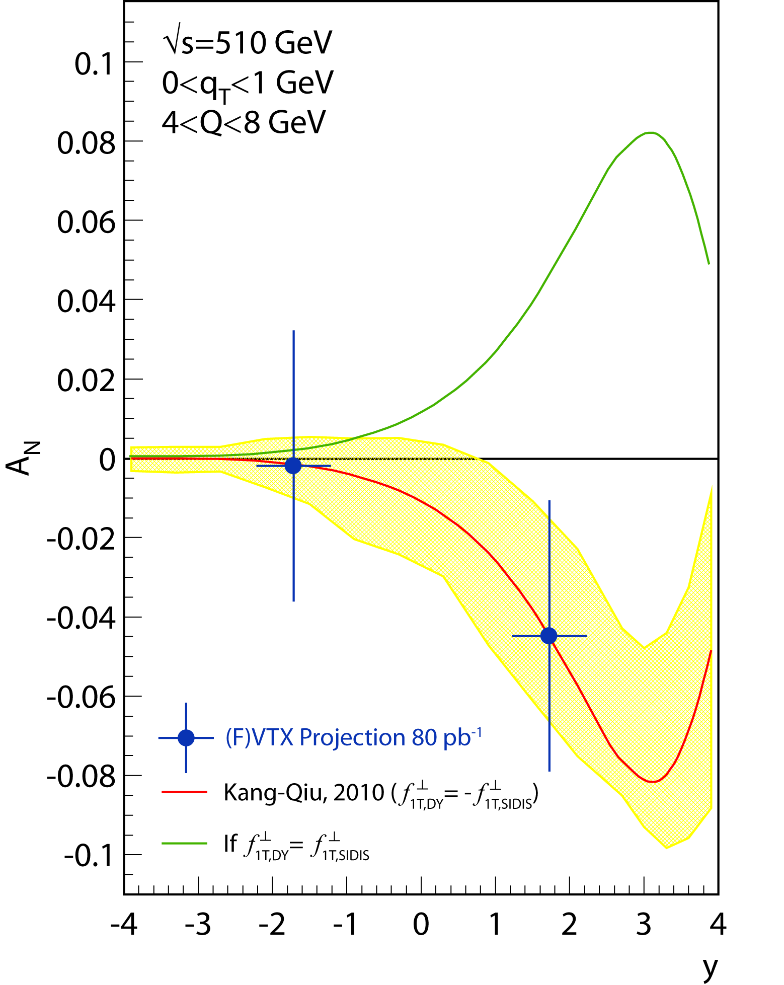
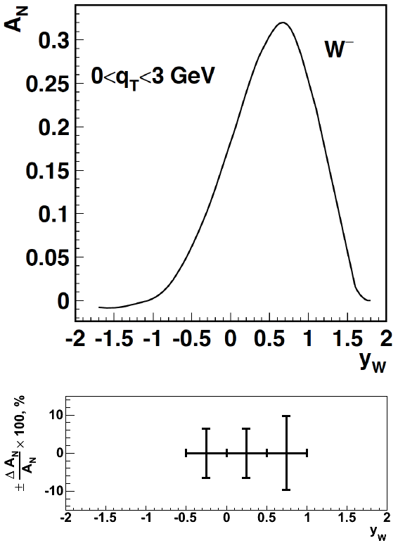
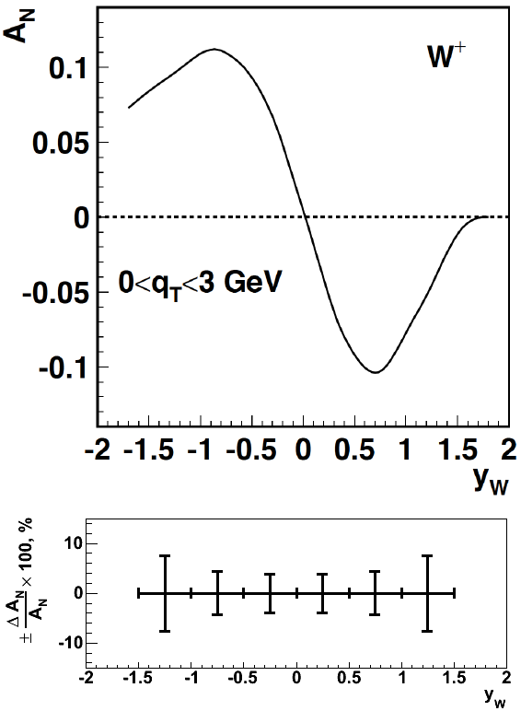
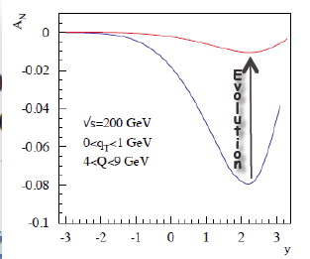
What Can PHENIX and STAR DO
Delivered Luminosity: 500pb⁻¹ (~6 weeks for Run14+)
PHENIX A_{N}(DY):
1.2<|y|<2.4
Muon-Arms+FVTX → S/B ~ 0.2
STAR A_{N}(W):
-1.5 < y < 1.5
1 GeV<q_{T}
1 GeV<q_{T}
Extremely clean measurement of δA_{N}(Z0)+/-10%
for <y> ~0
Caveat:
potentially large evolution effects on A_{N} for DY, W, Z0
not yet theoretically full under control and accounted for

Slide 8
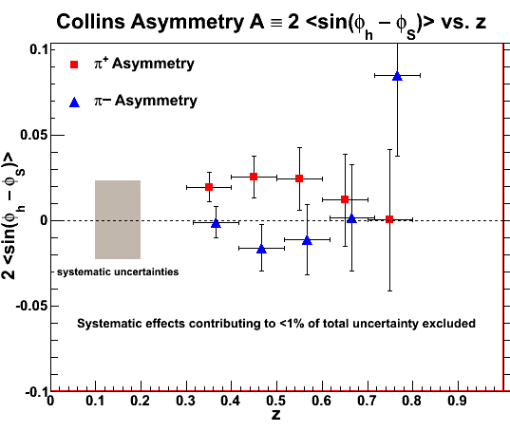
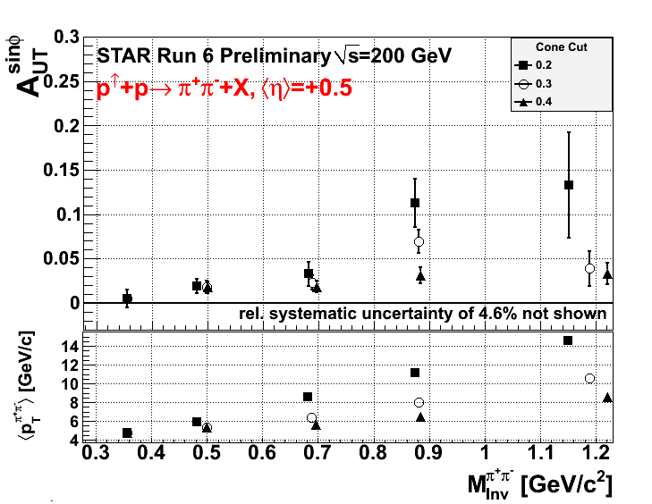
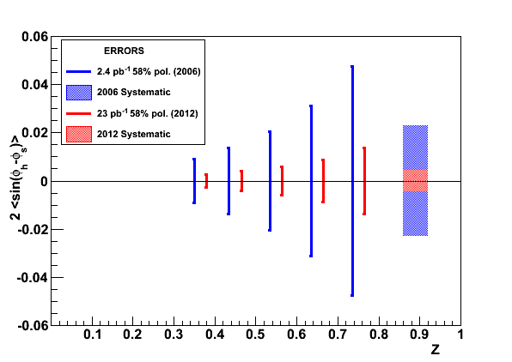
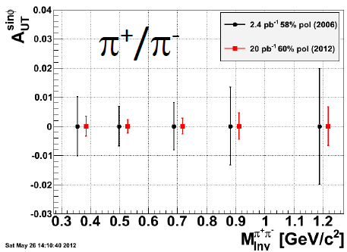
A_{N}: How to get to THE underlying Physics
SIVERS
Transversity x Collins
Rapidity dependence of
A_{N} for π⁰ and eta with increased p_{t} coverage
A_{N} for jets
A_{N} for direct photons
A_{N} for heavy flavour → gluon
π^{+/-}π⁰ azimuthal distribution in jets
Interference fragmentation function
TransversityxInterference FF
Direct Photon at 200 GeV
P=60% L=50 pb⁻¹
Sivers models:
fits to SIDIS pp-A_{N}

Slide 9
ADDITIONAL Material

Slide 10
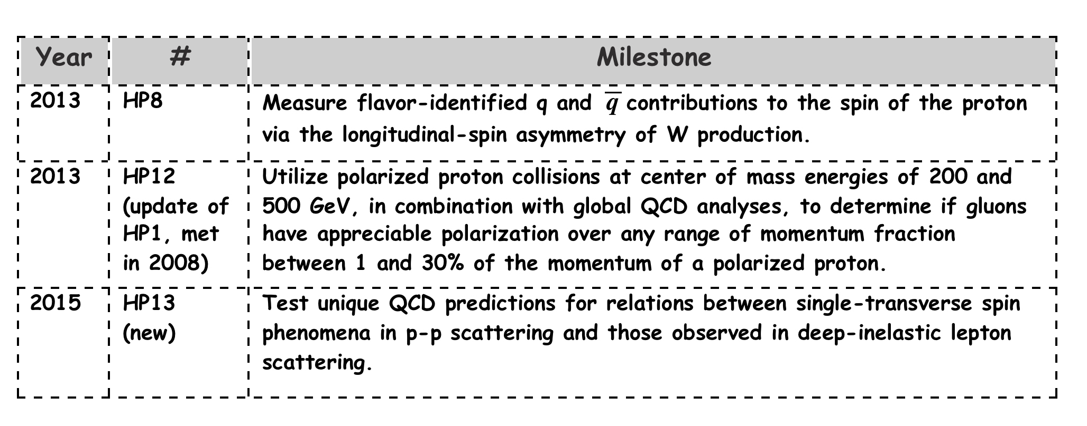
The RHIC SPIN PROGRAM Milestones

Slide 11
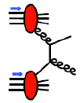
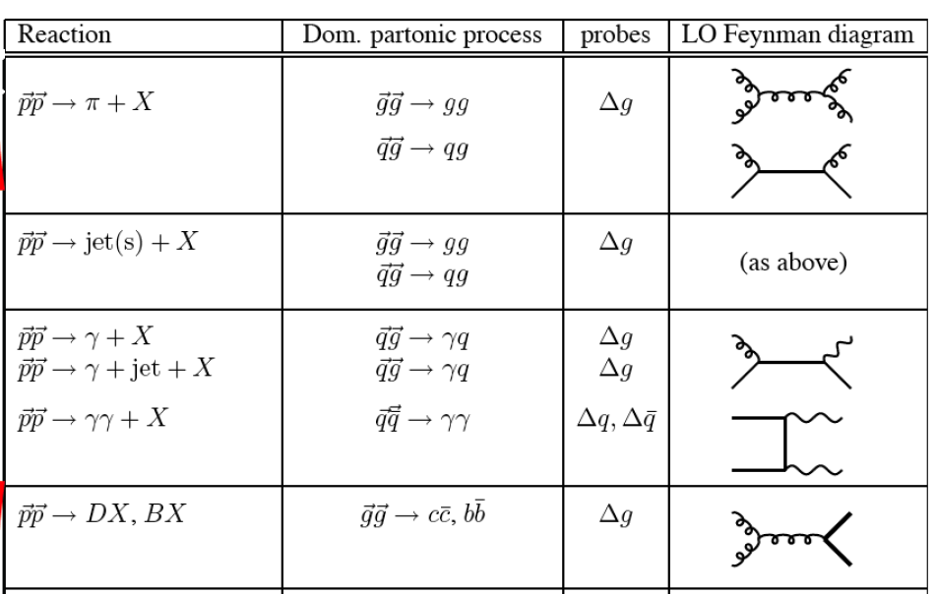
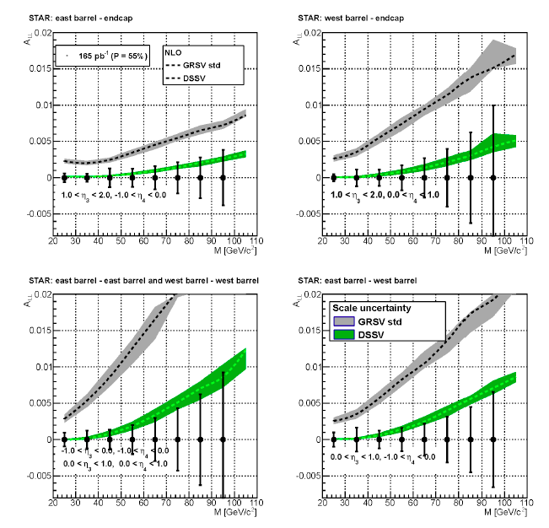
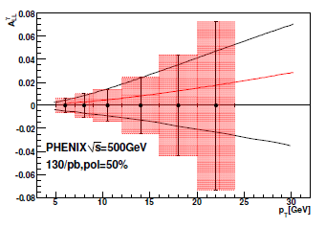
DG: Other Observables
RHIC: many sub-processes with a
dominant gluon contribution
high-p_{T} jet, pion,
heavy quark, …
π⁰:
π±→ sign of Δg
L ~ 600 pb⁻¹ (500GeV)
π±:
di-jets
→ constrain x-shape
theoretically clean
but luminosity hungry
L ~5fb⁻¹ (500 GeV)
Di-jets
GRSV-max
500 GeV
combining
Run12+13
will reduce
uncertainties
by 2
GRSV-std
GRSV-min
600/pb P=50%

Slide 12
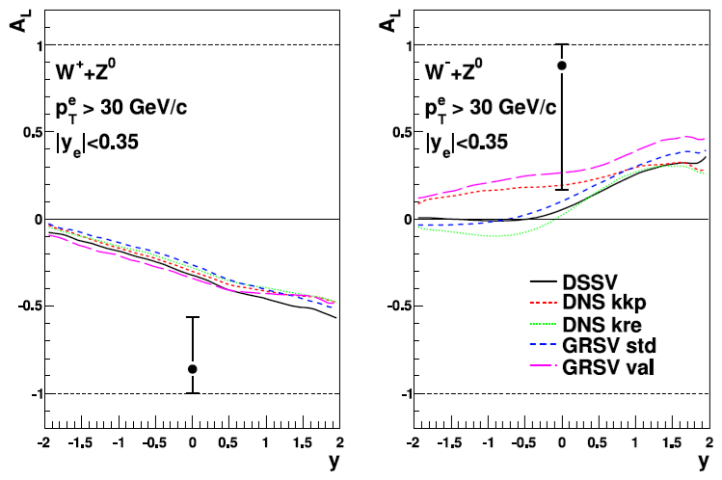
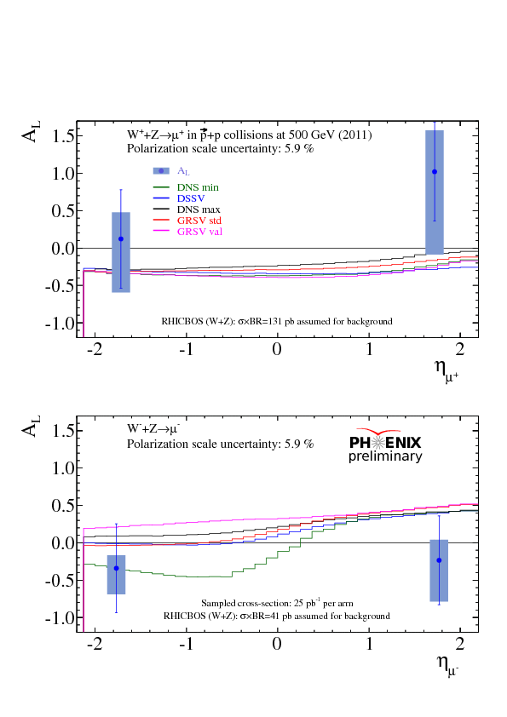
Current W-Results
Run-2009:
Run-2011:

Slide 13
Transverse PHYSICS: What else do we know
Collins / Transversity:
  conserve universality in hadron hadron interactions
  FF_{unf} = - FF_{fav} and δu ~ -2δd
  evolve ala DGLAB, but soft because no gluon contribution (i.e. non-singlet)
Sivers, Boer Mulders, ….
  do not conserve universality in hadron hadron interactions
  k_{t} evolution → can be strong
    till now predictions did not account for evolution
  FF should behave as DSS, but with k_{t} dependence unknown till today
  u and d Sivers fct. opposite sign d >~ u
  Sivers and twist-3 are correlated
    global fits find sign mismatch, possible explanations,
    like node in k_{t} or x don’t work

Slide 14
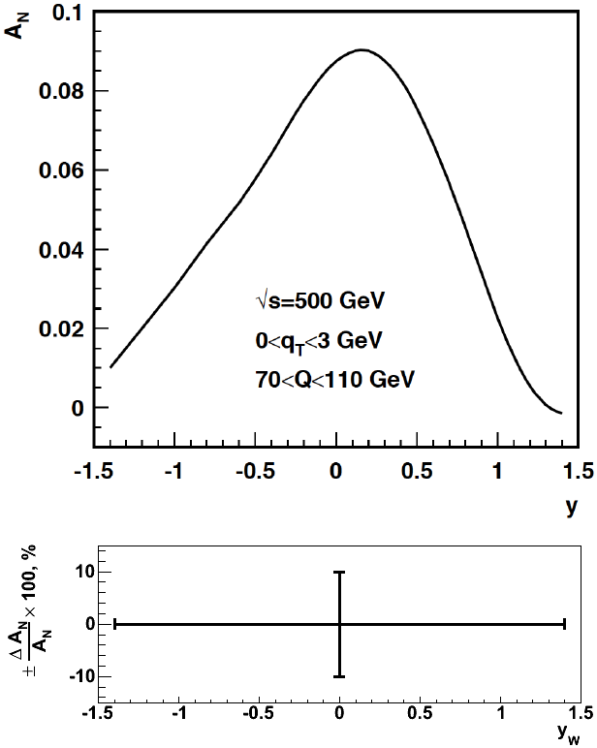
A_{N}: Z0
300 pb⁻¹ -> ~10% on a single bin of A_{N}
Generator: PYTHIA 6.8
Clean experimental momentum reconstruction
Negligible background
electrons rapidity peaks within tracker acceptance (|η|< 1)
Statistics limited

Slide 15
THE RHIC SPIN Program > 2015
potential to get the first glimpse of GPD E for gluons
  A_{UT}(J/ψ) in p↑A
going forward:
map out transverse spin effects (Sivers, Collins, IFF)
Δg(x) at low-x

Slide 16
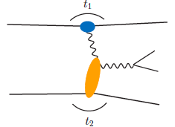
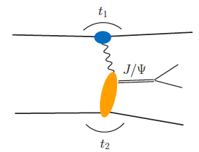
From pp to γ p/A
Get quasi-real photon from one proton
Ensure dominance of g from one identified proton
by selecting very small t₁, while t₂ of “typical hadronic
size”
small t₁ ←→ large impact parameter b (UPC)
Final state lepton pair ←→ timelike compton scattering
timelike Compton scattering: detailed access to GPDs
including E^{q;g} if have transv. target pol.
Challenging to suppress all backgrounds
Final state lepton pair not from γ* but from J/ψ
  Done already in AuAu
  Estimates for J/ψ (hep-ph/0310223)
transverse target spin asymmetry → calculable with GPDs
information on helicity-flip distribution E for gluons
golden measurement for eRHIC
Z²
A²
Gain in statistics doing polarized p↑A

Slide 17
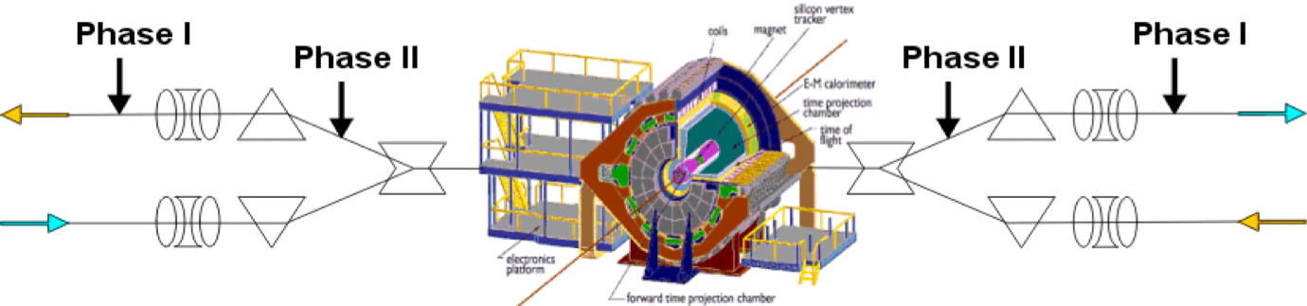
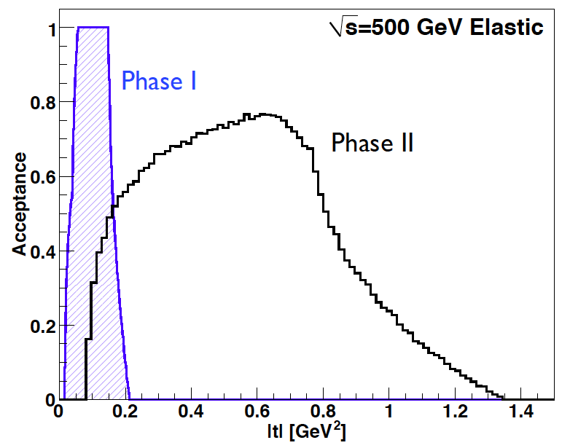
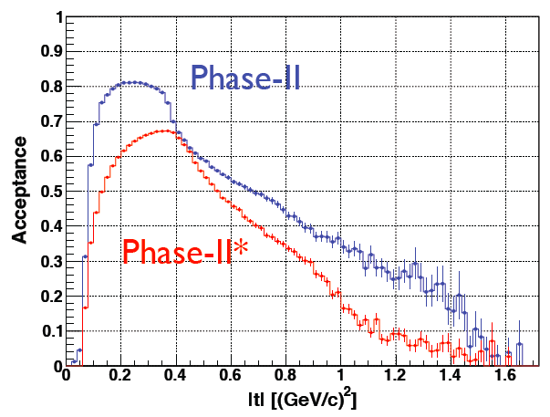
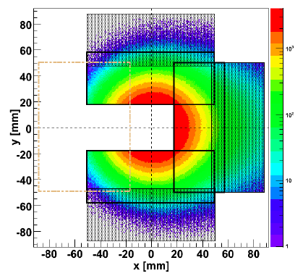
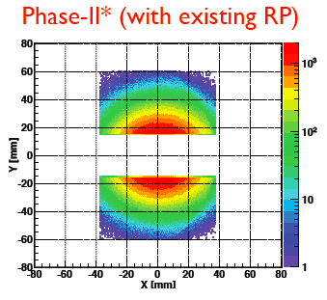
Forward Proton Tagging at STAR/RHIC
at 55-58m
at 15-17m
J.H. Lee
Roman Pot detectors to measure forward scattered protons in diffractive processes
Staged implementation to cover wide kinematic coverage
Phase I (Installed): for low-t coverage
Phase II (planned) : for higher-t coverage
    8(12) Roman Pots at ±15 and ±17m
    2π coverage in φ will be limited due to
    machine constraint (incoming beam)
No special β* running needed any more
→ 250 GeV to 100 GeV
scale t-range by 0.16

Slide 18
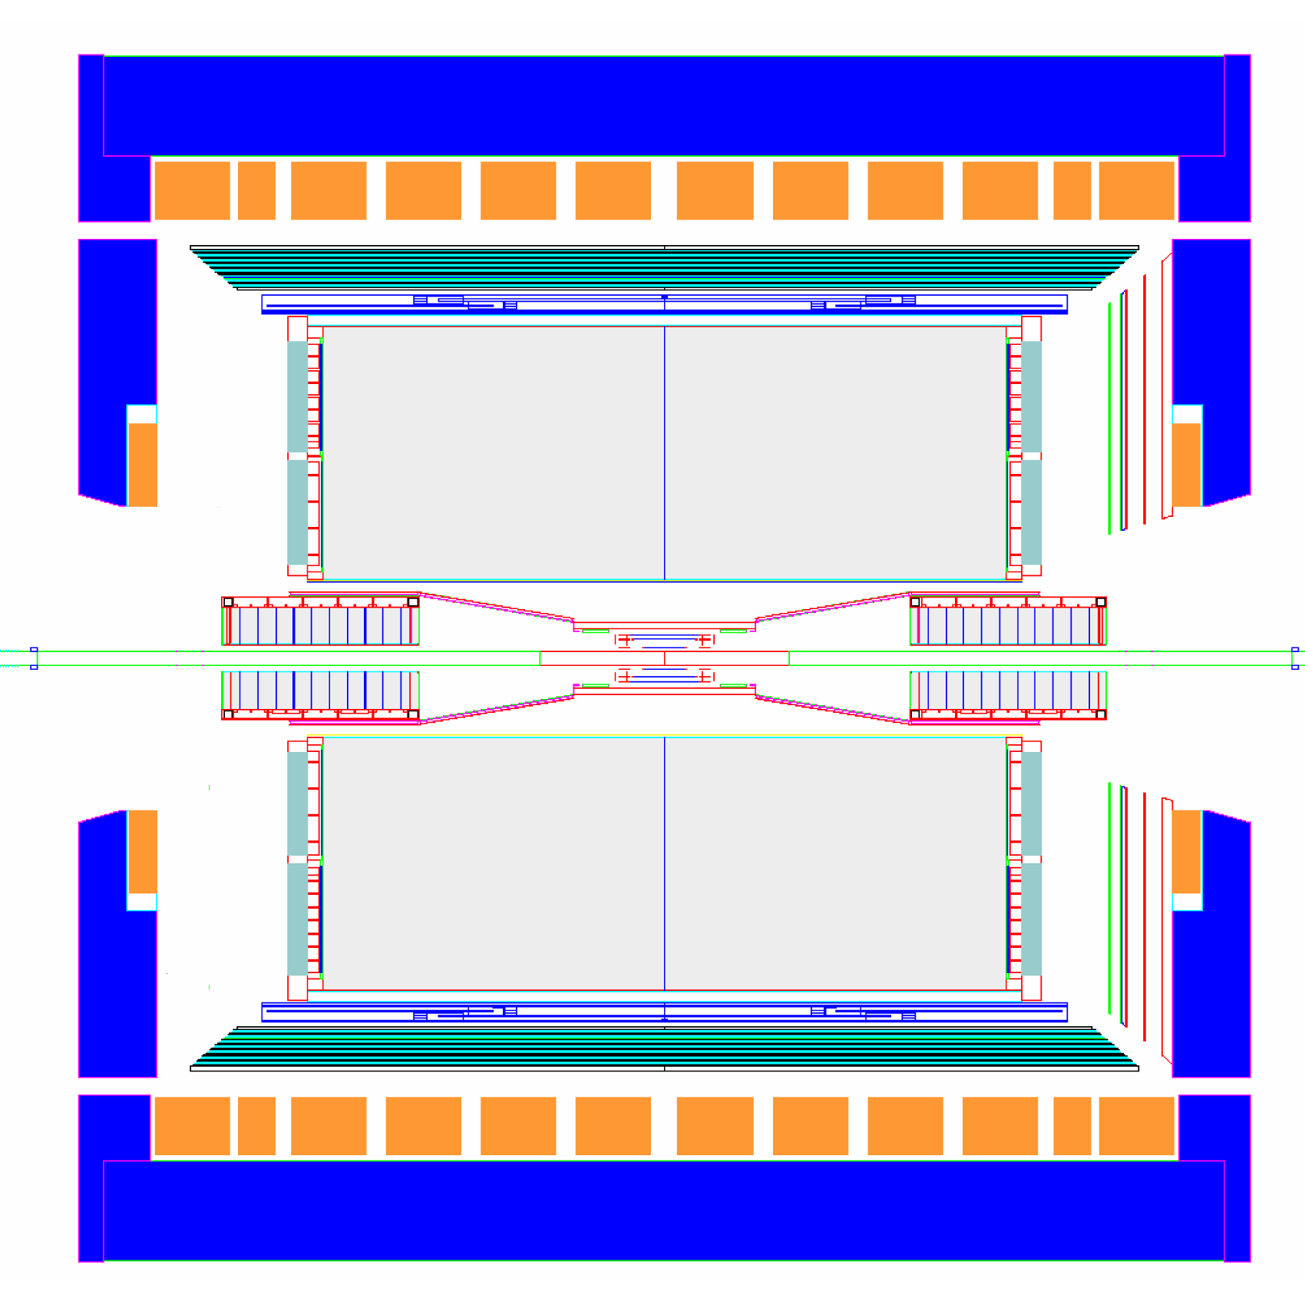
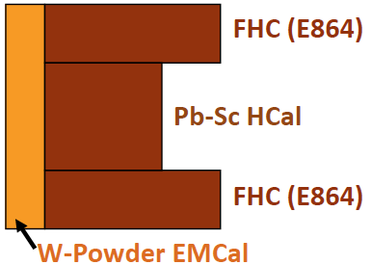
STAR Forward Instrumentation UpGrade
proton
nucleus
~ 6 GEM disks
Tracking: 2.5 < η < 4
> 2016
SPACAL
Threshold Cerenkov
π^{+/-} ID
Preshower
1/2” Pb radiator
Shower “max”
Forward instrumentation optimized for p+A and transverse spin physics
– Charged‐particle tracking
– e/h and γ/π⁰ discrimination
– Possibly Baryon/meson separation

Slide 19
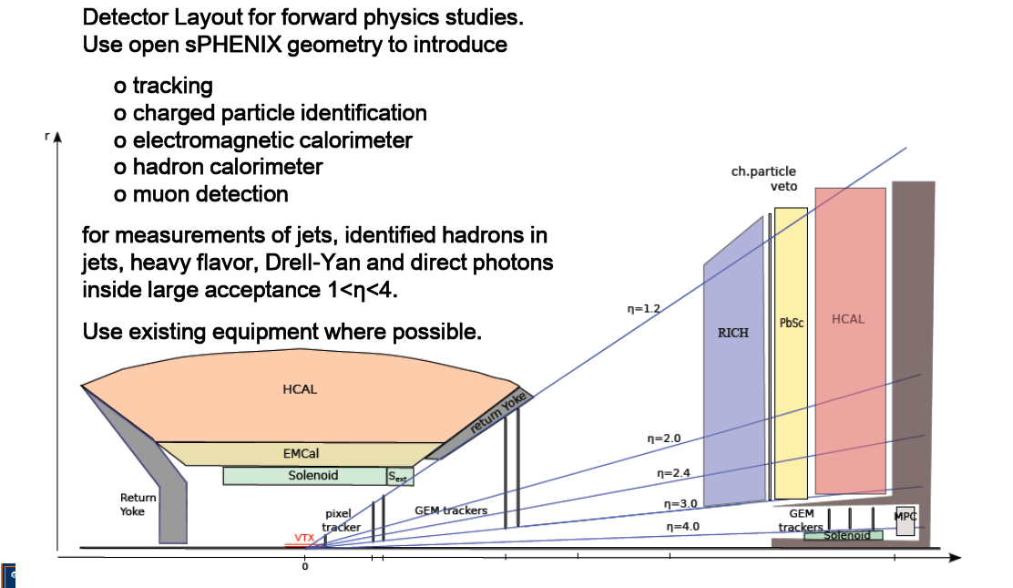
The sPHENIX forward Upgrade

Slide 20
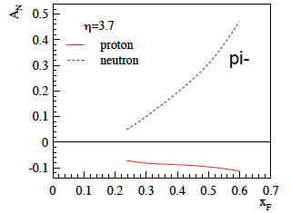
What pHe³ can teach us
Polarized He-3 is an effective neutron target → d-quark target
  Polarized protons are an effective u-quark target
Therefore combining pp and pHe3 data will allow a full
quark flavor separation u, d, ubar, dbar
Two physics trusts for a polarized pHe3 program:
Measuring the sea quark helicity distributions through W-production
  Access to Δdbar
  Caveat maximum beam energy for He-3: 166 GeV
    Need increased luminosity to compensate for lower W-cross section
Measuring single spin asymmetries A_{N} for pion production and Drell-Yan
  expectations for A_{N} (pions)
    similar effect for π± (π⁰ unchanged)
³He: helpful input for understanding
of transverse spin phenomena
Critical to tag spectator protons from 3He with roman pots

Slide 21
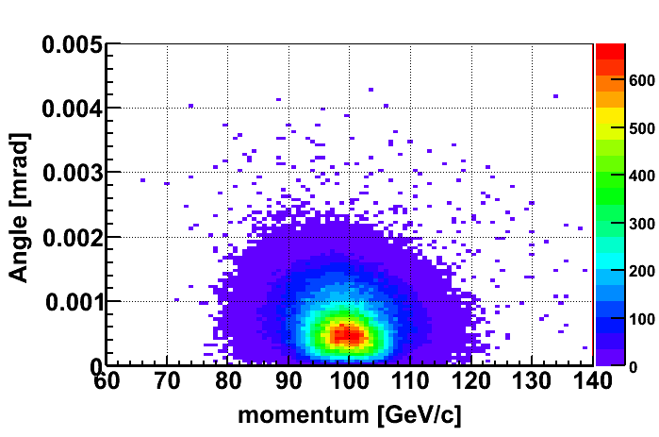
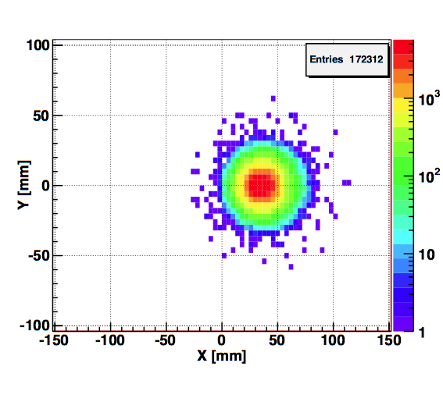
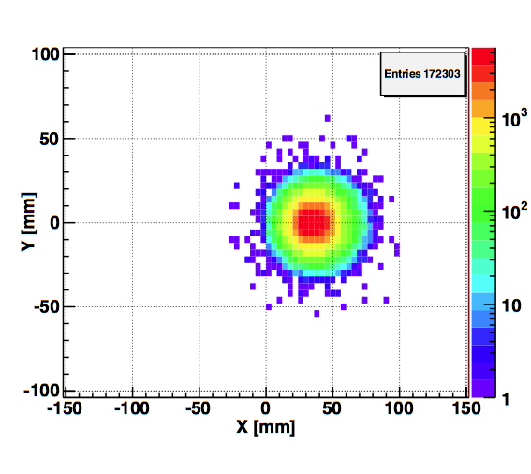
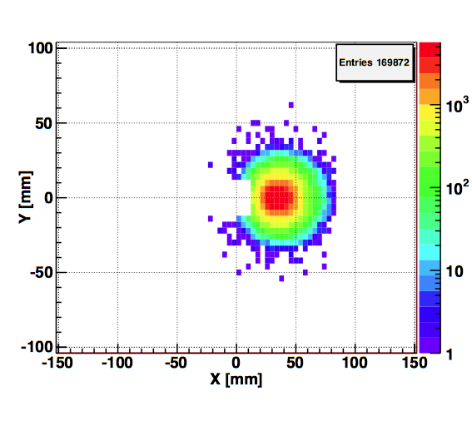
Spectator proton from ³He with the current RHIC optics
Momentum smearing mainly due
to Fermi motion + Lorentz boost
Angle <~3mrad (>99.9%)
Angle [rad]
Study: JH Lee
generated
Passed DX aperture
Accepted in RP
The same RP configuration with the current RHIC optics (at z ~ 15m between DX-D0)
Acceptance ~ 98%

Slide 22
Collected Luminosity with longitudinal Polarization
Year | √s [GeV] | Recorded PHENIX | Recorded STAR | Pol [%]
2002 (Run 2) | 200 | / | 0.3 pb⁻¹ | 15
2003 (Run 3) | 200 | 0.35 pb⁻¹ | 0.3 pb⁻¹ | 27
2004 (Run 4) | 200 | 0.12 pb⁻¹ | 0.4 pb⁻¹ | 40
2005 (Run 5) | 200 | 3.4 pb⁻¹ | 3.1 pb⁻¹ | 49
2006 (Run 6) | 200 | 7.5 pb⁻¹ | 6.8 pb⁻¹ | 57
2006 (Run 6) | 62.4 | 0.08 pb⁻¹ |  | 48
2009 (Run9) | 500 | 10 pb⁻¹ | 10 pb⁻¹ | 39
2009 (Run9) | 200 | 14 pb⁻¹ | 25 pb⁻¹ | 55
2011 (Run11) | 500 | 27.5 / 9.5pb⁻¹ | 12 pb⁻¹ | 48
2012 (Run12) | 500 | 30 / 15 pb⁻¹ | 82 pb⁻¹ | 50/54

Slide 23
Collected Luminosity with transverse Polarization
Year | √s [GeV] | Recorded PHENIX | Recorded STAR | Pol [%]
2001 (Run 2) | 200 | 0.15 pb⁻¹ | 0.15 pb⁻¹ | 15
2003 (Run 3) | 200 | / | 0.25 pb⁻¹ | 30
2005 (Run 5) | 200 | 0.16 pb⁻¹ | 0.1 pb⁻¹ | 47
2006 (Run 6) | 200 | 2.7 pb⁻¹ | 8.5 pb⁻¹ | 57
2006 (Run 6) | 62.4 | 0.02 pb⁻¹ |  | 53
2008 (Run8) | 200 | 5.2 pb⁻¹ | 7.8 pb⁻¹ | 45
2011 (Run11) | 500 | / | 25 pb⁻¹ | 48
2012 (Run12) | 200 | 9.2/4.3 pb⁻¹ | 22 pb⁻¹ | 61/58

