Slide 1
eRHIC:
New Scientific and Technology Frontiers
TO DO Parton femtoscopy
Thanks to Tom B., Thomas, Ramiro, Salvatore, Matt, Jh, Dieter, Hubert, Marco, Liang, Tobias, Anders, Will,
AND eRHIC –CAD-TEAM

Slide 2

What is eRHIC
RHIC
Existing = $2B
Electron accelerator
to be build
p
Polarized protons
50-250 GeV
Unpolarized and
polarized leptons
5-20 (30) GeV
e⁻
Light ions (d,Si,Cu)
Heavy ions (Au,U)
50-100 GeV/u
e⁻
e⁺
70% e⁻ beam polarization goal
polarized positrons?
Polarized light ions He³ 166 GeV/u
Center mass energy range: √s=30-200 GeV; L~100-1000xHera
longitudinal and transverse polarization for p/He³ possible
protons
electrons

Slide 3
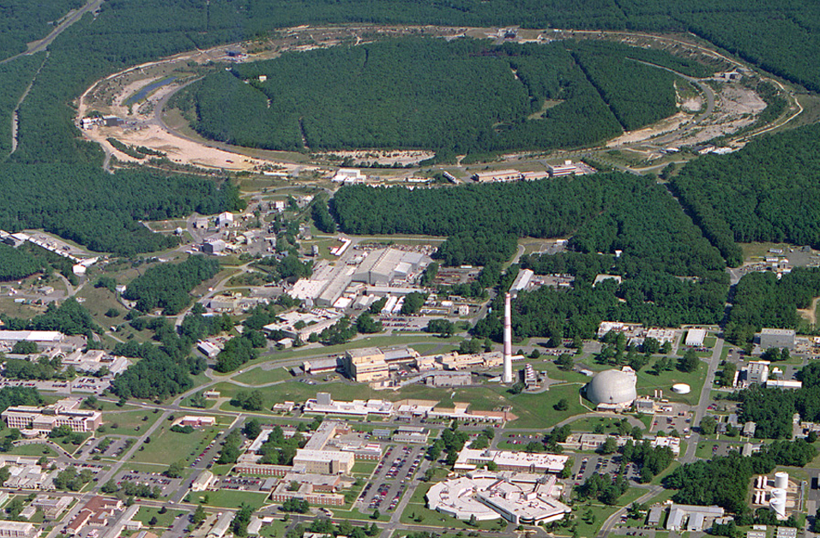
From RHIC to eRHIC
eLenses
10:00 o’clock
Jet/C-Polarimeters
12:00 o’clock
eRHIC-Detector
& Polarimeters
12:00 o’clock
CeC
2:00 o’clock
RHIC
eRHIC
e
PHENIX
8:00 o’clock
RF
4:00 o’clock
e
STAR
6:00 o’clock
LINAC
NSRL
EBIS
Booster
ERL Test Facility
AGS
Tandems

Slide 4

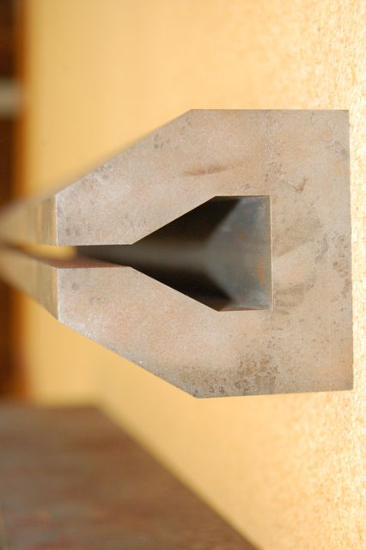

EIC@BNL: eRHIC
All energies scale proportionally by adding SRF cavities to the injector
0.02 Eo
Polarized
e-gun
0.6 GeV
Beam
dump
27.55 GeV
New
detector
 | e | p | ²He³ | ⁷⁹Au¹⁹⁷ | ⁹²U²³⁸
Energy, GeV | 20 | 250 | 167 | 100 | 100
CM energy, GeV |  | 141 | 115 | 89 | 89
Number of bunches/distance between bunches | 74 nsec | 166 | 166 | 166 | 166
Bunch intensity (nucleons) ,10¹¹ | 0.24 | 2 | 1.3 | 0.79 | 0.83
Bunch charge, nC | 3.8 | 32 | 10 | 5.2 | 5.2
Beam current, mA | 50 | 420 | 140 | 67 | 67
Normalized emittance of hadrons , 95% , mm mrad |  | 1.2 | 1.2 | 1.2 | 1.2
Normalized emittance of electrons, rms, mm mrad |  | 32 | 48 | 80 | 80
Polarization, % | 80 | 70 | 70 | none | none
rms bunch length, cm | 0.2 | 8.3 | 8.3 | 8.3 | 8.3
β*, cm | 5 | 5 | 5 | 5 | 5
Luminosity per nucleon, x 10³⁴ cm⁻²s⁻¹ |  | 0.97 | 0.65 | 0.39 | 0.41
Linac
Coherent e-cooler
0.9183 Eo
Linac 2.45 GeV
Eo
0.8367 Eo
0.7550 Eo
0.6733 Eo
0.5917 Eo
E/Eo
0.0200
0.1017
0.1833
0.2650
0.3467
0.4283
0.5100
0.5917
0.6733
0.7550
0.8367
0.9183
1.0000
0.5100 Eo
0.4286 Eo
0.3467 Eo
0.2650 Eo
0.1017 Eo
0.1833 Eo
30 GeV
All magnets would installed from day one and we would be cranking power supplies up as energy is increasing
All staging in lepton Beam RF
ePHENIX
eSTAR
100 m
30 GeV
Notes:
We returned to developing cost effective and ECO-friendly eRHIC option with ERL located in the existing RHIC tunnel. We plan to install all magnets for 6 passes and 30 GeV from the start and then build up SRF linac from 1 GeV to 5 GeV per pass.
In this case electrons will pass through the detector halls in the way to the top energy, will collide in up to 3 IRs. Then they will be decelerated to the injection energy and damped.

Slide 5
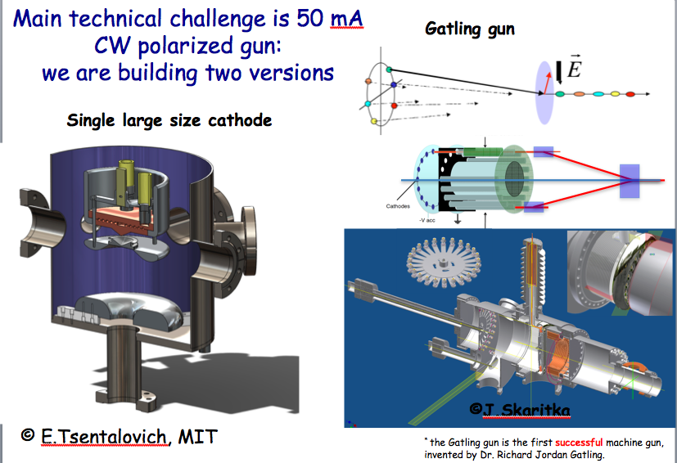
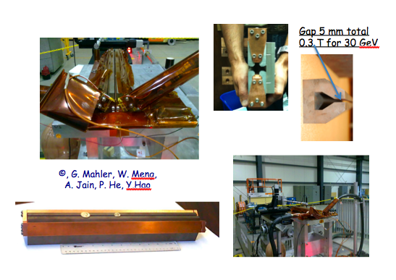
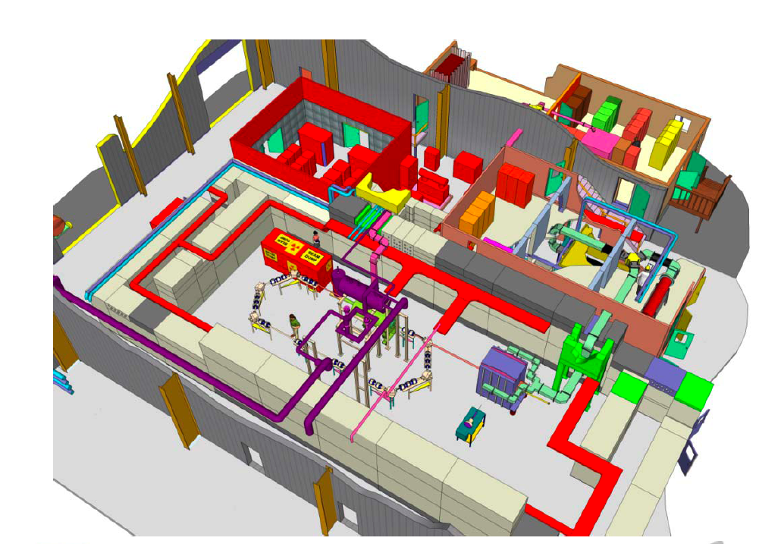
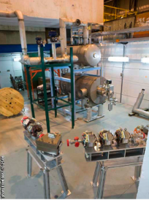
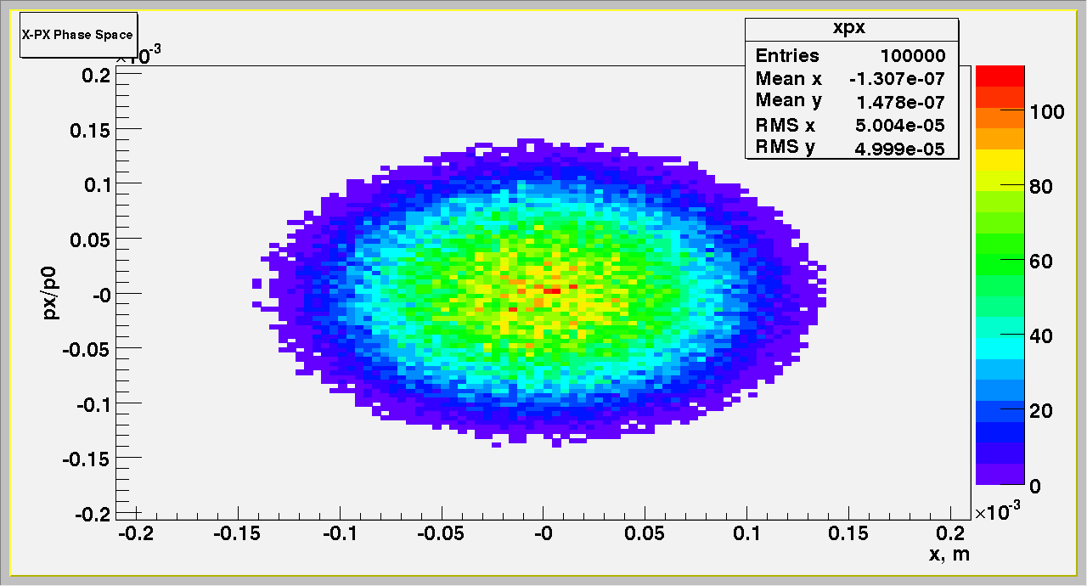
eRHIC R&D highlights
Polarized gun for e-p program – LDRD at BNL + MIT
Development of compact magnets - LDRD at BNL, ongoing
SRF R&D ERL – ongoing
Beam-beam effects, beam disruption, kink instability suppression, etc.
Polarized He³ source - Workshop: https://indico.bnl.gov/conferenceDisplay.py?confId=405
Coherent Electron Cooling including PoP – plan to pursue

Slide 6
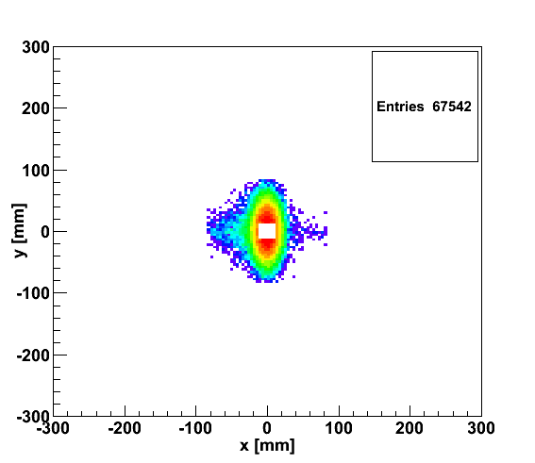
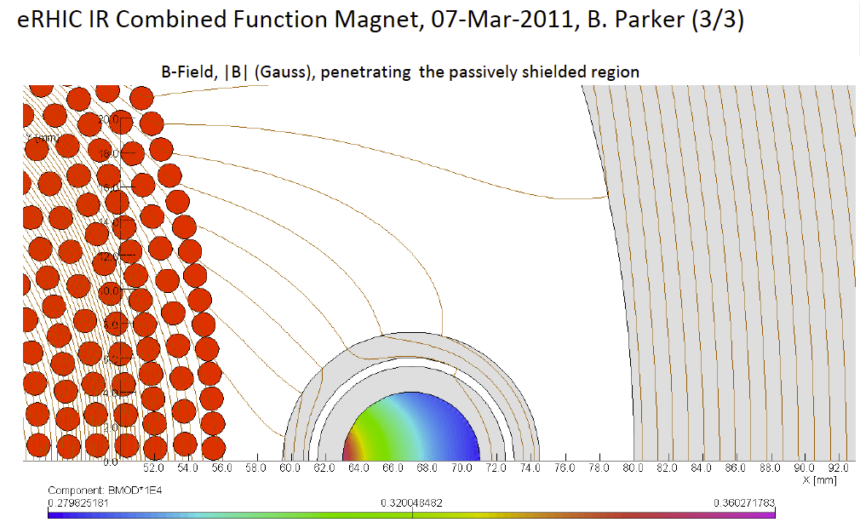
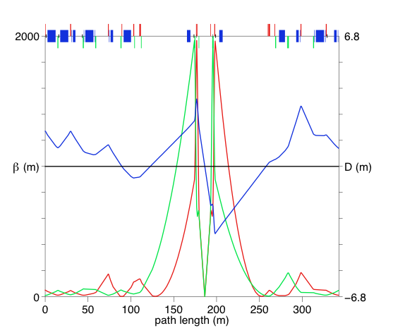
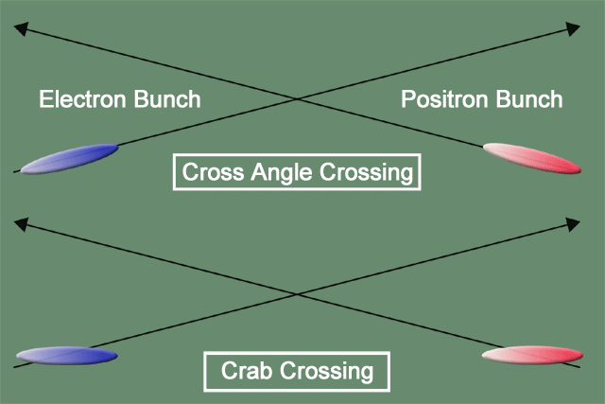
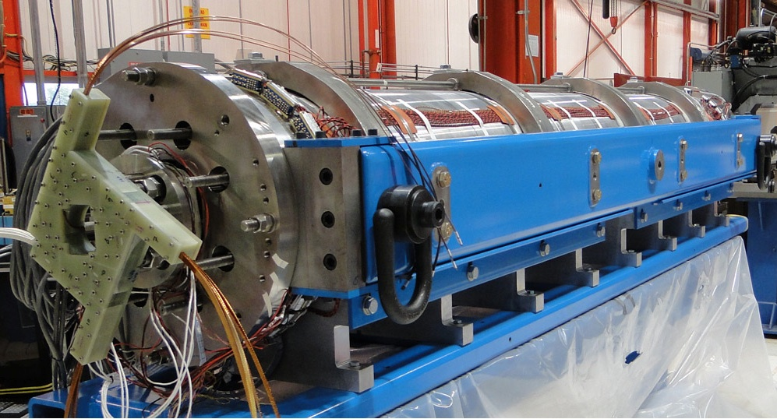
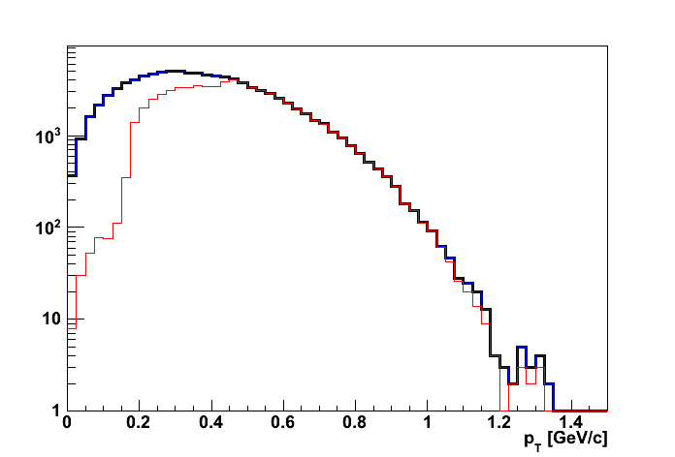
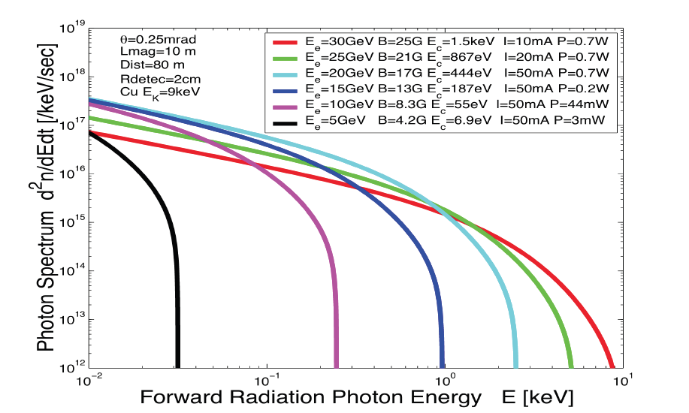
eRHIC high-luminosity IR with β*=5 cm
20x250
p
Proton beam lattice
G.Ambrosio et al., IPAC’10
e
Nb₃Sn
20x250
200 T/m
eRHIC - Geometry high-lumi IR with β*=5 cm, l*=4.5 m
and 10 mrad crossing angle → this is required for 10³⁴ cm⁻² s⁻¹
Generated
Quad aperture limited
RP (at 20m) accepted
10 mrad crossing angle and crab-crossing
High gradient (200 T/m) large aperture Nb₃Sn focusing magnets
Arranged free-field electron pass through the hadron triplet magnets
Integration with the detector: efficient separation and registration of low angle collision products
Gentle bending of the electrons to avoid SR impact in the detector
© D.Trbojevic, B.Parker, S. Tepikian, J. Beebe-Wang

Slide 7
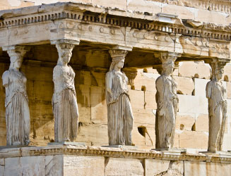
The Pillars of the eRHIC Physics program
Electro Weak
physics of
strong color
fields
spin Physics
2D+1 Imiging
Hadronisation
Wide physics program with high requirements on detector and machine performance

Slide 8
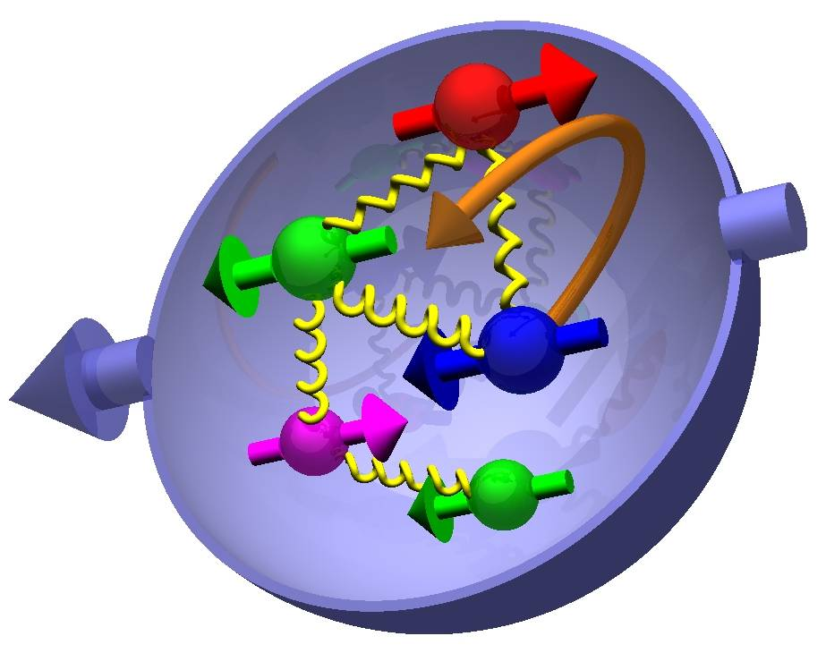
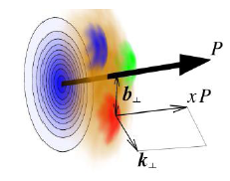

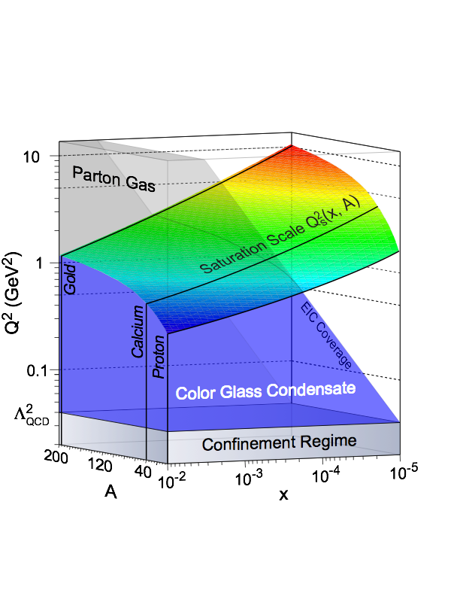
Most Compelling Physics Questions
spin physics
imaging
what is the polarization of gluons at
small x where they are most abundant
what is the spatial distribution of
quarks and gluons in nucleons/nuclei
what is the flavor decomposition of
the polarized sea depending on x
understand deep aspects of gauge
theories revealed by k_{T} dep. distr’n
determine quark and gluon contributions
to the proton spin at last
possible window to
orbital angular momentum
physics of strong color fields
quantitatively probe the universality of
strong color fields in AA, pA, and eA
understand in detail the transition to the non-linear
regime of strong gluon fields and the physics of saturation
how do hard probes in eA interact with the medium

Slide 9

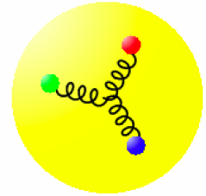
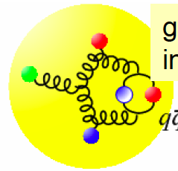
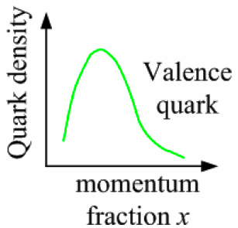
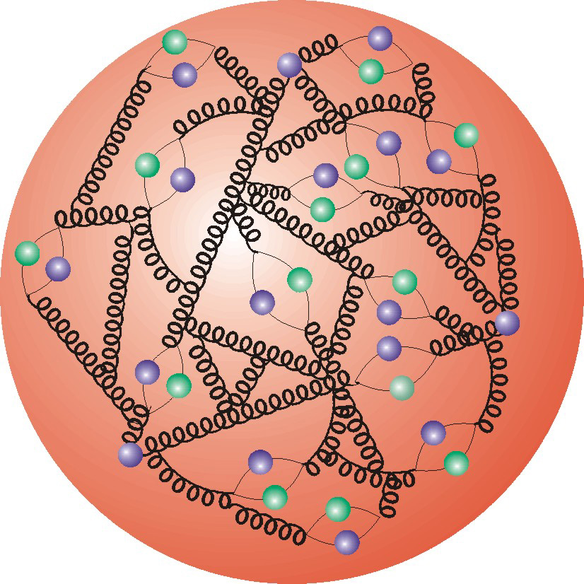
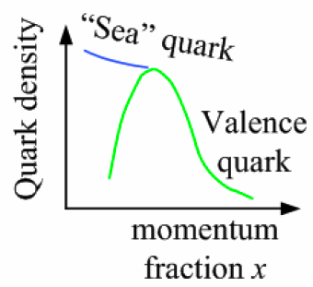
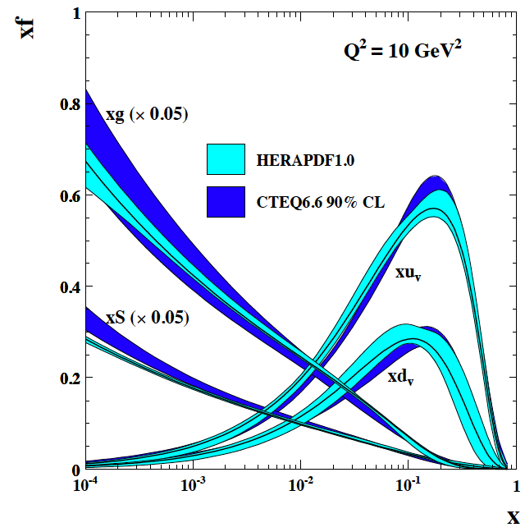
Deep Inelastic Scattering
Kinematics:
Measure of resolution power
Measure of inelasticity
Measure of momentum fraction of struck quark
Gluon splits
into quarks
Quark splits
into gluon
splits
into quarks …
10⁻¹⁶m
10⁻¹⁹m
higher √s
increases resolution

Slide 10

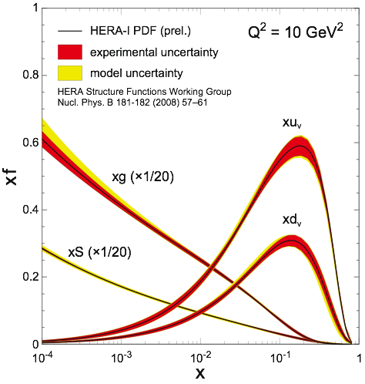
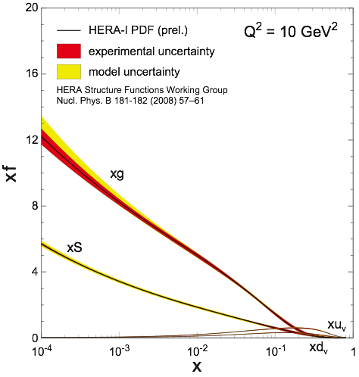


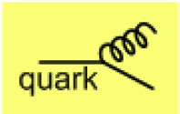
What do we know
small x
x=10⁻⁵
quark density
valence quarks
gluon density
Observation of large scaling violations
Gluon density dominates
Strong increase of sea quarks towards
low x
Density increases with Q²
  more partons by magnified view
Dynamic creation
of partons
at low x
large x
x=1
eA-coverage
Notes:
Counter-intuitively the best way is through an EM process: DIS
y = inelasticity = fraction of the incoming electron energy carried by photon in the rest frame of the nucleon
The structure function F2 is sensitive to the sum of quark and anti-quark momentum distribution in the nucleon.
The apparent scaling of the data with Q2 at large x in early DIS data from SLAC was termed “Bjorken scaling” and motivated the parton model.
In the parton model, FL = 0, while in QCD, it is directly proportional to the gluon structure function, FL(x,Q2) ~ aS xG(x,Q2), at low x.
DGLAP: fixed x -> evolution along Q2
sigma (gamma N) = sig_T + sig_L
sig_L ~ FL
sig_tot ~ F2/Q^2
\frac{d^2 \sigma^{ep \rightarrow eX}}{dx dQ^2} = \frac{4 \pi \alpha^2_{e.m.}}{xQ^4} \left[ \left(1-y+\frac{y^2}{2} \right ) F_2(x,Q^2) - \frac{y^2}{2} F_L(x,Q^2) \right]

Slide 11
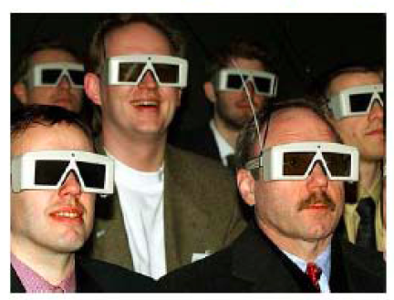
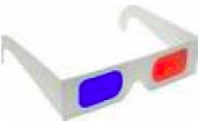
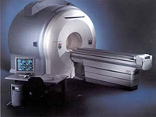
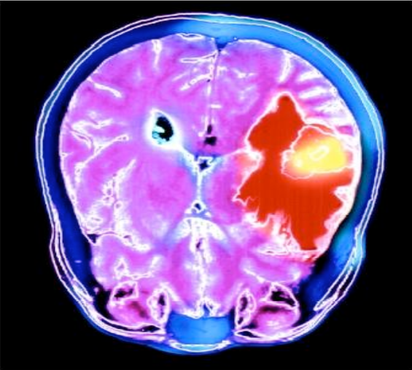
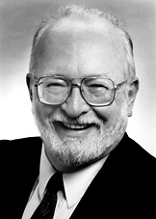

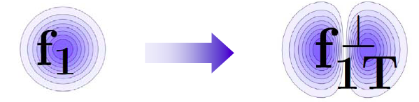
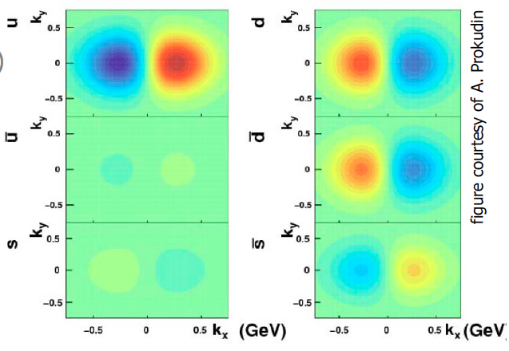
Quantum tomography of the nucleon
Join the real
3D experience !!
TMDs
GPDs
Spin as vehicle to do tomography of the nucleon
We do this daily in medicine
2D+1 picture in momentum space 2D+1 picture in coordinate space
  transverse momentum generalized parton distributions
  dependent distributions → exclusive reaction like DVCS
Quarks
unpolarised polarised
Paul C. Lauterbur
Sir Peter Mansfield
Nobel Prize, 2003: "for their discoveries concerning magnetic resonance imaging"

Slide 12




the path to imaging quarks and gluons
PDFs do not resolve transverse momenta or positions in the nucleon
transverse
plane
fast moving nucleon turns into a `pizza’ but transverse size remains about 1 fm
compelling questions
how are quarks and gluons spatially distributed
how do they move in the transverse plane
do they orbit and do we have access to spin-orbit correlations
required set of measurements & theoretical concepts
1-D
form factor
parton densities
not related by
Fourier transf.
2+1-D
transv. mom. dep. PDF
impact par. dep. PDF
generalized PDF
semi-inclusive DIS
exclusive processes
Wigner function
high-level connection
4+1-D
measurable ?
important in other branches of Physics

Slide 13
More insights to the proton
Transversity distribution function δq(x)
Correlation between and
Single Spin Asymmetries
Unpolarized distribution φυνχτιον q(x), G(x)
beyond collinear picture
Explore spin orbit correlations
Helicity distribution function Δq(x), ΔG(x)
Boer-Mulders distribution function
Correlation between and
peculiarities of f⊥_{1T}
chiral even naïve T-odd DF
related to parton orbital angular momentum
violates naïve universality of PDFs
QCD-prediction: f⊥_{1T,DY} = -f⊥_{1T,DIS}
Sivers distribution function
Correlation between and

Slide 14
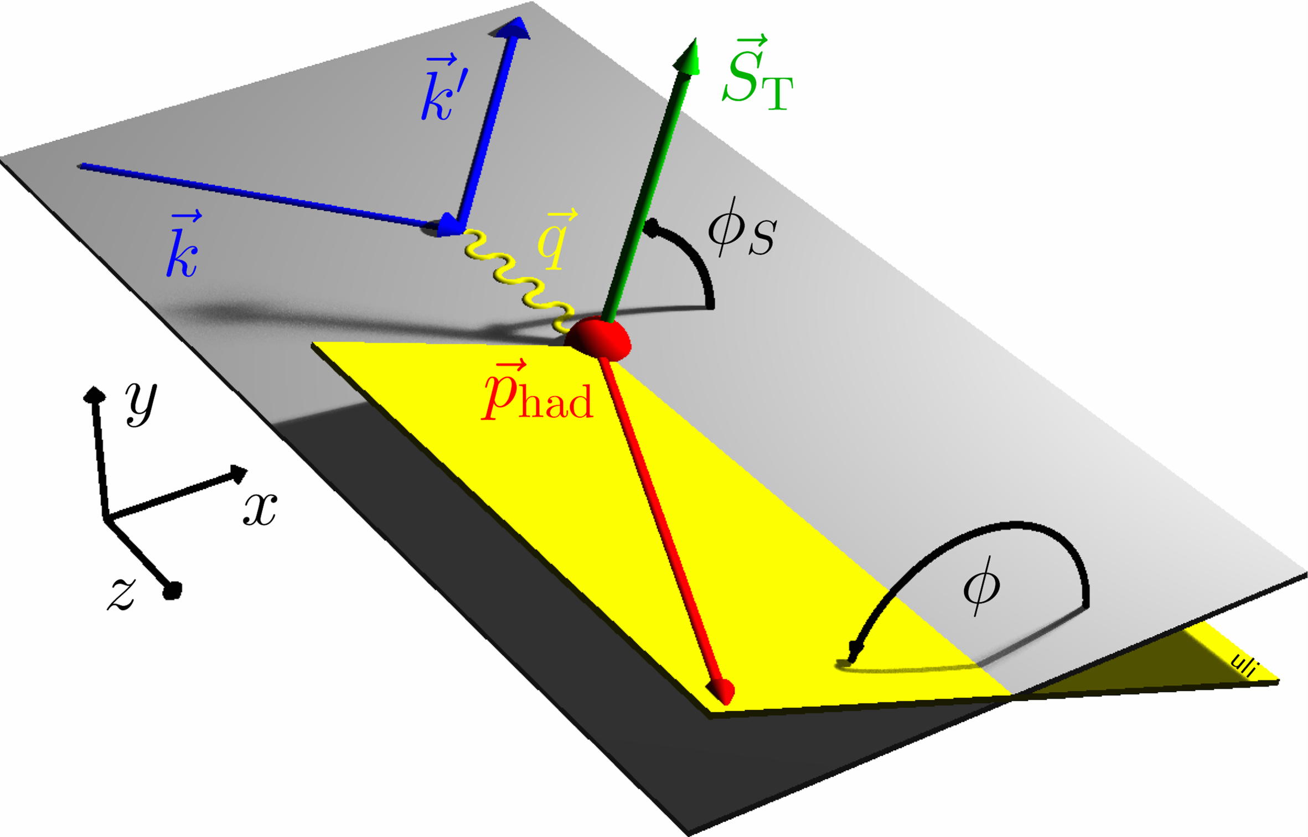
Azimuthal angles and asymmetries
angle of hadron relative to final quark spin (Collins)
Collins
angle of hadron relative to initial quark spin (Sivers)
Sivers
SIDIS allows to study subprocesses individually

Slide 15
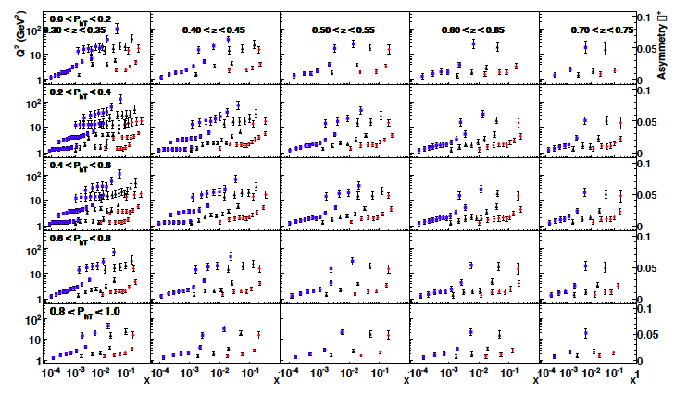
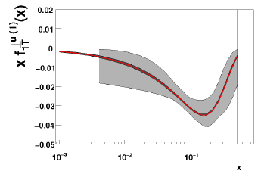
Quark TMDs @ EIC
Sivers asymmetry for π+:
√s=140 GeV / 45 GeV / 15 GeV
u-Sivers fct. before and after
A. Prokudin
What is the influence of evolution
on the size of the asymmetry?
Other quarks look similar
what about the gluon ?

Slide 16
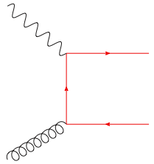
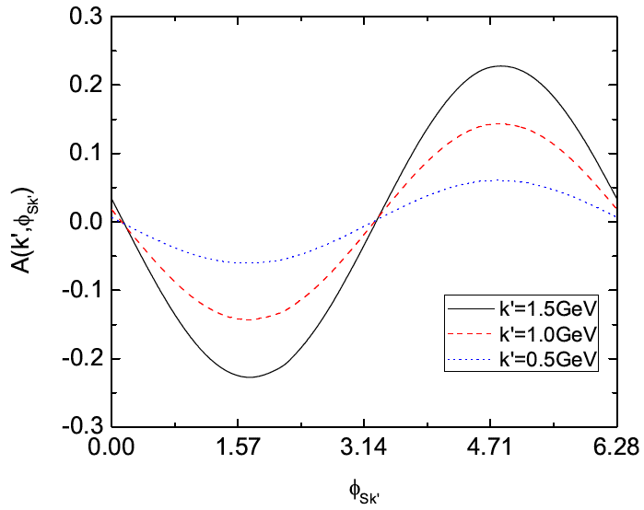
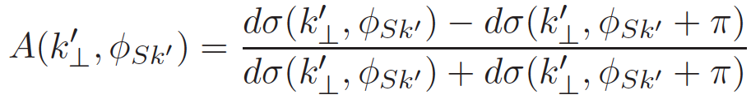

The Gluon Sivers Function: γ*N⇑ → h+h+X
e
k⊥<<p_{t}
qqbar interacts like g
“Correlation limit”
Measure a pair of D mesons
k⊥ = |k1T + k2T|
PT = (k1T - k2T) / 2
study charm to tag PGF
Statistically challenging
N⇑
EIC INT proceedings
arXiv:1108.1713v1
section 2.3
~8 months with 50% efficiency and
L = 10³⁴cm²s⁻¹
Beam Energies: 20 GeV x 250 GeV
Q²: 1 – 10 GeV², y: 0.01 – 0.95, z>0.25
no cut on k⊥ and p_{t,}
but on k⊥/p_{t} < 0.5 for “correlation limit”

Slide 17
Quantum tomography of the nucleon
Join the real
3D experience !!
TMDs
GPDs
2D+1 picture in momentum space
transverse momentum
dependent distributions
2D+1 picture in coordinate space
  generalized parton distributions
  → exclusive reaction like DVCS
Quarks
unpolarised polarised

Slide 18
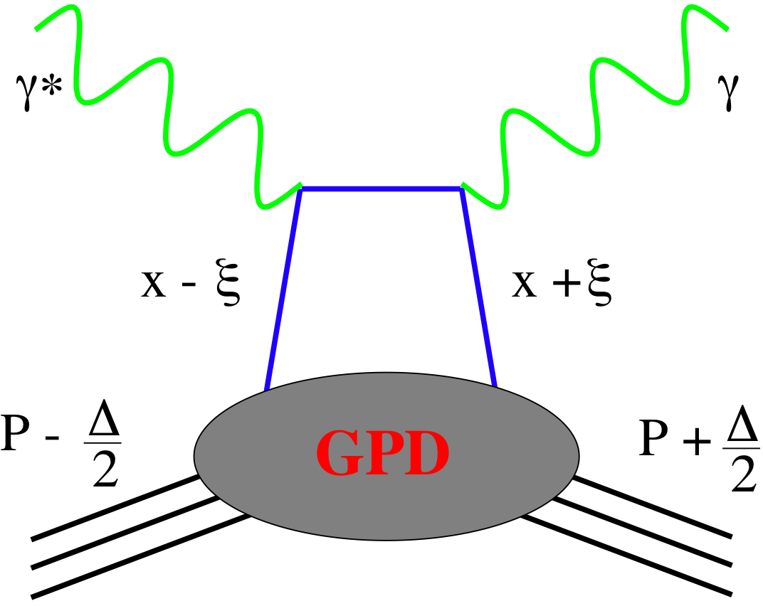
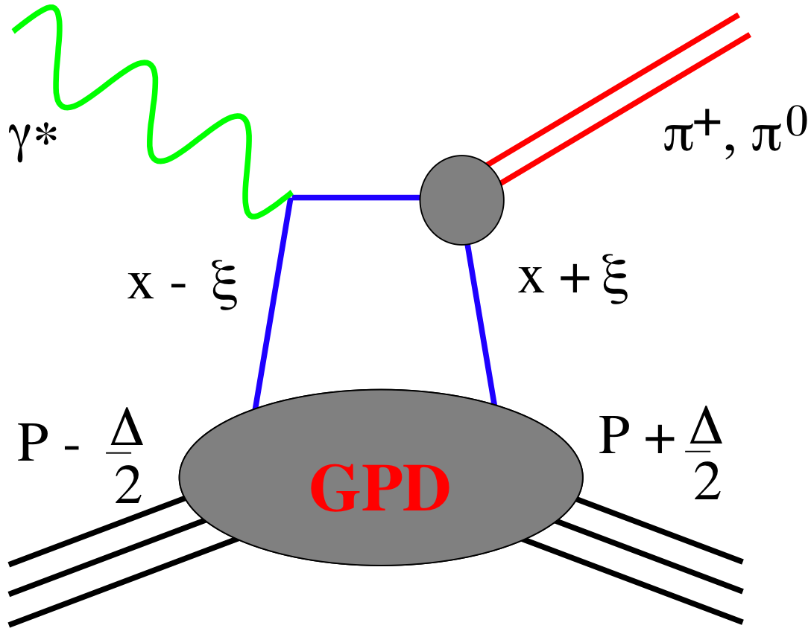
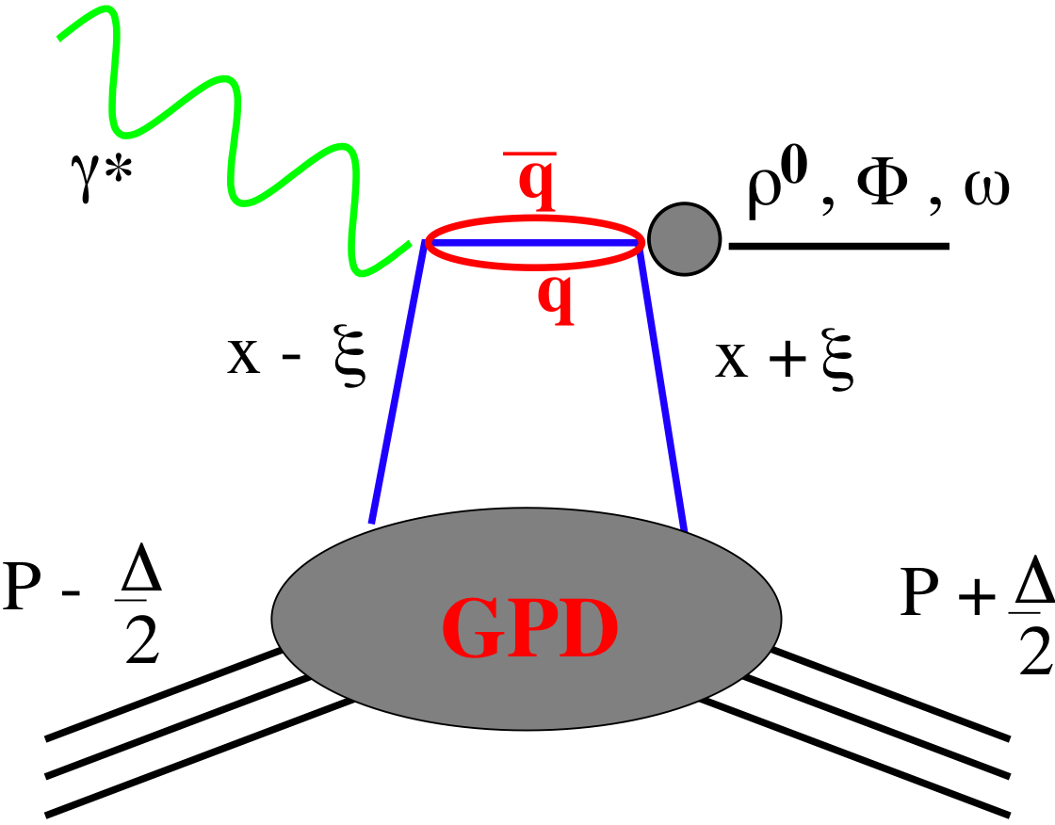
SMALL GPD Primer
How are GPDs characterized?
unpolarized polarized
conserve nucleon helicity
flip nucleon helicity
not accessible in DIS
quantum numbers of final state select different GPD
Spin-Sum-Rule in PRF:
from g₁
DVCS
pseudo-scaler mesons
vector mesons
π⁰ | 2Δu+Δd
η | 2Δu−Δd
ρ⁰ | 2u+d, 9g/4
ω | 2u−d, 3g/4
φ | s, g
ρ⁺ | u−d
J/ψ | g
Q²= 2E_{e}E_{e}’(1-cosθ_{e’})
x_{B} = Q²/2Mν ν=E_{e}-E_{e’}
x+ξ, x-ξ long. mom. fract.
t = (p-p’)²
ξ ≅ x_{B}/(2-x_{B})

Slide 19
The DVCS Phase Space
Stage 2
Stage 1
HERA results on GPDs
very much limited by
lack of statistics
imaging in
valence region
but limited t-range

Slide 20


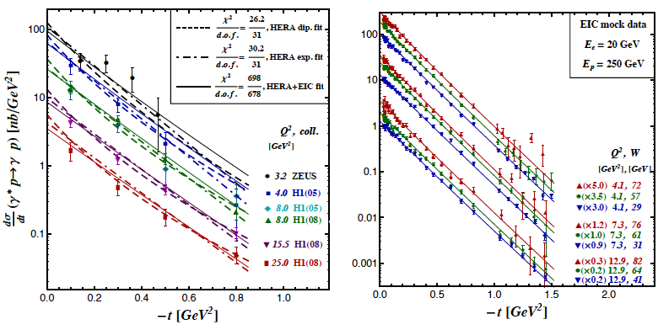
DVCS at eRHIC
e’
γ
e
γ_{L}*
(Q²)
DVCS: Golden channel
theoretically clean
wide range of observables
(σ, A_{UT}, A_{LU}, A_{UL}, A_{C})
to disentangle different GPDs
x+ξ
x-ξ
~
~
p
H, H, E, E (x,ξ,t)
p’
t
DVCS data at end of HERA
D. Mueller, K. Kumericki
S. Fazio, M. Diehl and ECA
needs
100 fb⁻¹
Fourier
Transform
large t
small t
needs
10 fb⁻¹
+ Roman Pots

Slide 21
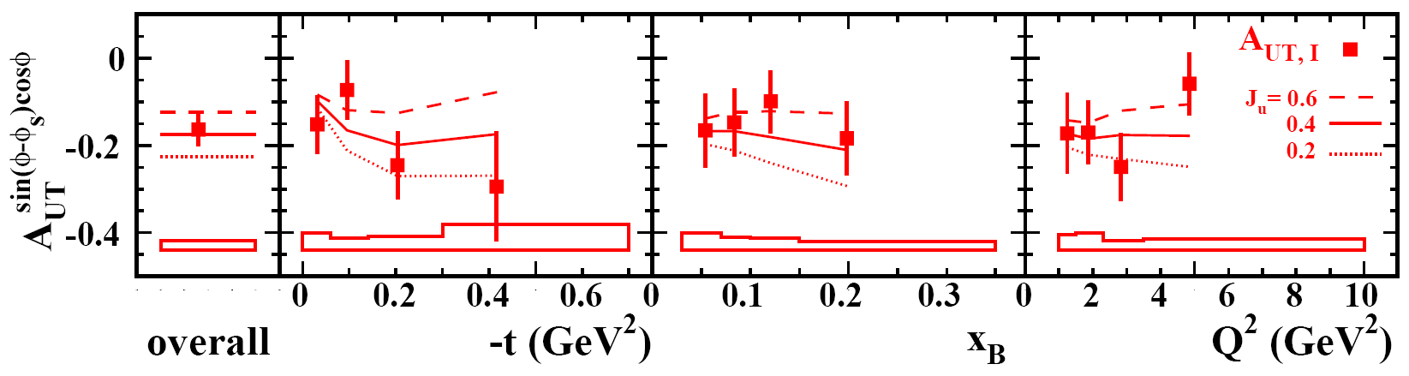
Constrain J_{q} via GPD E
observables sensitive to E:
(J_{q} input parameter in ansatz for E)
DVCS A_{UT} : HERMES
nDVCS A_{LU} : Hall A
Hermes DVCS-TTSA [arXiv: 0802.2499]:
VGG
eRHIC:
HERMES like A_{UT}
20 GeV x 250 GeV
Lumi: 2x50fb⁻¹
Notes:
AHLT: Ahmad, Honkanen, Liuti, Taneja PRD75(2007)

Slide 22
Different DVCS Asymmetries
D. Mueller

Slide 23
What will we learn about 2d+1 structure of the proton
GPD H and E as function of t, x and Q²
GPD H and E 1d+1
Plots from D. Mueller
GPD H and E 2d structure for quarks
A global fit over all pseudo data was done, based on the GPDs-based model:
[K. Kumerički, D Müller, K. Passek-Kumerički 2007]
Known values q(x), g(x) are assumed for H^{q}, H^{g} (at ξ=0, t=0 forward limits E^{q}, E^{g} are unknown)
Excellent reconstruction of H^{sea}, H^{sea} and good reconstruction of H^{g} (from dσ/dt)
shift due to GPD E

Slide 24
GPD H^{g}: J/ψ
M. Diehl
To improve imaging on gluons
add J/ψ observables
cross section
A_{UT}
…..
Fourier
Transform

Slide 25


What else can be done
Xiangdong Ji
The Spin Sum Rules
Jaffe & Manohar
The Holy Grail

Slide 26

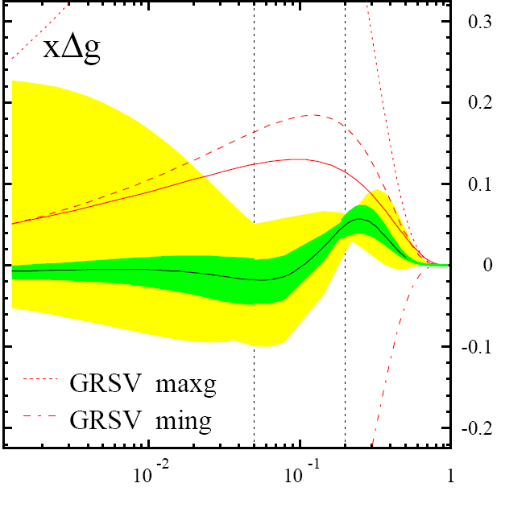
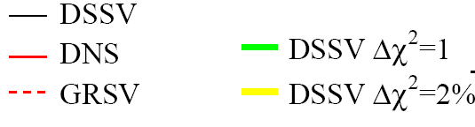
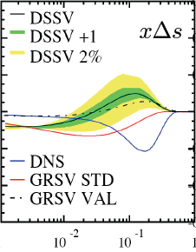

helicity structure - open questions
significant experimental and theoretical progress in past 25+ years, yet many unknows …
Δg(x,Q²)
DSSV global fit
de Florian, Sassot,
MS, Vogelsang
found to be small at 0.05 < x < 0.2 [RHIC, COMPASS, HERMES]
RHIC can slightly extend x range & reduce uncertainties
[500 GeV running & particle correlations]
can hide one
unit of here
yet, full 1st moment [proton spin sum]
will remain to have significant uncertainties
from unmeasured small x region
DIS
&
pp
RHIC
pp
Δq’s (x,Q²)
x
known: quarks contribute much less to proton spin
than expected from quark models
large uncertainties in ΔΣ from unmeasured small x
surprisingly small/positive Δs from SIDIS: large SU(3)
breaking?
_
_
flavor separation not well known, e.g., Δu - Δd

Slide 27
present vs EIC kinematic coverage
cross section:
pQCD scaling violations

Slide 28
present vs EIC kinematic coverage
RHIC pp data
constraining Δg(x)
in approx. 0.05 < x <0.2
data plotted at x_{T}=2p_{T}/√S
likewise for Q²
5 x 100 GeV eRHIC stage-1
20 x 250 GeV eRHIC
EIC extends x coverage
by up to 2 decades
(at Q²=1 GeV²)
lowest x so far 4.6 x10⁻³ COMPASS

Slide 29
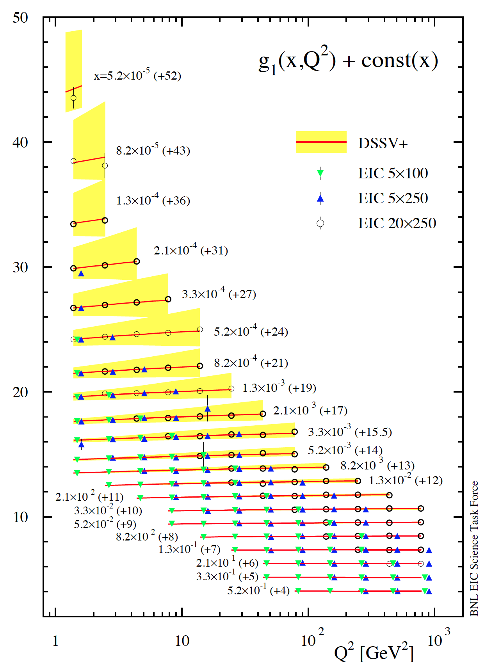
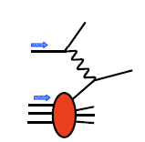

example: projected DIS data for g₁^{p}
hep-ph:1206.6014
3 sets of [eRHIC] energy settings studied:
E_{e}×E_{p} [GeV] | √s [GeV] | x_{min} for y_{max} = 0.95 and Q² = 1 GeV² Q² = 2 GeV²
5 x 100 | 44.7 | 5.3 x 10⁻⁴ 1.1 x 10⁻³
5 x 250 | 70.7 | 2.1 x 10⁻⁴ 4.2 x 10⁻⁴
20 x 250 | 141.4 | 5.3 x 10⁻⁵ 1.1 x 10⁻⁴
5 x 250 starts here
4 [5] bins/decade in Q² [x] (spaced logarithmically)
bands reflect current uncertainties on g₁^{p}
DSSV+ estimate
5 x 100 starts here
COMPASS data
start here
taken from
Blumlein,
Bottcher

Slide 30

impact of EIC data on helicity PDFs
EIC: DIS scaling violations mainly determine Δg at small x
yet, small x behavior completely
unconstrained
(determines x-integral,
which enters proton spin sum)
Q² = 10 GeV²
can hide one
unit of ℏ here
dramatic reduction of uncertainties:
DIS
&
pp
“before”
RHIC
pp
“after”
x

Slide 31

impact of EIC data on helicity PDFs
DIS scaling violations mainly determine Δg at small x
in addition, SIDIS data provide detailed flavor separation of quark sea
includes only “stage-1 data”
[even then Q²_{min} can be 2-3 GeV²]
can be pushed to x=10⁻⁴ with
20 x 250 GeV data
[still one can play with Q²_{min} ]
uncertainties determined with
both Lagrange mult. & Hessian
“issues”:
(SI)DIS @ EIC limited by
systematic uncertainties
need to control rel. lumi, polarimetry,
detector performance, … very well
QED radiative corrections
need to “unfold” true x,Q²
well known problem (HERA)
BNL-LDRD project to sharpen tools

Slide 32
progress towards spin sum rule
combined correlated uncertainties for ΔΣ and Δg
“Helicity sum rule”
gluon
spin
✔
results obtained with two
Lagrange multipliers
Hessian method consistent
current data
access through
Twist-3 GPDs
more theoretical
work needed
✔
angular
momentum
total
quark spin
similar improvement
for 0.0001-1 moments
needs 20 x 250 GeV data
“X. Ji sum rule”
✔
w/ EIC data
difficult,
but should be
possible in
GPD models
can expect approx. 5-10%
uncertainties on ΔΣ and Δg
but need to control systematics

Slide 33


The eA Physics program
time
Hard Processes
(pQCD)
FF/coal.
CGC
JIMWLK/BK
I
Hadron
Transport
Hydro (EoS)
Our understanding of some fundamental
properties of the Glasma, sQGP and
Hadron Gas depend strongly on our
knowledge of the initial state!
The Initial Conditions
3 conundrums of the initial state:
What is the spatial transverse distributions
of nucleons and gluons?
2. How much does the spatial distribution
fluctuate? Lumpiness, hot-spots etc.
3. How saturated is the initial state of the
nucleus?

Slide 34




Is the sQGP a perfect fluid?
IP-GLASMA
AdS/CFT predicts for a perfect fluid:
η/s = 1/(4π) ~ 0.08
Schenke, Tribedy, Venugopalan arXiv:1202.6646
KLN-CGC
Glauber
Wood-Saxon
Different initial states =
different fluctuation scales
Different initial states=
different fluctuation scales
Different initial states=
different fluctuation scales

Slide 35

How many gluons have space in A proton?
at small x linear evolution gives strongly
rising g(x)
  cannot go on forever
BK/JIMWLK non-linear evolution includes
recombination effects → saturation
  Dynamically generated scale
  Saturation Scale: Q²_{s}(x)
    Increases with energy or decreasing x
  Scale with Q²/Q²_{s}(x) instead of x and Q²
small x / higher energy
x = P_{parton}/P_{nucleon}
Terra Incognita
Bremsstrahlung
~ α_{s}ln(1/x)
Recombination
~ α_{s}ρ
Saturation must set in at
low x → high occupancy
α_{s}~1 α_{s} << 1

Slide 36
What Do We Know About xG in Nuclei?
99% of all h± have p_{t} < 2 GeV/c
“Bulk Matter” → x < 0.01
Other than in p:
G(x,Q²) for nuclei is little known
Key: F_{L} (x,Q²) ~ xG(x,Q²)

Slide 37

h-h Forward Correlation in p(d)A at RHIC
side-view
beam-view
large-x1 (q dominated)
p
p
A
π
low-x2 (g dominated)
Low gluon density (pp):
pQCD predicts 2→2 process ⇒ back-to-back di-jet
High gluon density (pA):
2 → many process
⇒ expect broadening of away-side
  Small-x evolution ↔ multiple emissions
  Multiple emissions → broadening
  Back-to-back jets (here leading hadrons) may get broadening in pT with a spread of the order of QS
First prediction by: C. Marquet (’07)
Latest review: Stasto, Xiao, Yuan arXiv:1109.1817 (Sep. ’11)
Notes:
Raju: Di-hadron correlations are a test of universality because the same measurement in p+A and e+A is sensitive to "dipole" and "quadrupole" operators which are the same for both processes.

Slide 38





Forward Correlations in dA at RHIC
1 question, 2 answers
Initial state saturation model
“Non-initial state” shadowing model
Away side parton randomized
by strong color field
Albacete, Marquet
+offset
+offset
Kang, Vitev, Xing arXiv:1112.6021v1
B. Xiao et al. 2012
How saturated is the initial state?

Slide 39


eRHIC: Reaching the Saturation Region
HERA (ep):
Despite high energy range:
F2, Gp(x, Q²) outside the
saturation regime
Need also Q² lever arm!
Only way in ep is to
increase √s
Would require an ep
collider at √s ~ 1-2 TeV
Different approach (eA):
L ~ (2m_{N} x)⁻¹ > 2 R_{A} ~ A^{1/3}
Probe interacts
coherently with all nucleons
Gold: A=197, effective x 197 times smaller!

Slide 40

Dihadron Correlations in eA at EIC
EIC:
  Extract the spatial multi-gluon correlations and study their non-linear evolution
    essential for understanding the transition from a deconfined into a confined state.
Advantage over p(d)A:
  eA experimentally much cleaner
    no “spectator” background to subtract
    Access to the exact kinematics of the DIS process (x, Q²)
Perfect saturation signature:
Either jets or use leading hadrons from jets (dihadrons)
Notes:
Raju: Di-hadron correlations are a test of universality because the same measurement in p+A and e+A is sensitive to "dipole" and "quadrupole" operators which are the same for both processes.

Slide 41

EIC: eA Dihadron Correlations Studies
Exp: Saturation versus
“conventional” scenario
Theory: Saturation
Dominguez, Xiao, Yuan, Lee, Zheng ‘11/12
J.H. Lee, L. Zheng (CCNU) ‘11/12
eA-MC: Pythia6.4 + nPDF (EPS09) + nuclear geometry from DPMJetIII without PS
Here for 10 fb⁻¹/A (~ 20 weeks), std. experimental cuts
Clear signal, pronounced differences between sat and no-sat

Slide 42



Hard Diffraction in DIS at Small x
e+p
t = (p-p’)²
β is the momentum fraction of the struck parton w.r.t. the Pomeron
x_{IP} = x/β: momentum fraction of the exchanged object (Pomeron) w.r.t. the hadron
  Diffraction in e+p:
    coherent ⇔ p intact
    incoherent ⇔ breakup of p
    HERA: 15% of all events are hard diffractive
Diffraction in e+A:
  coherent diffraction (nuclei intact)
  breakup into nucleons (nucleons intact)
  incoherent diffraction
  Predictions: σdiff/σtot in e+A ~25-40%

Slide 43


Why is DiFfraction So Important
Sensitive to spatial gluon distribution
  Hot topic:
    Lumpiness?
    Just Wood-Saxon+nucleon g(b)
  Incoherent case: measure fluctuations/lumpiness
  in g_{A}(b)
Sensitive to gluon momentum distributions
  σ ~ g(x,Q²)²

Slide 44




Exclusive Vector Meson Production
  Golden channel: e + A → e’ + A’ + VM
    Only channel where t can be derived from VM and e’
    Detecting neutron emission from nuclear breakup allows to separate coherent from incoherent
Dipole Cross-Section:
J/ψ
ϕ

Slide 45
Diffraction Sensitive to Saturation
Simple but effective
Measurement:
  σ_{Diff(eA)}/σ_{Diff(ep)}/A^{4/3} as fct. of Q²
  Coherent events only scale with A^{4/3} for large Q²
  Sartre event generator based on dipole model
    describes HERA data
  nosat: dipole cross-section linearized
Clear difference in model prediction between sat and nosat
nosat
sat
J/ψ
nosat
φ
sat

Slide 46
eRHIC: Inclusive Diffraction
Can constrain models a lot with a few months of running!
Already in Stage 1!

Slide 47

Deep Inelastic Scattering - Vacuum
h
e’
γ*
q
e
What happens if we add a nuclear medium
Observables:
Broadening:
Attenuation:
Δp_{t}² linked directly with saturation scale
ratio of hadron production in A to d
modifications of nPDF cancel out
Notes:
Example here is DIS in vacuum
Propagating quark is colored, thus emits gluons. “Free.” “Lifetime of deconfined quark.” Universal for light quarks?
Dipole is a color singlet object, thus no gluon emission. “Prehadron.” Formation time depends on hadron formed.
Heuristic arguments and models: Formation time is longer, ~ 1 order of magnitude for pions.
One of the goals of the studies I will be describing is to directly measure these two time parameters. Another is to understand the detailed mechanisms of how the hadron gets formed. The method of determining these quantities consists of studying this process embedded in a nuclear medium of well-known properties such as size and density.
Make point here - whole process is hadronization? or make that point later?

Slide 48
What do we know and what can EIC do
Hermes:
E_{e} = 27 GeV → √s = 7.2 GeV
E_{h} = 2-15 GeV
Unprecedented precision to distinguish between different models
large ν range
hadronization in and out of nucleus
first time for charm
EIC:

Slide 49


What else Do we need?
Innovative Machine Design
Very Novel Physics Program
0.60 GeV
0.6 GeV
Polarized
e-gun
Beam
dump
27.55 GeV
0.6 GeV
New
detector
Linac 2.45 GeV
Magnet 2-3T
Detector
Concept
Coherent e-cooler
3.05 GeV
Linac 2.45 GeV
5.50 GeV
7.95 GeV
10.4 GeV
12.85 GeV
15.3 GeV
17.75 GeV
20.2 GeV
22.65 GeV
25.1 GeV
27.55 GeV
30.0 GeV
30 GeV
ePHENIX
eSTAR
30 GeV

Slide 50

Emerging Detector Concept
Magnet 2-3T
Backward Spectrometer
For very low Q²-electrons:
space for low-Θ
e-tagger
high acceptance -5 < η < 5 central detector
good PID (π,K,p and lepton) and vertex resolution (< 5μm)
tracking and calorimeter coverage the same → good momentum resolution, lepton PID
low material density → minimal multiple scattering and brems-strahlung
Magnetic field extremely critical to get good tracking resolution in forward direction
very forward electron and proton/neutron detection → Roman Pots, ZDC, low e-tagger
Integration of detector in IR design

Slide 51






Vibrant Detector r&D Program Started
Calorimetry
  W-Scintillator & W-Si
    compact and high resolution
  Crystal calorimeters PbW & BGO
Pre-Shower
  W-Si
  LYSO pixel array with
  cartesian readout via X-Y WLS fibers
“Cartesian PreShower”
PID via Cerenkov
  DIRC and timing info
  RICH based on GEM readout
  e-PID: GEM based TRD → eSTAR
Tracking
  μ-Vertex: central and forward based on MAPS
  Central: TPC/HBD provides low mass,
  good momentum, dE/dx, eID
  Fast Layer: μ-Megas or
  PImMS (MAPS+ timing)
  Forward: Planar GEM detectors
Details: https://wiki.bnl.gov/conferences/index.php/EIC_R%25D

Slide 52

SummaRY
ep /eA Data from an EIC
will provide answers to many
questions
What are the spatial transverse
distributions of nucleons and gluons?
How much does the spatial distribution
fluctuate? Lumpiness, hot-spots etc.
How saturated is the initial state of the
nucleus?
2d +1 imaging in transverse momentum
and impact parameter space of the
partons in the proton
will determine the quark and
gluon contribution to the spin and get a
shot on the orbital contribution
and many things not mentioned
using a novel accelerator and
a 21st century detector
ACHIEVED

Slide 53
BACKUP

Slide 54
an Electron Ion Collider in the US
Requirements:
High Luminosity > 10³³ cm⁻²s⁻¹
Flexible center of mass energies
Electrons and protons/light nuclei polarised
Wide range of nuclear beams
a wide acceptance detector with good PID (e/h and π, K, p)
wide acceptance for protons from elastic reactions and
neutrons from nuclear breakup

Slide 55
EIC@BNL: eRHIC
All energies scale proportionally by adding SRF cavities to the injector
0.02 Eo
Polarized
e-gun
0.6 GeV
Beam
dump
 | Main Accelerator Challenges In red –increase/reduction beyond the state of the art
 | Polarized electron gun – 10x increase
 | Coherent Electron Cooling – New concept
 | Multi-pass SRF ERL 5x increase in current 30x increase in energy
 | Crab crossing New for hadrons
Polarized ³He production
 |  | Understanding of beam-beam affects New type of collider
 |  | β*=5 cm 5x reduction
 |  | Multi-pass SRF ERL 3-4x in # of passes
 |  | Feedback for kink instability suppression Novel concept
27.55 GeV
New
detector
 | e | p | ²He³ | ⁷⁹Au¹⁹⁷ | ⁹²U²³⁸
Energy, GeV | 20 | 250 | 167 | 100 | 100
CM energy, GeV |  | 141 | 115 | 89 | 89
Number of bunches/distance between bunches | 74 nsec | 166 | 166 | 166 | 166
Bunch intensity (nucleons) ,10¹¹ | 0.24 | 2 | 1.3 | 0.79 | 0.83
Bunch charge, nC | 3.8 | 32 | 10 | 5.2 | 5.2
Beam current, mA | 50 | 420 | 140 | 67 | 67
Normalized emittance of hadrons , 95% , mm mrad |  | 1.2 | 1.2 | 1.2 | 1.2
Normalized emittance of electrons, rms, mm mrad |  | 32 | 48 | 80 | 80
Polarization, % | 80 | 70 | 70 | none | none
rms bunch length, cm | 0.2 | 8.3 | 8.3 | 8.3 | 8.3
β*, cm | 5 | 5 | 5 | 5 | 5
Luminosity per nucleon, x 10³⁴ cm⁻²s⁻¹ |  | 0.97 | 0.65 | 0.39 | 0.41
Linac
Coherent e-cooler
0.9183 Eo
Linac 2.45 GeV
Eo
0.8367 Eo
0.7550 Eo
0.6733 Eo
0.5917 Eo
E/Eo
0.0200
0.1017
0.1833
0.2650
0.3467
0.4283
0.5100
0.5917
0.6733
0.7550
0.8367
0.9183
1.0000
0.5100 Eo
0.4286 Eo
0.3467 Eo
0.2650 Eo
0.1017 Eo
0.1833 Eo
30 GeV
All magnets would installed from day one and we would be cranking power supplies up as energy is increasing
All staging in lepton Beam RF
ePHENIX
eSTAR
100 m
30 GeV
Notes:
We returned to developing cost effective and ECO-friendly eRHIC option with ERL located in the existing RHIC tunnel. We plan to install all magnets for 6 passes and 30 GeV from the start and then build up SRF linac from 1 GeV to 5 GeV per pass.
In this case electrons will pass through the detector halls in the way to the top energy, will collide in up to 3 IRs. Then they will be decelerated to the injection energy and damped.

Slide 56


Hard Diffraction in DIS at Small x
e+p
t = (p-p’)²
β is the momentum fraction of the struck parton w.r.t. the Pomeron
xIP = x/β: momentum fraction of the exchanged object (Pomeron) w.r.t. the hadron
Diffraction Analogy: plane monochromatic wave incident on a circular screen of radius R
  Diffraction in e+p:
    coherent ⇔ p intact
    incoherent ⇔ breakup of p
    HERA: 15% of all events are hard diffractive
Diffraction in e+A:
  coherent diffraction (nuclei intact)
  breakup into nucleons (nucleons intact)
  incoherent diffraction
  Predictions: σdiff/σtot in e+A ~25-40%

Slide 57

Why Is Diffraction So Difficult?
Key in identifying diffraction is
rapidity gap
  requires hermetic detector
  does not allow separation of
coherent from incoherent
Measuring the scattered nucleus with
Forward Spectrometer (Roman Pots)
  coherent → cannot separate
  from beam
  incoherent → cannot reconstruct
all fragments to get p’
LRG
Cannot measure t in eA except in exclusive vector meson production, e.g.:
Lack of t not a big issue for measurements of F2^{D}, FL^{D} and hence G(x,Q²)
e + A → e’ + J/ψ + A’

Slide 58


Large Rapidity Gap Method (LRG)
  Identify Most Forward Going
  Particle (MFP)
    Works at HERA but at higher √s
    EIC smaller beam rapidities
Diffractive ρ⁰ production at EIC:
η of MFP
M. Lamont ’10
DIS
Hermeticity requirement:
needs just to detector presence
does not need momentum or PID
simulations: √s not a show stopper for EIC
(can achieve 1% contamination, 80% efficiency)
Diffractive

Slide 59
EIC eA Key Measurements
Key Measurements: Small set of measurements whose
ability to extract novel physics is beyond question.
Low x:
EIC INT-Report: arXiv:1108.1713v1
Large x:

Slide 60
Best Knowledge of QS in eA
Model-I: IPSat dipole model
Model-II: BK + higher order corr.
Enhancement of Q_{S} with A
⇒ saturation regime reached at significantly lower energy in nuclei

Slide 61

Measuring FL with the EIC (I)
quark+anti-quark
momentum distributions
gluon momentum distribution
In practice use reduced cross-section:
How to extract F_{L}
  Need different values of y²/Y⁺
  FL slope of σr vs y²/Y⁺
  F2 intercept of σr vs y²/Y⁺ with y-axis
  σr
  y²/Y⁺
0
Notes:
\begin{eqnarray*}\sigma_r = \left( \frac{d^2 \sigma}{dx dQ^2}\right)\ \frac{x Q^4}{2 \pi \alpha^2 [1 + (1-y)^2]}
&=& F_2(x, Q^2) - \frac{y^2}{\color{red}{1+(1-y)^2}} F_L(x, Q^2) \\
{} &=& F_2(x, Q^2) - \frac{y^2}{{\color{red}Y^+}} \ F_L(x, Q^2) \\\end{eqnarray*}

Slide 62



Measuring FL with the EIC (II)
In order to extract F_{L} one needs at least two measurements of the inclusive cross section with “wide” span in inelasticity parameter y (Q² = sxy)
F_{L} requires runs at various √s ⇒ longer program
Need sufficient lever arm in y²/Y⁺
Limits on y²/Y⁺:
At small y:
detector resolution for e’
At large y:
radiative corrections and charge symmetric background
EIC studies:
Statistical error is negligible
in essentially whole range
Systematical Error
Calibration
Normalization
Experiment
Radiative Corrections
Notes:
Lowest value of x and Q2 :
y y2/Y+ proton p
0.7 0.44 100
0.54 0.24 130
0.28 0.28 250

Slide 63


scaling violations at small x
rough small-x approximation to Q²-evolution:
spread in Δg(x,Q²) translates into
spread of scaling violations for g₁(x,Q²)
need x-bins with a least two Q² values to compute derivative (limits x reach somewhat)
smallest x bins require 20 x 250 GeV
5 x 250 starts here
error bars for moderate 10fb⁻¹ per c.m.s. energy; bands parameterize current DSSV+ uncertainties

Slide 64


preparation of DIS and SIDIS mock data
PEPSI MC to generate σ⁺⁺ and σ⁺⁻ with LO GRSV PDFs
DIS
SIDIS
inclusive final-state
identified charged pions and kaons
assume modest 10 fb⁻¹ for each energy, 70% beam polarizations
Q² > 1 GeV² , 0.01 < y < 0.95 , invariant mass W² > 10 GeV²
depolarization factor of virtual photon D(y,Q²) > 0.1 (cuts on small y)
scattered lepton: 1º < θ_{elec} < 179º and p_{elec} > 0.5 GeV
hadron: p_{hadr} > 1 GeV, 0.2 < z < 0.9,
1⁰ < θ_{hadr} < 179º
use rel. uncertainties of data to generate mock data by randomizing around
DSSV+ by 1-σ
SIDIS: incl. typical 5% (10%) uncertainty for pion (kaon) frag. fcts (from DSS analysis)

Slide 65

DVCS ASYMMETRIES
→ different charges: e⁺ e⁻:
~
Δσ_{C} ~ cosφ ∙Re{ H + ξH +… }
H
→ polarization observables:
~
Δσ_{LU} ~ sinφ∙Im{H + ξH + kE}
H
Δσ_{UT}
~
~
Δσ_{UL} ~ sinφ∙Im{H + ξH + …}
H
beam target
Δσ_{UT} ~ sinφ∙Im{k(H - E) + … }
H, E
ξ = x_{B}/(2-x_{B} ) k = t/4M²
kinematically suppressed

Slide 66

GPD Modeling and evolution
outer region governs the evolution at the cross-over trajectory
GPD at η = x is `measurable’ (LO)
net contribution of
outer + central region is
governed by a sum rule:

Slide 67
MC Simulation
Written by E. Perez, L Schoeffel, L. Favart [arXiv:hep-ph/0411389v1]
The code MILOU is based on GPD convolution by:
Freund and M. McDermott [All ref.s in: http://durpdg.dur.ac.uk/hepdata/dvcs.html]
GPDs, evolved at NLO by an independent code which provides tables of CFF
- at LO, the CFFs are just a convolution of GPDs:
provide the real and imaginary parts of Compton form factors (CFFs), used to calculate cross sections for DVCS and DVCS-BH interference.
-> The B slope is allowed to be constant or to vary with Q²:
Proton dissociation (ep → eγY) can be included
Other non-GPD based models are implemented like FFS, DD

Slide 68
Data Simulation and Selection
Acceptance criteria
    for Roman pots: 0.03< |t| < 0.88 GeV²
    for |t| > 1GeV2 detect recoil proton in
    main detector
    0.01 < y < 0.85 GeV²
    η < 5
BH rejection criteria
(applied to x-sec. measurements)
    y < 0.6
    (θ_{el}-θ_{γ}) > 0
    Eγ >1GeV²; E_{e}>1GeV²
Events smeared for expected resolution in t, Q2, x
Systematic uncertainty assumed to be ~5%
(having in mind experience from HERA)
Overall systematic uncertainty from luminosity
measurement not taken into account
0.01 < |t| < 0.85 GeV²
(Low-|t| sample)
Very high statistics
Systematics will dominate!
Within Roman pots acceptance
1.0 < |t| < 2.0 GeV²
(Large-|t| sample)
Xsec goes down exponentially
requires a year of data taking @ 20x250 GeV (stage 2)
Main detector can be used in measuring |t|
eRHIC-Stage 1: 5 X 100 GeV → ~10 fb⁻¹ (~ a year)
eRHIC-Stage 2: 20 X 250 GeV → ~100 fb⁻¹ (~ a year)

Slide 69
BH Fraction
5 GeV x 100 GeV
BH subtraction will be relevant in stage 1, at large y, depending on the x-Q² bin
BUT…
5 GeV x 100 GeV
and
5 GeV x 250 GeV
are overlapping:
x-sec. measurements at 5x250 at low-y can
crosscheck the BH
subtrac. made for 5x100
20 GeV x 250 GeV
BH subtraction will be not an issue for y<0.6

Slide 70
GPDs: DVCS@eRHIC
b=5.6
Specifications:
Statistical error down to 1%
It uses smeared t values (5% momentum resol.)
|t|-binning –> 3 * resolution (or higher)
5 X 100
(~ 10 months EIC)
S. Fazio

Slide 71
More insights to the proton
Transversity distribution function δq(x)
Correlation between and
Single Spin Asymmetries
Unpolarized distribution function q(x), G(x)
beyond collinear picture
Explore spin orbit correlations
Helicity distribution function Δq(x), ΔG(x)
Boer-Mulders distribution function
Correlation between and
peculiarities of f⊥_{1T}
chiral even naïve T-odd DF
related to parton orbital angular momentum
violates naïve universality of PDFs
QCD-prediction: f⊥_{1T,DY} = -f⊥_{1T,DIS}
Sivers distribution function
Correlation between and

Slide 72
Quark TMDs @ EIC
Sivers asymmetry for π+:
√s=140 GeV / 45 GeV / 15 GeV
u-Sivers fct. before and after
A. Prokudin
What is the influence of evolution
on the size of the asymmetry?
Other quarks look similar
what about the gluon ?

Slide 73
The Gluon Sivers Function: γ*N⇑ → h+h+X
e
k⊥<<p_{t}
qqbar interacts like g
“Correlation limit”
Measure a pair of D mesons
k⊥ = |k1T + k2T|
PT = (k1T - k2T) / 2
study charm to tag PGF
Statistically challenging
N⇑
EIC INT proceedings
arXiv:1108.1713v1
section 2.3

Slide 74



Simulation ASsumptions
Pythia:
unpolarised with CEQT 10 PDF
Beam Energies: 20 GeV x 250 GeV
Q²: 1 – 10 GeV², y: 0.01 – 0.95, z>0.25
no cut on k⊥ and p_{t,} but on k⊥/p_{t} < 0.5 for “correlation limit”
Both D0 and D0-bar → π K
  Easily reconstructed
  Branching ratio 3.87%
  Are down feeds from different Mesons an issue?
  Is the charm Meson a good proxy for the charm quark
kT^{D0} vs kT^{c}
Direct D⁰/D⁰bar
D⁰ from D^{*+}→π⁺D⁰
D⁰bar from D^{*-}→π⁻D⁰
Δϕ(c ↔ D⁰)

Slide 75

Simulation Result
0.5 < k⊥ < 1
1 < k⊥ < 2
EIC
will allow a measurement of the gluon Sivers function
ϕ
~8 months with 50% efficiency and
L = 10³⁴cm²s⁻¹
1/sqrt(N) error per (ϕ, k⊥) bin, scaled for
    70% beam polarisation
    100 fb⁻¹ integrated luminosity

Slide 76



Kinematics of Breakup Neutrons
Results from GEMINI++ for 50 GeV Au
Results:
With an aperture of ±3 mrad we are in relative good shape
• enough “detection” power for t > 0.025 GeV²
• below t ~ 0.02 GeV² we have to look into photon detection
‣ Is it needed?
Question:
For some physics rejection power for incoherent is needed ~10⁴
→ How efficient can the ZDCs be made?
by Thomas Ullrich
+/-5mrad acceptance seems sufficient

Slide 77


Diffractive Physics: p’ kinematics
Diffraction:
t=(p4-p2)² = 2[(mp^{in}.mp^{out})-(E^{in}E^{out} - pz^{in}pz^{out})]
→ “ Roman Pots” acceptance studies see later
?
5x50
p’
5x100
5x250
Simulations by J.H Lee

Slide 78




proton distribution in y vs x at s=20 m
without quadrupole aperture limit
20x250
5x50
with quadrupole aperture limit
20x250
5x50

Slide 79


Accepted in“Roman Pot”(example) at s=20m
25x250
5x50
25x250
5x50
Generated
Quad aperture limited
RP (at 20m) accepted

Slide 80

Processes to study Single Spin Asymmetries
π,K,γ
jet
γ*
π,K
u,d,s,g
u,d,s
u,d,s,g
polarized SIDIS
δq_{f}, f⊥_{1T}
polarized pp scattering
? δq_{f}, f⊥_{1T}?
e⁺/μ⁺
e⁻/μ⁻
polarized DY
f⊥_{1T}
γ∗
u
u,d,s
polarized W-prod.
f⊥_{1T}
d

Slide 81


Summary
without EIC
we will just be able to
explored the
tip of the iceberg
to understand gluons
and sea quarks
you are here
EIC
will be a quantum step to
provide the answers to many
of our questions
why WE have mass
protons spin
“understand” non linear effects
initial conditions for AA
………….
Physics Case: http://arXiv.org/pdf/1108.1713
Δu_{tot}, Δd_{tot}
Knowledge about
Gluons in p /A
GPDs
TMDs
Δs
Δg
L_{q,g}
spin sum rule

Slide 82
the path to imaging quarks and gluons
PDFs do not resolve transverse momenta or positions in the nucleon
transverse
plane
fast moving nucleon turns into a `pizza’ but transverse size remains about 1 fm
compelling questions
how are quarks and gluons spatially distributed
how do they move in the transverse plane
do they orbit and do we have access to spin-orbit correlations
required set of measurements & theoretical concepts
Wigner function
high-level connection
4+1-D
measurable ?
important in other branches of Physics
not related by
Fourier transf.
2+1-D
transv. mom. dep. PDF
impact par. dep. PDF
generalized PDF
semi-inclusive DIS
exclusive processes
1-D
parton densities
form factor

