Slide 1

eRHIC and IR-Design
Considerations

Slide 2
The Electron Ion Collider in the US
Requirements from Physics:
High Luminosity ~ 10³³ cm⁻²s⁻¹ and bigger
Flexible center of mass energy
Electrons and protons/light nuclei polarised
Wide range of nuclear beams
a wide acceptance detector with good PID (e/h and π, K, p)
wide acceptance for protons from elastic reactions and
neutrons from nuclear breakup

Slide 3


What needs to be covered
e’
e
γ, π,J/Ψ
γ_{L}*
(Q²)
x+ξ
x-ξ
~
~
H, H, E, E (x,ξ,t)
p
p’
t
Inclusive Reactions:
Momentum/energy and angular resolution of e’ critical
Very good electron id
Moderate luminosity >10³² cm⁻¹ s⁻¹
Need low x ~10⁻⁴ → high √s (Saturation and spin physics)
Semi-inclusive Reactions:
Excellent particle ID: π,K,p separation over a wide range in η
full Φ-coverage around γ*
Excellent vertex resolution → Charm, bottom identification
high luminosity >10³³ cm⁻¹ s⁻¹ (5d binning (x,Q²,z, p_{t},Φ))
Need low x ~10⁻⁴ → high √s
Exclusive Reactions:
Exclusivity → high rapidity coverage → rapidity gap events
high resolution in t → Roman pots
high luminosity >10³³ cm⁻¹ s⁻¹ (4d binning (x,Q²,t,Φ))

Slide 4

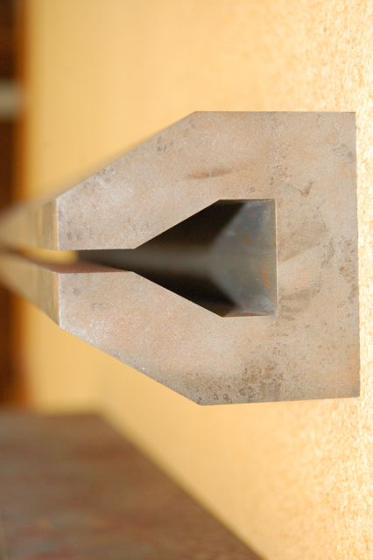

Staging of eRHIC: E_{o} : 5 -> 30 GeV
All energies scale proportionally by adding SRF cavities to the linacs
0.02 Eo
Polarized
e-gun
0.6 GeV
Beam
dump
27.55 GeV
New
detector
 | e | p | ²He³ | ⁷⁹Au¹⁹⁷ | ⁹²U²³⁸
Energy, GeV | 20 | 250 | 167 | 100 | 100
CM energy, GeV |  | 141 | 115 | 89 | 89
Number of bunches/distance between bunches | 74 nsec | 166 | 166 | 166 | 166
Bunch intensity (nucleons) ,10¹¹ | 0.24 | 2 | 1.3 | 0.79 | 0.83
Bunch charge, nC | 3.8 | 32 | 10 | 5.2 | 5.2
Beam current, mA | 50 | 420 | 140 | 67 | 67
Normalized emittance of hadrons , 95% , mm mrad |  | 1.2 | 1.2 | 1.2 | 1.2
Normalized emittance of electrons, rms, mm mrad |  | 32 | 48 | 80 | 80
Polarization, % | 80 | 70 | 70 | none | none
rms bunch length, cm | 0.2 | 8.3 | 8.3 | 8.3 | 8.3
β*, cm | 5 | 5 | 5 | 5 | 5
Luminosity per nucleon, x 10³⁴ cm⁻²s⁻¹ |  | 0.97 | 0.65 | 0.39 | 0.41
Linac
Coherent e-cooler
0.9183 Eo
Linac 2.45 GeV
Eo
0.8367 Eo
0.7550 Eo
E/Eo
0.0200
0.1017
0.1833
0.2650
0.3467
0.4283
0.5100
0.5917
0.6733
0.7550
0.8367
0.9183
1.0000
0.6733 Eo
0.5917 Eo
0.5100 Eo
0.4286 Eo
0.3467 Eo
0.2650 Eo
0.1017 Eo
0.1833 Eo
30 GeV
All magnets would be installed from day one and we would be cranking power supplies up as energy is increasing
ePHENIX
100 m
eSTAR
30 GeV
Notes:
We returned to developing cost effective and ECO-friendly eRHIC option with ERL located in the existing RHIC tunnel. We plan to install all magnets for 6 passes and 30 GeV from the start and then build up SRF linac from 1 GeV to 5 GeV per pass.
In this case electrons will pass through the detector halls in the way to the top energy, will collide in up to 3 IRs. Then they will be decelerated to the injection energy and damped.

Slide 5
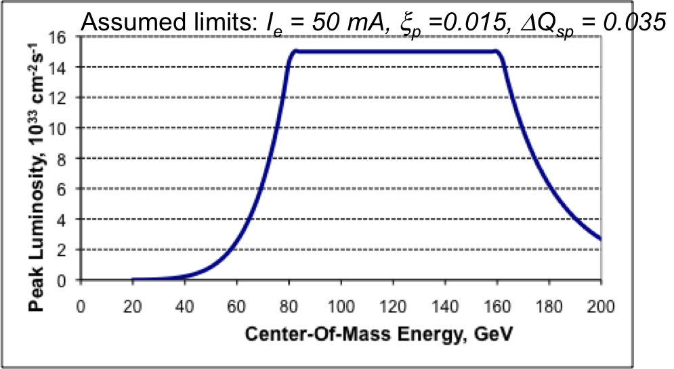
Beam Energy Combinations for MC
Hadron Beam Energies
  proton: 75 – 250 GeV → 2x10³² cm⁻²s⁻¹ < lumi < 9x10³³ cm⁻²s⁻¹
  Ion: 50 – 100 GeV → 5x10³² cm⁻²s⁻¹ < lumi < 4x10³³ cm⁻²s⁻¹
  MC: 50 GeV, 100 GeV and 250 GeV
Lepton Beam Energies
  Stage-I: 5 GeV and 10 GeV
  Stage-II: 20 GeV and 30 GeV
  MC: 5 GeV, 10 GeV, 20 GeV and 30 GeV
→ so in total 3x4 MC settings
Lumi reduced due
to reduced I_{e} at 30GeV

Slide 6
Simulation Example
Cuts: Q²>1 GeV, 0.01<y<0.95, z>0.1

Slide 7
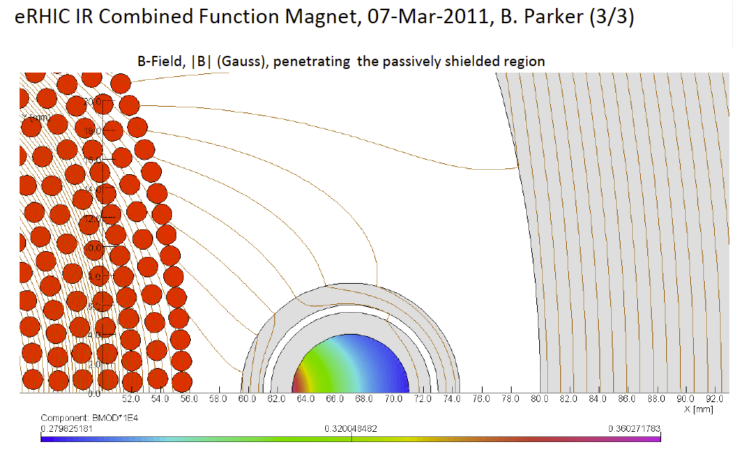
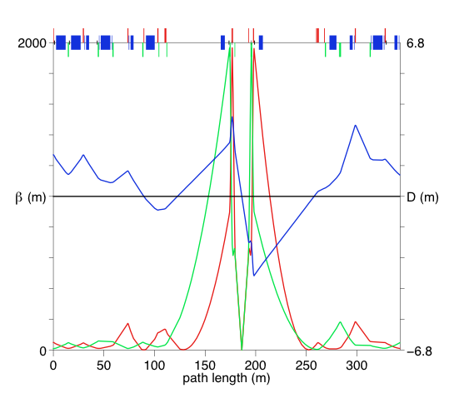
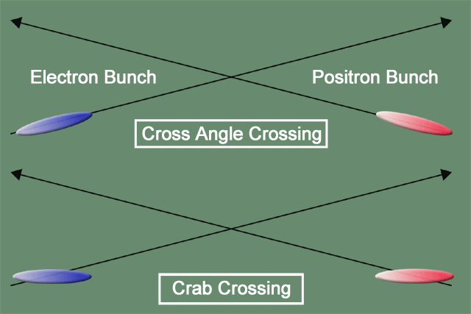
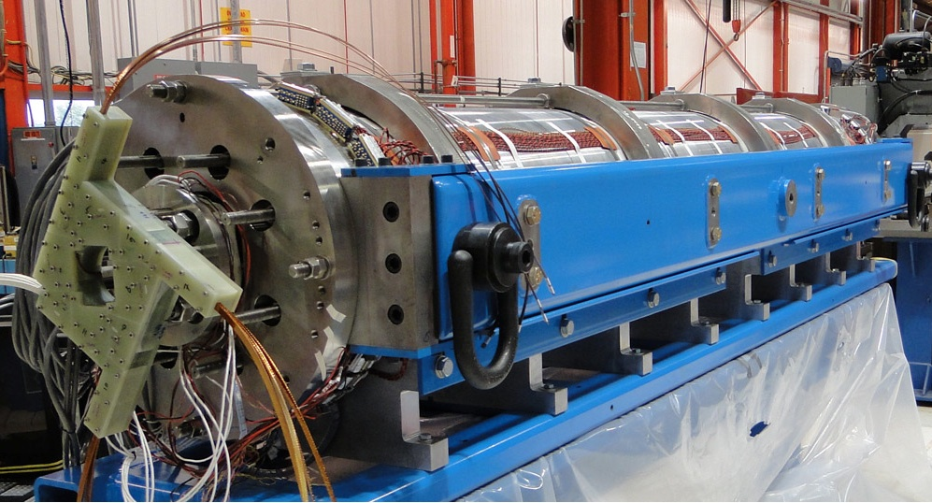
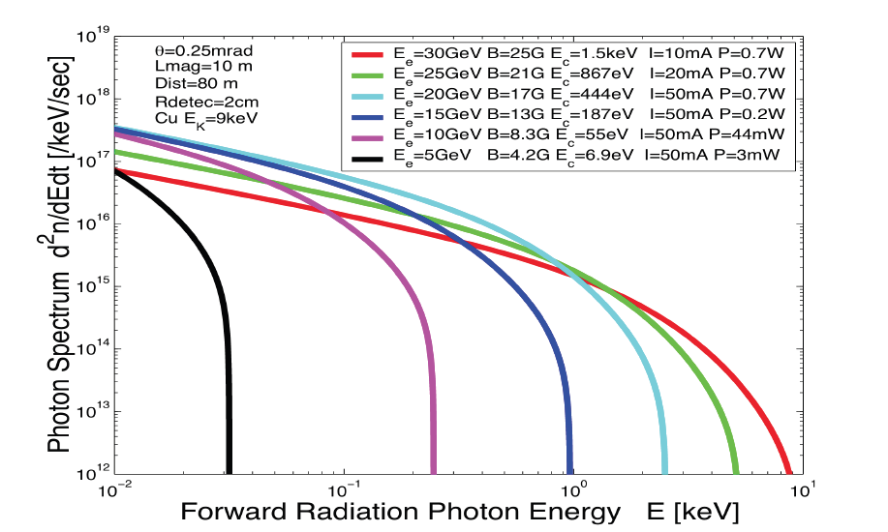
eRHIC high-luminosity IR with β*=5 cm
© D.Trbojevic, B.Parker, S. Tepikian, J. Beebe-Wang
p
Proton beam lattice
G.Ambrosio et al., IPAC’10
e
Nb₃Sn
200 T/m
eRHIC - Geometry high-lumi IR with β*=5 cm, l*=4.5 m
and 10 mrad crossing angle → this is required for 10³⁴ cm⁻² s⁻¹
10 mrad crossing angle and crab-crossing
High gradient (200 T/m) large aperture Nb₃Sn focusing magnets
Arranged free-field electron pass through the hadron triplet magnets
Integration with the detector: efficient separation and registration of low angle collision products
Gentle bending of the electrons to avoid SR impact in the detector

Slide 8
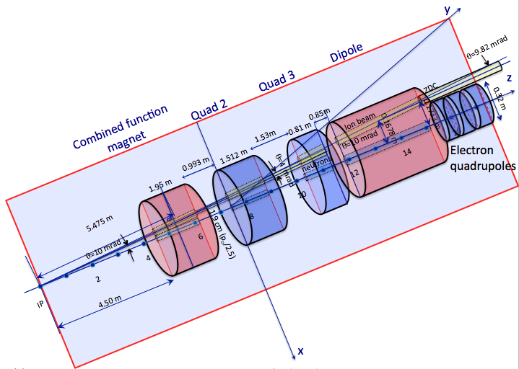
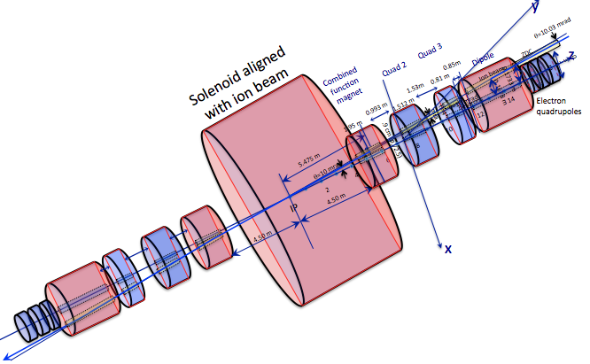
IR-Design
All optimized for dedicated detector
Have +/-4.5m for main-detector
roman pots / ZDC
low Q2-tagger

Slide 9
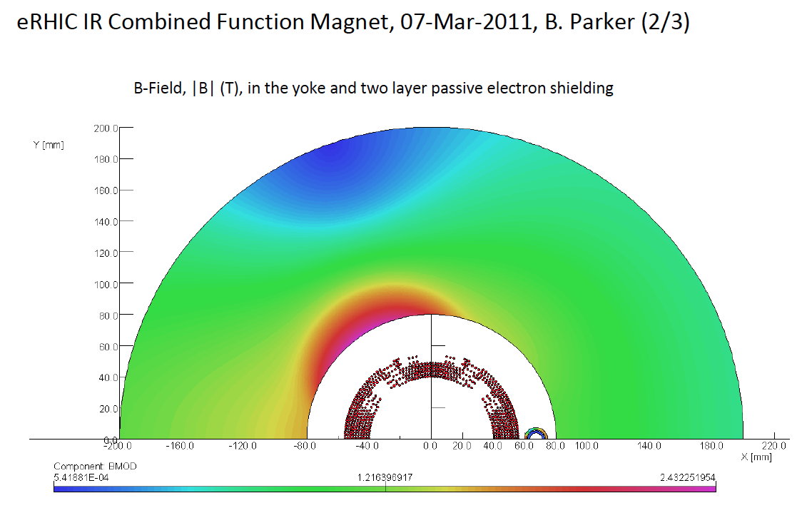
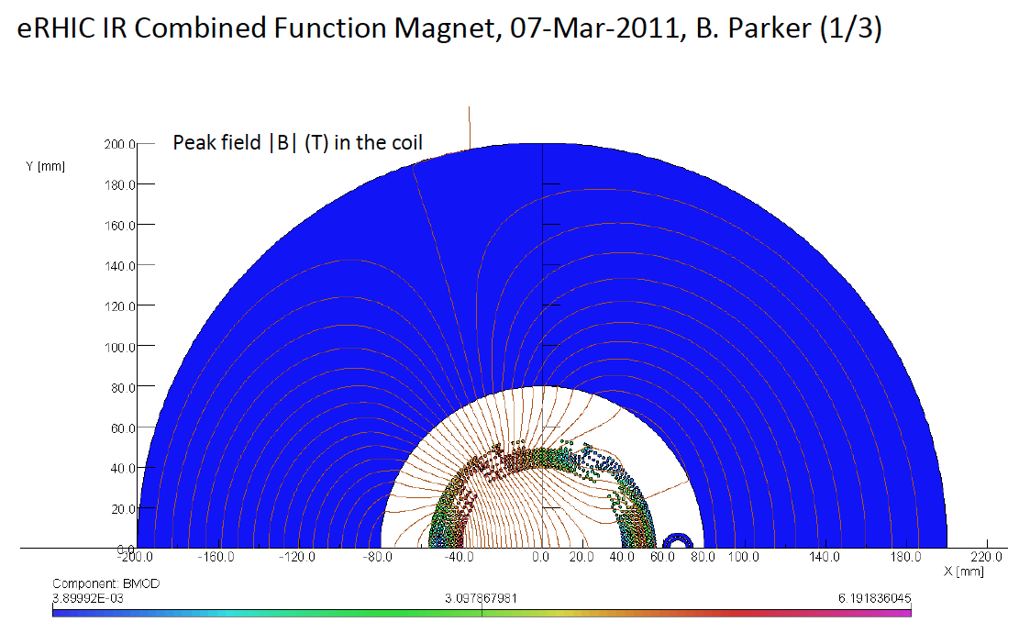
Combined function magnet with zero field for electron passage Brett Parker-March-2011-BNL
40 cm
Protons/ions enter with offset 22 mm
22 mm
5.4 E-04 T
4.5 cm
2.432 T
0.28 T
0.36 T

Slide 10
Synchrotron Radiation@IR
all simulations/estimates done for 30 GeV lepton beam energy
60cm down in y over 55m

Slide 11
Synchrotron Radiation@IR
SR Absorbers integrated in
beam line
design idea inspired by NSLS-II

Slide 12
Synchrotron Radiation@IR
1. In the photon energy range we are interested in ( 10⁰-10² keV)
The secondary radiation (off copper surface, go down stream) rate: ~10⁻⁶
The Beryllium pipe (1mm) penetration rate: ~10⁻⁵
2. What is not included in this study:
A. Some photons could scatter off the thin pipe (shorter pass length);
B. Backward radiation from the elements down stream of the detector;
C. SR from electron going through triplet and some other magnetic elements;
D. Assumed perfect general background shielding and perfect collimation.
3. In this calculation the effective pass length in the material is half of the physical length in the attempt to account what is not included. It could be an over (or under) estimate.
NSLS-II experts have started to help with the simulation o SR
5. Full Simulation using FLUKA is needed to get a realistic SR-Photon spectrum in the detector
@ IR
First estimate of SR-Photons
in Detector done by “hand”

Slide 13
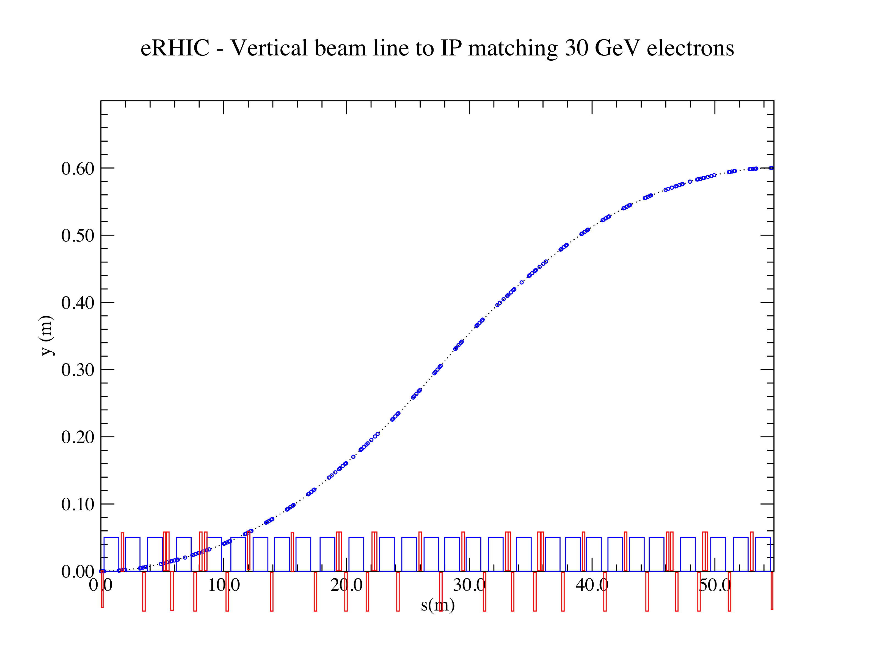
Integration into Machine: IR-Design
Outgoing electron direction currently under detailed design
detect low Q² scattered leptons
want to use the vertical bend to separate very low-Θ e’ from beam-electrons
can make bend faster for outgoing beam → faster separation
for 0.1º<Θ<1º will add calorimetry after the main detector
space for
low-Θ e-tagger

Slide 14
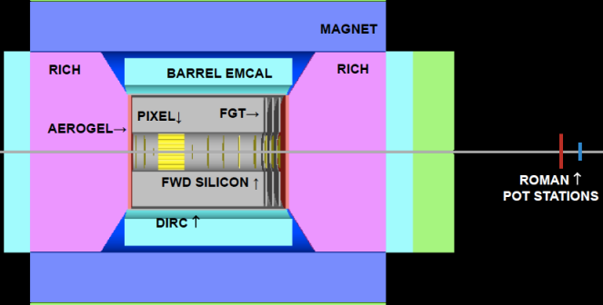
Emerging Detector Concept
Magnet 2-3T
Backward Spectrometer
For very low Q²-electrons:
space for low-Θ
e-tagger
high acceptance -5 < η < 5 central detector
good PID (π,K,p and lepton) and vertex resolution (< 5μm)
tracking and calorimeter coverage the same → good momentum resolution, lepton PID
  Barrel: MAPS & TPC, Forward: MAPS & GEM
low material density → minimal multiple scattering and brems-strahlung
very forward electron and proton/neutron detection → Roman Pots, ZDC, low e-tagger

Slide 15
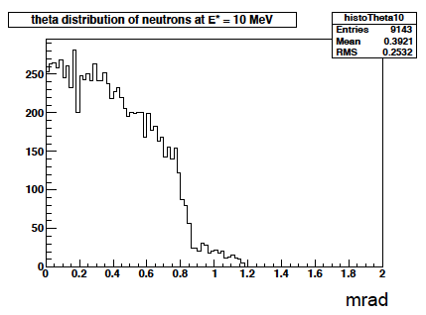
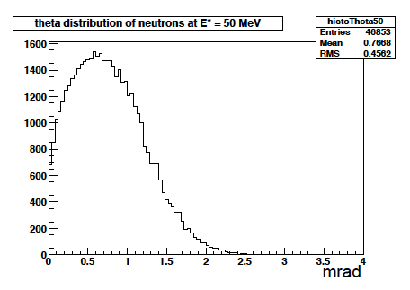
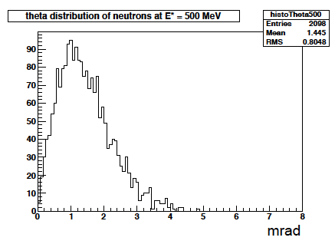
Kinematics of Breakup Neutrons
Results from GEMINI++ for 50 GeV Au
Results:
With an aperture of ±3 mrad we are in relative good shape
• enough “detection” power for t > 0.025 GeV²
• below t ~ 0.02 GeV² we have to look into photon detection
‣ Is it needed?
Question:
For some physics rejection power for incoherent is needed ~10⁴
→ How efficient can the ZDCs be made?
by Thomas Ullrich
+/-5mrad acceptance seems sufficient

Slide 16
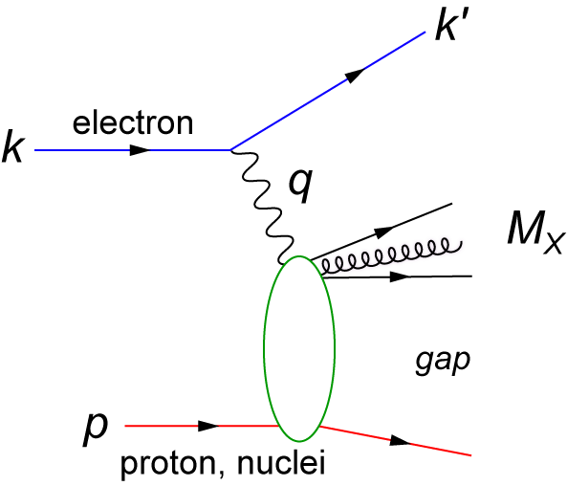
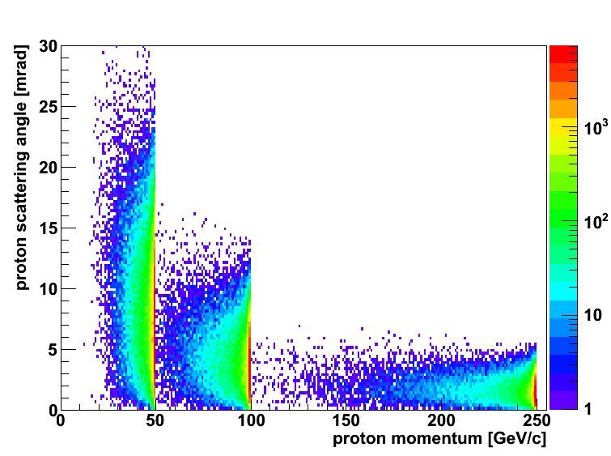
Diffractive Physics: p’ kinematics
Diffraction:
t=(p4-p2)² = 2[(mp^{in}.mp^{out})-(E^{in}E^{out} - pz^{in}pz^{out})]
→ “ Roman Pots” acceptance studies see later
?
5x50
p’
5x100
5x250
Simulations by J.H Lee

Slide 17
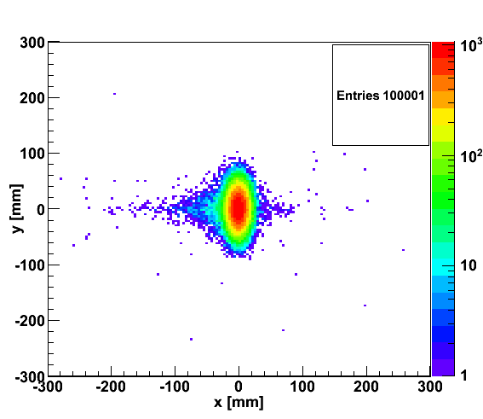
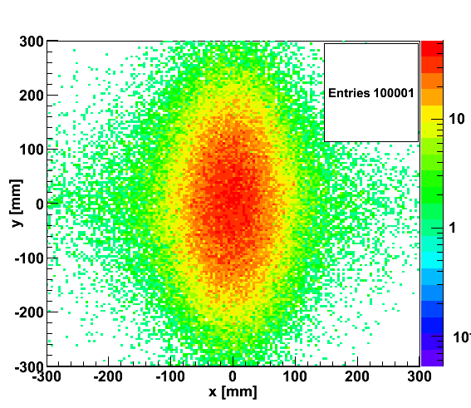

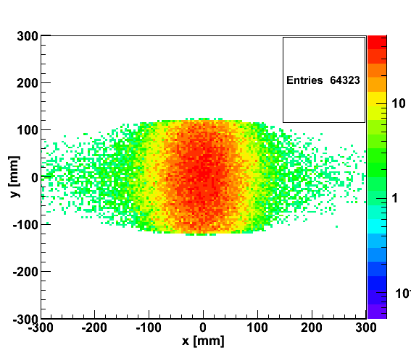
proton distribution in y vs x at s=20 m
without quadrupole aperture limit
20x250
5x50
with quadrupole aperture limit
20x250
5x50

Slide 18
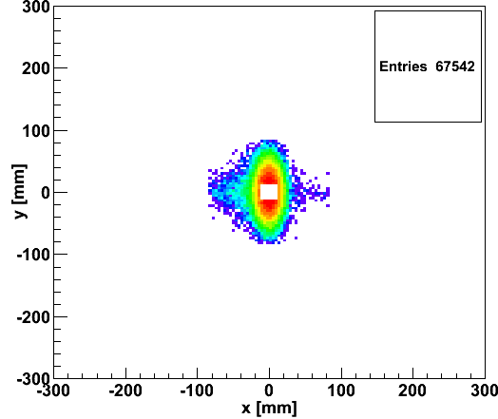
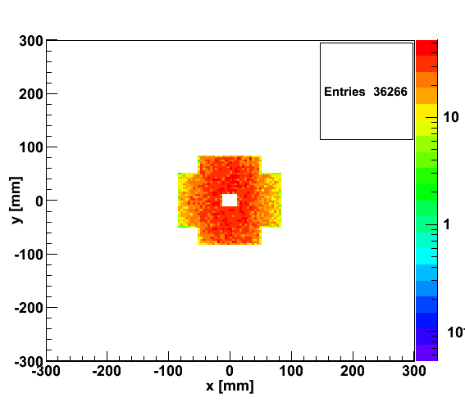
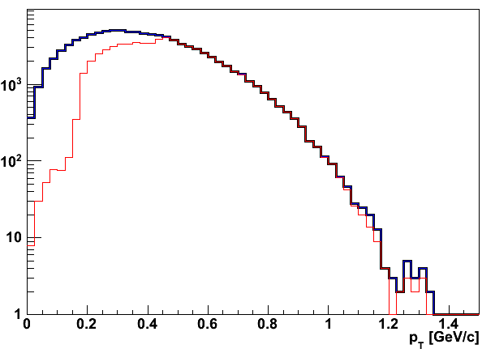
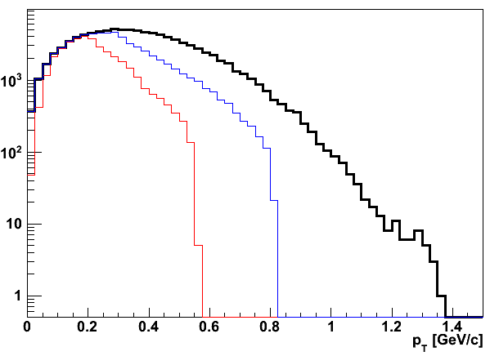
Accepted in“Roman Pot”(example) at s=20m
20x250
5x50
Summary:
Still a lot of work to be done
  But we have started to address all the important issues
    integration of detector and forward particle reconstruction into
    machine design
    Synchrotron radiation
    ………
20x250
5x50
Generated
Quad aperture limited
RP (at 20m) accepted

Slide 19
BACKUP

Slide 20
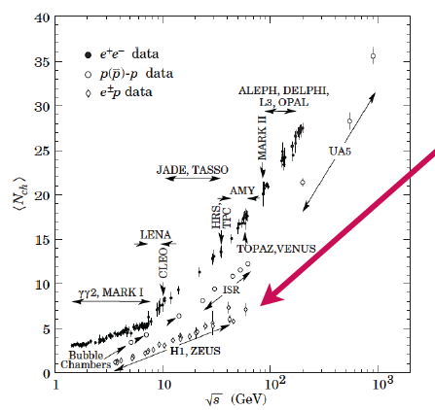
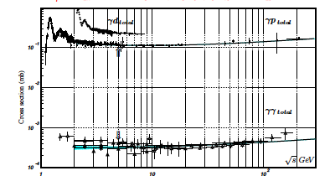
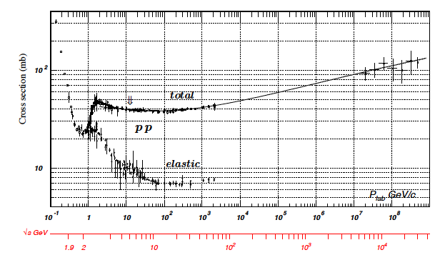
Some thought about rates
low multiplicity
4-6 √s = 40-65 GeV
N_{ch} (ep) ~ N_{ch} (eA) < N_{ch}(pA)
→ no occupancy problem
Cross section:
Pythia σ_{ep}: 0.030 – 0.060 mb
Luminosity: 10³⁴ cm⁻¹ s⁻¹ ⁼ 10⁷ mb⁻¹ s⁻¹
Interaction rate:
300 -600 kHz

Slide 21

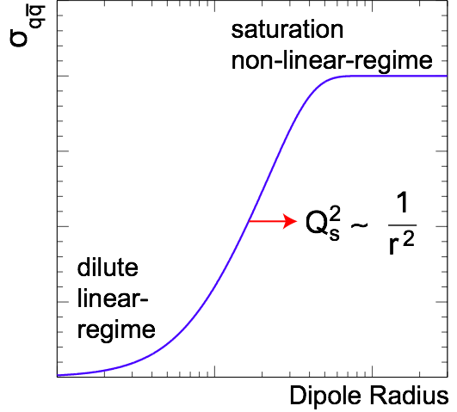
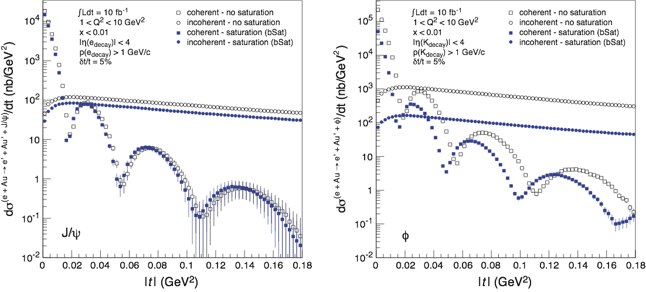

Exclusive Vector Meson Production
  Golden channel: e + A → e’ + A’ + VM
    Only channel where t can be derived from VM and e’
    Detecting neutron emission from nuclear breakup allows to separate coherent from incoherent
Dipole Cross-Section:
J/ψ
ϕ

Slide 22
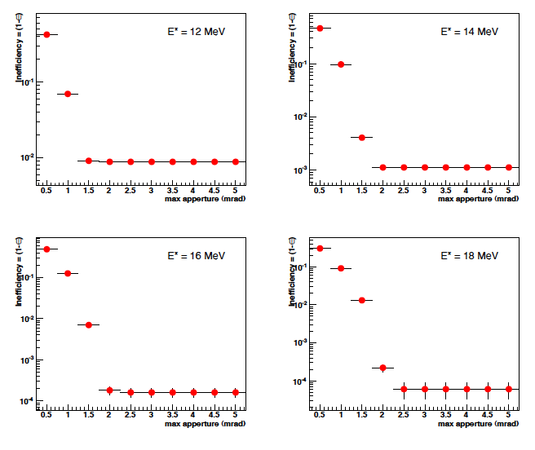
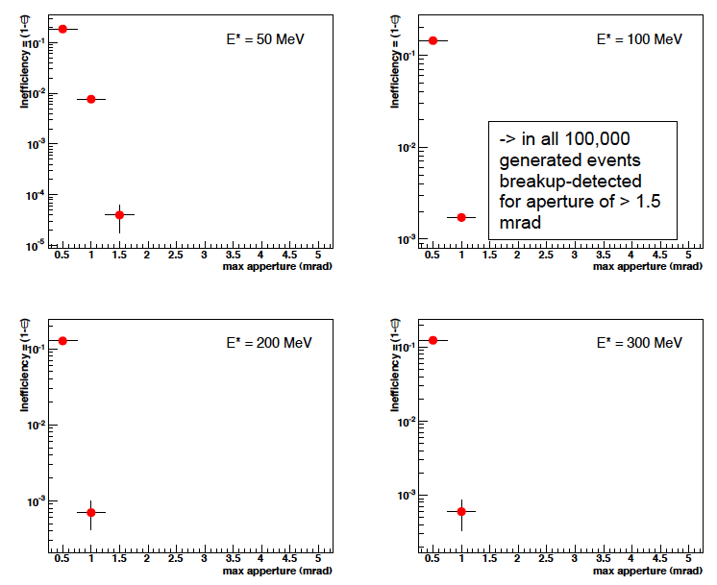
Detection efficiency of Breakup Neutrons
Results:
With an aperture of ±3 mrad we are in relative good
shape even for 50 GeV Au beams
• enough “detection” power for t > 0.025 GeV²
• below t ~ 0.02 GeV² we have to look into photon detection
‣ Is it needed?
Assumptions:
• Gemini++ is correct, was verified by SMM
• E* ~ -t/2mN
• Can we make a ZDC 100% (>99.9999%) efficient
‣ do we understand neutron detection on the 10⁻⁴ level?

