Slide 1
Correlation between
Physics Reach,
Luminosity and √s

Slide 2

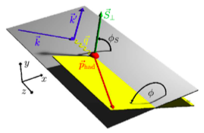
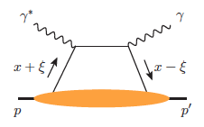
ep Physics reach
experimental program to address these questions:
prerequisites
inclusive and semi-inclusive DIS
all need √s_{ep} > 50 GeV
to access x < 10⁻³ where
sea quarks and gluons dominate
longitudinal motion of spinning quarks and gluons
machine & detector requirements
azimuthal asymmetries in DIS
adds their transverse momentum dependence
multi-dimensional binning
to reach kT > 1 GeV
to reach |t| > 1 GeV²
exclusive processes
adds their transverse position

Slide 3
ep Physics reach
Luminosity
cm⁻²s⁻¹
Charged Lepton Flavor Violation
Precision Measurements of Weak Neutral Current Couplings
10³⁴
novel electroweak
spin SF
GPDs of gluons
DVCS, Vector mesons
GPDs of valence and sea-quarks
DVCS, Pseudoscaler, Vector mesons
gluon Sivers & unpolarised TMD
quark Sivers & unpolarised TMD
Transversity & Boer-Mulders fct
polarised gluon distribution Δg(x,Q²)
polarised quark and anti-quark densities
10³³
HERA:
√s=315 GeV
Lumi: 2x10³¹cm⁻²s⁻¹
√s
45 GeV
63 GeV
100 GeV
140 GeV

Slide 4
kinematic coverage for double spin observables
RHIC pp data
constraining Δg(x)
in approx. 0.05 < x <0.2
data plotted at x_{T}=2p_{T}/√S
20 x 250 GeV eRHIC
5 x 100 GeV eRHIC
lowest x so far 4.6 x10⁻³ COMPASS

Slide 5
The DVCS Phase Space
20 x 250 GeV eRHIC
5 x 100 GeV eRHIC
quantum numbers of final state → selects different GPD
DVCS: wide range of observables (σ, A_{UT}, A_{LU}, A_{UL}, A_{C}) to disentangle GPDs

Slide 6
The TMD Phase Space
20 x 250 GeV eRHIC
5 x 100 GeV eRHIC

Slide 7
eA Physics reach
experimental program to address these questions:
prerequisites
inclusive DIS and diffraction
need √s_{ep} > 50 GeV
to access x < 10⁻³ where
sea quarks and gluons dominate
integrated gluon and sea-quark distributions
machine & detector requirements
semi-inclusive DIS
L ~ 1 fb⁻¹
g_{A}(x,k_{T}); transport coefficients; fluctuations
of nuclear density
L ~ 10 fb⁻¹
multi-dimensional binning
to reach high pT
to reach |t| >= 0.2 GeV²
exclusive diffraction
g_{A}(x,b_{T});

Slide 8
eA Physics reach
Luminosity
cm⁻²s⁻¹
HERA:
√s=315 GeV
Lumi: 2x10³¹cm⁻²s⁻¹
10³⁴
SATURATION
Spatial gluon distribution
g_{A}(x,b_{T}) as fct. of A; gluon correlations
10³³
Transport coefficients in nuclear matter
Fluctuations of the nuclear density
k_{T}-dependent gluon distribution
g_{A}(x,k_{T}) as fct. of A; gluon correlations
10³²
Integrated gluon momentum distribution
g_{A}(x,Q²) as fct. of A
collective nuclear effects
at intermediate-x
√s
31 GeV
45 GeV
63 GeV
90 GeV

Slide 9
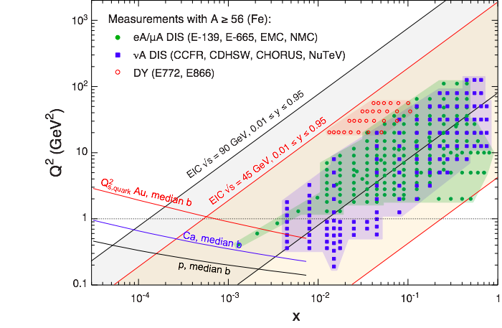
The Phase Space for eA
20 x 100 GeV eRHIC
5 x 100 GeV eRHIC

Slide 10
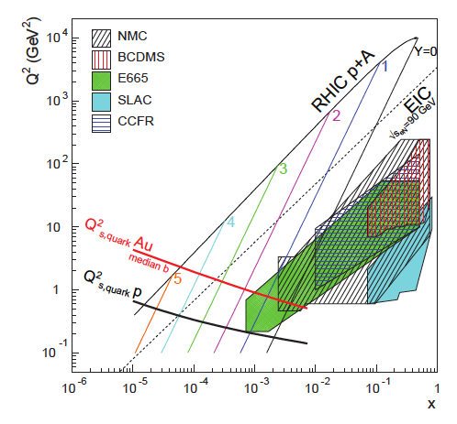
The Phase Space for eA
20 x 100 GeV eRHIC

