Slide 1
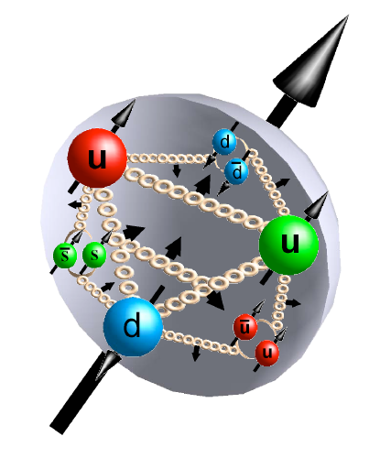
EIC TF meeting, January 12th, 2012
Brief Update:
eRHIC Impact on Helicity PDFs
Marco Stratmann
marco@bnl.gov
work based on Elke’s DIS/SIDIS pseudo-data; in collaboration with Rodolfo

Slide 2
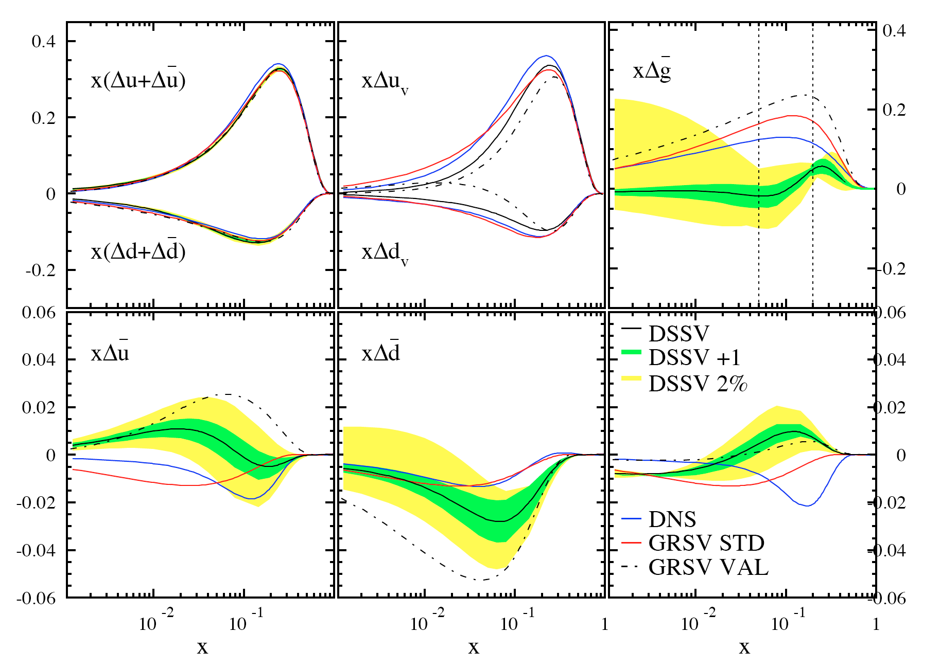
recall: DSSV analysis in 2008/09
DSSV: de Florian, Sassot, MS, Vogelsang; PRL101 (2008) 072001; PRD80 (2009) 034030
gluon small (node?)
in x-region
constrained by data
well constrained
total quark densities
x -> 1 behavior
to be determined
indications for non-trivial
sea quark polarizations
surprising strangeness polarization
sizable SU(3) breaking?
requires reliable kaon fragmentation fcts.
lattice: Bali et al., 0811.0807; 0911.2407; 1011.2194

Slide 3
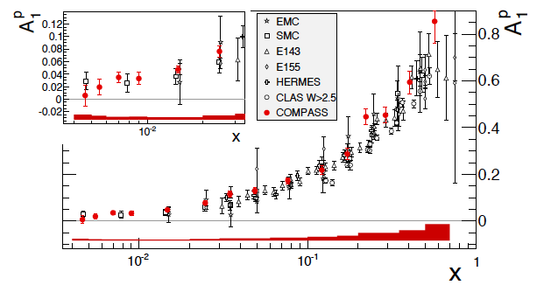
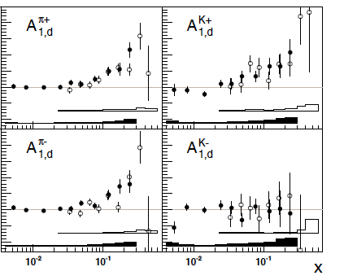
meanwhile: new data -> DSSV+ as baseline for eRHIC studies
DIS: A₁^{p} from COMPASS
arXiv:1001.4654
SIDIS: A_{1,d}^{π,K} from COMPASS
arXiv:0905.2828
SIDIS: A_{1,p}^{π,K} from COMPASS
arXiv:1007.4061
extended x coverage w.r.t. HERMES

Slide 4
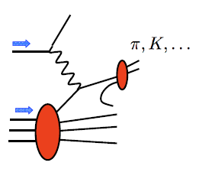
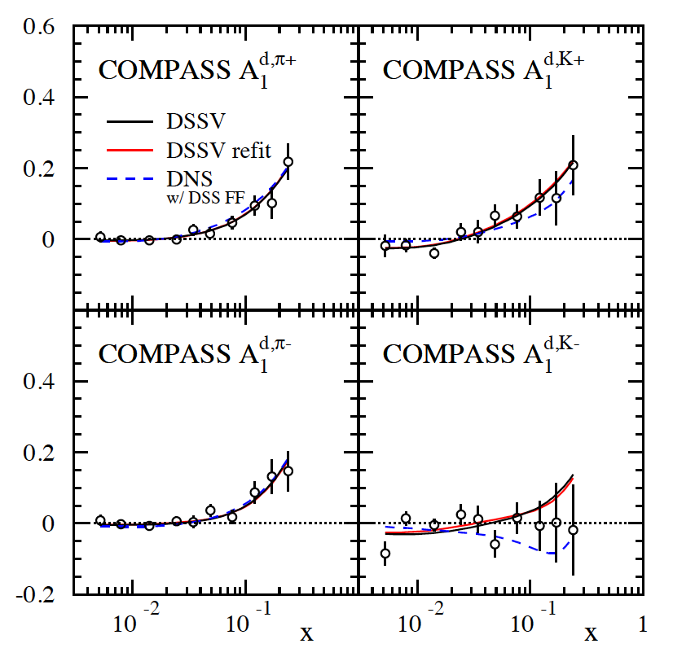
coping with new data: SIDIS A₁^{d,π,K}
DSSV works well:
no surprises at small x
x-range
not covered
by HERMES
χ² numerology♮:
 | DSSV 08 data sets | with A₁^{d,π,K}
DSSV 08 | 392.5 | 420.8
DSSV+ |  | 418.9
arXiv:0905.2828
♮ the branch of knowledge that deals
with the occult significance of numbers

Slide 5
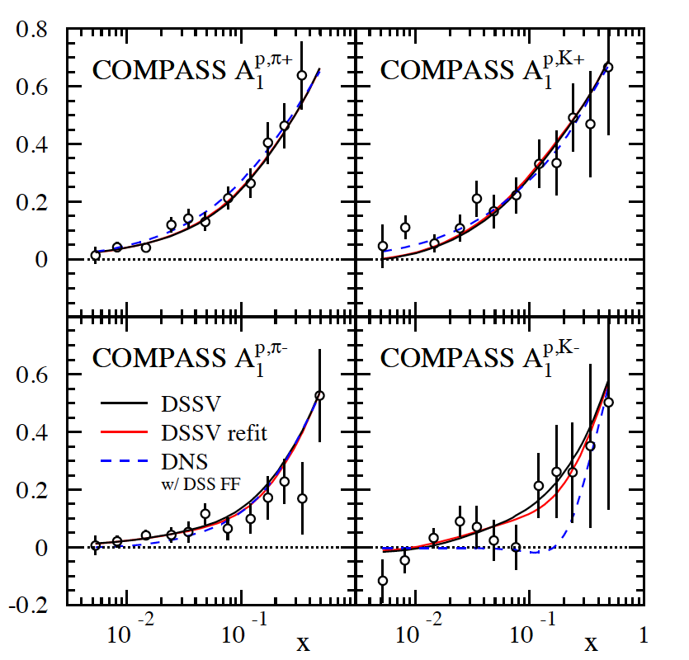
coping with new data: SIDIS A₁^{p,π,K}
1st kaon data on p-target
(not available from HERMES)
x-range
not covered
by HERMES
χ² numerology:
 | DSSV 08 data sets | with A₁^{p&d,π,K}
DSSV 08 | 392.5 | 456.4
DSSV+ |  | 453.0
arXiv:1007.4061
no refit required
(Δχ²=1 does not reflect
faithful PDF uncertainties)
trend for somewhat less
polarization of sea quarks;
less significant

Slide 6
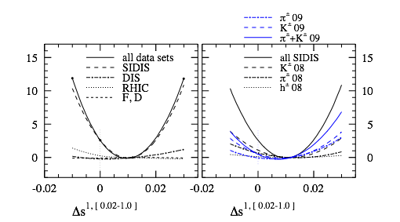
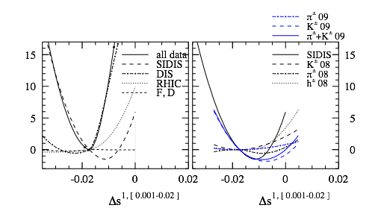
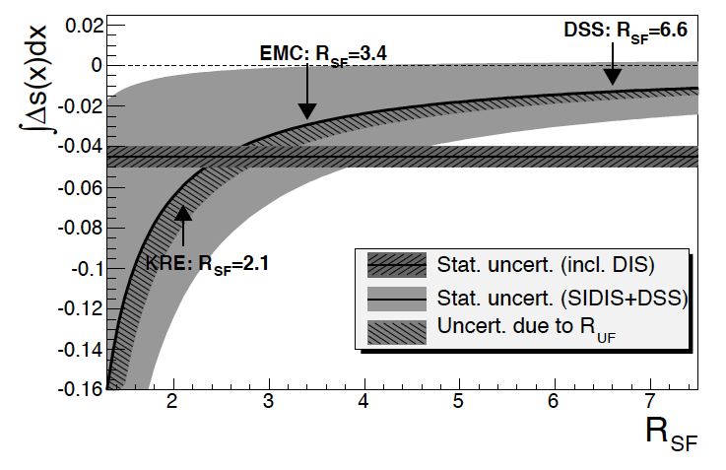
Δs revisited: impact of COMPASS data
current value for ΔΣ strongly depends on assumptions on low-x behavior of Δs
new COMPASS data support small/positive Δs(x) at x > 0.01
they also prefer a sign change at around x=0.01
>0
<0
but large negative 1st moment entirely driven by assumptions on SU(3)
caveat: dependence on FFs
0.004 < x < 0.3
COMPASS

Slide 7
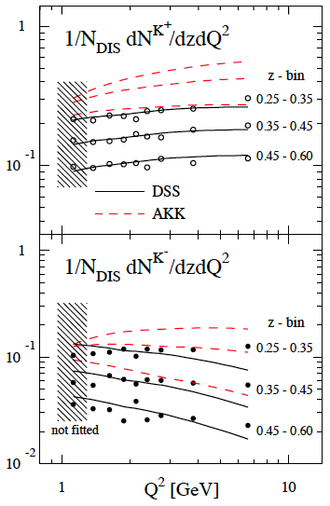
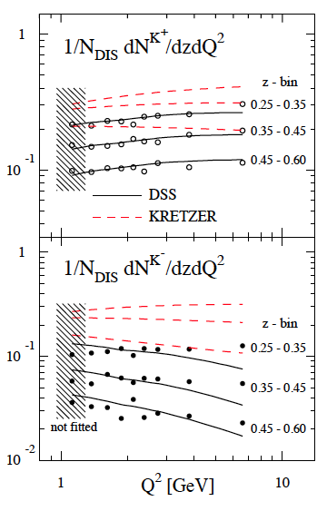
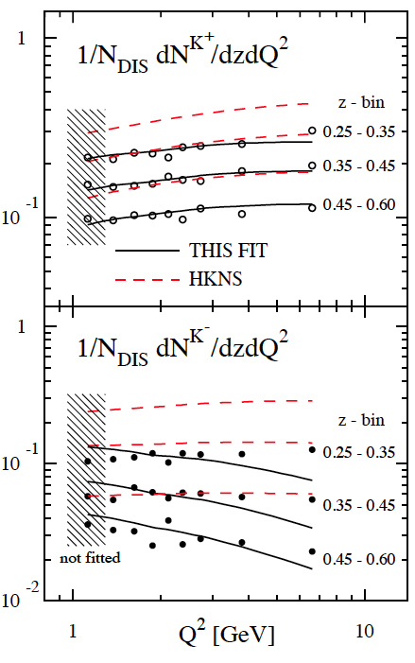
Δs: can we blame it on the fragmentation fcts ?
recently proposed as a “solution” to the “strange quark puzzle”:
Leader, Sidorov, Stamenov
arXiv:1103.5979
indeed, flavor decomposition strongly depends on fragmentation functions
different FFs different results
but wrong FFs misleading results
find: only DSS FFs describe underlying unpol. cross sections in the relevant kinematics
of course, this does not guarantee that we extracted the right Δs: more data are needed

Slide 8
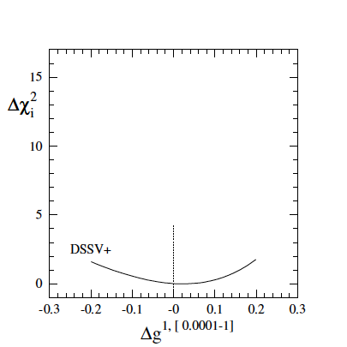
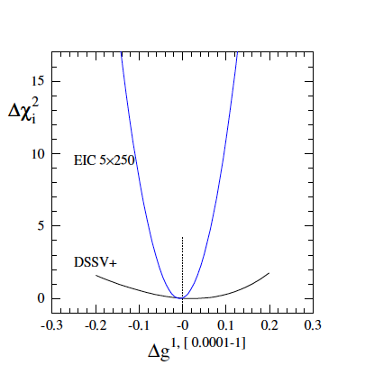
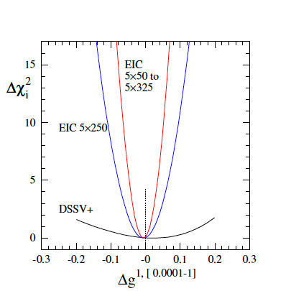
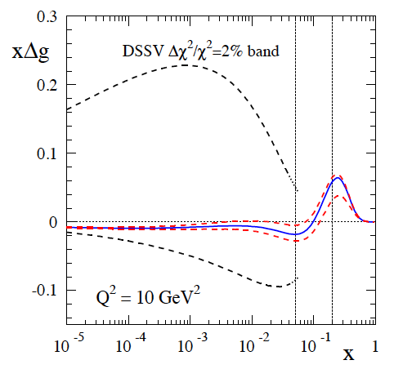
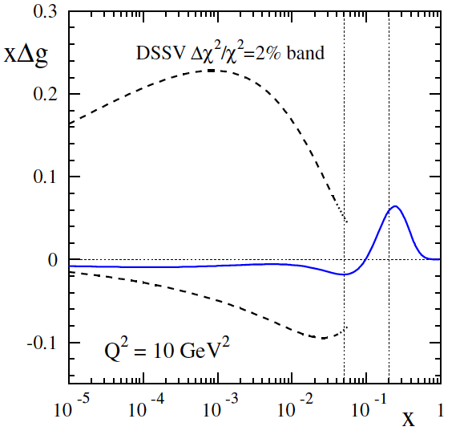
previous study for “EIC science book”
how effective are scaling violations ?
quantitative studies based on simulated data for stage-1: 5 x (50, 100, 250, 325) GeV
Sassot, MS
χ² profile for
uncertainties on the x-shape of
from current ep & RHIC data
expect to determine at about 10% level (more studies needed)
kinematic reach down to x = 10⁻⁴ essential to determine integral

Slide 9
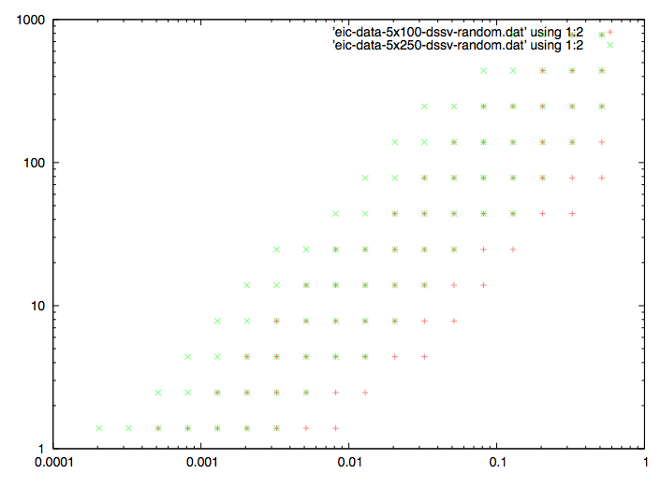
new pseudo-data
data for DIS & SIDIS (π± and K±)
Elke
5x100 and 5x250
10 fb⁻¹ each, 70% beam pol.
cuts:
W² > 10 GeV²
depol. factor > 0.1
0.01 < y < 0.95
p_{elec} > 0.5 GeV
1º < θ < 179º
p_{hadr} > 1 GeV
global analysis:
use relative uncertainty of each point to produce mock data (based on DSSV)
“randomize” data within 1-sigma
for SIDIS: incl. 5% (10%) uncertainty from pion (kaon) frag. fcts.
map out χ² profiles with Lagrange multiplier method (Hessian is work in progress)

Slide 10
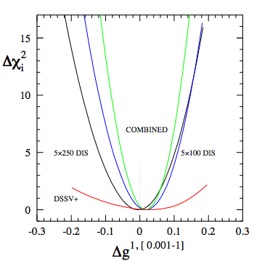
update on Δg
previous result
very similar results as before
slightly larger uncertainties
need to study 0.0001-1 range
need to translate into
error on x-shape of Δg

Slide 11
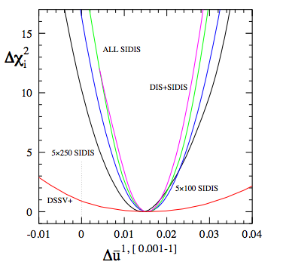
first results on quark sea (I)
very encouraging results
as expected, DIS has no impact
need to study 0.0001-1 range
need to translate into
error on x-shape

Slide 12
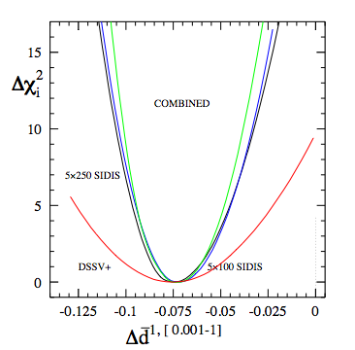
first results on quark sea (II)
not the change of scale on x-axis
perhaps “neutron beam” would
lead to further improvements

Slide 13
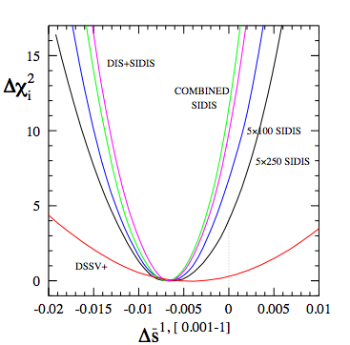
first results on quark sea (III)
should be able to test “constraint”
from SU(3) symmetry
(F,D values from hyperon decays)

