Slide 1
Thoughts about F₂ and F_{L} in eA

Slide 2
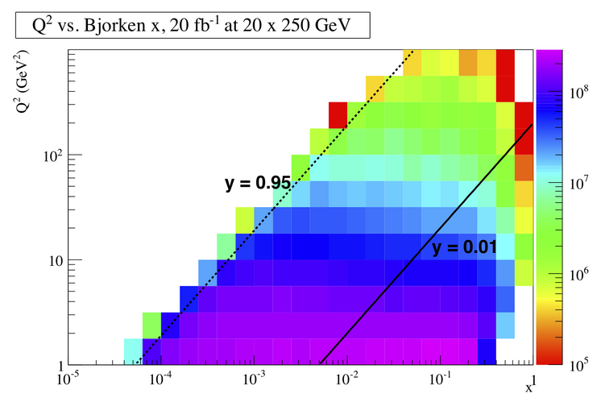
DIS Kinematics
Potential limitations in kinematic coverage:
high y limited by
radiative corrections
can be suppressed by
by requiring hadronic
activity
y=0.85
HERA
y>0.005
y=0.05
Strong x-Q² correlation
high x → high Q²
low x → low Q²
low y limited by
Theta/momentum resolution for e’
→ use hadron method

Slide 3
Structure function in eA

Slide 4
Inclusive Structure functions in eA
How to extract F_{L}:
Plot σ_{r} vs Y⁺
Need different values of Y⁺
→ Need to run at different √s
F_{L} slope of σ_{r} vs Y⁺
F₂ intercept of σ_{r} vs Y⁺ with y-axis
Issues:
Lever arm in Y⁺
Value of y / Y⁺
At low y: detector resolution for e’
At high y: radiative corrections and charge symmetric background

Slide 5
Inclusive Structure functions in eA
Cuts:
Bin in Q² (12 bins logarithmic ) and y (10 bins linear) with fixed x for each bin
Lowest √s y-bins Δy= 0.1
Higher √s Δy gets smaller by ratio of √s₁ / √s₂
3 points in Y⁺ for each Q²-bin
0.01 < Y⁺ < 0.95
ΔY⁺ > 0.1

Slide 6
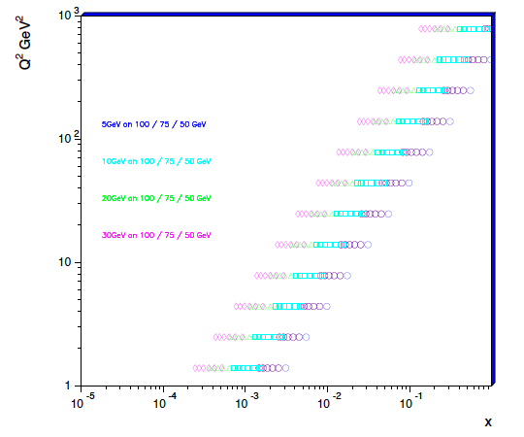
Inclusive Structure functions in eA

Slide 7
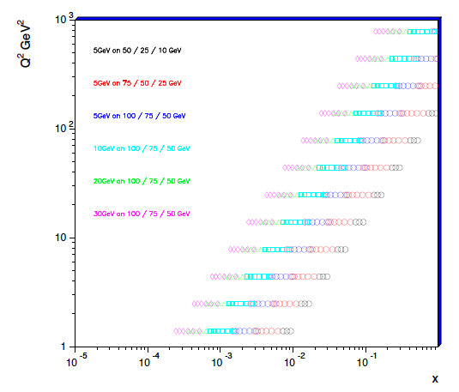
Inclusive Structure functions in eA
Need to combine bins according to the detector resolution
Final y-range needs full MC study
Start generate all the data now
Djangoh in eA mode with eps-09-PDFs and rad-corrections

Slide 8
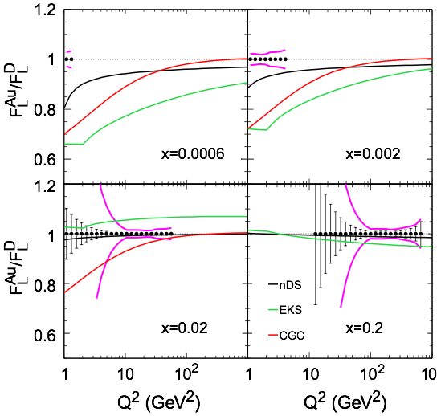
Old plots
syst. uncertainties
∫Ldt = 4/A fb⁻¹ (10+100) GeV &
4/A fb⁻¹ (10+50) GeV &
2/A fb⁻¹ (5+50) GeV
All together 5 weeks at
L ~ 1x10³⁴cm⁻² s⁻¹ & 50% duty cycle (Note: 1000x Hera L)
WHAT was required for this study

Slide 9
Diffractive Structure functions in eA
Defined the same way as inclusive ones
→ same x-Q² coverage
Additional requirements
Rapidity gap between hadron beam and produced jet, J/psi, ….
For ep it was required: M_{y} < 1.6GeV –t<1.0GeV
Need to study:
What is our M_{y} and t – range
What is the influence of this on the model predictions
Is it okay to require no neutrons in the ZDC
this means we go from incoherent diffraction to coherent
diffraction → Is this what we want?

