Slide 1
Steps to second high-L IR in eRHIC

Slide 2
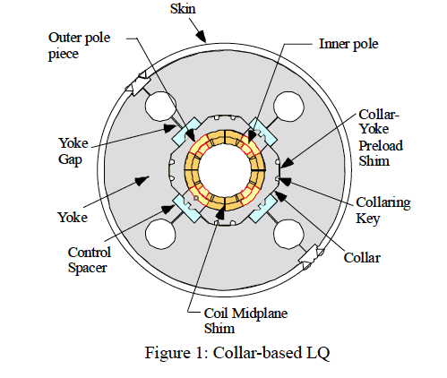
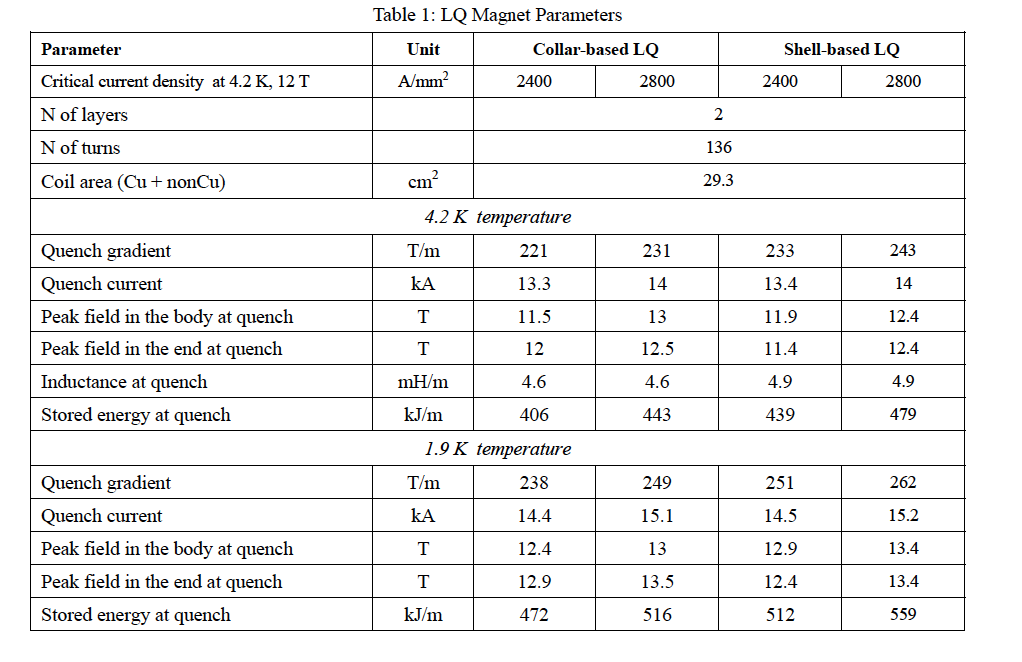
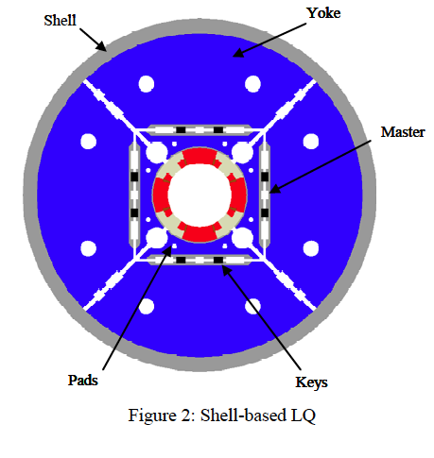

Slide 3
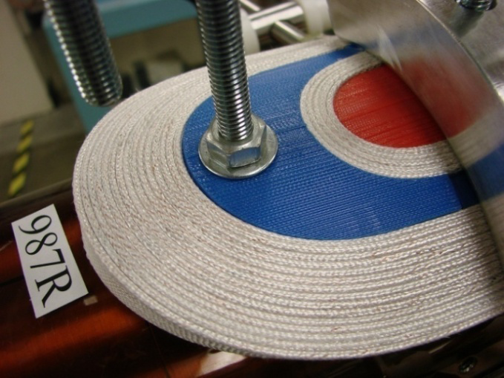
US LARP Magnet Program
Steve Gourlay
Large aperture, Nb₃Sn Quadrupoles for LHC Upgrade
Length
Scale-up
High Performance
Conductor Development
90 mm
> 250 T/m

Slide 4
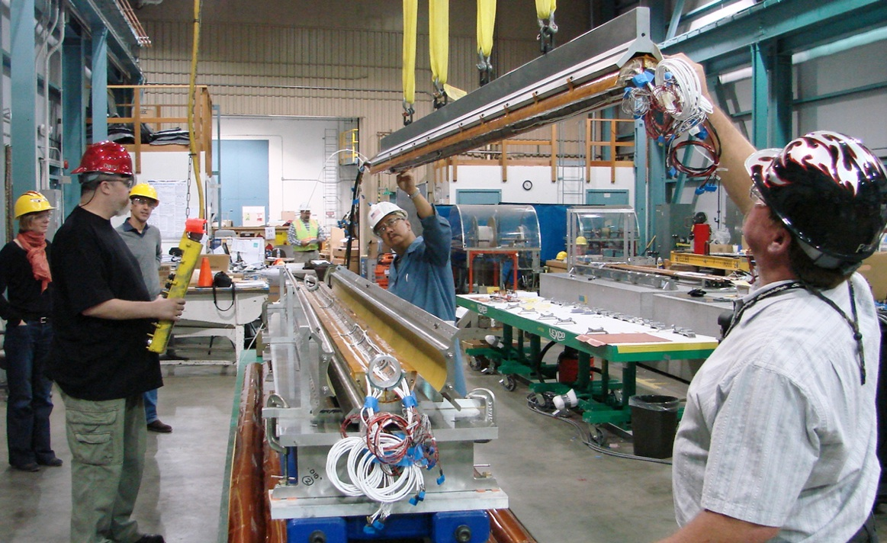
Making the quads

Slide 5
Nb3Sn MAGNET DEVELOPMENT FOR LHC LUMINOSITY UPGRADE* P. Wanderer#, Brookhaven National Lab, Upton, NY 11973, U.S.A.

Slide 6
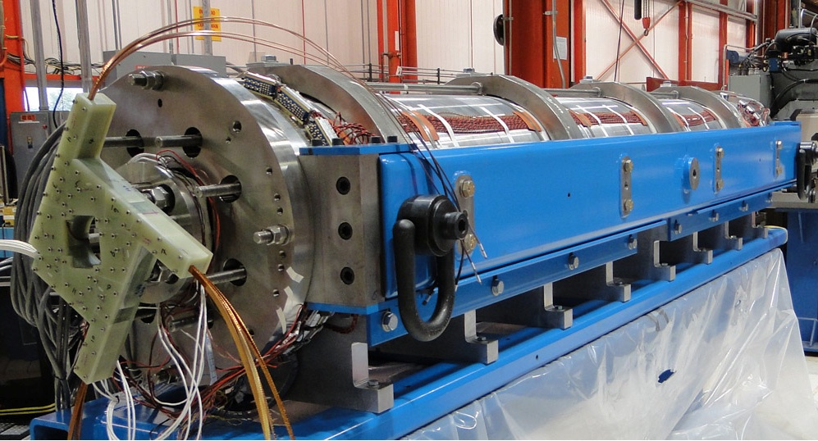
Assembled triplet

Slide 7
Goal #3 High Gradient in a Large Aperture
4-layer: G=280-310 T/m
High Gradient Quadrupole (HQ)
Explore ultimate performance
Increase peak field on the coil to ~ 15 T
Precursor to larger aperture
Subject of Design Studies

Slide 8
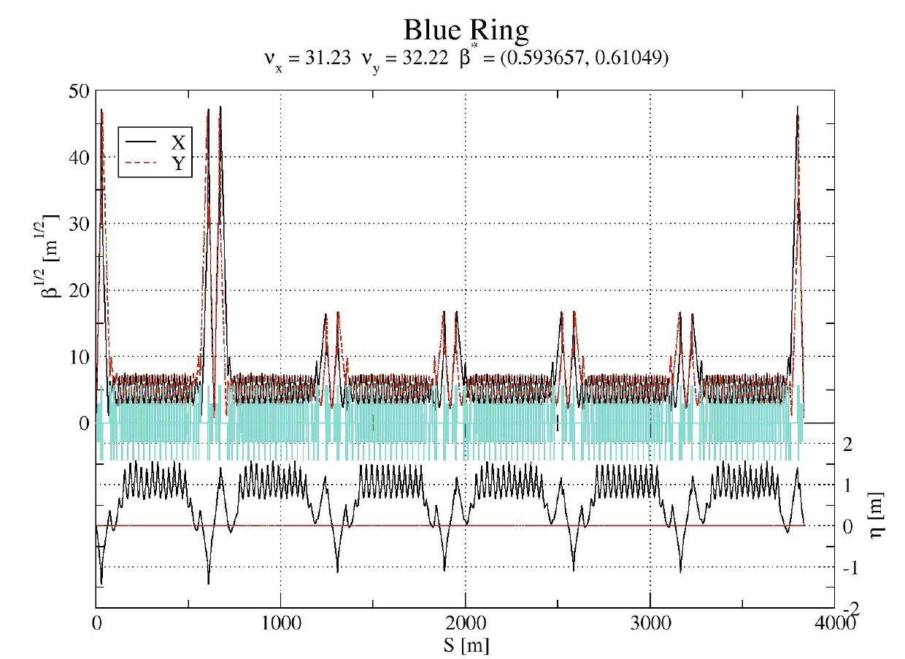

Slide 10
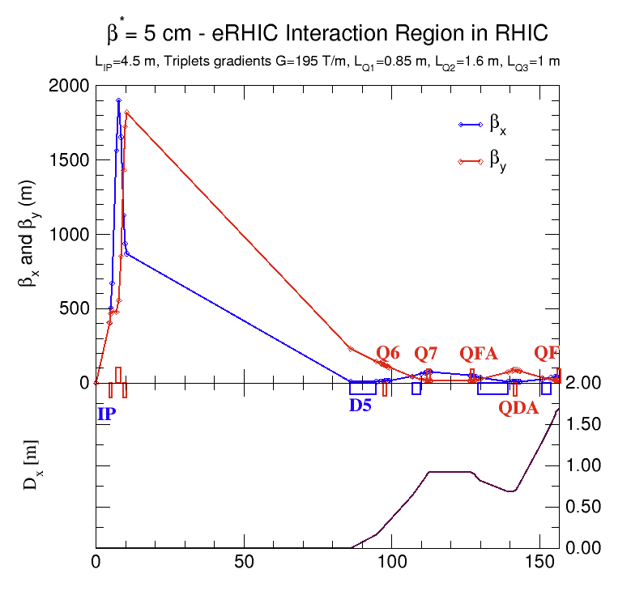

Slide 11
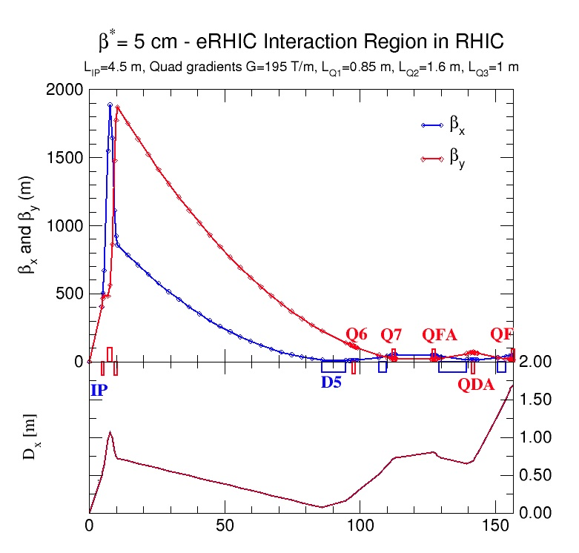

Slide 12
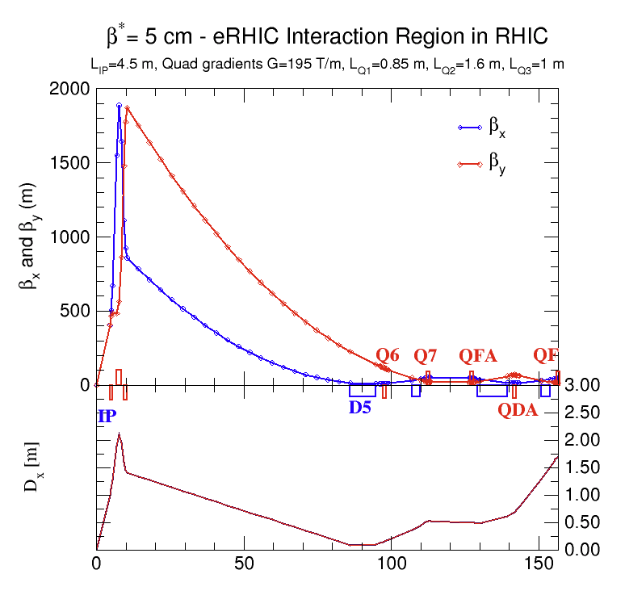

Slide 13
