Slide 1
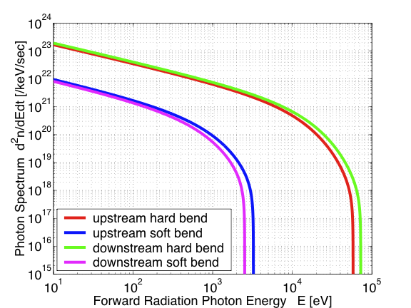
Detector Synchrotron Radiation Background
Forward Radiation Spectrum
1. A horizontal hard bend and a vertical soft bend on both side of the detector;
The forward radiation from the up stream hard bend (red) is completely masked. No hard radiation passes through the detector;
The forward radiation from the up stream soft bend (blue) will pass through the detector without hitting detector wall.
4. The secondary backward radiation induced by the forward radiation generated in down stream bends will be largely masked from the detector;
5. The detector radiation background due to multiple scattering from the vacuum system, masks, collimators and absorbers will be investigated with computer simulations.

