Slide 1
IR design
Dejan Trbojevic
January 25, 2011

Slide 2
January 25, 2010, IP configuration for eRHIC
1.12 m
1.773 m
1.95 m
0.59m
10.8642 m
0.927 m
5.475 m
p_{c}/2.5
1.90 m
D=120 mm
θ=10 mrad
θ=4 mrad
1.9 cm (p_{c}/2.5)
θ=7 mrad
ZDC
4.50 m
θ=10 mrad
IP
2
4
6
8
10
12
14
16
beam
neutrons
Combined function magnet:
L=1.95 m, B=1.71 T, G=-86 T/m
θ=4 mrad
θ=7 mrad
D=120 mm

Slide 3
February 12, 2011, IP configuration for eRHIC
1.045 m
1.719 m
1.95 m
5.475 m
1.1m
1.057 m
p_{c}/2.5
1.902 m
D=120 mm
θ=10 mrad
θ=4 mrad
1.9 cm (p_{o}/2.5)
ZDC
4.50 m
θ=10 mrad
IP
2
4
6
8
10
12
14
16
Combined function:
1.6 m, 2.230 T, -109 T/m
Θ=4 mrad
beam
neutrons
D=120 mm

Slide 4
Q4
Q5
D5
θ=10.3255 mrad
10.26m
3 m
θ=4 mrad
θ=0.0036745 mrad
0.44843 m
0.2582 m
0.315726 m
5.3 m
10 mrad
4.5
10
20
30
39.98 m
60.0559 m
90.08703 m

Slide 5
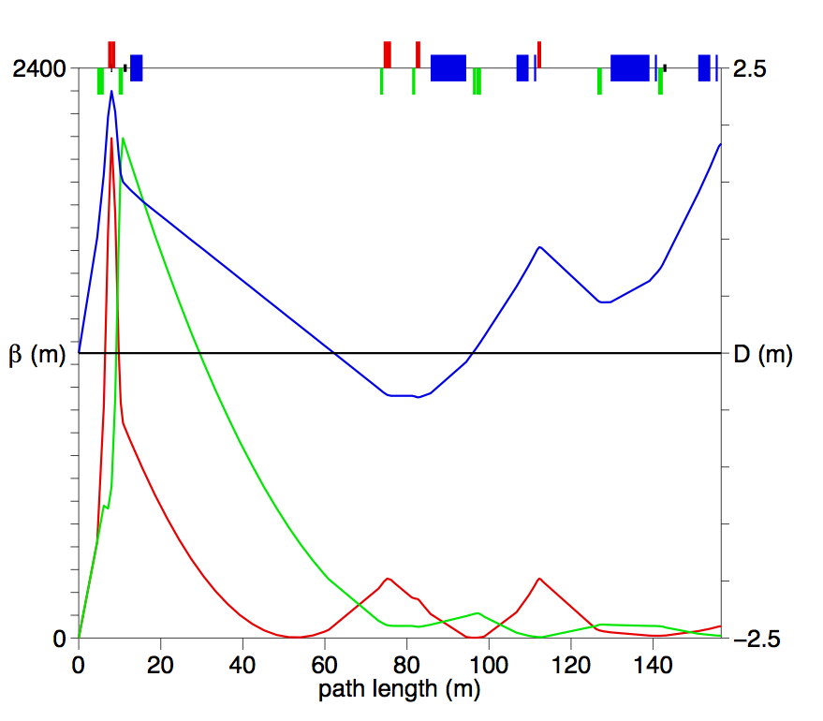

Slide 6
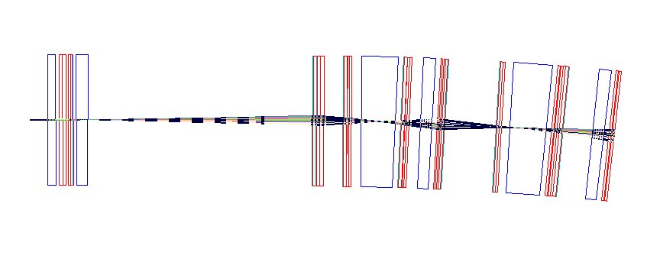
Tracking through the triplets: The whole interaction region up to the arcs
Q2
Q3
Q5O6
Q7O6
QDA6
DX2O
D0NW
Q4O6
Q6O6
QFB6
Q4OT6
QF9
D5O
DS
D8
DS

Slide 7
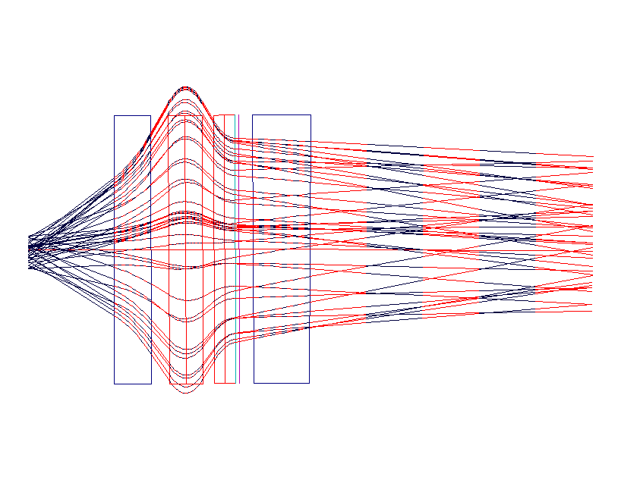
Tracking through the triplets: Just first four magnets
200T/m
185T/m
-200T/m
Magnification 10⁶
DX2O
Q2
Q3
D0NW
x, x’
10 μm
x’=100 mrad
4.5 m
1.95 m

Slide 8
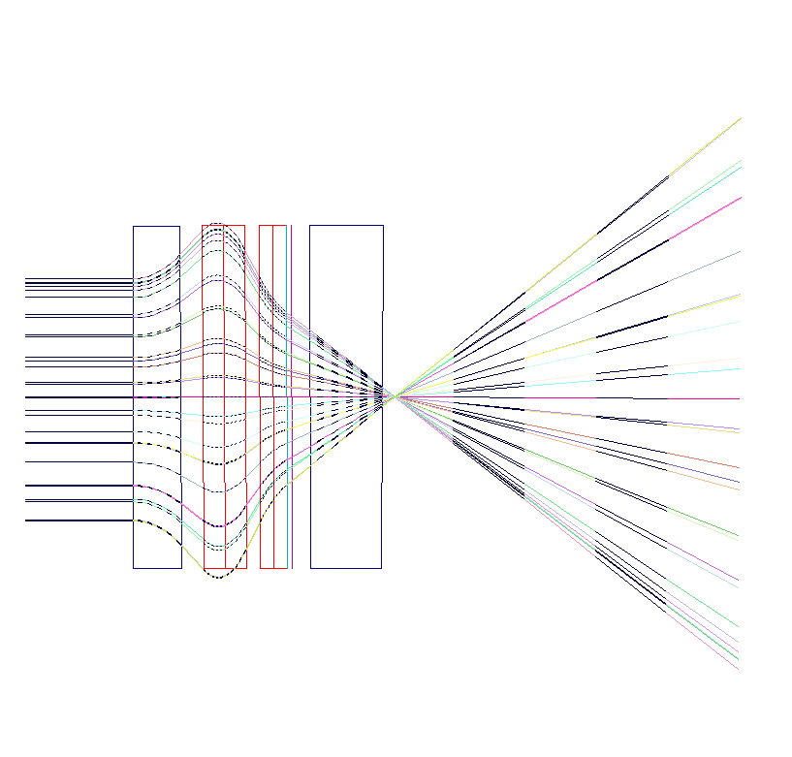
Tracking through the triplets: The whole interaction region up to the arcs
200T/m
185T/m
-200T/m
Magnification 10⁶
DX2O
Q2
Q3
D0NW
10 μm
4.5 m
1.95 m

Slide 9
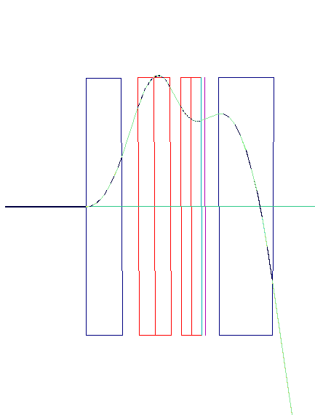
Tracking through the triplets: momentum = p_{o}/2.5
1.9 cm
185T/m
DX2O
Q2
Q3
D0NW
200T/m
-200T/m
4.5 m
1.95 m
1.77 m
1.1 m
3.0 m
0.96 m
0.59 m

Slide 10
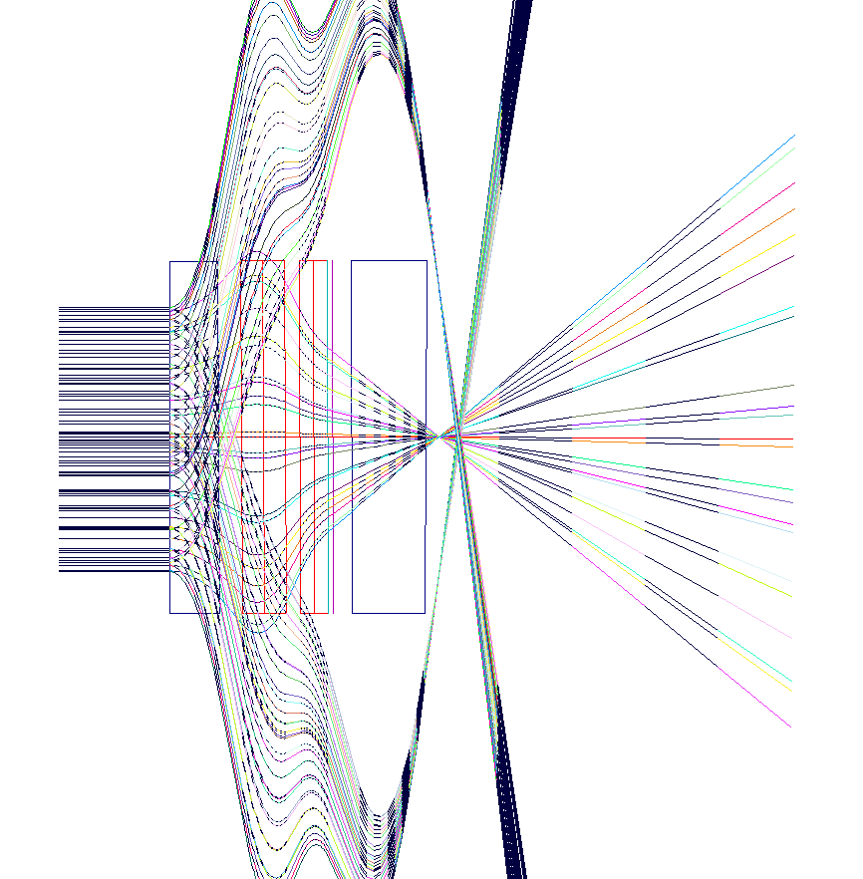
Particle tracking through the triplets δp/p=±0.001
Magnification 10⁶
10 μm

