Slide 1
Developing a Long-Term Strategy for RHIC
Steve Vigdor
eRHIC Coordination Meeting
March 10, 2011
Tim Hallman at 2010 RHIC Users Meeting: “Your future is in your hands.”
How do WE flesh out an optimal RHIC strategy, with broad user buy-in, to present at next NP Long Range Plan (~2013?)?

Slide 2
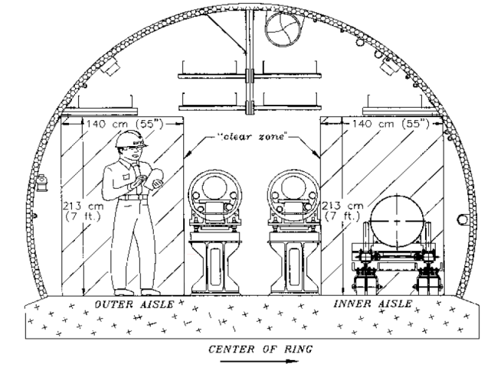
eRHIC-I physics
RHIC-II science by-passing RHIC-II project
Opportunity for up-grade* or 1st EIC stage (eRHIC-I)
EIC = Electron-Ion Collider; eRHIC = BNL realization by adding e beam to RHIC
Luminosity upgrade:
Staged approach to eRHIC
Further luminosity upgrades (pp, low-E)
Further luminosity upgrades (pp, low-E)
LHC HI starts
electron recirc-ulation mag-nets
eRHIC will add electron ERL inside RHIC tunnel, going from 5 to 30 GeV in stages
© V. Litvinenko
* New PHENIX and STAR Decadal Plans provide options for this period. Dedicated storage ring for novel charged-particle EDM measurements another option.
Notes:
2

Slide 3
EIC Realization Imagined
Potential Electron-Ion Collider Timeline Shown by Hugh Montgomery at INT Workshop, Sept. 2010
Activity Name | 2010 | 2011 | 2012 | 2013 | 2014 | 2015 | 2016 | 2017 | 2018 | 2019 | 2020 | 2021 | 2022 | 2023 | 2024 | 2025
12 Gev Upgrade
FRIB
EIC Physics Case
NSAC LRP
CD0
Machine Design/R&D
CD1/D’nselect
CD2/CD3
Construction
N.B. It is unlikely ONP could support operations at 3 major facilities (RHIC, CEBAF, FRIB) and simultaneous construction of a 4th (EIC) after ~2018.
Notes:
3

Slide 4
Three Stages of RHIC’s Future
Short-term (2011-2016): ongoing upgrades to RHIC L , PHENIX & STAR fuel well-defined program addressing key open questions:
  How perfect is the near-perfect liquid?
  Is the nature of QCD vacuum transformed at RHIC T? (e.g., are LPV “bubbles” real effect? Chiral symmetry restored?)
  Is there a critical endpoint in QCD phase diagram?
  How is force between q and q modified in QGP?
  How do partons lose energy in traversing QGP?
  Can we determine speed of sound in the QGP @ RHIC?
  How do nucleons get their spin from q, g constituents?
  …
  Issue: Define complementarity to LHC HI clearly & compellingly!
  Medium-term (2017-2022): PHENIX, STAR Decadal Plans aimed at pursuing compelling long-term questions in A+A, d(p)+A, and p+p that require further detector upgrades
  Issues: Why are RHIC HI collisions still needed? Can national NP budget support operations at CEBAF, RHIC and FRIB, plus construction of EIC? What is optimal strategy for RHIC going into next NP Long Range Plan?

Slide 5
Three Stages of RHIC’s Future
  Long-term (> 2022): eRHIC – add ~5 GeV electron Energy Recovery Linac inside RHIC tunnel to facilitate e+A, e+p (³He) experiments aimed at studying gluon-dominated cold matter. Fall 2010 INT Workshop progressed in defining golden experiments, core science program.
  Issues: Can we match compelling science program to realizable project cost? How do we transition from RHIC to eRHIC – can we accommodate continuing A+A and p+p programs in parallel with e+A and e+p? Will we have to sacrifice some years of RHIC operations to support eRHIC construction?

Slide 6
Updated RHIC 5-Year Run Plan
Assumes sufficient ops. funding for healthy 2-species run each year; aimed at meeting NP Performance Milestones on schedule; will be updated as we have definitive information about upgrade schedule and/or budget changes
Year | Likely Beam Species | Science Goals | New Detector Sub-systems | New Machine Upgrades | Gain from Machine Upgrades | Comments
FY10 | Au+Au at 200, 62.4 GeV + assorted lower E | Low-mass dilepton spectrum; early collision temp.; improved jet quenching studies (especially e⁻ from heavy quarks); begin energy scan for critical pt. | STAR TOF completed; PHENIX HBD for heavy ions | Blue ring longitudinal + yellow and blue vertical stochastic cooling; yellow longitudinal cooling (μwave link) upgrade | Factor >2 increase in average store luminosity for full-energy Au+Au | Need 4-8 weeks early in run to (re)com-mission all 4 stoch. cooling systems, demonstrate gain in lumi. lifetime
FY11 | 200 GeV Au+Au; 500 GeV p+p; short 200 GeV U+U; continue low-E Au+Au scan | Bottom vs. charm suppression, flow; antiquark pol’n from W production; 1st characterization of deformation effects in U+U centrality distrib’ns; continue critical pt. search | PHENIX VTX engineer-ing run; AnDY installed, commis-sioned in IP2 | EBIS commis-sioning; 9 MHz cavity; RHIC beam dump; AGS tune jump quads (comm’d in Run 10); RHIC spin flipper | U beam capability; improved pp vertex distrib’n; improved pol’n from AGS; reduced syst. errors | 9MHz requires upgrade to main PS + “bouncer” cavity for both rings + longitudinal damper or Landau cavity for each ring.

Slide 7
Year | Likely Beam Species | Science Goals | New Detector Sub-systems | New Machine Upgrades | Gain from Machine Upgrades | Comments
FY12 | Au+Au and U+U at 200 GeV; 500 GeV p+p | RHIC-II HI goals: heavy flavor, γ-jet, quarkonium, multi-particle correlations; anti-quark and low-x gluon polariza-tions in proton | PHENIX FVTX and μ trigger; PHENIX DAQ/trig upgrades; STAR FGT | Full yellow + blue horiz. stoch. cooling (6 planes in all); | Further heavy-ion luminosity improve-ments + improved proton polarization | “Proton cannon” increases pol. source current, to allow scraping to improve polarization
FY13 | 200 + 500 GeV p+p; further heavy-ion running to comple-ment earlier runs | Continue RHIC-II heavy-ion goals; transverse spin asymmetry for Drell-Yan (2015 spin milestone); pp reference data for new subsystems | STAR HFT prototype | Polarized source upgrade; Electron lenses | improved pp luminos-ity | Electron lens commission-ing ⇒ Run 13 gains possible; detailed collimator upgrade plans still to be developed
FY14 | 200 GeV Au+Au; low-E Au+ Au dictated by Run 10+ 11 results | Continue pursuit of γ + jet, energy scan and identified heavy flavor (DM10-12) milestones; quarkonium prodn | STAR HFT pixel det. (full HFT in Run 15); 50% STAR MTD ? | RHIC collimator upgrade; 56 MHz SRF; coherent e-cooling install starts in IP2 | Full RHIC-II heavy-ion luminosity + improved vertex & store length
Notes:
7

Slide 8
Plans and Upgrades for Coming ~5 Years Address All New RHIC-Related Performance Milestones…
Year | # | Milestone
2013 | HP8 | Measure flavor-identified q and ‾q contributions to the spin of the proton via the longitudinal-spin asymmetry of W production.
2013 | HP12 (update of HP1) | Utilize polarized proton collisions at center of mass energies of 200 and 500 GeV, in combination with global QCD analyses, to determine if gluons have appreciable polarization over any range of momentum fraction between 1 and 30% of the momentum of a polarized proton.
2015 | HP13 (new) | Test unique QCD predictions for relations between single-transverse spin phenomena in p-p scattering and those observed in deep-inelastic lepton scattering
2014 | DM9 (new) | Perform calculations including viscous hydrodynamics to quantify, or place an upper limit on, the viscosity of the nearly perfect fluid discovered at RHIC.
2014 | DM10 (new) | Measure jet and photon production and their correlations in A≈200 ion+ion collisions at energies from medium RHIC energies to the highest achievable energies at LHC.
2015 | DM11 (new) | Measure bulk properties, particle spectra, correlations and fluctuations in Au + Au collisions at √sNN between 5 and 60 GeV to search for evidence of a critical point in the QCD matter phase diagram.
2016 | DM12 (new) | Measure production rates, high pT spectra, and correlations in heavy-ion collisions at √sNN = 200 GeV for identified hadrons with heavy flavor valence quarks to constrain the mechanism for parton energy loss in the quark-gluon plasma.
2018 | DM13 (new) | Measure real and virtual thermal photon production in p + p, d + Au and Au + Au collisions at energies up to √sNN = 200 GeV.
spin
Heavy ion
Making clear progress toward all the above!

Slide 9
Not all the exciting physics is yet incorporated in existing milestones…
For example:
Does explanation of Local Parity Violating bubbles (and close analogy to speculated origin of baryon-antibaryon asymmetry at EW phase transition) hold up under more detailed scrutiny?
Can we observe predicted sequential melting of different quarkonium species in QGP?
Are gluon densities saturated in RHIC’s colliding (cold) nuclei?
Can we produce even heavier anti-hypernuclei?

Slide 10
Short-Term Take-Away Message:
1) There are a good number of exciting physics questions to pursue for next ~5 years, fueled by recent and ongoing upgrades.
2) RHIC operations are likely to be funded reasonably for next ~5 years, barring federal budget disasters (which could well occur!).
3) We will get asked repeatedly why RHIC funding should continue, when there is a newer machine that can address similar issues, and budgets are very tight. We need to develop concise, compelling, consistent answers!
4) We need to develop a coherent strategy for RHIC’s long-term future during the next two years. The user community must be actively engaged in this process.

Slide 11
Charge for PAC Review of Decadal Plans
Are the science goals in each Plan well-posed and compelling? Are there important questions addressable with RHIC’s capabilities (perhaps after minor upgrades) that you find missing from the Collaboration’s list?
How well do the suggested measurement programs answer the highlighted science questions? Are there additional simulations or theoretical work that would strengthen the case for making those measurements?
Are the suggested measurement techniques and upgrades essential for answering these questions? (For example, can some questions be adequately answered by high-p_{T} hadron detection without full jet reconstruction?)
Is the complementarity of the proposed RHIC program and of LHC heavy-ion capabilities clearly defined and convincing? If not, what would it take to clarify complementarity?
Do the measurements proposed with polarized beams constitute a compelling extension of the RHIC Spin Program, achievable with anticipated integrated luminosities?
Do the plans and proposed detector upgrades provide the basis for a useful transition of each Collaboration to an era with substantial focus on ep and eA collisions at an eRHIC?
How would you rank the priority (high, medium or low) of each proposed upgrade, taking into account both scientific and technical merit and rough estimates of cost?
Does the suite of proposed measurements justify RHIC operations beyond ~2017, assuming RHIC-II luminosities? If not yet, how can the case be strengthened?

Slide 12
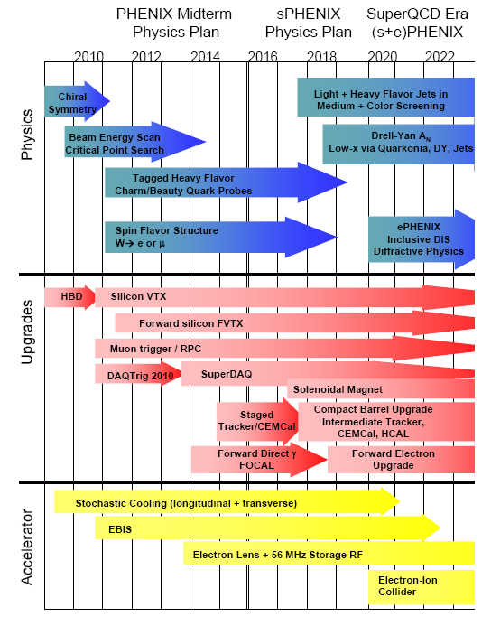
The Different Approaches of PHENIX & STAR Decadal Plans
Questions for PHENIX Plan:
Does science case justify major overhaul $$$?
Does jet focus play too much into LHC strengths?
Can we understand parton interactions in QGP well enough for jets to quanti-tatively probe degrees of freedom vs. length scale?
Can we supplement DOE $ by foreign investments? Stage barrel upgrades?
Is ePHENIX well enough integrated into Plan?

Slide 13
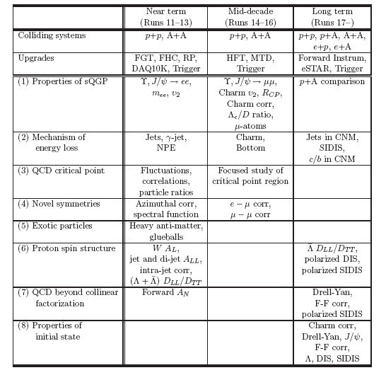
Questions for STAR Plan:
What is the need for A+A beyond 2017? Are collaborators primarily interested in HI collisions on board with Plan?
Is science plan strong enough to support RHIC operations beyond ~2017?
Will TPC remain robust throughout another decade?
What is time scale for fleshing out what eSTAR comprises?

Slide 14
Medium-Term Take-Away Message:
1) The argument of complementarity with LHC HI begins to ring hollow. We need to make a compelling argument for the uniqueness and critical strengths RHIC brings to the investigation of QCD matter.
2) All detector and machine upgrade plans for this period need to be clearly connected to a long-term strategy for the facility.
3) The PHENIX and STAR Decadal Plans are the beginning of a process of defining the long-term strategy. There are significant questions for both, and both are likely to evolve as we develop the long-term strategy.
4) It will be extremely challenging to attract DOE funding at levels > ~ $20M for machine and detector upgrades in this period, unless they are part of a larger project, such as eRHIC. Foreign and NSF contributions can certainly help.

Slide 15
EIC ⇒ High-Resolution, Ultra-Fast Imaging of Gluon-Dominated Matter
Probing the momentum-dependence of gluon densities and the onset of saturation in nucleons and nuclei
Mapping the transverse spatial and spin distributions of quarks and gluons in the gluon-dominated regime
Twin central themes:
Why should we care about gluon-dominated matter? How do goals connect to other physics goals? Why are they of interest to nuclear physicists?
Is an electron machine necessary? Why not just p+A @ RHIC, LHC?
What will EIC do that HERA couldn’t?
If we haven’t solved the nucleon spin puzzle yet, why do we need a new expensive facility to pursue it further?
Real questions from Galveston LRP 2007:
At next LRP, we need to answer these questions crisply!
Notes:
15

Slide 16
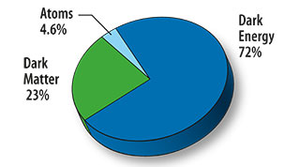
How Do EIC Goals Connect to Other Forefronts in Nuclear, Particle and Astrophysics?
The unfolding mysteries of the energy budget in our universe:
72% comes not from matter but from dark energy of unknown origin and mysterious magnitude (⇒ cosmological probes)
23% comes from dark matter of unknown composition (⇒ DM exp’ts & supersymmetry searches at LHC)
4.6% comes from “mass without mass”[ive constituents] of known baryonic matter (⇒ EIC to probe critical gluon role)
<<1% comes from Standard Model mass generation for quarks and leptons, attributed to as yet undiscovered particle (⇒ Higgs searches @ LHC and Tevatron, ν mass exp’ts)
Notes:
16

Slide 17
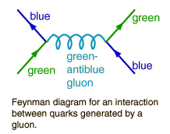
Why Should We Care About Gluon-Dominated Matter? Gluons and Mass Without Mass…
F. Wilczek, in “The Origin of Mass”:
“Its enhanced coupling to soft radiation…means that…a ‘bare’ color charge, inserted into empty space, will start to surround itself with a cloud of virtual color gluons. These color gluon fields themselves carry color charge, so they are sources of additional soft radiation. The result is a self-catalyzing enhancement that leads to runaway growth. A small color charge, in isolation, builds up a big color thundercloud… theoretically the energy for a quark in isolation is infinite… Having only a finite amount of energy to work with, Nature always finds a way to short-circuit the ultimate thundercloud.”
Confinement of color-coordinated quarks inside hadrons cancels the “thundercloud” at long distances from the hadron. But the short-circuit mechanism also needs saturation of gluon densities (via gg → g recombination) to limit the growth of gluon fields inside the hadron.
⇒ Need to probe gluons in non-linear QCD regime of high gluon density ⇒ Need high energies for “soft” glue, but can use heavy nuclei to boost reach, lower cost, probe onset of gluon saturation inside nuclear matter
Notes:
17

Slide 18
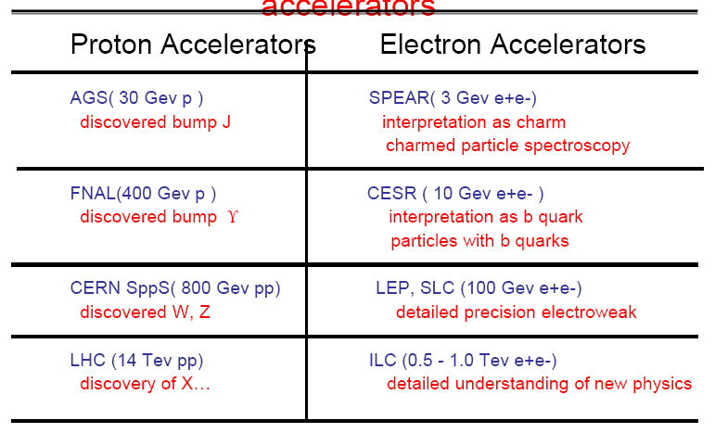
Why An Electron Machine?
Electron accelerators have traditionally been used for quantitative characterization of phenomena discovered at hadron machines:
Example table from C. Baltay talk at June 2010 NUFO Meeting
Proton Accelerators
RHIC, LHC may ⇒ hints of gluon saturation, but need eA to probe quanti-tatively, despite primary EM sensitivity to quarks, rather than gluons. Electron Deep Inelastic Scattering (DIS) is the best demonstrated method to provide time-dilated “freeze-frame” imaging of partons in matter.
Notes:
18

Slide 19
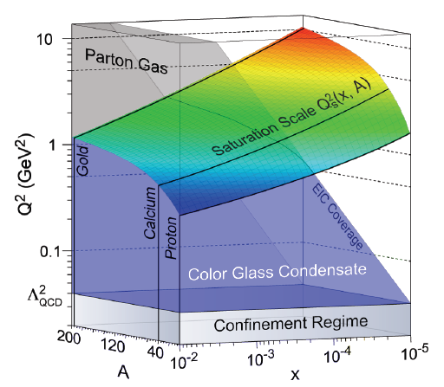
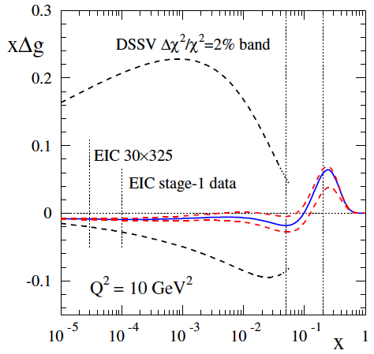
What Will EIC Have That HERA Didn’t?
Heavy-ion beams to take advantage of coherent contributions of many nucleons to gluon density, provide more cost-effective reach into gluon saturation regime when QCD coupling is still weak.
nuclear “oomph”
Constraints from RHIC spin data to date
Polarized proton and ³He (for neutron), as well as electron, beams to pursue search for gluon contributions to nucleon spin down to very soft gluons, and map spin-momentum correlations of quarks and gluons inside nucleons.
Constraints from projected EIC data
Notes:
19

Slide 20
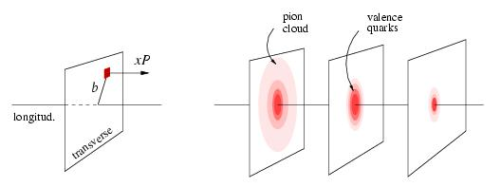
What Will EIC Have That HERA Didn’t?
Proton tomography via exclusive reactions
x < 0.1
x ~ 0.3
x ~ 0.8
3 orders of magnitude higher collision luminosity to facilitate exclusive reaction studies yielding 2+1- dim’l maps of internal nucleon wave function, and symmetry violation studies of fundamental electroweak interaction properties.
Parity-violating DIS to map “running” of the electroweak coupling
Notes:
20

Slide 21
Notes:
21

Slide 22
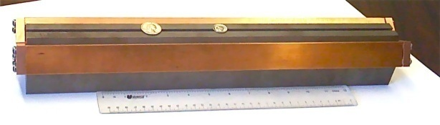


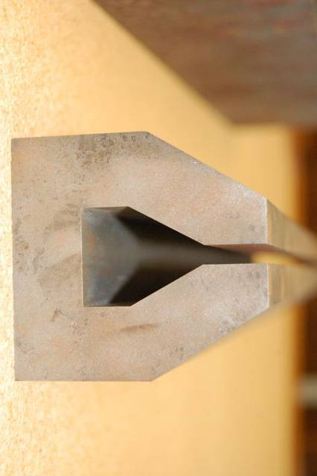

eRHIC Design Under Active Consideration
Vertically separated
recirculating passes.
# of passes will be chosen
to optimize eRHIC cost
27.55 GeV
New
detector
Vis-à-vis earlier MeRHIC design, this allows for:
more IP’s
reusing infra-structure + det. components for STAR, PHENIX?
reduced cost
easier up-grade path
minimal environmental impact concerns
IR design to reach 10³⁴ lumi-nosity
Linac
2.45 GeV
RHIC: 325 GeV p or 130 GeV/u Au with DX magnets removed
Linac
2.45 GeV
Beam
dump
Coherent e-cooler
3.05 GeV
5.50 GeV
0.6 GeV
7.95 GeV
10.4 GeV
Polarized
e-gun
12.85 GeV
15.3 GeV
17.75 GeV
20.2 GeV
22.65 GeV
25.1 GeV
27.55 GeV
30 GeV
30.0 GeV
Gap 5 mm total
0.3 T for 30 GeV
eRHIC-I → eRHIC: energy of e beam increased from 5 to 30 GeV by building up the linacs
ePHENIX
V.N. Litvinenko, January 30, 2011
eSTAR
30 GeV
100 m
Notes:
22

Slide 23
eRHIC Capture Strategy: Major Achievements To Date
Established BNL EIC Task Force + BNL-JLab EIC Advisory Comm., 2009
Convinced community, both labs of wisdom of staged facility approach
Carried out internal cost review for 1st design of RHIC-based medium-energy stage in Oct. 2009 ⇒ ~$350M for machine w/o detector
Revised staging design in response to user demand for additional order of magnitude in luminosity, and DOE feedback to keep TPC to ~$500M
Launched targeted LDRD program to advance S&T planning for eRHIC
Attracted initial (~$1.5M) ONP funds for dedicated EIC accelerator R&D – for Coherent electron Cooling demo, jointly with JLab
Organized a number of conference sessions and workshops, culminating with 2-month Institute for Nuclear Theory program in Fall 2010
Launched generic EIC detector R&D program with RHIC funding, to engage more of experimental user communities – 1st proposals due April 4
Got consideration of eSTAR, ePHENIX upgrades in new Decadal Plans
Notes:
23

Slide 24
eRHIC Capture Strategy: Upcoming Milestones
April 10, 2011: 3rd EIC International Advisory Committee meeting before start of DIS 2011 Conference in Newport News
May 9-10, 2011: Detector Advisory Committee review of first round of submitted EIC detector R&D proposals (see T. Ludlam talk)
June 6-8, 2011: PAC review of PHENIX & STAR Decadal Plans
June 21-24, 2011: RHIC user workshop to develop optimal RHIC strategy going into LRP (more below)
Summer 2011: eRHIC technical design review
Fall 2011: EIC science White Paper (BNL, JLab, EICC have agreed on candidate Steering Comm. Members); eRHIC cost review
Fall 2012 (??): Town Meetings for next Nuclear Physics Long Range Plan? ⇒ Need clear formulation of RHIC strategy by Summer 2012, presumably by time of August 2012 Quark Matter in Washington, D.C.
Notes:
24

Slide 25
Agenda for Users’ Workshop on RHIC Future Strategy (June 21-24, 2011)
Session I: Long-Term Options and Near-Term Plans
Session II: The Role of Heavy Ion Collisions at RHIC Beyond ~2017
Session III: PHENIX and STAR Decadal Plans
Session IV: eRHIC S&T
Session V: Panel and Community Discussion Toward Developing a RHIC Strategy to Present at Next Long Range Plan
Among the critical questions to be discussed:
Since LHC HI results very similar to RHIC’s, are both facilities needed?
Will 2-3 year cessation of RHIC ops. be essential to fund eRHIC? If so, what is optimal timing?
Is it crucial to maintain AA & pp capability into eRHIC era? If so, can we reconfigure IR’s annually, or do we separate HI from eA in different IR’s?
What eRHIC science is realizable within $500M total project cost limit?
What is optimal path for detectors and collaborations to evolve from RHIC to eRHIC?
Notes:
25

Slide 26
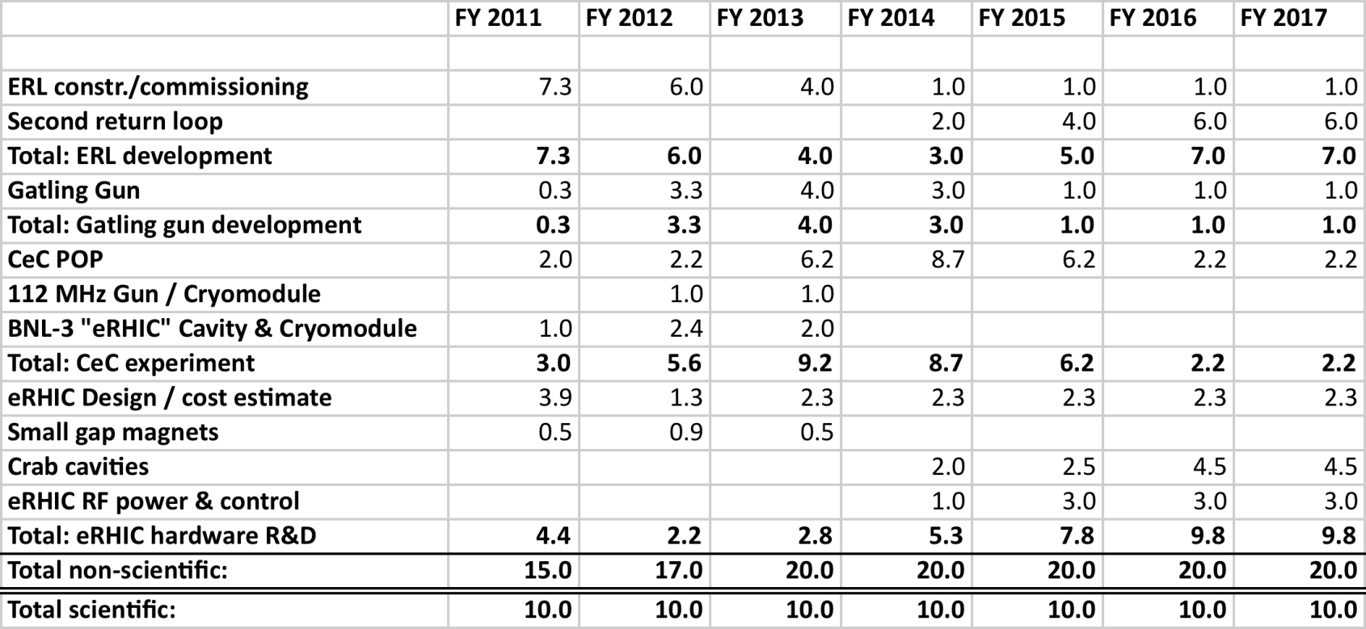
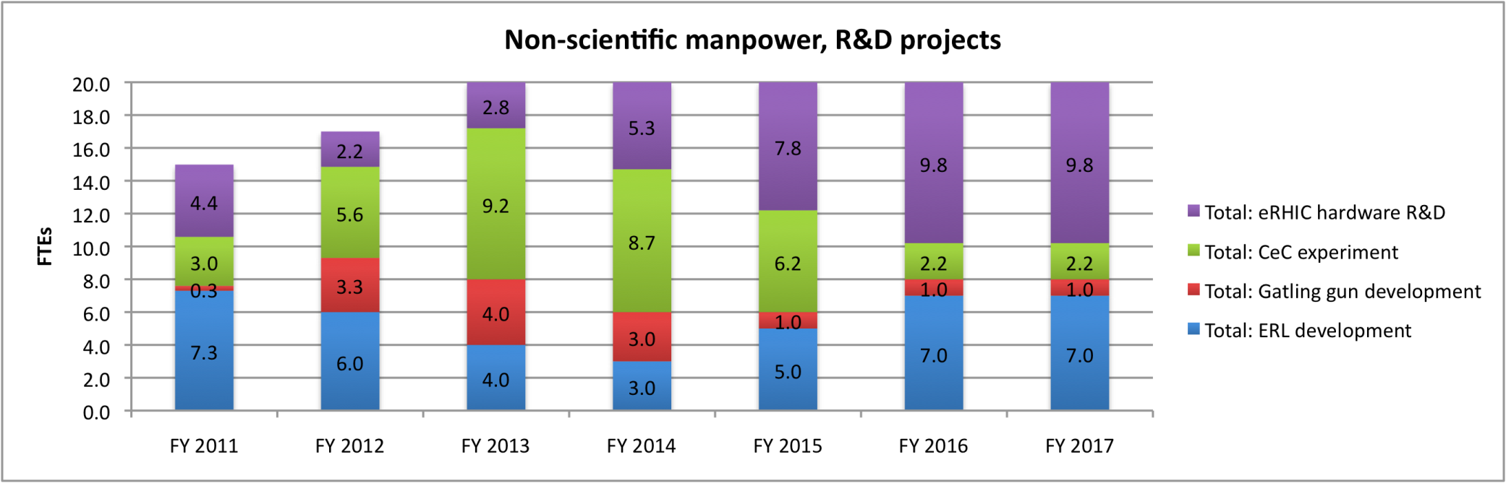
eRHIC Accelerator R&D is a Major Long-Term Commitment
30 FTE supported from RHIC operations
Notes:
26

Slide 27
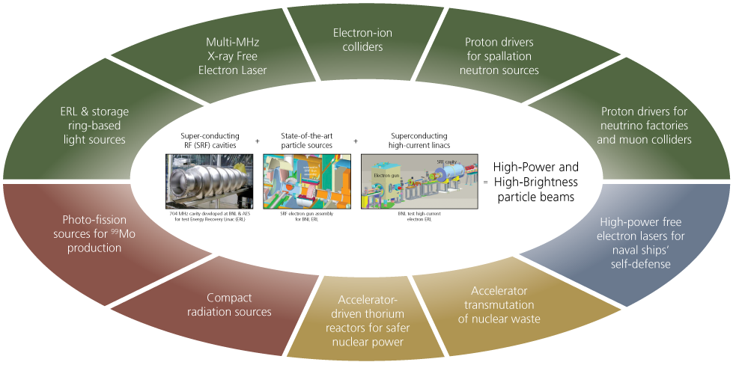

State-of-the-Art Accelerator Technology Being Developed for eRHIC Has Broad Applications
It is increasingly important to make the case for the practical applications of the technology at the same time as the science case for a new facility!
Notes:
27

Slide 28
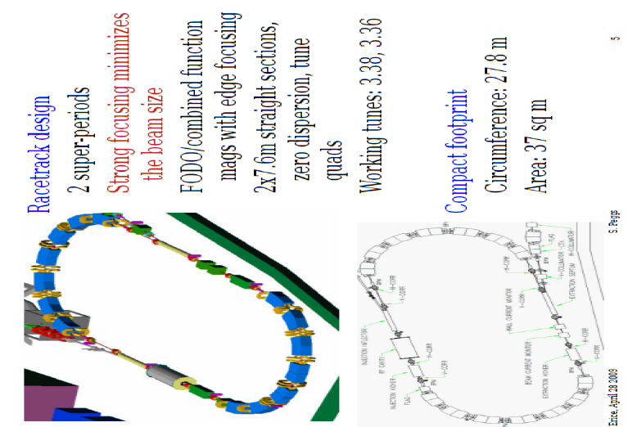
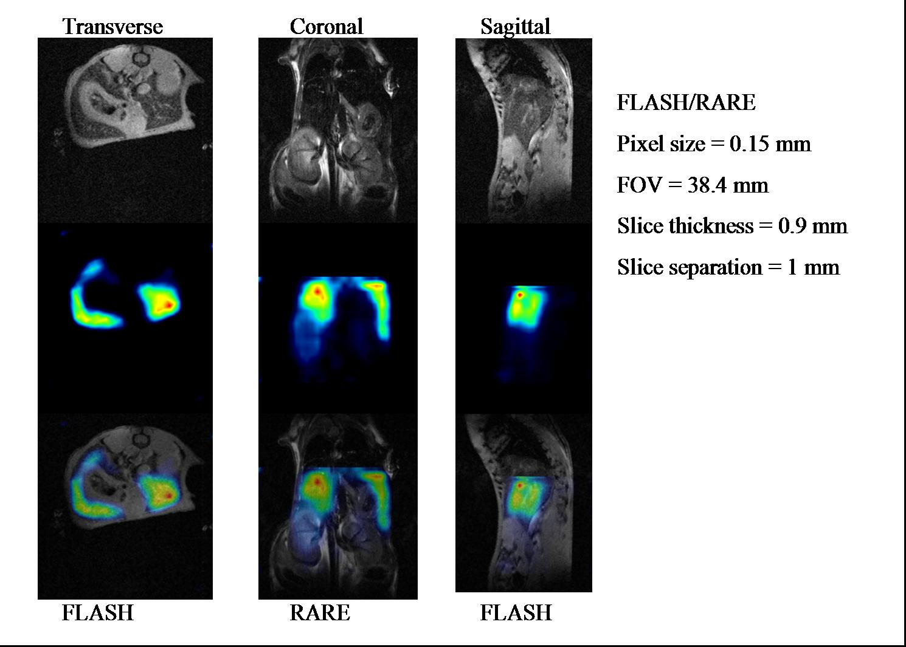
Recent Technological Impacts of BNL NP Research
CRADA to develop ion Rapid Cycling Medical Synchrotron (iRCMS) with BEST Medical
HTS magnet development expertise from BNL’s work for NP accelerators critical in attracting ARPA-E grant for Superconducting Magnet Energy Storage (SMES)
First combined MRI-PET imaging (on mouse liver) done with ⁵²Fe nanoparticles developed by BNL’s radioisotope group
a)
c)
MRI
b)
PET
combined
Notes:
28

Slide 29
Long-Term Take-Away Message:
1) The immediate eRHIC focus should be on defining the science program clearly, crisply, compellingly and on doing reasonable facility cost estimates. Let BNL management and DOE worry about (healthy) competition with JLab.
2) A full, new collider detector with new exp’tal hall is not likely to fit within cost cap for a 1st stage eRHIC ⇒ must incorporate STAR and PHENIX upgrade plans to make them viable ep/eA detectors, while also pursuing foreign contributions to a new detector.
3) Work on eSTAR, ePHENIX needs to be coordinated with work already done and ongoing for generic EIC detector – hence, this Workshop!
4) RHIC user community needs to participate actively in defining a path to eRHIC, as well as its detailed configuration. The process must take into account realistic constraints imposed by federal budgets, other developments in the field, and the need to have champions for the project within DOE.
This is your facility ! My job is to keep it going and maximize its science impact.

Slide 30
Backup Slides

Slide 31
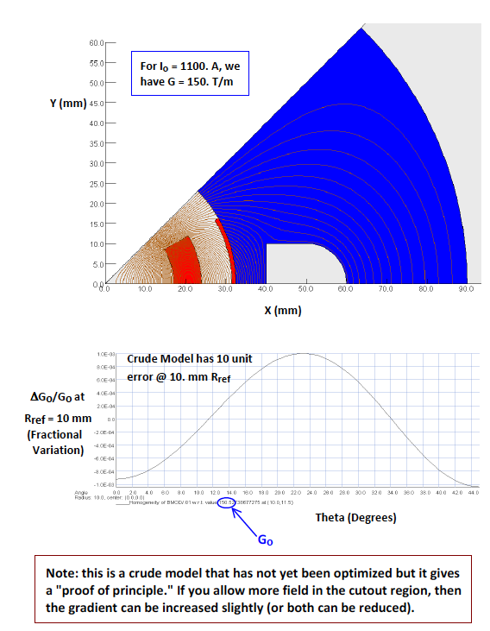
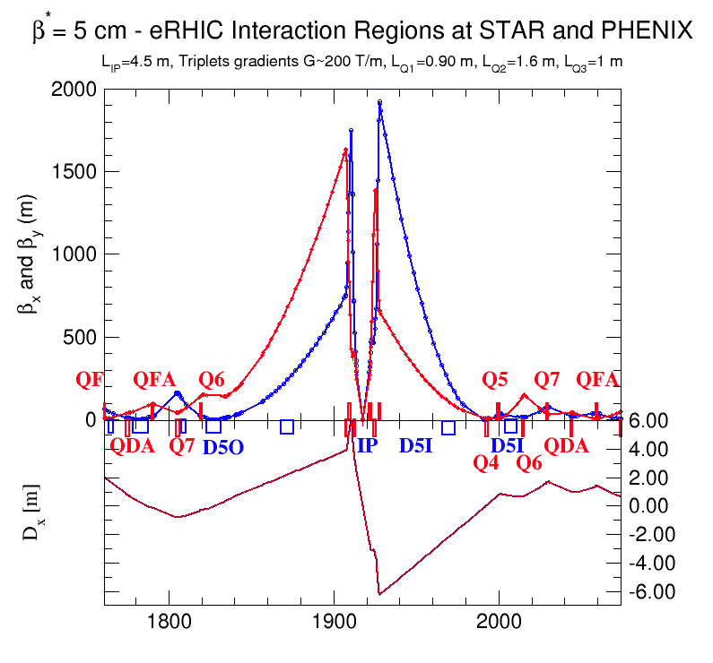
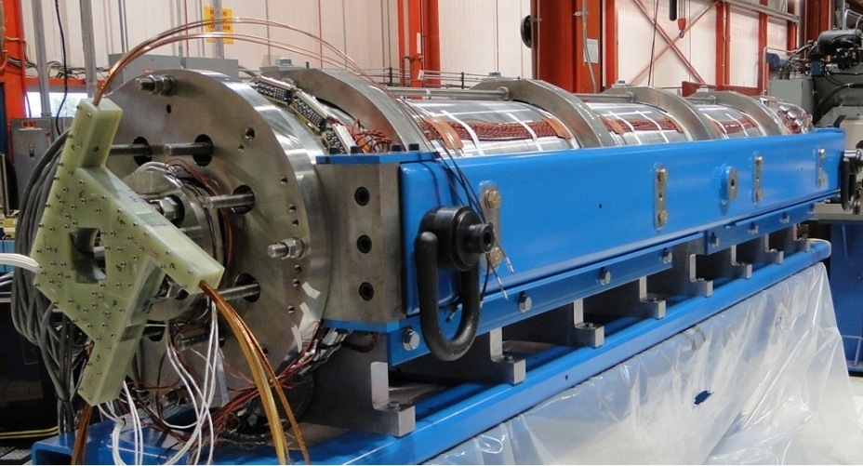
eRHIC IRs, β*=5cm, l*=4.5 m
Star detector
Plan to use newly commissioned LARP Nb₃Sn SC quads with 200 T/m gradient
©Dejan Trbojevic
325 GeV p beam
0.45 m
10 mrad
30 GeV e⁻ beam
90.m
Spin-Rotator
Nb₃Sn
325 GeV p beam
The first Nb3Sn Long Quadrupole (LQS01) designed and fabricated by the US LHC Accelerator Research Program (LARP) reached its target gradient of 200 T/m during the first test. LQS01 is a 90 mm aperture, 4 meter long quadrupole with Nb3Sn coils made of RRP 54/61 strand
200 T/m
L=1.4x10³⁴cm⁻²s⁻¹, 200 T/m gradient
Notes:
We took advantage of recent achievement by LARP researches demonstrated SC quads with 200 T/m gradient and designed IR with 5 cm beta* for eRHIC. To avoid SR problem, we do not bend electrons before the detector an have 10 mrad crab-crossing. Bret Parker has preliminary design of such quad with pass of electron beam through its yoke
Note that we blew transverse dim x100 fold to make it visible
31

Slide 32

30 GeV e⁺ ring
1.27 m beam high
30 GeV ERL 6 passes
HE ERL passes
30
25
20
LE ERL passes
15
10
5 GeV
© V. Litvinenko

Slide 33
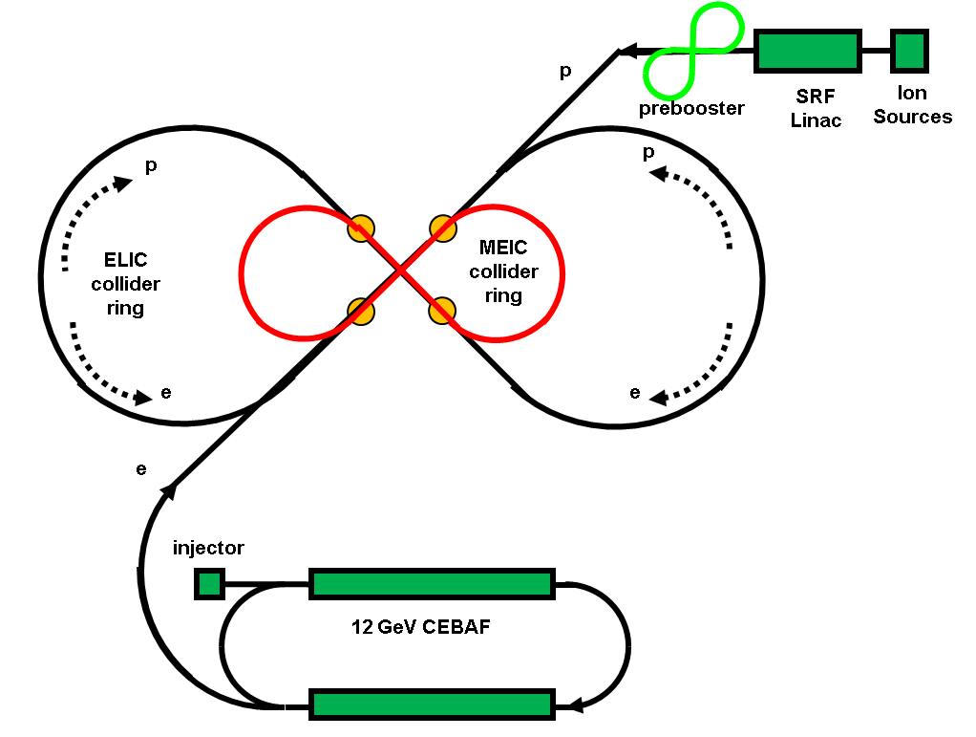
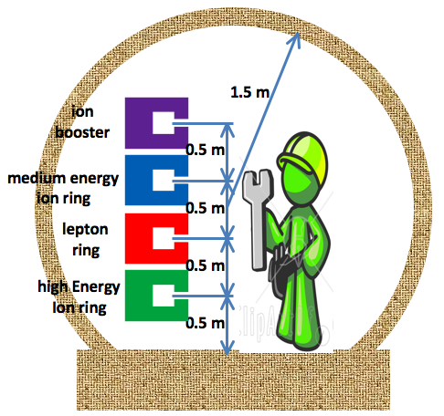
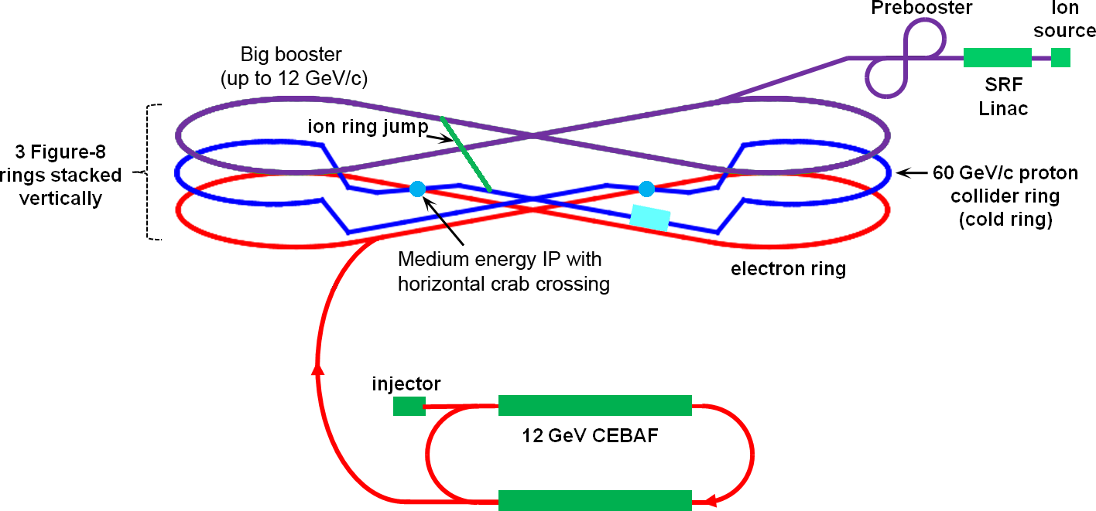
JLab’s Proposed ELIC Staging
Serves as a large booster to the full energy collider ring
Straight section
Stage | Max. Energy (GeV/c) |  | Ring Size (m) | Ring Type |  | IP #
 | p | e |  | p | e
Medium | 96 | 11 | 1000 | Cold | Warm | 3
High | 250 | 20 | 2500 | Cold | Warm | 4
JLab would add a hadron accelerator complex, in 2-3 stages. Figure 8 layout eliminates depolarizing resonances.
MEIC Detailed Layout
cold ring
Notes:
33
33

Slide 34
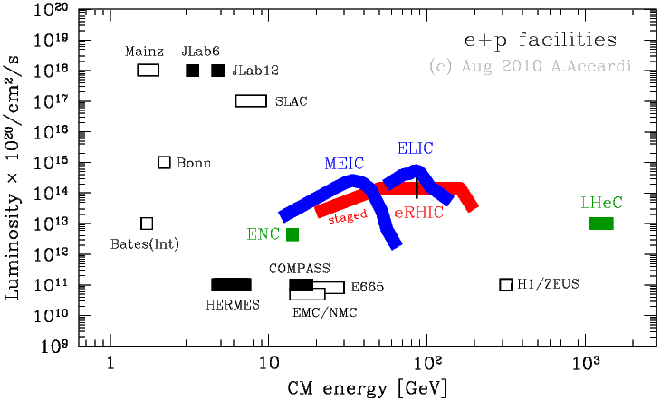
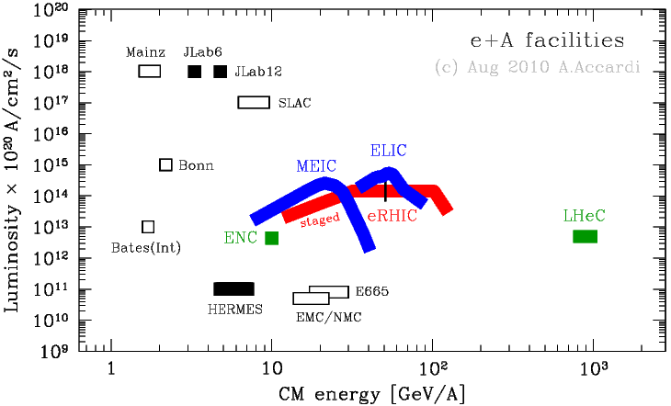
Collider Performance Parameters for RHIC vs. JLab Designs Have Converged in Past Year
e + p facilities
e + A facilities
https://eic.jlab.org/wiki/index.php/Machine_designs
Notes:
34
34

Slide 35




Science Deliverable | Basic Measurement | Uniqueness and Feasibility | Requirements
spin structure at small x contribution of Δg, ΔΣ to spin sum rule | inclusive DIS | ✔ | minimal large x,Q² coverage about 10fb⁻¹
full flavor separation in large x,Q² range strangeness, s(x)-s(x) | semi-inclusive DIS | ✔ | very similar to DIS particle ID improved FFs (Belle,LHC)
electroweak probes of proton structure flavor separation electroweak parameters | inclusive DIS at high Q² | ✔ some unp. results from HERA | 20x250 to 30x325 positron beam polarized ³He beam
treatment of heavy flavors in pQCD | DIS (g₁, F₂, and F_{L}) with tagged charm | ✔ some results from HERA | large x,Q² coverage charm tag
(un)polarized γ PDFs relevant for γγ physics at an ILC | photoproduction of inclusive hadrons, charm, jets | ✔ unp. not completely unknown | tag low Q² events about 10 fb⁻¹
Notes:
35

Slide 36
Zeroth Draft Agenda for Users’ Workshop on RHIC Future Strategy (~annual users meeting June 20-24, 2011)
Session I: Long-Term Options and Near-Term Plans
S. Vigdor: Purpose and scope of workshop; long-term strategy options and constraints
C-AD: Ongoing RHIC machine upgrades and performance projections
PHENIX: Ongoing upgrades + science strategy (HI and spin) for coming ~5 years
STAR: Ongoing upgrades + science strategy (HI and spin) for coming ~5 years
Session II: The Role of Heavy Ion Collisions at RHIC Beyond ~2017
Experimentalist: Early results and future prospects for LHC heavy-ion program
Theorist 1: Compelling open and quantifiably addressable questions that require next generation of RHIC
Theorist 2: A complementary take on same issue addressed by theorist 1
Experimentalist: Experimentalist’s view of the science case for RHIC HI beyond 2017
Session III: Decadal Plans
PHENIX 1: PHENIX heavy-ion science goals and upgrade strategies beyond 2015
STAR 1: STAR heavy-ion science goals and upgrade strategies beyond 2015
PHENIX 2: PHENIX spin program goals and upgrades beyond 2015, including possible migration toward eRHIC capabilities
STAR 2: STAR spin program goals and upgrades beyond 2015, including possible migration toward eRHIC capabilities
PAC member: PAC feedback on PHENIX and STAR decadal plans

Slide 37
Zeroth Draft Agenda for Users’ Workshop on RHIC Future Strategy (~annual users meeting June 20-24, 2011)
Session IV: eRHIC
Theorist: Why is an Electron-Ion Collider needed?
Experimentalist: EIC eA science program, including 1st stage goals
Experimentalist: EIC spin science program, including 1st stage goals
Accelerator physicist: eRHIC design and R&D
Experimentalist: eRHIC detectors: ideal vs. eSTAR and ePHENIX possibilities
Session V: Developing a RHIC Strategy to Present at Next Long Range Plan
C-AD: Possibilities for maintaining AA and pp capabilities in parallel with eRHIC
Panel and Community Discussion:
Each panel member starts with ~5-10 minute statement of personal views on best strategy and critical questions/branch points
Follow with ~2 hours for open discussion with audience: audience questions, comments, statements of preference, opinions about next steps in formulating strategy
Among the critical questions to be discussed:
Since LHC HI results very similar to RHIC’s, are both facilities needed?
Will 2-3 year cessation of RHIC ops. be essential to fund eRHIC? If so, what is optimal timing?
Is it crucial to maintain AA & pp capability into eRHIC era? If so, can we reconfigure IR’s annually, or do we separate HI from eA in different IR’s?
What eRHIC science is realizable within $500M total project cost limit?

