Slide 1
Momentum vs. Angle A Loose Collection of Plots For E’, Pi+, and K+ Using e-p RAPGAP Data
Created: July 2009, William Foreman, BNL
Last Updated: October 2009

Slide 2
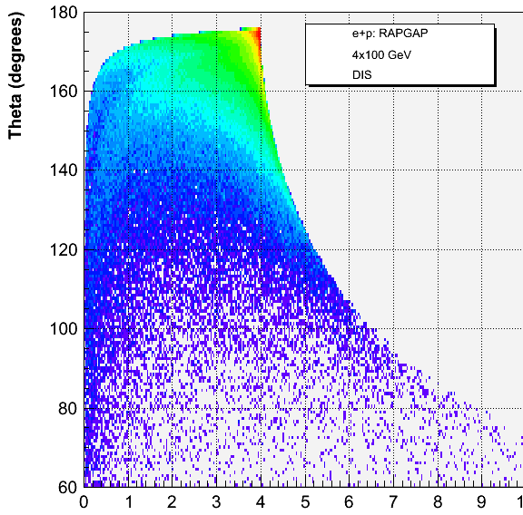
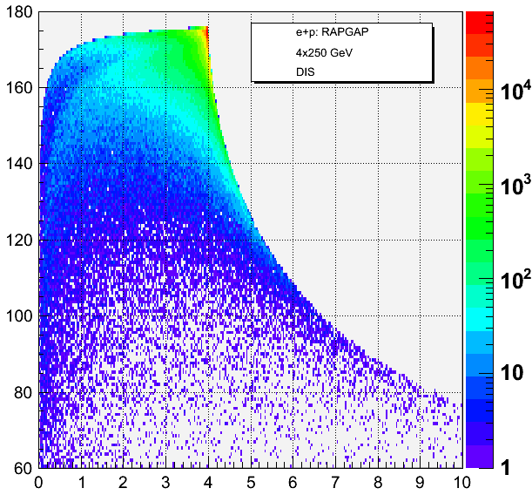
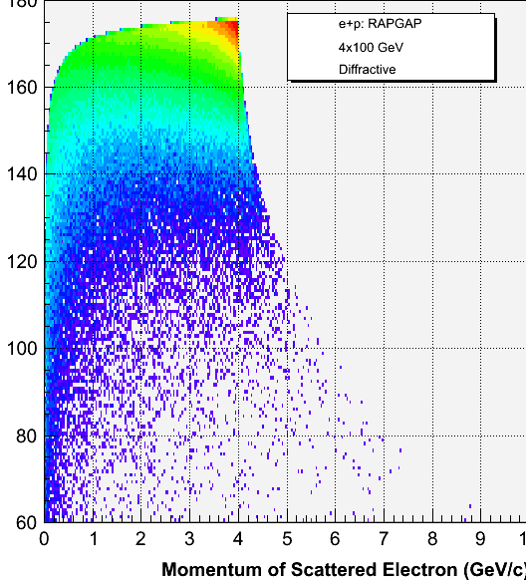
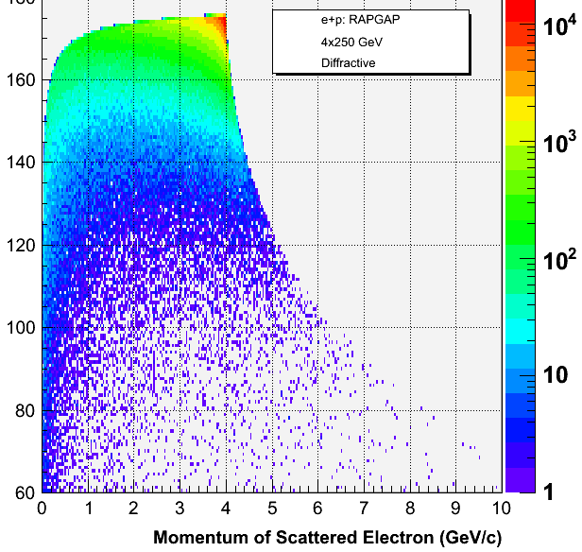
4x100
4x250
DIS
p_{E’}
vs. Theta
4x100
4x250
Diffractive

Slide 3
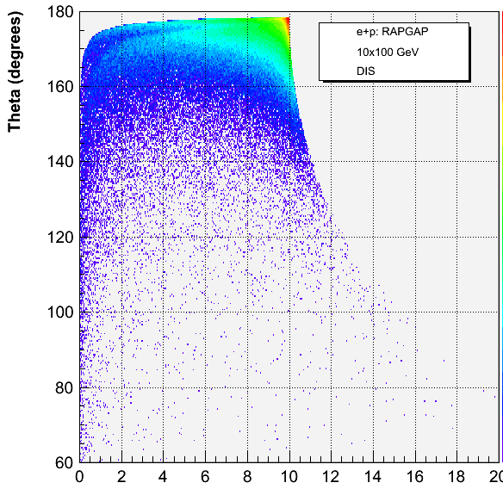
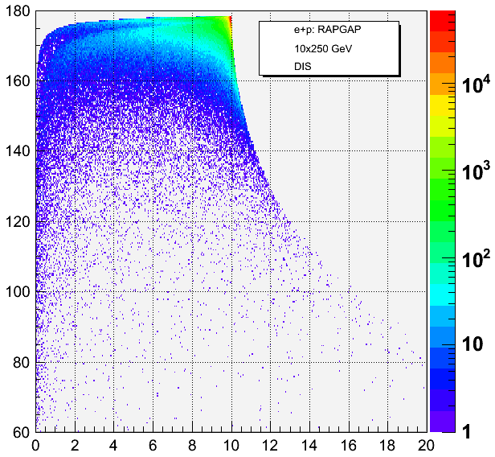
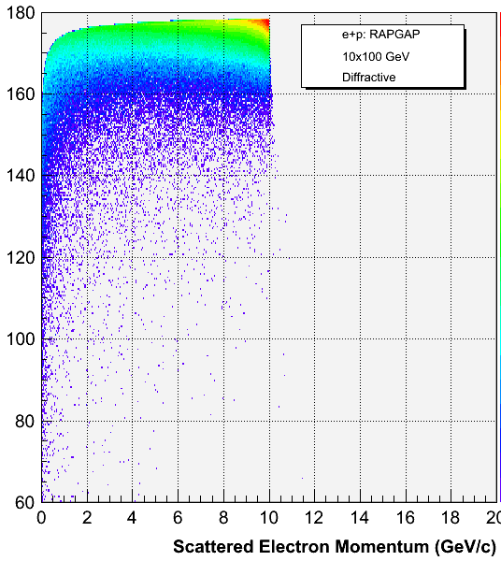
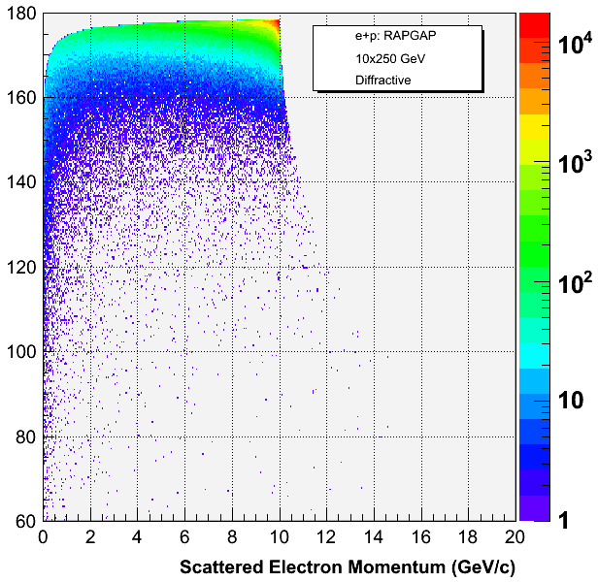
10x100
10x250
DIS
p_{E’}
vs. Theta
10x100
10x250
Diffractive

Slide 4
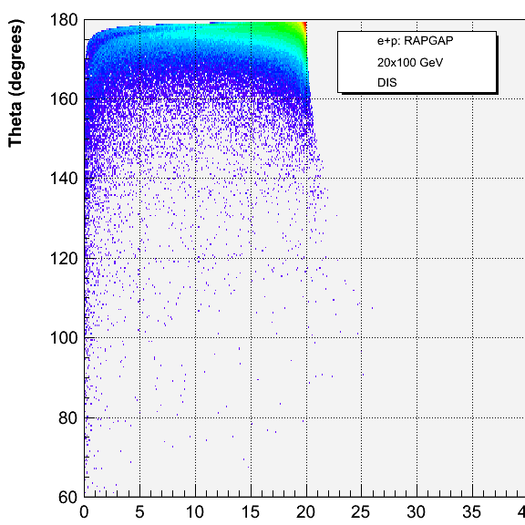
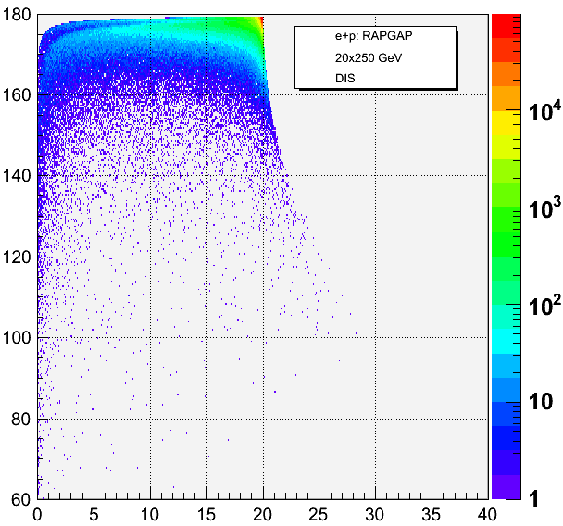
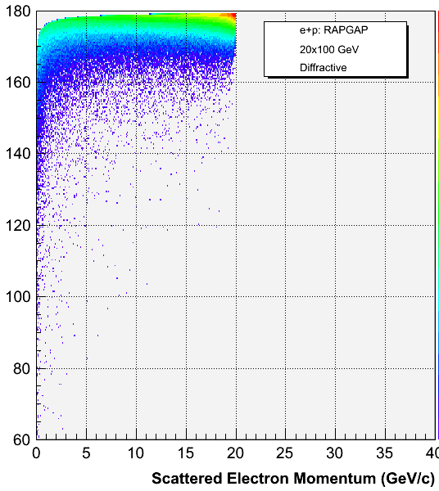
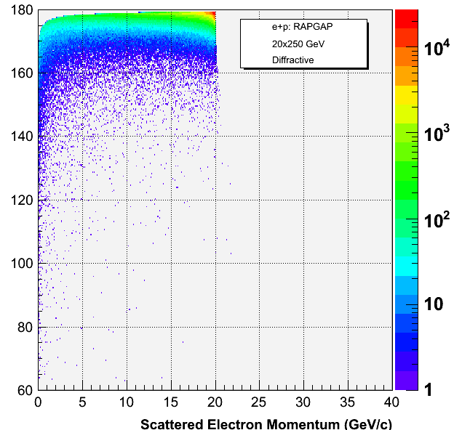
20x100
20x250
DIS
p_{E’}
vs. Theta
20x100
20x250
Diffractive
20x100

Slide 5
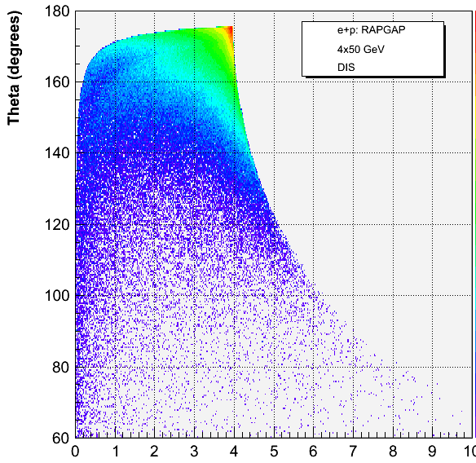
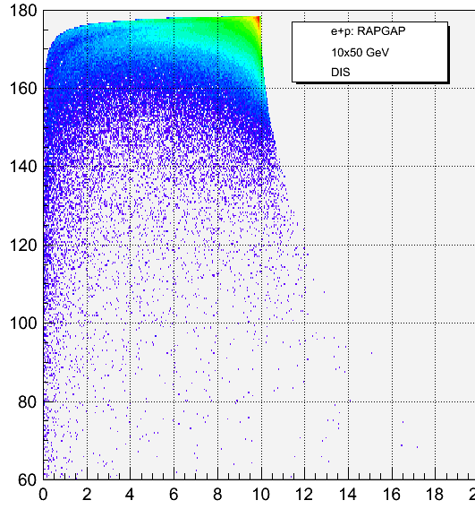
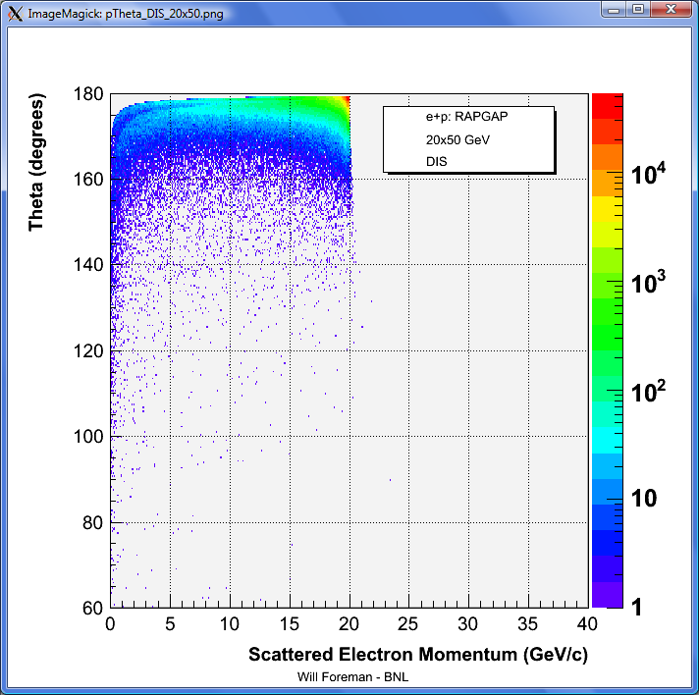
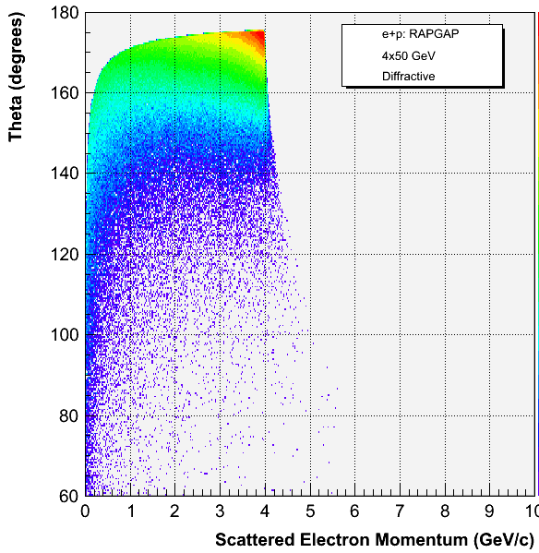
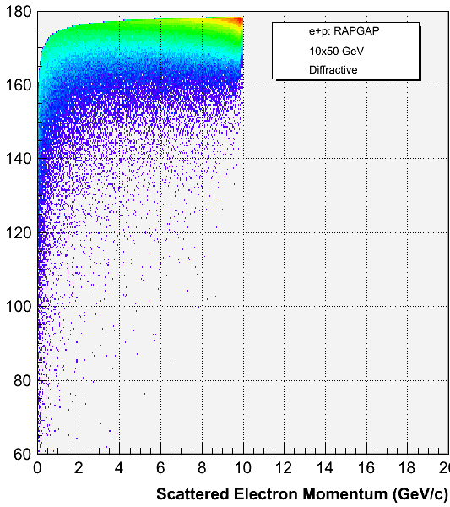
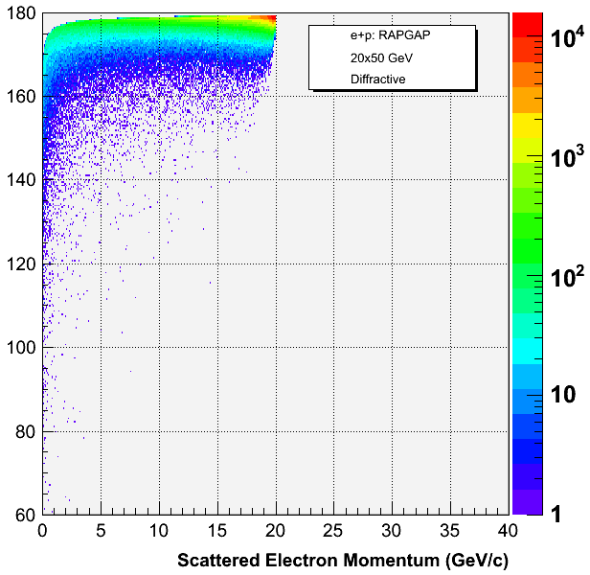
4x50
10x50
20x50
DIS
Diffractive

Slide 6
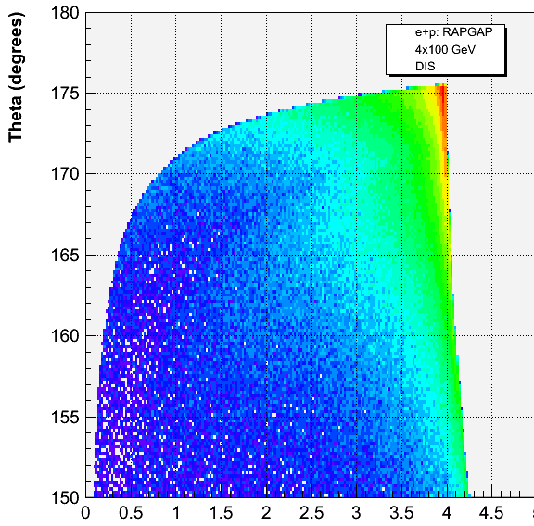
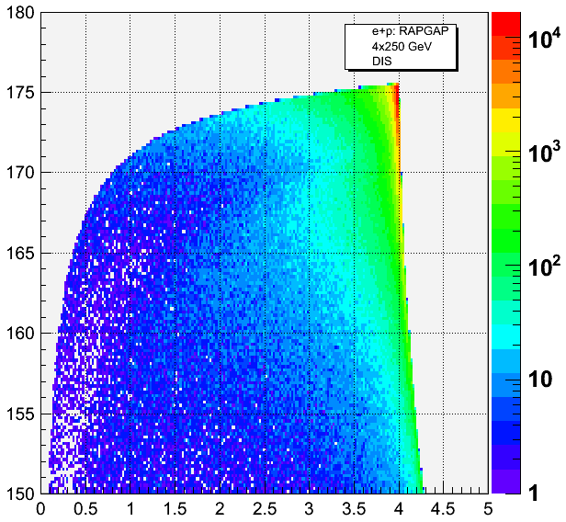
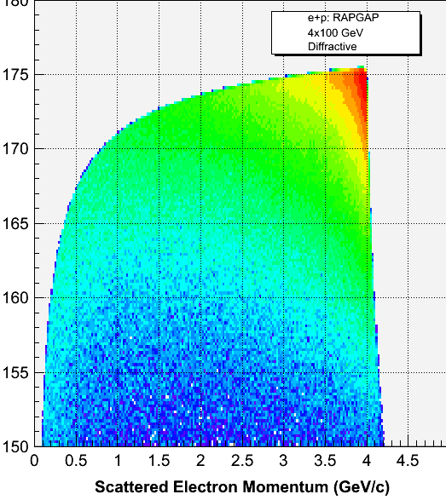
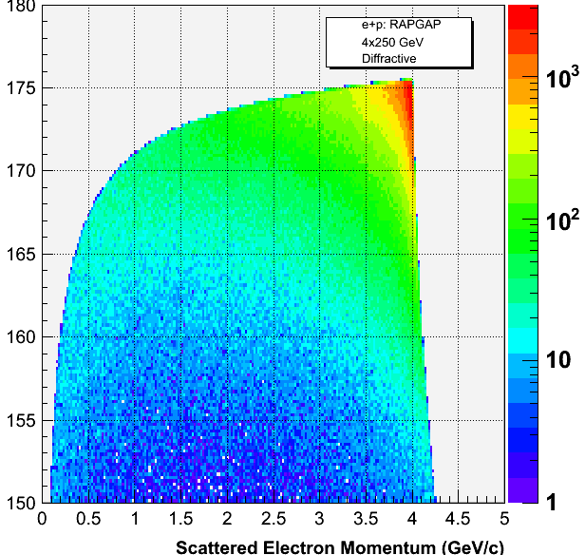
4x100
4x250
DIS
E’ momentum
vs. theta
(zoomed views)
4x100
4x250
Diffractive

Slide 7
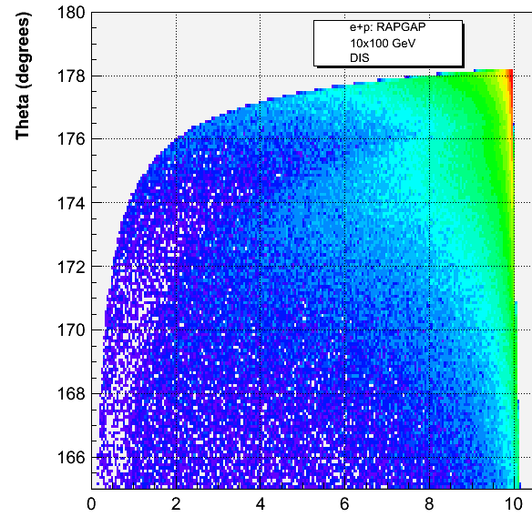
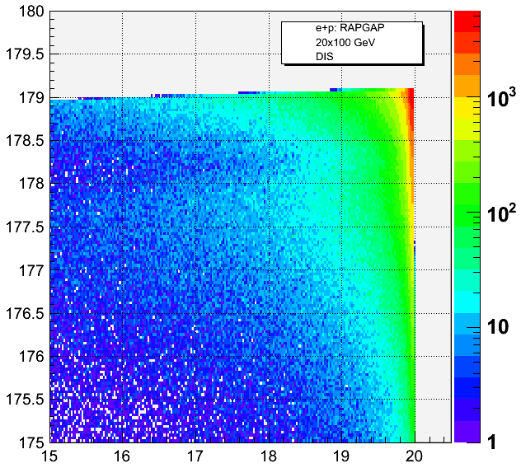
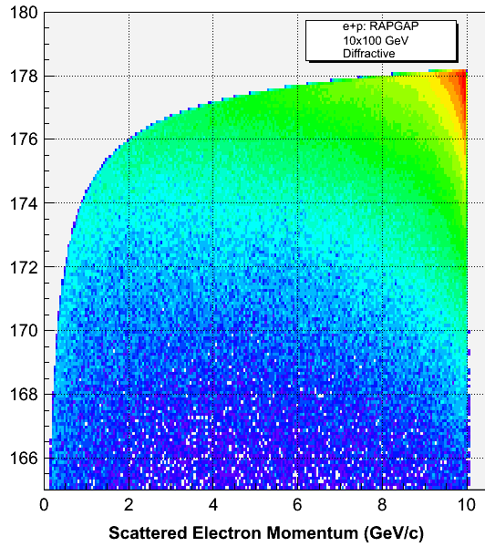
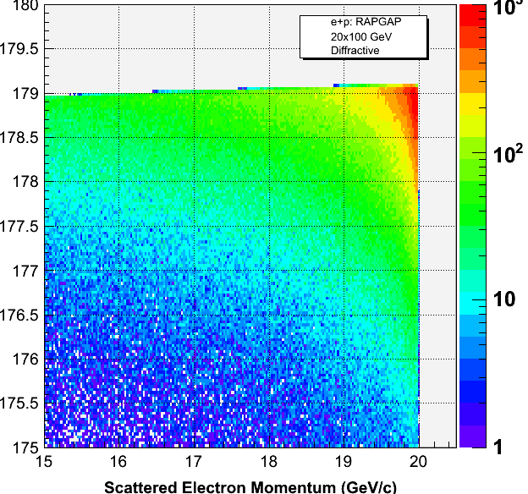
10x100
20x100
DIS
E’ momentum
vs. theta
(zoomed views)
10x100
20x100
Diffractive

Slide 8
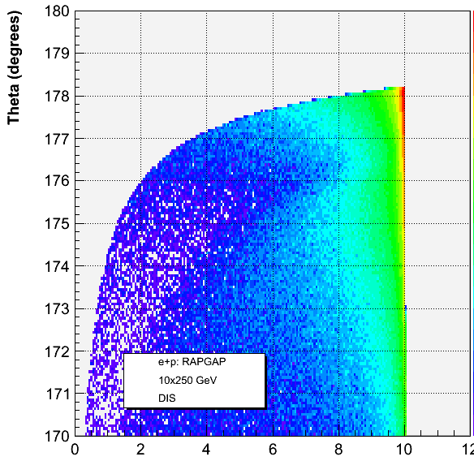
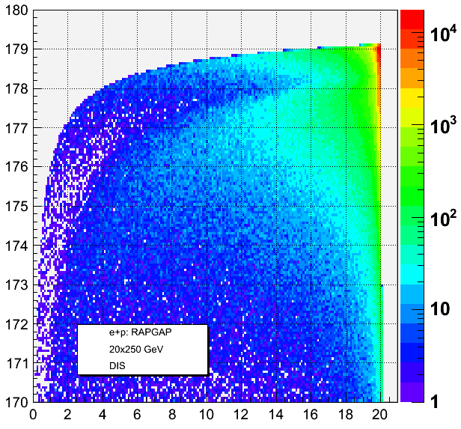
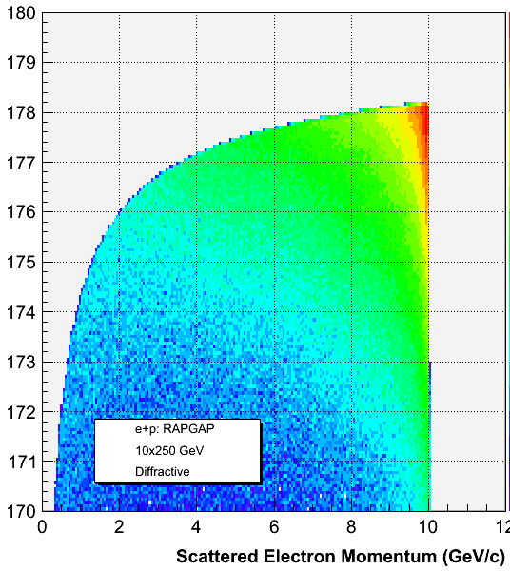
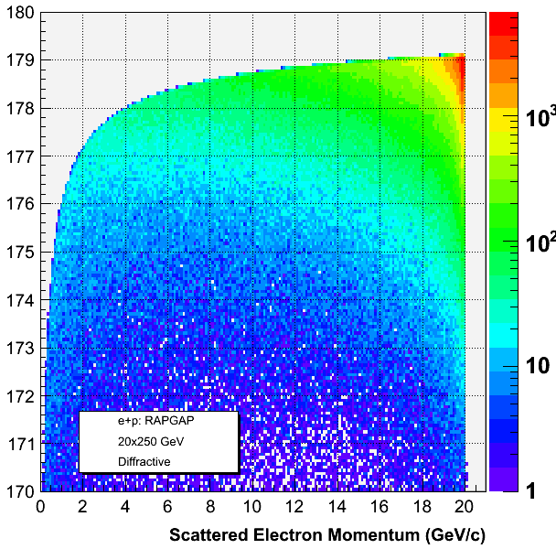
10x250
20x250
DIS
E’ momentum
vs. theta
(zoomed views)
20x250
10x250
Diffractive

Slide 9
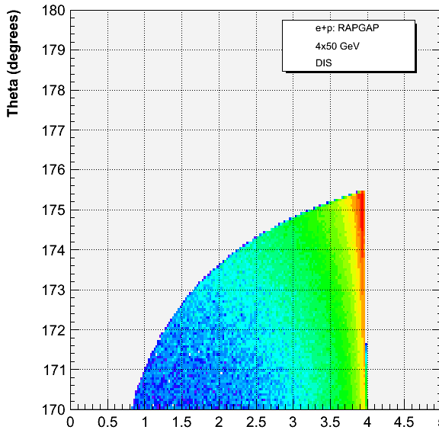
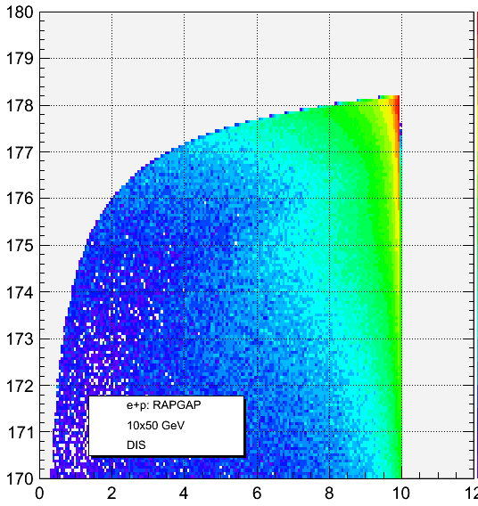
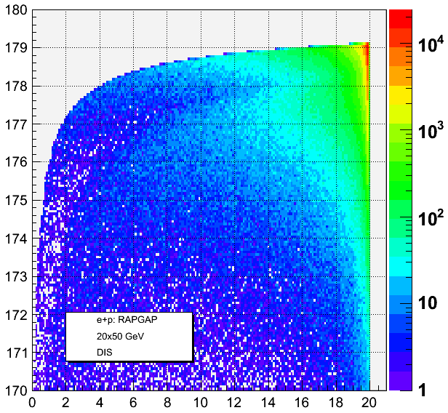
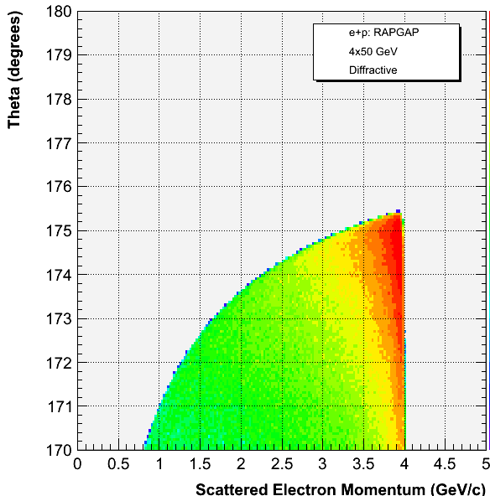
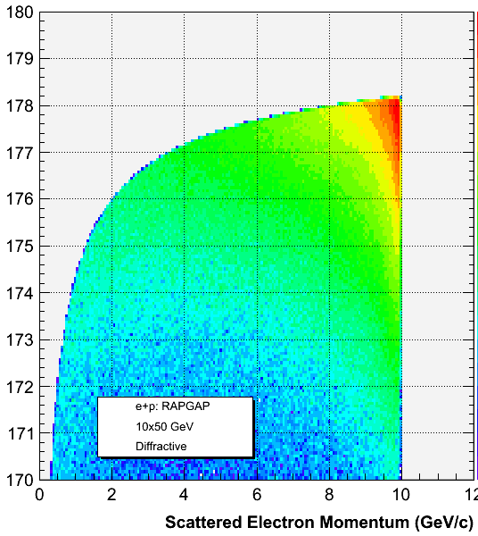
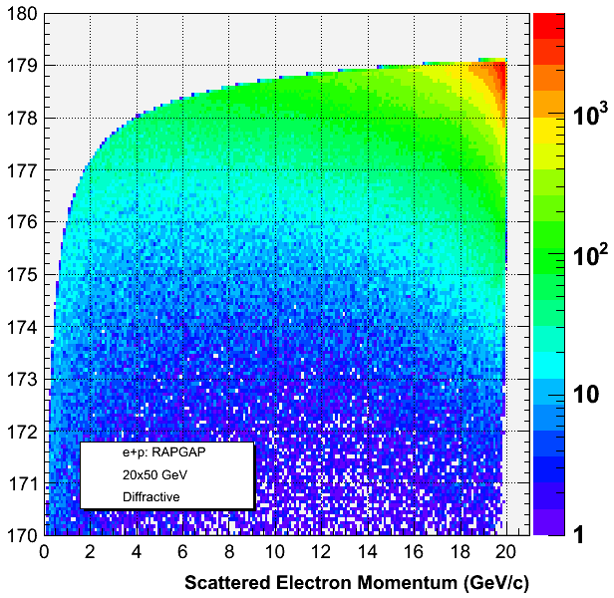
4x50
10x50
20x50
DIS
Diffractive

Slide 10
Momentum vs. theta of scat. electron
Proton Energy
50 GeV 100 GeV 250 GeV
Electron Energy
4 GeV 10 GeV 20 GeV

Slide 11
Particle Angle vs. Momentum

Slide 12
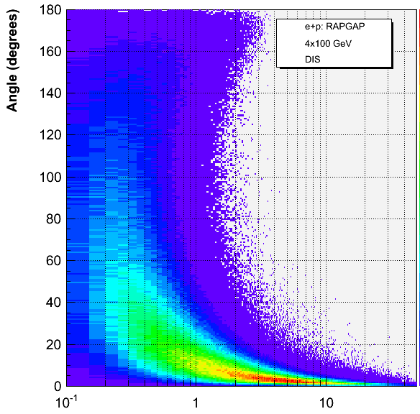
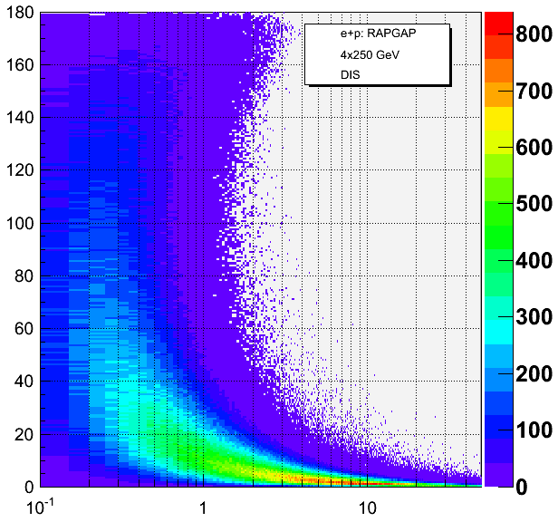
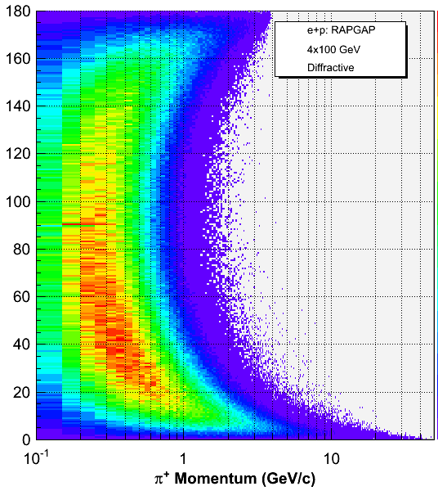
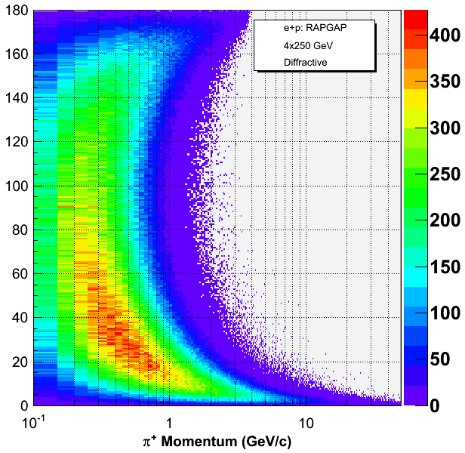
4x100
4x250
DIS
Pi+
P vs. Angle
4x100
4x250
Diffractive

Slide 13
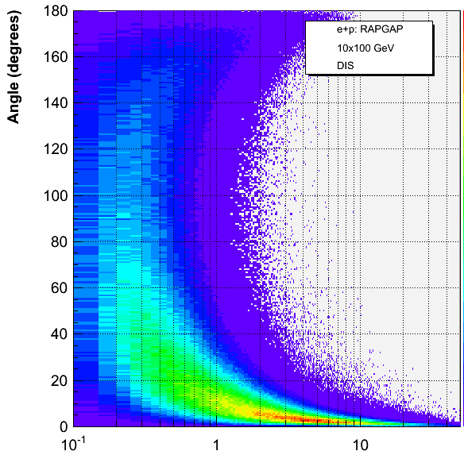
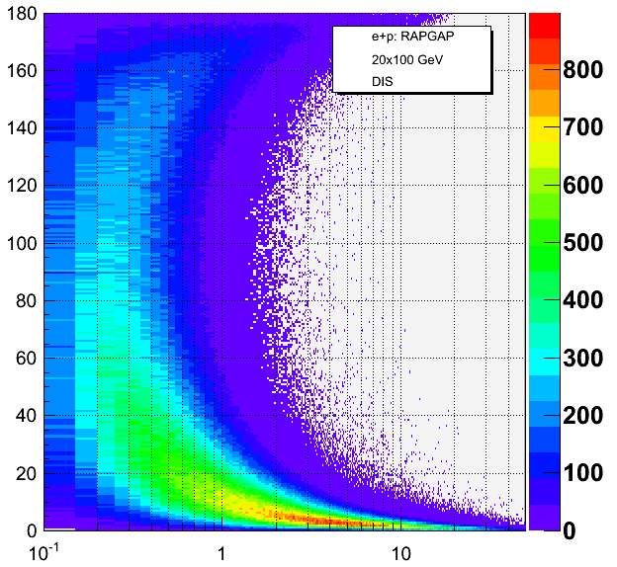
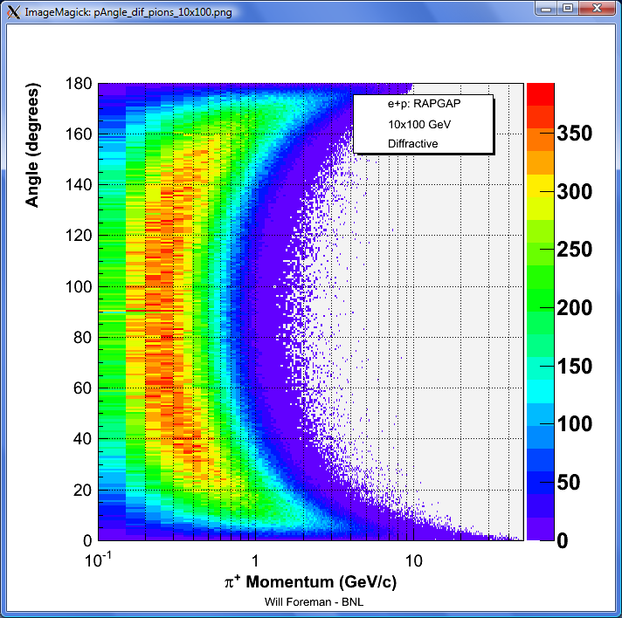
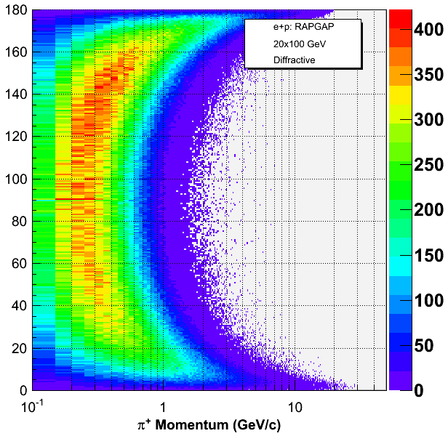
10x100
20x100
DIS
Pi+
P vs. Angle
10x100
20x100
Diffractive

Slide 14
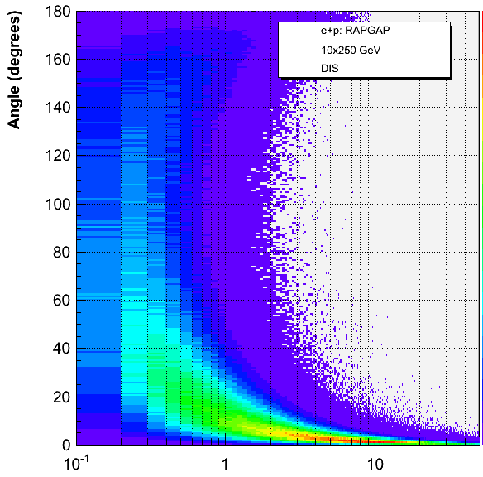
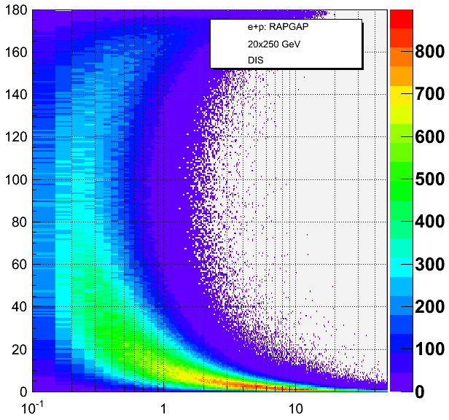
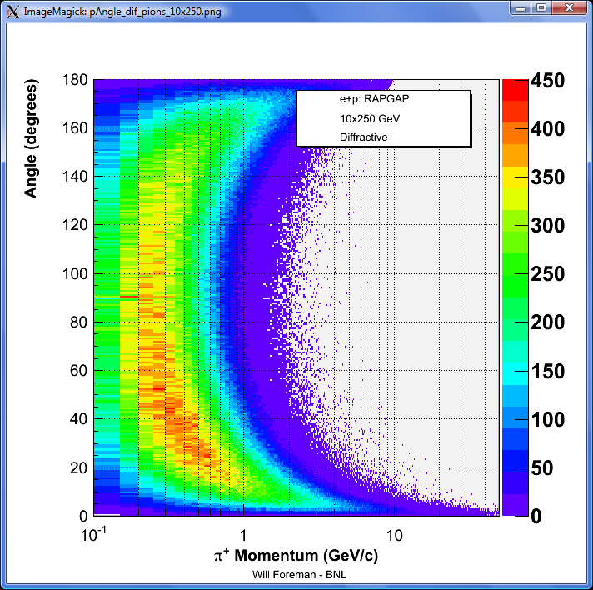
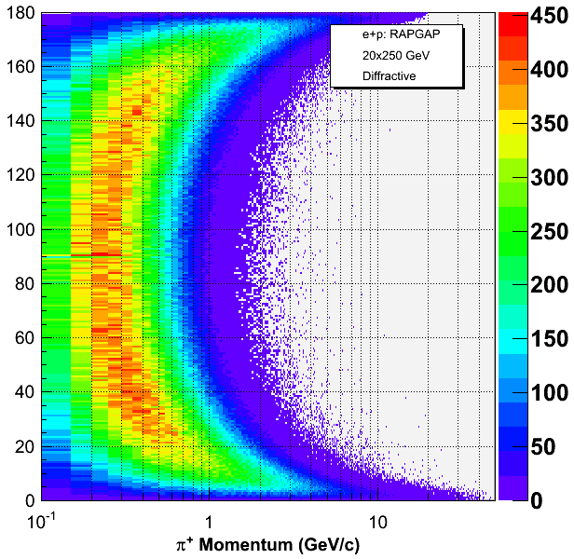
10x250
20x250
DIS
Pi+
P vs. Angle
10x250
20x250
Diffractive

Slide 15
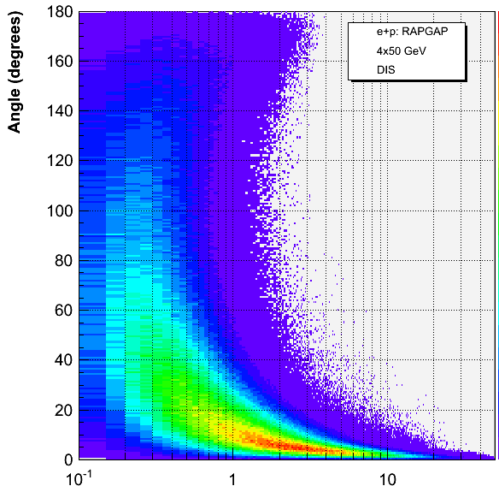
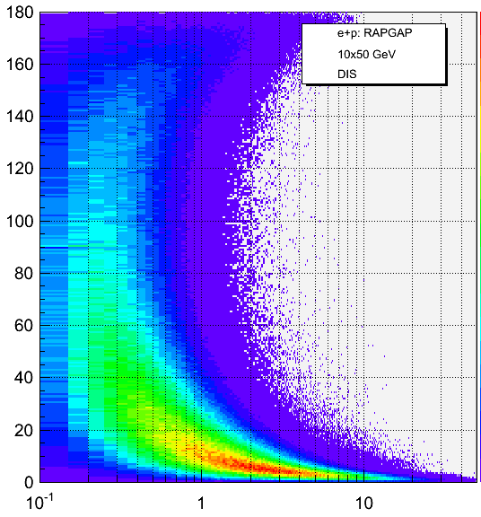
4x50
10x50
20x50
DIS
Diffractive

Slide 16
4x50
4x100
DIS
Pi+
P vs. Angle
0⁰ - 20⁰
4x250

Slide 17
10x50
10x100
DIS
Pi+
P vs. Angle
0⁰ - 20⁰
10x250

Slide 18
20x50
20x100
DIS
Pi+
P vs. Angle
0⁰ - 20⁰
20x250

Slide 19
4x100
4x250
DIS
K+
P vs. Angle
4x100
4x250
Diffractive

Slide 20
10x100
20x100
DIS
K+
P vs. Angle
10x100
20x100
Diffractive

Slide 21
10x250
20x250
DIS
K+
P vs. Angle
10x250
20x250
Diffractive

Slide 22
4x50
10x50
20x50
DIS
Diffractive
Peter Schnatz

Slide 23
4x50
4x100
DIS
K+
P vs. Angle
0⁰ - 20⁰
4x250

Slide 24
10x50
10x100
DIS
K+
P vs. Angle
0⁰ - 20⁰
10x250

Slide 25
20x50
20x100
DIS
K+
P vs. Angle
0⁰ - 20⁰
20x250

Slide 26
Scattered Proton p vs. angle
Standard 0-0.25⁰
Standard 0-1.2⁰ with logarithmic Z-axis
Variable scaling for each energy

Slide 27
4x50
4x100
Proton
P vs. Angle
0⁰ - 0.25⁰
4x250
Diffractive

Slide 28
10x50
10x100
Proton
P vs. Angle
0⁰ - 0.25⁰
10x250
Diffractive

Slide 29
20x50
20x100
Proton
P vs. Angle
0⁰ - 0.25⁰
20x250
Diffractive

Slide 30
4x50
4x100
Proton
P vs. Angle
Large-Scale Distribution
(note: log-Z axis)
4x250
Diffractive

Slide 31
10x50
10x100
Proton
P vs. Angle
Large-Scale Distribution
(note: log-Z axis)
10x250
Diffractive

Slide 32
20x50
20x100
Proton
P vs. Angle
Large-Scale Distribution
(note: log-Z axis)
20x250
Diffractive

Slide 33
4x50
4x100
Proton
Variable zoomed views
4x250
Diffractive

Slide 34
10x50
10x100
Proton
Variable zoomed views
10x250
Diffractive

Slide 35
20x50
20x100
Proton
Variable zoomed views
20x250
Diffractive

Slide 36
Comparisons
(DIS – 4x100 GeV)
Pions
Kaons
Though very subtle, it is apparent in the zoomed versions of the plots that kaons have higher momenta than pions for every corresponding projection angle.

Slide 37
Comparisons
(DIS – 4x250 GeV)
Pions
Kaons

Slide 38
Comparisons
(DIS – 10x100 GeV)
Pions
Kaons

Slide 39
Comparisons
(DIS – 20x100 GeV)
Pions
Kaons

Slide 40
Comparisons
(Diffractive – 4x100 GeV)
Pions
Kaons
When diffractive collisions are turned on, most kaons are clearly projected at smaller angles compared to most pions (approx. 25 degrees vs. 45 degrees)

Slide 41
Comparisons
(Diffractive – 4x250 GeV)
Pions
Kaons

Slide 42
Comparisons
(Diffractive – 10x100 GeV)
Pions
Kaons

Slide 43
Comparisons
(Diffractive – 20x100 GeV)
Pions
Kaons

Slide 44
Cuts 4+100 GeV
Pi+
K+
Protons
all data normalized by 1/entries
DIS 0-0.5 Gev/c 0.5-1.0 GeV/c 1.0 – 1.5 GeV/c 1.5 – 2.0 GeV/c
Diffractive

Slide 45
Cuts 4+100 GeV
Pi+
K+
Protons
all data normalized by 1/entries
DIS 2.0 – 2.5 Gev/c 2.5 – 3.0 GeV/c 3.0 – 5.0 GeV/c 5.0 – 10.0 GeV/c
Diffractive

Slide 46
Cuts 4+250 GeV
Pi+
K+
Protons
all data normalized by 1/entries
DIS 0-0.5 Gev/c 0.5-1.0 GeV/c 1.0 – 1.5 GeV/c 1.5 – 2.0 GeV/c
Diffractive

Slide 47
Cuts 4+250 GeV
Pi+
K+
Protons
all data normalized by 1/entries
DIS 2.0 – 2.5 Gev/c 2.5 – 3.0 GeV/c 3.0 – 5.0 GeV/c 5.0 – 10.0 GeV/c
Diffractive

Slide 48
Cuts 10+100 GeV
Pi+
K+
Protons
all data normalized by 1/entries
DIS 0-0.5 Gev/c 0.5-1.0 GeV/c 1.0 – 1.5 GeV/c 1.5 – 2.0 GeV/c
Diffractive

Slide 49
Cuts 10+100 GeV
Pi+
K+
Protons
all data normalized by 1/entries
DIS 2.0 – 2.5 Gev/c 2.5 – 3.0 GeV/c 3.0 – 5.0 GeV/c 5.0 – 10.0 GeV/c
Diffractive

Slide 50
Original plots and more:
/afs/rhic.bnl.gov/eic/PACKAGES.NEW/wforeman/RAPGAP/plots_angle_p/
/afs/rhic.bnl.gov/eic/PACKAGES.NEW/wforeman/RAPGAP/plots_theta_p/

Slide 51
EXTRAS…

Slide 52
4x100
4x250
DIS
(log z-axis)
Pi+ momentum vs. angle
4x100
4x250
Diffractive

Slide 53
4x100
4x250
DIS
(log z-axis)
Pi+ momentum vs. angle
(forward angles)
4x100
4x250
Diffractive

Slide 54
4x100
4x250
DIS
K+ momentum vs. angle
(forward angles)
4x100
4x250
Diffractive

