Slide 1


What needs to be covered
e’
e
γ, π,J/Ψ
γ_{L}*
(Q²)
x+ξ
x-ξ
~
~
H, H, E, E (x,ξ,t)
p
p’
t
Inclusive Reactions:
Momentum/energy and angular resolution of e’ critical
Very good electron id
Moderate luminosity >10³² cm⁻¹ s⁻¹
Need low x ~10⁻⁴ → high √s (Saturation and spin physics)
Semi-inclusive Reactions:
Excellent particle ID: π,K,p separation over a wide range in η
full Φ-coverage around γ*
Excellent vertex resolution → Charm, bottom identification
high luminosity >10³³ cm⁻¹ s⁻¹ (5d binning (x,Q²,z, p_{t},Φ))
Need low x ~10⁻⁴ → high √s
Exclusive Reactions:
Exclusivity → high rapidity coverage → rapidity gap events
high resolution in t → Roman pots
high luminosity >10³³ cm⁻¹ s⁻¹ (4d binning (x,Q²,t,Φ))

Slide 2
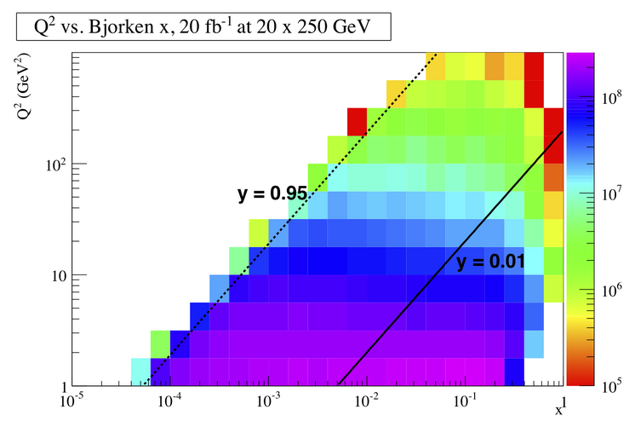
DIS Kinematics
Potential limitations in kinematic coverage:
high y limited by
radiative corrections
can be suppressed by
by requiring hadronic
activity
y=0.85
HERA
y>0.005
y=0.05
Strong x-Q² correlation
  high x → high Q²
  low x → low Q²
low y limited by
resolution for e’
→ use hadron method

Slide 3
DVCS: ep → e’p’γ
cuts: Q2>1.0GeV² && 0.01<y<0.9
&& Eγ>1GeV
With increasing
lepton energy
real photon is
boosted even more
in electron beam
direction

Slide 4
Detector technology concepts
Si-Vertex
  MAPS technology from IPHC ala STAR, CBM, Alice, …
    Barrel:
    4 double sided layers @ 3. 5.5 8. 15. cm 10 sectors in Φ
    chip 20mm x 30mm ---> 1cm 300 pixel pitch 33 micron dual readout, one column 60 μs readout time
    Forward Disks:
    4 single sided disks spaced in z starting from 20cm
    Radial extension 3 (19 μm pixel) to 12 cm (75 μm pixel), dual sided readout
Barrel Tracking
  Preferred technology TPC (alternative GEM-Barrel tracker Mass???)
    Low mass, PID e/h via dE/dx
Forward tracking
  GEM-Trackers
Forward/Backward RICH-Detectors
  Momenta to be covered: 0.5-80 GeV for 2<|y|<5
  Technology:
    Dual Radiator (HERMES, LHCb) Aerogel+Gas (C₄F₁₀ or C₄F₈O)
  Photondetector: low sensitivity to magnetic field

Slide 5
Detector technology concepts
Barrel PID-Detectors
  Momenta to be covered 0.5-10 GeV for -2<y<2
  Technology:
    Aerogel Proximity focusing RICH
    DIRC
ECal:
  Backward/Barrel:
    PbW-crystal calorimeter → great resolution, small Molière radius → electron-ID: e/p, measure lepton via Ecal, important for DVCS
  Forward:
    Less demanding: sampling calorimeter
Preshower
  Si-W technology as proosed for PHENIX MPCEX
Hcal/μ-Detectors
  Not obvious they are really needed
Luminosity monitor, electron and hadron polarimeters

Slide 6
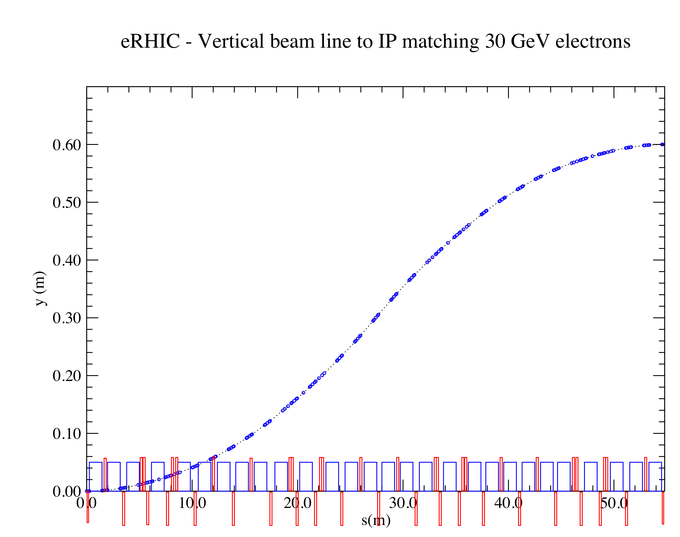
Integration into Machine: IR-Design
Outgoing electron direction currently under detailed design
detect low Q² scattered leptons
want to use the vertical bend to separate very low-Θ e’ from beam-electrons
can make bend faster for outgoing beam → faster separation
for 0.1º<Θ<1º will add calorimetry after the main detector
space for
low-Θ e-tagger

Slide 7
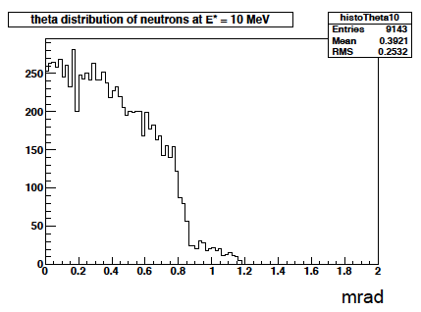
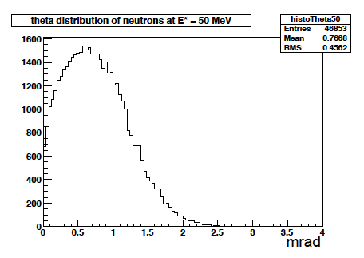
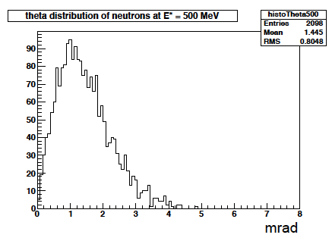
Kinematics of Breakup Neutrons
Results from GEMINI++ for 50 GeV Au
Results:
With an aperture of ±3 mrad we are in relative good shape
• enough “detection” power for t > 0.025 GeV²
• below t ~ 0.02 GeV² we have to look into photon detection
‣ Is it needed?
Question:
For some physics rejection power for incoherent is needed ~10⁴
→ How efficient can the ZDCs be made?
by Thomas Ullrich
+/-5mrad acceptance seems sufficient

Slide 8
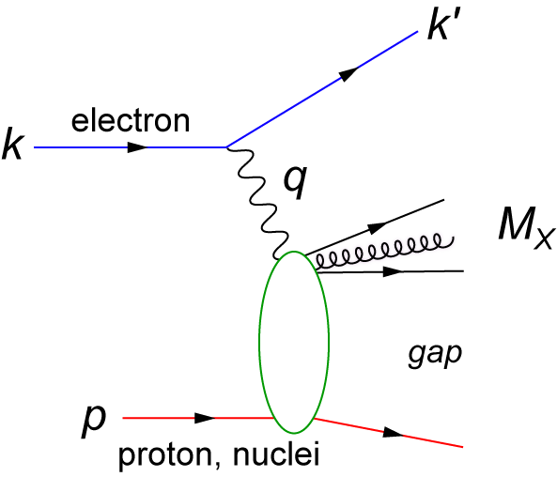
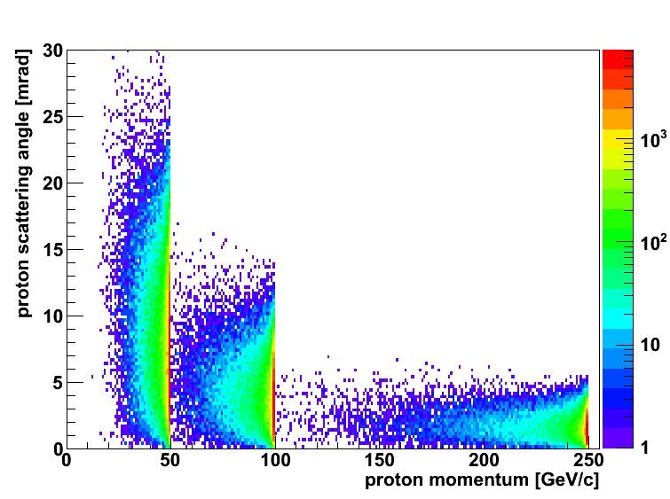
Diffractive Physics: p’ kinematics
Diffraction:
t=(p4-p2)² = 2[(mp^{in}.mp^{out})-(E^{in}E^{out} - pz^{in}pz^{out})]
→ “ Roman Pots” acceptance studies see later
?
5x50
p’
5x100
5x250
Simulations by J.H Lee

Slide 9
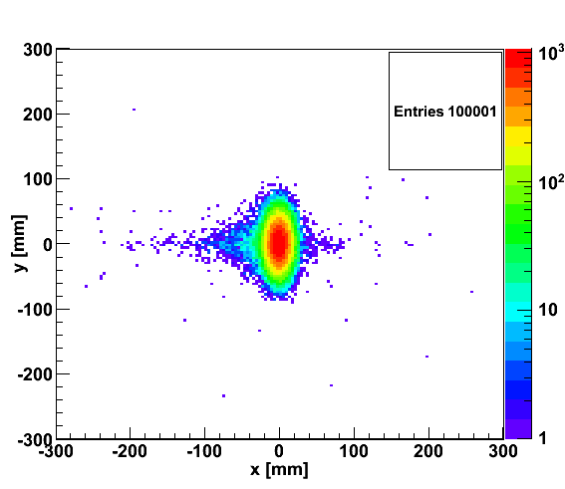
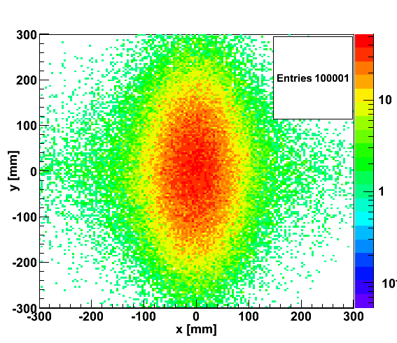

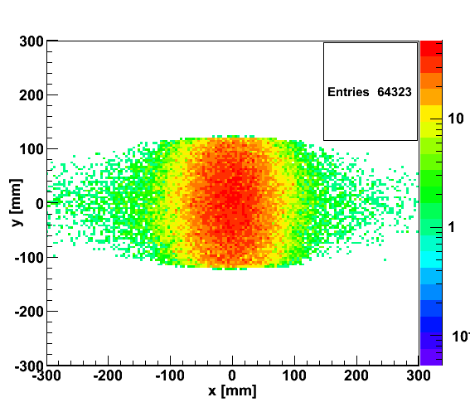
proton distribution in y vs x at s=20 m
without quadrupole aperture limit
25x250
5x50
with quadrupole aperture limit
25x250
5x50

Slide 10
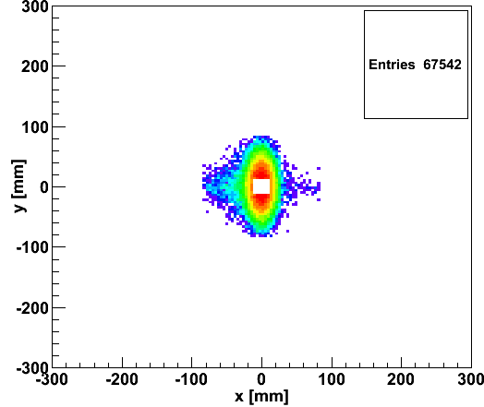
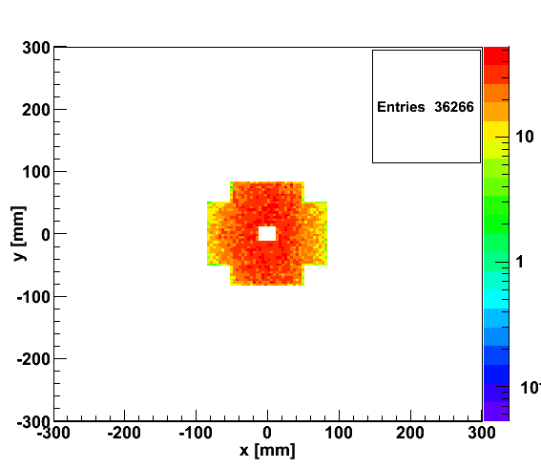
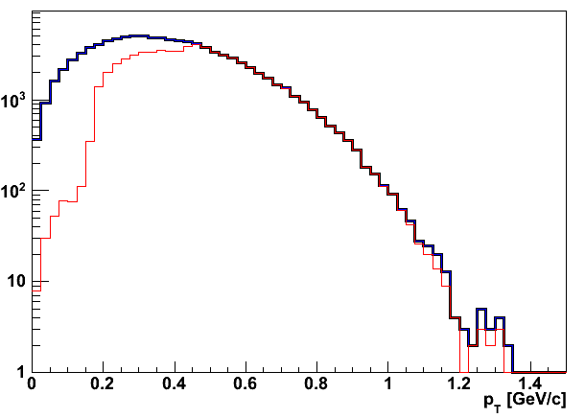
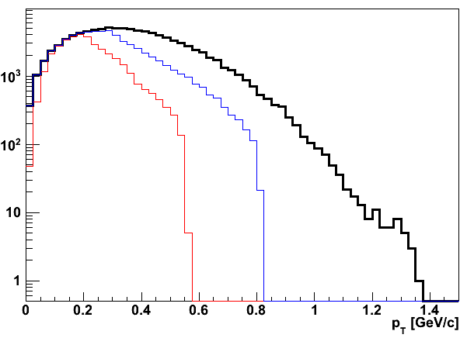
Accepted in“Roman Pot”(example) at s=20m
25x250
5x50
25x250
5x50
Generated
Quad aperture limited
RP (at 20m) accepted

Slide 11
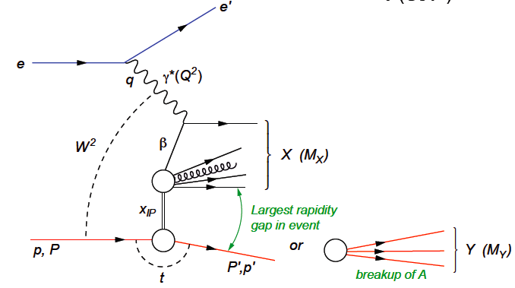
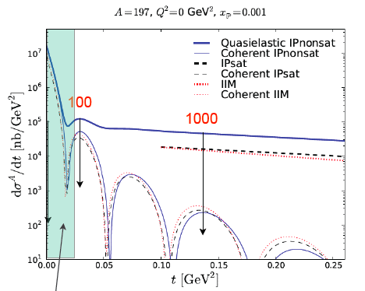
How to detect coherent/in-coherent events in ep/A ?
e+p/A → e’+p’/A’ + γ / J/ψ / ρ / φ / jet
Challenges to detect p’/A’
  Beam angular divergence limits smallest outgoing Θ_{min} for p/A that can be measured
  Can measure the nucleus if it is separated from the beam in Si (Roman Pot) “beamline” detectors
    p_{Tmin} ~ p_{z}^{A} θ_{min}
      For beam energies = 100 GeV/n and θ_{min} = 0.1 mrad
  Large momentum kicks, much larger
  than binding energy (~8 MeV)
    For large A, coherently diffractive nucleus
    cannot be separated from beamline
    without breaking up
    → break up neutron detection
    → veto incoherent events
incoherent dominates at a t at 1/e
of coherent cross section
→ p_{t} << p_{tmin}
p_{t}=√t

Slide 12
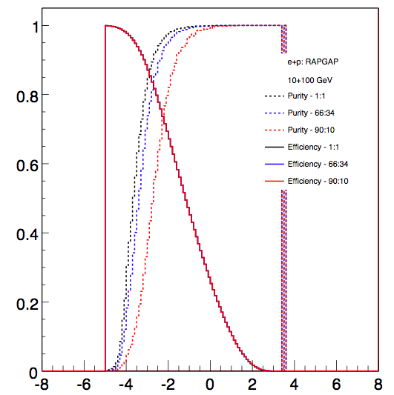
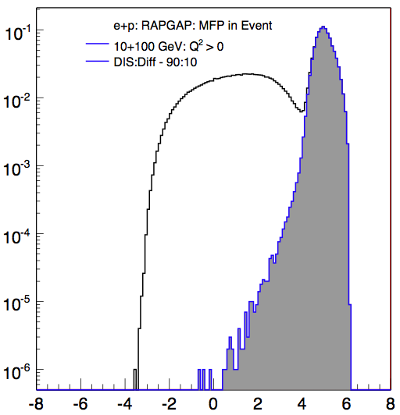
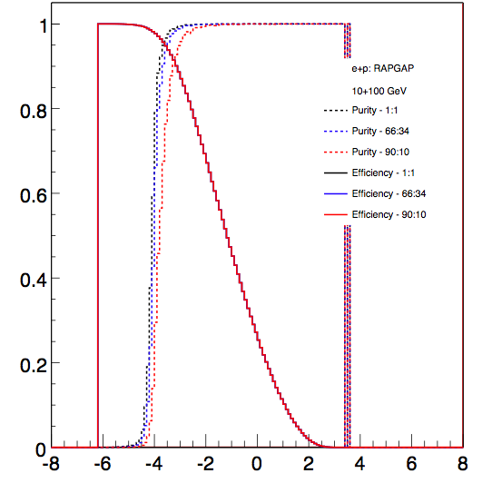
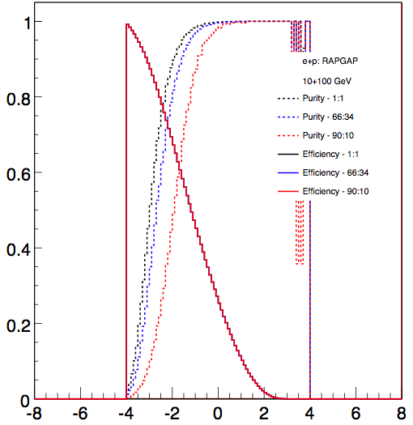
How to detect coherent/in-coherent events in ep/A ?
Rely on rapidity gap method
  simulations look good
  clear difference between DIS and
  diffractive events
  high eff. high purity
  possible with gap alone
    ~1% contamination
    ~80% efficiency
  depends critical on detector
  hermeticity
    However, reduce the acceptance by 1 or 2 units of rapidity and these values drop significantly
  improve further by veto on
  breakup of nuclei (DIS)
Very critical
  mandatory to detect nuclear
  fragments from breakup
  n: Zero-Degree calorimeter
  p, A frag: Forward Spectrometer
Efficiency
Purity
Rapidity
Rapidity

