Slide 1
Letter of Intent for Detector R&D Towards an EIC Detector
TK Hemmick for the EIC Tracking R&D Group
Brookhaven National Laboratory
Florida Institute of Technology
Iowa State University
Lawrence Berkeley National Laboratory
Massachusetts Institute of Technology
Riken Research Center at BNL
Stony Brook University
University of Virginia
Yale University

Slide 2
The Physics we want to study
What is the role of gluons and gluon self-interactions in nucleons and nuclei?
  Observables in eA / ep:
    elastic/diffractive events: rapidity gap events, elastic VM production, DVCS
    inclusive events: structure functions F₂^{A}, F_{L}^{A}, F_{2c}^{A}, F_{Lc}^{A}, F₂^{p}, F_{L}^{p},………
What is the internal landscape of the nucleons?
  What is the nature of the spin of the proton?
    Observables in ep
      inclusive & semi-inclusive events: Asymmetries → polarized cross-sections,
      inclusive events: electroweak Asymmetries (γ-Z interference, W^{+/-})
  What is the three-dimensional spatial landscape of nucleons?
    Observables in ep/eA
      semi-inclusive events: single spin asymmetries (TMDs)
      elastic/diffractive events: cross sections, SSA of exclusive VM, PS and DVCS (GPDs)
What governs the transition of quarks and gluons into pions and nucleons?
  Observables in ep / eA
    semi-inclusive events: cross sections, R_{eA}, azimuthal distributions, jets

Slide 3

Deep Inelastic Scattering
Kinematics:
Measure of resolution power
Measure of inelasticity
Measure of momentum fraction of struck quark
e-
p/A
0º 180º
Challenge:
need to cover wide range in beam energies
lepton: 5 - 30 GeV
hadron (p/Au) 100 – 325 GeV / 50 – 130 GeV
Resolution in x, Q² dominated how well the scattered lepton is measured
or
how well the hadronic method works → large acceptance for hadronic final state

Slide 4
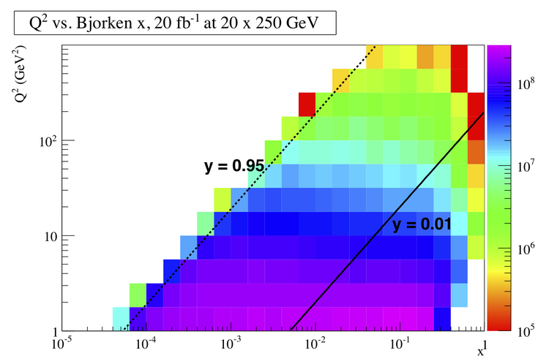
DIS Kinematics
high y limited by
radiative corrections
can be suppressed by
by requiring hadronic
activity
y=0.85
HERA
y>0.005
y=0.05
Strong x-Q² correlation
  high x → high Q²
  low x → low Q²
low y limited by
theta resolution for e’
→ use hadron method

Slide 5
Important for Detector Design
Detector must be multi-purpose
  One detector for inclusive (ep -> e’X), semi-inclusive (ep->e’hadron(s)X), exclusive (ep -> e’πp) reactions in ep/eA interactions
  run at very different beam energies (and ep/A kinematics)
  E_{p/A}/E_{e} ~ 1 – 65 → HERA: 17 – 34; lepton beam energy always 27GeV
Inclusive DIS:
  with increasing center-of-mass energy lepton goes more and more in original beam direction
  high Q² events go into central detector
  low Q2 events have small scattering angle and close to original beam energy
  need low forward electron tagger for low Q² events
  low-mass high resolution trackers over wide angular acceptance
Semi-Inclusive DIS
  hadrons go from very forward to central to even backward with lepton beam energy increasing
  good particle-ID over the entire detector
Exclusive Reactions:
  decay products from excl. ρ / φ / J/ψ go from very forward to central to even backward with lepton beam energy increasing

Slide 6
Additional Remarks
Charm detection
  structure functions
    detecting lepton form decay in addition to scattered via displaced vertex should be enough
  charm in fragmentation
    need to reconstruct D⁰ meson completely to measure its z
      good PID
Very high luminosity 10³⁴ cm⁻¹s⁻¹
  will be systematic limited in many measurement
  needs a lot of care to account for this in the design
    detector: alignment, ……
    polarization measurements
    luminosity measurement

Slide 7
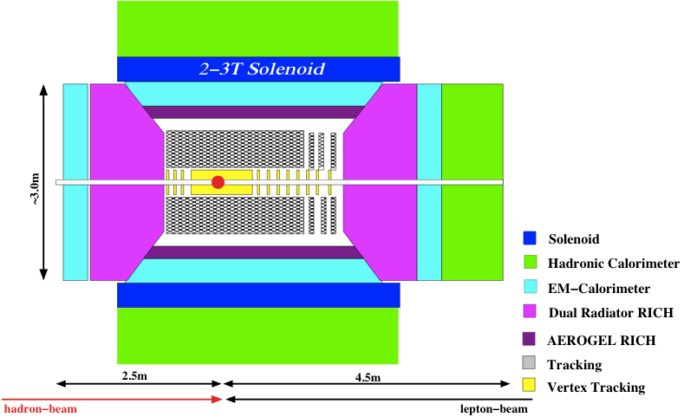
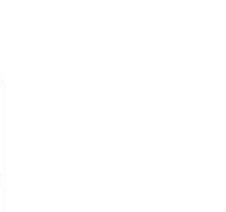
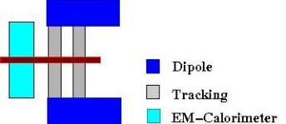
Emerging Detector Concept
low Q² e’ Spectrometer:
high acceptance -5 < η < 5 central detector
good PID and vertex resolution (< 5μm)
tracking and calorimeter coverage the same → good momentum resolution, lepton PID
low material density → minimal multiple scattering and brems-strahlung
very forward electron and proton detection → dipole spectrometers

Slide 8
Why a LOI Response to a Call for Proposals?
Tracking and PID technologies must be driven by the physics goals of the EIC, not by the technology du jour.
Detector performance a “coupled problem”
  E vs hadron for Q^2
  Tracking provides “some” PID.
  Cherenkov is velocity measure through BOTH TOF and Ring
Success will be defined by
  Gathering a community that cross-cuts R&D with physics.
  Use diverse experience to formulate reasoned plans.
Our Letter of Intent:
  Announces a fledgling community taking on this task.
  Contains requests for small scale “seed grant” work.
  Promises a full R&D tracking proposal in one year’s time.

Slide 9
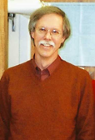





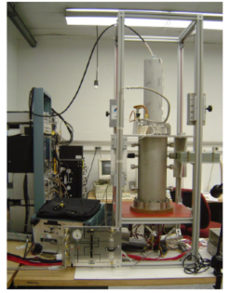
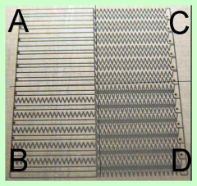
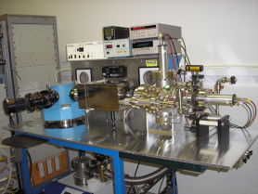
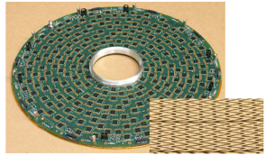
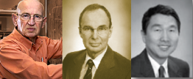
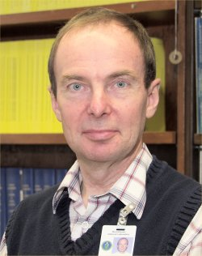
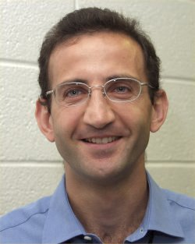
Brookhaven Lab
Hadron-Blind Detector
Chevron charge division
Fast drift/low mass TPC
ASIC development
VUV spectrometry

Slide 10
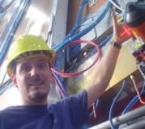
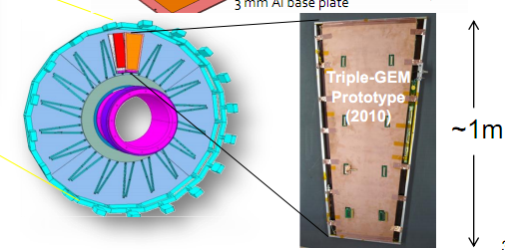
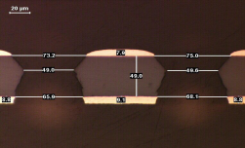
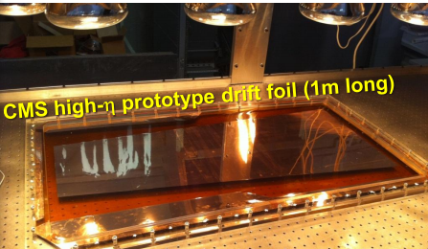
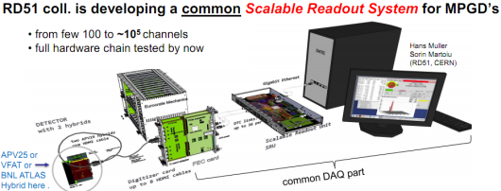
Florida Institute of Technology
CMS High-η GEM Upgrade
RD51 SRS readout System
Large-Area GEM production
CERN workshops
Single-mask GEM cross section

Slide 11



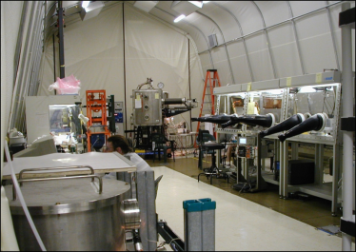
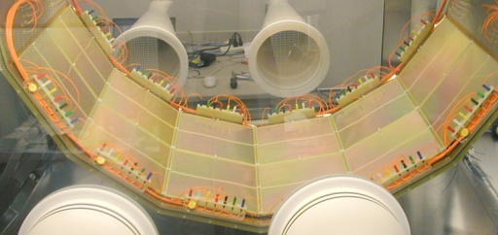
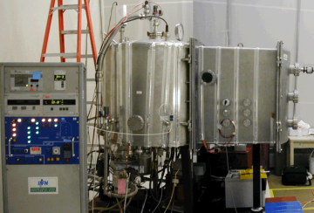
Stony Brook University
Hadron-Blind Detector
Large Clean Room
Gas Chromatography
CsI Photocathodes

Slide 12

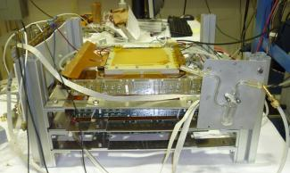
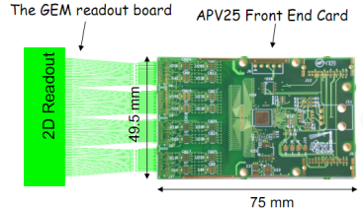
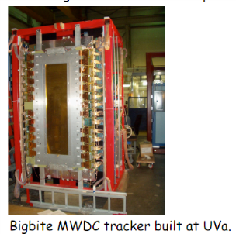
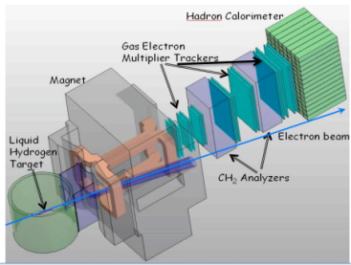
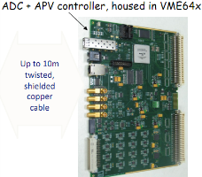
University of Virginia
Prototype GEM tracker tested at Jlab now
Super Big Bite
SoLID
prototype tracker prepared for beam test.

Slide 13
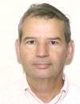

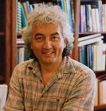
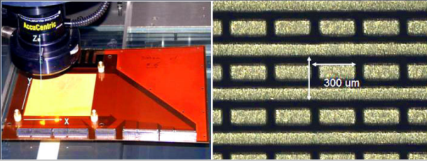
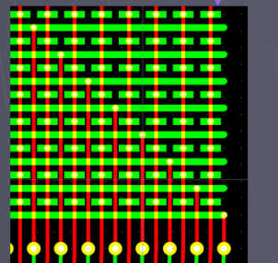

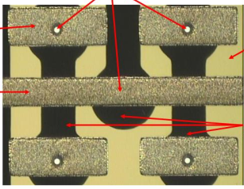
Yale University
Forward GEM Tracker
Developed Strip-pixel readout system.
Short term proposal:
  3-coordinate strip-pixel readout.

Slide 14
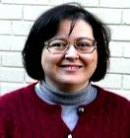
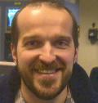
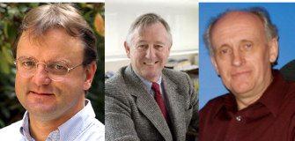
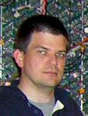
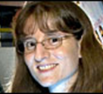
Not requesting funds…
Iowa State University
MIT
Lawrence Berkeley Laboratory
Los Alamos National Laboratory

Slide 15
Simulation Issues I:
Material and position resolution budgets:
  Depends upon source of Q².
  Depends upon measurement channel.
  Golden channel to push tracking: F_{L}
Choices between Fast Drift TPC & GEM tracking outside of the thin micro-vertex tracking layer
  Nothing is thinner than a TPC.
  Can have a “thinnest direction”?
  Can it resolve multiple tracks from overlapping events?
  Collision rate limitation?
High performance dE/dx measurements via Cluster Counting.
What magnetic field configurations could be considered to maintain high performance at high η?
  Solenoid not optimal for resolution at small angles.

Slide 16
Simulation Issues II:
What form of B-insensitive detector can be used for PID?
  RICH with various readout choices:
    CsI photocathode, SiPM
  High Resolution TOF alone or within RICH
    SiPM, MCP-PM readouts…
Proximity-focus RICH in central arm.
  Can PID momentum-limits be extended via blob-ID??
  TOF within RICH by RICH
Limits on Ring radius resolution due to B-field, M-Scat.

Slide 17
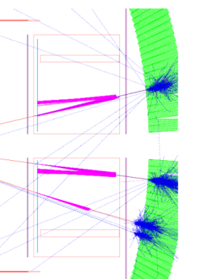
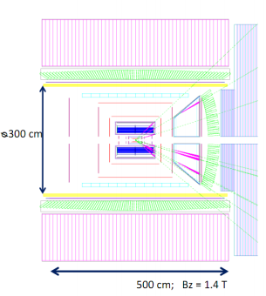
Simulation framework…
The most important work over the coming year involves simulations to propose viable technology choices for R&D.
A simulation framework exists.
The work plan involves driving processes:
  F_{L} drives momentum precision.
  PID driven by strange particles:
    Δs measurements
    Charm via hadrons
No funds requested for simulations.

Slide 18
Hardware tasks during 1st year
Measurements of fast TPC performance characteristics.
Development of very large area GEM detectors.
Development of GEM-based CsI-photocathode detectors for PID in barrel and endcap.
Development of methods to minimize electronics-induced gaps in large area GEM detectors.
Development of a 3-coordinate strip-pixel readout.

Slide 19
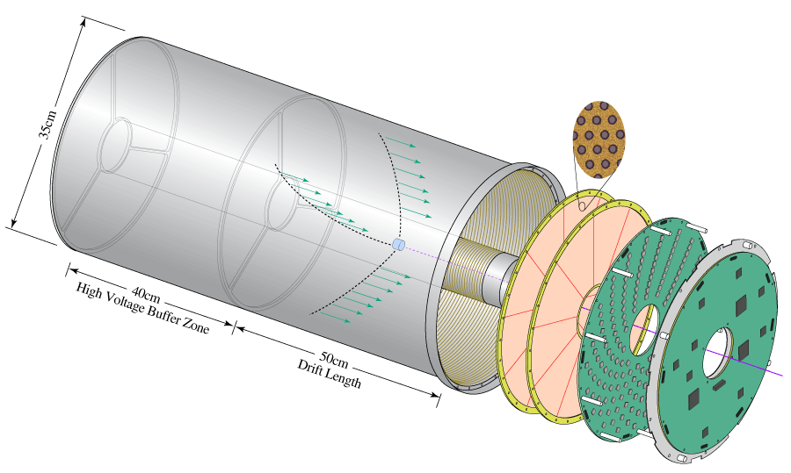
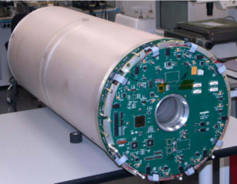
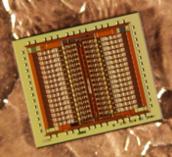
Fast Drift TPC Development
GEM Readout TPC for the Laser Electron Gamma Source (LEGS) at BNL
Double GEM Readout
Designed and built by BNL Instrumentation Division
GEM TPC Test Facility in BNL Physics Dept
Custom ASIC
32 channels - mixed signal
40,000 transistors
low-noise charge amplification
energy and timing, 230 e⁻, 2.5 ns
neighbor processing
multiplexed and sparse readout
G. De Geronimo et al., IEEE TNS 51 (2004)

Slide 20
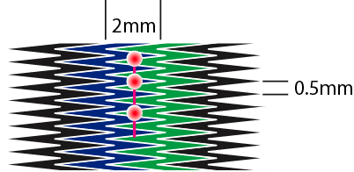
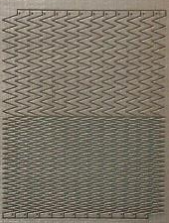
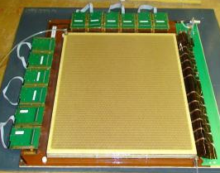
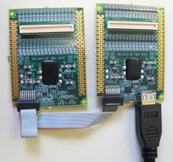
Large-Area Readout Using Zigzag Strips
Follow up on previous BNL R&D to reduce required
strip & channel numbers. Position errors < 80µm
achieved with 2mm strip pitch in small prototypes:
Bo Yu, BNL
Bo Yu, BNL
Test performance with
medium-size 3-GEM det.
using analog SRS readout
with APV25 hybrid cards
(128 ch. per card) at BNL
& Florida Tech
30cm × 30 cm
Triple-GEM
Hans Muller, CERN
First commercially produced
front-end APV25 hybrids (RD51)

Slide 21
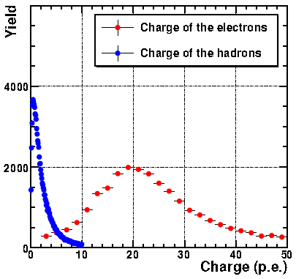
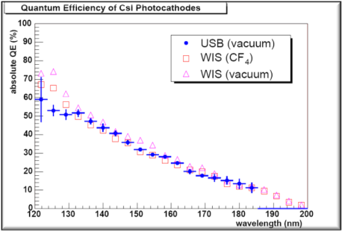
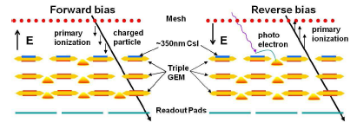
CsI Photocathode Research
The Stony Brook group wishes to investigate the feasibility of CsI-coated GEMs as a large area, B-field tolerant solution for RICH work.
Operating in CF₄ the PHENIX HBD detector demonstrated the highest measured N₀ (327)
of any large Cherenkov Detector.
However, there are limitations due to the
sensitivity range of CsI (110 – 200 nm).
  Windows provide
  provide higher cutoff.
  Most (not all) optics for
  reflection provide higher
  cutoff.
  Aerogel opaque in VUV

Slide 22
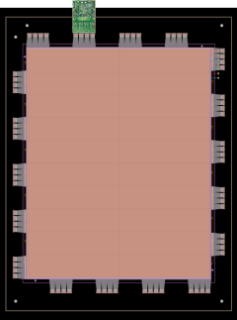
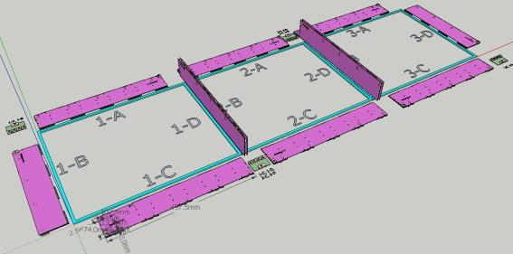
Large Area GEM w/ “hidden” Readout
EIC requires large area GEM coverage: disks with radii up to ~ 2m
Single mask technique, GEM splicing: GEM foils up to 2 m x 0.5 m.
Large area coverage requires segmentation with narrow dead areas
Optimized for the large GEM chambers of Super-Bigbite
Readout cards perpendicular to the active area
Flexible extensions of readout-board: directly plug in the front end card
R&D proposal: build a 1 m x 0.9 m prototype with two segments.

Slide 23
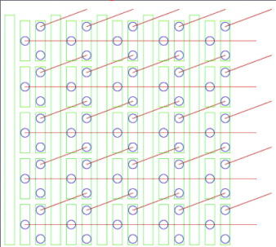


Strip-pixel R&D
PROPOSED
COMPASS
Position by charge division (~100 μm).
Readout count set by occupancy:
  2D uses X-Y charge matching allows
  up to 10 particles per “patch”
  3D uses chg & GEOMETRY matching
  requires R&D to determine limit.
STAR FGT
NOTE: Redundancy “hardens” detector against failure.

Slide 24
Budget Summary
The budget consists of a set of so-called “seed grant” projects that are likely interesting to pursue regardless of the findings of our physics/simulations work.

Slide 25
Summary
A Large and growing group of scientists have already begun to work on determining specific and integrated proposals of tracking and PID for the EIC.
A list of small seed projects relevant to the later work is included in the letter of intent.
The principle deliverable from this work will be a specific research plan within one year’s time leading to a specific and realistic tracking and PID scheme for meeting the physics goals of EIC.
https://wiki.bnl.gov/eic/index.php/Tracking
eic-rd-tracking-l@lists.bnl.gov

Slide 26
BACKUP SLIDES

Slide 27





Budget
The budget consists of a set of so-called “seed grant” projects that are likely interesting to pursue regardless of the findings of our physics/simulations work.

Slide 28
Deep Inelastic Scattering
Kinematics:
Measure of resolution power
Measure of inelasticity
Measure of momentum fraction of struck quark
Inclusive events:
e+p/A → e’+X
detect only the scattered lepton in the detector
Semi-inclusive events:
e+p/A → e’+h(π,K,p,jet)+X
detect the scattered lepton in coincidence with identified hadrons/jets in
the detector
with respect to γ

Slide 29
Deep Inelastic Scattering
Kinematics:
e’
Measure of resolution power
e
γ
γ_{L}*
(Q²)
x+ξ
x-ξ
Measure of inelasticity
~
~
H, H, E, E (x,ξ,t)
p
p’
Measure of momentum fraction of struck quark
t
Exclusive events:
e+p/A → e’+p’/A’+γ / J/ψ / ρ / φ
detect all event products in the detector
Special sub-event category rapidity gap events
e+p/A → e’+γ / J/ψ / ρ / φ / jet
don’t detect p’ → HERA: 20% non-exclusive event contamination
missing mass technique as for fixed target does not work

