Slide 1
Letter of Intent for Detector R&D Towards an EIC Detector
TK Hemmick for the EIC Tracking R&D Group
Brookhaven National Laboratory
Florida Institute of Technology
Iowa State University
Lawrence Berkeley National Laboratory
Massachusetts Institute of Technology
Riken Research Center at BNL
Stony Brook University
Temple University
University of Virginia
Yale University

Slide 2
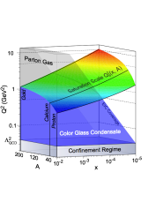



Most Compelling Physics Questions
physics of strong color fields
quantitatively probe the universality of
strong color fields in AA, pA, and eA
understand in detail the transition to the non-linear
regime of strong gluon fields and the physics of saturation
how do hard probes in eA interact with the medium
spin physics
imaging
what is the polarization of gluons at
small x where they are most abundant
what is the spatial distribution of
quarks and gluons in nucleons/nuclei
what is the flavor decomposition of
the polarized sea depending on x
understand deep aspects of gauge
theories revealed by k_{T} dep. distr’n
determine quark and gluon contributions
to the proton spin at last
possible window to
orbital angular momentum

Slide 3
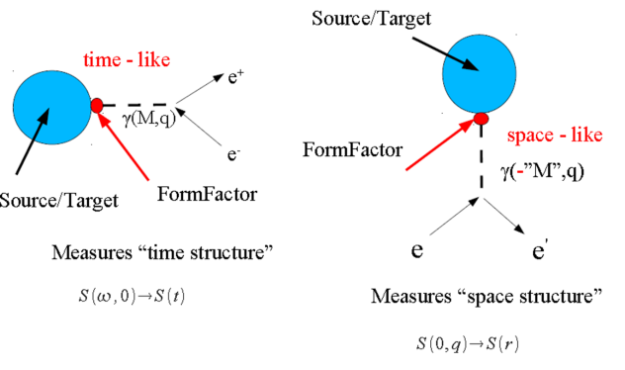
Primer for Heavy Ion Physicists
Much interest in RHI collisions has focused on the measurements of di-lepton emission from the plasma state.
dilepton production and DIS are simply rotated diagrams.
One cannot perform DIS on hot QCD matter.
However, when cold nuclear matter is your interest, DIS is the cleanest and most informative probe.

Slide 4

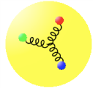
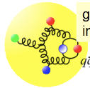
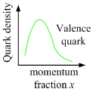

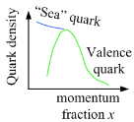
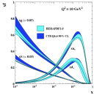
How to see the gluons: Deep Inelastic Scattering
Kinematics:
Measure of resolution power
Measure of inelasticity
Measure of momentum fraction of struck quark
Gluon splits
into quarks
Quark splits
into gluon
splits
into quarks …
10⁻¹⁶m
10⁻¹⁹m
higher √s
increases resolution

Slide 5
Our approach to EIC R&D
Technology choices must be driven by the physics goals.
Success will be defined by
  Gathering a community that cross-cuts R&D with physics.
  Use diverse experience to formulate reasoned plans.
Well received:
  The formation of consortia of universities and national labs … are to be encouraged. In these six proposals we have already seen evidence of such consortia forming around tracking and PID…
  The collaboration emphasized their intention to carry out extensive physics simulations to shape the direction of future detector R&D proposals. … The committee appreciates and encourages this approach. Only after the demanding simulation effort progresses can detector R&D proceed with the desired focus.
  It was suggested that a funding request for post docs in support of simulations would be reasonable. It was also suggested that machine related backgrounds should be included in the simulations.

Slide 6
Today’s Presentation:
Collaboration Status
  Institutional
  Individual
Progress Reports on Hardware Efforts
  Early Accomplishments
  Establishing coherence & community
Progress Report on Simulation Efforts
  Frameworks
  F₂ & F_{L}
  Machine Backgrounds
Request for additional funding in two areas:
  Funding for personnel in support of simulations.
  Funding to support broadened scope for RICH Test Beam.
Full scale proposal Spring 2012.

Slide 7
Collaboration Status
A “consortium” of diverse efforts is most effective if all members participate actively and the group builds comradery.
We have gone through the process of having our member institutions re-affirm their commitment to the group:
  LANL has dropped participation.
  LBNL efforts will be minimal for the next 6 months due to the distraction of heavy administrative duties.
  MIT will undergo a change in personnel.
  Temple University has joined our proposal.
Most important (and impressive) is the level to which we are forming a cohesive effort by sharing resources, technology, and ideas.
We welcome additional collaborators with overlap in our interests to contact us and possibly join in on the fun!

Slide 8
Cooperative Efforts
BNL and Yale working together on GEM TPC development.
Stony Brook engineer Chuck Pancake designed layouts for zigzag TPC & GEM readout boards using input on the specifications from BNL and FIT to test a variety of zigzag pad geometries. The system is designed to directly couple to the Scalable Readout System (SRS) used by BNL, FIT, and UVa.
Kondo Gnanvo has moved from a post-doc position at FIT to a research position at UVa to implement SRS readout systems for system tests including those already performed at Mainz and those upcoming at JLab.
Stony Brook, Temple, and UVa have combined forces to mount the Cherenkov test beam effort in Hall A of Jefferson Lab, using the UVa tracking coupled to the SBU Cherenkov detector.
Stony Brook PhD student Huijin Ge has begun simulations of the three-coordinate readout system to determine the performance of this scheme as a function of particle multiplicity.
Postdocs from SBU and ISU are contributing to the previously BNL-exclusive simulation effort.

Slide 9
Leading Technological Sharing: SRS
The SRS DAQ system has proved a boon to our efforts.
Initial expertise from FIT has spread through UVa, BNL, SBU and is rapidly becoming the common standard for all our test beam efforts.
Present applications are APV25-based, but will branch out.
EXAMPLE: Cherenkov Test @ J-Lab will use ~2500 channels.

Slide 10
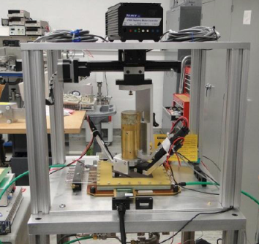
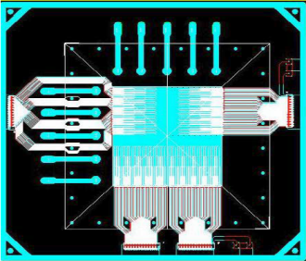
Micro-TPC
Tests of 1-2cm drift micro-TPC soon coupled to ATLAS chip.
  64 ch ASIC (front end only) available Spring 2012.
  Designing coupling to SRS.
⁹⁰Sr vectored source with 10 micron scan steps.
CERN “Compass” readout; 2000 channels SRS.
Alternative readout planes from SBU engineer.
Several chip options will be identified by proposal time.

Slide 11
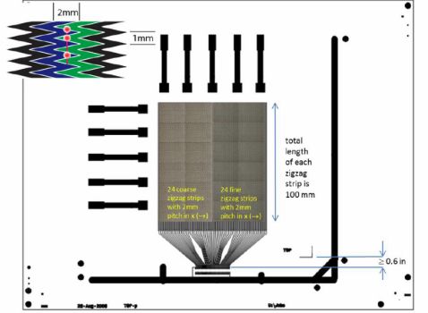
Zig-Zag readouts to Reduce Channel Count
Readout test board compatable with CERN 10x10cm^2 GEMS.
FIT design/
SBU layout
Investigation of long “Zig-Zag” patterns at FIT.
Low channel-count readout for very large area GEMs.
FIT has ~1m-long functioning GEMs as prototypes from CMS.

Slide 12
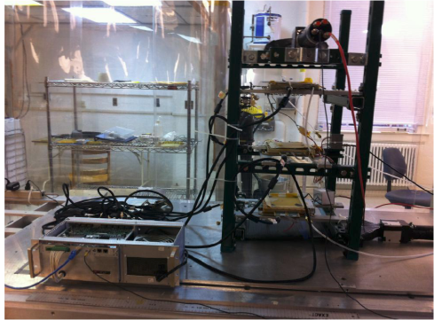
Dead Area at GEM Edges Reduction
2000 channels of SRS running successfully.
Orders out for 40x50cm²; Design underway for 90x40cm²
UVa will provide tracking & DAQ for RICH Tests @ J-Lab
(Spring 2012)

Slide 13
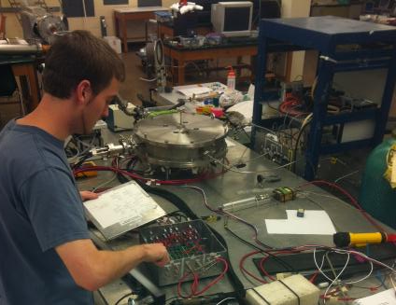
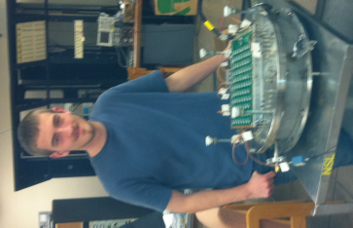
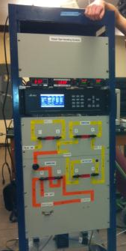
RICH Detector Development
Test “beam” available in Hall A.
Joined with Temple & U.Va for two-stage tests:
  Simple background studies (leave for J-Lab this week!)
  RICH tests with tracking support in Spring 2012.
Full-time grad students: Thomas Videbaek, Serpil Yalcin. Part-time grad students: Ciprian Gal, Paul Kline, Huijun Ge
Five undergrads working part-time.

Slide 14
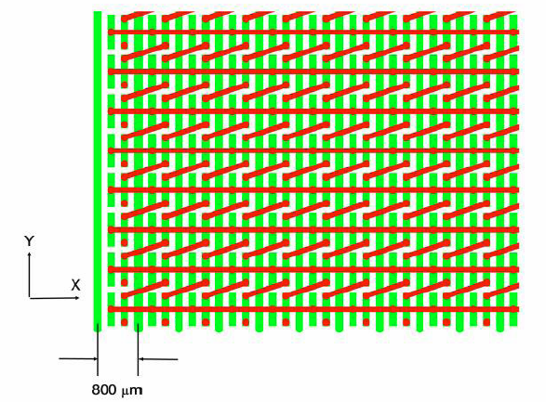
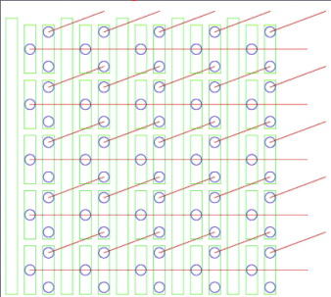
3D Strip-pad Readout Scheme
PROPOSED
Layout completed for 880 mm pitch.
Next is 600 mm pitch (limit of Tech-Etch capability?).
Beam test 2012.
BNL and SBU doing detailed simulations of charge deposition and pattern recognition respectively.

Slide 15
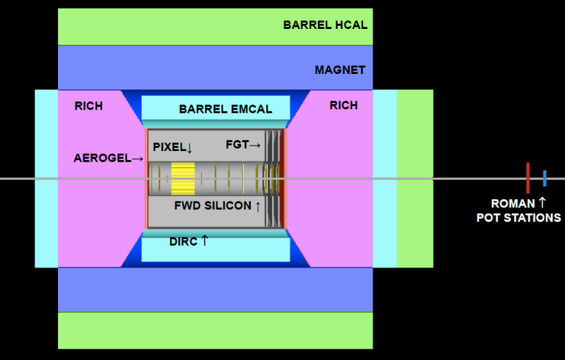
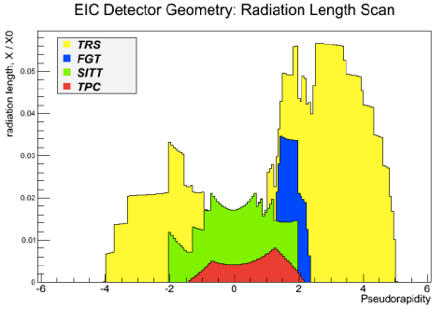
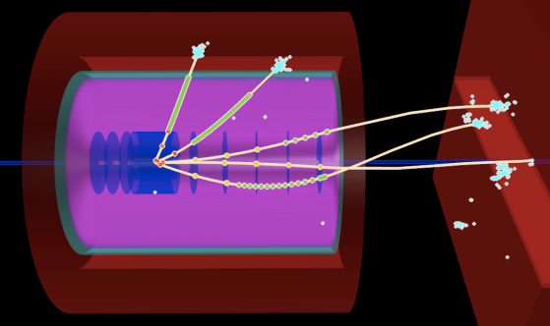
Emerging Detector Concept
Pythia-event
high acceptance -5 < η < 5 central detector
good PID and vertex resolution (< 5μm)
tracking and calorimeter coverage the same → good momentum resolution, lepton PID
low material density → minimal multiple scattering and brems-strahlung
very forward electron and proton detection → dipole spectrometers

Slide 16
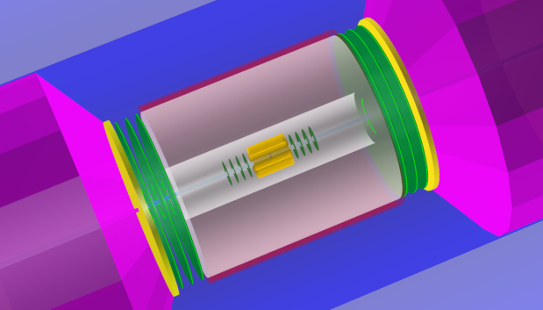
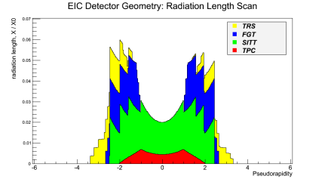
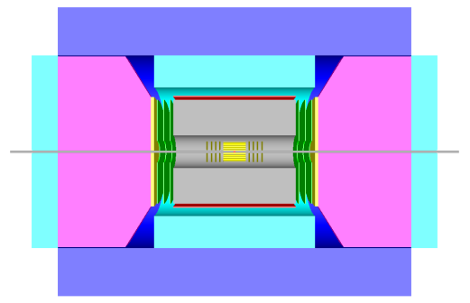
And in a symmetric version…

Slide 17
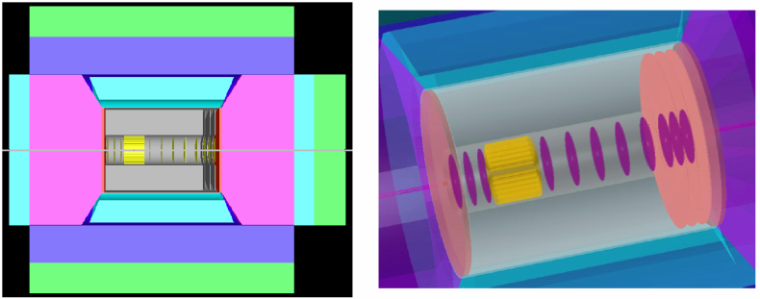
Framework 1: FairROOT
IO Manager based on ROOT TFolder and TTree (TChain);
Geometry Readers: ASCII, ROOT, CAD2ROOT;
Radiation length manager;
Generic track propagation based on Geane;
Generic event display based on EVE and Geane;
Fast simulation base services based on VMC and ROOT TTasks;
a unified interface to integrate different Monte Carlo (MC) generators
CUDA support

Slide 18
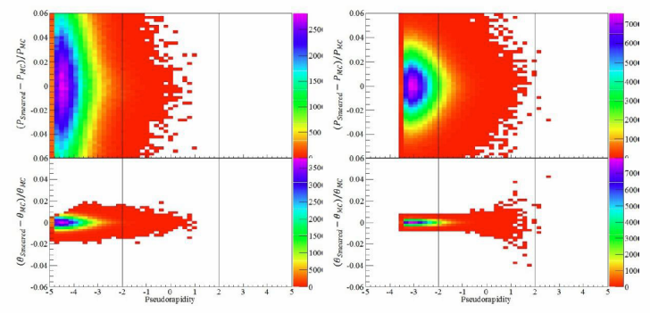
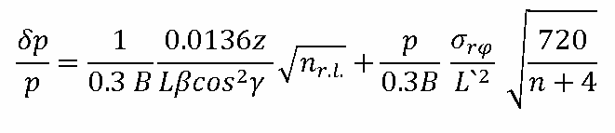
Framework 2: Smear
Layers of “Logical” detectors with smearing function.
Mis-ID matrix ala HERMES
Crystal Ball function for Bremsstrahlung tails.

Slide 19
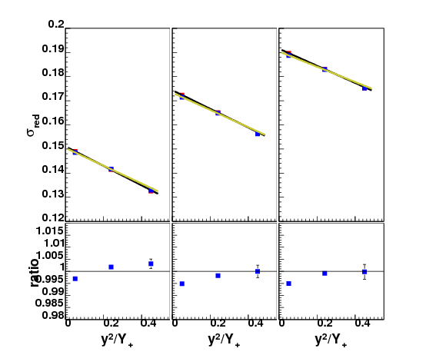
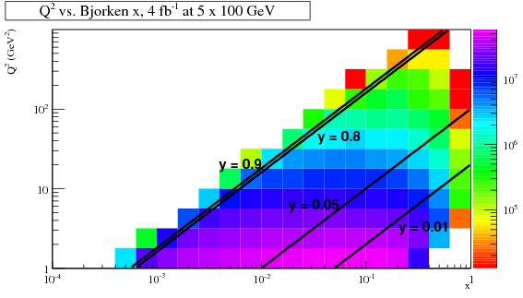
Golden Measurement for Tracking F_{L}
Measurements of F_{L} are made by varying the beam kinematics so as to inspect the same (x,Q²) at different y.
This challenges al aspects of measurement:
  Varying particle mometa vs h.
  Resolution.
  Running time trade-offs.
  Systematic errors.

Slide 20
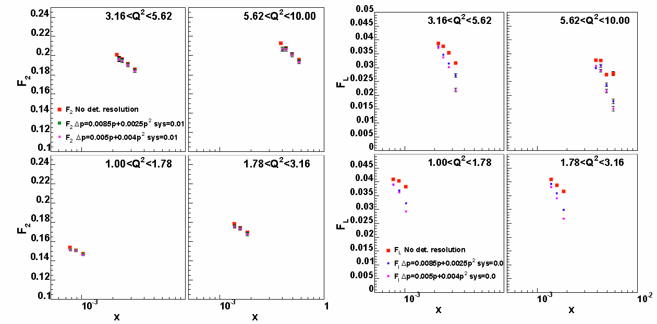

Study #1: F₂ & F_{L}
No correction for detector resolution.
Demonstrates veracity of F_{L} as “Golden Measurement”.

Slide 21

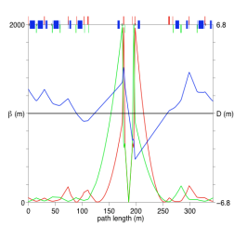
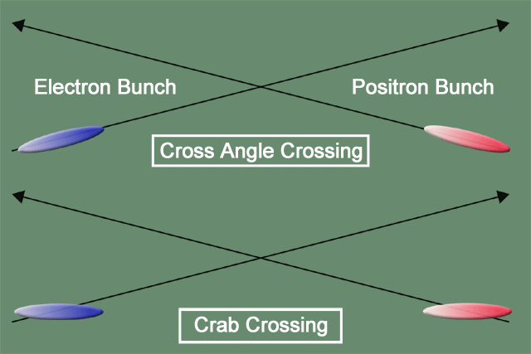
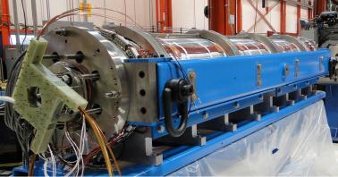
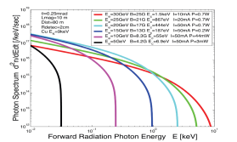
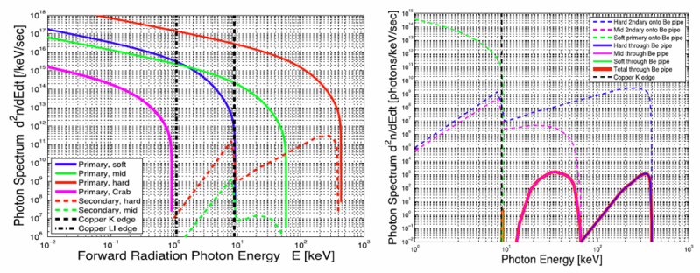
eRHIC high-luminosity IR with β*=5 cm
p
Proton beam lattice
G.Ambrosio et al., IPAC’10
e
Nb₃Sn
200 T/m
eRHIC - Geometry high-lumi IR with β*=5 cm, l*=4.5 m
and 10 mrad crossing angle → this is required for 10³⁴ cm⁻² s⁻¹
10 mrad crossing angle and crab-crossing
High gradient (200 T/m) large aperture Nb₃Sn focusing magnets
Arranged free-field electron pass through the hadron triplet magnets
Integration with the detector: efficient separation and registration of low angle collision products
Gentle bending of the electrons to avoid SR impact in the detector
© D.Trbojevic, B.Parker, S. Tepikian, J. Beebe-Wang

Slide 22
Future Simulation Work
Complete the geometry implementation of the detector for the GEANT simulations.
Implement all IR magnets to allow for tracking of, e.g. the forward going protons from exclusive
reactions in Roman pots.
Simulate the impact of synchrotron radiation on the detector.
Provide results on the following questions:
  Is the occupancy in the CMOS-pixel μ-vertex tracker small enough that we can track
  from inside out?
  Is any intermediate tracking detector needed between the CMOS-pixel μ-vertex tracker and the TPC / Barrel GEM tracker?
  What is the occupancy for the different CMOS-pixel μ-vertex layers in the barrel and in the forward direction?
  Is the material budget of a barrel GEM tracker tolerable?
  What magnetic field is needed given the intrinsic resolutions of a TPC or Barrel GEM tracker and the CMOS-pixel μ -vertex disks and a GEM tracker in the forward direction?
  Do we have heavy fragments in the direction of the forward CMOS-pixel μ-vertex disks?
  What is the achievable Q2, x and y resolution for the different tracking solutions?
  What efficiency and misidentification can be tolerated in hadron (, K, p) identification?

Slide 23
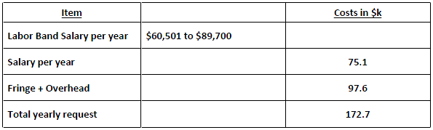
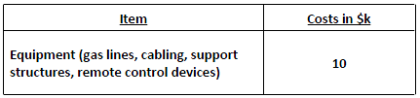
Budget
Request to hire Monte-Carlo software simulation specialist for the next three years.
Yearly cost:
Request additional support for Cherenkov tests due to evolving scope of the tests and additional infrastructure:

Slide 24
BACKUP SLIDES

Slide 25
Technology Choices Abound
 | Forward eta (η>2) | Barrel |η|<2
Ecal | PbWO₄ | SciFi & W-powder CsI crystals Shish-kebab
PID | Dual Rad RICH H.R. TOF | Proximity RICH DIRC dE/dx w/ H.R. TOF
Tracking | Silicon MAPS MAPS w/ gas | TPC (long or short) Barrel GEMs MAPS

Slide 26
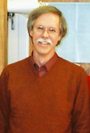





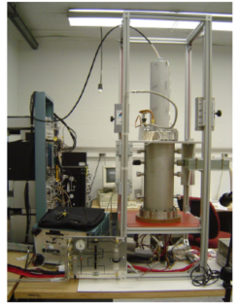
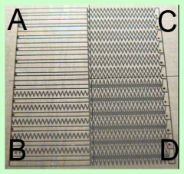
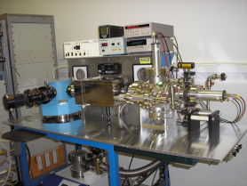
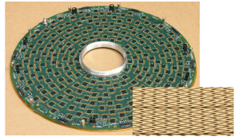
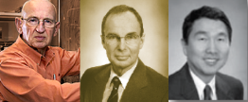
Brookhaven Lab
Hadron-Blind Detector
Chevron charge division
Fast drift/low mass TPC
ASIC development
VUV spectrometry

Slide 27
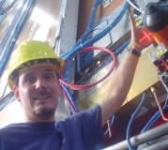
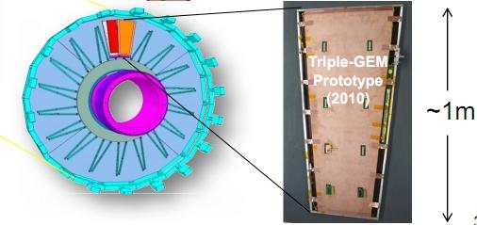
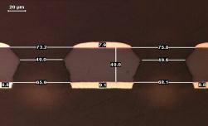
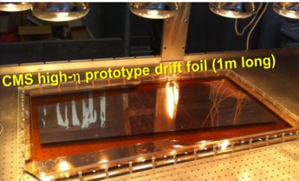
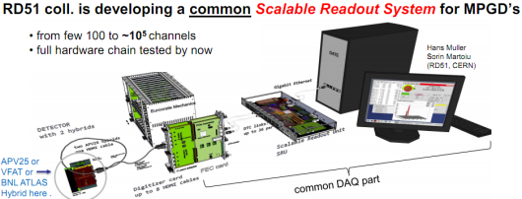
Florida Institute of Technology
CMS High-η GEM Upgrade
RD51 SRS readout System
Large-Area GEM production
CERN workshops
Single-mask GEM cross section

Slide 28
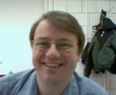
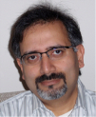
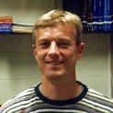
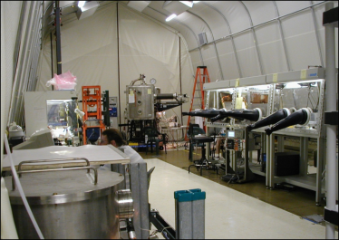


Stony Brook University
Hadron-Blind Detector
Large Clean Room
Gas Chromatography
CsI Photocathodes

Slide 29






University of Virginia
Prototype GEM tracker tested at Jlab now
Super Big Bite
SoLID
prototype tracker prepared for beam test.

Slide 30







Yale University
Forward GEM Tracker
Developed Strip-pixel readout system.
Short term proposal:
  3-coordinate strip-pixel readout.

Slide 31





Not requesting funds…
Iowa State University
MIT
Lawrence Berkeley Laboratory
Los Alamos National Laboratory

Slide 32
Simulation Issues I:
Material and position resolution budgets:
  Depends upon source of Q².
  Depends upon measurement channel.
  Golden channel to push tracking: F_{L}
Choices between Fast Drift TPC & GEM tracking outside of the thin micro-vertex tracking layer
  Nothing is thinner than a TPC.
  Can have a “thinnest direction”?
  Can it resolve multiple tracks from overlapping events?
  Collision rate limitation?
High performance dE/dx measurements via Cluster Counting.
What magnetic field configurations could be considered to maintain high performance at high η?
  Solenoid not optimal for resolution at small angles.

Slide 33
Simulation Issues II:
What form of B-insensitive detector can be used for PID?
  RICH with various readout choices:
    CsI photocathode, SiPM
  High Resolution TOF alone or within RICH
    SiPM, MCP-PM readouts…
Proximity-focus RICH in central arm.
  Can PID momentum-limits be extended via blob-ID??
  TOF within RICH by RICH
Limits on Ring radius resolution due to B-field, M-Scat.

Slide 34
The Physics we want to study
What is the role of gluons and gluon self-interactions in nucleons and nuclei?
  Observables in eA / ep:
    elastic/diffractive events: rapidity gap events, elastic VM production, DVCS
    inclusive events: structure functions F₂^{A}, F_{L}^{A}, F_{2c}^{A}, F_{Lc}^{A}, F₂^{p}, F_{L}^{p},………
What is the internal landscape of the nucleons?
  What is the nature of the spin of the proton?
    Observables in ep
      inclusive & semi-inclusive events: Asymmetries → polarized cross-sections,
      inclusive events: electroweak Asymmetries (γ-Z interference, W^{+/-})
  What is the three-dimensional spatial landscape of nucleons?
    Observables in ep/eA
      semi-inclusive events: single spin asymmetries (TMDs)
      elastic/diffractive events: cross sections, SSA of exclusive VM, PS and DVCS (GPDs)
What governs the transition of quarks and gluons into pions and nucleons?
  Observables in ep / eA
    semi-inclusive events: cross sections, R_{eA}, azimuthal distributions, jets

Slide 35


Simulation framework…
The most important work over the coming year involves simulations to propose viable technology choices for R&D.
A simulation framework exists.
The work plan involves driving processes:
  F_{L} drives momentum precision.
  PID driven by strange particles:
    Δs measurements
    Charm via hadrons
No funds requested for simulations.

Slide 36
Hardware tasks during 1st year
Measurements of fast TPC performance characteristics.
Development of very large area GEM detectors.
Development of GEM-based CsI-photocathode detectors for PID in barrel and endcap.
Development of methods to minimize electronics-induced gaps in large area GEM detectors.
Development of a 3-coordinate strip-pixel readout.

Slide 37



Fast Drift TPC Development
GEM Readout TPC for the Laser Electron Gamma Source (LEGS) at BNL
Double GEM Readout
Designed and built by BNL Instrumentation Division
GEM TPC Test Facility in BNL Physics Dept
Custom ASIC
32 channels - mixed signal
40,000 transistors
low-noise charge amplification
energy and timing, 230 e⁻, 2.5 ns
neighbor processing
multiplexed and sparse readout
G. De Geronimo et al., IEEE TNS 51 (2004)

Slide 38




Large-Area Readout Using Zigzag Strips
Follow up on previous BNL R&D to reduce required
strip & channel numbers. Position errors < 80µm
achieved with 2mm strip pitch in small prototypes:
Bo Yu, BNL
Bo Yu, BNL
Test performance with
medium-size 3-GEM det.
using analog SRS readout
with APV25 hybrid cards
(128 ch. per card) at BNL
& Florida Tech
30cm × 30 cm
Triple-GEM
Hans Muller, CERN
First commercially produced
front-end APV25 hybrids (RD51)

Slide 39

CsI Photocathode Research
The Stony Brook group wishes to investigate the feasibility of CsI-coated GEMs as a large area, B-field tolerant solution for RICH work.
Operating in CF₄ the PHENIX HBD detector demonstrated the highest measured N₀ (327) of any large Cherenkov Detector.
However, there are limitations due to the sensitivity range of CsI (110 – 200 nm).
  Windows provide
  provide higher cutoff.
  Most (not all) optics for
  reflection provide higher
  cutoff.
  Aerogel opaque in sensitive
  range.

Slide 40


Large Area GEM w/ “hidden” Readout
EIC requires large area GEM coverage: disks with radii up to ~ 2m
Single mask technique, GEM splicing: GEM foils up to 2 m x 0.5 m.
Large area coverage requires segmentation with narrow dead areas
Optimized for the large GEM chambers of Super-Bigbite
Readout cards perpendicular to the active area
Flexible extensions of readout-board: directly plug in the front end card
R&D proposal: build a 1 m x 0.9 m prototype with two segments.

Slide 41


Strip-pixel R&D
PROPOSED
COMPASS
Position by charge division (~100 μm).
Readout count set by occupancy:
  2D uses X-Y charge matching allows
  up to 10 particles per “patch”
  3D uses chg & GEOMETRY matching
  requires R&D to determine limit.
STAR FGT
NOTE: Redundancy “hardens” detector against failure.

Slide 42
Budget Summary
The budget consists of a set of so-called “seed grant” projects that are likely interesting to pursue regardless of the findings of our physics/simulations work.

Slide 43
Summary
A Large and growing group of scientists have already begun to work on determining specific and integrated proposals of tracking and PID for the EIC.
A list of small seed projects relevant to the later work is included in the letter of intent.
The principle deliverable from this work will be a specific research plan within one year’s time leading to a specific and realistic tracking and PID scheme for meeting the physics goals of EIC.

Slide 44

DIS Kinematics
high y limited by
radiative corrections
can be suppressed by
by requiring hadronic
activity
y=0.85
HERA
y>0.005
y=0.05
Strong x-Q² correlation
  high x → high Q²
  low x → low Q²
low y limited by
theta resolution for e’
→ use hadron method

Slide 45
Important for Detector Design
Detector must be multi-purpose
  One detector for inclusive (ep -> e’X), semi-inclusive (ep->e’hadron(s)X), exclusive (ep -> e’πp) reactions in ep/eA interactions
  run at very different beam energies (and ep/A kinematics)
  E_{p/A}/E_{e} ~ 1 – 65 → HERA: 17 – 34; lepton beam energy always 27GeV
Inclusive DIS:
  with increasing center-of-mass energy lepton goes more and more in original beam direction
  high Q² events go into central detector
  low Q2 events have small scattering angle and close to original beam energy
  need low forward electron tagger for low Q² events
  low-mass high resolution trackers over wide angular acceptance
Semi-Inclusive DIS
  hadrons go from very forward to central to even backward with lepton beam energy increasing
  good particle-ID over the entire detector
Exclusive Reactions:
  decay products from excl. ρ / φ / J/ψ go from very forward to central to even backward with lepton beam energy increasing

Slide 46
Additional Remarks
Charm detection
  structure functions
    detecting lepton form decay in addition to scattered via displaced vertex should be enough
  charm in fragmentation
    need to reconstruct D⁰ meson completely to measure its z
      good PID
Very high luminosity 10³⁴ cm⁻¹s⁻¹
  will be systematic limited in many measurement
  needs a lot of care to account for this in the design
    detector: alignment, ……
    polarization measurements
    luminosity measurement

Slide 47





Budget
The budget consists of a set of so-called “seed grant” projects that are likely interesting to pursue regardless of the findings of our physics/simulations work.

Slide 48
Deep Inelastic Scattering
Kinematics:
Measure of resolution power
Measure of inelasticity
Measure of momentum fraction of struck quark
Inclusive events:
e+p/A → e’+X
detect only the scattered lepton in the detector
Semi-inclusive events:
e+p/A → e’+h(π,K,p,jet)+X
detect the scattered lepton in coincidence with identified hadrons/jets in
the detector
with respect to γ

Slide 49
Deep Inelastic Scattering
Kinematics:
e’
Measure of resolution power
e
γ
γ_{L}*
(Q²)
x+ξ
x-ξ
Measure of inelasticity
~
~
H, H, E, E (x,ξ,t)
p
p’
Measure of momentum fraction of struck quark
t
Exclusive events:
e+p/A → e’+p’/A’+γ / J/ψ / ρ / φ
detect all event products in the detector
Special sub-event category rapidity gap events
e+p/A → e’+γ / J/ψ / ρ / φ / jet
don’t detect p’ → HERA: 20% non-exclusive event contamination
missing mass technique as for fixed target does not work

