Slide 1
Silicon-based tracker system for EIC detector
M.A. Antonioli, P. Bonneau, L. Elouadrhiri*, B. Eng, Y. Gotra, M. Leffel, S. Mandal, M. McMullen, B. Raydo, W. Teachey, and
A. Yegneswaran*
Thomas Jefferson National Accelerator Facility, Newport News, VA 23606
E. Kurbatov, M. Merkin, S. Rogozhin, and S. Voronin
Moscow State University, Moscow, Russia
M. Holtrop and S. Phillips
University of New Hampshire, Durham, NH 03824
FNAL
SIDET Facility
Saclay/CEA
J. Ball F. Sabatie, and S. Procureur

Slide 2
Topics
Introduction
CLAS12 SVT
Proposal
Plan: cost, schedule and collaboration
Summary

Slide 3
Introduction
Silicon detectors
Ideally suited for tracking close to the interaction region
Capable of handling high rates
Withstand high radiation dose
Provide exceptionally good vertex and tracking resolutions
Standard technology
Highly reliable.
Cost effective
Silicon detectors are used in high-energy physics laboratories across the world
Our Science interest is in the study of Generalized Parton Distributions (GPDs) that require measurement of exclusive processes

Slide 4
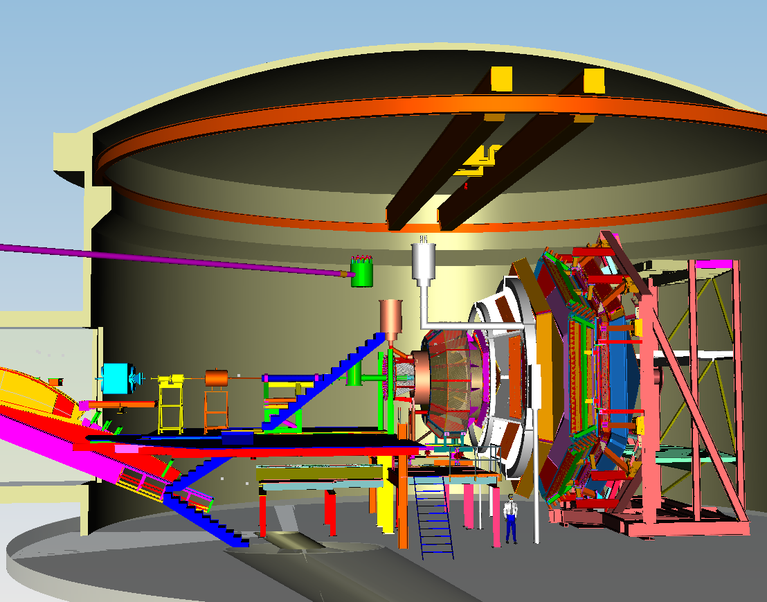
CLAS12 in Hall B
High Threshold
Cerenkov Counter (HTCC)
Low Threshold
Cerenkov
Forward TOF
Pre-Shower
Calorimeter
Electromagnetic
Calorimeter
SC Torus Magnet
Drift Chambers
Moeller Shield
5 T SC Solenoid
Central TOF
Silicon Vertex Tracker (SVT)
Micromegas
Beam-line:
Raster magnets
Beam Position
Targets
Moeller System,
etc.

Slide 5
CLAS12 – Central Detector
CTOF
Scintillators
CLAS 12 will have several Cryogenic targets, 2” max radius at CLAS CL (50.8mm)
Minimum ID of the SVT =57mm
CLEARANCE = 6mm
SVT max radius is 179mm
CTOF min radius is 251 mm
CLEARANCE : ~16 mm between Micromegas and SVT tracker
Design for Micromegas
Inside radius 138mm
Note R3 with skin radius max is 133mm
Outside radius 242mm
Space for tracking upgrade Micromegas
Cryogenic Target

Slide 6
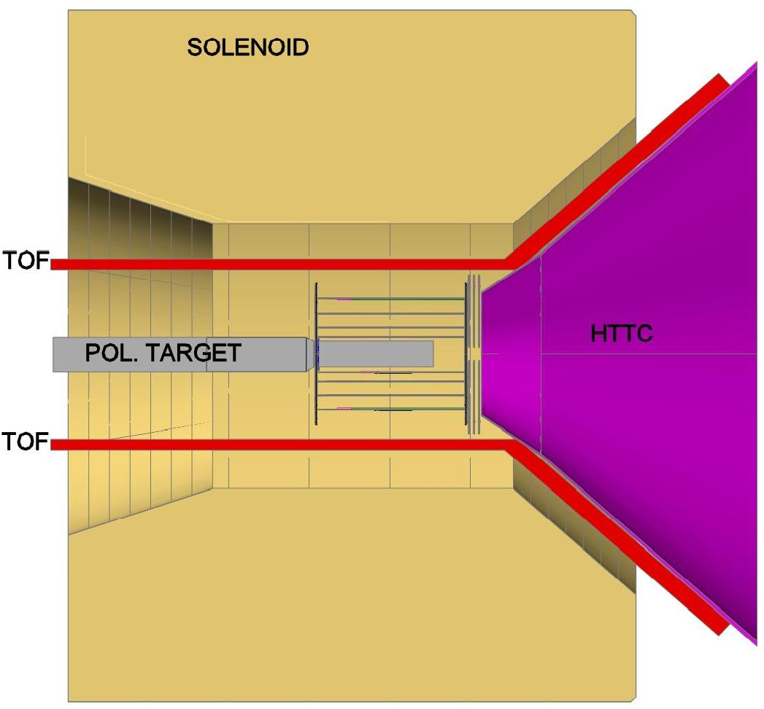
Overview: Detector Design Considerations
Space
Location constrained
by the high threshold Cerenkov counter in the forward direction
by size of polarized target and by the time-of-flight detector in the radial direction
Multiple scattering
Radiation dose
Heat load
Placement tolerances

Slide 7
Design of SVT
Four region barrel
Region 1: 10 modules
Region 2: 14 modules
Region 3: 18 modules
Region 4: 24 modules (separately supported to allow dismount and replacement with Micro Megas Detector)
Simulations indicate that this configuration, three silicon double layers and three Micromegas double layers, dramatically improves the vertex, angular, and tracking resolutions.
All modules for all Regions are identical
Operating Temperature 21ºC
Low mass inside acceptance region X₀ ~1%

Slide 8
Overview: Performance Expectations
Coverage | Θ | 35º — 125º
 | Φ | ~2 π
Resolutions | σ_{p}/p | < 5 % @ 1 GeV
 | Δθ | < 10 — 20 [mrad]
 | ΔΦ | < 5 [mrad]
Tracking Efficiency | ~90%
Luminosity | 10³⁵ cm⁻²s⁻¹

Slide 9
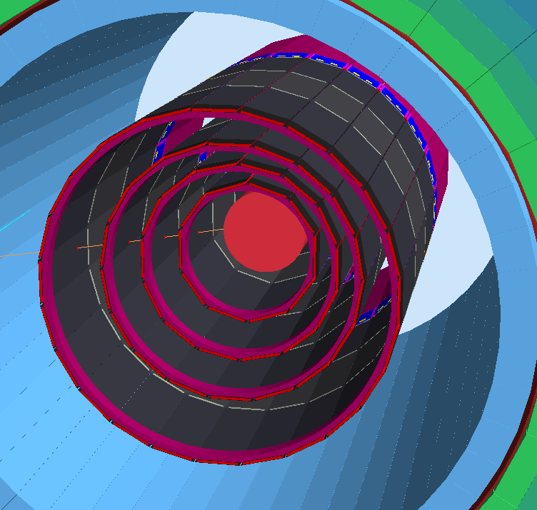
Geometry Implementation in GEMC
Silicon 320
Epoxy 100
Bus Cable 31
Carbon Fiber 200
Rohacell 1250
We have a full, realistic implementation of the SVT and Micromegars in the Geant4
simulation that includes electronic noise, charge sharing and physics background
For CLAS12 configuration. The simulation and reconstruction framework in place,
could be extended to simulate the EIC configuration to calculate rate and radiation
doses.
Notes:
The geometry implements in details the engineering design. This includes the sensors gaps, dead zones, chips and boards, pitch adapter, wire bonding. In particular, in the sensitive region, all layer thicknesses such as:
Also visible here are the remaining central detectors : the CTOF and the CND. And the scattering chambers containing the target

Slide 10
Overview: Rates and Radiation Dose
GEMC Detector Simulation
Includes electro-magnetic and hadronic backgrounds and noise
Rates estimated for LH2, LD2, C, Fe, and Pb targets
For L = 10³⁵ cm⁻²s⁻¹
Rates from carbon target
Threshold E ≈ 40 KeV
Hadronic rate : ~5 MHz
Total rate: ~16 MHz
Strip hit rate (R1, 6.3 KHz), (R2, 4.5 KHz),
(R3, 3.5 KHz), (R4, 2.6 KHz)
Radiation dose for carbon target
50 % operation
15 years duration
~2.5 Mrads

Slide 11
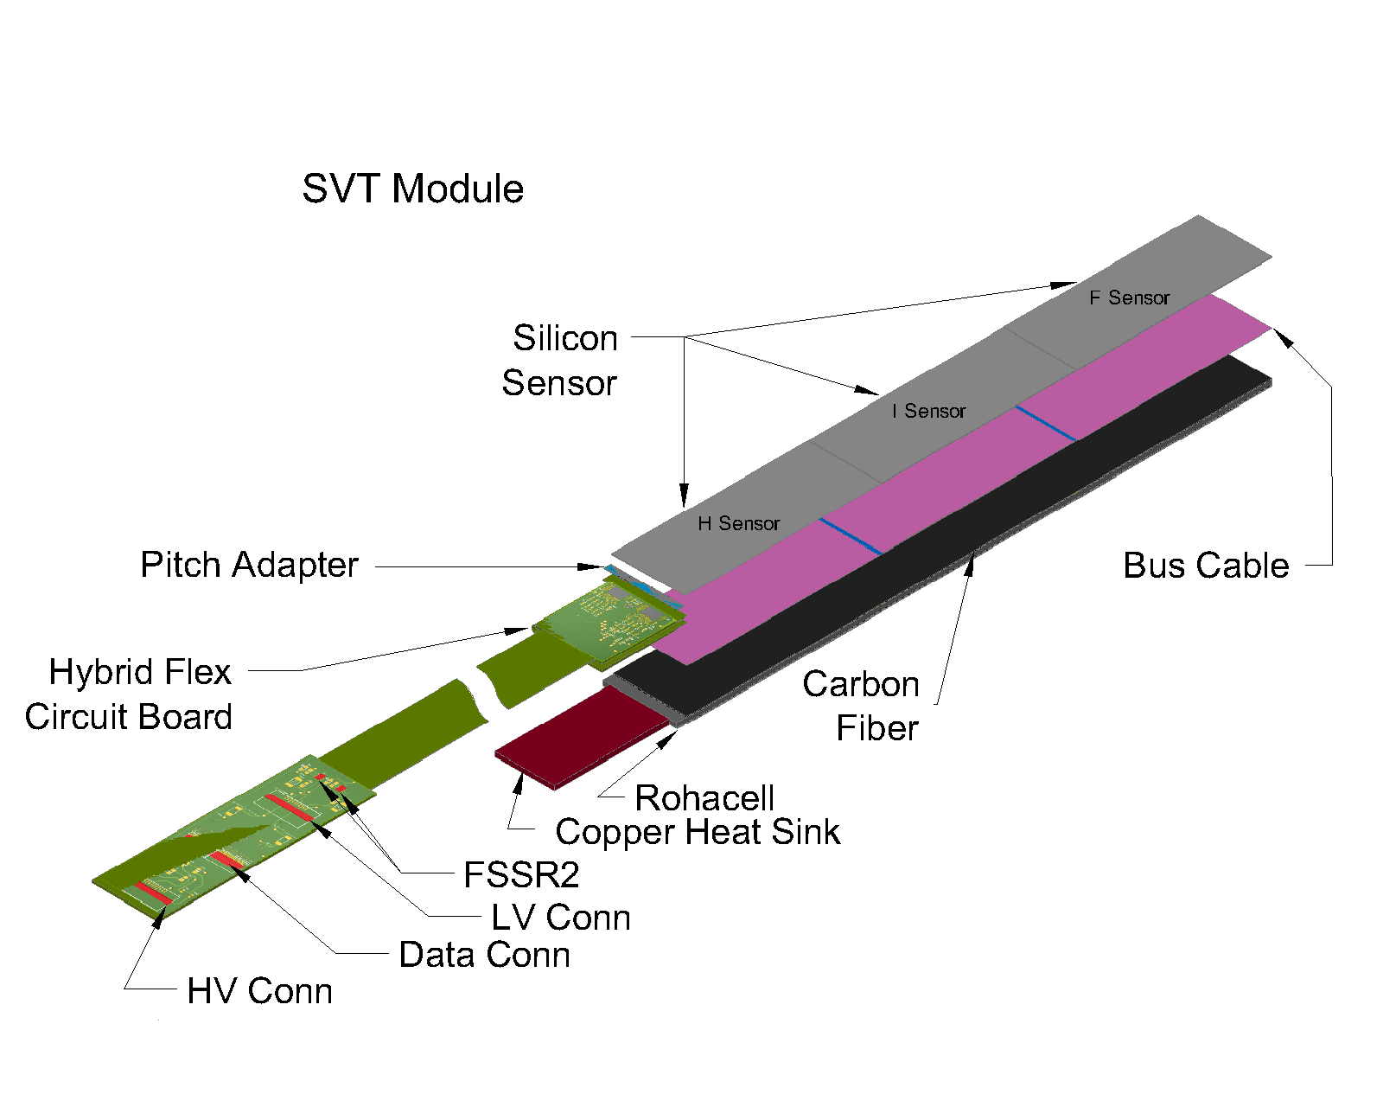
Design Overview: SVT Module
Sensor
All modules have 3 types of sensors
Hybrid, Intermediate, and Far
Sensors cut from 6 inch wafers
2 sensors/wafer
All sensors have the same size
111.625 mm × 42 mm
FSSR2 ASIC
Developed for BTeV
Readout cable
Hybrid Flex Circuit Board
Based on CDF and D0 designs
Backing structure
Composite structure
Rohacell and Carbon Fiber
Based on CDF and D0 designs
Pitch Adapter
156 µm to 50 µm
Metal on glass technology

Slide 12
Sensor Design
Sensors design based on proven and reliable designs used at other labs
Comparison study of sensor designs performed for:
CDF, D0, ATLAS, CMS, GLAST
50+ electrical and mechanical design parameters were reviewed.
Contract with Hamamatsu in place, sensor delivery in
progress will be completed by October 31, 2012.

Slide 13
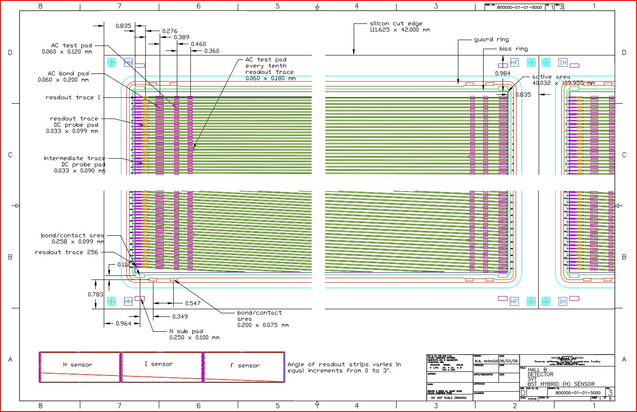
Sensor Design: Hybrid Sensor Layout

Slide 14
Sensor Specifications –Mechanical
Outer size 42.000 mm x 111.625 mm
Active area 40.032 mm x 109.955 mm
Dicing tolerance ± 20 µm
# of readout strips 256
# of intermediate strips 256
Implant strip pitch 78 µm
Readout strip pitch 156 µm
Implant strip width 20 µm
Aluminum strip width 26 µm
Implant width / pitch ratio 0.256
Angle of strips 0°(strip 1) to 3°(strip 256)
Overhang of Al strip 3 µm (on each side)

Slide 15
Sensor Parameters: Summary
Jlab Spec # | Specification Item | Specification Value | Hamamatsu Measured Values |  |  |  |  |  | Comments
 |  |  | Hybrid |  | Intermediate |  | Far
5.8.a | Full depletion voltage | 40<V<100 (25° C@<45% RH) | Serial # 1 | 65 V | Serial # 1 | 70 V | Serial # 1 | 70 V | Meets specification
 |  |  | Serial # 2 | 65 V | Serial # 2 | 65 V | Serial # 2 | 70 V
 |  |  | Serial # 3 | 65 V | Serial # 3 | 65 V | Serial # 3 | 70 V
 |  |  | Serial # 4 | 65 V | Serial # 4 | 70 V | Serial # 4 | 70 V
 |  |  | Serial # 5 | 70 V | Serial # 5 | 70 V | Serial # 5 | 70 V
 |  |  | Serial # 6 | 70 V | Serial # 6 | 70 V | Serial # 6 | 70 V
5.8.b | Total leakage current | ≤10 nA/cm² (at full depletion voltage) | Serial # 1 | 2.2 nA/cm² | Serial # 1 | 2.3 nA/cm² | Serial # 1 | 2.6 nA/cm² | Exceeds specification avg over 18 sensors is a factor of 4.2 better than the spec.
 |  |  | Serial # 2 | 2.1 nA/cm² | Serial # 2 | 2.3 nA/cm² | Serial # 2 | 2.8 nA/cm²
 |  |  | Serial # 3 | 2.8 nA/cm² | Serial # 3 | 2.4 nA/cm² | Serial # 3 | 2.2 nA/cm²
 |  |  | Serial # 4 | 2.4 nA/cm² | Serial # 4 | 2.3 nA/cm² | Serial # 4 | 2.5 nA/cm²
 |  |  | Serial # 5 | 2.1 nA/cm² | Serial # 5 | 2.5 nA/cm² | Serial # 5 | 2.2 nA/cm²
 |  |  | Serial # 6 | 2.2 nA/cm² | Serial # 6 | 2.3 nA/cm² | Serial # 6 | 2.4 nA/cm²
5.8.c | Interstrip capacitance | <1.2 pf/cm | Max | 0.46 pf/cm | Max | 0.50 pf/cm | Max | 0.53 pf/cm | Exceeds specification. avg over 18 sensors is a factor of 2.5 better than the spec.
 |  |  | Min | 0.45 pf/cm | Min | 0.45 pf/cm | Min | 0.52 pf/cm
 |  |  | Avg | 0.46 pf/cm | Avg | 0.48 pf/cm | Avg | 0.52 pf/cm
5.8.f | Resistance of Al electrode on strips | < 20 Ω/cm | Max | 6.89 Ω/cm | Max | 6.82 Ω/cm | Max | 6.94 Ω/cm | Exceeds specification avg over 18 sensors is a factor of 3 better than the spec.
 |  |  | Min | 6.51 Ω/cm | Min | 6.59 Ω/cm | Min | 6.57 Ω/cm
 |  |  | Avg | 6.69 Ω/cm | Avg | 6.72 Ω/cm | Avg | 6.79 Ω/cm
5.8.k | Value of poly-silicon bias resistor | 1.5 MΩ ±0.5 MΩ | Max | 1.43 MΩ | Max | 1.53 MΩ | Max | 1.53 MΩ | Meets specification
 |  |  | Min | 1.37 MΩ | Min | 1.48 MΩ | Min | 1.48 MΩ
 |  |  | Avg | 1.40 MΩ | Avg | 1.50 MΩ | Avg | 1.51 MΩ
5.9.a & 5.9.b | Strip yield | Bad channel rate (avg. over every 100 sensors) ≤1% max # of channels per sensor ≤ 2% | Serial # 1 | 0 % | Serial # 1 | 0 % | Serial # 1 | 0 % | Exceeds specification (actual Yield ~ .025% bad strips)
 |  |  | Serial # 2 | 0.2 % | Serial # 2 | 0 % | Serial # 2 | 0 %
 |  |  | Serial # 3 | 0 % | Serial # 3 | 0 % | Serial # 3 | 0 %
 |  |  | Serial # 4 | 0 % | Serial # 4 | 0 % | Serial # 4 | 0 %
 |  |  | Serial # 5 | 0 % | Serial # 5 | 0 % | Serial # 5 | 0.3 %
 |  |  | Serial # 6 | 0 % | Serial # 6 | 0 % | Serial # 6 | 0 %

Slide 16
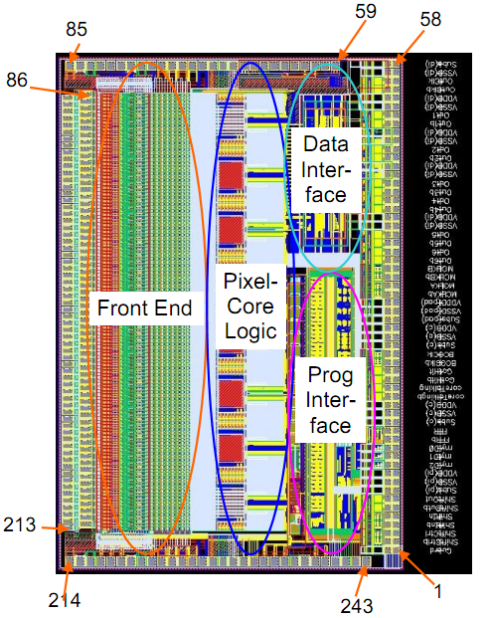
Design Overview: FSSR2
Fermilab Silicon Strip Readout Chip – Rev.2
128 channels / chip, 50 μm input pitch
Data-driven architecture - self-triggered, time-stamped
1 MHz input rate with < 2% missed
Beam Cross Over (BCO) clock: from 128 ns
DAQ synchronized with timestamp clock
Zero-suppressed data readout
1-6 programmable serial outputs (for hit data output)
Double Data Rate (DDR) output
Maximal data output rate 840 Mbits/s
Anticipated data rate ~ 200 Mbits/s
Data readout clock: use 70 MHz
24 bit data format for ‘hit’ channel
12 bit Address
8 bit BCO clock counter
3 bit ADC
1 Sync
Power consumption < 4 mW / channel
Single 2.5 V supply separated on chip
Designed to handle 5 Mrad
Notes:
Expected dose 0.75 Mrad

Slide 17
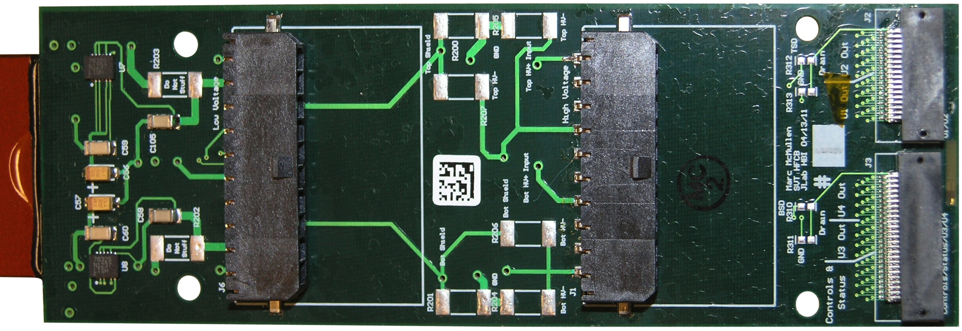
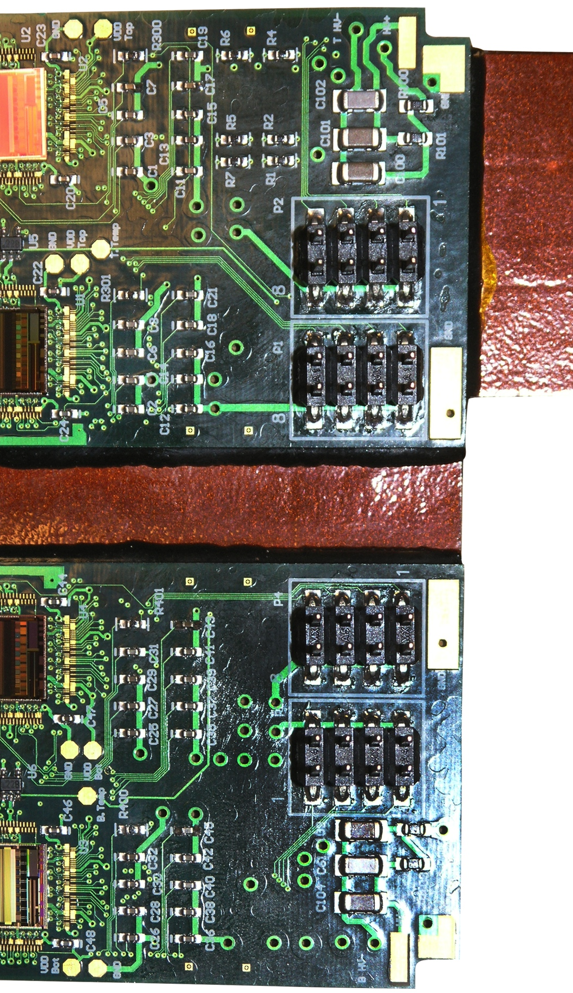
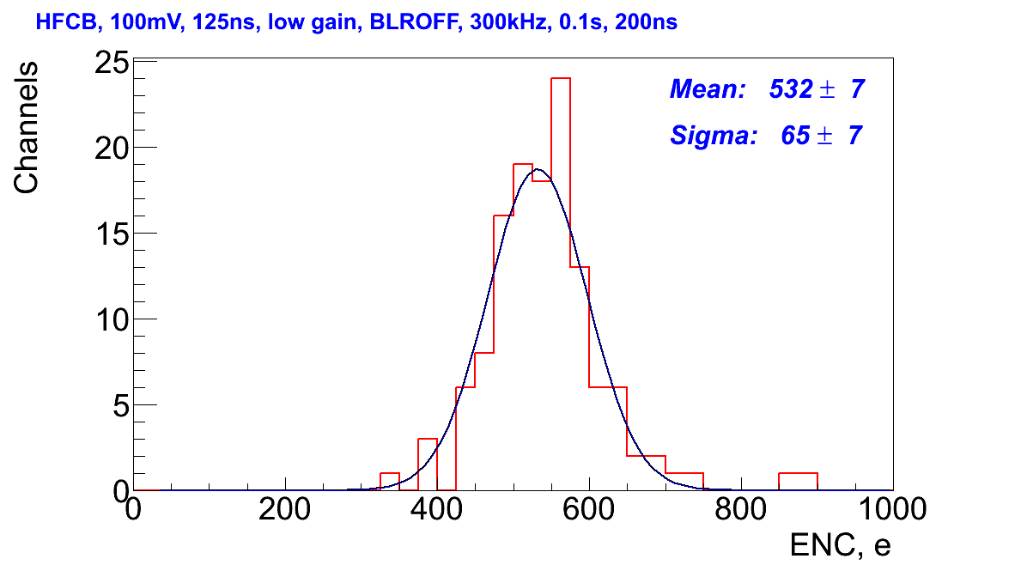
Module Components: HFCB
Hybrid Flex Circuit Board (HFCB)
Data
FSSR2
Power
Power
Data
FSSR2

Slide 18
Proposal
For the EIC silicon tracking system
Build, initially, a 66-cm long module—two standard modules placed end to end—and read out from both ends.
Investigate the mechanical stability of the long module
determine how to maximize the signal-to-noise ratio of the module.
Conduct extensive tests, including a full-scale test with the CLAS SVT and CLAS Micromegas
Understand and optimize the compatibility of these two tracking detectors
Readout all strips including intermediate strip which will require new readout board with 4 ASICs
Perform detail Geant 4 simulation

Slide 19
Collaboration Strategy
Jefferson Lab – JLab
Design module and design of the mechanical support
Development of readout & system integration
DAQ/Software
Procurement of all part
FNAL/MSU/UNH/Jlab
Simulation (background and radiation doses,…)
Production module assembly & test
Production module laser testing
FNAL/JLab
Module Assembly
Wire-bonding
CEA/Saclay
Provide Micromegas Module with readout and testing procedures
Charge particle tracking

Slide 20
Infrastructure
Class 10,000 clean room dedicated for module fabrication,
Associated infrastructure
granite table wire bonder,
test and measurement equipment,
probe station
dark box needed to evaluate the silicon modules and
environmental chamber
dry-storage systems
SVT and Micromegas prototypes

Slide 21
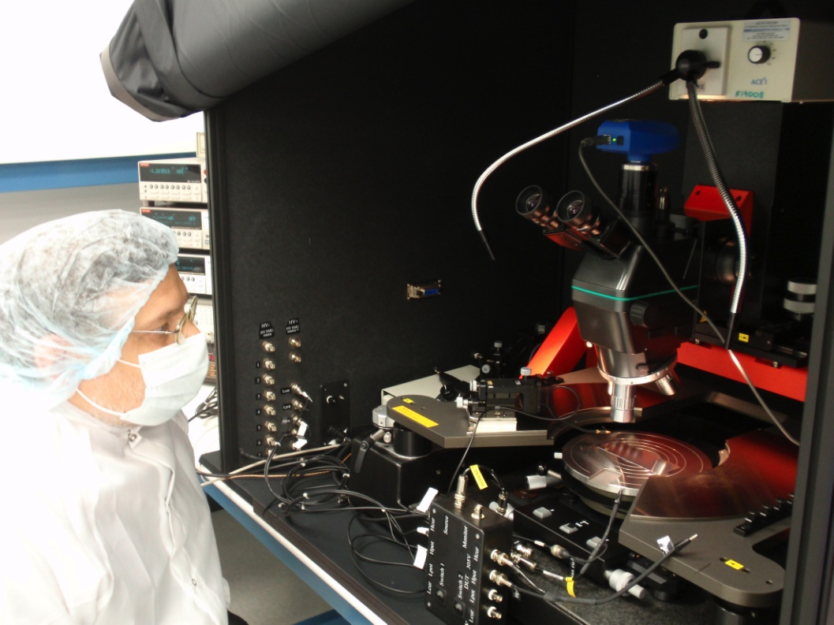
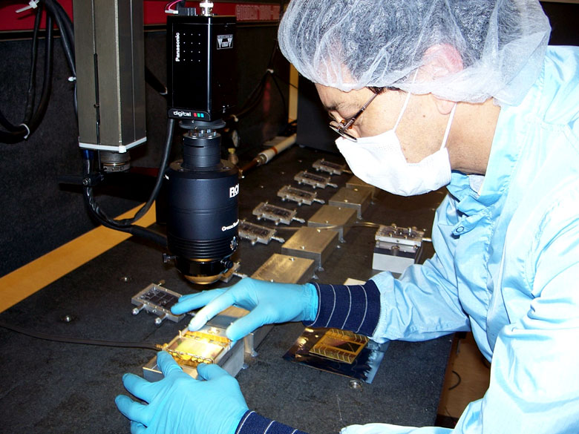
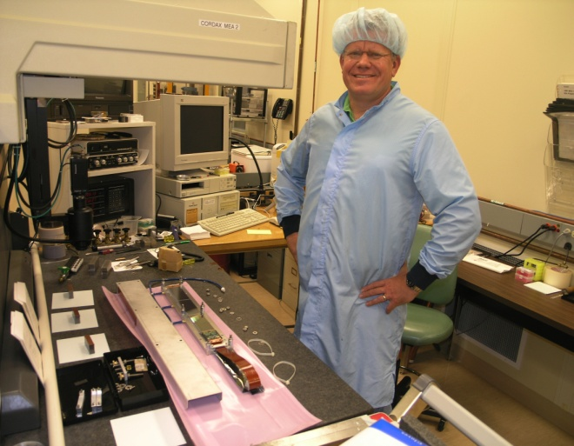
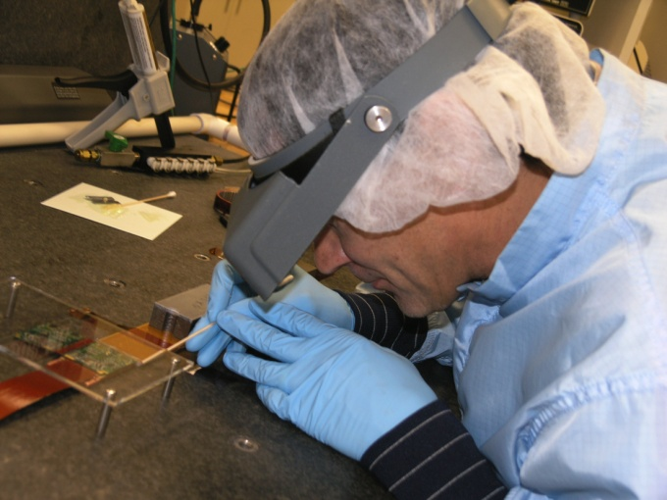
JLab/ FNAL Infrastructure
JLab Infrastructure
FNAL SIDET Facility
Notes:
Left: SUSS probe station
Middle: Picture from probe station showing shorted pitch adapter traces
Top Right: Wire bonder
Bottom Right: Wire bonded MSU sensor to FSSR2 test board

Slide 22
Will be provided by Saclay Group

Slide 23
Funding Profile Request
Year 1 Year 2 Year 3 Total
Labor $50K $50K $50K $150K
Hardware $25K $25K $25K $75K
Travel $8K $7K $7K $22K
Total $83K $82K $82K $247K
Labor includes
mechanical designer and electrical designer
Labor for simulation and testing
Procurement includes
additional sensors (4 of each type)
readout board

Slide 24
Three Year Plan
Year 1
Procure backing structure materials for the silicon module
Build module
Test module performance
Work on optimizing signal-to-noise ratio.
Recruit post-doc
Year 2
Procure components to install the silicon module in close proximity to a curved Micromegas prototype
Start compatibility tests.
Year 3
Complete compatibility tests on the module and the Micromegas prototype
Proceed to full-scale compatibility studies with CLAS SVT and CLAS Micromegas.

Slide 25
Summary
Silicon based tracking system
Appropriate and cost effective
Sensor mask already made, contract with Hamamatsu in place
Contract with FNAL in place for module production
Chips tested and in hand
Backing structure component and cooling system available
Essential R&D
Study long modules ~66 cm
Investigate interaction between Micromegas and SVT
Micromegas will be provided by Saclay
(Approved EIC R&D proposal)
Strong Collaboration
JLAB / MSU / CEASaclay- IRFU / UNH / Fermilab
Extensive experience

Slide 26
^{Thank You}

Slide 27
Sensor Specifications: Electrical
Full depletion voltage 40<V<100 (25° C@<45% RH)
Interstrip capacitance <1.2 pF/cm
Leakage current (@ depletion V) <10 nA/cm²
Strip to back side capacitance < 0.2 pF/cm
Interstrip isolation (@150 V) >1 GΩ
Resistance of Al strips < 20 Ω/cm
Coupling capacitance > 20 pF/cm
Total (strip) capacitance ≤ 1.3 pF/cm; (C_{tot} = 2*C_{int} + C_{back} @ 1 MHz)
Value of poly-silicon bias resistor 1.5 MΩ
Single strip DC current < 2 nA
CLAS-Note 2009-020, Silicon Micro-Strip Sensors for the Hall B CLAS12 SVT

Slide 28
Radiation Dose on Silicon
------------
carbon
Layer 1a Fluences:
------------
particles GeV/s mrad/s rad/year
pi- 229 0.112763 3556
e- 209 0.102942 3246
gamma 5236 2.57438 81185
n 47 0.0232453 733
e+ 58 0.0286764 904
pi+ 365 0.1798 5670
p 9967 4.89975 154518
all 19468 9.57049 301814
301 Krad / year (2 years on the floor)
2.2 Mrad for 15 years on Carbon
Within acceptable limits of 5 Mrad
Lodovico Ratti, Massimo Manghisoni, Valerio Re, Gianluca Traversi, Andrea Candelori
RADECS 2005
Nuclear Instruments and Methods in Physics Research A 466 (2001) 354–358

Slide 29
Radiation Dose on Chip
-----------------------
iron
Layer chip_r1 Fluences:
-----------------------
particles GeV/s mrad/s rad/year
pi- 0 0.0146573 462
e- 8 0.257076 8107
gamma 2 0.0822083 2592
n 0 0.00509819 160
e+ 0 0.0307166 968
pi+ 0 0.0261282 823
p 3 0.0949537 2994
all 20 0.635616 20044
20 Krad / year (2 years on the floor)
0.15 Mrad for 15 years on Iron
Within acceptable limits of 5 Mrad
Lodovico Ratti, Massimo Manghisoni, Valerio Re, Gianluca Traversi, Andrea Candelori
RADECS 2005
Nuclear Instruments and Methods in Physics Research A 466 (2001) 354–358

Slide 30
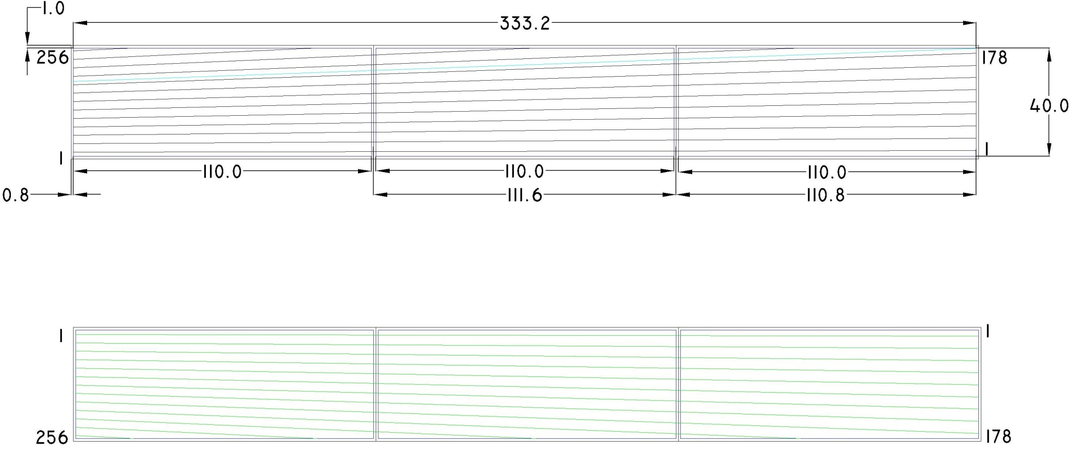
Sensor Design: Layout of Sensors
U Layer
V Layer
Graded pitch design; Stereo angle from 0°- 3°
CLAS-Note 2009-022, Sensor Mask Layout Procedure

Slide 31
Cold Plate
Provides mechanical support to the SVT
Provides cooling for the electronics on the modules
Material : Noryl - 30% Glass Filled
Coolant: Water
Coolant temperature: 15ºC
Flow rate: 3 LPM
(ΔT_{water} ~0.6ºC)
Heat Sink Material : Copper
Sub-atmospheric system is also being considered
Coolant Channel
Copper Insert

