Slide 1
The PHENIX Decadal Plan:
Crafting the Future of RHIC
Christine A. Aidala
Los Alamos National Lab
Winter Workshop on Nuclear Dynamics
Winter Park, CO
February 8, 2011

Slide 2
Why did we build RHIC in the first place?
To study QCD!
An accelerator-based program, but not at the energy (or intensity) frontier. More closely analogous to many areas of condensed matter research—create a system and study its properties!
What systems are we studying?
  “Simple” QCD bound states—the proton is the simplest stable bound state in QCD (and conveniently, nature has already created it for us!)
  Collections of QCD bound states (nuclei, also available out of the box!)
  QCD deconfined! (QGP, some assembly required!)

Slide 3
QCD: Nuclei/Hadrons Partons
Quantum chromodynamics an elegant and by now well-established field theory
  But d.o.f. in QCD are quarks and gluons, never observed in the lab!
How are (colorless) hadrons/nuclei comprised of (colored) partons, but also—what are the ways in which partons can turn into hadrons/nuclei?
  Hadronization via fragmentation, “freeze-out,” recombination (quasiparticles in medium?), . . .?
  Gluons vs. quarks?
  In vacuum vs. cold nuclear matter vs. hot + dense matter?
  Spin-momentum correlations in hadronization?
  …
Understand more complex QCD systems within
the context of simpler ones
RHIC was designed from the start as a single facility capable of A+A, d+A, and p+p collisions
at the same center-of-mass energy

Slide 4
What could RHIC look like in the future?
QCD subfields studied at RHIC are at different points in terms of our present level of understanding, but everything moving in the same direction to (finally!) become more quantitative.
QCD’s a challenge!! (Nobel prize 2004, after 30 years!)
But—our fields are maturing.
One facility that does it all!
e+p, p+p, e+A, p(d)+A, a+a, a+A, A+A
  Extend comparisons/complementarities even further!
Electroweak and colored probes available in both the initial and final states!
Control over parton kinematics—e+A, e+p, fully reconstructed jets/more hermetic detectors
Variety of options for collision geometry (a+A, …)
Controlled experiments in hadronization
Quantitative understanding will develop from having a variety of measurements to compare . . .
Notes:
Starting to drop simplifying assumptions and approximations,
[deeper levels of understanding],. . .
Compare, contrast, provide different handles

Slide 5
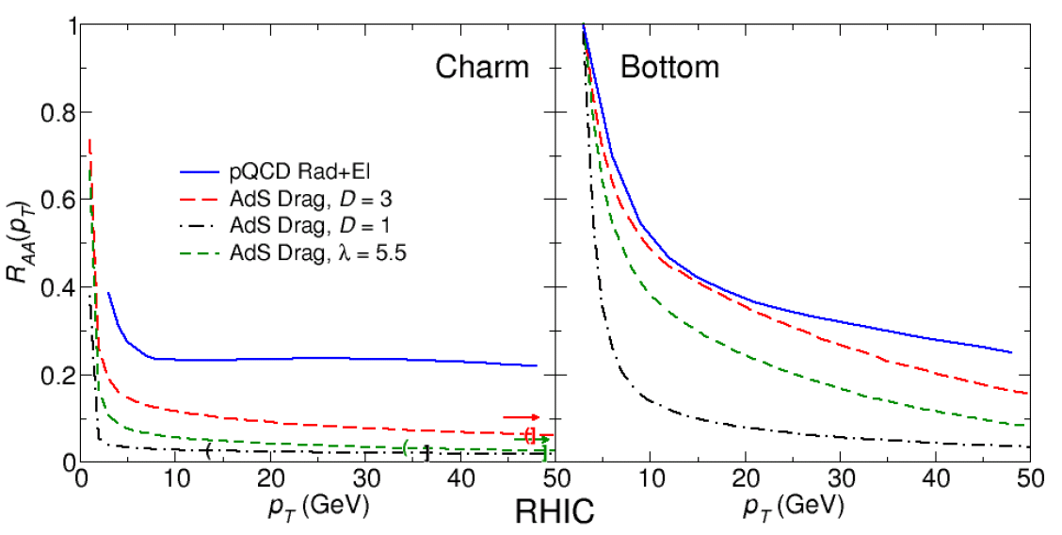
Unanswered and Emerging Questions (HI)
Are quarks strongly coupled to the QGP at all distance scales?
What are the detailed mechanisms for parton-QGP interactions and responses?
Are there quasiparticles at any scale?
Is there a relevant screening length in the QGP?
How is rapid equilibration achieved?
arXiv:0804.4330
J. L. Nagle, PAC presentation, June 2010

Slide 6
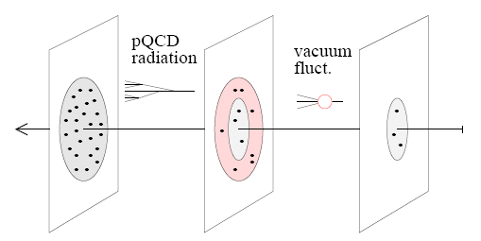
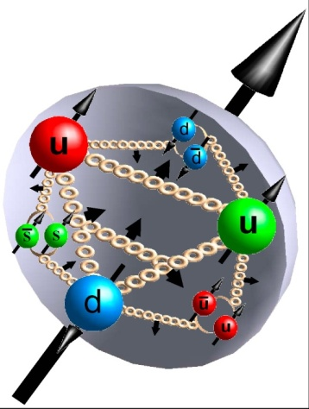
Unanswered and emerging questions in nucleon structure and the formation of hadrons
[Weiss 09]
What is the 3D spatial structure of the nucleon?
What is the nature of the spin of the nucleon (Spin puzzle continues!)
  Does orbital angular momentum contribute?
What spin-momentum correlations exist within hadrons and in the process of hadronization?
What is the role of color interactions in different processes?
radiative gluons/sea
non-pert. sea quarks/gluons
valence quarks/gluons

Slide 7
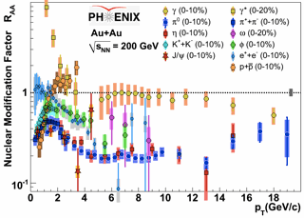
e+A vs. A+A:
Calibration using different probes
Already a technique extensively taken advantage of in heavy ion physics!
  Probes that don’t interact strongly: direct photons, internal conversions of thermal photons, Z bosons
  Light mesons (light quarks—strongly interacting, various potential means of in-medium energy loss)
  Heavy flavor (strongly interacting but less affected by radiative energy loss)
e+A probes the initial state without the complications of strong interactions

Slide 8
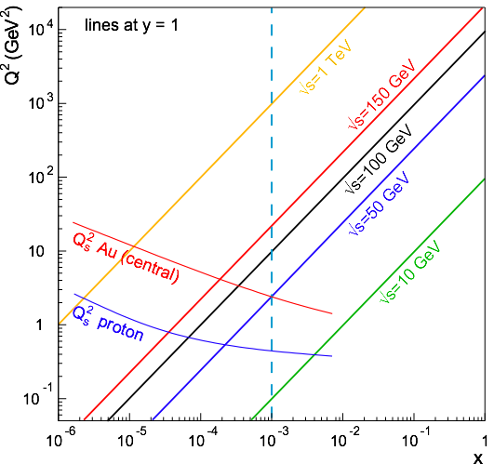
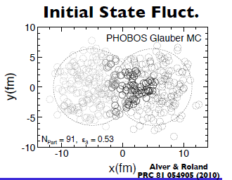
How can the RHIC A+A program be strengthened by adding electron beam capabilities?
Some thoughts—(not an exhaustive list!)
Saturation/CGC/Glasma—can piece together a clear picture from e+A, p(d)+A, and A+A!
What’s the role of the initial state in the rapid thermalization observed at RHIC?
Can we pin down and quantify the role of initial-state fluctuations in the observed final-state correlations?
….

Slide 9
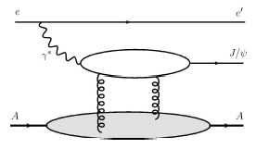
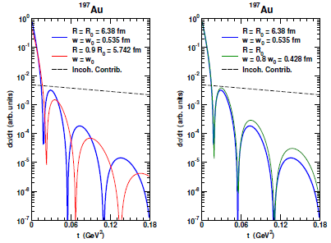

Impact-parameter-dependent nuclear gluon density via coherent vector meson production in e+A
Assume Woods-Saxon gluon density
Coherent diffraction pattern extremely sensitive to details of gluon density!

Slide 10
Continued p+p collisions at RHIC just for HI comparison once we have e+p?
If major new investment in RHIC as a facility is tied to adding an electron ring, aren’t e+p collisions better for studying nucleon structure anyway??
While electrons offer several advantages (interactions easy to calculate, reconstruct kinematics exactly), you can’t learn everything about the proton by probing it with an electron!!
  (Recall the ‘C’ in ‘QCD’ . . .)

Slide 11
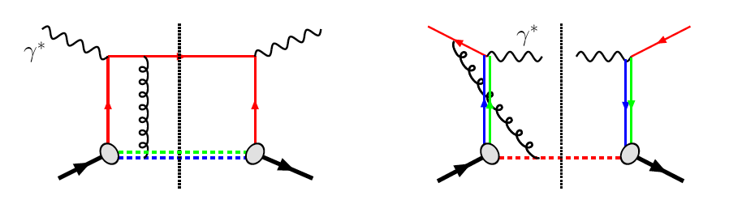
Modified universality of T-odd k_{T}-unintegrated distributions:
Color in action!
DIS: attractive FSI
Drell-Yan: repulsive ISI
Some measurements in semi-inclusive DIS already exist. A Drell-Yan measurement at RHIC will be a crucial test of our understanding of QCD!
Being able to make detailed measurements in both DIS and p+p at the same facility even more powerful!
As a result:

Slide 12
Factorization, color, and hadronic collisions
  Last year, theoretical work (PRD 81:094006, 2010) claimed pQCD factorization broken in processes involving hadro-production of hadrons if parton k_{T} taken into account (pdfs and/or FFs)
  “Color entanglement”
  To understand further, useful to be able to compare measurements with 2, 3, and 4 hadrons in different combinations of initial and final state
    Semi-inclusive DIS, Drell-Yan, p+p → photon-hadron and hadron-hadron correlations, . . . RHIC could study all of these in detail!
Non-collinear pQCD an exciting sub-field—lots of recent experimental activity, and theoretical questions probing deep issues of both universality and factorization in (perturbative) QCD!

Slide 13
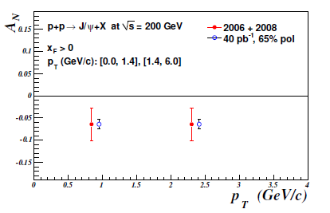
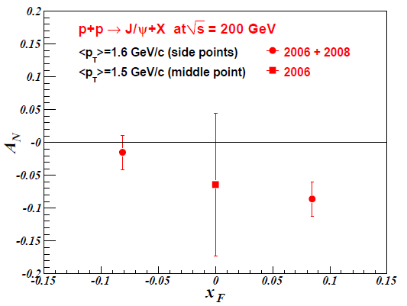
J/Psi transverse single-spin asymmetry and the J/Psi production mechanism:
Unanticipated synergy between programs!
Other consequences of non-universality of these non-collinear distributions being discovered!
  PRD 78, 014024 (2008)—Prediction that J/Psi transverse single-spin asymmetry sensitive to J/Psi production mechanism, with different expectations for p+p vs. semi-inclusive DIS
PHENIX recently published p+p results: 3.3σ negative asymmetry
If confirmed in next few years, provides evidence against large contributions from color-octet diagrams!
Future measurements in e+p at RHIC would allow direct comparison of DIS and p+p results, providing further information not only on gluon dynamics but on J/Psi production mechanism!
PRD, 82, 112008 (2010)
J/Psi projections for 40 pb⁻¹, 65% pol, expected by 2015 with current detector. Open heavy flavor also quite interesting—silicon upgrades will help!

Slide 14
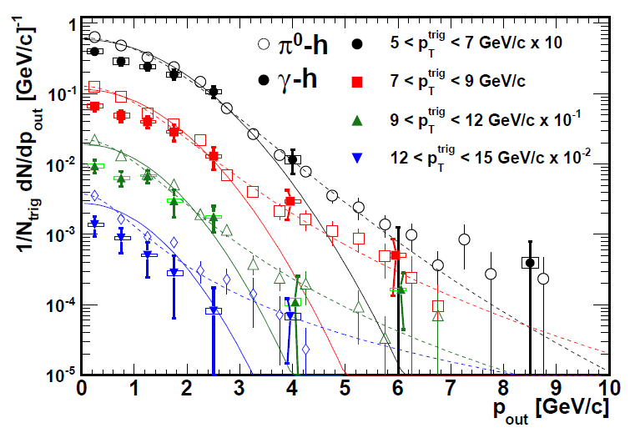
Testing factorization breaking with p+p comparison measurements for HI physics:
Unanticipated synergy between programs!
Will test using photon-hadron and dihadron correlation measurements in unpolarized p+p collisions—lots of expertise on such measurements within PHENIX, driven by heavy ion program!
Calculate p_{out} distributions assuming factorization works
Will show different shape than data??
Difference between factorized calculation and data will vary for 3-hadron vs. 4-hadron processes??
PHENIX, PRD82, 072001 (2010)
(Curves shown here just empirical parameterizations from PHENIX paper)
First step toward calculations just came out!
arXiv:11015057 [hep-ph]

Slide 15
Is quantitative QCD for real??
Theory already forging ahead!
pQCD calculations down to much lower energies (resummation, . . .)
Moving beyond collinear approximation in pQCD
Moving beyond simplest picture of pQCD factorization (ISI, FSI, twist-three)
Rethinking universality of non-perturbative functions in pQCD
Starting to think about explicit role of color interactions in p+p collisions
3D spatial imaging of protons and nuclei via Generalized Parton Distributions
Non-linear evolution at low x in pQCD (JIMWLK, . . .)
Lattice progress in hadron structure and high-temperature QCD
Starting to investigate control on theoretical uncertainties in different formalisms for heavy ion calculations
MC modeling in heavy ion physics has begun
AdS/CFT
Let’s keep the data coming!

Slide 16
Heavy ions at the LHC: Helping us push forward into a more quantitative era for A+A!
A+A collisions at RHIC and LHC look “similar” in the broad strokes painted so far—what differences will eventually be observed?
  How to understand them quantitatively? (And if they’re “exactly” the same, need to understand that quantitatively as well!)
  Quark vs. gluon jets?
  …

Slide 17
How do we approach designing a detector (or detectors) to do all the physics we’d like to?

Slide 18
Questions
Observables
Needs
Quarks strongly coupled
Interaction mechanisms
Jets, Dijets,
γ-Jet (FF, radiation)
Charm/Beauty Jets
Quasiparticles in medium
Identify physics questions
→Define observables
→Determine detector needs
…Still lots of work ahead of us!
J/ψ at multiple energies
Screening Length
Upsilons (all states)
Thermal Behavior
Thermalization time
Direct γ* flow
Large Acceptance
High Rate
Electron ID
Photon ID
Excellent Jet Capabilities (HCAL)

Slide 19
Some thoughts on future detectors
Multipurpose, flexible—ready to address new questions as they arise!
Uniform, compact
Two multipurpose detectors? One optimized for hadronic/nuclear collisions with secondary capabilities in e+A, e+p; other vice versa? (Challenging to optimize for both!)
Staged implementations?
Renewed collaborations!
  Major new program should attract new collaborators!

Slide 20
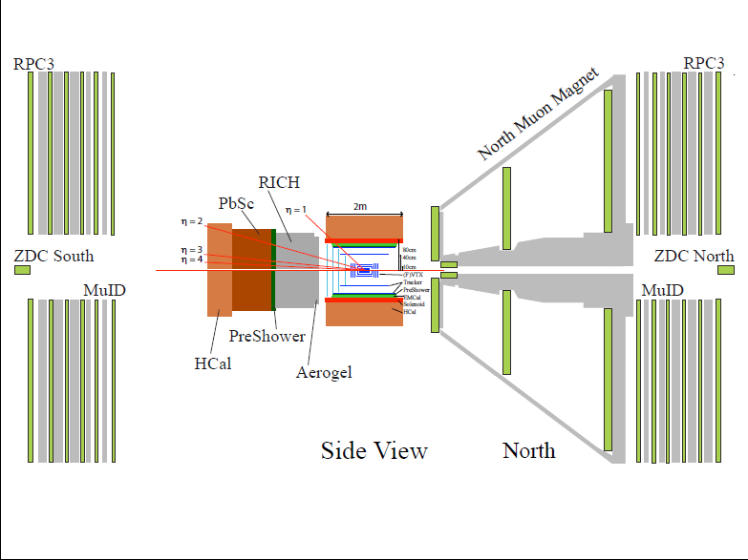
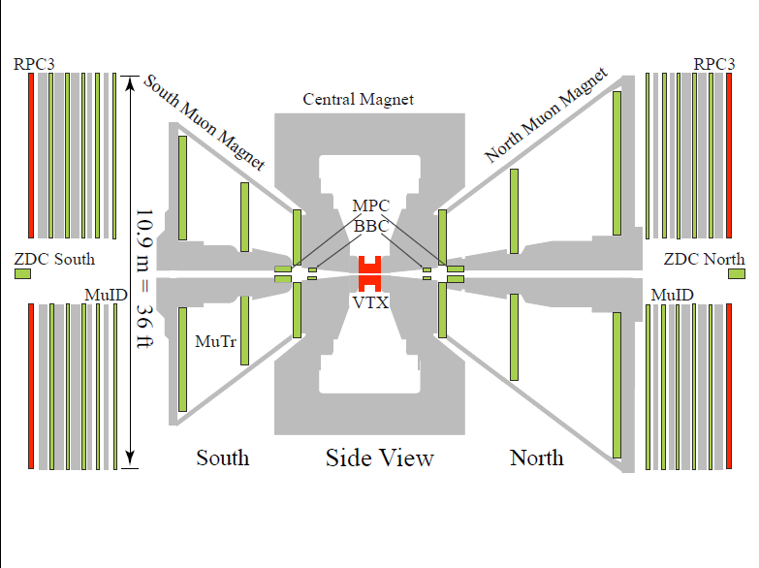

Slide 21
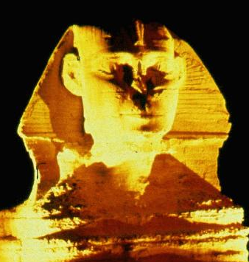
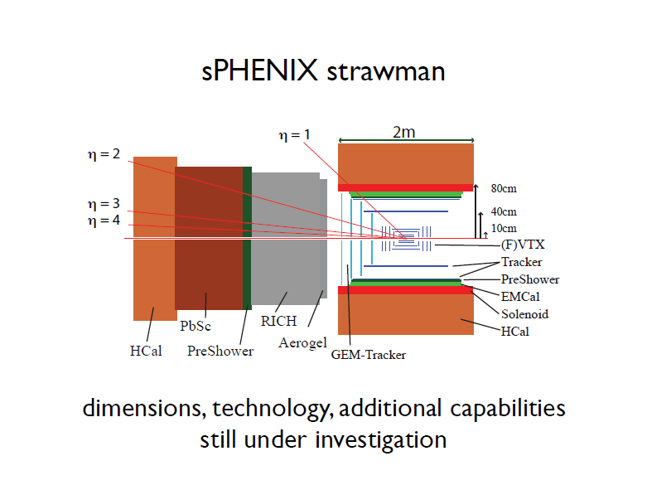
SPHNX??

Slide 22
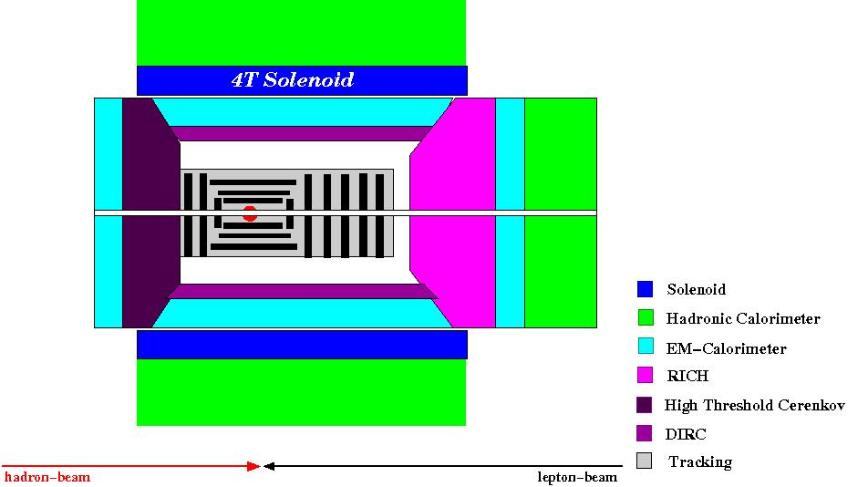
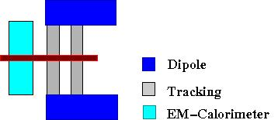
Forward spectrometer as conceived for hadronic/nuclear collisions similar to that in e+p/e+A-optimized concept
Forward / Backward
Spectrometers:
high acceptance -5 < η < 5 central detector
good PID and vertex resolution
tracking and calorimeter coverage the same → good momentum resolution
low material density → minimal multiple scattering and bremsstrahlung
forward electron and proton dipole spectrometers

Slide 23
Long-term accelerator prospects
Could go up to energies as high as sqrt(s)=650 GeV for p+p, 260 GeV for Au+Au with new DX magnets
  Should know much more about prospects for polarization with higher beam energies by the end of current 500 GeV run
  W cross section ~2x higher
Polarized He³ beams?
  R&D for polarized He³ source starting now

Slide 24
Recent progress and next steps
PHENIX handed in written document on future planning to BNL Management at end of September (nearly 300 pages!!)
GEANT4 studies initiated last year and ongoing
Initial detector R&D workshops December 14-16, 2010 at BNL
Modest detector R&D funding available this year—proposals due February 22
Need to hone in further on best suites of observables to carry out the physics program we’re interested in, and corresponding detailed detector requirements!

Slide 25
So, is this really a decadal plan we’ve been talking about??
Not really. We’re talking about how we could, by 2020, be starting to embark on a new longer-term program at RHIC, with both electron-hadron and hadron-hadron collisions available to us, and with major new detection capabilities designed to allow us to pursue a comprehensive QCD program!

Slide 26
Summary and outlook
The next stage of all of QCD physics is to move toward much more quantitative measurements and calculations—RHIC an excellent facility to drive this!
  Comfortable energy regime for the quarks and gluons of QCD to be the relevant d.o.f.
  Unprecedented control of numerous variables over a wide range—energy, geometry, probe, parton kinematics, polarization, . . .
Strategy: Develop and propose an integrated, comprehensive physics program for the future of the facility taking full advantage of both electroweak and hadronic/nuclear collisions!
The challenge of QCD continues!
RHIC could become an even more powerful tool to fulfill advancement to a quantitative era in QCD by the 2020s!

Slide 27
Extra

Slide 28
What would we as the present RHIC community like to see our facility become ten years from now?

Slide 29
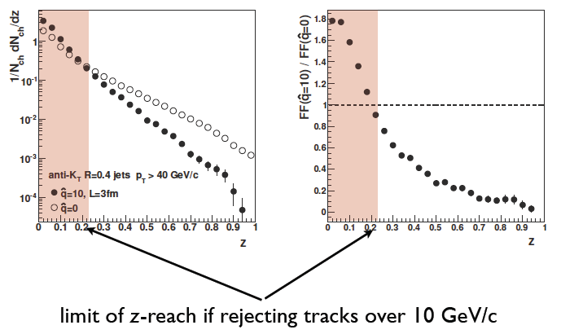
Modification of fragmentation functions
Possible with hadronic calorimetry and comparison of multiple colliding systems!

Slide 30
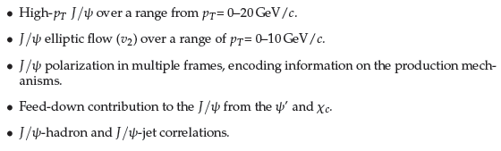
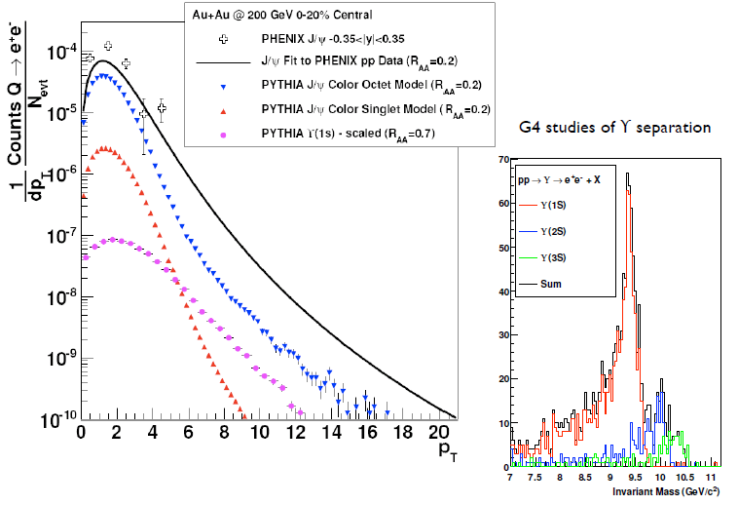
Prospects for quarkonia in A+A

Slide 31
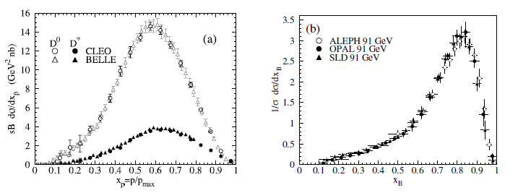
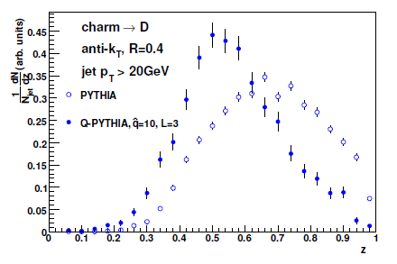
Heavy flavor fragmentation functions
As measured in e+e- collisions
D
B
Simulated for p+p (PYTHIA), A+A (Q-PYTHIA)

Slide 32
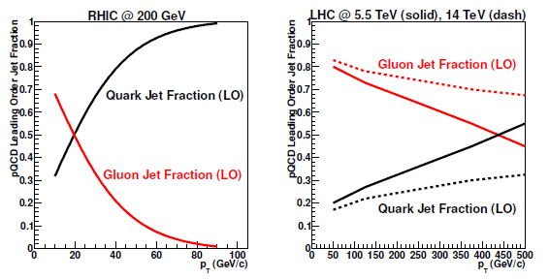
Quark vs. gluon jets at RHIC and LHC

Slide 33
Is there more after 2015?
Not easy to predict the future, but we
expect that the following will be in hand:
Heavy Ions:
1. Full characterization of bulk medium dynamics (e.g. η/s, ζ, T, ε)
2. Completion of Low Energy scan for critical point
3. Experimental measure of charm/beauty dynamics p_{T} ~ 6 GeV
4. Parton energy loss (jets) start on program
Spin:
1. W→lepton measurements to constrain Δu, Δubar, Δd, Δdbar
2. Completion of gluon Δg via π⁰, η, h^{+/-} A_{LL} @ 200 and 500 GeV
3. A_{N} measurements for hadrons

Slide 34
Jet Flow Chart
Jet R_{AA}
Jet Fragment
dN/dz dk_{T}²
Jet Fragment
dN/dR, Ψ(R)
Centrality,
φ dependence
Di-jet,
γ-jet
Light vs c vs b
+ energy loss calculations & MC
pQCD-like parton
showers or not?
Radiative vs collisional
Transport parameter(s)
Mass dependence
L dependence
+ theory
Medium properties:
thermal masses, screening scales, …
Weak vs strong coupling
(jets to medium)
2➛2, 2➛3 dominant?
(weak +
quasi-particles?)
Less speculative/ambitious
More speculative/ambitious

Slide 35
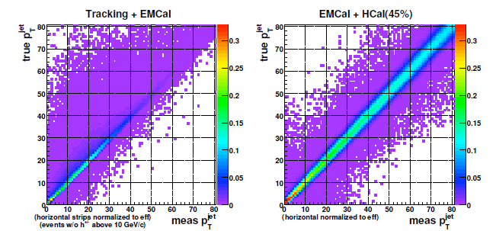
Hadronic calorimetry tightens relation between measured and true jet energy
GEANT4 simulation

Slide 36
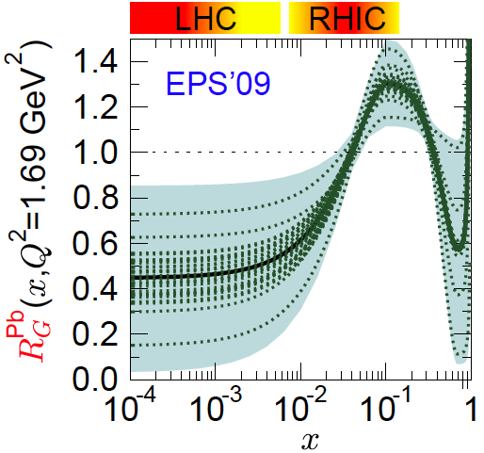
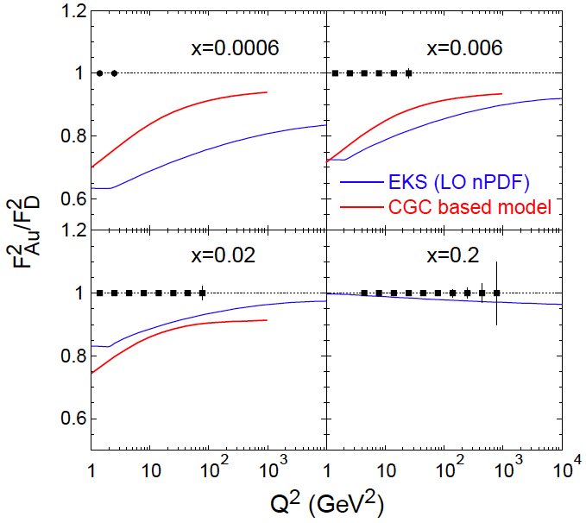
F₂: for Nuclei
shadowing
LHC η=0
RHIC η=3
Assumptions:
10GeV x 100GeV/n
  √s=63GeV
Ldt = 4/A fb⁻¹
  equiv to 3.8 10³³ cm⁻²s⁻¹
  T=2weeks; DC:50%
Detector: 100% efficient
  Q² up to kin. limit sx
Statistical errors only
  Note: L~1/A
“sweet” spot
R=1
antishadowing

Slide 37
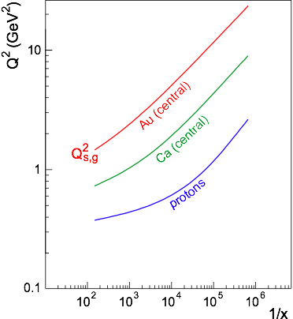
Reaching the saturation regime
Saturation:
Au: Strong hints from RHIC at x ~ 10⁻³
p: Weak hints at Hera up to x=6.32⋅10⁻⁵, Q² = 1-5 GeV²
Nuclear Enhancement:
Hera
Coverage:
  Need lever arm in Q² at fixed x to constrain models
  Need Q > Qs to study onset of saturation
ep: even 1 TeV is on the low side
eA: √s = 50 GeV is marginal,
around √s = 100 GeV desirable
→ 20 GeV x 100 GeV
Kowalski, Lappi and Venugopalan, PRL 100, 022303 (2008));
Armesto et al., PRL 94:022002;
Kowalski, Teaney, PRD 68:114005)

Slide 38
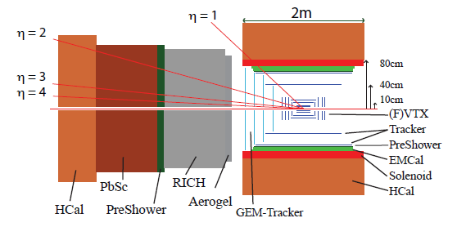
Improved forward detection capabilities
Many of the striking effects related to parton dynamics in the proton have been observed at forward rapidities→ Large-acceptance forward spectrometer
Full jet reconstruction capabilities → allow separation of effects
PID → Study surprising species dependences (e.g. kaons, antiprotons)
Tracking and EMCal → Drell-Yan measurements
Design single detector for hadronic collisions and DIS? Optimal strategy to get the most physics out of the facility still to be worked out.

Slide 39
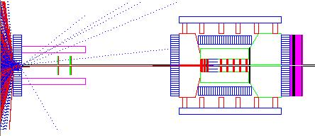
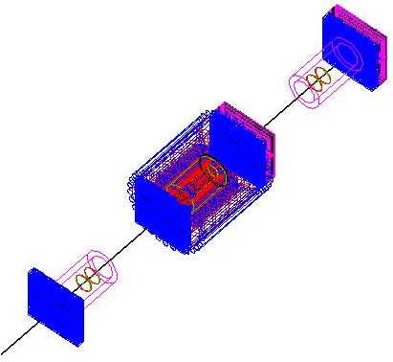
First Model of eRHIC Detector
Si-Vertex
as Zeus
Central Tracker
as BaBar
Traditional
Drift-Chambers
better GEM-Tracker
Hadronic
Calorimeter
Dual-Radiator
RICH
as LHCb /
HERMES
EM-Calorimeter
PbGl
High Threshold
Cerenkov
fast trigger on e’
e/h separation
DIRC: not shown because of cut;
modeled following Babar
no hadronic calorimeter and μ-ID jet
  CALIC technology combines μID with HCAL

Slide 40

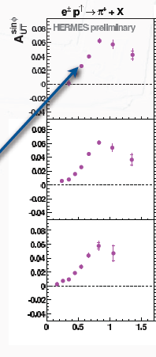
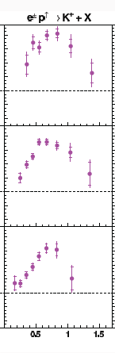
Comparing to DIS: p_{T} dependence of HERMES inclusive(!) hadron data
Inclusive p+p data intriguing enough for a DIS experiment to attempt a similar measurement by giving up measuring their precious scattered electron!!
In this case, clear rise from low p_{T} and turn-over at ~0.8 GeV/c, for both pions and kaons.
Relationship between DIS and p+p measurements not yet understood! Can inclusive hadron measurements in DIS help us to understand the p+p??
π⁺
Κ⁺
0.2 < x_{F} < 1
0.2 < x_{F} < 1
0.08 < x_{F} < 0.2
0.08 < x_{F} < 0.2
-0.1 < x_{F} < 0.08
-0.1 < x_{F} < 0.08
p_{T} (GeV/c)

Slide 41
So . . .Why use hadronic collisions to study QCD in hadrons?
Unique handles on antiquarks – Drell-Yan, W production
Unique handles on gluons
Different color interactions compared to DIS!!
  Going beyond collinear, leading-twist pdfs has been probing deep issues of universality, factorization, and color interactions in (perturbative) QCD
And hadronic collisions will be increasingly tractable through upcoming years
  As more is learned from the simpler systems of DIS and e+e-
  As the limits of applicability of pQCD are pushed ever further
If you can’t understand p+p collisions, your work isn’t done yet in understanding QCD in hadrons!

Slide 42
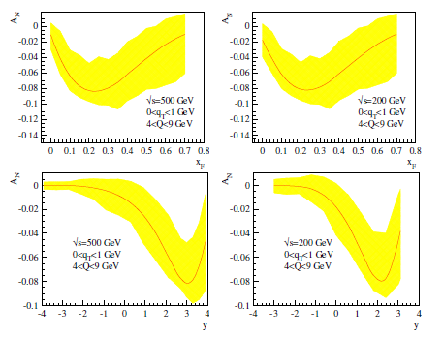
Drell-Yan transverse SSA predictions
x_{F}
x_{F}
y
y

Slide 43
Collinear factorization in pQCD:
Long history, relatively well tested
Origins ~30 years ago
Wealth of data on linear momentum structure of the nucleon that can be described in terms of twist-2, collinear pdf’s
  Less experimental data for the polarized case, but (most) theoretical concepts for the polarized twist-2, collinear distributions shared the same origin as in the unpolarized case
Realm in which the ΔG and W helicity programs at RHIC exist
Everything described as a function of linear momentum fraction
If want to access QCD dynamics, need to go beyond the twist-2, collinearly factorized picture.
Dynamics ↔ (transverse) SSA’s ~ S•(p₁×p₂)

Slide 44
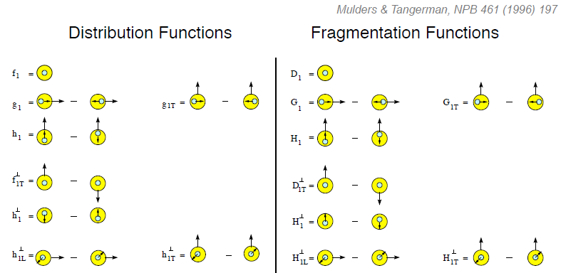
Twist-two pdf’s and FF’s, including TMD’s
Transversity
Measured non-zero
Sivers
Polarizing FF
Boer-Mulders
Pretzelosity
Collins
N.B. Also experimental evidence for non-zero collinear “interference” or “di-hadron” FF.
Only single-hadron FF’s shown here.

Slide 45
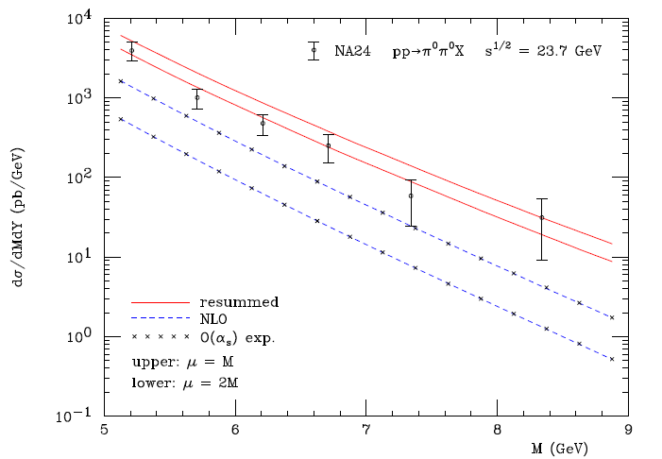
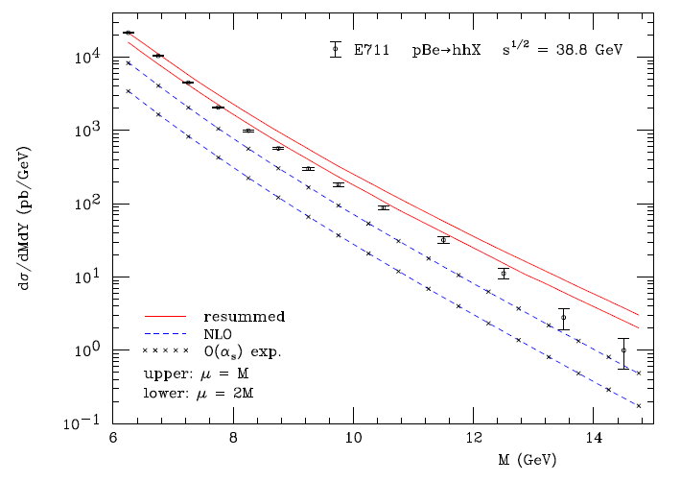
Other progress in pQCD calculational techniques
“Modern-day ‘testing’ of (perturbative) QCD is as much about pushing the boundaries of its applicability as about the verification that QCD is the correct theory of hadronic physics.”
– G. Salam, hep-ph/0207147 (DIS2002 proceedings)
One recent example:
Almeida, Sterman, Vogelsang PRD80, 074016 (2009)
Cross section for dihadron production vs. invariant mass at sqrt(s)~20-40 GeV using threshold resummation (rigorous method for implementing p_{T} and rapidity cuts on hadrons to match experiment)

Slide 46
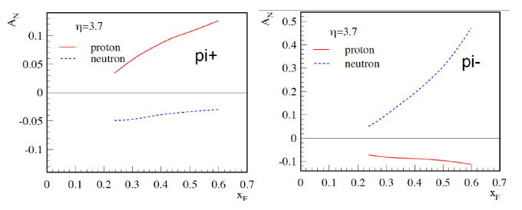
Example:
Flavor separation of TMDs using He³
Zhongbo
Kang
With polarized He³ as well as proton beams at RHIC, new handles on flavor separation of various transverse spin observables possible
  What will the status of the (non-)valence quark puzzle be by then??

Slide 47
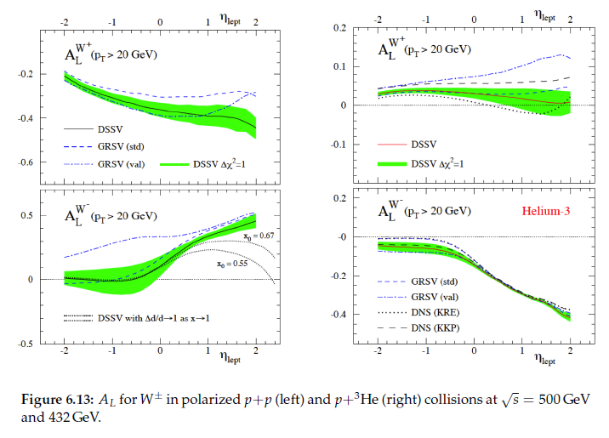
Full flavor separation of light quark helicity distributions with p+p and p+He³

