Slide 1
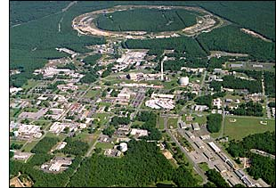
Investigating Proton Structure at the
Relativistic Heavy Ion Collider
Christine Aidala
University of Michigan
Wayne State University
January 30, 2013
Notes:
I feel that the overarching question that those of us working on the proton structure program at RHIC would like to contribute to answering is . . .

Slide 2
How do we understand the visible matter in our universe in terms of the fundamental quarks and gluons of quantum chromodynamics?
Notes:
An essential tool of the trade if this is a question you’re interested in tackling is . . .

Slide 3
The proton as a QCD “laboratory”
Proton—simplest stable bound state in QCD!
?...
observation & models
fundamental theory
precision measurements
& more powerful theoretical tools
application?

Slide 4
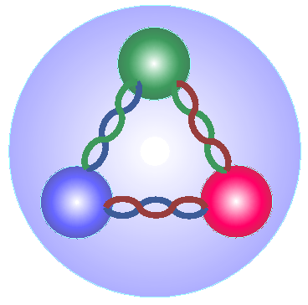
Nucleon structure: The early years
1932: Estermann and Stern measure proton anomalous magnetic moment → proton not a pointlike particle!
1960s: Quark structure of the nucleon
  SLAC inelastic electron-nucleon scattering experiments by Friedman, Kendall, Taylor → Nobel Prize
  Theoretical development by Gell-Mann → Nobel Prize
1970s: Formulation of QCD . . .

Slide 5
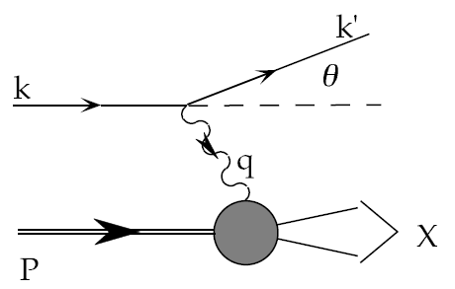
Deep-Inelastic Scattering:
A Tool of the Trade
Probe nucleon with an electron or muon beam
Interacts electromagnetically with (charged) quarks and antiquarks
“Clean” process theoretically—quantum electrodynamics well understood and easy to calculate
Technique that originally discovered the parton structure of the nucleon in the 1960’s!

Slide 6
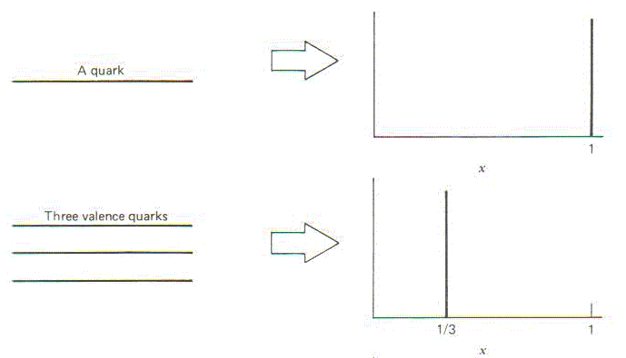
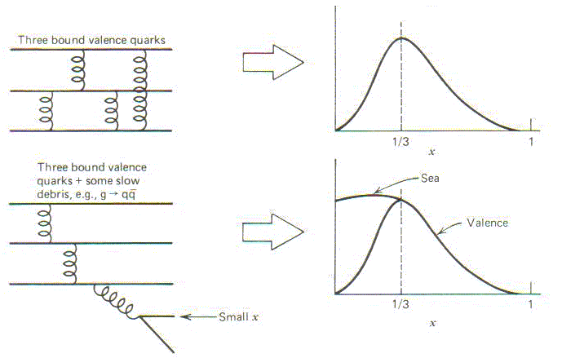
Parton distribution functions inside a nucleon:
The language we’ve developed (so far!)
What momentum fraction would the scattering particle carry
if the proton were made of …
3 bound valence quarks
A point particle
x_{Bjorken}
1
1/3
1
3 bound valence quarks + some
low-momentum sea quarks
x_{Bjorken}
Sea
3 valence quarks
Valence
Small x
1/3
1
x_{Bjorken}
1/3
x_{Bjorken}
1
Halzen and Martin, “Quarks and Leptons”, p. 201

Slide 7
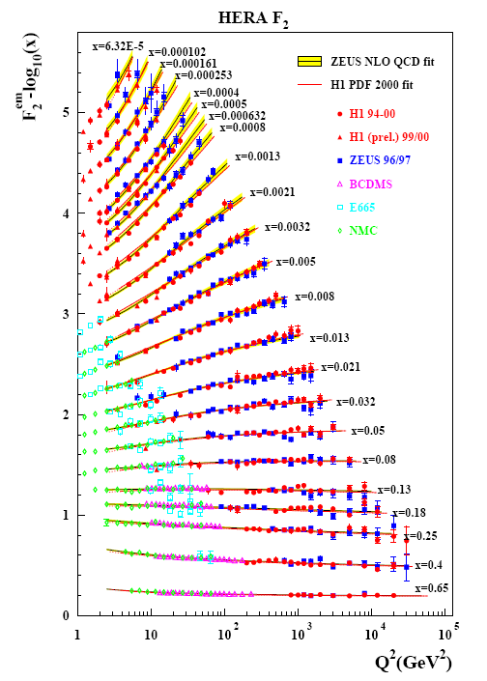
Decades of DIS Data: What Have We Learned?
Wealth of data largely from HERA e+p collider
Rich structure at low x
Half proton’s linear momentum carried by gluons!
PRD67, 012007 (2003)
Notes:
There are a number of useful ways to look at and describe nucleon structure. For example in addition to the structure functions such as F2 shown here, which, if you will, lets you “see” the asymptotic freedom of QCD, you can also describe the proton in terms of parton distribution functions, . . . In any case, we’ve learned quite a lot from decades of DIS data on the linear momentum structure of the proton, but even in the age of HERA, . . .

Slide 8
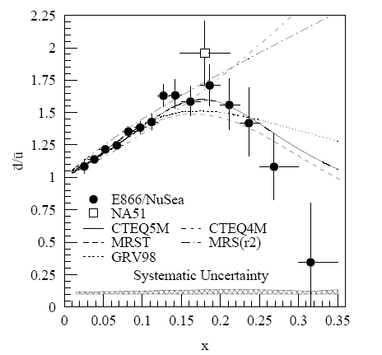
And a (Relatively) Recent Surprise From p+p, p+d Collisions
Fermilab Experiment 866 used proton-hydrogen and proton-deuterium collisions to probe nucleon structure via the Drell-Yan process
Anti-up/anti-down asymmetry in the quark sea, with an unexpected x behavior!
Hadronic collisions play a complementary role to DIS and have let us continue to find surprises in the rich linear momentum structure of the proton, even after 40 years!
PRD64, 052002 (2001)

Slide 9
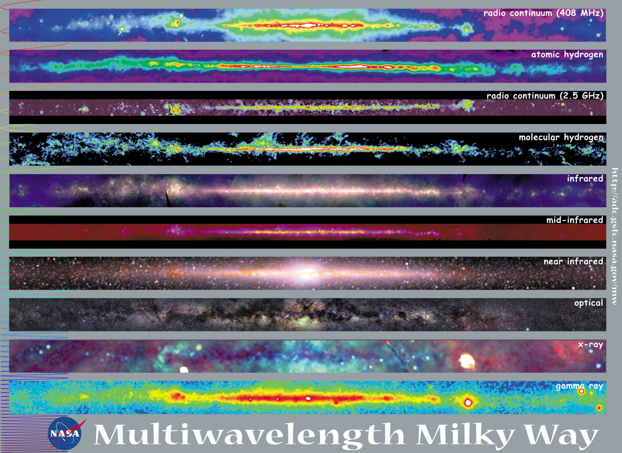
Observations with different probes allow us to learn different things!

Slide 10
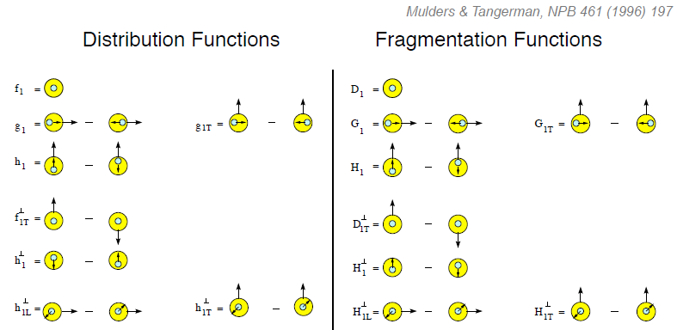
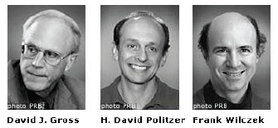
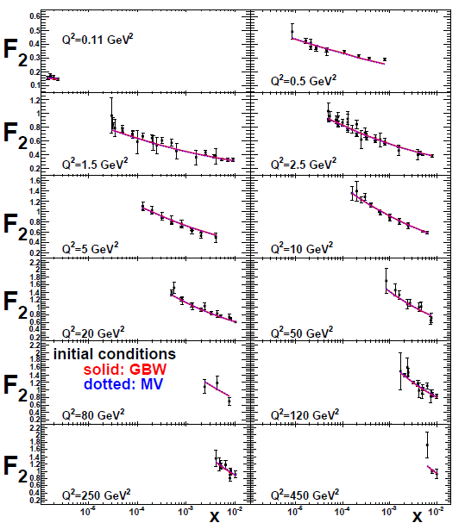
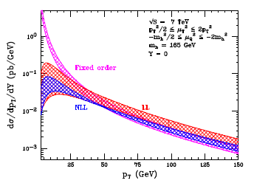
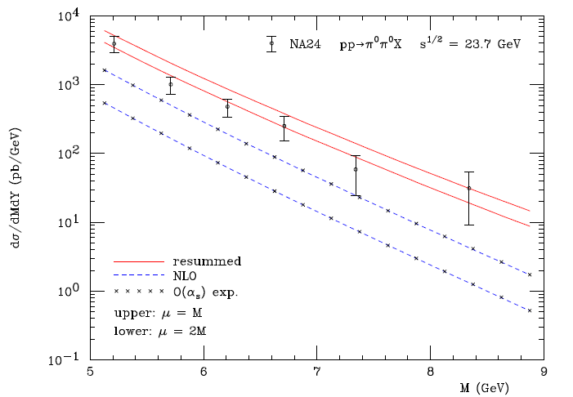
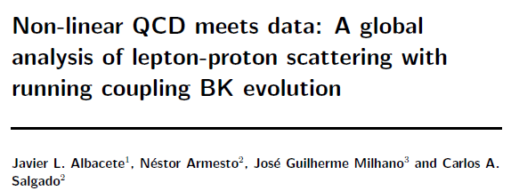
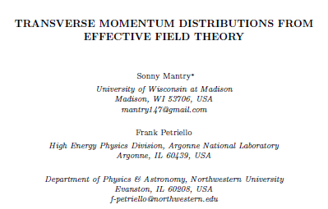
The nascent era of quantitative QCD!
Transverse-Momentum-Dependent
QCD: Discovery and development
  1973 → ~2004
Since 1990s starting to consider detailed internal QCD dynamics, going beyond traditional parton model ways of looking at hadrons—and perform phenomenological calculations using these new ideas/tools!
  Various resummation techniques
  Non-collinearity of partons with parent hadron
  Various effective field theories, e.g. Soft-Collinear Eff. Th.
  Non-linear evolution at small momentum fractions
Higgs vs. pT
Mulders & Tangerman, NPB 461, 197 (1996)
Collinear
Worm gear
arXiv:1108.3609
Almeida, Sterman, Vogelsang
PRD80, 074016 (2009)
Transversity
PRD80, 034031 (2009)
pp→π⁰π⁰X
Sivers
Boer-Mulders
M (GeV)
Pretzelosity
Worm gear

Slide 11
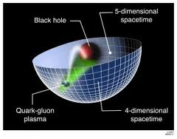
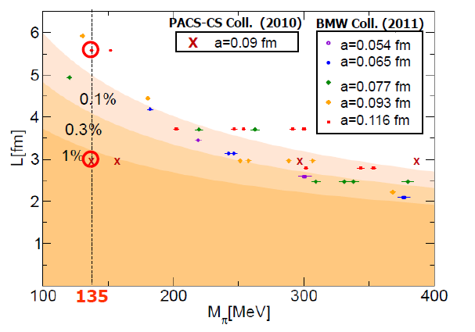
Additional recent theoretical progress in QCD
Progress in non-perturbative methods:
  Lattice QCD just starting to perform calculations at physical pion mass!
  AdS/CFT “gauge-string duality” an exciting recent development as first fundamentally new handle to try to tackle QCD in decades!
PACS-CS: PRD81, 074503 (2010)
BMW: PLB701, 265 (2011)
“Modern-day ‘testing’ of (perturbative) QCD is as much about pushing the boundaries of its applicability as about the verification that QCD is the correct theory of hadronic physics.”
– G. Salam, hep-ph/0207147 (DIS2002 proceedings)
T. Hatsuda,
PANIC 2011
Notes:
Hadron spectrum, quark masses, pseudoscalar meson decay constants

Slide 12
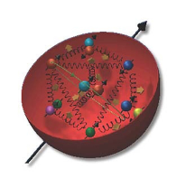
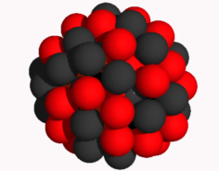
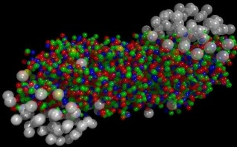
The Relativistic Heavy Ion Collider at Brookhaven National Laboratory
A great place to be to study QCD!
An accelerator-based program, but not designed to be at the energy (or intensity) frontier. More closely analogous to many areas of condensed matter research—create a system and study its properties!
What systems are we studying?
  “Simple” QCD bound states—the proton is the simplest stable bound state in QCD (and conveniently, nature has already created it for us!)
  Collections of QCD bound states (nuclei, also available out of the box!)
  QCD deconfined! (quark-gluon plasma, some assembly required!)
Understand more complex QCD systems within
the context of simpler ones
RHIC was designed from the start as a single facility capable of nucleus-nucleus, proton-nucleus, and proton-proton collisions

Slide 13
Mapping out the proton
What does the proton look like in terms of the quarks and gluons inside it?
Position
Momentum
Spin
Flavor
Color
Theoretical and experimental concepts to describe and access position only born in mid-1990s. Pioneering measurements over past decade.
Vast majority of past four decades focused on
1-dimensional momentum structure! Since 1990s starting to consider other directions . . .
Polarized protons first studied in 1980s. How angular momentum of quarks and gluons add up still not well understood!
Good measurements of flavor distributions in valence region. Flavor structure at lower momentum fractions still yielding surprises!
Accounted for by theorists from beginning of QCD, but more detailed, potentially observable effects of color have come to forefront in last couple years . . .

Slide 14
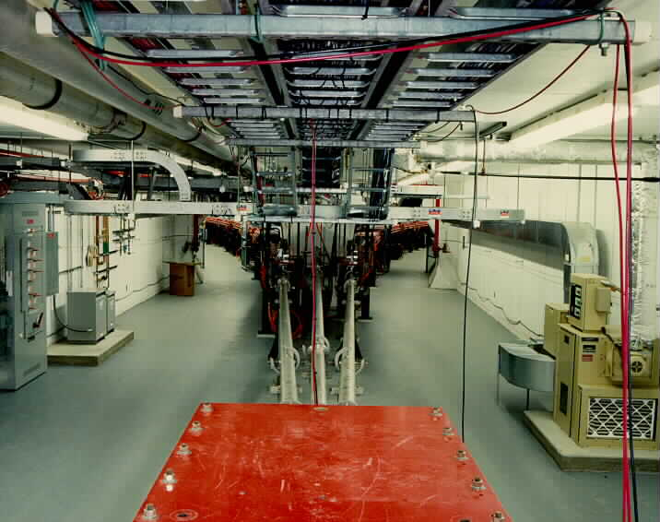
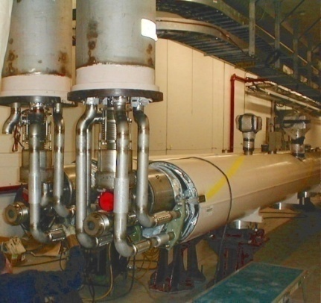
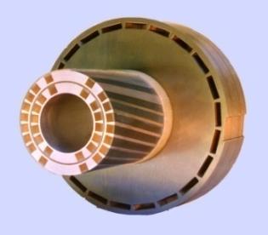
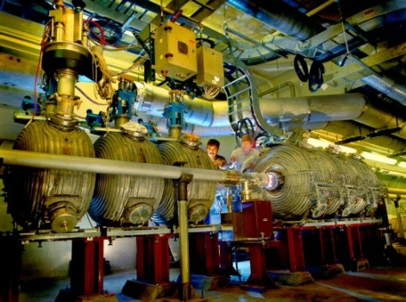
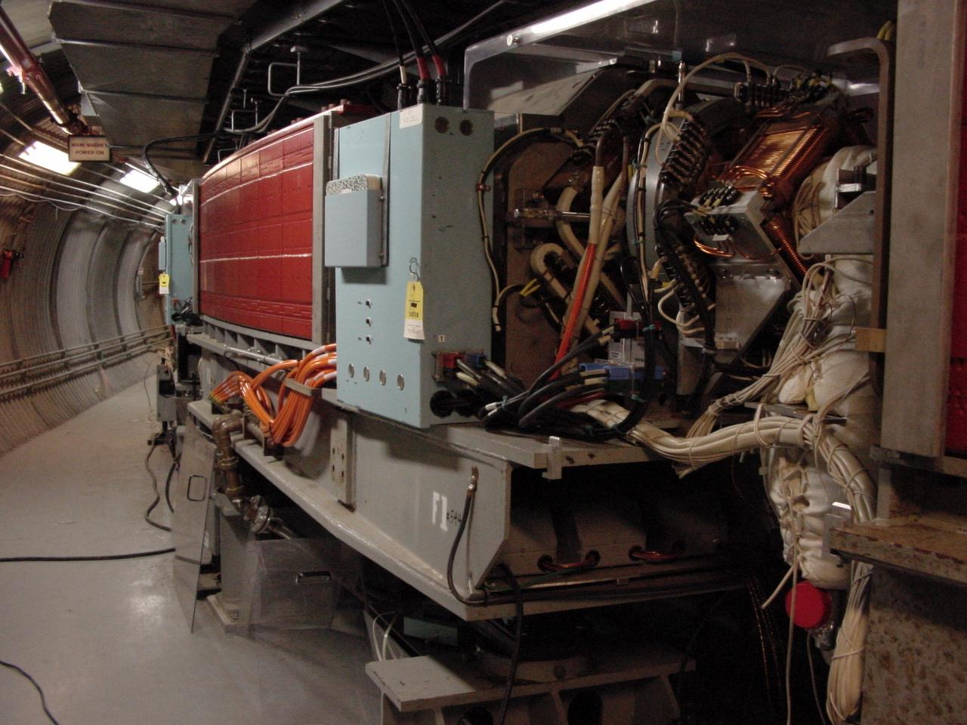
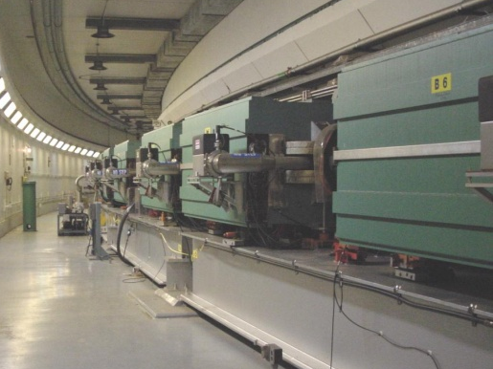
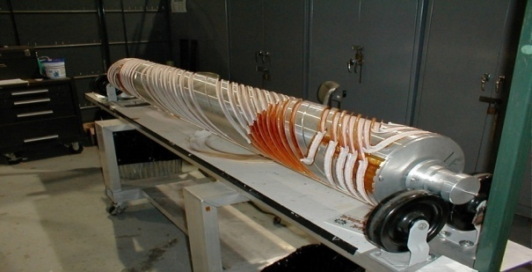
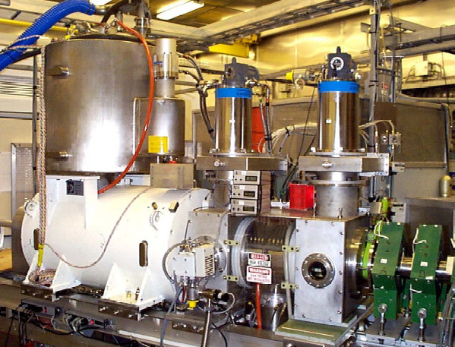
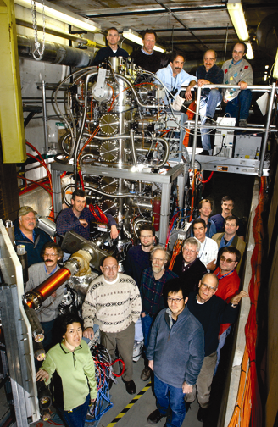
RHIC as a Polarized p+p Collider
Absolute Polarimeter (H jet)
RHIC pC Polarimeters
Siberian Snakes
PHOBOS
BRAHMS & PP2PP
Siberian Snakes
PHENIX
Spin Flipper
STAR
Spin Rotators
Various equipment to maintain and measure beam polarization through acceleration and storage
Partial Snake
Helical Partial
Snake
Polarized Source
Strong Snake
LINAC
AGS
200 MeV Polarimeter
BOOSTER
Rf Dipole
AGS Internal Polarimeter
AGS pC Polarimeter
Notes:
RHIC, as a high-energy polarized proton collider, really represents an outstanding achievement in accelerator physics. . . . [equipment].

Slide 15
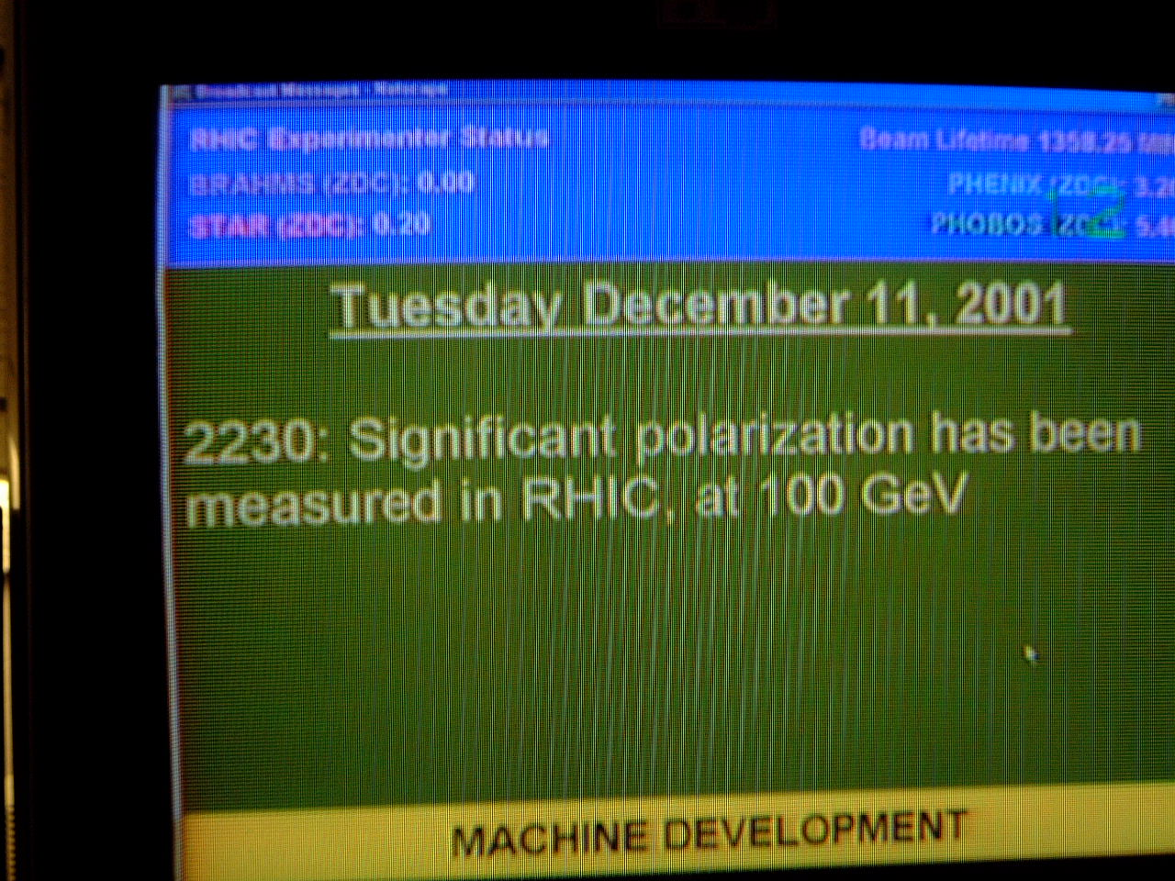
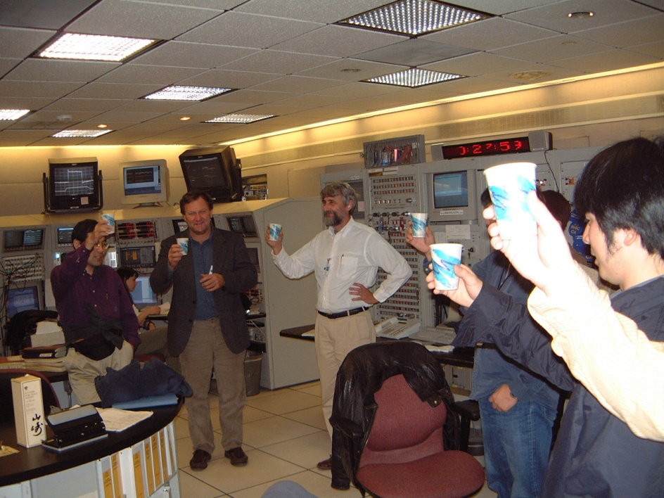

December 2001: News to Celebrate

Slide 16


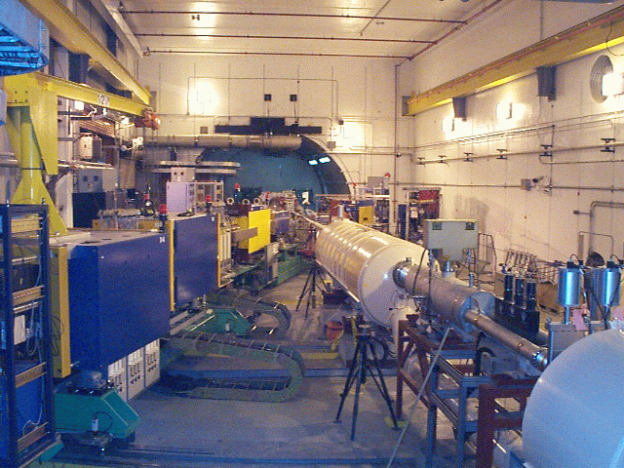
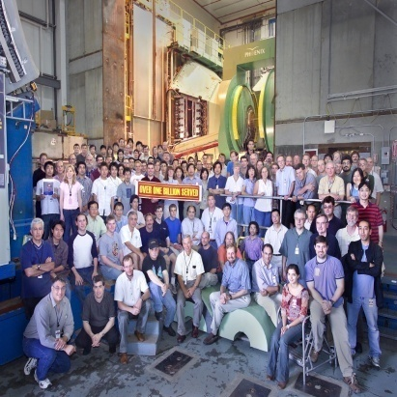
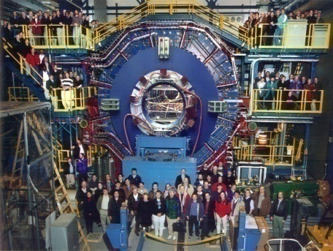


RHIC Spin Physics Experiments
Three experiments: STAR, PHENIX, BRAHMS
Current running only with STAR and PHENIX
Transverse spin only
(No rotators)
Longitudinal or transverse spin
Longitudinal or transverse spin
Accelerator performance:
Polarization up to 65% for 100 GeV beams,
60% for 255 GeV beams (design 70%).
Achieved 2x10³² cm⁻² s⁻¹ lumi at √s = 510 GeV (design).

Slide 17
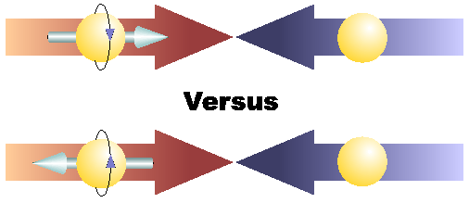
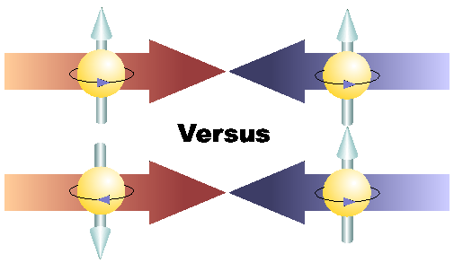
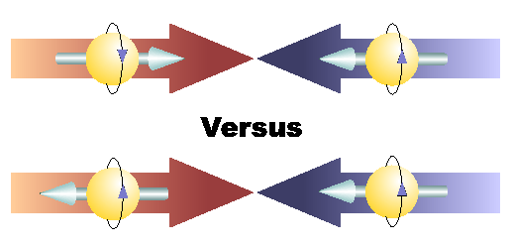
Proton Spin Structure at RHIC
Transverse spin and
spin-momentum
correlations
Transverse-momentum-
dependent distributions
, Jets
Prompt Photons
Single-Spin Asymmetries
Back-to-Back Correlations
Advantages of a polarized proton-proton collider:
Hadronic collisions → Leading-order access to gluons
High energies → Applicability of perturbative QCD
High energies → Production of new probes: W bosons

Slide 18
Reliance on Input from
Simpler Systems
Disadvantage of hadronic collisions: much “messier” than deep-inelastic scattering! → Rely on input from simpler systems
  Just as the heavy ion programs at RHIC and the LHC rely on information from simpler collision systems
The more we know from simpler systems such as DIS and e+e- annihilation, the more we can in turn learn from hadronic collisions!

Slide 19
Predictive power of pQCD
q(x₁)
Hard Scattering Process
X
g(x₂)
High-energy processes have predictable rates given:
Partonic hard scattering rates (calculable in pQCD)
    Parton distribution functions (need experimental input)
    Fragmentation functions (need experimental input)
Universal non-perturbative factors

Slide 20
Proton Spin Structure at RHIC
Transverse spin and
spin-momentum
correlations
Transverse-momentum-
dependent distributions
, Jets
Prompt Photons
Single-Spin Asymmetries
Back-to-Back Correlations

Slide 21
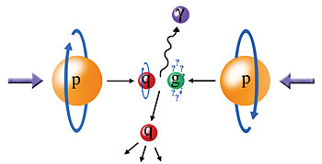
Probing the Helicity Structure of the Nucleon with p+p Collisions
Study difference in particle production rates for same-helicity vs. opposite-helicity proton collisions
DIS
?
pQCD
e+e-
Leading-order access to gluons → ΔG
Notes:
Let me now show you some highlights from the helicity program at RHIC.

Slide 22

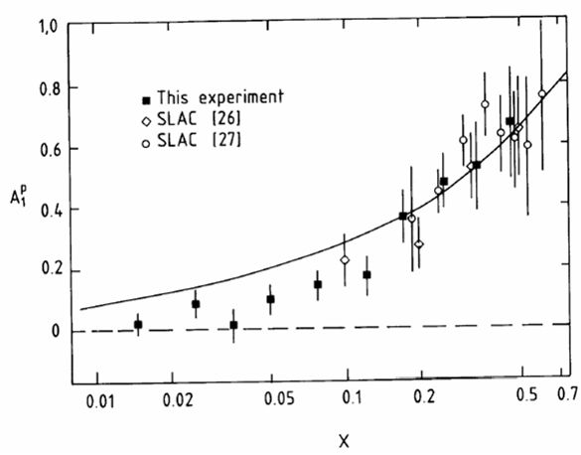
Proton “Spin Crisis”
SLAC: 0.10 < x <0.7
CERN: 0.01 < x <0.5
Quark-Parton Model
expectation!
A₁(x)
0.1 < x_{SLAC} < 0.7
E130, Phys.Rev.Lett.51:1135 (1983)
448 citations
These haven’t been easy to measure!
EMC (CERN), Phys.Lett.B206:364 (1988)
1621 citations!
0.01 < x_{CERN} < 0.5
“Proton Spin Crisis”
x-Bjorken
Notes:
SLAC – up by 20 in 2 years, EMC – 130 in 2 years

Slide 23
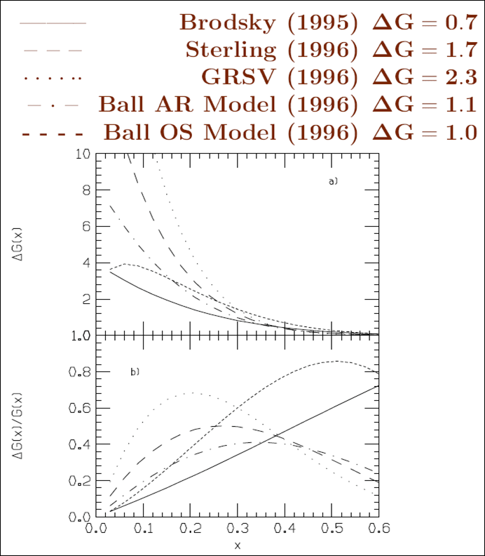
The Quest for ΔG, the Gluon Spin Contribution to the Spin of the Proton
With experimental evidence indicating that only about 30% of the proton’s spin is due to the spin of the quarks, in the mid-1990s predictions for the integrated gluon spin contribution to proton spin ranged from 0.7 – 2.3!
  Many models hypothesized large gluon spin contributions to screen the quark spin, but these would then require large orbital angular momentum in the opposite direction.

Slide 24
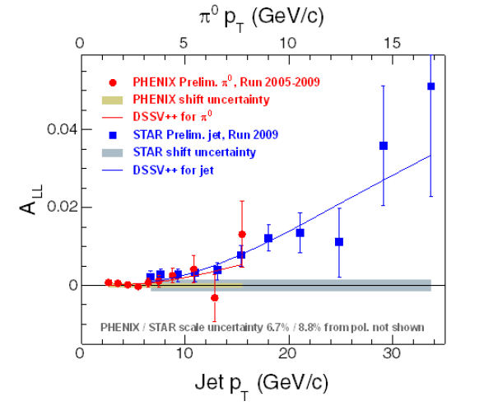
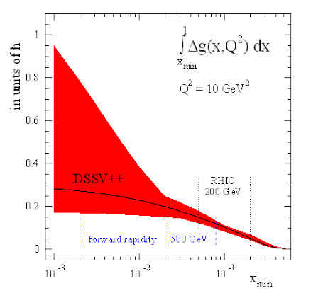

Latest RHIC Data and Present Status of ΔG
Clear non-zero asymmetry (finally!) measured in helicity-dependent jet production at STAR from data taken in 2009!
PHENIX results from helicity-dependent pion production consistent
Best fit gives gluon spin contribution of only ~30%, not enough!
Possible larger contributions from lower (unmeasured) momentum fractions??
Or: Significant orbital angular momentum contributions?
Need to understand better how to measure orbital angular momentum!
(And exact interpretation of measurements!!)
de Florian et al., 2008 : First global NLO pQCD analysis to include inclusive DIS, semi-inclusive DIS, and RHIC p+p data (200 and 62.4 GeV) on equal footing. 2012 update on ΔG shown here.
STAR
Notes:
If you consider the thousands of points going into standard global fits of unpolarized pdf’s, we’ve still got a long way to go!

Slide 25
Proton Spin Structure at RHIC
Transverse spin and
spin-momentum
correlations
Transverse-momentum-
dependent distributions
Not expected to resolve spin crisis, but of particular interest given surprising isospin-asymmetric structure of the unpolarized sea discovered by E866 at Fermilab.
, Jets
Prompt Photons
Single-Spin Asymmetries
Back-to-Back Correlations

Slide 26
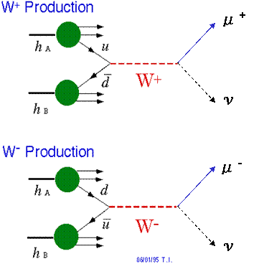
Flavor-Separated Sea Quark Polarizations Through W Production
Flavor separation of the polarized sea quarks with no reliance on fragmentation functions, and at much higher scale than previous fixed-target experiments.
Complementary to semi-inclusive DIS measurements.
Parity violation of the weak
interaction in combination with
control over the proton spin
orientation gives access to the
flavor spin structure in the proton!

Slide 27
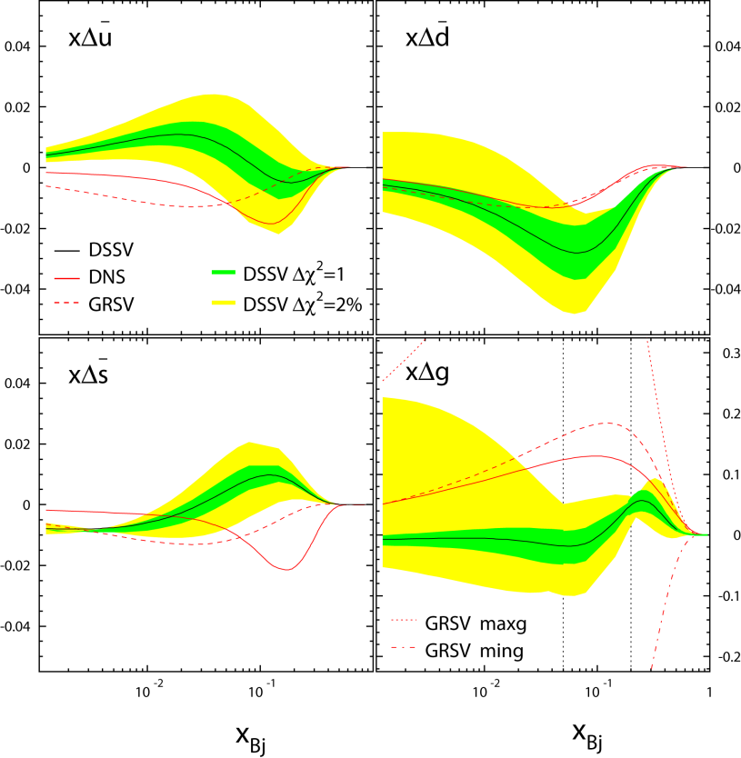
Flavor-Separated Sea Quark Polarizations Through W Production
2008 global fit to helicity distributions (before RHIC W data): Indication of SU(3) breaking in the polarized quark sea (as in the unpolarized sea), but still relatively large uncertainties on helicity distributions of anti-up and anti-down quarks!
DSSV, PRL101, 072001 (2008)

Slide 28
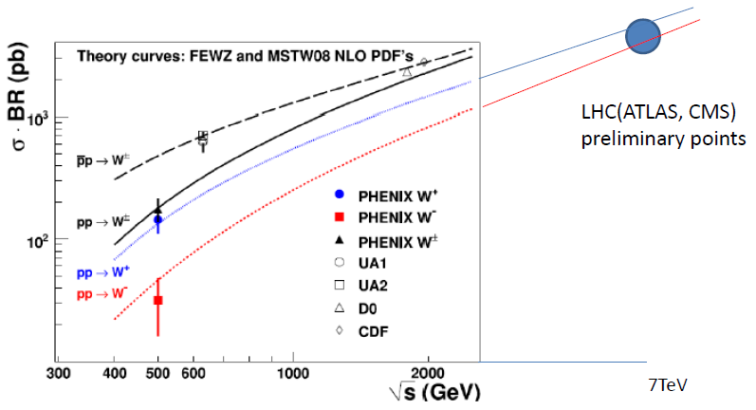
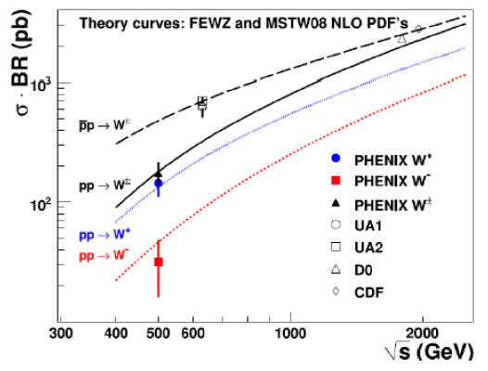
Total W Cross Section
PHENIX made first-ever W measurement in p+p collisions!
In agreement with predictions
PHENIX: PRL 106:062101 (2011)

Slide 29
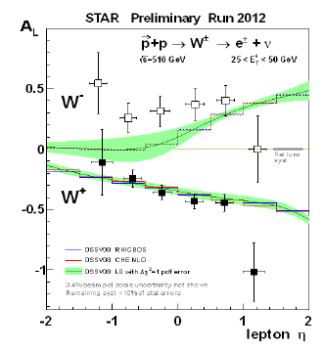
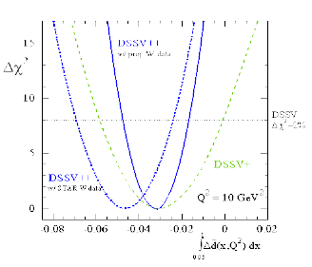
Parity-Violating Single-Helicity Asymmetries
STAR
Expect a lot more data at 510 GeV in the next few months, with upgraded detectors!
PHENIX: arXiv:1009.0505
Better-constrained W+ measurement shifts anti-down contribution to be slightly more negative.
Large parity-violating asymmetries seen by both PHENIX and STAR for W+ and W-.

Slide 30
Proton Spin Structure at RHIC
Transverse spin and
spin-momentum
correlations
Transverse-momentum-
dependent distributions
, Jets
Prompt Photons
Single-Spin Asymmetries
Back-to-Back Correlations

Slide 31
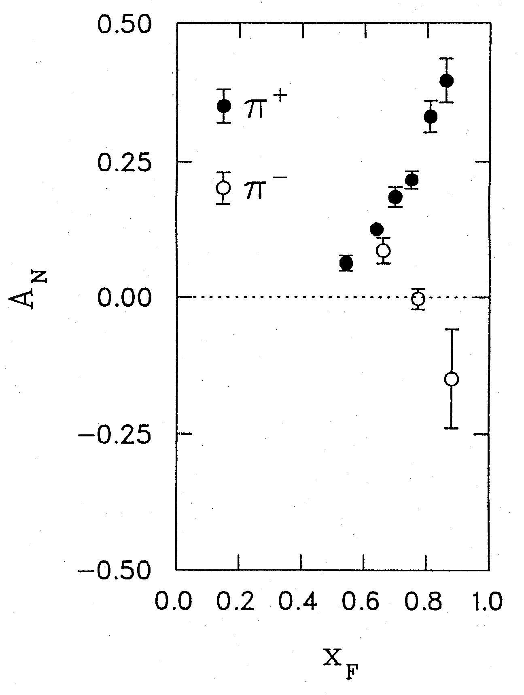
1976: Discovery in p+p Collisions!
Large Transverse Single-Spin Asymmetries
Argonne √s=4.9 GeV
Charged pions produced preferentially on one or the other side with respect to the transversely polarized beam direction!
left
Due to quark transversity, i.e. correlation of transverse quark spin with transverse proton spin? Other effects? We’ll need to wait more than a decade for the birth of a new subfield in order to explore the possibilities . . .
right
W.H. Dragoset et al., PRL36, 929 (1976)

Slide 32
Transverse-Momentum-Dependent Distributions and Single-Spin Asymmetries
1989: The “Sivers mechanism” is proposed in an attempt to understand the observed asymmetries.
D.W. Sivers, PRD41, 83 (1990)
The Sivers distribution: the first transverse-momentum-dependent distribution (TMD)!
Departs from the traditional collinear factorization assumption in pQCD and proposes a correlation between the intrinsic transverse motion of the quarks and gluons and the proton’s spin
New frontier! Parton dynamics inside hadrons, and in the hadronization process
Spin and momenta can be of partons or hadrons

Slide 33
Quark Distribution Functions
Similarly, can have k_{T}-dependent fragmentation functions (FFs). One example: the chiral-odd Collins FF, which provides one way of accessing transversity distribution (also chiral-odd).
No (explicit) k_{T} dependence
Transversity
k_{T} - dependent, T-even
k_{T} - dependent, T-odd
Sivers
Relevant measurements in simpler systems (DIS, e+e-) only starting to be made over the last ~8 years, providing evidence that many of these correlations are non-zero in nature! Rapidly advancing field both experimentally and theoretically!
Boer-Mulders

Slide 34
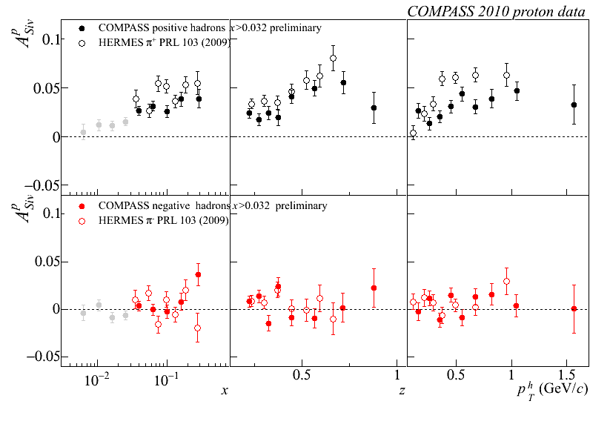




Sivers
e+p
μ+p
BELLE PRL96, 232002 (2006)
Collins
e⁺e⁻
Boer-Mulders
SPIN2008
e+p
BaBar: Released August 2011
Collins
e⁺e⁻
e+p
μ+p
Transversity x Collins

Slide 35


Transverse Single-Spin Asymmetries:
From Low to High Energies!
ANL
√s=4.9 GeV
BNL
√s=6.6 GeV
FNAL
√s=19.4 GeV
RHIC
√s=62.4 GeV
RHIC:
Up to √s=500 GeV!
π⁰
left
right

Slide 36

Effects persist up to transverse momenta of 7 GeV/c!
Can use tools of perturbative QCD to try to interpret!!

Slide 37

TMDs and Universality:
Modified Universality of Sivers Asymmetries
DIS: attractive FSI
Drell-Yan: repulsive ISI
Measurements in semi-inclusive DIS already exist. A p+p measurement will be a crucial test of our understanding of QCD!
As a result:

Slide 38

Factorization and Color
2010—groundbreaking work by T. Rogers, P. Mulders claiming that pQCD factorization is broken in processes involving more than two hadrons total if parton k_{T} is taken into account (TMD pdfs and/or FFs)
  PRD 81, 094006 (2010)
  No unique color flow
Transverse momentum-dependent distributions an exciting sub-field—lots of recent experimental activity, and theoretical questions probing deep issues of both universality and factorization in (perturbative) QCD!

Slide 39



Testing factorization/factorization breaking with (unpolarized) p+p collisions
Testing factorization in transverse-momentum-dependent case
  Important for broad range of pQCD calculations
Can we parametrize transverse-momentum-dependent distributions that simultaneously describe many measurements?
  So far yes for Drell-Yan and Z boson data, including recent Z measurements from Tevatron and LHC!
Z boson production,
Tevatron CDF
dσ/dp_{T}
dσ/dp_{T}
C.A. Aidala,
T.C. Rogers
√s = 0.039 TeV
√s = 1.96 TeV
p_{T} (GeV/c)
p_{T} (GeV/c)

Slide 40

Testing factorization/factorization breaking with (unpolarized) p+p collisions
Then will test predicted factorization breaking using e.g. dihadron correlation measurements in unpolarized p+p collisions
  Lots of expertise on such measurements within PHENIX, driven by heavy ion program!
PRD82, 072001 (2010)
Out-of-plane momentum component
C.A. Aidala,
T.C. Rogers, work in progress

Slide 41
Spin-momentum correlations and the proton as a QCD “laboratory”
“Transversity” pdf:
Correlates proton transverse spin and quark transverse spin
“Sivers” pdf:
Correlates proton transverse spin and quark transverse momentum
“Boer-Mulders” pdf:
Correlates quark transverse spin and quark transverse momentum
S_{p}-S_{q} coupling
S_{p}-L_{q} coupling
S_{q}-L_{q} coupling

Slide 42
Summary and outlook
We still have a ways to go from the quarks and gluons of QCD to full descriptions of the protons and nuclei of the world around us!
The proton as the simplest QCD bound state provides a QCD “laboratory” analogous to the atom’s role in the development of QED
As the various subfields in QCD mature, the power they have to strengthen and inform one another is ever increasing!
There’s a large and diverse community of people—at RHIC and complementary facilities—driven to continue coaxing the secrets out of one of the most fundamental building blocks of the world around us.

Slide 43
Additional Material

Slide 44



π
π
π, K, p
at 200 and 62.4 GeV
Pattern of pion species asymmetries in the forward direction
→ valence quark effect.
But this conclusion confounded by kaon and antiproton asymmetries!
200 GeV
62.4 GeV
Note different scales
K
K
K- asymmetries
underpredicted
200 GeV
62.4 GeV
p
p
Large antiproton asymmetry?? Unfortunately no 62.4 GeV measurement
200 GeV
62.4 GeV

Slide 45

Another Surprise: Transverse Single-Spin Asymmetry in Eta Meson Production
Further evidence against a valence quark effect!
Lots of territory still to explore to understand spin-momentum correlations in QCD!
Larger than the neutral pion!
STAR
PRD 86:051101 (2012)

Slide 46


Improvements in knowledge of gluon and sea quark spin contributions from RHIC data

Slide 47

World data on polarized proton structure function

Slide 48


Dijet Cross Section and
Double Helicity Asymmetry
Dijets as a function of invariant mass
More complete kinematic reconstruction of hard scattering—pin down x values probed
STAR

Slide 49

√s=62.4 GeV
Forward pions
Comparison of NLO pQCD calculations with BRAHMS π data at high rapidity. The calculations are for a scale factor of μ=p_{T}, KKP (solid) and DSS (dashed) with CTEQ5 and CTEQ6.5.
Surprisingly good description of data, in apparent disagreement with earlier analysis of ISR π⁰ data at 53 GeV.

Slide 50

√s=62.4 GeV
Forward kaons
K⁻ data suppressed ~order of magnitude (valence quark effect).
NLO pQCD using recent DSS FF’s gives ~same yield for both charges(??).
Related to FF’s? PDF’s??
K⁺: Not bad!
K⁻: Hmm…
Notes:
Authero of DSS knows about this.

Slide 51
Fragmentation Functions (FF’s):
Improving Our Input for Inclusive Hadronic Probes
FF’s not directly calculable from theory—need to be measured and fitted experimentally
The better we know the FF’s, the tighter constraints we can put on the polarized parton distribution functions!
Traditionally from e+e- data—clean system!
Framework now developed to extract FF’s using all available data from deep-inelastic scattering and hadronic collisions as well as e+e-
  de Florian, Sassot, Stratmann: PRD75:114010 (2007) and arXiv:0707.1506

Slide 52



Extending x Coverage
PRD79, 012003 (2009)
Measure in different kinematic regions
  e.g. forward vs. central
Change center-of-mass energy
  Most data so far at 200 GeV
  Brief run in 2006 at 62.4 GeV
  First 500 GeV data-taking to start next month!
62.4 GeV
Extend to lower x at √s = 500 GeV
Extend to higher x at √s = 62.4 GeV
200 GeV
present
x-range
√s = 200 GeV
Notes:
Get rid of!

Slide 53
Prokudin et al. at Ferrara

Slide 54
Prokudin et al. at Ferrara

Slide 55

Forward neutrons at √s=200 GeV at PHENIX
Large negative SSA observed for x_{F}>0, enhanced by requiring concidence with forward charged particles (“MinBias” trigger).
No x_{F} dependence seen.
Mean p_{T}
(Estimated by simulation assuming ISR p_{T} dist.)
0.4<|x_{F}|<0.6 0.088 GeV/c
0.6<|x_{F}|<0.8 0.118 GeV/c
0.8<|x_{F}|<1.0 0.144 GeV/c
preliminary | A_{N}
Without MinBias | -6.6 ±0.6 %
With MinBias | -8.3 ±0.4 %
charged
particles
neutron
neutron

Slide 56






Single-Spin Asymmetries for Local Polarimetry:
Confirmation of Longitudinal Polarization
A_{N}
Spin Rotators OFF
Vertical polarization
Blue
φ
Yellow
Spin Rotators ON
Current Reversed!
Radial polarization
Blue
Yellow
Spin Rotators ON
Correct Current
Longitudinal polarization!
Blue
Yellow

Slide 57
The Collins Effect Must be Present
In e⁺e⁻ Annihilation into Quarks!
electron
Collins effect in e+e-
Quark fragmentation
will lead to effects
in di-hadron correlation
measurements!
q₁
q₂
quark-1
spin
quark-2
spin
positron

Slide 58
Helicity Flip Amplitudes
Elastic proton-quark scattering
(related to inelastic scattering through optical theorem)
Helicity flip distribution also called the “transversity” distribution.
Corresponds to the difference in probability of scattering off of a transversely polarized quark within a transversely polarized proton with the quark spin parallel vs. antiparallel to the proton’s.
Chiral-odd! But chirality conserved in QCD processes . . . Can transversity exist and produce observable effects?
Three independent pdf’s corresponding to following helicity states:
Take linear combinations to form:
Helicity average
Helicity difference
Helicity flip

Slide 59

Calibration using different probes
Electroweak probes of the hot, dense matter in the A+A final state already exploited
  Direct photons, internal conversions of thermal photons, Z bosons
Learn by comparing to a variety of strongly interacting probes
  Light mesons as proxies for light quarks—various potential means of in-medium energy loss
  Charm and bottom mesons as proxies for heavy quarks—less affected by radiative energy loss
d+A allows us instead to use strong probes of the initial state
e+A will enable electroweak probes of the initial state for the first time!

Slide 60
Sampling the Integral of ΔG: π⁰ p_{T} vs. x_{gluon}
Inclusive asymmetry measurements in p+p collisions sample from wide bins in x—sensitive to (truncated) integral of ΔG, not to functional form vs. x
Based on simulation using NLO pQCD as input
PRL 103, 012003 (2009)

Slide 61


Final W Results from 2009 Data
PHENIX: arXiv:1009.0505
STAR: arXiv:1009.0326

Slide 62
Longitudinal (Helicity) vs. Transverse Spin Structure
Transverse spin structure of the proton cannot be deduced from longitudinal (helicity) structure
  Spatial rotations and Lorentz boosts don’t commute!
  Only the same in the non-relativistic limit
Transverse structure linked to intrinsic parton transverse momentum (k_{T}) and orbital angular momentum!

Slide 63
Factorization and universality in perturbative QCD
Need to systematically factorize short- and long-distance physics—observable physical QCD processes always involve at least one long-distance scale (confinement)!
Long-distance (i.e. non-perturbative) functions need to be universal in order to be portable across calculations for many processes (and to be meaningful in describing hadron structure!)
Measure observables sensitive to parton distribution functions (pdfs) and fragmentation functions (FFs) in many colliding systems over a wide kinematic range→constrain by performing
simultaneous fits to world data

Slide 64


PHENIX Detector
Philosophy:
  High rate capability to measure rare probes,
  but limited acceptance.
2 central
spectrometers
Track charged particles and detect electromagnetic processes
azimuth
2 forward
spectrometers
- Identify and track muons

Slide 65


BRAHMS detector
Philosophy:
  Small acceptance spectrometer arms
  designed with good charged particle ID.

Slide 66

The STAR Detector at RHIC
STAR

