Slide 1
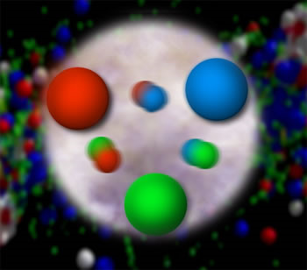
From Quarks and Gluons to the World Around Us:
Advancing Quantum Chromodynamics by Probing Nucleon Structure
Christine A. Aidala
Los Alamos National Lab
University of Michigan
February 13, 2012

Slide 2
Theory of strong interactions:
Quantum Chromodynamics
  Salient features of QCD not evident from Lagrangian!
    Color confinement – the color-charged quarks and gluons of QCD are always confined in color-neutral bound states
    Asymptotic freedom – when probed at high energies/short distances, the quarks and gluons inside a hadron behave as nearly free particles
  Gluons: mediator of the strong interactions
    Determine essential features of strong interactions
    Dominate structure of QCD vacuum (fluctuations in gluon fields)
    Responsible for > 98% of the visible mass in universe(!)
An elegant and by now well established field theory, yet with degrees of freedom that we can never observe directly in the laboratory!

Slide 3
How do we understand the visible matter in our universe in terms of the fundamental quarks and gluons of QCD?

Slide 4
The proton as a QCD “laboratory”
Proton—simplest stable bound state in QCD!
?...
observation & models
fundamental theory
precision measurements
& more powerful theoretical tools
application?

Slide 5
Nucleon structure: The early years
1932: Estermann and Stern measure proton anomalous magnetic moment → proton not a pointlike particle!
1960s: Quark structure of the nucleon
  SLAC inelastic electron-nucleon scattering experiments by Friedman, Kendall, Taylor → Nobel Prize
  Theoretical development by Gell-Mann → Nobel Prize
1970s: Formulation of QCD . . .

Slide 6
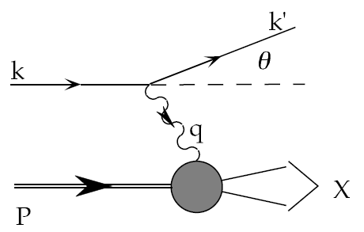
Deep-inelastic lepton-nucleon scattering:
A tool of the trade
Probe nucleon with an electron or muon beam
Interacts electromagnetically with (charged) quarks and antiquarks
“Clean” process theoretically—quantum electrodynamics well understood and easy to calculate!

Slide 7
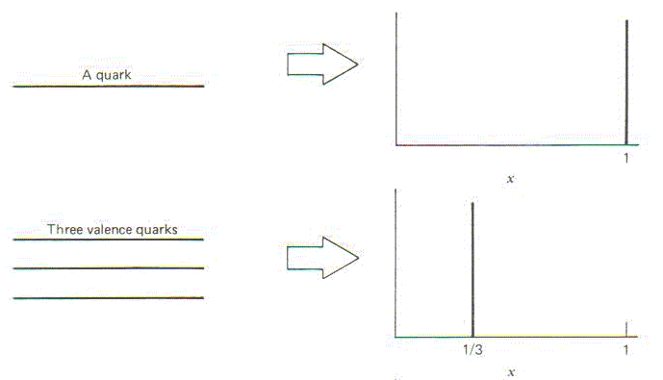
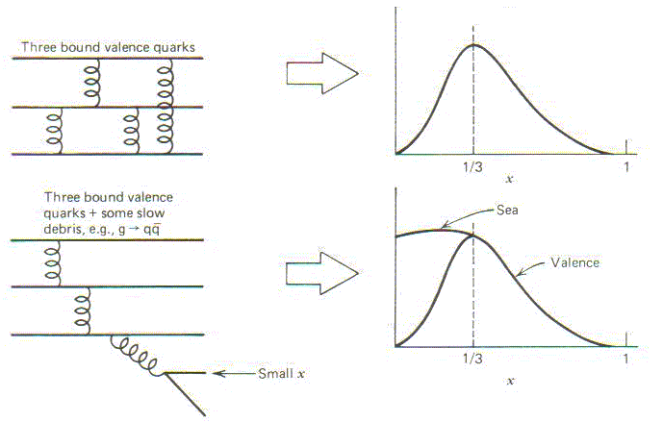
Parton distribution functions inside a nucleon:
The language we’ve developed (so far!)
What momentum fraction would the scattering particle carry
if the proton were made of …
3 bound valence quarks
A point particle
x_{Bjorken}
1
1/3
1
3 bound valence quarks + some
low-momentum sea quarks
x_{Bjorken}
Sea
3 valence quarks
Valence
Small x
1/3
1
x_{Bjorken}
1/3
x_{Bjorken}
1
Halzen and Martin, “Quarks and Leptons”, p. 201

Slide 8
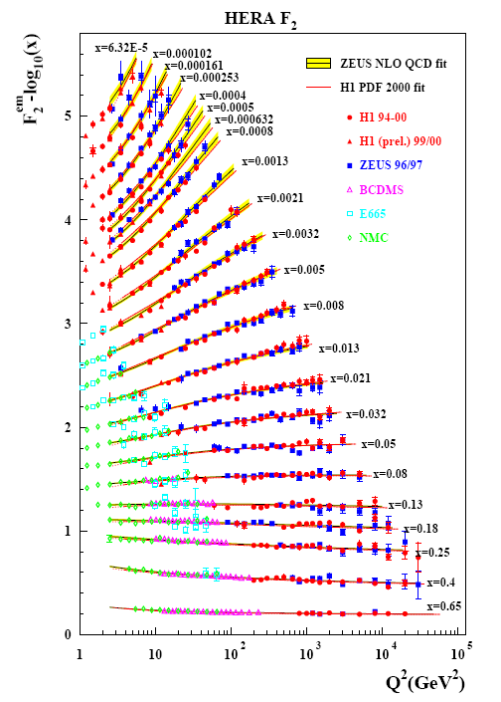
Decades of DIS data: What have we learned?
F₂(x,Q²)
Wealth of data largely thanks to proton-electron collider, HERA, in Hamburg (1992-2007)
Rich structure at low x
Half proton’s momentum carried by gluons!
parton distribution function
momentum fraction
PRD67, 012007 (2003)

Slide 9
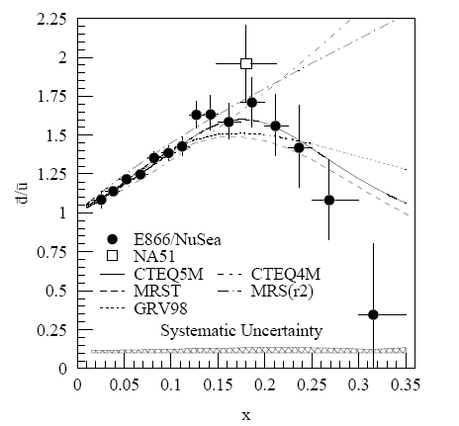
And a (relatively) recent surprise from p+p, p+d collisions
Fermilab Experiment 866 used proton-hydrogen and proton-deuterium collisions to probe nucleon structure via the Drell-Yan process
Anti-up/anti-down difference in the quark sea, with an unexpected x behavior!
Indicates “primordial” sea quarks, in addition to those dynamically generated by gluon splitting!
Hadronic collisions play a complementary role to e+p DIS and have let us continue to find surprises in the rich linear momentum structure of the proton, even after > 40 years!
PRD64, 052002 (2001)

Slide 10
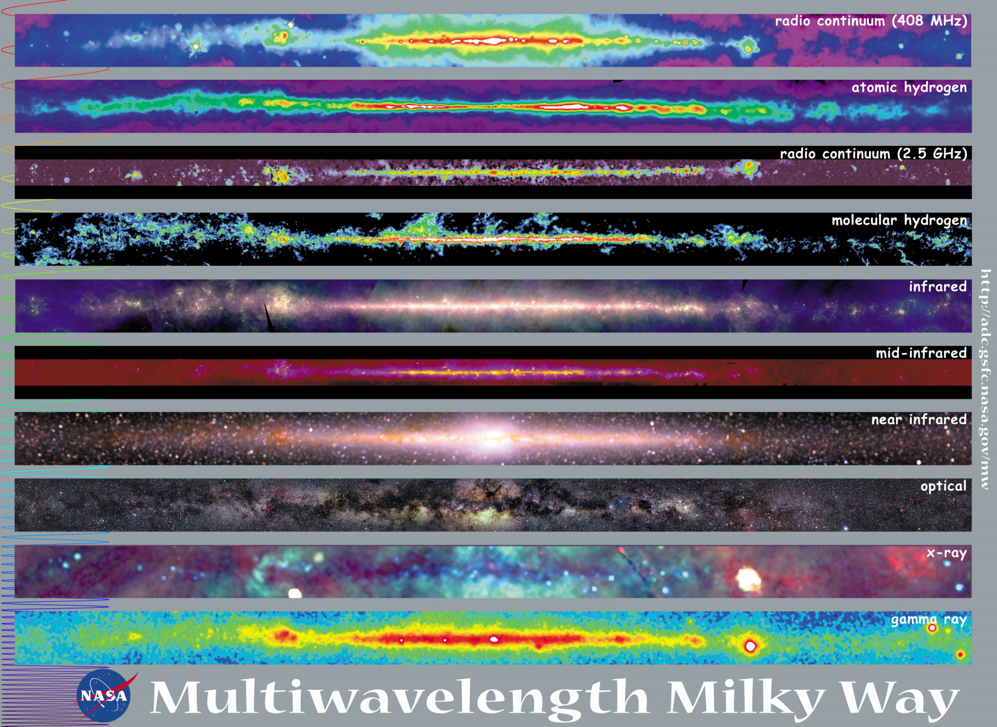
Observations with different probes allow us to learn different things!

Slide 11
Mapping out the proton
What does the proton look like in terms of the quarks and gluons inside it?
Position
Momentum
Spin
Flavor
Color
Theoretical and experimental concepts to describe and access position only born in mid-1990s. Pioneering measurements over past decade.
Vast majority of past four decades focused on
1-dimensional momentum structure! Since 1990s starting to consider other directions . . .
Polarized protons first studied in 1980s. How angular momentum of quarks and gluons add up still not well understood!
Good measurements of flavor distributions in valence region. Flavor structure at lower momentum fractions still yielding surprises!
Accounted for by theorists from beginning of QCD, but more detailed, potentially observable effects of color have come to forefront in last couple years . . .

Slide 12
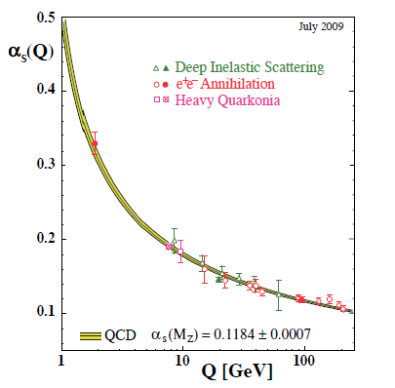
Perturbative QCD
Take advantage of running of the strong coupling constant with energy (asymptotic freedom)—weak coupling at high energies (short distances)
Perturbative expansion as in quantum electrodynamics (but many more diagrams due to gluon self-coupling!!)
Most importantly: pQCD provides a rigorous way of relating the fundamental field theory to a variety of physical observables!
Stronger coupling
Higher resolution
Higher resolution
Notes:
Scattering energy

Slide 13
Predictive power of pQCD
q(x₁)
Hard Scattering Process
X
g(x₂)
High-energy processes have predictable rates given:
    Partonic hard scattering rates (calculable in pQCD)
    Parton distribution functions (need experimental input)
    Fragmentation functions (need experimental input)
Universal non-perturbative factors

Slide 14
Factorization and universality in perturbative QCD
Need to systematically factorize short- and long-distance physics—observable physical QCD processes always involve at least one long-distance scale (confinement)!
Long-distance (i.e. non-perturbative) functions need to be universal in order to be portable across calculations for many processes (and to be meaningful in describing hadron structure!)
Measure observables sensitive to parton distribution functions (pdfs) and fragmentation functions (FFs) in many colliding systems over a wide kinematic range→constrain by performing
simultaneous fits to world data

Slide 15
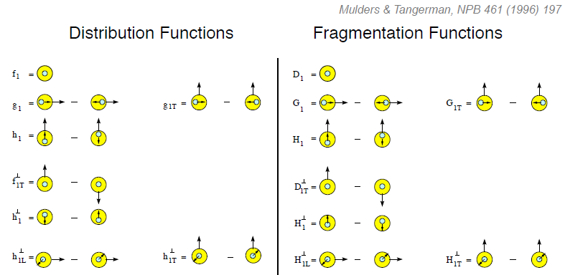
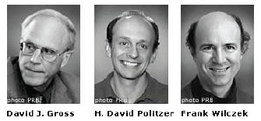
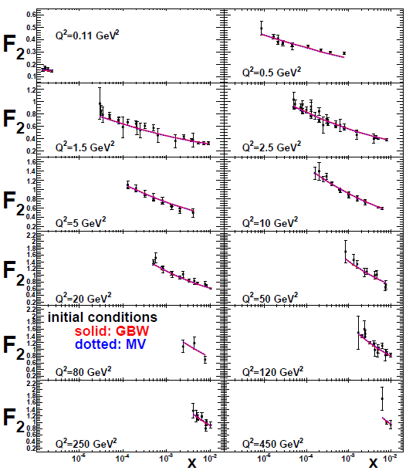
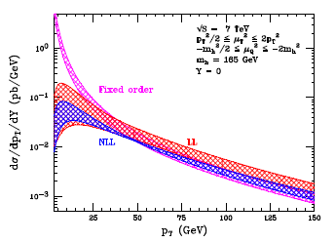
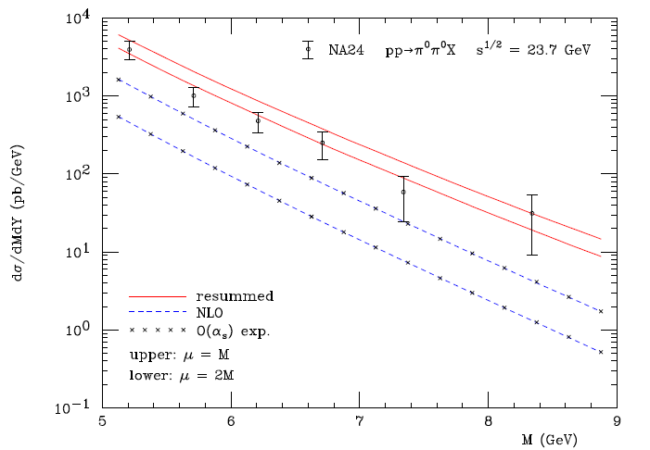
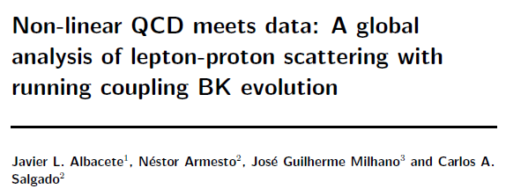
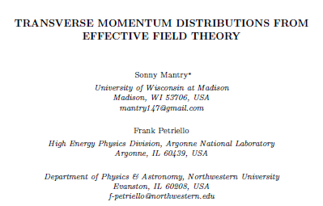
The nascent era of quantitative QCD!
Transverse-Momentum-Dependent
QCD: Discovery and development
  1973 → ~2004
Since 1990s starting to consider detailed internal QCD dynamics, going beyond traditional parton model ways of looking at hadrons—and perform phenomenological calculations using these new ideas/tools!
  Various resummation techniques
  Non-collinearity of partons with parent hadron
  Various effective field theories, e.g. Soft-Collinear Eff. Th.
  Non-linear evolution at small momentum fractions
Higgs vs. pT
Mulders & Tangerman, NPB 461, 197 (1996)
Collinear
Worm gear
arXiv:1108.3609
Almeida, Sterman, Vogelsang
PRD80, 074016 (2009)
Transversity
PRD80, 034031 (2009)
pp→π⁰π⁰X
Sivers
Boer-Mulders
M (GeV)
Pretzelosity
Worm gear

Slide 16
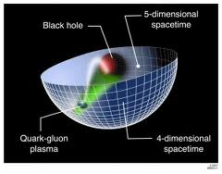
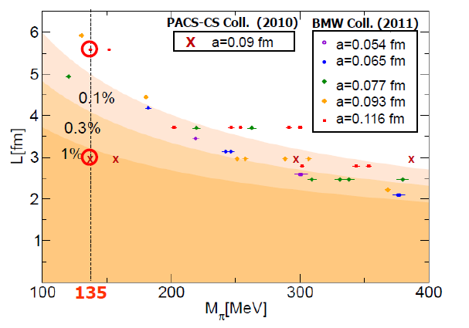
Additional recent theoretical progress in QCD
Progress in non-perturbative methods:
  Lattice QCD just starting to perform calculations at physical pion mass!
  AdS/CFT “gauge-string duality” an exciting recent development as first fundamentally new handle to try to tackle QCD in decades!
PACS-CS: PRD81, 074503 (2010)
BMW: PLB701, 265 (2011)
“Modern-day ‘testing’ of (perturbative) QCD is as much about pushing the boundaries of its applicability as about the verification that QCD is the correct theory of hadronic physics.”
– G. Salam, hep-ph/0207147 (DIS2002 proceedings)
T. Hatsuda,
PANIC 2011
Notes:
Hadron spectrum, quark masses, pseudoscalar meson decay constants

Slide 17
Critical to perform experimental work where quarks and gluons are relevant d.o.f. in the processes studied!

Slide 18
Experimental evidence for variety of spin-momentum correlations in proton, and in process of hadronization
Collinear
Worm gear
Collinear
Transversity
Measured non-zero!
Sivers
Polarizing FF
Boer-Mulders
Pretzelosity
Collins
Worm gear
S•(p₁×p₂)

Slide 19
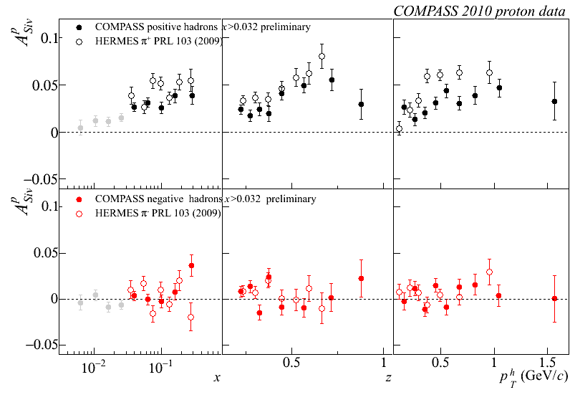
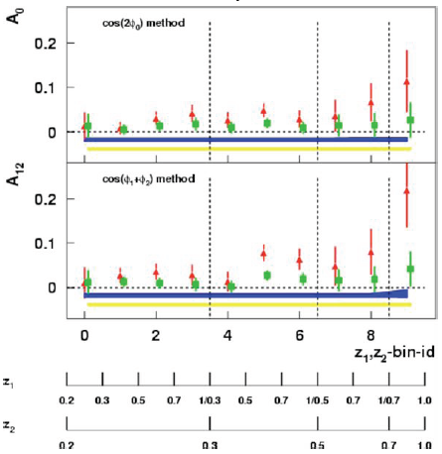
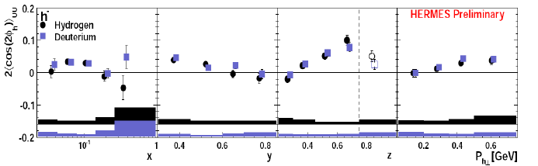
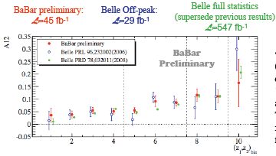
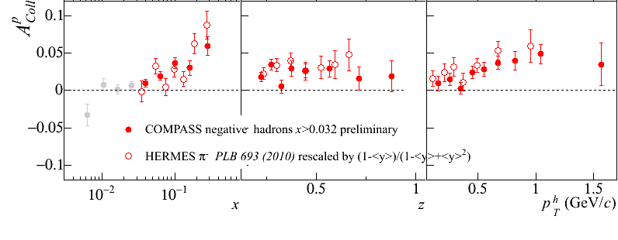
Sivers
A flurry of new experimental results from deep-inelastic e+p scattering and e⁺e⁻ annihilation over last ~8 years!
e+p
μ+p
BELLE PRL96, 232002 (2006)
Collins
e⁺e⁻
Boer-Mulders
SPIN2008
e+p
BaBar: Released August 2011
Collins
e⁺e⁻
e+p
μ+p
Transversity x Collins

Slide 20
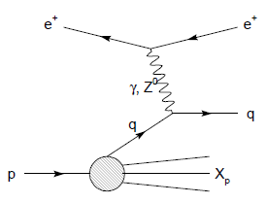
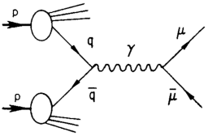
Modified universality of T-odd transverse-momentum-dependent distributions:
Color in action!
DIS: attractive final-state
interactions
Drell-Yan: repulsive initial-state interactions
Some DIS measurements already exist. A polarized Drell-Yan measurement will be a crucial test of our understanding of QCD!
As a result:

Slide 21
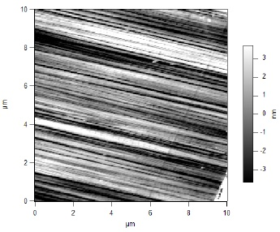
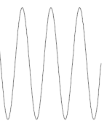
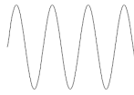
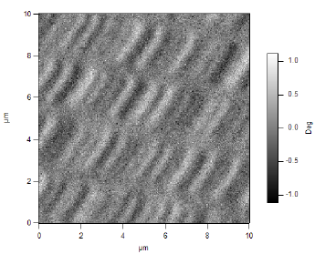
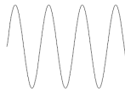
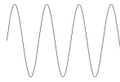
What things “look” like depends on how you “look”!
Slide courtesy of K. Aidala
Magnetic Force Microscopy
Computer Hard Drive
magnetic tip
Topography
Probe interacts with system being studied!
Lift height
Magnetism

Slide 22
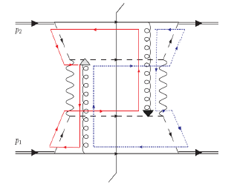
Factorization, color, and hadronic collisions
  In 2010, theoretical work by T.C. Rogers, P.J. Mulders claimed pQCD factorization broken in processes involving hadro-production of hadrons if parton transverse momentum taken into account
  “Color entanglement”
PRD 81:094006 (2010)
Non-collinear pQCD an exciting subfield—lots of recent experimental activity, and theoretical questions probing deep issues of both universality and factorization in pQCD!
Color flow can’t be described as flow in the two gluons separately. Requires simultaneous presence of both!

Slide 23
How to keep pushing forward experimentally?
Need continued measurements where quarks and gluons are relevant degrees of freedom → “High enough” collision energies
Need to study different collision systems and processes!!
  Electroweak probes of QCD systems (DIS): Allow study of many aspects of QCD in hadrons while being easy to calculate
  Strong probes of QCD systems (hadronic collisions): The real test of our understanding! Access color . . .
My own work—
Hadronic collisions
  Drell-Yan → Fermilab E906
  p+p to various final states → PHENIX experiment at the Relativistic Heavy Ion Collider (RHIC)
Deep-inelastic scattering
  Working toward Electron-Ion Collider as a next-generation facility
If you can’t understand p+p collisions, your work isn’t done yet in understanding QCD in hadrons!

Slide 24
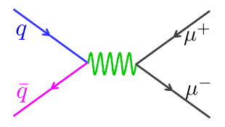
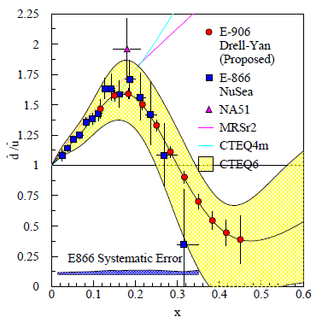
Fermilab E906/Seaquest: A dedicated Drell-Yan experiment
Follow-up experiment to Fermilab E866 with main goal of extending measurements to higher x
120 GeV proton beam from Fermilab Main Injector (E866: 800 GeV)
E866

Slide 25
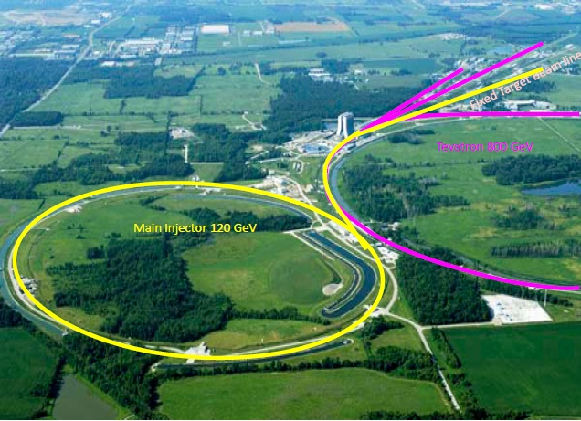
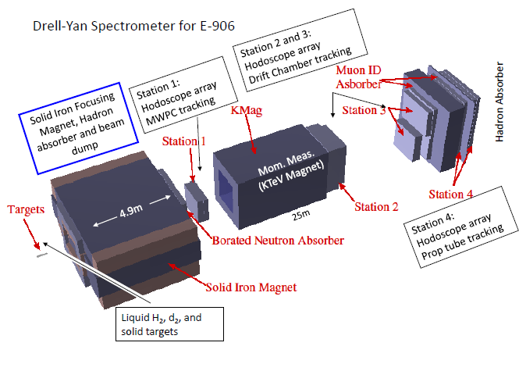
Fermilab E906
Targets: Liquid hydrogen and deuterium (W. Lorenzon), and C, Ca, W nuclei
  Also cold nuclear matter program
Commissioning starts in one week(!!), data-taking through ~2014

Slide 26
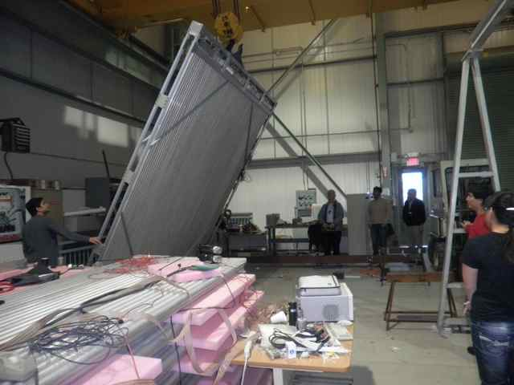
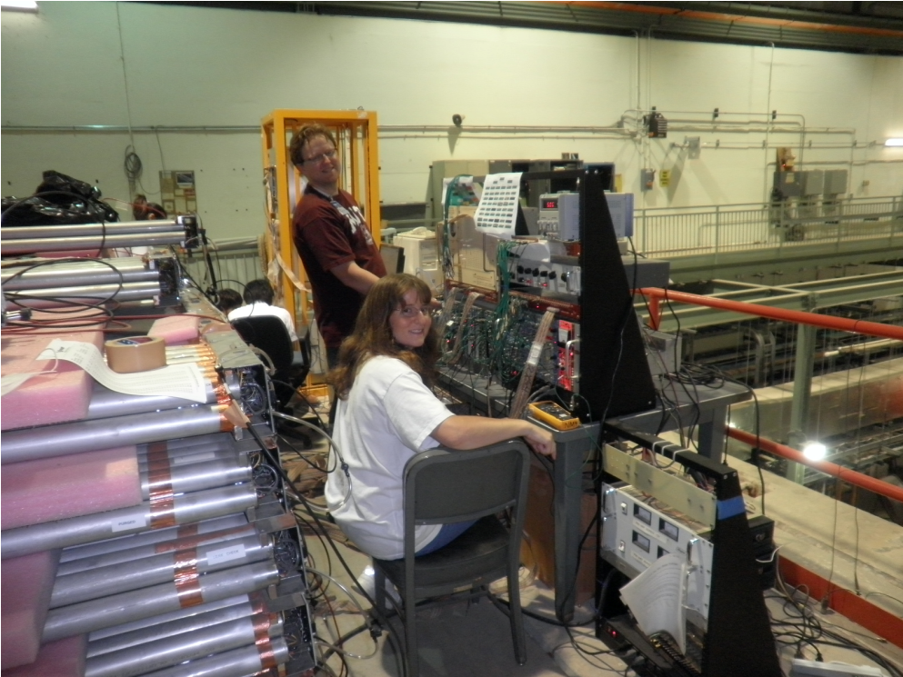
E906 Station 4 plane for tracking and muon identification
Assembled from old proportional tubes scavenged from LANL “threat reduction” experiments!

Slide 27
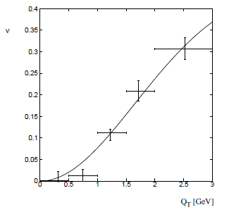
Azimuthal dependence of unpolarized Drell-Yan cross section
cos2φ term sensitive to correlations between quark transverse spin and quark transverse momentum!
Large cos2φ dependence seen in pion-induced Drell-Yan
ν
NA10 dataa
194 GeV/c
π⁻+W
Q_{T} (GeV)
D. Boer, PRD60, 014012 (1999)

Slide 28
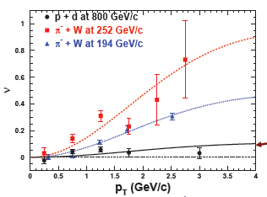

What about proton-induced Drell-Yan?
Significantly reduced cos2φ dependence in proton-induced Drell-Yan observed by E866
Suggests sea quark transverse spin-momentum correlations small?
Will be interesting to measure for higher-x sea quarks in E906!
E866, PRL 99, 082301
(2007)
Looking forward to forthcoming data!!
E866

Slide 29
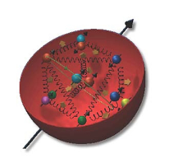
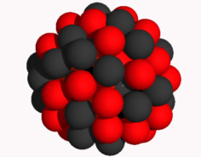
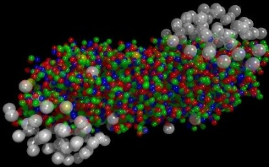
The Relativistic Heavy Ion Collider at Brookhaven National Laboratory
A great place to be to study QCD!
An accelerator-based program, but not designed to be at the energy (or intensity) frontier. More closely analogous to many areas of condensed matter research—create a system and study its properties!
What systems are we studying?
  “Simple” QCD bound states—the proton is the simplest stable bound state in QCD (and conveniently, nature has already created it for us!)
  Collections of QCD bound states (nuclei, also available out of the box!)
  QCD deconfined! (quark-gluon plasma, some assembly required!)
Understand more complex QCD systems within
the context of simpler ones
RHIC was designed from the start as a single facility capable of nucleus-nucleus, proton-nucleus, and proton-proton collisions

Slide 30
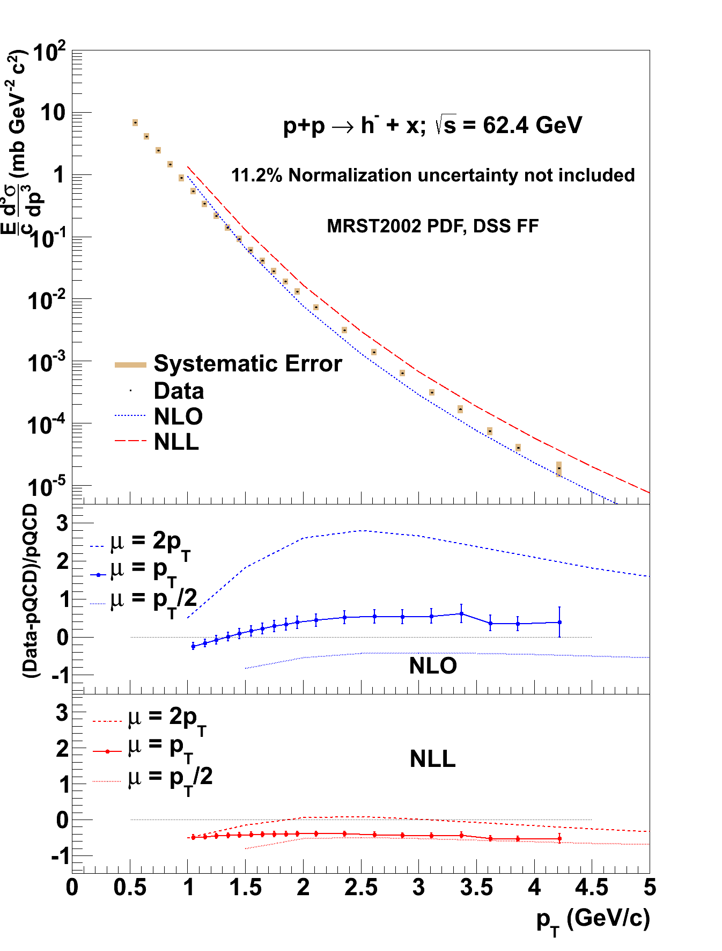

Studying particle production at intermediate center-of-mass energies in p+p
Testing the ranges of applicability of various pQCD tools:
While next-to-leading-order (NLO) calculations in α_{s} underpredict lower-energy data by factors of 3 or more, and including a subset of higher-order terms via “resummation” vastly improves agreement, at √s=62.4 GeV NLO still underpredicts, but resummation techniques overpredict
→Suggests (omitted) higher-order terms of similar magnitude and opposite sign to the ones included by resummation!
To be submitted to Phys.Rev.D Feb. 17
C.A. Aidala, PHENIX

Slide 31
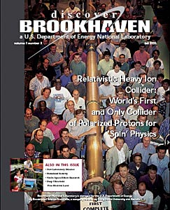
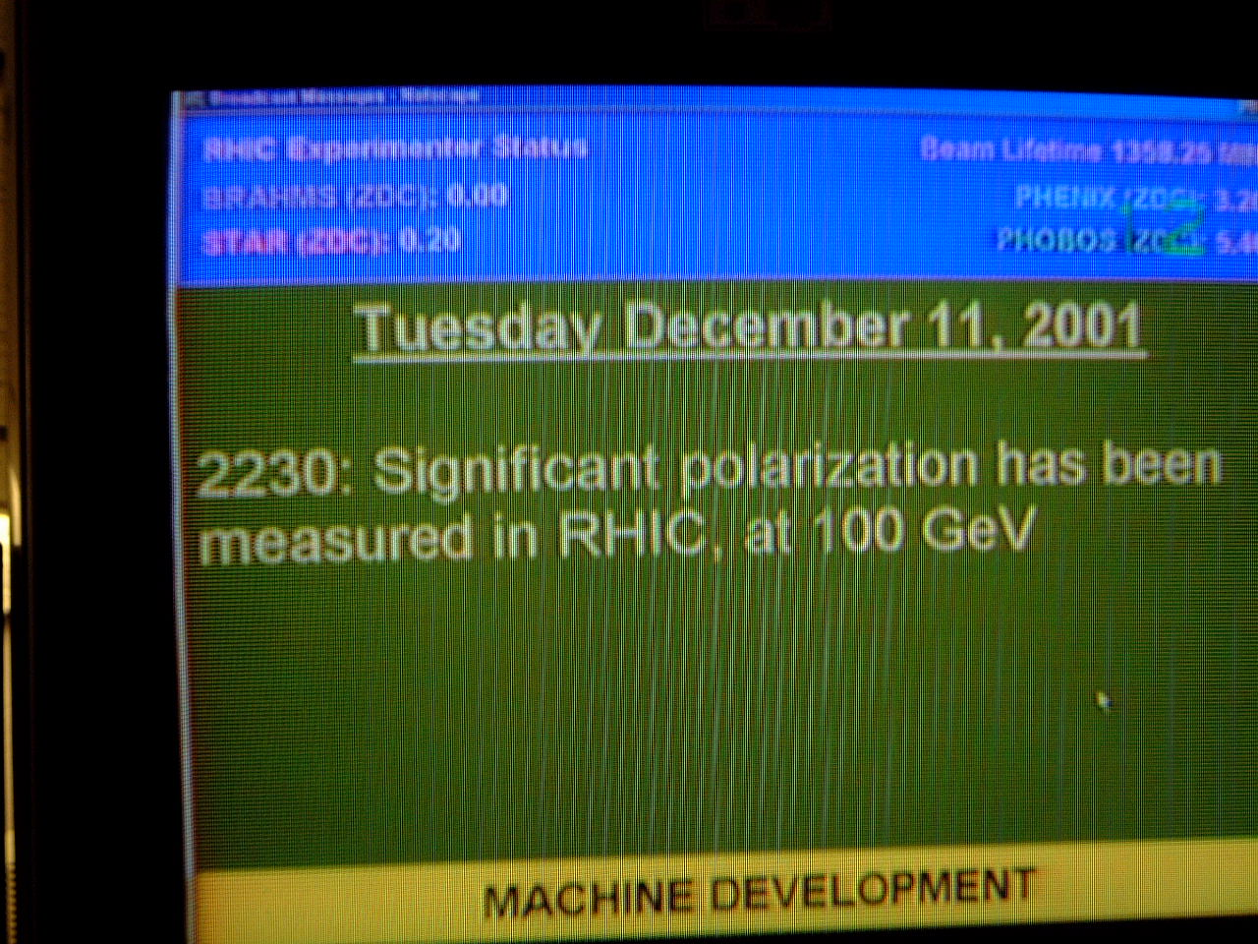
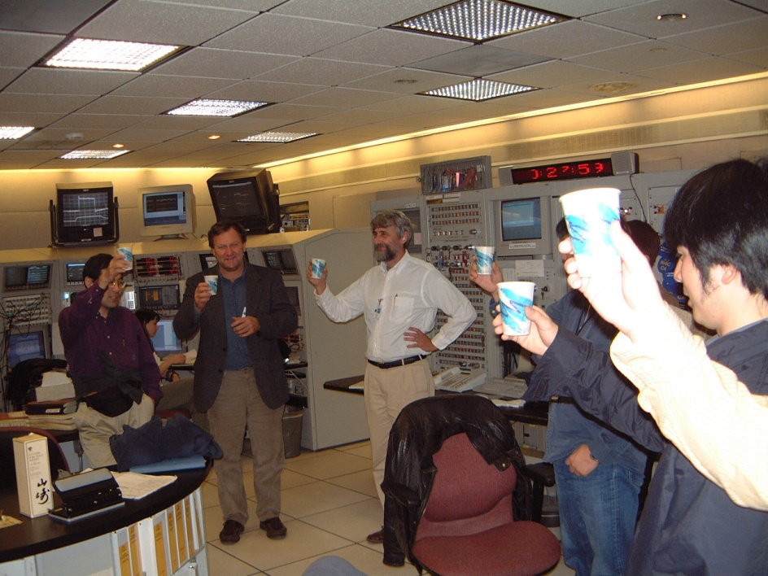
First and only polarized proton collider
31

Slide 32
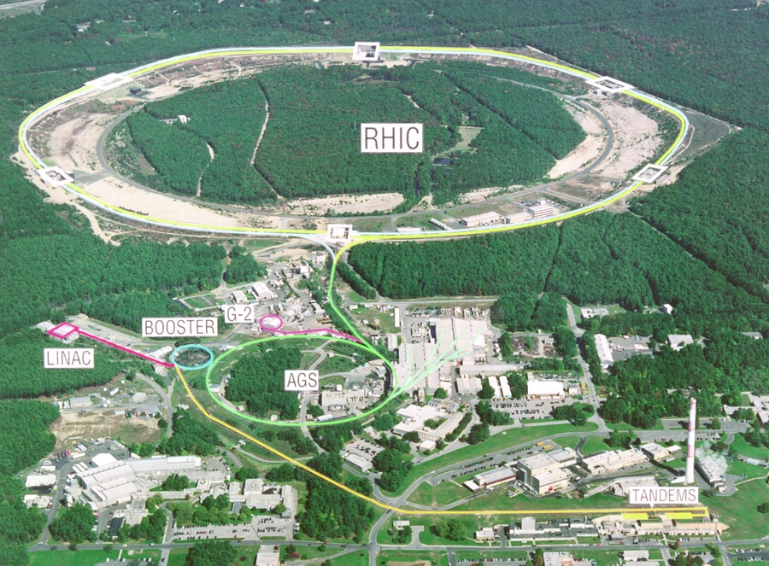

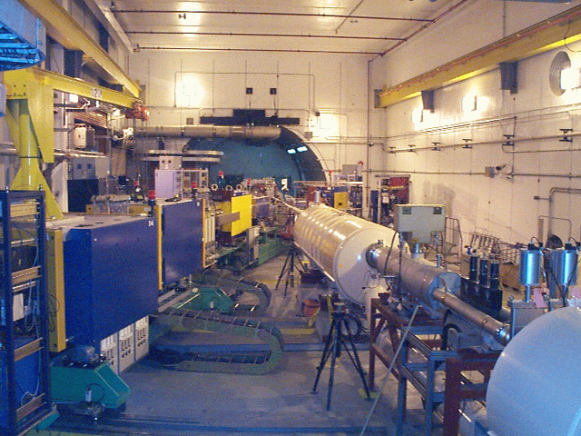
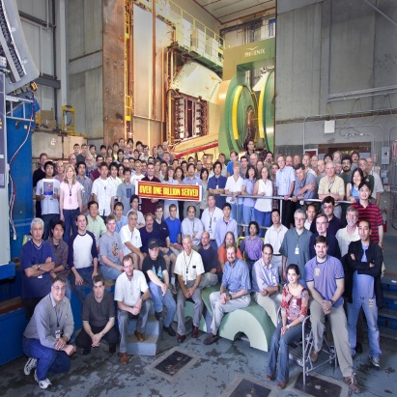
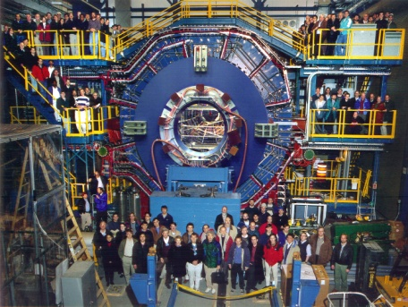


Spin physics at RHIC
Polarized protons at RHIC 2002-present
Mainly √s = 200 GeV, also 62.4 GeV in 2006, started 500 GeV program in 2009
Two large multipurpose detectors: STAR and PHENIX
  Longitudinal or transverse polarization
One small spectrometer until 2006: BRAHMS
  Transverse polarization only
Transverse spin only
(No rotators)
Longitudinal or transverse spin
Longitudinal or transverse spin

Slide 33

Transverse single-spin asymmetries:
From low to high energies!
ANL
√s=4.9 GeV
BNL
√s=6.6 GeV
FNAL
√s=19.4 GeV
RHIC
√s=62.4 GeV
left
Effects persist to RHIC energies
→ Can probe this striking spin-momentum correlation in a calculable regime!
right

Slide 34


High-x_{F} asymmetries, but not valence quarks??
K
p
200 GeV
200 GeV
Negative kaons same as positive??
Large antiproton asymmetry?!
Pattern of pion species asymmetries in the forward direction
→ valence quark effect.
But this conclusion confounded by kaon and antiproton asymmetries from RHIC!

Slide 35


Another surprise: Transverse single-spin asymmetry in η meson production
Larger than the neutral pion!
STAR
Note earlier Fermilab E704 data consistent . . .
Further evidence against a valence quark effect!

Slide 36


Forward η transverse single-spin asymmetry from PHENIX
→ Disagrees with STAR!
C.A. Aidala, PHENIX
Not quite apples-to-apples, but difference unlikely to be explained by the modestly different kinematics . . .
But still a hint from PHENIX that spin-momentum correlations in η production larger than π⁰??
STAR
Will need to wait for final results from both collaborations . . .

Slide 37


pQCD calculations for η mesons recently enabled by first-ever fragmentation function parametrization
Simultaneous fit to world e⁺e⁻ and p+p data
  e⁺e⁻ annihilation to hadrons simplest colliding system to study FFs
  Technique to include deep-inelastic scattering and p+p data in addition to e⁺e⁻ only developed in 2007!
  Included PHENIX p+p cross section in η FF parametrization
C.A. Aidala, F. Ellinghaus, R. Sassot, J.P. Seele, M. Stratmann,
PRD83, 034002 (2011)

Slide 38



With η FF now published, can calculate . . .
C.A. Aidala, PHENIX
Kanazawa + Koike,
PRD83, 114024 (2011)
PRD83, 032001 (2011)
Cyclical process of refinement—the more non-perturbative functions are constrained, the more we can learn from additional measurements!
η double-helicity asymmetry, to learn more about gluon polarization in the proton
η cross section at LHC, to evaluate existing pQCD tools and pdfs against particle production at much higher √s
η transverse single-spin asymmetry. Obtains η larger than π⁰ due to strangeness! (But not as large as STAR . . .)
ALICE, arXiv:1106.5932

Slide 39



Testing factorization/factorization breaking with (unpolarized) p+p collisions
Testing factorization in transverse-momentum-dependent case
  Important for broad range of pQCD calculations
Can we parametrize transverse-momentum-dependent distributions that simultaneously describe many measurements?
  So far yes for Drell-Yan and Z boson data, including recent Z measurements from Tevatron and LHC!
Z boson production,
Tevatron CDF
dσ/dp_{T}
dσ/dp_{T}
C.A. Aidala,
T.C. Rogers
√s = 0.039 TeV
√s = 1.96 TeV
p_{T} (GeV/c)
p_{T} (GeV/c)

Slide 40

Testing factorization/factorization breaking with (unpolarized) p+p collisions
Then will test predicted factorization breaking using e.g. dihadron correlation measurements in unpolarized p+p collisions
  Lots of expertise on such measurements within PHENIX, driven by heavy ion program!
PRD82, 072001 (2010)
Out-of-plane momentum component
C.A. Aidala,
T.C. Rogers, work in progress
PRD 81:094006 (2010)

Slide 41
Spin-momentum correlations and the proton as a QCD “laboratory”
“Transversity” pdf:
Correlates proton transverse spin and quark transverse spin
“Sivers” pdf:
Correlates proton transverse spin and quark transverse momentum
“Boer-Mulders” pdf:
Correlates quark transverse spin and quark transverse momentum
S_{p}-S_{q} coupling
S_{p}-L_{q} coupling
S_{q}-L_{q} coupling

Slide 42
Summary and outlook
We still have a ways to go from the quarks and gluons of QCD to full descriptions of the protons and nuclei of the world around us!
The proton as the simplest QCD bound state provides a QCD “laboratory” analogous to the atom’s role in the development of QED
After an initial “discovery and development” period lasting ~30 years, we’re now taking the first steps into an exciting new era of quantitative QCD!

Slide 43
Afterword:
QCD “versus” nucleon structure?
A personal perspective

Slide 44
We shall not cease from exploration
And the end of all our exploring
Will be to arrive where we started
And know the place for the first time.
T.S. Eliot

Slide 45
Extra

Slide 46


Parametrizing transverse-momentum-dependent parton distribution functions
Can successfully simultaneously describe data from fixed-target energies to LHC energies! With better knowledge of the quark and gluon distributions inside the proton, will be able to improve predictions for transverse momentum dependence of particle production at LHC.
C.A. Aidala,
T.C. Rogers
dσ/dp_{T}
dσ/dp_{T}
√s = 1.96 TeV
√s = 7.0 TeV
p_{T} (GeV/c)
p_{T} (GeV/c)

Slide 47

Midrapidity η/π⁰ cross section ratio
C.A. Aidala, PHENIX, PRD83, 032001 (2011)
Significantly lower ratio in pQCD calculation compared to data → need to simultaneously fit fragmentation functions for multiple particle species. Hadronization phenomenology hasn’t reached that point yet. . .

Slide 48

First η transverse single-spin asymmetry theory calculation
Using new η FF parametrization, first theory calculation now published (STAR kinematics)
Obtain larger asymmetry for eta than for neutral pion over entire x_{F} range, not nearly as large as STAR result
Kanazawa + Koike, PRD83, 114024 (2011)

Slide 49


Cross section and double-helicity asymmetry in charged hadron production at √s=62.4 GeV
To be submitted to Phys.Rev.D
p+p→ h⁺+X
To be submitted to Phys.Rev.D
C.A. Aidala, PHENIX

Slide 50

Cross section and double-helicity asymmetry in charged hadron production at √s=62.4 GeV
To be submitted to Phys.Rev.D
p+p→ h⁻+X
To be submitted to Phys.Rev.D
C.A. Aidala, PHENIX

Slide 51

Left-right pion asymmetry at
90º from the beam
A_{N}
C.A. Aidala,
PHENIX
left
Consistent with zero within < 0.01, compared to measurements of ~0.1 close to the beam direction
right
Notes:
Color code

Slide 52

Left-right π⁰ vs. η asymmetry at
90º from the beam
A_{N}
p_{T}
left
At 90º from beam, both η and π⁰ consistent with zero
right

Slide 53

Drell-Yan complementary to DIS

Slide 54

Azimuthal dependence of Drell-Yan cross section
In terms of transverse-momentum-dependent parton distribution functions
Arnold, Metz, Schlegel, PRD79, 034005 (2009)
Contributions if you have unpolarized (U), longitudinally polarized (L), or transversely polarized (T) beam and target

Slide 55

The Electron-Ion Collider
A facility to bring this new era of quantitative QCD to maturity!
How can QCD matter be described in terms of the quark and gluon d.o.f. in the field theory?
How does a colored quark or gluon become a colorless object?
Study in detail
  “Simple” QCD bound states: Nucleons
  Collections of QCD bound states: Nuclei
  Hadronization
Collider energies: Focus on
sea quarks and gluons

Slide 56

Why an Electron-Ion Collider?
Electroweak probe
  “Clean” processes to interpret (QED)
  Measurement of scattered electron → full kinematic information on partonic scattering
Collider mode → Higher energies
  Quarks and gluons relevant d.o.f.
  Perturbative QCD applicable
  Heavier probes accessible (e.g. charm, bottom, W boson exchange)

Slide 57




Accelerator concepts
Polarized beams of p, ³He
  Previously only fixed-target polarized experiments!
Beams of light → heavy ions
  Previously only fixed-target electron-ion experiments!
Luminosity 100-1000x that of HERA e+p collider
Two concepts: Add electron facility to RHIC at BNL or ion facility to CEBAF at JLab
EIC
EIC (20x100) GeV
EIC (10x100) GeV
Notes:
Add sqrt(s) ranges?

Slide 58







RHIC as a polarized p+p collider
Absolute Polarimeter (H jet)
RHIC pC Polarimeters
Siberian Snakes
BRAHMS & PP2PP
Siberian Snakes
PHENIX
Spin Flipper
STAR
Spin Rotators
Various equipment to maintain and measure beam polarization through acceleration and storage
Partial Snake
Helical Partial
Snake
Polarized Source
Strong Snake
LINAC
AGS
200 MeV Polarimeter
BOOSTER
Rf Dipole
AGS Internal Polarimeter
AGS pC Polarimeter
58

Slide 59

PHENIX detector
Philosophy:
  High rate capability to measure rare probes,
  limited acceptance.
2 central spectrometers
  Track charged particles and detect electromagnetic processes
2 forward muon spectrometers
  Identify and track muons
2 forward calorimeters (as of 2007)
  Measure forward pions, etas
Relative Luminosity
  Beam-Beam Counter (BBC)
  Zero-Degree Calorimeter (ZDC)

