Slide 1
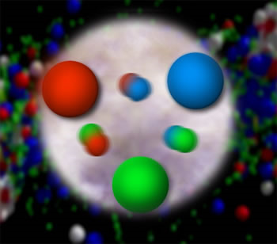
From Quarks and Gluons to the World Around Us:
Advancing into the Era of Quantitative QCD via Investigation of Nucleon Structure
Christine A. Aidala
Los Alamos National Lab
Stony Brook
February 28, 2011

Slide 2
Theory of strong interactions:
Quantum Chromodynamics
  Salient features of QCD not evident from Lagrangian!
    Color confinement
    Asymptotic freedom
  Gluons: mediator of the strong interactions
    Determine essential features of strong interactions
    Dominate structure of QCD vacuum (fluctuations in gluon fields)
    Responsible for > 98% of the visible mass in universe(!)
An elegant and by now well established field theory, yet with degrees of freedom that we can never observe directly in the laboratory!

Slide 3
How do we understand the visible matter in our universe in terms of the fundamental quarks and gluons of QCD?

Slide 4
The proton as a QCD “laboratory”
Proton—simplest stable bound state in QCD!
?...
observation & models
fundamental theory
precision measurements
& more powerful theoretical tools
application?

Slide 5
Nucleon structure: The early years
1933: Estermann and Stern measure the proton’s anomalous magnetic moment → indicates proton not a pointlike particle!
1960s: Quark structure of the nucleon
  SLAC inelastic electron-nucleon scattering experiments by Friedman, Kendall, Taylor → Nobel Prize
  Theoretical development by Gell-Mann → Nobel Prize
1970s: Formulation of QCD . . .

Slide 6
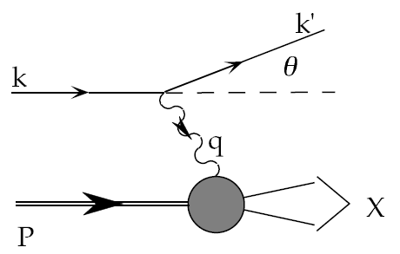
Deep-inelastic lepton-nucleon scattering:
A tool of the trade
Probe nucleon with an electron or muon beam
Interacts electromagnetically with (charged) quarks and antiquarks
“Clean” process theoretically—quantum electrodynamics well understood and easy to calculate!

Slide 7
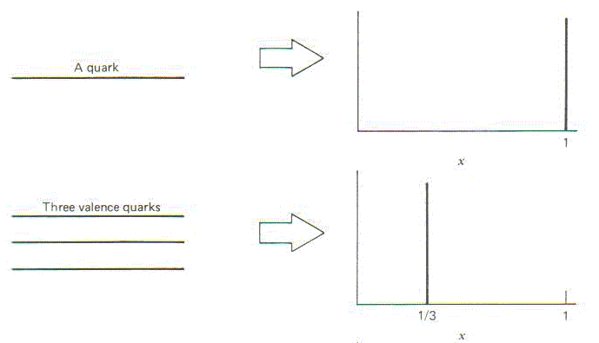
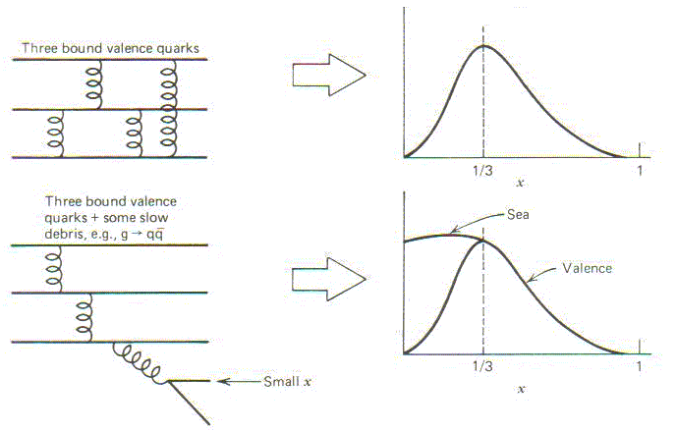
Parton distribution functions inside a nucleon:
The language we’ve developed (so far!)
What momentum fraction would the scattering particle carry
if the proton were made of …
3 bound valence quarks
A point particle
x_{Bjorken}
1
1/3
1
3 bound valence quarks + some
low-momentum sea quarks
x_{Bjorken}
Sea
3 valence quarks
Valence
Small x
1/3
1
x_{Bjorken}
1/3
x_{Bjorken}
1
Halzen and Martin, “Quarks and Leptons”, p. 201

Slide 8
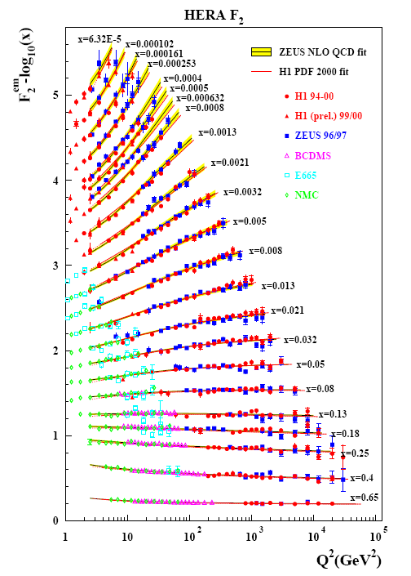
Decades of DIS data: What have we learned?
Wealth of data largely thanks to proton-electron collider, HERA, in Hamburg, which shut down in July 2007
Rich structure at low x
Half proton’s linear momentum carried by gluons!
PRD67, 012007 (2003)

Slide 9
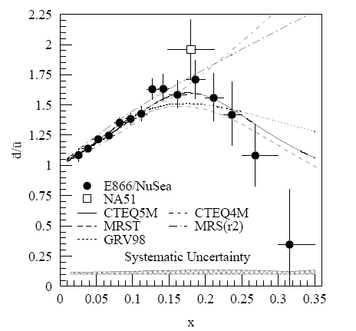
And a (relatively) recent surprise from p+p, p+d collisions
Fermilab Experiment 866 used proton-hydrogen and proton-deuterium collisions to probe nucleon structure via the Drell-Yan process
Anti-up/anti-down asymmetry in the quark sea, with an unexpected x behavior!
Indicates “primordial” sea quarks, in addition to those dynamically generated by gluon splitting!
Hadronic collisions play a complementary role to DIS and have let us continue to find surprises in the rich linear momentum structure of the proton, even after > 40 years!
PRD64, 052002 (2001)

Slide 10
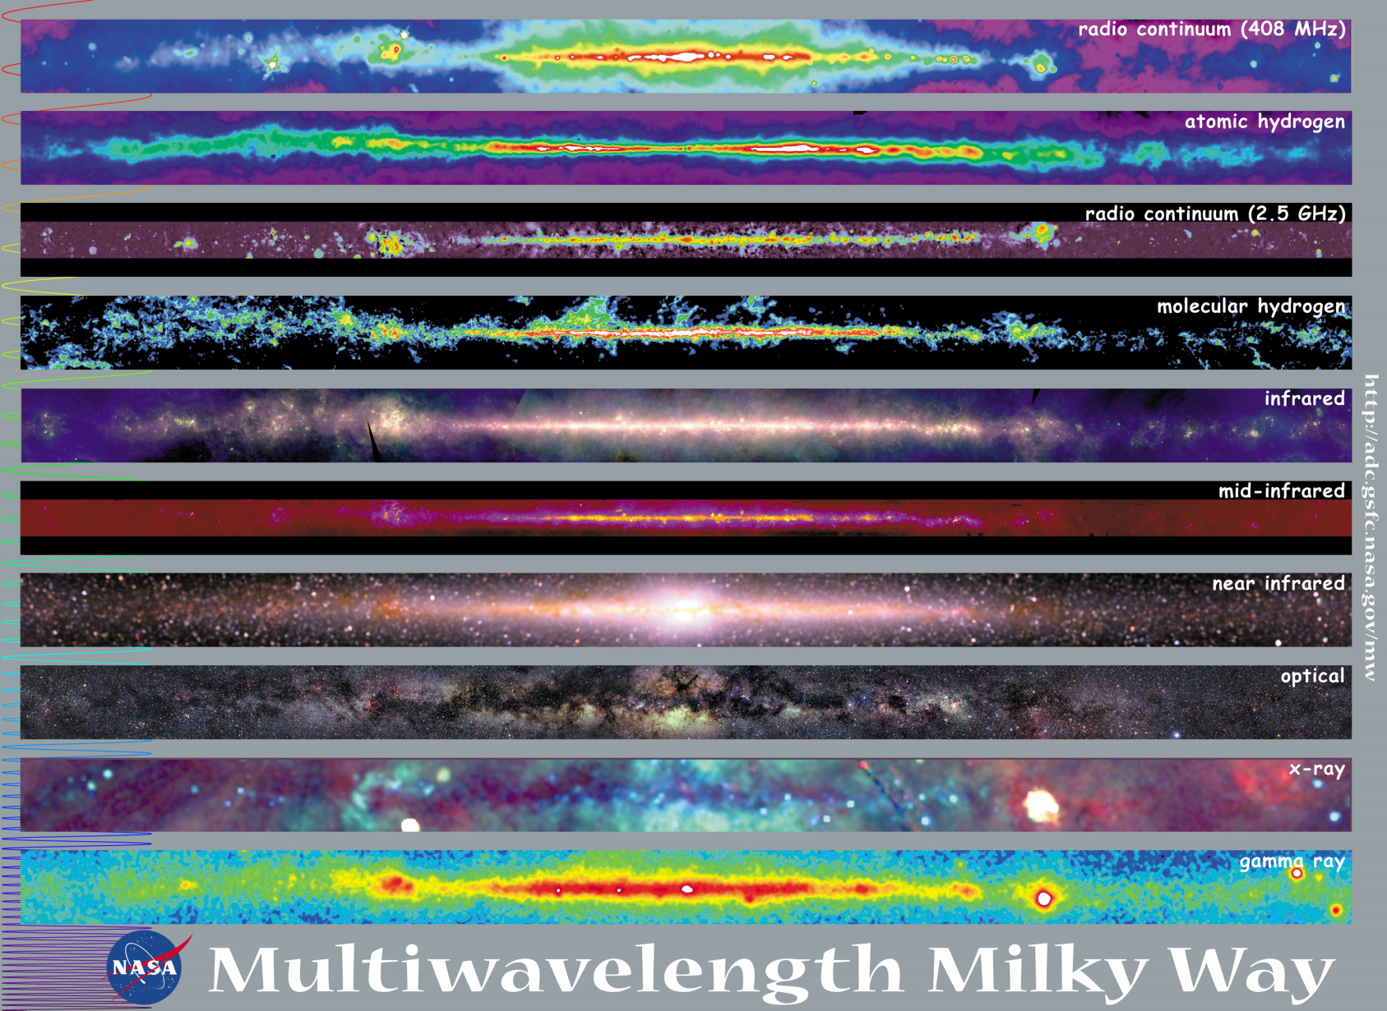
Observations with different probes allow us to learn different things!

Slide 11
Mapping out the proton
What does the proton look like in terms of the quarks and gluons inside it?
Position
Momentum
Spin
Flavor
Color
Theoretical and experimental concepts to describe and access position only born in mid-1990s. Pioneering measurements over past decade.
Vast majority of past four decades focused on
1-dimensional momentum structure! Since 1990s starting to consider other directions . . .
Polarized protons first studied in 1980s. How angular momentum of quarks and gluons add up still not well understood!
Early measurements of flavor distributions in valence region. Flavor structure at lower momentum fractions still yielding surprises!
Accounted for by theorists from beginning of QCD, but more detailed, potentially observable effects of color have come to forefront in last couple years . . .

Slide 12
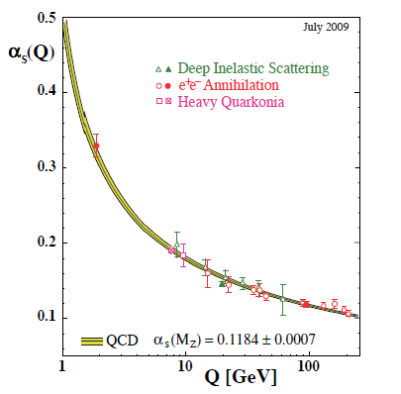
Perturbative QCD
Take advantage of running of the strong coupling constant with energy (asymptotic freedom)—weak coupling at high energies (short distances)
Perturbative expansion as in QED (but many more diagrams due to gluon self-coupling!!)
Most importantly: pQCD provides a rigorous way of relating the fundamental field theory to a variety of physical observables!
Notes:
Scattering energy

Slide 13
Predictive power of pQCD
q(x₁)
Hard Scattering Process
X
g(x₂)
“Hard” (high-energy) probes have predictable rates given:
    Partonic hard scattering rates (calculable in pQCD)
    Parton distribution functions (need experimental input)
    Fragmentation functions (need experimental input)
Universal non-perturbative factors

Slide 14
Factorization and universality in perturbative QCD
Need to systematically factorize short- and long-distance physics—observable physical QCD processes always involve at least one long-distance scale (confinement)!
Long-distance (i.e. non-perturbative) functions need to be universal in order to be portable across calculations for many processes
Measure pdfs and FFs in many colliding systems over a wide kinematic range, constrain by performing
simultaneous fits to world data

Slide 15
QCD: How far have we come?
QCD challenging!!
Three-decade period after initial birth of QCD dedicated to “discovery and development”
→ Symbolic closure: Nobel prize 2004 - Gross, Politzer, Wilczek for asymptotic freedom
Now very early stages of second phase:
quantitative QCD!
Notes:
[While some a generation or so ahead of me have enjoyed very exciting careers [centered on][based around] the discovery and development of QCD, …]

Slide 16
Advancing into the era of quantitative QCD: Theory already forging ahead!
In perturbative QCD, since 1990s starting to consider detailed internal QCD dynamics that parts with traditional parton model ways of looking at hadrons—and perform phenomenological calculations using these new ideas/tools!
  Non-collinearity of partons with parent hadron
  Non-linear evolution at small momentum fractions
  Various resummation techniques
Non-perturbative methods:
  Lattice QCD less and less limited by computing resources
  AdS/CFT an exciting recent development as first fundamentally new handle to try to tackle QCD in decades!

Slide 17
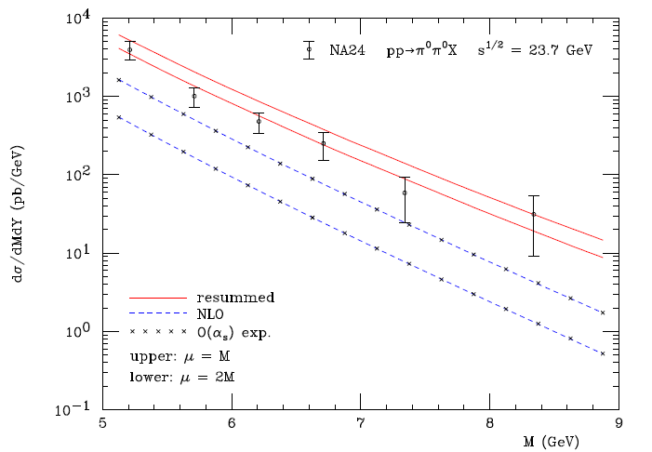
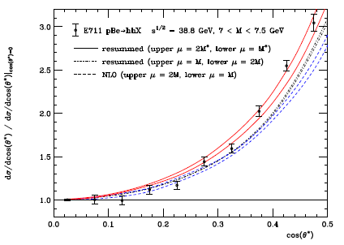
Example: Threshold resummation to extend pQCD to lower energies
pBe→hhX
pp→π⁰π⁰X
M (GeV)
cos θ*
Almeida, Sterman, Vogelsang PRD80, 074016 (2009) .
Cross section for dihadron production vs. invariant mass and cos θ* at sqrt(s)~20-40 GeV using threshold resummation (rigorous method for implementing p_{T} and rapidity cuts on hadrons to match experiment). Much improved agreement compared to NLO!

Slide 18
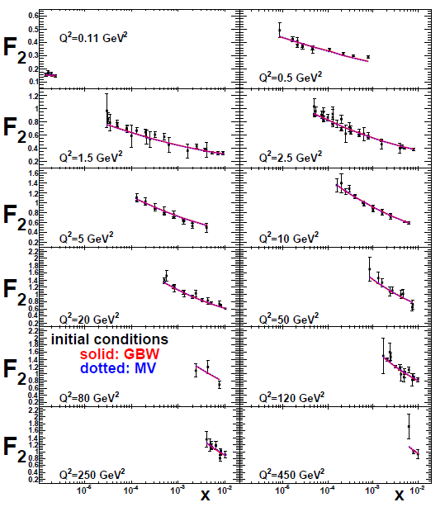
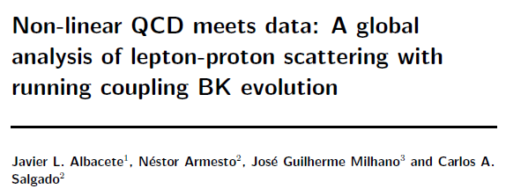
Example: Phenomenological applications of a non-linear gluon saturation regime at low x
Phys. Rev. D80, 034031 (2009)

Slide 19
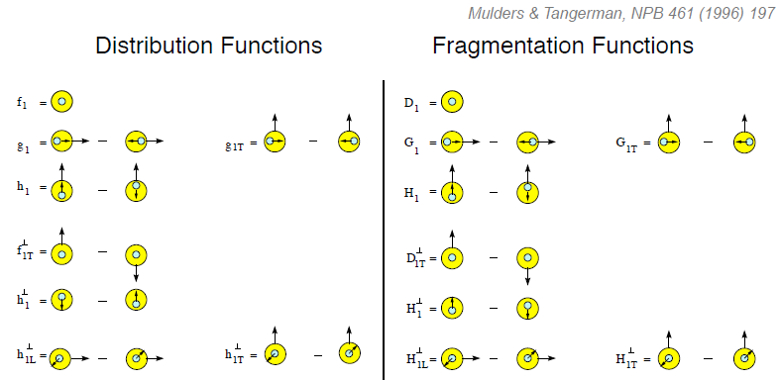
Dropping the simplifying assumption of collinearity: Transverse-momentum-dependent distributions (TMDs)
Collinear
Worm gear
“Modern-day ‘testing’ of (perturbative) QCD is as much about pushing the boundaries of its applicability as about the verification that QCD is the correct theory of hadronic physics.”
– G. Salam, hep-ph/0207147 (DIS2002 proceedings)
Collinear
Transversity
Sivers
Polarizing FF
Boer-Mulders
Pretzelosity
Collins
Worm gear

Slide 20
Critical to perform experimental work where quarks and gluons are relevant d.o.f. in the processes studied!

Slide 21
Evidence for variety of spin-momentum correlations in proton, and in process of hadronization!
Collinear
Worm gear
Collinear
Transversity
Measured non-zero!
Sivers
Polarizing FF
Boer-Mulders
Pretzelosity
Collins
Worm gear

Slide 22
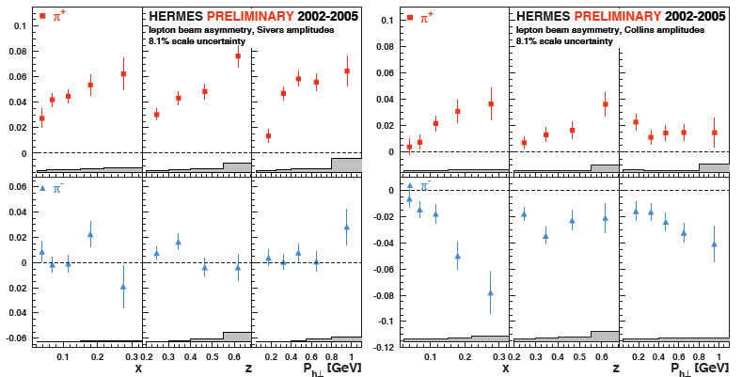
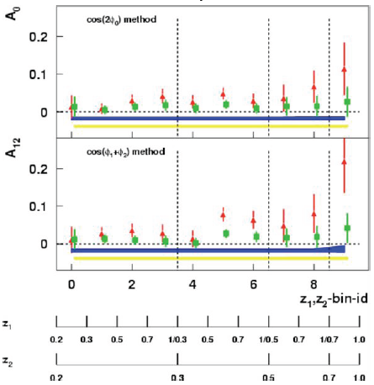
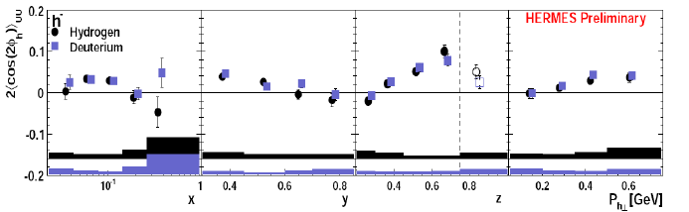
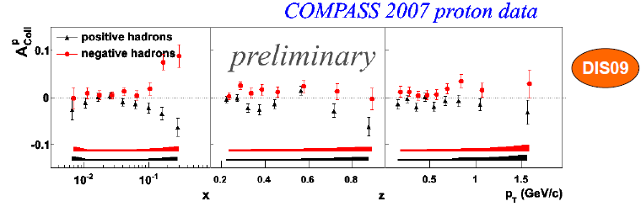
Sivers
Collins
BELLE Collins: PRL96, 232002 (2006)
Boer-Mulders
SPIN2008
A flurry of new experimental results from semi-inclusive DIS and e+e- over last ~8 years
Collins

Slide 23
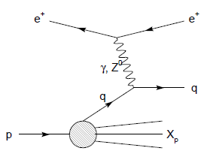
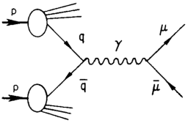
Modified universality of T-odd transverse-momentum-dependent distributions:
Color in action!
DIS: attractive final-state int.
Drell-Yan: repulsive initial-state int.
Some DIS measurements already exist. A polarized Drell-Yan measurement at RHIC will be a crucial test of our understanding of QCD!
As a result:

Slide 24
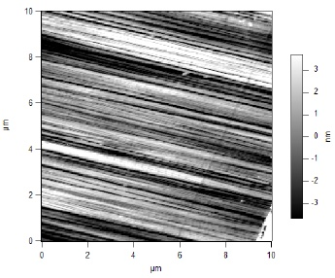
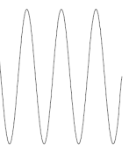
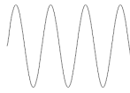
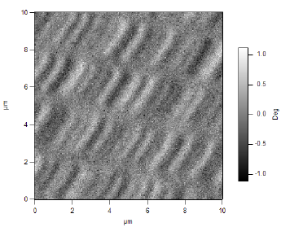
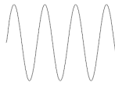
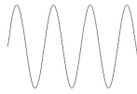
What things “look” like depends on how you “look”!
Slide courtesy of K. Aidala
Magnetic Force Microscopy
Computer Hard Drive
magnetic tip
Topography
Probe interacts with system being studied!
Lift height
Magnetism

Slide 25
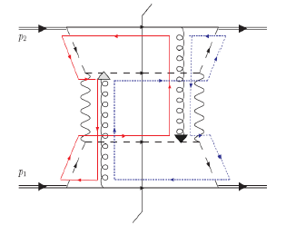
Factorization, color, and hadronic collisions
  Last year, theoretical work by T.C. Rogers, P.J. Mulders (PRD 81:094006, 2010) claimed pQCD factorization broken in processes involving hadro-production of hadrons if parton k_{T} taken into account (TMD pdfs and/or FFs)
  “Color entanglement”
Non-collinear pQCD an exciting subfield—lots of recent experimental activity, and theoretical questions probing deep issues of both universality and factorization in pQCD!
Color flow can’t be described as flow in the two gluons separately. Requires simultaneous presence of both!

Slide 26
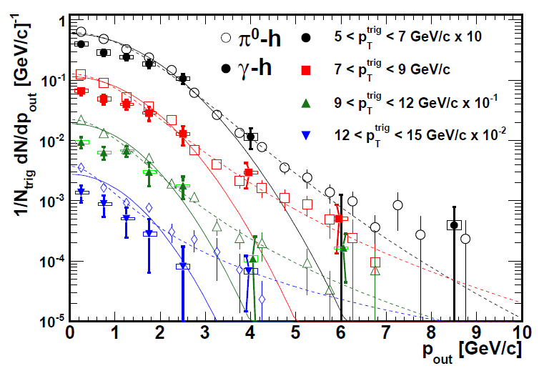
Testing TMD-factorization breaking with (unpolarized) p+p collisions at RHIC
Will test using photon-hadron and dihadron correlation measurements in unpolarized p+p collisions—lots of expertise on such measurements within PHENIX, driven by heavy ion program!
Calculate p_{out} distributions assuming factorization works
Will show different shape than data??
Difference between factorized calculation and data will vary for 3-hadron vs. 4-hadron processes??
PHENIX, PRD82, 072001 (2010)
(Curves shown here just empirical parameterizations from PHENIX paper)
First step toward calculations (TMD evolution) just came out!
S.M. Aybat, T.C. Rogers, arXiv:11015057 [hep-ph]

Slide 27
How to keep pushing forward experimentally?
Need continued measurements where quarks and gluons are relevant degrees of freedom
  Need “high enough” collision energies
Need to study different collision systems and processes!!
  Electroweak probes of QCD systems (DIS): Allow study of many aspects of QCD in hadrons while being easy to calculate
  Strong probes of QCD systems (hadronic collisions): The real test of our understanding! Access color . . .
My own work—
Hadronic collisions
  Drell-Yan → FNAL E906, (PHENIX)
  Variety of electroweak and hadronic final states → PHENIX
Deep-inelastic scattering
  Working toward Electron-Ion Collider as a next-generation facility
If you can’t understand p+p collisions, your work isn’t done yet in understanding QCD in hadrons!

Slide 28
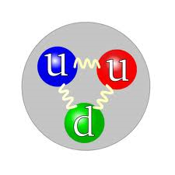

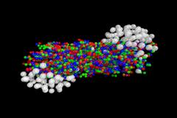
Studying QCD at RHIC
Great place to be for QCD!
Versatile facility, multipurpose detectors →Ability to follow the physics!!
Heavy ion and nucleon structure programs complement, inform, and strengthen each other

Slide 29
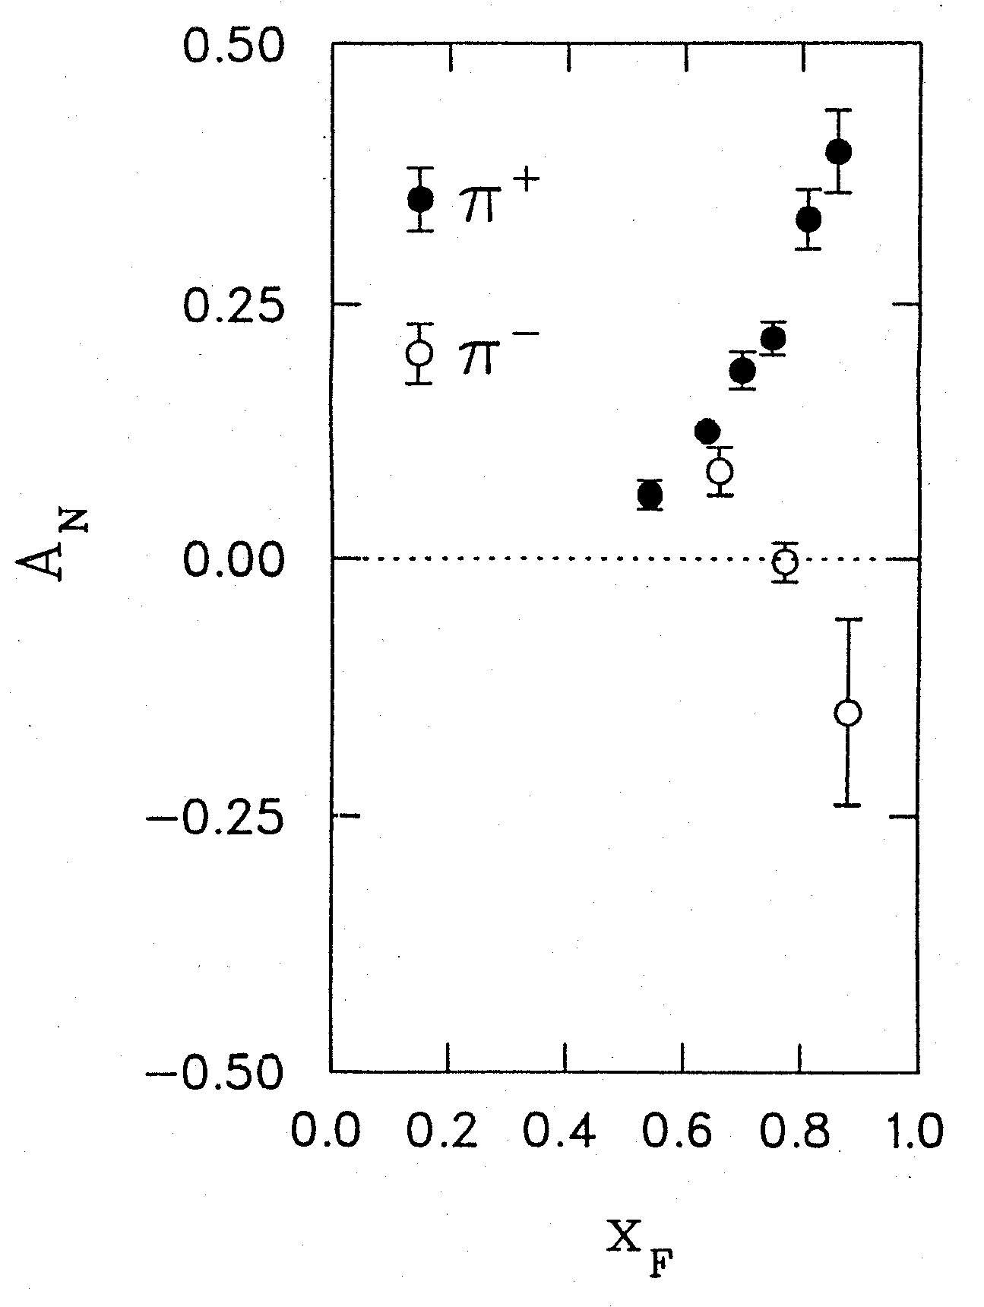
Transversely polarized hadronic collisions: A discovery ground
Argonne ZGS, p_{beam} = 12 GeV/c
left
right
What’s the origin of such striking asymmetries?? We’ll need to wait more than a decade for the birth of a new subfield in order to explore the possibilities . . .
W.H. Dragoset et al., PRL36, 929 (1976)

Slide 30
Transverse-momentum-dependent distributions and single-spin asymmetries
1989: “Sivers mechanism” proposed
Take into account the transverse momentum (k_{T}) of quarks within the proton, and postulate a correlation between quark k_{T} and proton spin!
Single-spin asymmetries ~ S•(p₁×p₂)
D.W. Sivers, PRD41, 83 (1990)

Slide 31


Transverse single-spin asymmetries:
From low to high energies!
ANL
√s=4.9 GeV
BNL
√s=6.6 GeV
FNAL
√s=19.4 GeV
RHIC
√s=62.4 GeV
RHIC
√s=200 GeV
Effects persist to RHIC energies
→ Can probe this non-perturbative structure of nucleon in a calculable regime!
π⁰
left
STAR
right

Slide 32
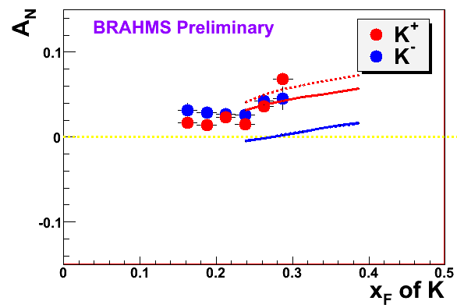
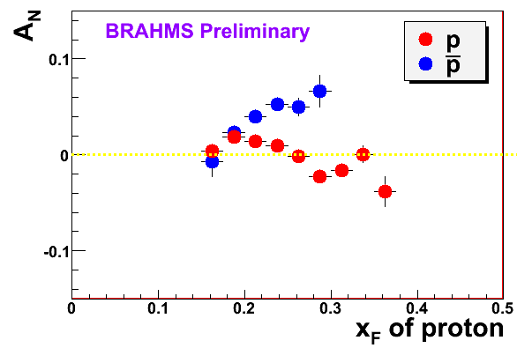
High-x_{F} asymmetries, but not valence quarks??
Pattern of pion species asymmetries in the forward direction→ valence quark effect.
But this conclusion confounded by kaon and antiproton asymmetries from RHIC!
Note different scales
PRL 101, 042001 (2008)
K
K
K⁻ asymmetries
underpredicted
200 GeV
62.4 GeV
p
p
Large antiproton asymmetry?!
(No one has attempted calculations yet . . .)
200 GeV
62.4 GeV

Slide 33
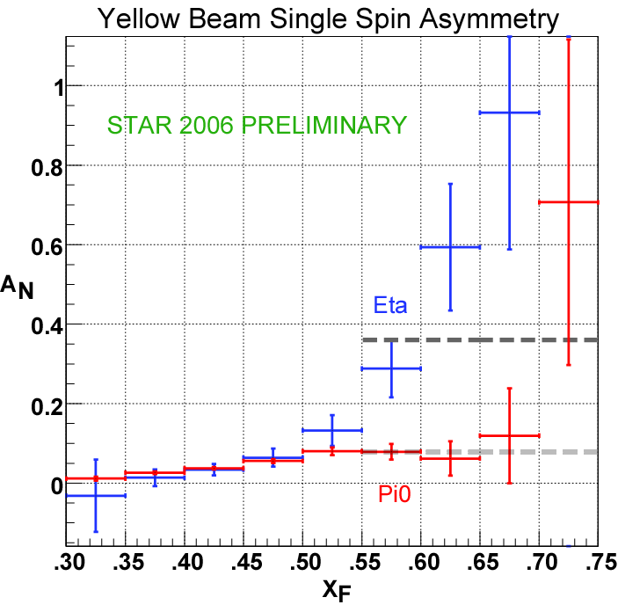
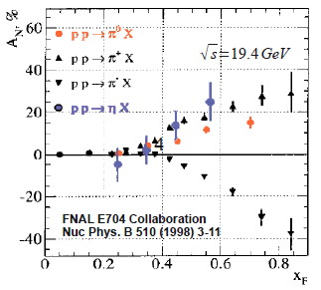

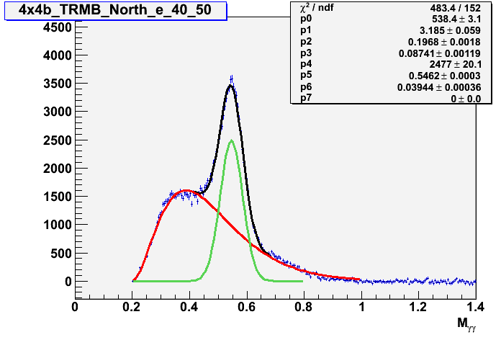
Another surprise: Transverse single-spin asymmetry in eta meson production
Further evidence against a valence quark effect!
results coming soon!
Larger than the neutral pion!
STAR
Mean mass: 0.546 GeV/c²
Width: 0.039 GeV/c²
(7% mass resolution)
0.4 < x_{F} < 0.5
Note earlier E704 data consistent . . .
m_{γγ} (GeV/c²)

Slide 34

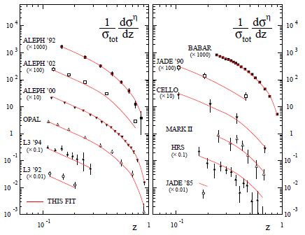
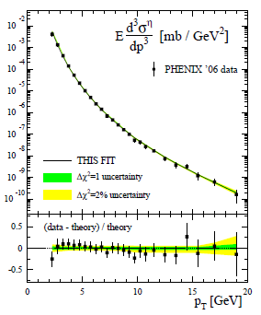
pQCD calculations for η mesons recently enabled by first-ever FF parametrization
Simultaneous fit to world e+e- and p+p data
  Included PHENIX p+p cross section
So far used to calculate η double-longitudinal spin asymmetry, and code requests from theorists working on transverse single-spin asymmetries and nuclear modification of FFs
Cyclical process of refinement—the more non-perturbative functions are constrained, the more we can learn from additional measurements
CAA, F. Ellinghaus, R. Sassot, J.P. Seele, M. Stratmann,
PRD83, 034002 (2011)

Slide 35
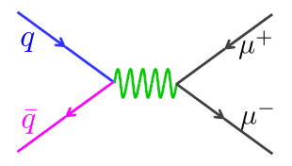
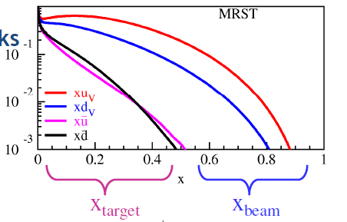
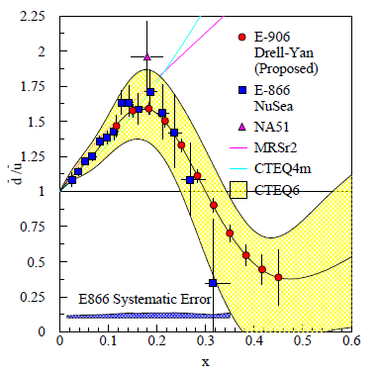
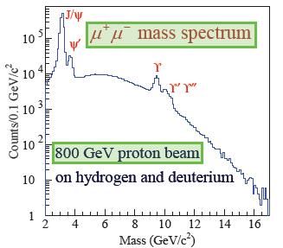
Fermilab E906/Seaquest: A dedicated Drell-Yan experiment
Follow-up experiment to FNAL E866 with main goal of extending measurements to higher x
120 GeV proton beam from FNAL Main Injector (E866: 800 GeV)
  D-Y cross section ~1/s – improved statistics
E906
E866

Slide 36
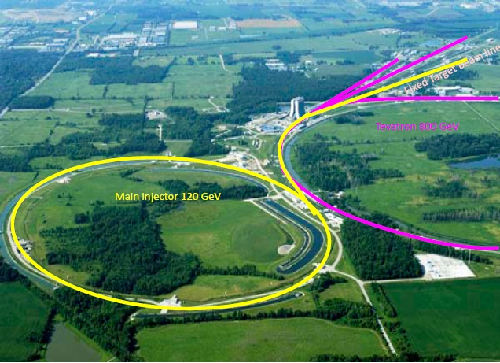
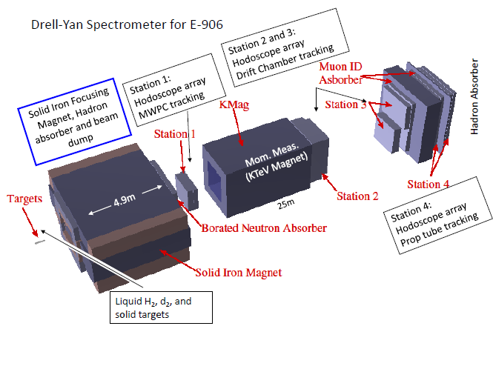
Fermilab E906
Targets: Hydrogen and deuterium (liquid), C, Ca, W nuclei
  Also cold nuclear matter program
Commissioning starts in March, data-taking through ~2013

Slide 37
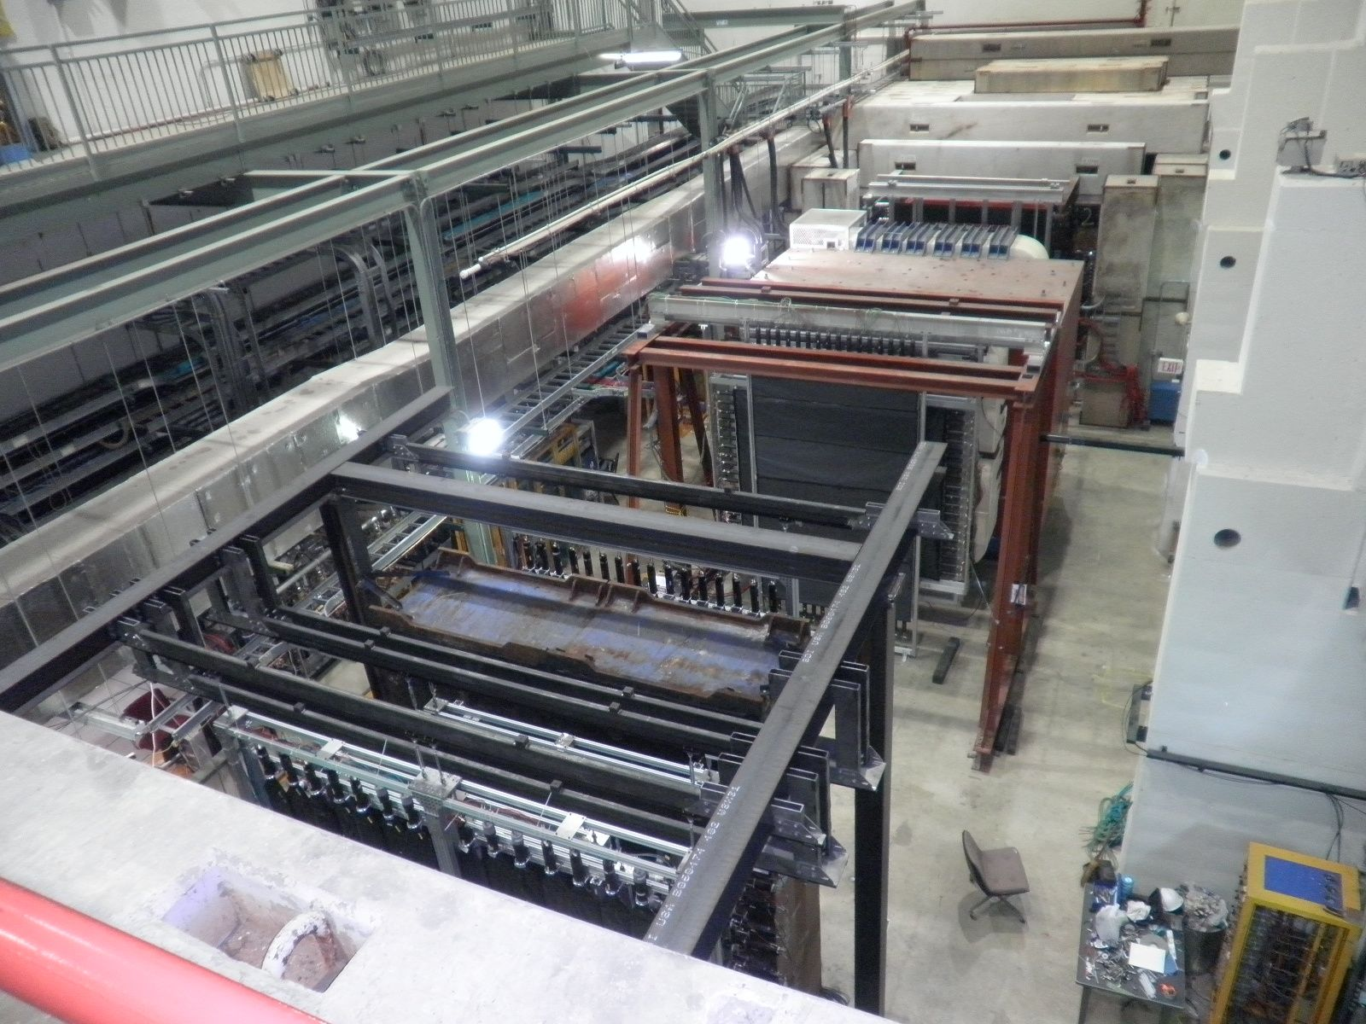
E906 hall, 1/20/2011

Slide 38
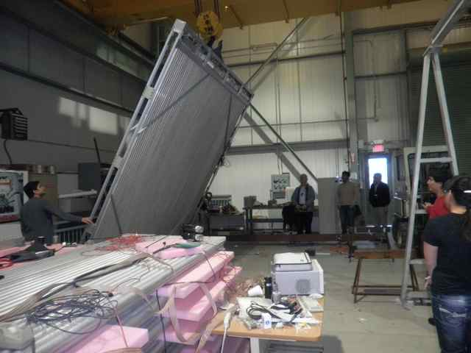
E906 Station 4 tracking plane
Assembled from old proportional tubes scavenged from LANL threat reduction experiments!

Slide 39
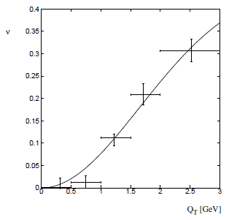
Azimuthal dependence of unpolarized Drell-Yan cross section
cos2φ term sensitive to correlations between quark transverse spin and quark transverse momentum! → Boer-Mulders TMD
Large cos2φ dependence seen in pion-induced Drell-Yan
ν
NA10 dataa
194 GeV/c
π⁻+W
Q_{T} (GeV)
D. Boer, PRD60, 014012 (1999)

Slide 40
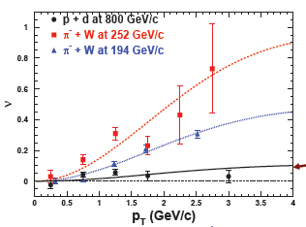

What about proton-induced Drell-Yan?
Significantly reduced cos2φ dependence in proton-induced D-Y
Suggests sea quark transverse spin-momentum correlations small?
Will be interesting to measure for higher-x sea quarks in E906!
E866, PRL 99, 082301
(2007)
E866

Slide 41
Single-spin asymmetries and the proton as a QCD “laboratory”
Transversity pdf:
Correlates proton transverse spin and quark transverse spin
Sivers pdf:
Correlates proton transverse spin and quark transverse momentum
Boer-Mulders pdf:
Correlates quark transverse spin and quark transverse momentum
S_{p}-S_{q} coupling??
S_{p}-L_{q} coupling??
S_{q}-L_{q} coupling??

Slide 42
Looking to the longer-term future
Discussions ongoing regarding future of RHIC past ~2016, as well as possibility of Electron-Ion Collider at RHIC or JLab after ~2020
Next-generation high-energy (clean partonic interpretation) DIS facility essential in order to efficiently fulfill the promise/prospects of quantitative QCD over the upcoming decades
Given you can never learn everything about colored matter with a colorless probe(!), continued high-energy hadronic collisions for study of QCD also a key component
Electron-Ion Collider capable of colliding electrons with polarized protons and (unpolarized) heavy ions, especially at RHIC, maintaining p+p and A+A capabilities → extremely powerful and flexible facility with rich physics program . . .

Slide 43
Summary and outlook
We still have a ways to go from the quarks and gluons of QCD to full descriptions of the protons and nuclei of the world around us!
The proton as the simplest QCD bound state provides a QCD “laboratory” analogous to the atom’s role in the development of QED
After an initial “discovery and development” period lasting ~30 years, we’re now taking the first steps into an exciting new era of quantitative QCD!

Slide 44
Afterword:
QCD “versus” nucleon structure?
A personal perspective

Slide 45
We shall not cease from exploration
And the end of all our exploring
Will be to arrive where we started
And know the place for the first time.
T.S. Eliot

Slide 46
Extra

Slide 47
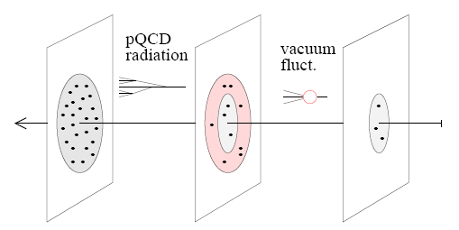
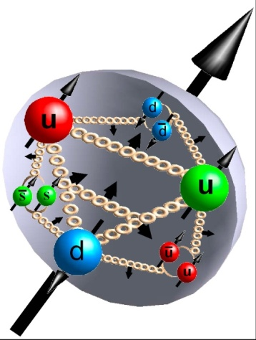
Unanswered and emerging questions in nucleon structure and the formation of hadrons
[Weiss 09]
What is the 3D spatial structure of the nucleon?
What is the nature of the spin of the nucleon (Spin puzzle continues!)
  Does orbital angular momentum contribute?
What spin-momentum correlations exist within hadrons and in the process of hadronization?
What is the role of color interactions in different processes?
radiative gluons/sea
non-pert. sea quarks/gluons
valence quarks/gluons

Slide 48
Studying QCD at RHIC
An accelerator-based program, but not at the energy (or intensity) frontier. More closely analogous to many areas of condensed matter research—create a system and study its properties!
What systems are we studying?
  “Simple” QCD bound states—the proton is the simplest stable bound state in QCD (and conveniently, nature has already created it for us!)
  Collections of QCD bound states (nuclei, also available out of the box!)
  QCD deconfined! (QGP, some assembly required!)

Slide 49
QCD: Nuclei/Hadrons Partons
Quantum chromodynamics an elegant and by now well-established field theory
  But d.o.f. in QCD are quarks and gluons, never observed in the lab!
How are (colorless) hadrons/nuclei comprised of (colored) partons, but also—what are the ways in which partons can turn into hadrons/nuclei?
  Hadronization via fragmentation, “freeze-out,” recombination (quasiparticles in medium?), . . .?
  Gluons vs. quarks?
  In vacuum vs. cold nuclear matter vs. hot + dense matter?
  Spin-momentum correlations in hadronization?
  …
Understand more complex QCD systems within
the context of simpler ones
RHIC was designed from the start as a single facility capable of A+A, d+A, and p+p collisions
at the same center-of-mass energy

Slide 50
Unpolarized collisions also relevant to study TMD’s . . . And vice versa
Initial attempts have been made to extract the k_{T}-unintegrated unpolarized gluon distribution from quarkonium p_{T} spectra (hadronic fixed target and TeVatron)
  PHENIX J/Psi cross sections ready and waiting to be used for this
  Driving interest has been gg→Higgs at LHC!
Recall: Two-scale world where TMD’s are relevant—effect of soft scales on hard processes in QCD.

Slide 51
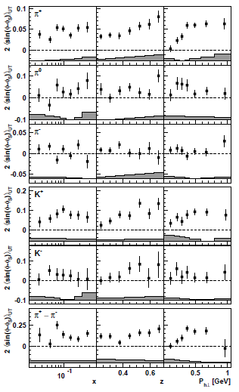

HERMES transversity x Collins
Phys.Lett. B693 (2010) 11-16
HERMES Sivers
Phys.Rev.Lett. 103 (2009) 152002

Slide 52

Drell-Yan complementary to DIS

Slide 53


Slide 54

Other explanations of cos2φ dependence:
Higher-twist effects in pion not large enough

Slide 55

Other explanations of cos2φ dependence:
QCD vacuum effect would be for valence and sea

Slide 56

Boer-Mulders fits to NA10 data

Slide 57

Azimuthal dependence of Drell-Yan cross section in terms of TMDs
Arnold, Metz, Schlegel, PRD79, 034005 (2009)

Slide 58


SPHNX??

Slide 59

Improved forward detection capabilities
Many of the striking effects related to parton dynamics in the proton have been observed at forward rapidities→ Large-acceptance forward spectrometer
Full jet reconstruction capabilities → allow separation of effects
PID → Study surprising species dependences (e.g. kaons, antiprotons)
Tracking and EMCal → Drell-Yan measurements
Design single detector for hadronic collisions and DIS? Optimal strategy to get the most physics out of the facility still to be worked out.

Slide 60


Forward spectrometer as conceived for hadronic/nuclear collisions similar to that in e+p/e+A-optimized concept
Forward / Backward
Spectrometers:
high acceptance -5 < η < 5 central detector
good PID and vertex resolution
tracking and calorimeter coverage the same → good momentum resolution
low material density → minimal multiple scattering and bremsstrahlung
forward electron and proton dipole spectrometers

Slide 61

Drell-Yan transverse SSA predictions
x_{F}
x_{F}
y
y

Slide 62

Example:
Flavor separation of TMDs using He³
Zhongbo
Kang
With polarized He³ as well as proton beams at RHIC, new handles on flavor separation of various transverse spin observables possible
  What will the status of the (non-)valence quark puzzle be by then??

