Slide 1
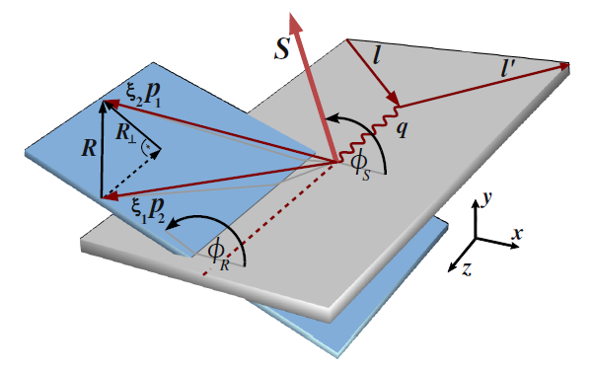
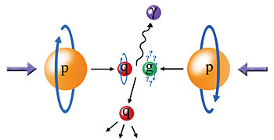
Measuring Polarization Effects in Proton-Proton and
Muon-Nucleon Scattering
left
right
Christine A. Aidala
University of Michigan
Penn State University
January 21, 2015

Slide 2
Polarization effects – one pillar of study within the recently entered era of quantitative QCD
Notes:
Or just say this, with no slide?

Slide 3
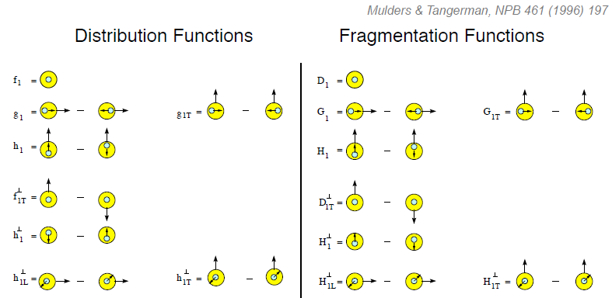
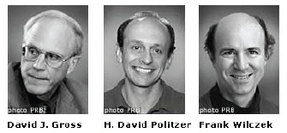
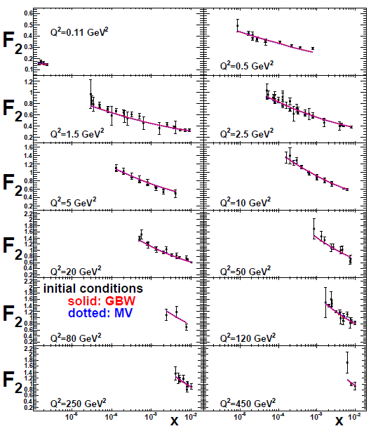
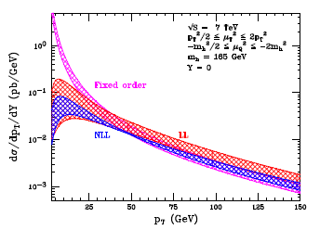
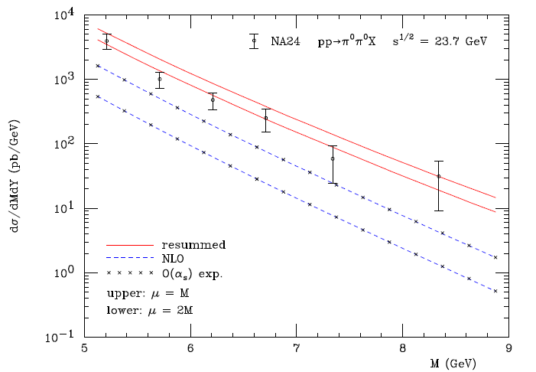
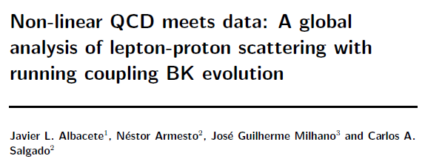
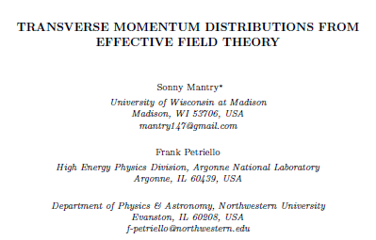
Now in the era of quantitative QCD!
Transverse-Momentum-Dependent
QCD: Discovery and development
  1973 → ~2004
Since 1990s starting to consider detailed internal QCD dynamics, going beyond traditional parton model ways of looking at hadrons—and perform phenomenological calculations using these new ideas/tools!
  Various resummation techniques
  Non-collinearity of partons with parent hadron
  Various effective field theories, e.g. Soft-Collinear Eff. Th.
  Non-linear evolution at small momentum fractions
Higgs vs. p_{T}
Collinear
Worm gear
Mulders & Tangerman, NPB 461, 197 (1996)
arXiv:1108.3609
Transversity
Almeida, Sterman, Vogelsang
PRD80, 074016 (2009)
PRD80, 034031 (2009)
Sivers
pp→π⁰π⁰X
Boer-Mulders
Worm gear
Pretzelosity
M (GeV)

Slide 4
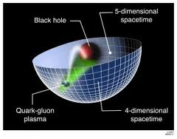
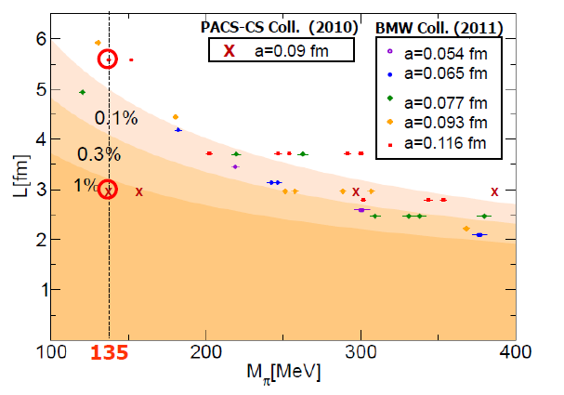
Additional recent theoretical progress in QCD
Progress in non-perturbative methods:
  Lattice QCD starting to perform calculations at physical pion mass!
  AdS/CFT “gauge-string duality” an exciting recent development as first fundamentally new handle to try to tackle QCD in decades!
PACS-CS: PRD81, 074503 (2010)
BMW: PLB701, 265 (2011)
“Modern-day ‘testing’ of (perturbative) QCD is as much about pushing the boundaries of its applicability as about the verification that QCD is the correct theory of hadronic physics.”
– G. Salam, hep-ph/0207147 (DIS2002 proceedings)
T. Hatsuda,
PANIC 2011
Notes:
Hadron spectrum, quark masses, pseudoscalar meson decay constants

Slide 5
Mapping out the proton
What does the proton look like in terms of the quarks and gluons inside it?
Position
Momentum
Spin
Flavor
Color
Theoretical and experimental concepts to describe and access position only born in mid-1990s. Pioneering measurements over past decade.
Vast majority of past four decades focused on
1-dimensional momentum structure! Since 1990s starting to consider other directions . . .
Polarized protons first studied in 1980s. How angular momentum of quarks and gluons add up still not well understood!
Good measurements of flavor distributions in valence region. Flavor structure at lower momentum fractions still yielding surprises!
Accounted for theoretically from beginning of QCD, but more detailed, potentially observable effects of color have come to forefront in last few years . . .
Notes:
This talk will focus on spin-spin correlations, spin-spin correlations specifically with flavor information, and spin-momentum correlations, with discussion in the latter part of the presentation on exciting predictions related explicitly to color effects. Won’t have time to go through spin-position correlations.

Slide 6
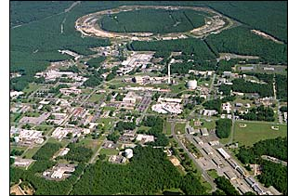
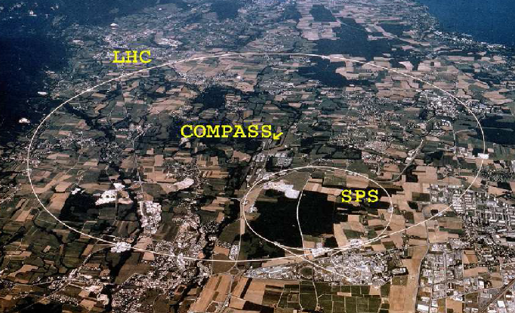
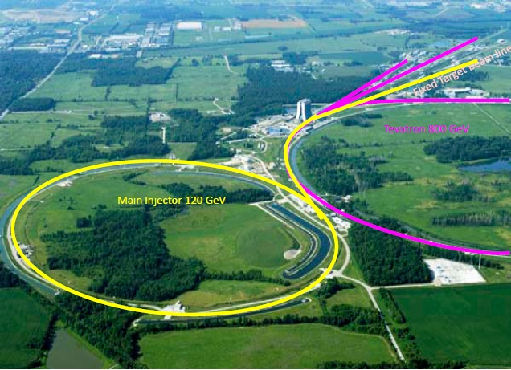
Facilities and experiments
STAR and PHENIX at RHIC, BNL
COMPASS
at CERN
SeaQuest
at Fermilab

Slide 7
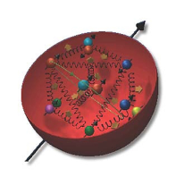
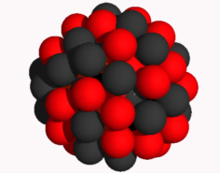
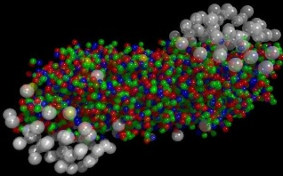
The Relativistic Heavy Ion Collider at Brookhaven National Laboratory
A great place to be to study QCD
A collider-based program, but not designed to be at the energy (or intensity) frontier. More closely analogous to many areas of condensed matter research—create a system and study its properties
What systems are we studying?
  “Simple” QCD bound states—the proton is the simplest stable bound state in QCD (and conveniently, nature has already created it for us!)
  Collections of QCD bound states (nuclei, also available out of the box!)
  QCD deconfined! (quark-gluon plasma, some assembly required!)
Polarized proton beams colliding at center-of-mass energies 62-510 GeV.
Running 2001-present

Slide 8
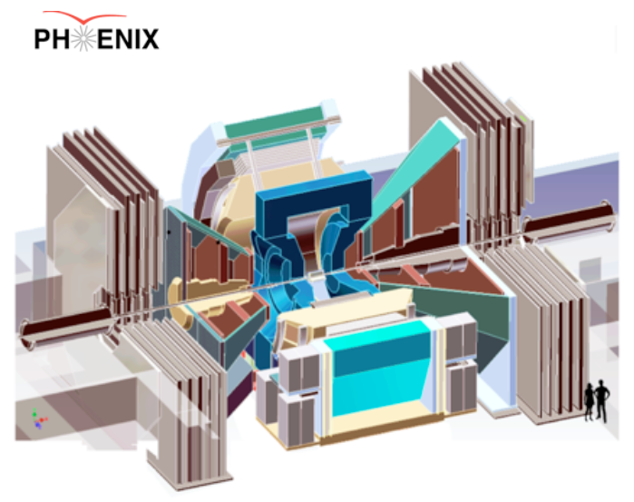
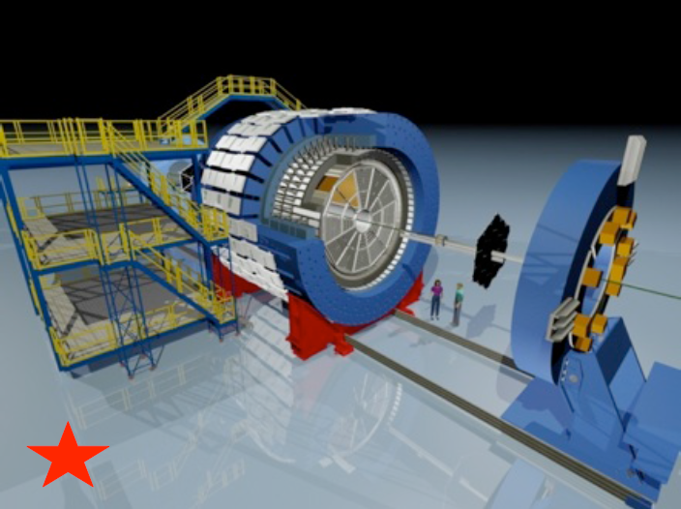
RHIC’s current main experiments
PHENIX:
High resolution; high rate capabilities for rare probes
Central arms |η|<0.35, Δφ∼2π with key strength measuring EM probes
Muon arms 1.2<|η|<2.4
Forward EM calorimetry
Control spin direction of proton beams independently
STAR:
Key strengths jets + correlations
Full acceptance including PID for |η|< 1, Δφ∼2π
Forward EM calorimetry

Slide 9
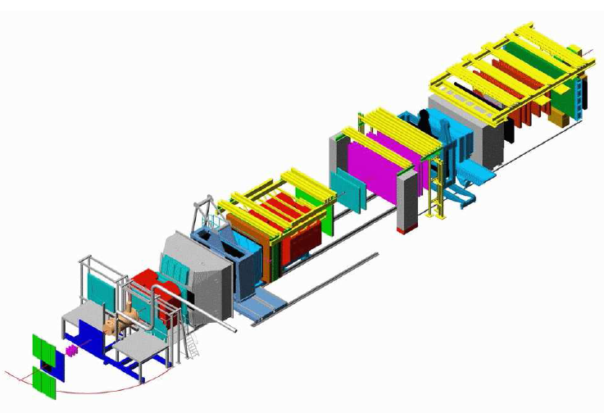
COMPASS at CERN:
Muon/Pion scattering off of fixed targets
60 m spectrometer
including particle ID
Nucleon structure and hadron spectroscopy
Polarized muon beam, unpolarized negative pion beam, 160-200 GeV/c
Polarized ⁶LiD and NH₃ targets (polarized deuterons and protons)
Running 2002-present

Slide 10
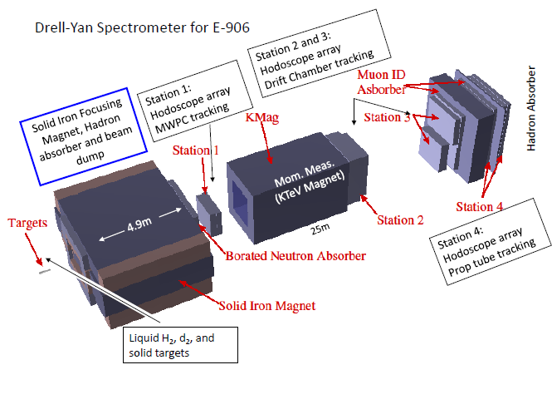
SeaQuest at Fermilab:
Fixed-target quark-antiquark annihilation experiment
Physics programs:
  Nucleon structure
  Cold nuclear matter
120 GeV/c proton beam from Fermilab Main Injector
Liquid hydrogen and deuterium, nuclear (C, Ca, W) targets
Running spring 2014-present
Unpolarized beam and targets for now, but can still measure certain polarization effects!

Slide 11
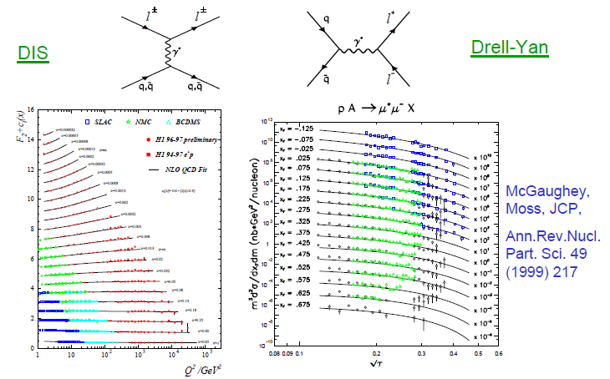
Complementarity of Drell-Yan and DIS
Both deep-inelastic lepton-nucleon scattering (DIS) and quark-antiquark annihilation to leptons (Drell-Yan process) are tools to probe the quark and antiquark structure of hadrons

Slide 12
Comparisons
Beam on fixed-target
vs. colliding beams
Lepton-nucleon scattering or annihilation to leptons
vs. p+p to hadrons
Colliding beams → higher energies
  Production of new probes, e.g. W bosons
  Wide range of perturbatively calculable observables
Fixed-target → higher luminosities
Leptonic processes → access to full parton kinematics
Annihilation → cleanly tag antiquarks
p+p to hadrons → leading-order access to gluons

Slide 13
Predictive power of pQCD
q(x₁)
Hard Scattering Process
X
g(x₂)
High-energy processes have predictable rates given:
Partonic hard scattering rates (calculable in pQCD)
    Parton distribution functions (need experimental input)
    Fragmentation functions (need experimental input)
Universal non-perturbative factors

Slide 14
Quark distribution functions
Unpolarized
Spin-spin correlations
Spin-momentum correlations

Slide 15
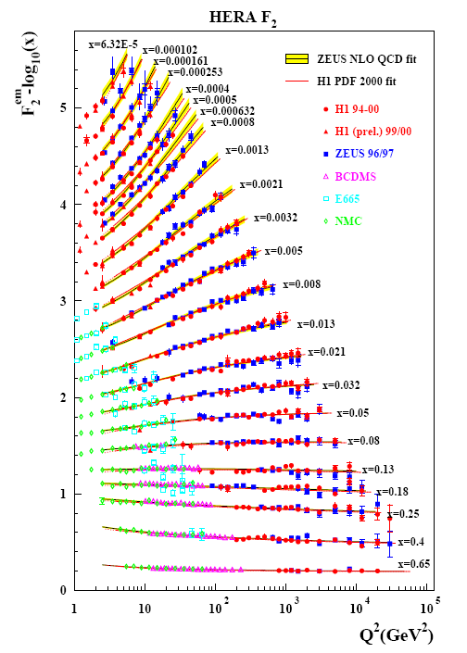
Unpolarized proton structure from deep-inelastic lepton-proton scattering
Wealth of data largely from HERA e+p collider
Rich structure at low x
Half proton’s linear momentum carried by gluons!
Kinematic coverage of polarized experiments much smaller
Notes:
There are a number of useful ways to look at and describe nucleon structure. For example in addition to the structure functions such as F2 shown here, which, if you will, lets you “see” the asymptotic freedom of QCD, you can also describe the proton in terms of parton distribution functions, . . . In any case, we’ve learned quite a lot from decades of DIS data on the linear momentum structure of the proton, but even in the age of HERA, . . .

Slide 16
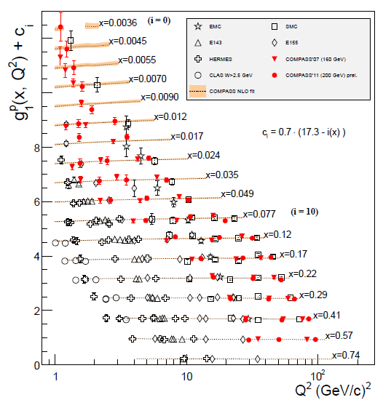
World data on longitudinally polarized proton structure function
Only ~1/3 of proton’s spin carried by quark spins.
Remainder from gluon spin and quark and gluon orbital angular momentum, but these haven’t been easy to measure . . .
COMPASS

Slide 17
Accessing gluon spin with p+p collisions
Study difference in particle production rates for same-helicity vs. opposite-helicity proton collisions
DIS
?
pQCD
e+e-
Leading-order access to gluons → ΔG
Notes:
Let me now show you some highlights from the helicity program at RHIC.

Slide 18
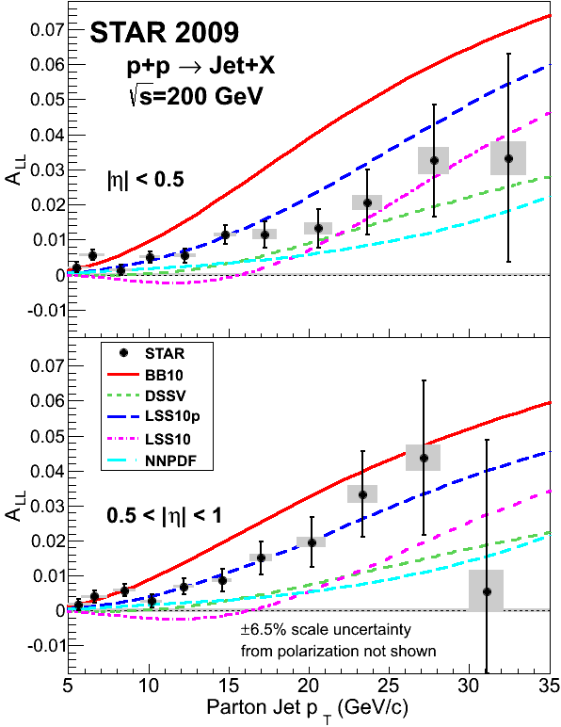
RHIC measurements sensitive to gluon spin
arXiv:1405.5134
Clear nonzero asymmetry seen in STAR jet measurements from 2009 data!
PHENIX π⁰ data consistent

Slide 19
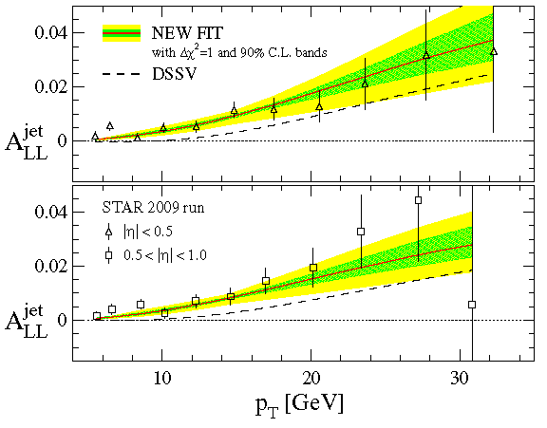
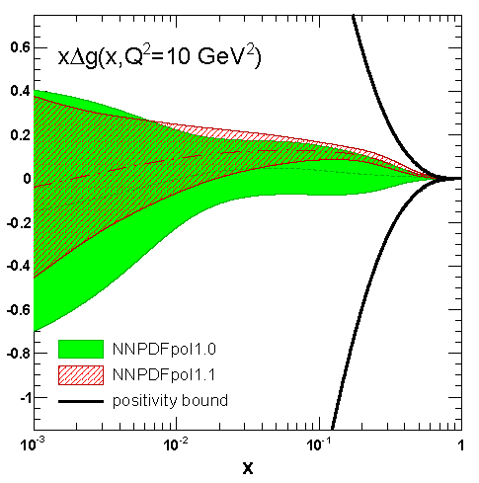
Gluon spin from two new fits
DSSV, PRL 113, 012001 (2014)
NNPDF, NPB 887.276 (2014)
DSSV and NNPDF have released new polarized pdf fits including RHIC data
2009 STAR jet A_{LL} results → significantly tighter constraints on gluon polarization
Both find evidence for positive gluon polarization in the region x > 0.05, but looks like orbital angular momentum will still be needed to account for total spin

Slide 20
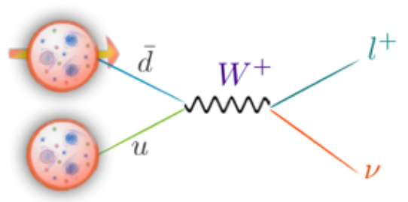
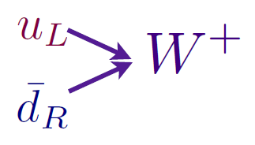
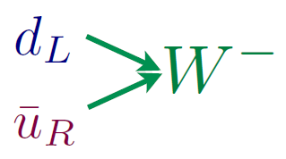
Flavor-separated sea quark helicities through W production
Flavor separation of the polarized sea quarks with no reliance on fragmentation functions, and at much higher scale than previous fixed-target experiments.
Complementary to semi-inclusive DIS measurements.
Parity violation of weak
interaction +
control over proton spin
orientation gives access to
flavor-spin structure of proton

Slide 21
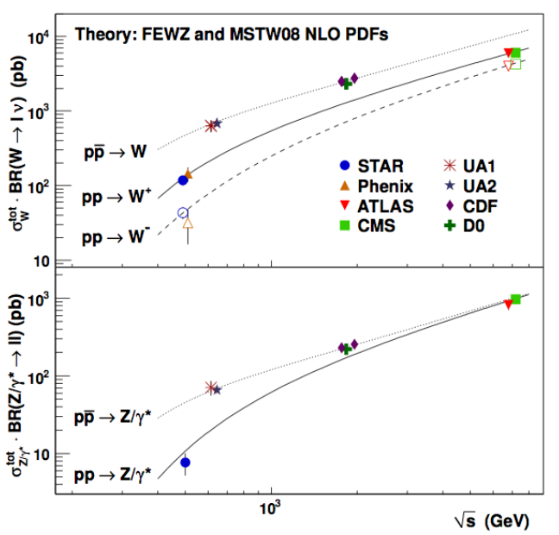
World W cross section measurements
RHIC
data

Slide 22
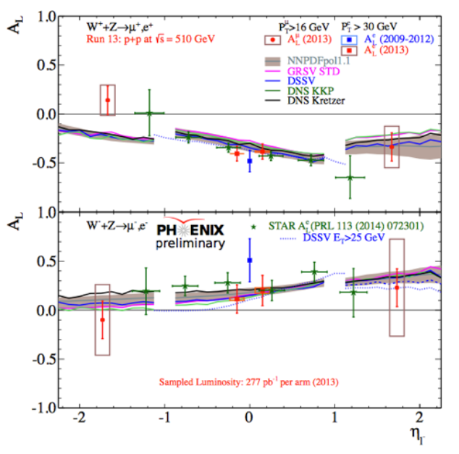
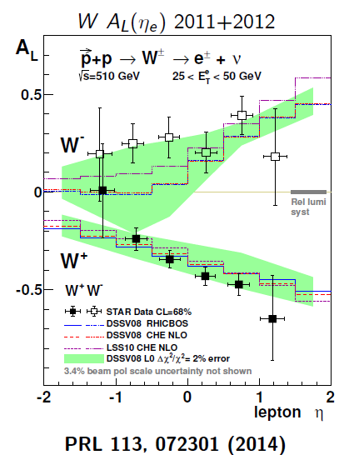
Large parity-violating single-helicity asymmetries
Improve constraints on light antiquark helicity distributions
New preliminary PHENIX muon results extend rapidity range

Slide 23
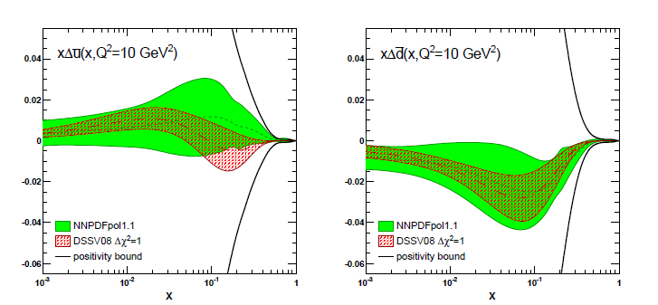
Flavor-separated sea quark helicities through W production
NNPDF, NPB 887.276 (2014)
Latest fit, including RHIC W boson data:
Indication of SU(3) breaking in polarized quark sea (as in unpolarized sea)

Slide 24
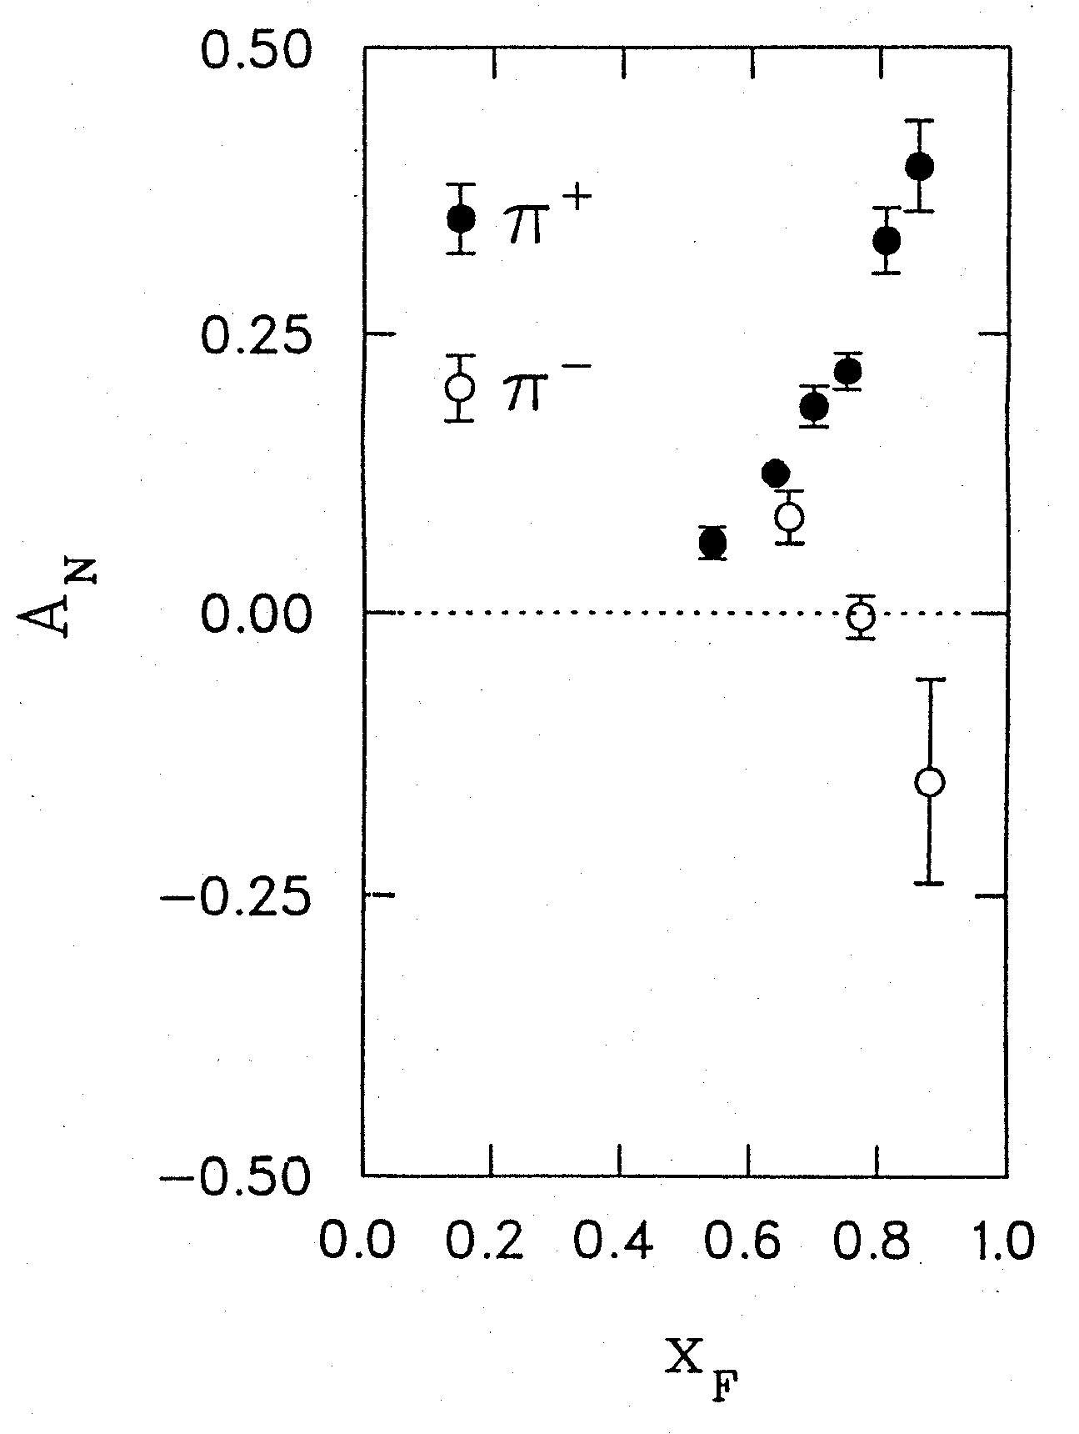
1976: Discovery in p+p collisions!
Huge transverse single-spin asymmetries
Argonne √s=4.9 GeV
Charged pions produced preferentially on one or the other side with respect to the transversely polarized beam direction
left
right
Had to wait more than a decade for the birth of a new subfield in order to explore the possibilities . . .
W.H. Dragoset et al., PRL36, 929 (1976)

Slide 25
Transverse-momentum-dependent distributions and single-spin asymmetries
1989: The “Sivers mechanism” is proposed in an attempt to understand the observed asymmetries.
D.W. Sivers, PRD41, 83 (1990)
The Sivers distribution: the first transverse-momentum-dependent distribution (TMD pdf) describing a spin-momentum correlation
Departs from the traditional collinear factorization assumption in pQCD and proposes a correlation between the intrinsic transverse motion of the quarks and gluons and the proton’s spin
New frontier! Parton dynamics inside hadrons, and in the hadronization process
Spin and momenta can be of partons or hadrons
Notes:
Dennis Sivers motivated by forthcoming E704 data

Slide 26
Quark distribution functions
Similarly, can have k_{T}-dependent fragmentation functions (FFs). One example: the chiral-odd Collins FF, which provides one way of accessing transversity distribution (also chiral-odd).
No (explicit) k_{T} dependence
Transversity
k_{T} - dependent, T-even
k_{T} - dependent, T-odd
Sivers
Measurements over the last ~10 years→ many of these correlations are non-zero in nature! Rapidly advancing field both experimentally and theoretically.
Boer-Mulders

Slide 27
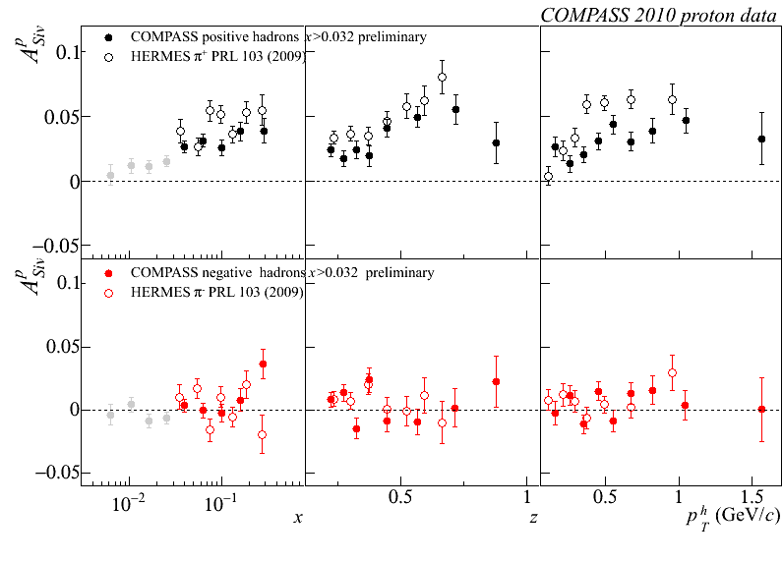
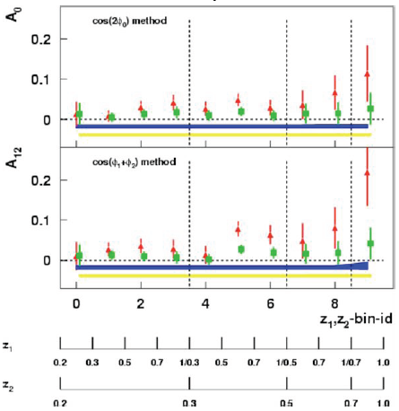
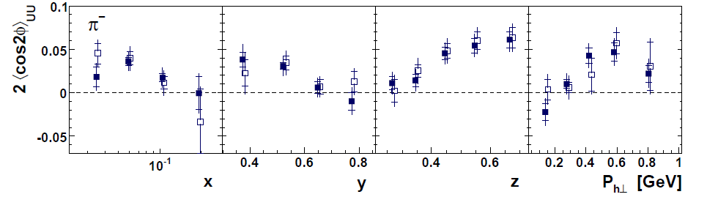
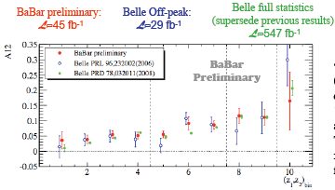
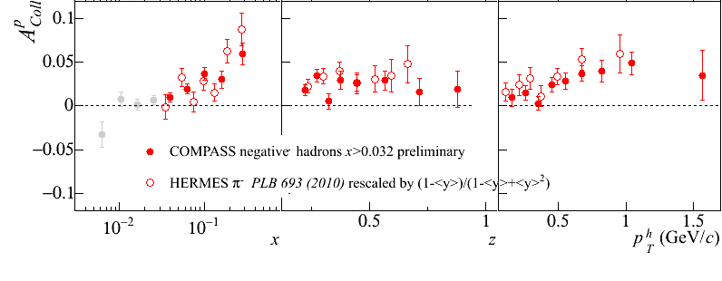
Sivers
e+p
μ+p
BELLE PRL96, 232002 (2006)
Collins x Collins
e⁺e⁻
Boer-Mulders x Collins
e+p
HERMES, PRD 87, 012010 (2013)
BaBar published ref. PRD90, 052003 (2014)
Collins x Collins
e⁺e⁻
e+p
μ+p
Transversity x Collins

Slide 28
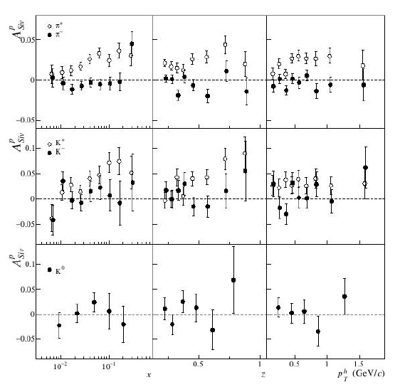
Final Sivers asymmetries from COMPASS
COMPASS,
arXiv:1408.4405
Positive 5-10%
for π⁺, K⁺.
Consistent with zero for π⁻, K⁻, K⁰
Indicates correlation between transverse (orbital) momentum of quarks and transverse spin of parent nucleon

Slide 29
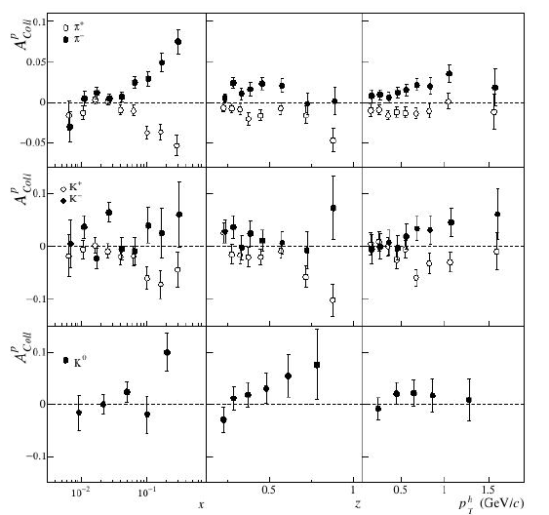
Final Collins asymmetries from COMPASS
COMPASS,
arXiv:1408.4405
Non-zero for π⁺, π⁻ .
More data needed for kaons.
Indicates transverse spin-spin correlation in the proton, plus spin-momentum correlation in hadronization

Slide 30

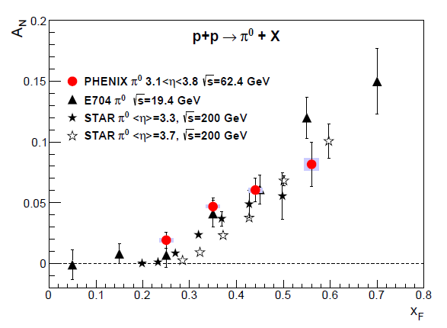

Transverse single-spin asymmetries:
From low to high energies!
ANL
√s=4.9 GeV
BNL
√s=6.6 GeV
FNAL
√s=19.4 GeV
RHIC
√s=62.4 GeV
π⁰
PRD90, 012006
(2014)
left
right

Slide 31
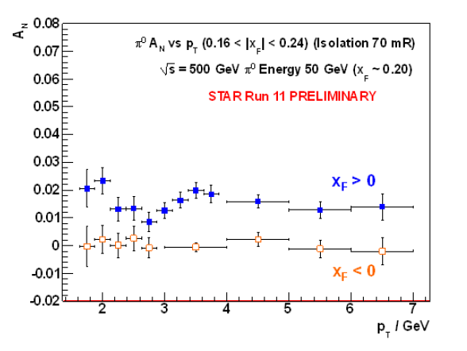
Effects persist up to transverse momenta of 7(!) GeV/c at √s=500 GeV
Can try to interpret these non-perturbative effects within the framework of perturbative QCD.
Haven’t yet disentangled all the possible contributing effects to the (messy) process of p+p to pions
π⁰

Slide 32
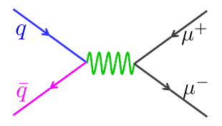
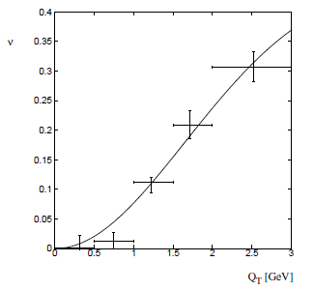
Measuring spin-momentum correlations via unpolarized Drell-Yan
cos2φ term sensitive to correlations between quark transverse spin and quark transverse momentum!
  Spin-orbit coupling loosely analogous to hydrogen fine structure
Huge cos2φ dependence seen in pion-induced Drell-Yan
ν
NA10 data
194 GeV/c
π⁻+W
Q_{T} (GeV)
D. Boer, PRD60, 014012 (1999)

Slide 33
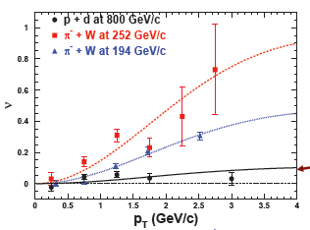

Smaller spin-momentum correlation for sea quarks?
Significantly reduced cos2φ dependence in proton-induced Drell-Yan observed by E866
Suggests sea quark transverse spin-momentum correlations small?
Will be interesting to measure for higher-x sea quarks in E906!
E866, PRL 99, 082301
(2007)
E866

Slide 34
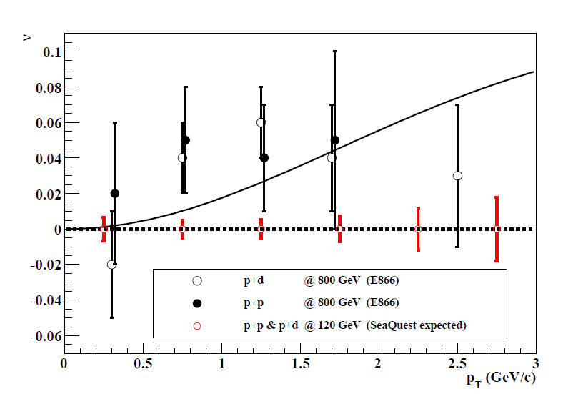
Will learn more soon from SeaQuest

Slide 35
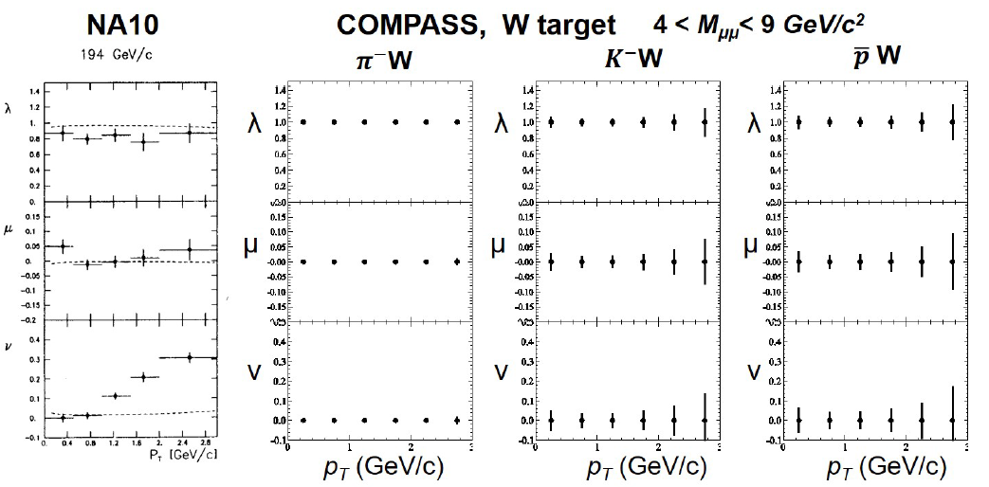
And from COMPASS
arXiv:1501.02520

Slide 36
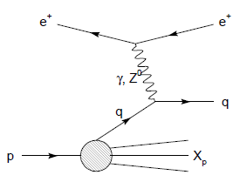

Modified universality of T-odd transverse-momentum-dependent distributions:
Color in action!
Deep-inelastic lepton-nucleon scattering:
Attractive final-state interactions
Quark-antiquark annihilation to leptons:
Repulsive initial-state interactions
Still waiting for a polarized quark-antiquark annihilation measurement to compare to existing lepton-nucleon scattering measurements . . .
As a result, get opposite sign for the Sivers transverse-momentum-dependent pdf when measure in semi-inclusive DIS versus Drell-Yan: process-dependent pdf! (Collins 2002)

Slide 37


Modified universality requires full QCD:
Gauge-invariant quantum field theory
Collins, 1993
From M. Anselmino, Transversity 2014

Slide 38

Planned or proposed polarized
Drell-Yan measurements

Slide 39
Physical consequences of a gauge-invariant quantum theory:
Aharonov-Bohm (1959)
Wikipedia:
“The Aharonov–Bohm effect is important conceptually because it bears on three issues apparent in the recasting of (Maxwell's) classical electromagnetic theory as a gauge theory, which before the advent of quantum mechanics could be argued to be a mathematical reformulation with no physical consequences. The Aharonov–Bohm thought experiments and their experimental realization imply that the issues were not just philosophical.
The three issues are:
whether potentials are "physical" or just a convenient tool for calculating force fields;
whether action principles are fundamental;
the principle of locality.”

Slide 40
Physical consequences of a gauge-invariant quantum theory:
Aharonov-Bohm (1959)
Physics Today, September 2009 :
The Aharonov–Bohm effects: Variations on a subtle theme,
by Herman Batelaan and Akira Tonomura.
“Aharonov stresses that the arguments that led to the prediction of the various electromagnetic AB effects apply equally well to any other gauge-invariant quantum theory. In the standard model of particle physics, the strong and weak nuclear interactions are also described by gauge-invariant theories. So one may expect that particle-physics experimenters will be looking for new AB effects in new domains.”

Slide 41
Physical consequences of a gauge-invariant quantum theory:
Aharonov-Bohm effect in QCD!!
See e.g. Pijlman,
hep-ph/0604226
or Sivers,
arXiv:1109.2521
Deep-inelastic lepton-nucleon scattering:
Attractive final-state interactions
Quark-antiquark annihilation to leptons:
Repulsive initial-state interactions
Simplicity of these two processes:
Abelian vs. non-Abelian nature of the gauge group doesn’t play a major qualitative role.
BUT: In QCD expect additional, new effects due to specific non-Abelian nature of the gauge group
As a result, get opposite sign for the Sivers transverse-momentum-dependent pdf when measure in semi-inclusive DIS versus Drell-Yan: process-dependent pdf! (Collins 2002)

Slide 42

QCD Aharonov-Bohm effect:
Color entanglement
  2010: Rogers and Mulders predict color entanglement in processes involving p+p production of hadrons if quark transverse momentum taken into account
  Quarks become correlated across the two protons
  Consequence of QCD specifically as a non-Abelian gauge theory!
PRD 81:094006 (2010)
Color flow can’t be described as flow in the two gluons separately. Requires simultaneous presence of both.

Slide 43



Testing the Aharonov-Bohm effect in QCD as a non-Abelian gauge theory
Landry, Brock, Nadolsky, Yuan, 2002
PRD82, 072001 (2010)
Drell-Yan lepton pair production
p+A → μ⁺+μ⁻+X
for different invariant masses:
No color entanglement expected
Hadron pair production
Get predictions from fits to data where no entanglement expected
Out-of-plane momentum component
Make predictions for processes where entanglement is expected; look for deviation

Slide 44
Summary and outlook
Still far to go from the quarks and gluons of QCD to full descriptions of the protons and nuclei of the world around us!
After initial “discovery and development” period lasting ~30 years, now in the early part of exciting new era of quantitative QCD
Polarization effects a major current focus, bringing to light fundamental predictions of process-dependent parton distribution functions and color entanglement across QCD bound states
Stay tuned for forthcoming results!

Slide 45
Additional Material

Slide 46









RHIC as a polarized p+p collider
Absolute Polarimeter (H jet)
RHIC pC Polarimeters
Siberian Snakes
PHOBOS
BRAHMS & PP2PP
Siberian Snakes
PHENIX
Spin Flipper
STAR
Spin Rotators
Various equipment to maintain and measure beam polarization through acceleration and storage
Partial Snake
Helical Partial
Snake
Polarized Source
Strong Snake
LINAC
AGS
200 MeV Polarimeter
BOOSTER
Rf Dipole
AGS Internal Polarimeter
AGS pC Polarimeter
Notes:
RHIC, as a high-energy polarized proton collider, really represents an outstanding achievement in accelerator physics. . . . [equipment].

Slide 47

RHIC performance for polarized protons

Slide 48


Slide 49

View of E906 experimental hall from downstream platform

Slide 50

Deep-Inelastic Scattering:
A Tool of the Trade
Probe nucleon with an electron or muon beam
Interacts electromagnetically with (charged) quarks and antiquarks
“Clean” process theoretically—quantum electrodynamics well understood and easy to calculate
Technique that originally discovered the parton structure of the nucleon in the 1960s

Slide 51


Parton distribution functions inside a nucleon:
The language we’ve developed (so far!)
What momentum fraction would the scattering particle carry
if the proton were made of …
3 bound valence quarks
A point particle
x_{Bjorken}
1
1/3
1
3 bound valence quarks + some
low-momentum sea quarks
x_{Bjorken}
Sea
3 valence quarks
Valence
Small x
1/3
1
x_{Bjorken}
1/3
x_{Bjorken}
1
Halzen and Martin, “Quarks and Leptons”, p. 201

Slide 52

Decades of DIS data: What have we learned?
Wealth of data largely from HERA e+p collider
Rich structure at low x
Half proton’s linear momentum carried by gluons!
Notes:
There are a number of useful ways to look at and describe nucleon structure. For example in addition to the structure functions such as F2 shown here, which, if you will, lets you “see” the asymptotic freedom of QCD, you can also describe the proton in terms of parton distribution functions, . . . In any case, we’ve learned quite a lot from decades of DIS data on the linear momentum structure of the proton, but even in the age of HERA, . . .

Slide 53

And a (relatively) recent surprise from p+p, p+d collisions
Fermilab Experiment 866 used proton-hydrogen and proton-deuterium collisions to probe nucleon structure via the Drell-Yan process
Would expect anti-down/anti-up ratio of 1 if sea quarks are only generated dynamically by gluon splitting into quark-antiquark pairs
Measured flavor asymmetry in the quark sea, with striking x behavior—still not well understood
Hadronic collisions play a complementary role to electron-nucleon scattering and have let us continue to find surprises in the rich linear momentum structure of the proton, even after > 40 years!
PRD64, 052002 (2001)

Slide 54
Complementarity of Drell-Yan and DIS

Slide 55


Proton “spin crisis”
SLAC: 0.10 < x <0.7
CERN: 0.01 < x <0.5
Quark-Parton Model
expectation
A₁(x)
0.1 < x_{SLAC} < 0.7
E130, Phys.Rev.Lett.51:1135 (1983)
472 citations
These haven’t been easy to measure!
EMC (CERN), Phys.Lett.B206:364 (1988)
1759 citations!
0.01 < x_{CERN} < 0.5
“Proton Spin Crisis”
x-Bjorken
Notes:
SLAC – up by 16 in 1 year, EMC – 84 in 1 year

Slide 56


Improvements in knowledge of gluon and sea quark spin contributions from RHIC data

Slide 57


NNPDF, NPB 887.276 (2014)

Slide 58


Dijet Cross Section and
Double Helicity Asymmetry
Dijets as a function of invariant mass
More complete kinematic reconstruction of hard scattering—pin down x values probed
STAR

Slide 59

RHIC measurements sensitive to gluon polarization
Neutral pion
double-helicity asymmetries
π⁰ 200 GeV - PRD90, 012007 (2014)
π⁰ 510 GeV - Preliminary

Slide 60




Other recently measured probes sensitive to gluon helicity
Midrapidity η
200 GeV
PRD90, 012007 (2014)
arXiv:1409.1907
Can provide complementary information.
Extending measurements to more forward rapidity and different √s will expand x range probed.
Forward π⁰
Very forward π⁰
510 GeV
PRD89, 012001 (2014)

Slide 61
Sampling the Integral of ΔG: π⁰ p_{T} vs. x_{gluon}
Inclusive asymmetry measurements in p+p collisions sample from wide bins in x—sensitive to (truncated) integral of ΔG, not to functional form vs. x
Based on simulation using NLO pQCD as input
PRL 103, 012003 (2009)

Slide 62


Slide 63
Longitudinal (Helicity) vs. Transverse Spin Structure
Transverse spin structure of the proton cannot be deduced from longitudinal (helicity) structure
  Spatial rotations and Lorentz boosts don’t commute!
  Only the same in the non-relativistic limit
Transverse structure linked to intrinsic parton transverse momentum (k_{T}) and orbital angular momentum!

Slide 64
Spin-momentum correlations and the proton as a QCD “laboratory”
“Transversity” pdf:
Correlates proton transverse spin and quark transverse spin
“Sivers” pdf:
Correlates proton transverse spin and quark transverse momentum
“Boer-Mulders” pdf:
Correlates quark transverse spin and quark transverse momentum
S_{p}-S_{q} coupling
S_{p}-L_{q} coupling
S_{q}-L_{q} coupling

Slide 65
Quark distribution functions
Similarly, can have k_{T}-dependent fragmentation functions (FFs). One example: the chiral-odd Collins FF, which provides one way of accessing transversity distribution (also chiral-odd).
No (explicit) k_{T} dependence
Transversity
k_{T} - dependent, T-even
k_{T} - dependent, T-odd
Sivers
Relevant measurements in simpler systems (DIS, e+e-) only starting to be made over the last ~9 years, providing evidence that many of these correlations are non-zero in nature! Rapidly advancing field both experimentally and theoretically.
Boer-Mulders

Slide 66
The Collins Effect Must be Present
In e⁺e⁻ Annihilation into Quarks!
electron
Collins effect in e+e-
Quark fragmentation
will lead to effects
in di-hadron correlation
measurements!
q₁
q₂
quark-1
spin
quark-2
spin
positron

Slide 67



π
π
π, K, p
at 200 and 62.4 GeV
Pattern of pion species asymmetries in the forward direction
→ valence quark effect.
But this conclusion confounded by kaon and antiproton asymmetries!
200 GeV
62.4 GeV
Note different scales
K
K
K- asymmetries
underpredicted
200 GeV
62.4 GeV
p
p
Large antiproton asymmetry?? Unfortunately no 62.4 GeV measurement
200 GeV
62.4 GeV

Slide 68

Another Surprise: Transverse Single-Spin Asymmetry in Eta Meson Production
Further evidence against a valence quark effect!
Lots of territory still to explore to understand spin-momentum correlations in QCD!
Larger than the neutral pion!
STAR
PRD 86:051101 (2012)

Slide 69

New eta A_{N} from PHENIX
PRD90, 072008 (2014)
Large η A_{N} observed by STAR and PHENIX (and E704), similar in magnitude to π⁰
Expect to measure forward direct photons from 2015 data for p+p, p+A with transverse proton polarization—minimal sensitivity to final-state effects
  PHENIX MPC-EX forward preshower upgrade

Slide 70



Transverse single-spin asymmetry in dihadron production from STAR
Nonzero result observed in 200 GeV
Collinear process—should be cleanly sensitive to transversity times dihadron interference FF
Recent results from 500 GeV—also nonzero, and larger for larger pair p_{T} and larger pseudorapidity
Kinematic coverage overlaps HERMES, COMPASS
Bacchetta, Courtoy, Radici,
JHEP 1303, 119 (2013)

Slide 71


Drell-Yan decay angular distributions
θ and φ are the decay polar and azimuthal angles of the μ⁺ in the dilepton rest frame: Collins-Soper frame
A general expression for Drell-Yan decay angular distributions
Lam-Tung relation: 1- λ = 2ν
  Reflects the spin-1/2 nature of (anti)quarks
  Analog of the Callan-Gross relation in deep-inelastic scattering

Slide 72
Lam-Tung relation
Lam and Tung, PRD18, 2447 (1978)
Theoretically robust
  Unaffected by NLO [O(α_{s})] corrections
  NNLO [O(α_{s}²)] corrections small
    Mirkes and Ohnemus, PRD 51, 4891 (1995)
  Preserved under resummation of soft gluons
    Berger, Qiu, and Rodrigues-Pedraza, arXiv:0707.3150 and PRD 76, 074006 (2007)
What do the data show?

Slide 73

Measured angular dependences
CERN NA10
π⁻ + W
Z. Phys. 37, 545
(1988)
Dashed curves
from pQCD
calculations
ν non-zero, increases with p_{T}

Slide 74

Lam-Tung relation violated!
NA10, Z. Phys. 37, 545 (1988)
Violation of the Lam-Tung relation suggests new mechanisms with non-perturbative origin!

Slide 75
Follow-up polarized target experiment: Fermilab E1039
Los Alamos and U. Virginia currently building polarized proton target for follow-up experiment (polarized frozen ammonia beads—3 hydrogen nuclei in the NH₃ are polarized)
Scheduled for installation second half of 2016, ~2 years of data-taking starting January 2017
Study spin-momentum correlations of antiquarks in a polarized proton to help elucidate origins of sea quarks

Slide 76

Boer-Mulders x Collins at COMPASS using muon scattering

Slide 77

arXiv:1501.02520

Slide 78

COMPASS polarized Drell-Yan projected uncertainty

Slide 79

Process dependence of Sivers spin-momentum correlation: Color in action!
J.D. Osborn

Slide 80



Testing the Aharonov-Bohm effect in QCD as a non-Abelian gauge theory
Don’t know what to expect from color-entangled quarks → Look for contradiction with predictions for the case of no color entanglement
But first need to parameterize (unpolarized) transverse-momentum-dependent parton distribution functions from world data—never looked at before!
Z boson production,
Tevatron CDF
dσ/dp_{T}
C.A. Aidala,
T.C. Rogers, in progress
dσ/dp_{T}
p+p → μ⁺+μ⁻+X
√s = 0.039 TeV
√s = 1.96 TeV
p_{T} (GeV/c)
p_{T} (GeV/c)

