Slide 1
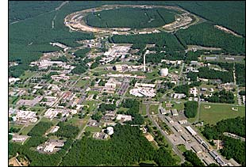
Investigating the Spin Structure of the Proton at the
Relativistic Heavy Ion Collider
Christine Aidala
Los Alamos National Lab
DESY
October 5-6, 2010
Notes:
I feel that the overarching question that those of us working on the proton structure program at RHIC would like to contribute to answering is . . .

Slide 2
How do we understand the visible matter in our universe in terms of the fundamental quarks and gluons of QCD?
Notes:
An essential tool of the trade if this is a question you’re interested in tackling is . . .

Slide 3
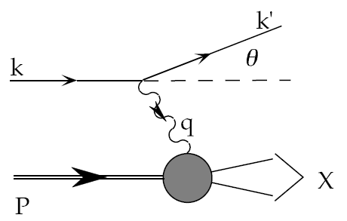
Deep-Inelastic Scattering:
A Tool of the Trade
Probe nucleon with an electron or muon beam
Interacts electromagnetically with (charged) quarks and antiquarks
“Clean” process theoretically—quantum electrodynamics well understood and easy to calculate
Technique that originally discovered the parton structure of the nucleon in the 1960’s!

Slide 4
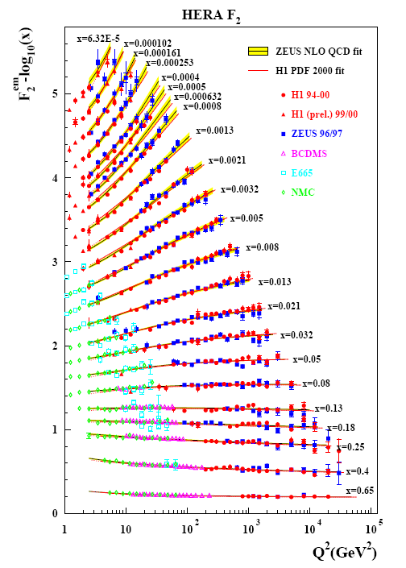
Decades of DIS Data: What Have We Learned?
Wealth of data largely from HERA (thanks!!)
Rich structure at low x
Half proton’s linear momentum carried by gluons!
PRD67, 012007 (2003)
Notes:
There are a number of useful ways to look at and describe nucleon structure. For example in addition to the structure functions such as F2 shown here, which, if you will, lets you “see” the asymptotic freedom of QCD, you can also describe the proton in terms of parton distribution functions, . . . In any case, we’ve learned quite a lot from decades of DIS data on the linear momentum structure of the proton, but even in the age of HERA, . . .

Slide 5
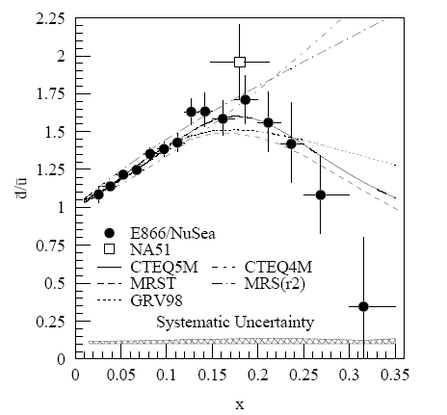
And a (Relatively) Recent Surprise From p+p, p+d Collisions
Fermilab Experiment 866 used proton-hydrogen and proton-deuterium collisions to probe nucleon structure via the Drell-Yan process
Anti-up/anti-down asymmetry in the quark sea, with an unexpected x behavior!
Hadronic collisions play a complementary role to DIS and have let us continue to find surprises in the rich linear momentum structure of the proton, even after 40 years!
PRD64, 052002 (2001)

Slide 6
What about the angular momentum structure of the proton?

Slide 7

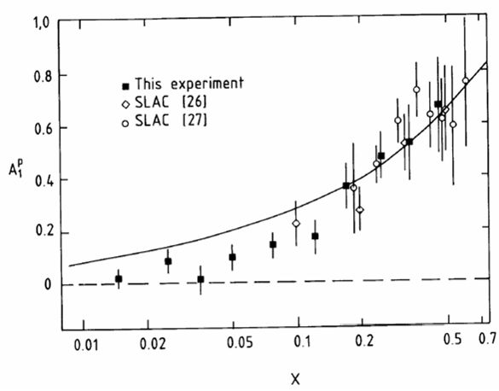
Proton “Spin Crisis”
SLAC: 0.10 < x <0.7
CERN: 0.01 < x <0.5
Quark-Parton Model
expectation!
A₁(x)
0.1 < x_{SLAC} < 0.7
E130, Phys.Rev.Lett.51:1135 (1983)
428 citations
These haven’t been easy to measure!
EMC (CERN), Phys.Lett.B206:364 (1988)
1491 citations!
0.01 < x_{CERN} < 0.5
“Proton Spin Crisis”
x-Bjorken

Slide 8
Decades of Polarized DIS
HERMES
Quark Spin – Gluon Spin – Transverse Spin – GPDs – L_{z}
SLAC E80-E155
CERN EMC,SMC COMPASS
DESY HERMES
JLAB Halls A, B, C
No polarized electron-proton collider to date, but we did end up with a polarized proton-proton collider . . .
→2000
ongoing
→2007
ongoing
PRL92, 012005 (2004)
Notes:
These have all been fixed-target experiments. By the 1990’s, the technology existed to accelerate polarized proton beams to high energies. In fact I got into this business in the 1990’s working on studies in support of polarizing the proton beam at HERA. Polarized HERA was never realized, but while discussions for polarized HERA were going on in the ‘90’s, plans were already being implemented to polarize the proton beams they would have at RHIC.

Slide 9
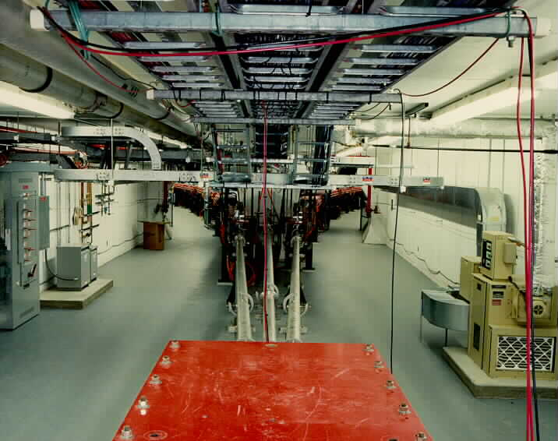
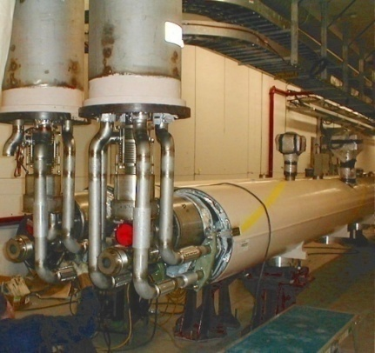
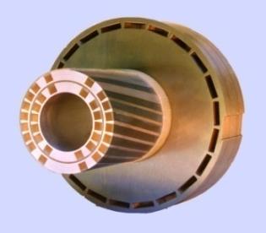
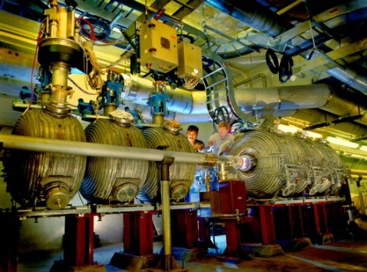
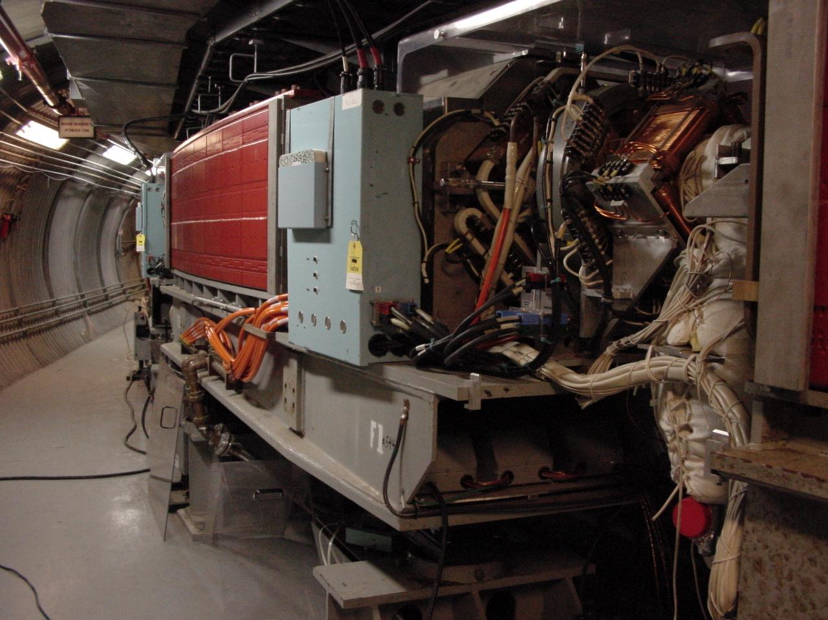
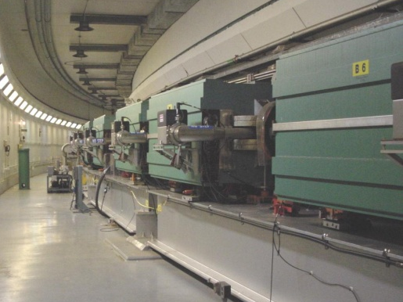
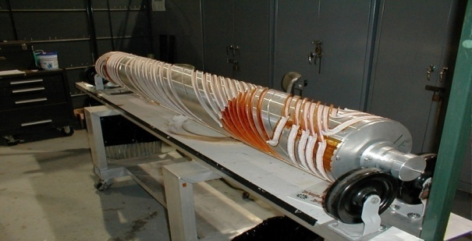
RHIC as a Polarized p+p Collider
Absolute Polarimeter (H jet)
RHIC pC Polarimeters
Siberian Snakes
PHOBOS
BRAHMS & PP2PP
Siberian Snakes
PHENIX
Spin Flipper
STAR
Spin Rotators
Various equipment to maintain and measure beam polarization through acceleration and storage
Partial Snake
Helical Partial
Snake
Polarized Source
Strong Snake
LINAC
AGS
200 MeV Polarimeter
BOOSTER
Rf Dipole
AGS Internal Polarimeter
AGS pC Polarimeter
Notes:
RHIC, as a high-energy polarized proton collider, really represents an outstanding achievement in accelerator physics. . . . [equipment].

Slide 10
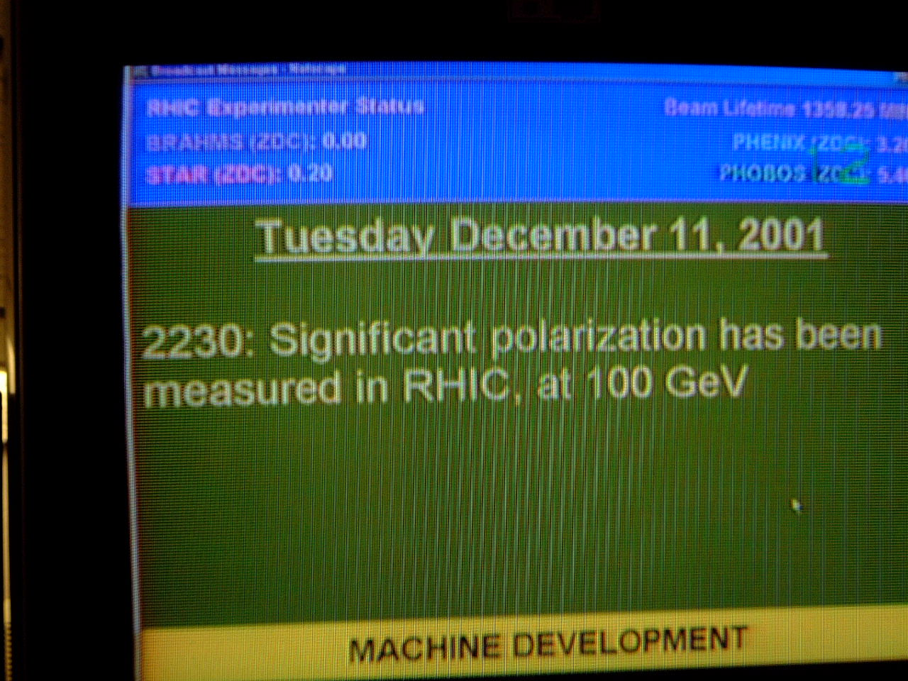
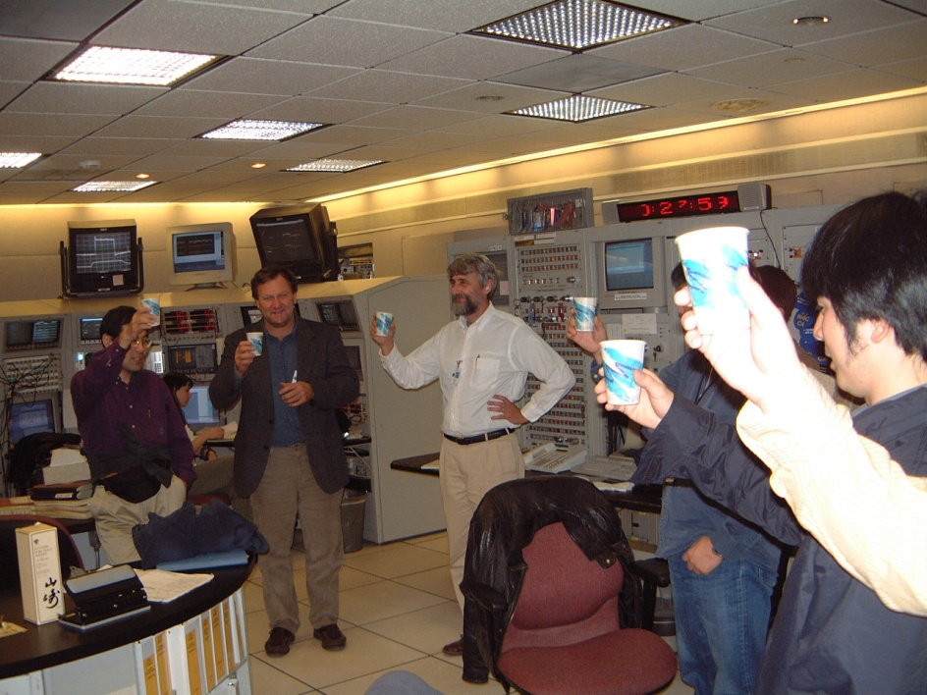
December 2001: News to Celebrate

Slide 11
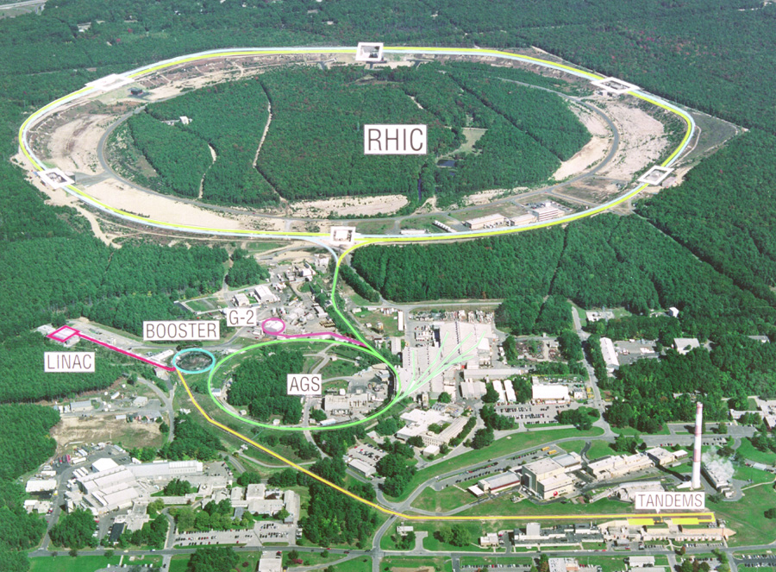

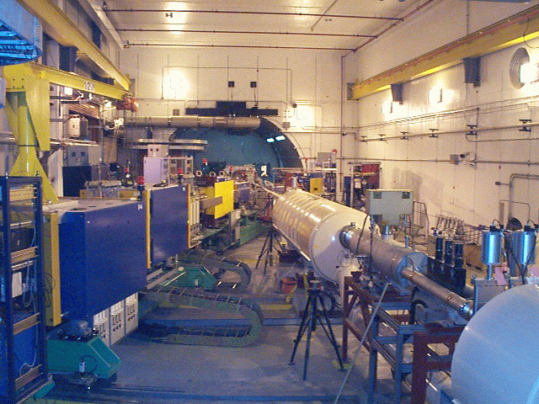
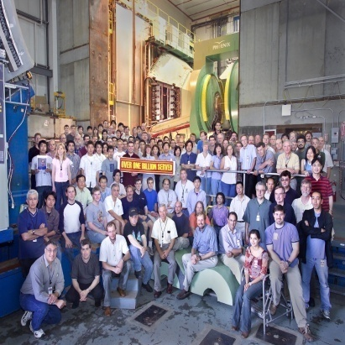
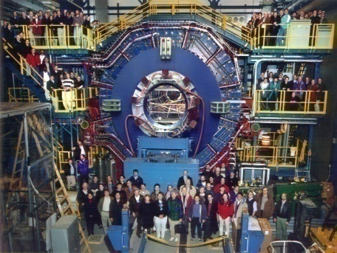


RHIC Spin Physics Experiments
Three experiments: STAR, PHENIX, BRAHMS
Future running only with STAR and PHENIX
Transverse spin only
(No rotators)
Longitudinal or transverse spin
Longitudinal or transverse spin
Accelerator performance:
Avg. pol ~57% at 200 GeV (design 70%).
Achieved 5.0x10³¹ cm⁻² s⁻¹ lumi (design ~4x this).

Slide 12
Proton Spin Structure at RHIC
Transversity
Transverse-momentum-
dependent distributions
, Jets
Prompt Photons
Single-Spin Asymmetries
Back-to-Back Correlations
Advantages of a polarized proton-proton collider:
Hadronic collisions → Leading-order access to gluons
High energies → Applicability of perturbative QCD
High energies → Production of new probes: W bosons

Slide 13
Reliance on Input from Simpler Systems
Disadvantage of hadronic collisions: much “messier” than DIS! → Rely on input from simpler systems
The more we know from simpler systems such as DIS and e+e- annihilation, the more we can in turn learn from hadronic collisions!

Slide 14
Factorization and Universality in Perturbative QCD
q(x₁)
Hard Scattering Process
X
g(x₂)
“Hard” probes have predictable rates given:
    Parton distribution functions (need experimental input)
    Partonic hard scattering rates (calculable in pQCD)
    Fragmentation functions (need experimental input)
Universality
(Process
independence)

Slide 15
Proton Spin Structure at RHIC
Transversity
Transverse-momentum-
dependent distributions
, Jets
Prompt Photons
Single-Spin Asymmetries
Back-to-Back Correlations

Slide 16
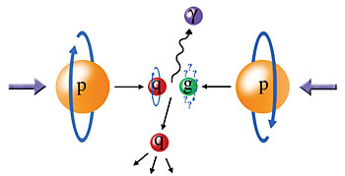
Probing the Helicity Structure of the Nucleon with p+p Collisions
Study difference in particle production rates for same-helicity vs. opposite-helicity proton collisions
DIS
?
pQCD
e+e-
Leading-order access to gluons → ΔG
Notes:
Let me now show you some highlights from the helicity program at RHIC.

Slide 17
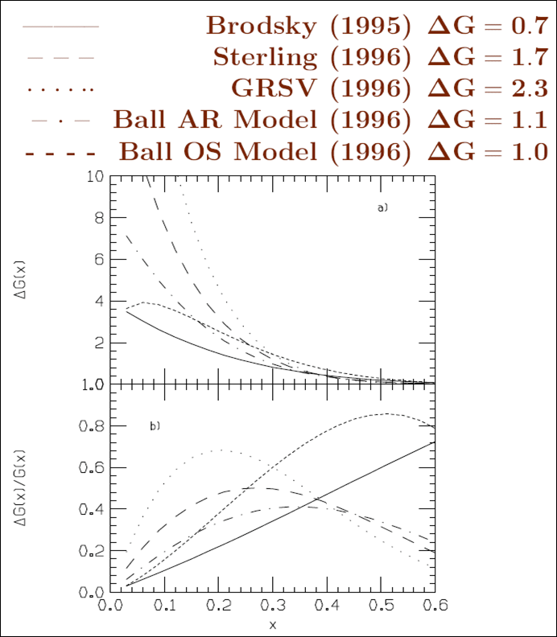
The Quest for ΔG, the Gluon Spin Contribution to the Spin of the Proton
With experimental evidence already indicating that only about 30% of the proton’s spin is due to the spin of the quarks, in the mid-1990s, predictions for ΔG(x) at x=0.1 ranged from 2 to 10(!)

Slide 18
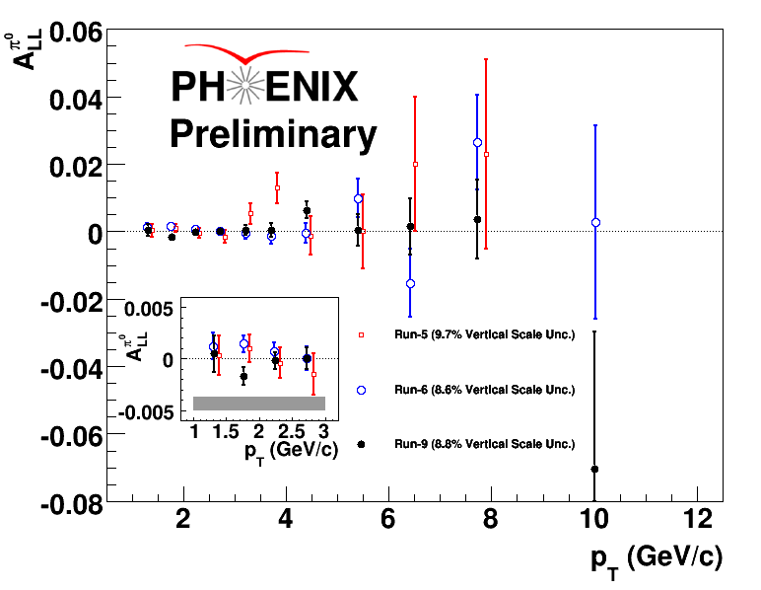
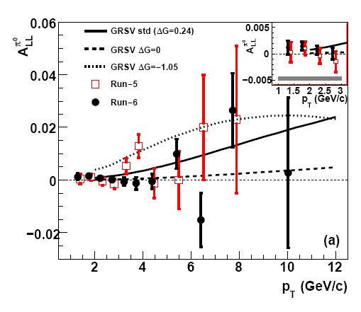
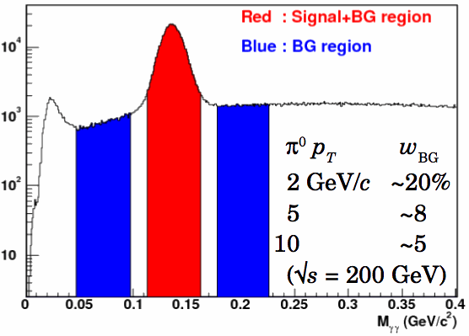

Inclusive Neutral Pion Asymmetry at √s=200 GeV
PRL 103, 012003 (2009)
PHENIX: Limited acceptance and fast EMCal trigger → Neutral pions have been primary probe
- Subject to fragmentation function uncertainties, but easy to reconstruct
New results from 2009 data released at SPIN 2010 last week!
Still no evidence for a non-zero asymmetry!
Helicity asymmetry measurement
Notes:
“Quality of data fits versus gluon spin in measured region”
How do we know that we can trust pqcd in extracting gluon spin?
“pQCD works well at RHIC energies”

Slide 19
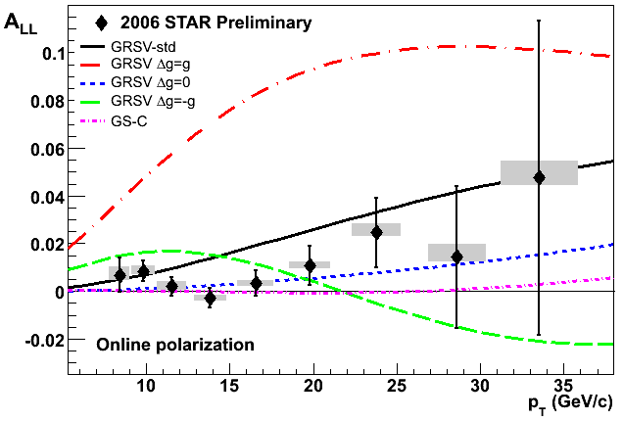
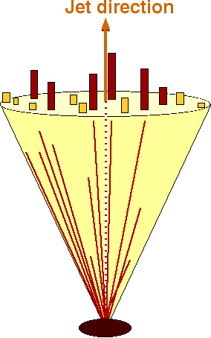
Inclusive Jet Asymmetry at √s=200 GeV
A_{LL} systematics | (x 10 ⁻³)
Reconstruction + Trigger Bias | [-1,+3] (p_{T} dep)
Non-longitudinal Polarization | ~ 0.03 (p_{T} dep)
Relative Luminosity | 0.94
Backgrounds | 1st bin ~ 0.5 Else ~ 0.1
STAR: Large acceptance
→ Jets have been primary probe
Not subject to uncertainties on fragmentation functions, but need to handle complexities of jet reconstruction
π⁺
e⁺
π⁰
π⁻
Κ⁰
p_{T} systematic | ±6.7%
Helicity asymmetry measurement
GRSV curves and data with cone radius R= 0.7 and -0.7 < η < 0.9
STAR
19
Notes:
19

Slide 20
Sampling the Integral of ΔG: π⁰ p_{T} vs. x_{gluon}
Inclusive asymmetry measurements in p+p collisions sample from wide bins in x—sensitive to (truncated) integral of ΔG, not to functional form vs. x
Based on simulation using NLO pQCD as input
PRL 103, 012003 (2009)

Slide 21
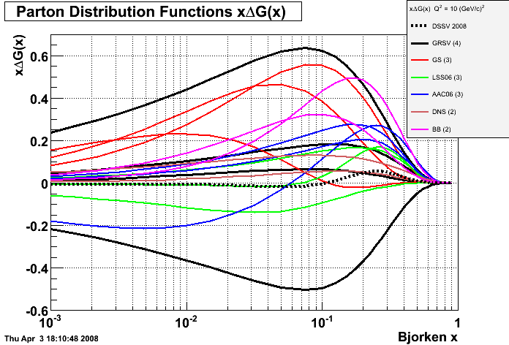
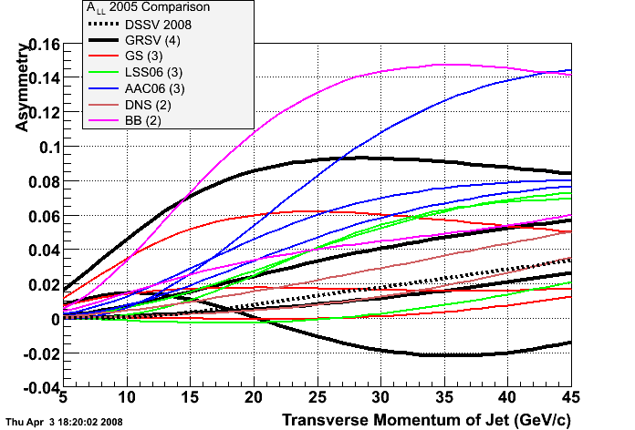
Q² = 10 GeV²
xΔg(x)
A_{LL}
Bjorken x
There are many predictions for Δg(x) vs x which can be translated into predictions for A_{LL} jet, pion, etc. vs p_{T} and compared with RHIC data.
Notes:
21

Slide 22
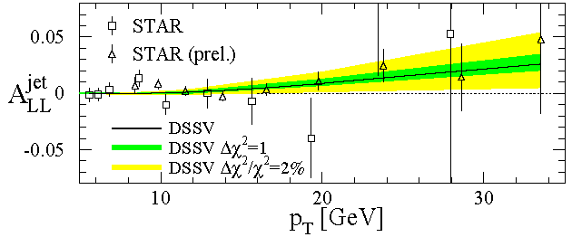
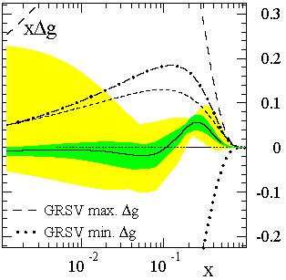
Present Status of Δg(x): Global pdf Analyses
de Florian et al., PRL101, 072001 (2008)
Data in the intervening years have significantly improved constraints, but it looks like we’re trying to hunt down something pretty small!
First global NLO analysis to include inclusive DIS, semi-inclusive DIS, and RHIC p+p data (200 and 62.4 GeV) on equal footing
Best fit finds node in gluon distribution near x ~ 0.1 (not prohibited, but not so intuitive . . .) and ΔG < 0.5 near x=0.1, 4-20 times smaller than predictions in 1990’s!
x range covered by current RHIC measurements at 200 GeV
Notes:
If you consider the thousands of points going into standard global fits of unpolarized pdf’s, we’ve still got a long way to go!

Slide 23
The Future of ΔG Measurements at RHIC
ΔG seems to be small! We’ve got a more challenging task than we anticipated!
Extend x coverage (more low-x surprises in store?)
  Run at different center-of-mass energies
    Already results for neutral pions at 62.4 GeV, now first data at 500 GeV
  Extend measurements to forward particle production
    Forward calorimetry recently enhanced in both PHENIX and STAR
Go beyond inclusive measurements—i.e. measure the final state more completely—to better reconstruct the kinematics and thus the x values probed.
  Jet-jet and direct photon – jet measurements

Slide 24
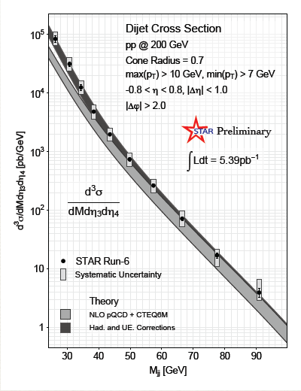
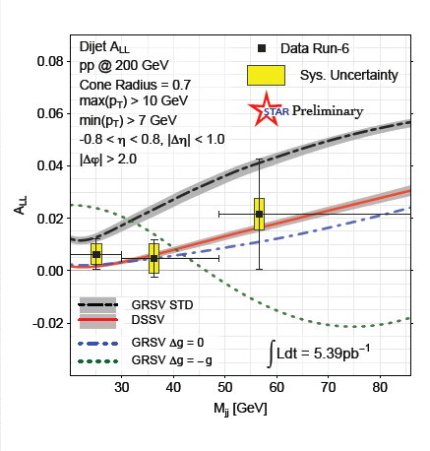
Dijet Cross Section and
Double Helicity Asymmetry
Dijets as a function of invariant mass
More complete kinematic reconstruction of hard scattering—pin down x values probed
Still a long road ahead! Need to perform measurements with higher precision and covering a greater range in gluon momentum fraction.
Spin crisis continues . . .
New! Released at SPIN 2010 last week!
STAR

Slide 25
Proton Spin Structure at RHIC
Not expected to resolve spin crisis, but of particular interest given surprising isospin-asymmetric structure of the unpolarized sea discovered by E866 at Fermilab.
Transversity
Transverse-momentum-
dependent distributions
, Jets
Prompt Photons
Single-Spin Asymmetries
Back-to-Back Correlations

Slide 26
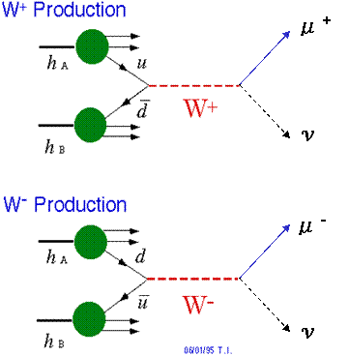
Flavor-Separated Sea Quark Polarizations Through W Production
Flavor separation of the polarized sea quarks with no reliance on fragmentation functions, and at much higher scale than previous fixed-target experiments.
Complementary to semi-inclusive DIS measurements.
Parity violation of the weak
interaction in combination with
control over the proton spin
orientation gives access to the
flavor spin structure in the proton!

Slide 27
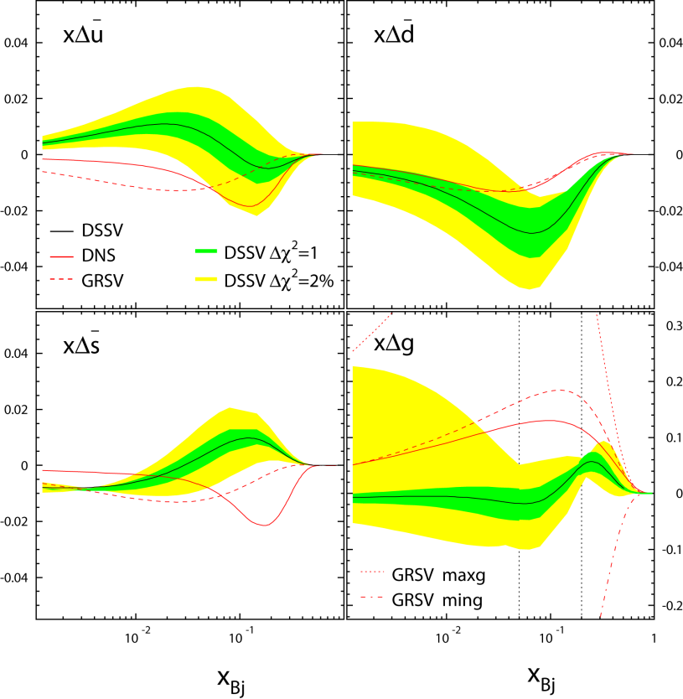
Flavor-Separated Sea Quark Polarizations Through W Production
2008 global fit to helicity distributions: Indication of SU(3) breaking in the polarized quark sea (as in the unpolarized sea), but still relatively large uncertainties on helicity distributions of anti-up and anti-down quarks!
DSSV, PRL101, 072001 (2008)

Slide 28
First 500 GeV Data in 2009
Largely a commissioning run for the accelerator, the polarimeters, and the detectors
  Average polarization ~39% —many additional depolarizing resonances compared to 200 GeV
  W → e at midrapidity already possible with current data
  PHENIX finished installing forward detector/trigger upgrades to be able to make full use of 2011 500 GeV run
  STAR will be ready for forward rapidity measurements in 2012
B. Surrow, DESY seminar, July 2010

Slide 29
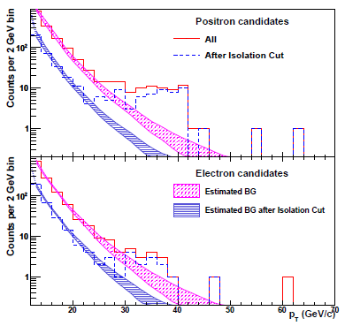
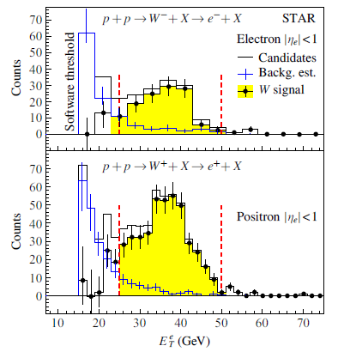
Final W Results from 2009 Data
New since July—results from STAR and PHENIX submitted simultaneously for publication in September
PHENIX: arXiv:1009.0505
STAR: arXiv:1009.0326

Slide 30
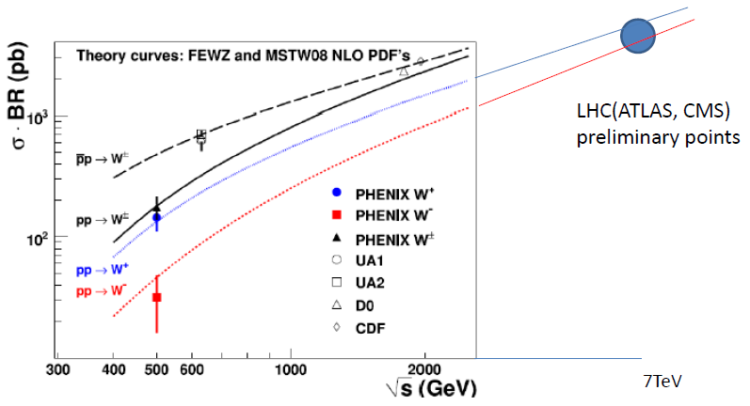
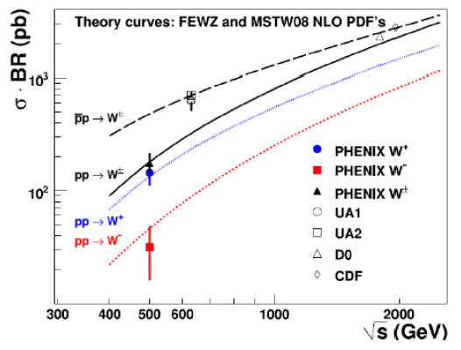
Total W Cross Section
Correct from PHENIX acceptance (p_{T}^{e}>30 GeV/c, |η|<0.35) to total cross section
In agreement with predictions
First W measurement in p+p collisions (at least first submitted for publication . . .!)
Now preliminary LHC results! Consistent with predictions as well.
PHENIX: arXiv:1009.0505

Slide 31
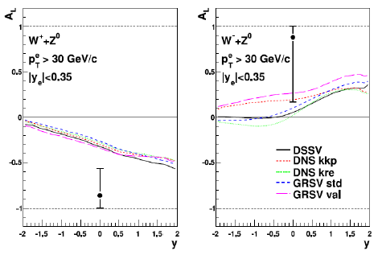
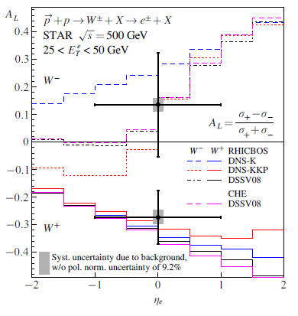
First Glimpse at Parity-Violating Single-Helicity Asymmetries
Long 500 GeV run planned for 2011. Expect significantly higher statistics and improved polarization, and forward in addition to mid-rapidity measurements will be possible.
PHENIX: arXiv:1009.0505
Negative parity-violating asymmetry seen by both PHENIX and STAR for W+. Consistent with SIDIS results, but not yet enough data to improve constraints on anti-u and anti-d helicity distributions.
STAR: arXiv:1009.0326

Slide 32
Proton Spin Structure at RHIC
Transversity
Transverse-momentum-
dependent distributions
, Jets
Prompt Photons
Single-Spin Asymmetries
Back-to-Back Correlations

Slide 33
Longitudinal (Helicity) vs. Transverse Spin Structure
Transverse spin structure of the proton cannot be deduced from longitudinal (helicity) structure
  Spatial rotations and Lorentz boosts don’t commute!
  Only the same in the non-relativistic limit
Transverse structure linked to intrinsic parton transverse momentum (k_{T}) and orbital angular momentum!

Slide 34
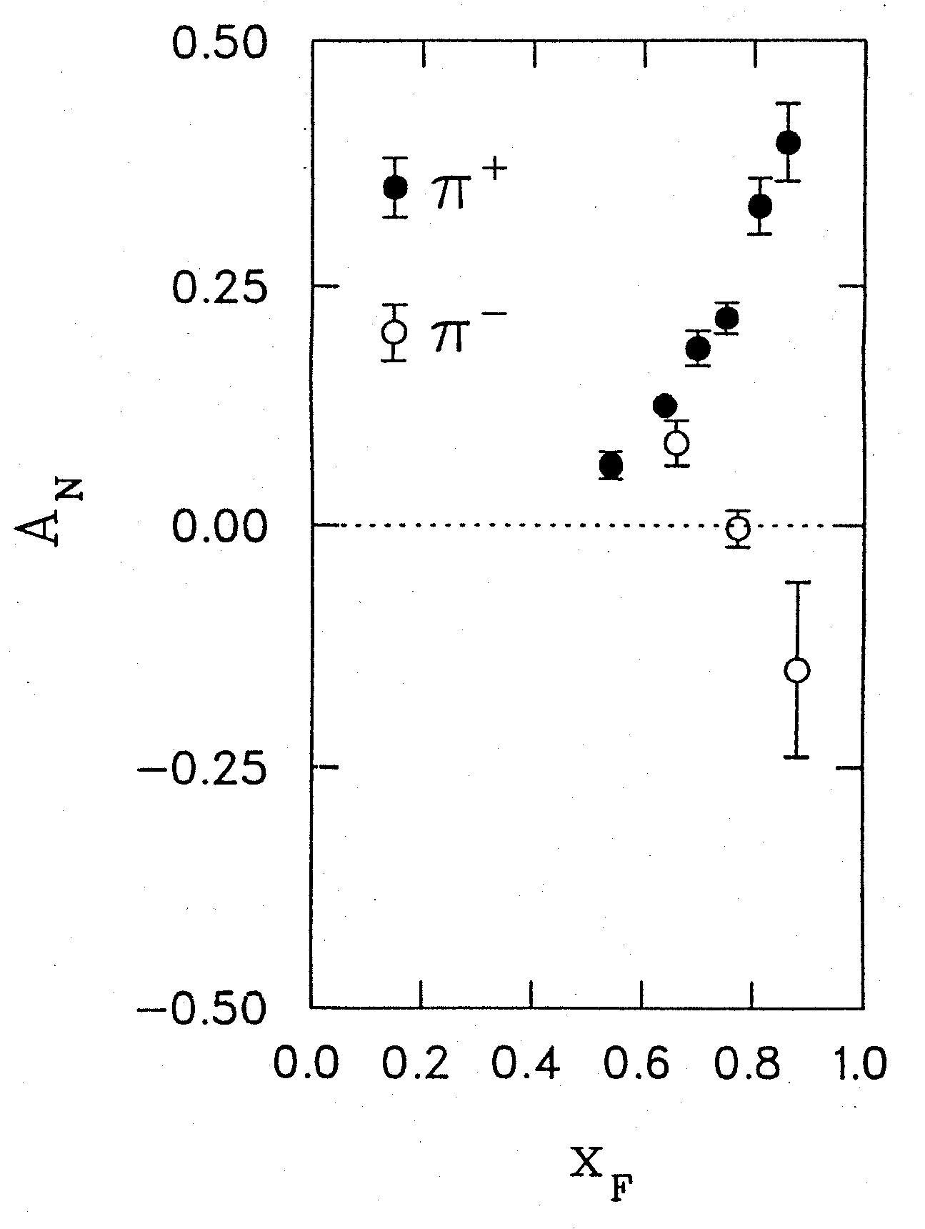
1976: Discovery in p+p Collisions!
Large Transverse Single-Spin Asymmetries
Argonne √s=4.9 GeV
Charged pions produced preferentially on one or the other side with respect to the transversely polarized beam direction!
left
Due to quark transversity, i.e. correlation of transverse quark spin with transverse proton spin? Other effects? We’ll need to wait more than a decade for the birth of a new subfield in order to explore the possibilities . . .
right
W.H. Dragoset et al., PRL36, 929 (1976)

Slide 35
Transverse-Momentum-Dependent Distributions and Single-Spin Asymmetries
1989: The “Sivers mechanism” is proposed in an attempt to understand the observed asymmetries.
D.W. Sivers, PRD41, 83 (1990)
The Sivers distribution: the first transverse-momentum-dependent distribution (TMD)!
Departs from the traditional collinear factorization assumption in pQCD and proposes a correlation between the intrinsic transverse motion of the quarks and gluons and the proton’s spin
New frontier! Parton dynamics inside hadrons, and in the hadronization process
Spin and momenta can be of partons or hadrons

Slide 36
Quark Distribution Functions
Similarly, can have k_{T}-dependent fragmentation functions (FFs). One example: the chiral-odd Collins FF, which provides one way of accessing transversity distribution (also chiral-odd).
No (explicit) k_{T} dependence
Transversity
k_{T} - dependent, T-even
k_{T} - dependent, T-odd
Sivers
Relevant measurements in simpler systems (DIS, e+e-) only starting to be made over the last ~5 years, providing evidence that many of these correlations are finite in nature! Rapidly advancing field both experimentally and theoretically!
Boer-Mulders

Slide 37
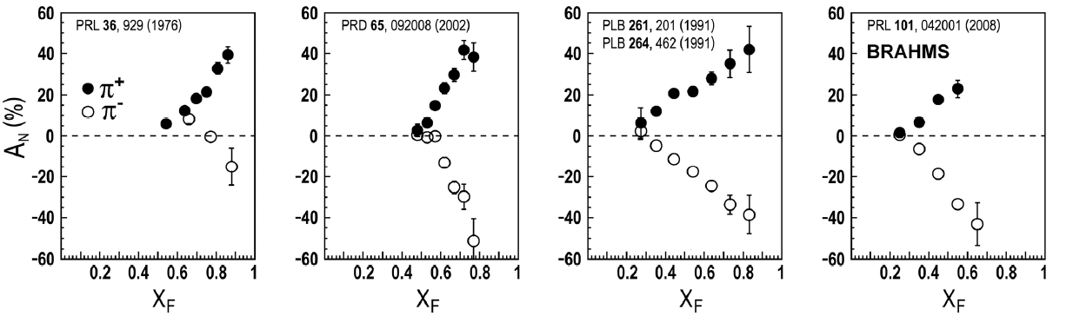
Transverse Single-Spin Asymmetries:
From Low to High Energies!
ANL
√s=4.9 GeV
BNL
√s=6.6 GeV
FNAL
√s=19.4 GeV
RHIC
√s=62.4 GeV
RHIC
√s=200 GeV!
π⁰
left
STAR
right

Slide 38
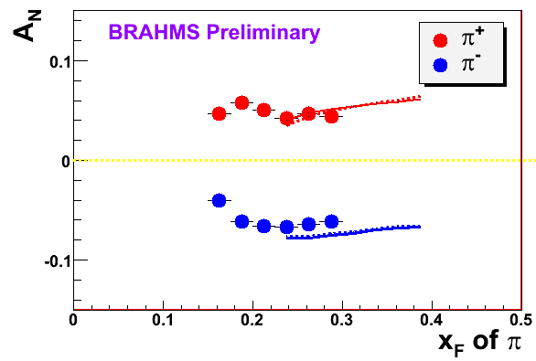
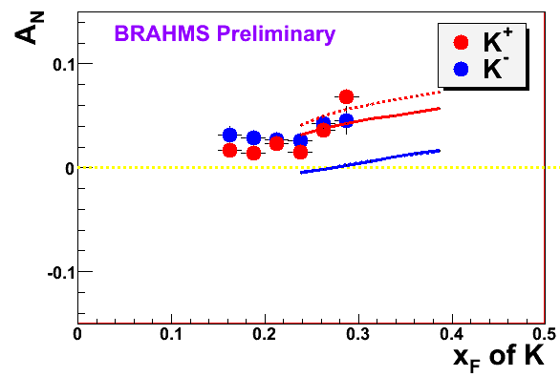
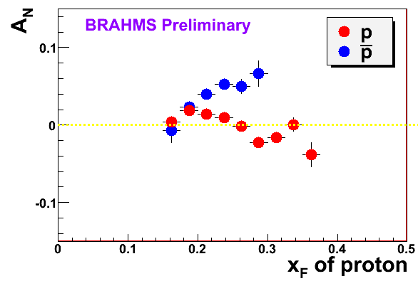
π
π
π, K, p
at 200 and 62.4 GeV
Pattern of pion species asymmetries in the forward direction
→ valence quark effect.
But this conclusion confounded by kaon and antiproton asymmetries!
200 GeV
62.4 GeV
Note different scales
K
K
K- asymmetries
underpredicted
200 GeV
62.4 GeV
p
p
Large antiproton asymmetry?? Unfortunately no 62.4 GeV measurement
200 GeV
62.4 GeV

Slide 39
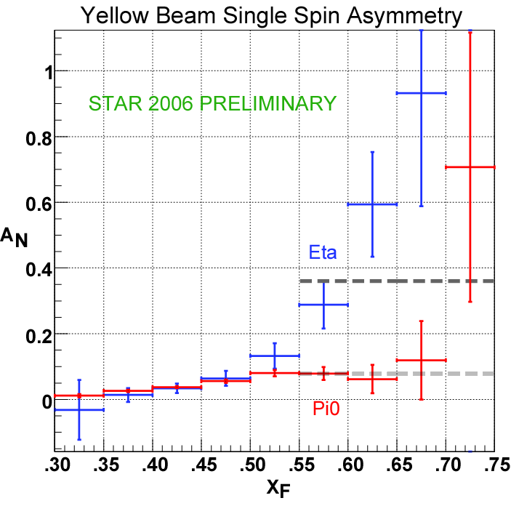
Another Surprise: Transverse Single-Spin Asymmetry in Eta Meson Production
Further evidence against a valence quark effect!
Larger than the neutral pion!
STAR

Slide 40
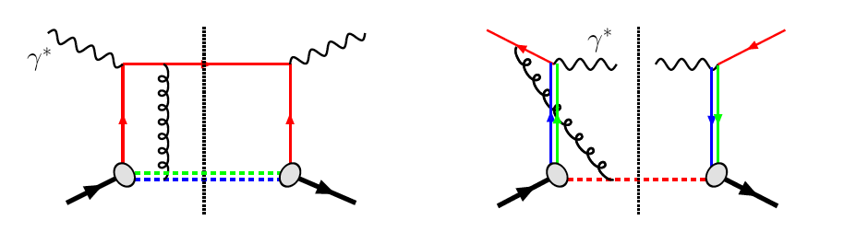
TMDs and Universality:
Modified Universality of Sivers Asymmetries
DIS: attractive FSI
Drell-Yan: repulsive ISI
Measurements in semi-inclusive DIS already exist. A p+p measurement will be a crucial test of our understanding of QCD!
But Drell-Yan in p+p requires large integrated luminosity—small, dedicated experiment currently being set up at RHIC to take transversely polarized data during 500 GeV running (longitudinal polarization at PHENIX and STAR for W program).
As a result:

Slide 41
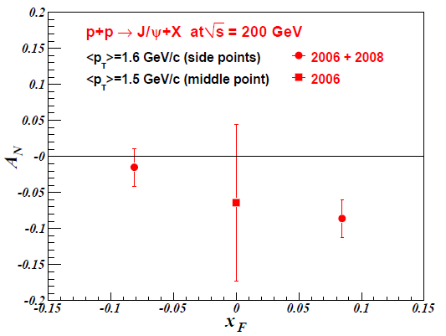
J/Psi A_{N} and Gluon Correlations with the (Transverse) Spin of the Proton
Other consequences of non-universality of Sivers TMD (and other T-odd TMDs) starting to be realized!
  PRD 78, 014024 (2008)—F. Yuan predicts that J/Psi transverse single-spin asymmetry sensitive to J/Psi production mechanism, with different expectations for p+p vs. SIDIS
No SIDIS measurement yet, but PHENIX just submitted result for publication!
3.3σ negative asymmetry at forward rapidity observed. J/Psi produced via gg interactions at RHIC. Suggests possible non-zero (collinear, twist-3) trigluon correlation functions in transversely polarized proton. Will need more data to confirm!
arXiv:1009.4864 [hep-ex]

Slide 42
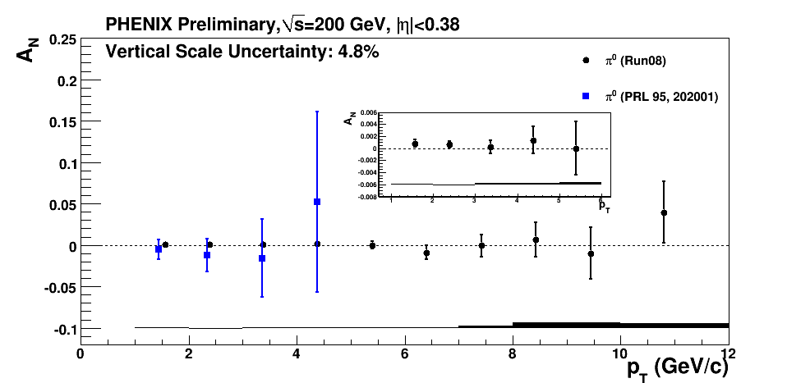
Gluons Look Different for Pions at Midrapidity??
2002 Published Result 2008 Preliminary Result
Not necessarily a contradiction! Importance of color interactions starting to be realized in these processes sensitive to parton dynamics within hadrons . . .
A_{N}
p_{T}
Midrapidity pion production at 200 GeV dominated by gg scattering up to p_{T}~5 GeV/c, but transverse single-spin asymmetry measured to be tiny . . . Contradicts J/Psi result??
Notes:
Color code

Slide 43
Factorization and Color
Earlier this year—groundbreaking work by T. Rogers, P. Mulders claiming that pQCD factorization is broken in processes involving more than two hadrons total if parton k_{T} is taken into account (TMD pdfs and/or FFs)
  PRD 81, 094006 (2010)
  No unique color flow
An exciting sub-field—lots of recent experimental activity, and theoretical questions probing deep issues of both universality and factorization in (perturbative) QCD!

Slide 44
Nucleon Structure and Spin-Momentum Correlations
Transversity : correlation between transverse proton spin and quark spin
Sivers : correlation between transverse proton spin and quark transverse momentum
Boer-Mulders: correlation between transverse quark spin and quark transverse momentum
Long-term goal: Description of the nucleon in terms of the quark and gluon wavefunctions!
S_{p}– S_{q} – coupling?
S_{p}-- L_{q}– coupling???
S_{q}-- L_{q}– coupling???

Slide 45
QED vs. QCD
observation & models
precision measurements
& fundamental theory

Slide 46

Glancing Into the Future:
The Electron-Ion Collider
Design and build a new facility with the capability of colliding a beam of electrons with a wide variety of nuclei as well as polarized protons and light ions: the Electron-Ion Collider
Add electron ring to RHIC at BNL, or hadron facility to CEBAF at JlLab.
Ongoing INT workshop in Seattle this fall: http://www.int.washington.edu/PROGRAMS/10-3/

Slide 47
Conclusions and Prospects
After > 40 years of studying the internal structure of the nucleon and nuclei, we remain far from the ultimate goal of being able to describe nuclear matter in terms of its quark and gluon degrees of freedom!
Further data from RHIC will better constrain the gluon and flavor-separated sea quark helicity distributions in the proton, and continue to push forward knowledge of the quantum mechanical spin-momentum correlations of partons in nucleons.
  Documents outlining plans for the next decade submitted to BNL management by PHENIX and STAR last week!
The EIC promises to usher in a new era of precision measurements that will probe the behavior of quarks and gluons in nucleons as well as nuclei, bringing us to a new phase in understanding the rich complexities of QCD in matter.
There’s a large and diverse community of people—at RHIC and complementary facilities—driven to continue coaxing the secrets out of one of the most fundamental building blocks of the world around us.

Slide 48
Additional Material

Slide 49
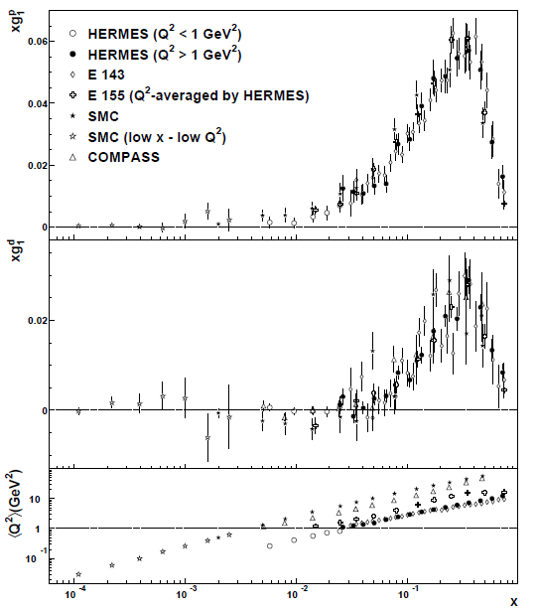
xg₁^{p}: Compilation of recent results
Phys.Rev.D75:012007,2007

Slide 50
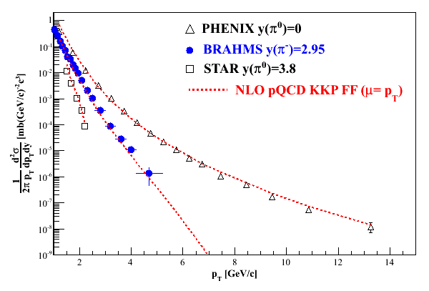
Polarization-averaged cross sections at √s=200 GeV
Good description at 200 GeV over all rapidities down to p_{T} of 1-2 GeV/c.

Slide 51

√s=62.4 GeV
Forward pions
Comparison of NLO pQCD calculations with BRAHMS π data at high rapidity. The calculations are for a scale factor of μ=p_{T}, KKP (solid) and DSS (dashed) with CTEQ5 and CTEQ6.5.
Surprisingly good description of data, in apparent disagreement with earlier analysis of ISR π⁰ data at 53 GeV.
Still not so bad!

Slide 52

√s=62.4 GeV
Forward kaons
K⁻ data suppressed ~order of magnitude (valence quark effect).
NLO pQCD using recent DSS FF’s gives ~same yield for both charges(??).
Related to FF’s? PDF’s??
K⁺: Not bad!
K⁻: Hmm…
Notes:
Authero of DSS knows about this.

Slide 53
Fragmentation Functions (FF’s):
Improving Our Input for Inclusive Hadronic Probes
FF’s not directly calculable from theory—need to be measured and fitted experimentally
The better we know the FF’s, the tighter constraints we can put on the polarized parton distribution functions!
Traditionally from e+e- data—clean system!
Framework now developed to extract FF’s using all available data from deep-inelastic scattering and hadronic collisions as well as e+e-
  de Florian, Sassot, Stratmann: PRD75:114010 (2007) and arXiv:0707.1506

Slide 54


Extending x Coverage
PRD79, 012003 (2009)
Measure in different kinematic regions
  e.g. forward vs. central
Change center-of-mass energy
  Most data so far at 200 GeV
  Brief run in 2006 at 62.4 GeV
  First 500 GeV data-taking to start next month!
62.4 GeV
Extend to lower x at √s = 500 GeV
Extend to higher x at √s = 62.4 GeV
200 GeV
present
x-range
√s = 200 GeV
Notes:
Get rid of!

Slide 55
Neutral Pion A_{LL} at 62.4 GeV
Converting to x_{T}, can see significance of 62.4 GeV measurement (0.08 pb⁻¹) compared to published data from 2005 at 200 GeV (3.4 pb⁻¹).
PRD79, 012003 (2009)

Slide 56



Inclusion of New 2009 PHENIX π⁰ A_{LL}
K. Boyle, SPIN 2010
Include new π⁰ A_{LL} data from PHENIX within DSSV framework
With new PHENIX data—stronger constraints on negative values
Previously (DSSV)

Slide 57


Slide 58

pQCD Scale Dependence at RHIC vs. Spin-Dependent DIS
Scale dependence
benchmark:
Tevatron ~ 1.2
RHIC ~ 1.3
COMPASS ~ 2.5 – 3
HERMES ~ 4 – 5
Scale dependence
at RHIC is significantly
reduced compared to
fixed-target polarized
DIS.
HERMES
(hadron pairs)
Change in pQCD calculation of
cross section if factorization scale
change by factor 2
COMPASS
(hadron pairs)
RHIC
(direct photon)
E708
(direct photon)
CDF
(direct photon)

Slide 59
Understanding Transverse Spin Measurements in Hadronic Collisions
Theoretical interpretation of longitudinally polarized measurements at RHIC relies on the existence of results from simpler systems, e.g.
  Fragmentation functions from e+e- experiments
  Δu, Δd from deep-inelastic scattering experiments
Relevant quantities for transverse spin calculations starting to be measured and parameterized now…

Slide 60
Prokudin et al. at Ferrara

Slide 61
Prokudin et al. at Ferrara

Slide 62



Transverse SSA’s Persist up to RHIC Energies!
√s = 62.4 GeV
PRL101, 042001 (2008)
π⁰

Slide 63

Transverse SSA’s at √s = 200 GeV at RHIC
π⁰
BRAHMS Preliminary
PRL101, 222001 (2008)
STAR

Slide 64
π
π
π, K, p
at 200 and 62.4 GeV
200 GeV
62.4 GeV
Rapid advances in transverse spin structure and
transverse-momentum-dependent distributions over the past seven years!
Unexpected experimental measurements drive theoretical progress!
Many more interesting transverse spin results expected from RHIC
in upcoming years.
Note different scales
K
K
K- asymmetries
underpredicted
200 GeV
62.4 GeV
p
p
Large antiproton asymmetry?? Unfortunately no 62.4 GeV measurement
But where can we go beyond RHIC to learn more?
200 GeV
62.4 GeV

Slide 65

Run-8 data does show expected decrease at low pT
Black points: Phys. Rev. Lett. 101, 222001 (2008)

Slide 66
Neutral Pion Transverse SSA:
Decrease at Low pT Now Observed
Black points: Phys. Rev. Lett. 101, 222001 (2008)

Slide 67
Forward π⁰ A_{N} at 200 GeV: p_{T} dependence
arXiv:0801.2990
Accepted by PRL
STAR

Slide 68




(i) Forward SSA A_{N} π⁰ in MPC at √s=62 GeV
η > 3.5
η < 3.5
3.1 < η < 3.7
PHENIX π⁰ results available for √s=62 GeV
Production dominated by quark-gluon
Similar x_{F} scaling to higher and lower center of masses
Asymmetries could enter a global analysis on transverse spin asymmetries
Process contribution to π⁰, η=3.3, √s=200 GeV
PLB 603,173 (2004)

Slide 69


(i) Forward SSA A_{N} Cluster in MPC at √s=200 GeV
Fraction of clusters
Decay photon
π⁰
Direct photon
p_{T} (GeV/c)

Slide 70


(i) Forward SSA A_{N} Cluster in MPC at √s=200 GeV
GeV/c
GeV/c
Fraction of clusters
η<3.3 η<3.3
Eta>3.3
Decay photon
π⁰
Direct photon
x_{F}
x_{F}

Slide 71


(i) Forward SSA A_{N} Cluster in MPC at √s=200 GeV
Fraction of clusters
Decay photon
π⁰
Direct photon
p_{T}

Slide 72


A_{N} of Mid-rapidity Neutral Pions
PRL 95,
202001 (2005)
A_{N} for both neutral pions and charged hadrons at mid-rapidity consistent with zero within a few percent.
|η| < 0.35

Slide 73

Interference Fragmentation Function to Probe Transversity
Added statistics from 2008 running. No significant asymmetries seen at mid-rapidity.

Slide 74

Forward neutrons at √s=200 GeV at PHENIX
Large negative SSA observed for x_{F}>0, enhanced by requiring concidence with forward charged particles (“MinBias” trigger).
No x_{F} dependence seen.
Mean p_{T}
(Estimated by simulation assuming ISR p_{T} dist.)
0.4<|x_{F}|<0.6 0.088 GeV/c
0.6<|x_{F}|<0.8 0.118 GeV/c
0.8<|x_{F}|<1.0 0.144 GeV/c
preliminary | A_{N}
Without MinBias | -6.6 ±0.6 %
With MinBias | -8.3 ±0.4 %
charged
particles
neutron
neutron

Slide 75
Forward neutrons at other energies
Significant forward neutron asymmetries observed down to 62.4 and up to 410 GeV!
√s=62.4 GeV
√s=410 GeV

Slide 76






Single-Spin Asymmetries for Local Polarimetry:
Confirmation of Longitudinal Polarization
A_{N}
Spin Rotators OFF
Vertical polarization
Blue
φ
Yellow
Spin Rotators ON
Current Reversed!
Radial polarization
Blue
Yellow
Spin Rotators ON
Correct Current
Longitudinal polarization!
Blue
Yellow

Slide 77

First Observation of the Collins Effect
in Polarized Deep Inelastic Electron-Proton Scattering
HERMES
Collins Asymmetries in semi-
inclusive deep inelastic scattering
e+p → e + π + X
~ Transversity (x) x Collins(z)
A_{UT} sin(φ+φ_{s})

Slide 78
The Collins Effect Must be Present
In e⁺e⁻ Annihilation into Quarks!
electron
q₁
q₂
quark-1
spin
quark-2
spin
Collins effect in e+e-
Quark fragmentation
will lead to effects
in di-hadron correlation
measurements!
positron

Slide 79


Observation of the Collins Effect in e⁺e⁻
Annihilation with Belle
Belle (UIUC/RBRC) group
Collins Asymmetries in e⁺e⁻
annihilation into hadrons
e⁺+e⁻ → π⁺ + π⁻ + X
~ Collins(z₁) x Collins (z₂)
PRELIMINARY
ϕ₂−π
Θ
e⁻
ϕ₁
e⁺
A₁₂ cos(φ₁+φ₂)

Slide 80




Sivers Asymmetries at HERMES
and COMPASS
implies non-zero L_{q}
π^{+/−}
Κ^{+/−}

Slide 81

Fundamental Theoretical Work: Sivers Effect
and Questions of Universality and Factorization
Annual number of publications on transverse spin
in SPIRES vs time. The total number of pulications
is about ~750, about 15% are experimental.

Slide 82




Towards a 3D spin-flavor landscape
W^{u}(x,k,r)
x = 0.01
m
x = 0.40
x = 0.70
m
d³r
d²k_{T}
p
x
p
TMD
GPD
B
TMD^{u}(x,k_{T})
f₁,g₁,f_{1T} ,g_{1T}
h₁, h_{1T} ,h_{1L} ,h₁
Link to Orbital Momentum
GPD^{u}(x,ξ,t)
H^{u}, E^{u}, H^{u}, E^{u}
Link to Orbital Momentum
~
~
Wigner function: Probability to find a u(x) quark with a certain polarization at position r and with momentum k
Fourier transform in momentum transfer
d²k_{T}
ξ = 0, t = 0
dx
f₁(x)
g₁, h₁
u(x)
Δu, δu
F₁^{u}(t)
F₂^{u},G_{A}^{u},G_{P}^{u}
Parton
Distributions
Form Factors
gives transverse position of quark (parton) with longitud. mom. fraction x

Slide 83

The STAR Detector at RHIC
STAR

Slide 84


PHENIX Detector
Philosophy:
  High rate capability to measure rare probes,
  but limited acceptance.
2 central
spectrometers
Track charged particles and detect electromagnetic processes
azimuth
2 forward
spectrometers
- Identify and track muons

Slide 85


BRAHMS detector
Philosophy:
  Small acceptance spectrometer arms
  designed with good charged particle ID.

Slide 86
Helicity Flip Amplitudes
Elastic proton-quark scattering
(related to inelastic scattering through optical theorem)
Helicity flip distribution also called the “transversity” distribution.
Corresponds to the difference in probability of scattering off of a transversely polarized quark within a transversely polarized proton with the quark spin parallel vs. antiparallel to the proton’s.
Chiral-odd! But chirality conserved in QCD processes . . . Can transversity exist and produce observable effects?
Three independent pdf’s corresponding to following helicity states:
Take linear combinations to form:
Helicity average
Helicity difference
Helicity flip

Slide 87


Progress in pQCD calculational techniques
23.7 GeV!
38.8 GeV!
pQCD an ever-more-powerful tool.
Interpretation of p+p results—over a wider range of energies—getting easier!
“Modern-day ‘testing’ of (perturbative) QCD is as much about pushing the boundaries of its applicability as about the verification that QCD is the correct theory of hadronic physics.”
– G. Salam, hep-ph/0207147 (DIS2002 proceedings)
One recent example:
Almeida, Sterman, Vogelsang, PRD80, 074016 (2009)
Cross section for di-hadron production vs. invariant mass using threshold resummation (rigorous method for implementing p_{T} and rapidity cuts on hadrons to match experiment)
87
Notes:
87

