Slide 1
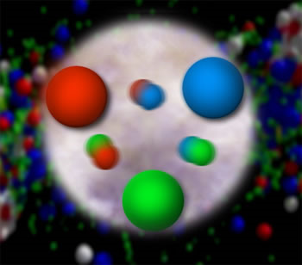
Pulling Apart the Strong Force by
Peering Into the Proton
Christine A. Aidala
University of Michigan
SPS Talk
February 12, 2013

Slide 2
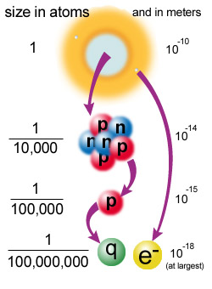
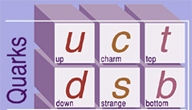
Inside the Proton:
The Quark-Parton Model
Similarly to Rutherford’s 1911 experiment in which the scattering of alpha particles at large angles off of gold revealed a hard atomic core (the nucleus), in the late 1960’s at SLAC, scattering of electrons at large angles off of protons revealed “hard” subcomponents in the proton
  Protons weren’t solid lumps of positive charge as previously believed!
  The pointlike constituents that make up the proton are called “quarks,” or slightly more generally, “partons.”
Quark

Slide 3
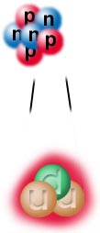

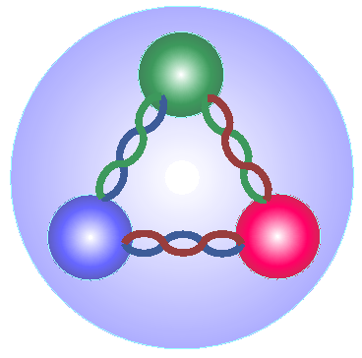
Quark-Parton Model (cont.)
The simplest model says a proton’s made of three “valence” quarks: 2 up “flavored” quarks and 1 down “flavored” quark.
But these quarks are not completely free in the nucleon!
  Bound by force-carrier particles called “gluons.”
  “Sea quarks” are also present: short-lived quark-antiquark pairs from quantum mechanical fluctuations.
As you hit the proton with more energy, you resolve shorter-lived fluctuations: gluons and sea quarks.

Slide 4
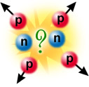
Strong Force
How does the nucleus stay together? The electromagnetic force should cause the protons to repel one another
Protons and neutrons interact via the strong force, carried by gluons
  Much stronger than the electromagnetic force (~100x) and waaayyy stronger than gravity (~10³⁸x!!) (thus the name!)
  But—very very short range! (~10⁻¹⁵ m)

Slide 5
Color Charge and QCD
Strong force acts on particles with color charge
  Quarks, plus gluons themselves! (Contrast with photons, which are electrically neutral)
“Color” because three different “charges” combine to make a neutral particle: red+blue+green = white
Quantum Chromodynamics (QCD)—theory describing the strong force
Note that quarks also carry fractional electromagnetic charge!!
Proton = up + up + down quarks
+1 = +2/3 + +2/3 + -1/3
Neutron = down + down + up
0 = -1/3 + -1/3 + +2/3

Slide 6
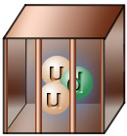
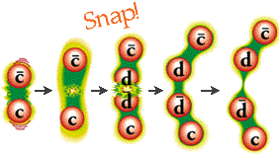
Quark Confinement
Never see quarks or gluons directly!
  Confined to composite, color-neutral particles
  Groups of three quarks (rgb), called baryons, or quark-antiquark pairs (red-antired, . . .), called mesons
If you try to pull two quarks apart, energy between them increases until you produce a new quark-antiquark pair (recall good old E=mc²)
“D⁻ meson”
“D⁺ meson”

Slide 7
How do we understand the visible matter in our universe in terms of the fundamental quarks and gluons described by our theory of the strong force, quantum chromodynamics?

Slide 8
For More Information
For more info on quarks, gluons, and the strong force, see
http://www.particleadventure.org/
(Many pictures on previous pages borrowed from this site)

Slide 9
Studying Proton Structure
If can’t see individual quarks and gluons (“partons”), how to determine the proton’s structure?
Inelastic scattering—shoot a high-energy beam (e.g. of electrons) at the proton to break it up, and try to understand what happens
  Electron exchanges a photon with quarks, because quarks carry electromagnetic charge as well as color
Describe proton structure in terms of parton distribution functions (pdf’s)
- Probability of scattering off of a parton carrying a particular fraction of the proton’s momentum (“Bjorken-x” variable)
  (Recall that even if protons are in a stationary target, have non-zero momentum in center-of-mass frame)

Slide 10
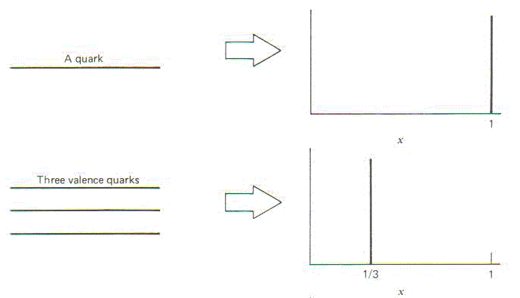
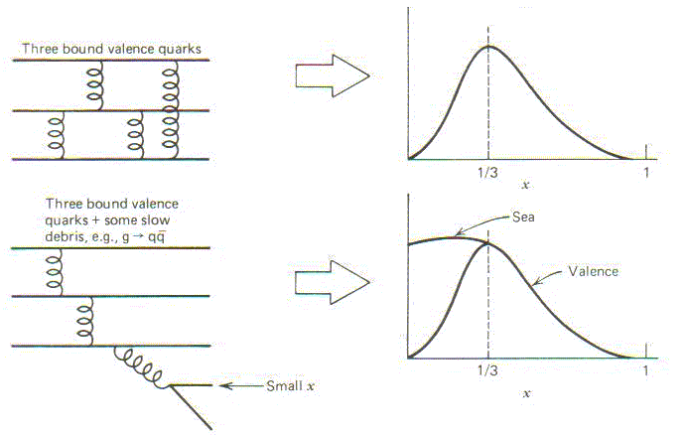
Proton structure and momentum fraction
What momentum fraction would the scattering particle carry
if the proton were made of …
3 bound valence quarks
A point particle
x_{Bjorken}
1
1/3
1
3 bound valence quarks + some
low-momentum sea quarks
x_{Bjorken}
Sea
3 valence quarks
Valence
Small x
1/3
1
x_{Bjorken}
1/3
x_{Bjorken}
1
Halzen and Martin, “Quarks and Leptons”, p. 201

Slide 11
So what do the parton distribution functions look like?
Wealth of data largely thanks to proton-electron collider, HERA, in Hamburg, Germany (1992-2007)
Up and down valence quark distributions peaked at a little less than 1/3
Lots of sea quark-antiquark pairs and even more gluons (scaled down by 20x in figure!)
parton distribution function
momentum fraction
PRD67, 012007 (2003)

Slide 12
What Have We Learned?
Conclusions from decades of inelastic scattering data investigating proton momentum structure:
  3 “valence” quarks carry (on average) the largest single momentum fractions of the proton
  But lots of gluons and “sea” quark-antiquark pairs in the proton as well! Gluons carry ~50% of total momentum of proton.
Despite all the recent excitement about the Higgs boson, gluons are actually responsible for more than 98% of the mass of the visible universe!!

Slide 13
Mapping out the proton:
Other questions to ask!
What does the proton look like in terms of the quarks and gluons inside it?
Position
Momentum
Spin
Flavor
Color
Theoretical and experimental concepts to describe and access position only born in mid-1990s. Pioneering measurements over past decade.
Vast majority of past four decades focused on
1-dimensional momentum structure! Since 1990s starting to consider other directions . . .
Polarized protons first studied in 1980s. How angular momentum of quarks and gluons add up still not well understood!
Good measurements of flavor distributions in valence region. Flavor structure at lower momentum fractions still yielding surprises!
Accounted for by theorists from beginning of QCD, but more detailed, potentially observable effects of color have come to forefront since 2010 . . .

Slide 14
What is Spin?
?
Spin is a quantum mechanical property of fundamental particles or combinations of particles.
It’s called “spin” because it’s a type of angular momentum and is described by equations treating angular momentum.
The units of angular momentum are the same
as Planck's constant, h, and can only have
values that are integer : 0, 1, 2, 3, . . .
or half-integer: 1/2, 3/2, 5/2, . . .
Quarks, like protons, have spin 1/2.
Proton spin is what makes the medical diagnostic technique of MRI possible!
In a magnetic field, different spin states have different energies but have the same magnitude of the angular momentum.

Slide 15
Stern-Gerlach Experiment
Any particle with spin
Spin ½ particle (e.g. ¹⁰⁷Ag or ¹H)
Spin 1 particle (e.g. ²H)
Apply a magnetic field
Spin 3/2 particle (e.g. ⁷Li)
2s+1 Energy Levels

Slide 16
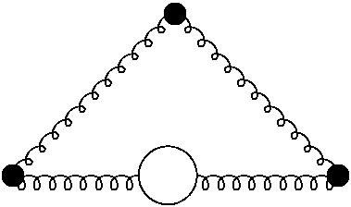

The Proton Spin Crisis
gluon
Say you have a proton with total spin +1/2 along some axis. You’d expect it to contain two quarks with spin +1/2 and one with spin -1/2.
1/2 + 1/2 - 1/2 = +1/2
Proton
Surprising data from late 1980s!
1987: Only 12% +- 16% of proton’s spin carried by quarks’ spins!
The Proton Spin Crisis begins!!
Quark Spin
Gluon Spin
Spin
The rest now expected to be from gluon spin
and orbital angular momentum of quarks and
gluons, but this hasn’t been easy to measure!
Orbital Angular
Momentum

Slide 17
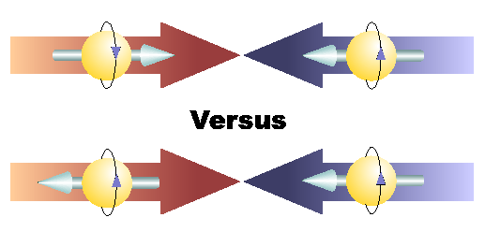
Polarized Parton Distribution Functions
Describe spin structure in terms of polarized parton distribution functions
Helicity distributions—difference in probability of scattering off of a quark or gluon with same vs. opposite helicity of proton
  To study the spin structure of the proton:
  Do inelastic scattering with polarized protons! (spin directions all aligned)
Positive helicity
Helicity: Projection of spin vector onto momentum vector for particles polarized longitudinally, i.e. parallel to direction of motion.
  Either positive or negative.
Negative helicity
vs.

Slide 18
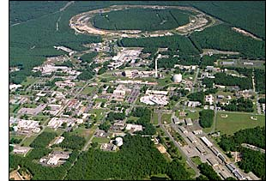
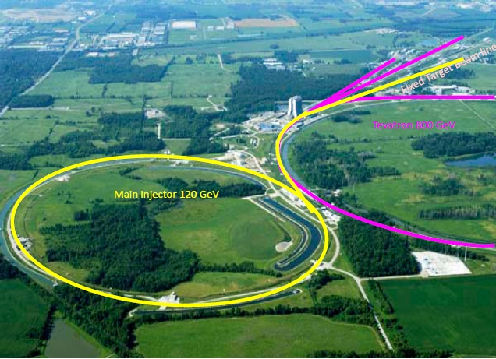
My own work: The PHENIX and SeaQuest experiments
Polarized proton-proton collisions to a variety of final states at the PHENIX experiment at Brookhaven National Lab (BNL) on Long Island, NY
  Very flexible, multi-purpose experiment
Quark-antiquark annihilation to muon pairs at the SeaQuest experiment at Fermilab outside Chicago
  Dedicated measurement of simple final state—doesn’t carry color! (Muons are like heavy electrons)

Slide 19
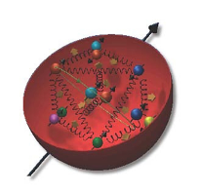
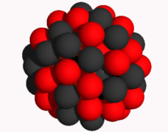
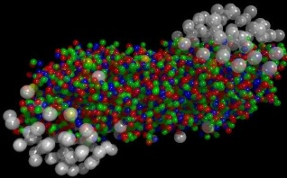
The Relativistic Heavy Ion Collider at Brookhaven National Laboratory
A great place to be to study QCD!
An accelerator-based program, but not designed to be at the energy (or intensity) frontier. More closely analogous to many areas of condensed matter research—create a system and study its properties!
What systems are we studying?
  “Simple” QCD bound states—the proton is the simplest stable bound state in QCD (and conveniently, nature has already created it for us!)
  Collections of QCD bound states (nuclei, also available out of the box!)
  QCD deconfined! (“quark-gluon plasma”, some assembly required!)
Understand more complex QCD systems within
the context of simpler ones
RHIC was designed from the start as a single facility capable of nucleus-nucleus, proton-nucleus, and proton-proton collisions

Slide 20
Proton-Proton Scattering Vs.
Electron-Proton Scattering
Studying the proton by breaking it up with another proton is much more complicated than probing it with an electron beam!
  Two composite objects colliding and breaking up
Rely on some input from experiments performed in simpler systems
One specific advantage: Direct access to gluons, which cannot be probed directly via electron beams (no electromagnetic charge)

Slide 21


RHIC at Brookhaven National Laboratory
Long Island,
New York
Notes:
RHIC is (was) visible from space and is located on Eastern Long Island

Slide 22
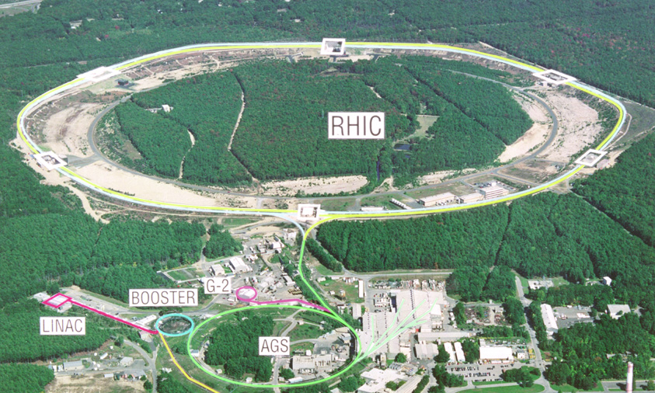

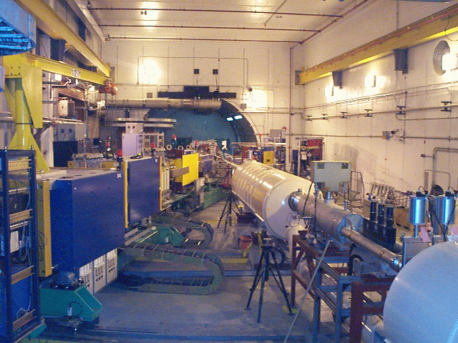
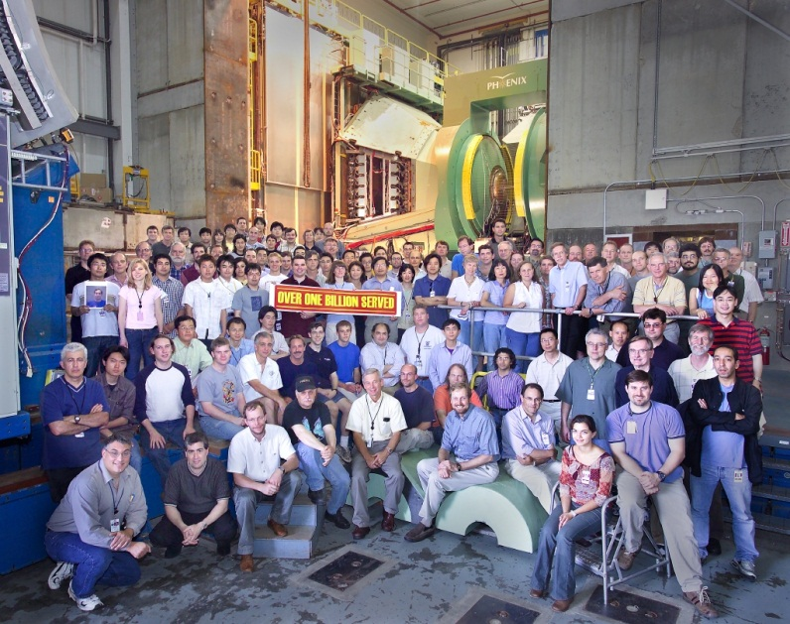
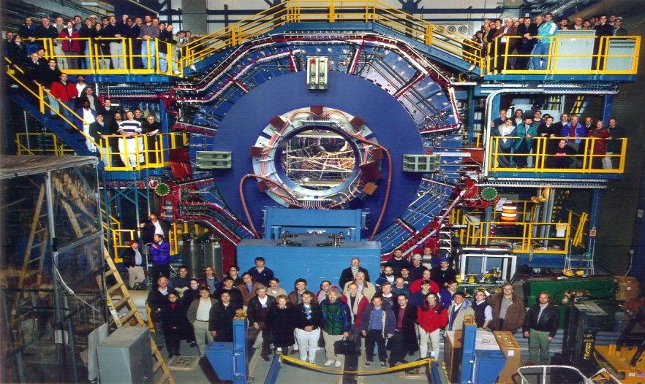


RHIC’s Experiments
Transverse spin only
(No rotators)
Longitudinal or transverse spin
Longitudinal or transverse spin

Slide 23
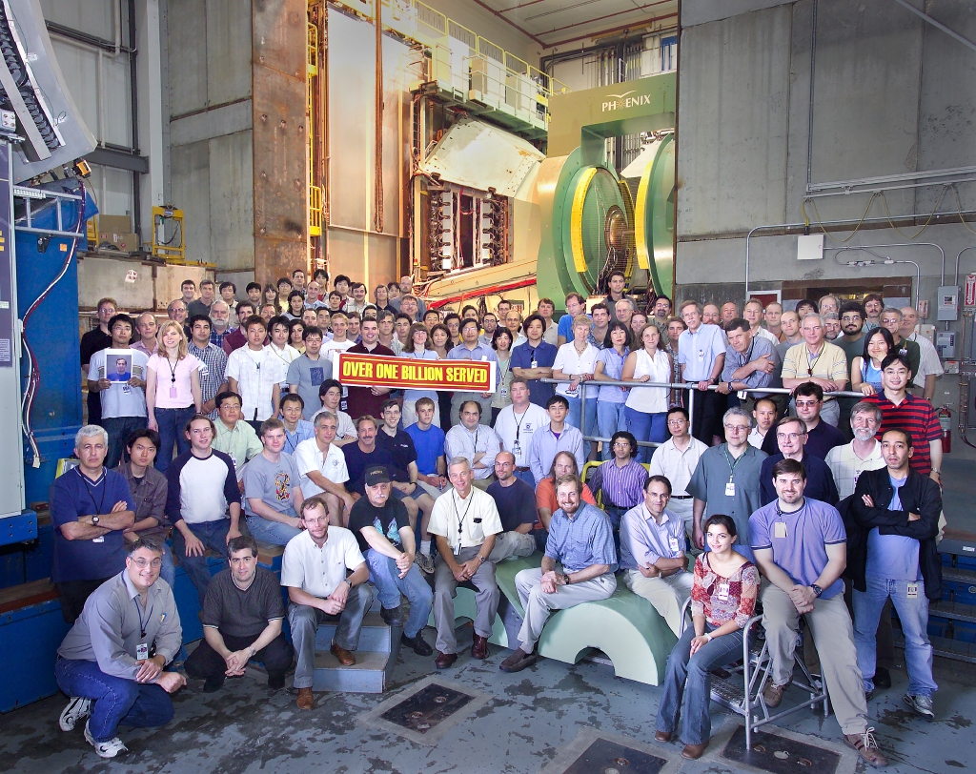

PHENIX
14 Countries; 71 Institutions;
~550 Participants

Slide 24
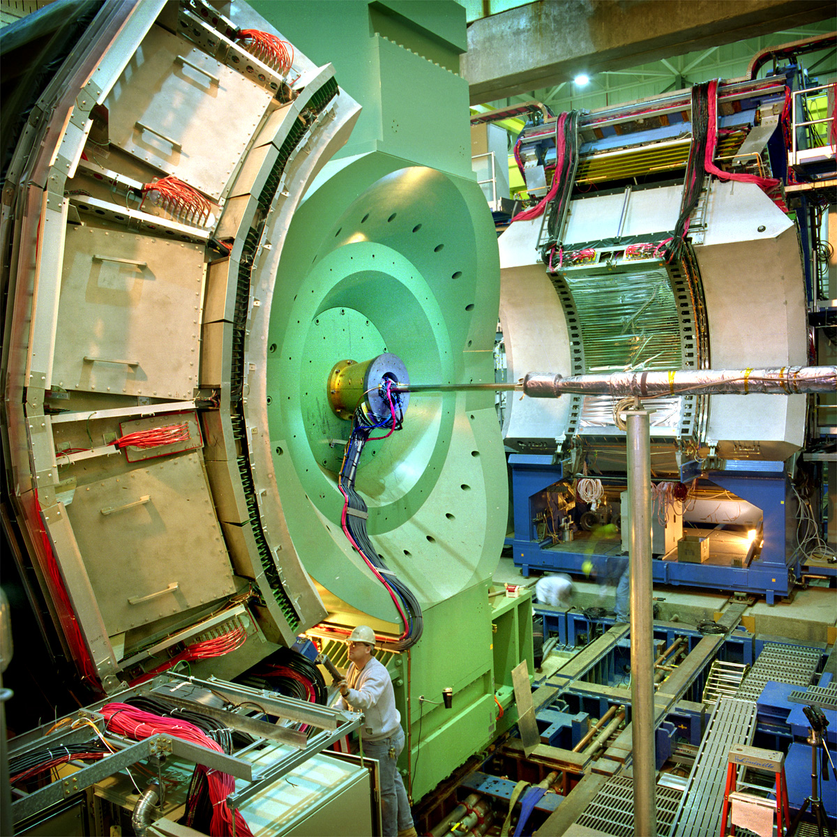
PHENIX Detector
Philosophy:
  Fast data acquisition & high granularity
  Trade-off area covered
2 central arms
- Track charged particles and detect electromagnetic processes
2 forward muon arms
Identify and track muons
2 forward electromagnetic calorimeters

Slide 25
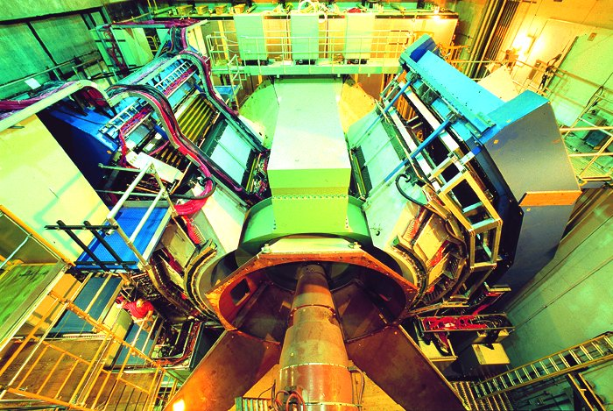
PHENIX Detector

Slide 26
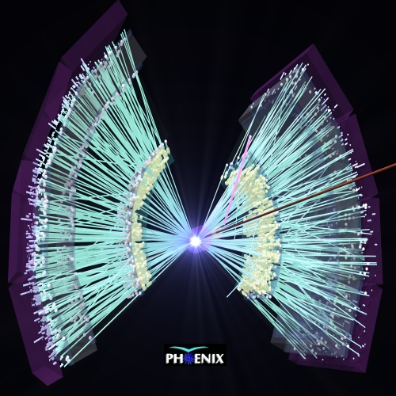
Gold-Gold Collision in PHENIX Central Arms
Thousands of tracks!
Proton-proton collisions only produce ~5-10 tracks at the energies I study

Slide 27
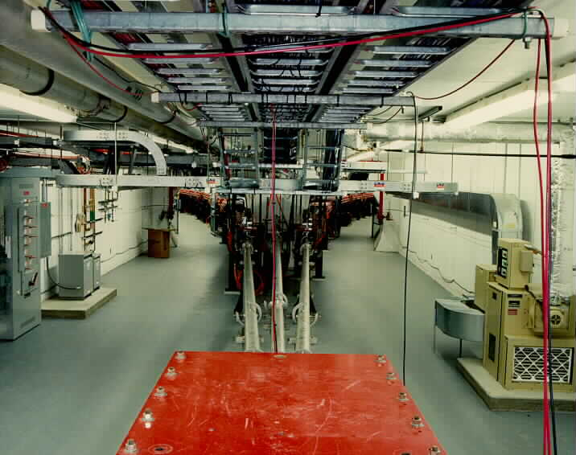
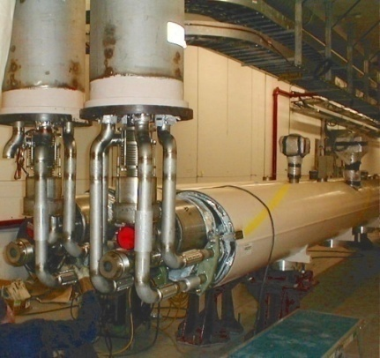
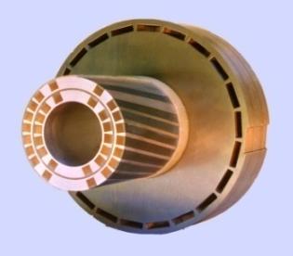
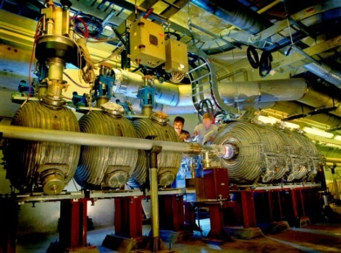
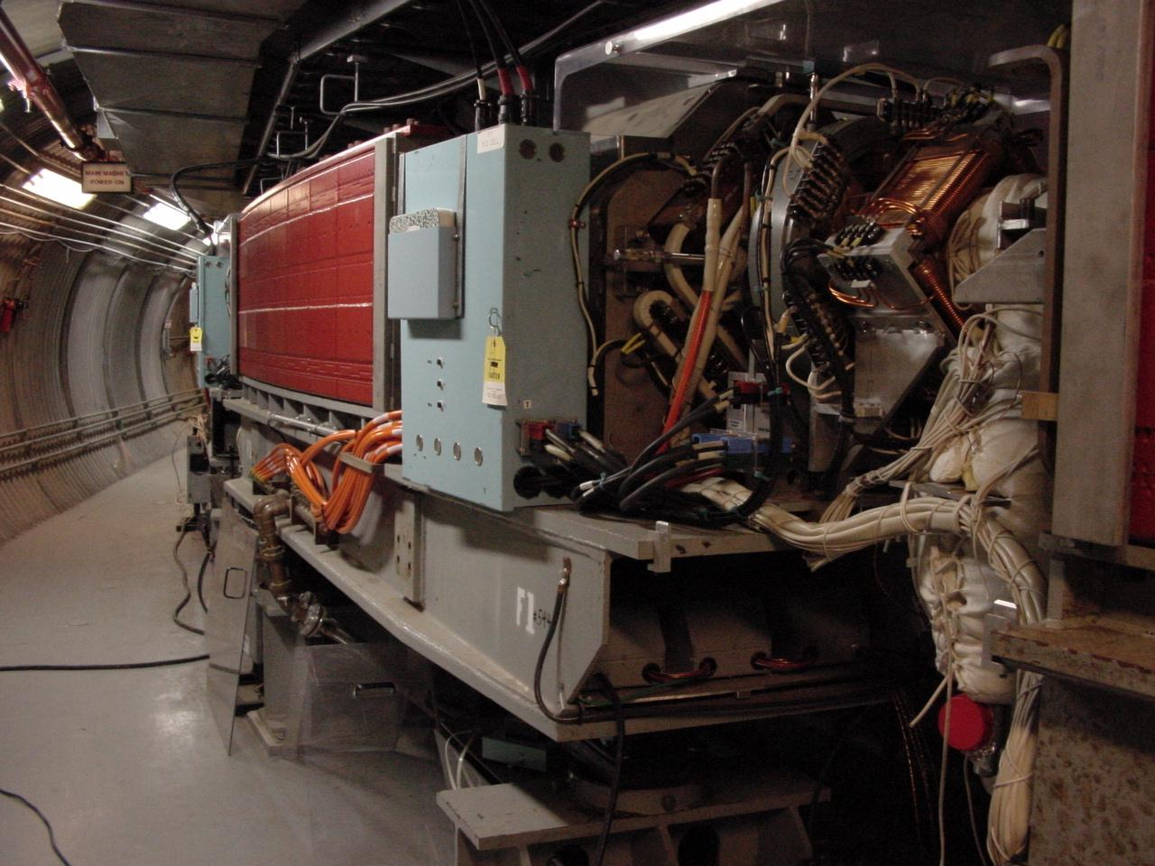
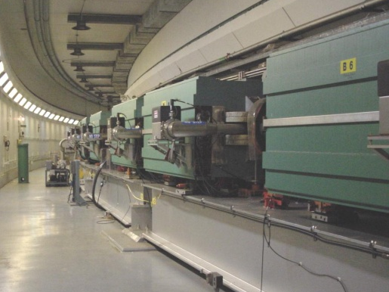
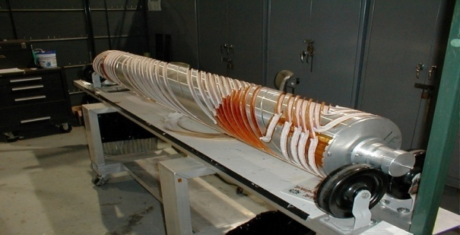
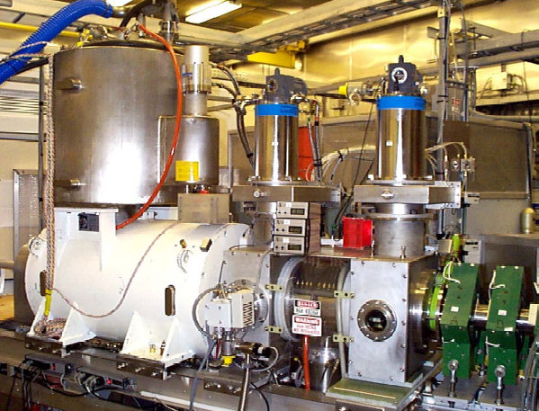
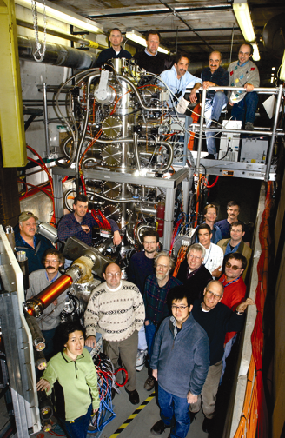
RHIC as a polarized p+p collider
Absolute Polarimeter (H jet)
RHIC pC Polarimeters
Siberian Snakes
BRAHMS & PP2PP
Siberian Snakes
PHENIX
Spin Flipper
STAR
Spin Rotators
Various equipment to maintain and measure beam polarization through acceleration and storage
Partial Snake
Helical Partial
Snake
Polarized Source
Strong Snake
LINAC
AGS
200 MeV Polarimeter
BOOSTER
Rf Dipole
AGS Internal Polarimeter
AGS pC Polarimeter
27

Slide 28
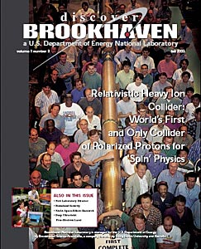
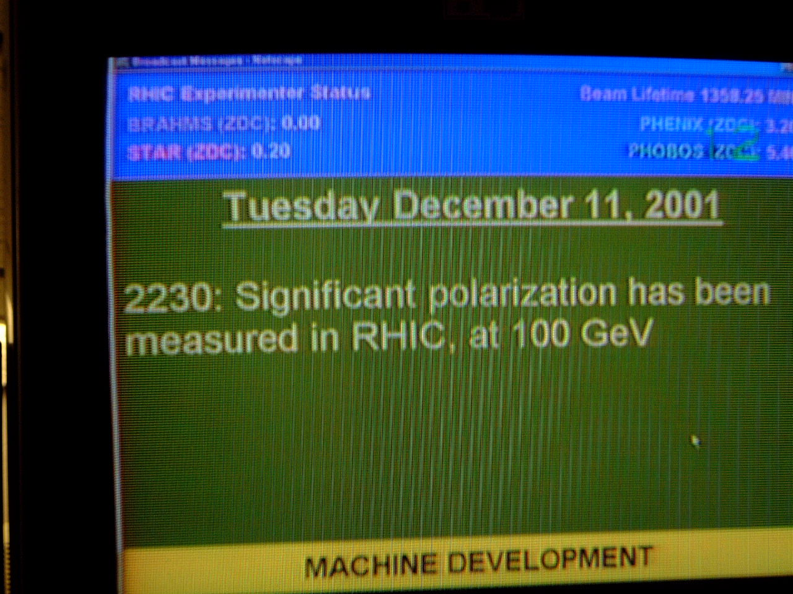
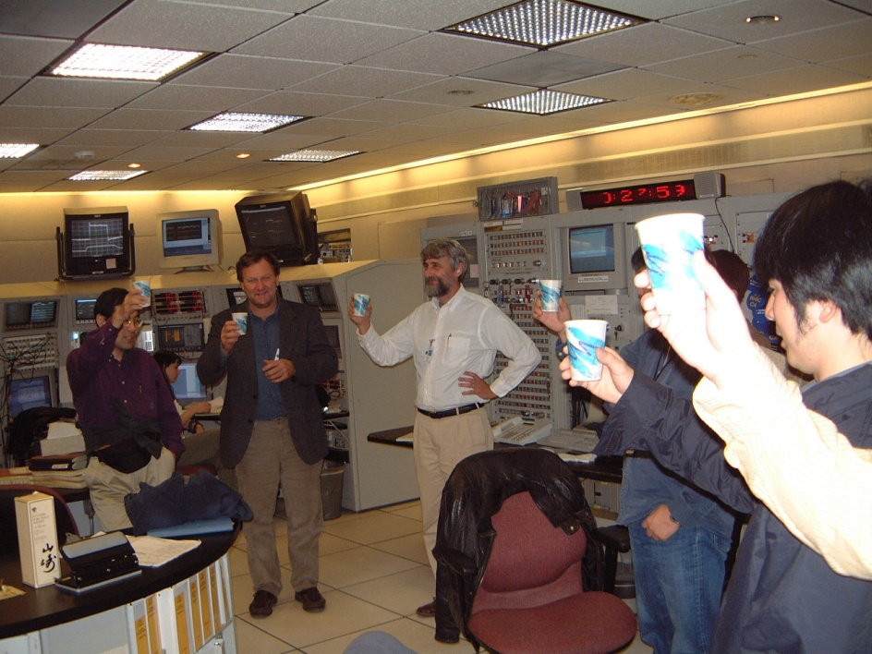

First and only polarized proton collider
28

Slide 29
How Can We Investigate the Proton’s Spin at RHIC?
Collide polarized protons in different configurations and see what we observe in our detector
Most often examining asymmetries
  e.g. difference in the number of a certain particle produced when the beams have the same vs. opposite polarization
  Same number produced gives asymmetry = 0.
  All from one configuration and none from the other gives +1 or -1.
Knowing what processes involving quarks and gluons led to production of the observed particle gives us a handle on the quarks’ and gluons’ contribution to the spin.

Slide 30
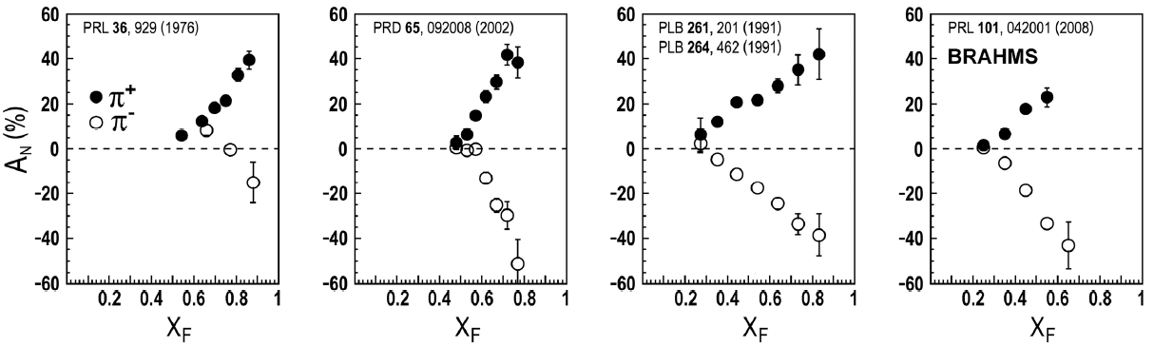
Transverse single-spin asymmetries in p+p collisions:
From low to high energies!
ANL
√s=4.9 GeV
BNL
√s=6.6 GeV
FNAL
√s=19.4 GeV
RHIC
√s=62.4 GeV
Effects persist to RHIC energies
→ Can probe this striking spin-momentum correlation in a calculable regime and extract physics by comparing experiment to theory!
left
right

Slide 31
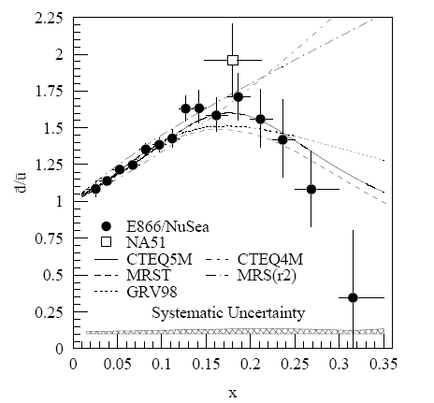
2001: A surprising discovery in the proton flavor structure
Fermilab Experiment NuSea used proton-hydrogen and proton-deuterium collisions to probe nucleon structure via the Drell-Yan process
Anti-up/anti-down asymmetry in the quark sea, with an unexpected behavior as a function of momentum fraction!
  Was previously expected to be ~constant at 1
PRD64, 052002 (2001)

Slide 32
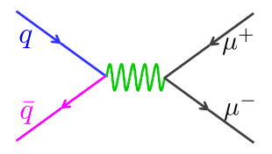
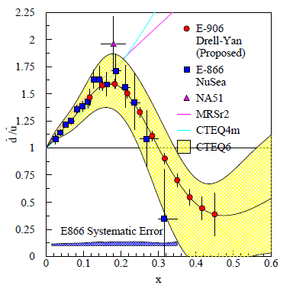
Fermilab SeaQuest: To understand this flavor structure better
Follow-up experiment to Fermilab NuSea with main goal of extending measurements to higher momentum fraction x
120 GeV proton beam from Fermilab Main Injector + proton, deuteron (proton+neutron), and nuclear targets (C, Fe, W)
E866

Slide 33
Fixed-Target (SeaQuest)
Versus Collider (PHENIX) Experiments
Earliest experiments studying proton structure used electron beams to probe stationary (“fixed”) proton targets (think of tube of hydrogen gas)
  Typically easier and cheaper to perform fixed-target experiments
Collider experiments allow you to reach higher energy
  Can use different theoretical tools to interpret results (“perturbative QCD”)
  Can produce heavier particles (E=mc² again!)
  Can access different kinematic region (e.g. lower momentum fraction, x_{Bjorken})

Slide 34
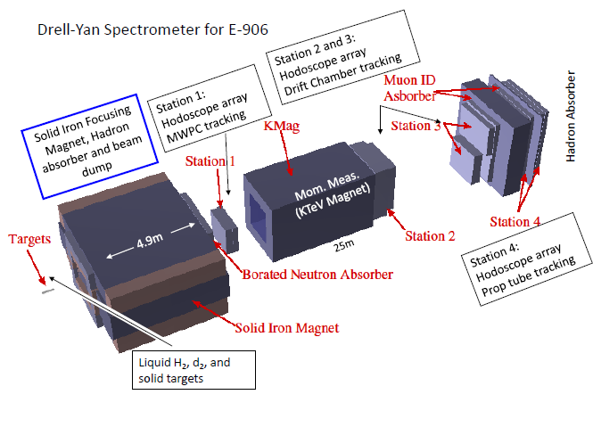
Fermilab SeaQuest
Targets: Liquid hydrogen and deuterium (UMich responsibility!), and C, Fe, W nuclei
Commissioned March-April 2012, physics data-taking summer 2013 through mid-2015
~65 participants from 14 institutions

Slide 35
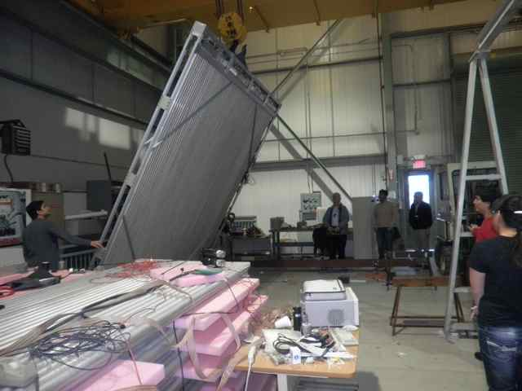
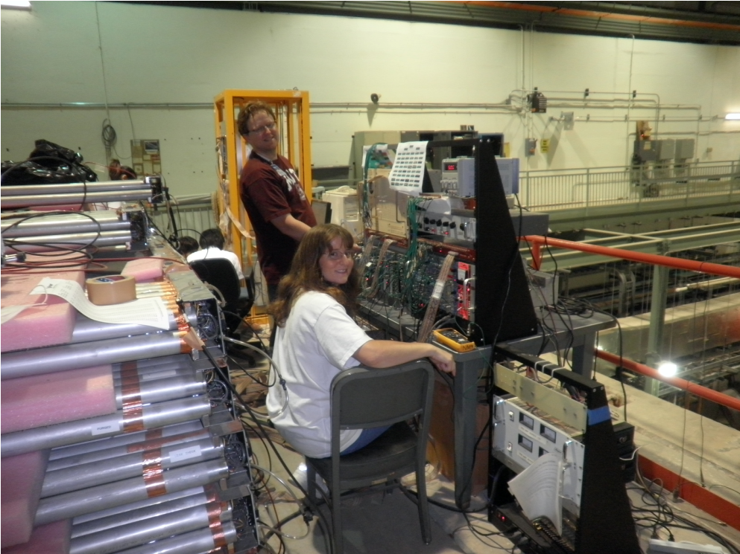
E906 model: Reuse, recycle!
Station 4 tracking plane assembled from old proportional tubes scavenged from LANL “threat reduction” experiments!

Slide 36
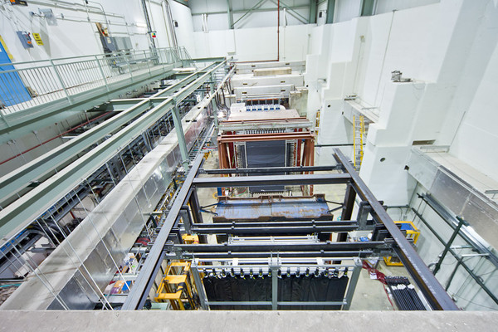
View of E906 experimental hall from downstream platform

Slide 37
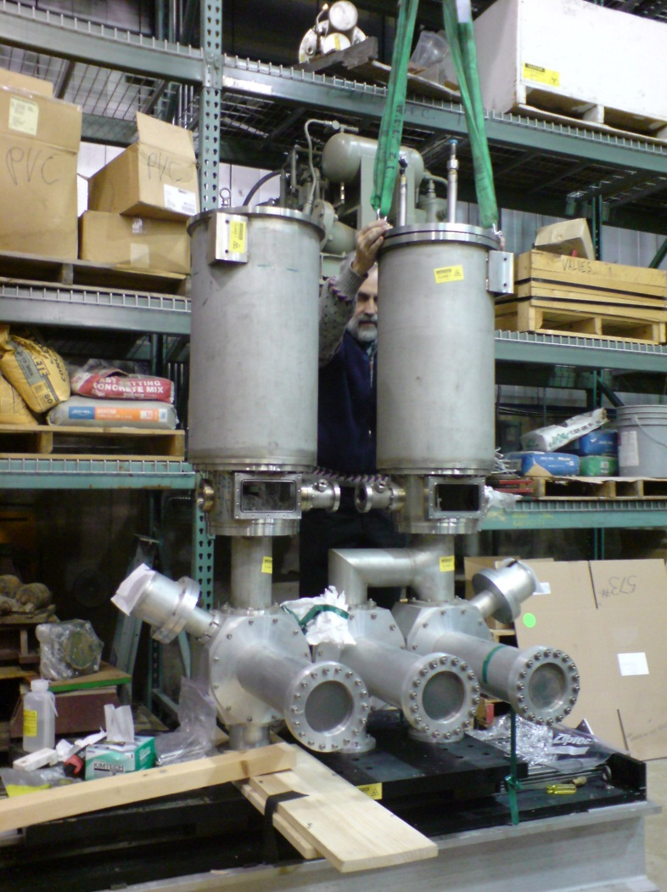
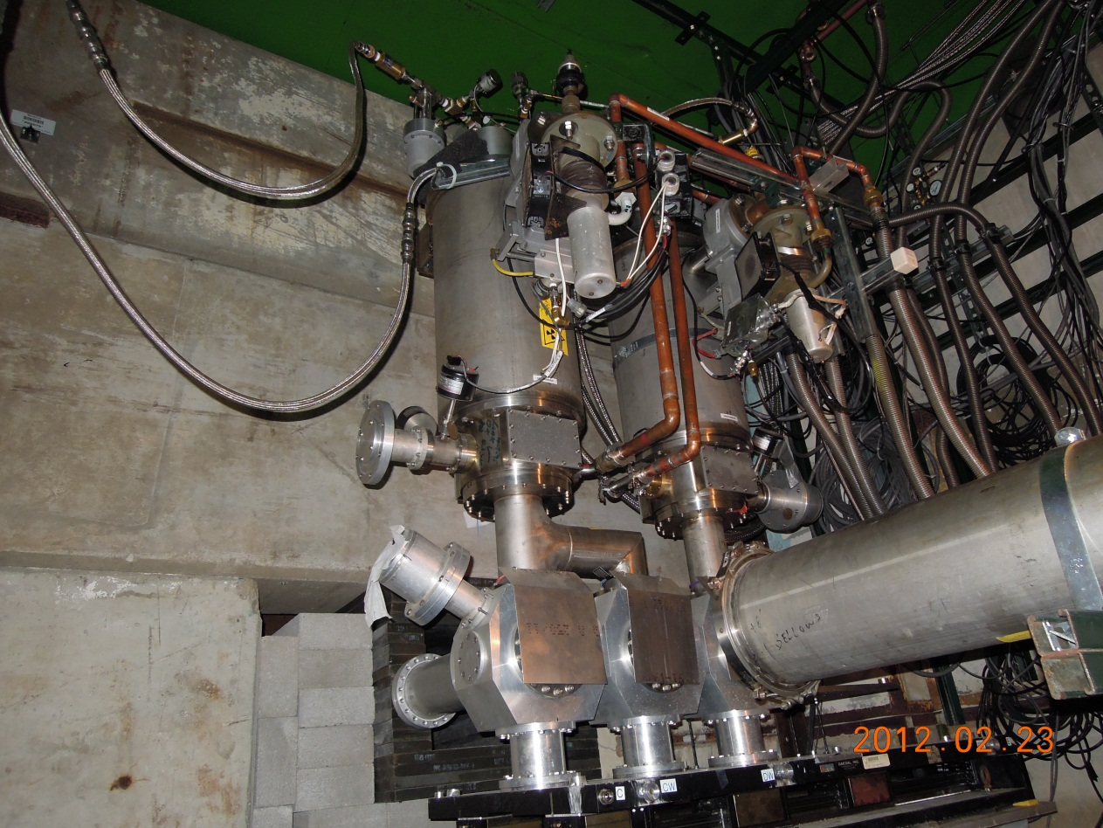
UMich hardware
(with Prof. W. Lorenzon):
E906 cryogenic target system

Slide 38
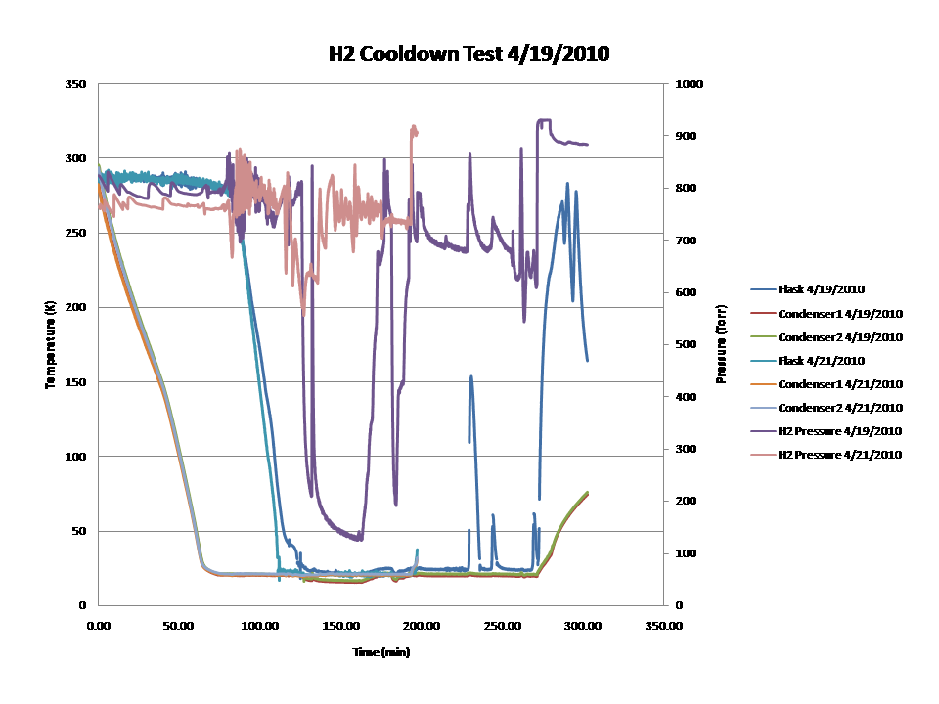
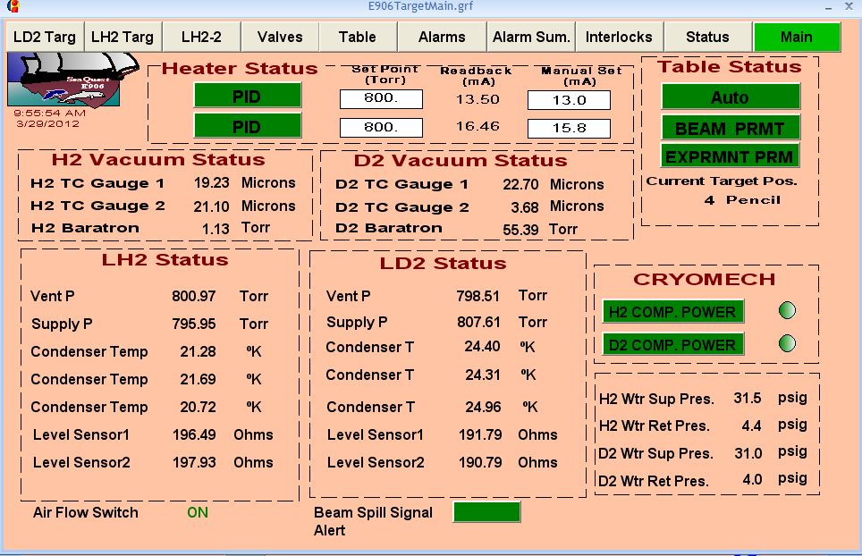
Target cooldown and monitoring at Fermilab
Looking forward to starting our 2-year run in a few months!

Slide 39
Summary
We still have a ways to go from the quarks and gluons of the theory of the strong force to full descriptions of the protons and nuclei of the world around us!
Since the late 1990s things have been developing rapidly as we’ve discovered new questions we can ask about proton structure and have come up with ideas to perform relevant measurements
Different experiments at BNL, Fermilab, and other world facilities are working to unravel the mysteries of the proton . . .

Slide 40
Afterword:
Studying the strong force “versus” studying nucleon structure?
A personal perspective

Slide 41
We shall not cease from exploration
And the end of all our exploring
Will be to arrive where we started
And know the place for the first time.
T.S. Eliot

Slide 42
Extra

Slide 43
Nucleon structure: The early years
1932: Estermann and Stern measure proton anomalous magnetic moment → proton not a pointlike particle!
1960s: Quark structure of the nucleon
  SLAC inelastic electron-nucleon scattering experiments by Friedman, Kendall, Taylor → Nobel Prize
  Theoretical development by Gell-Mann → Nobel Prize
1970s: Formulation of QCD . . .

Slide 44
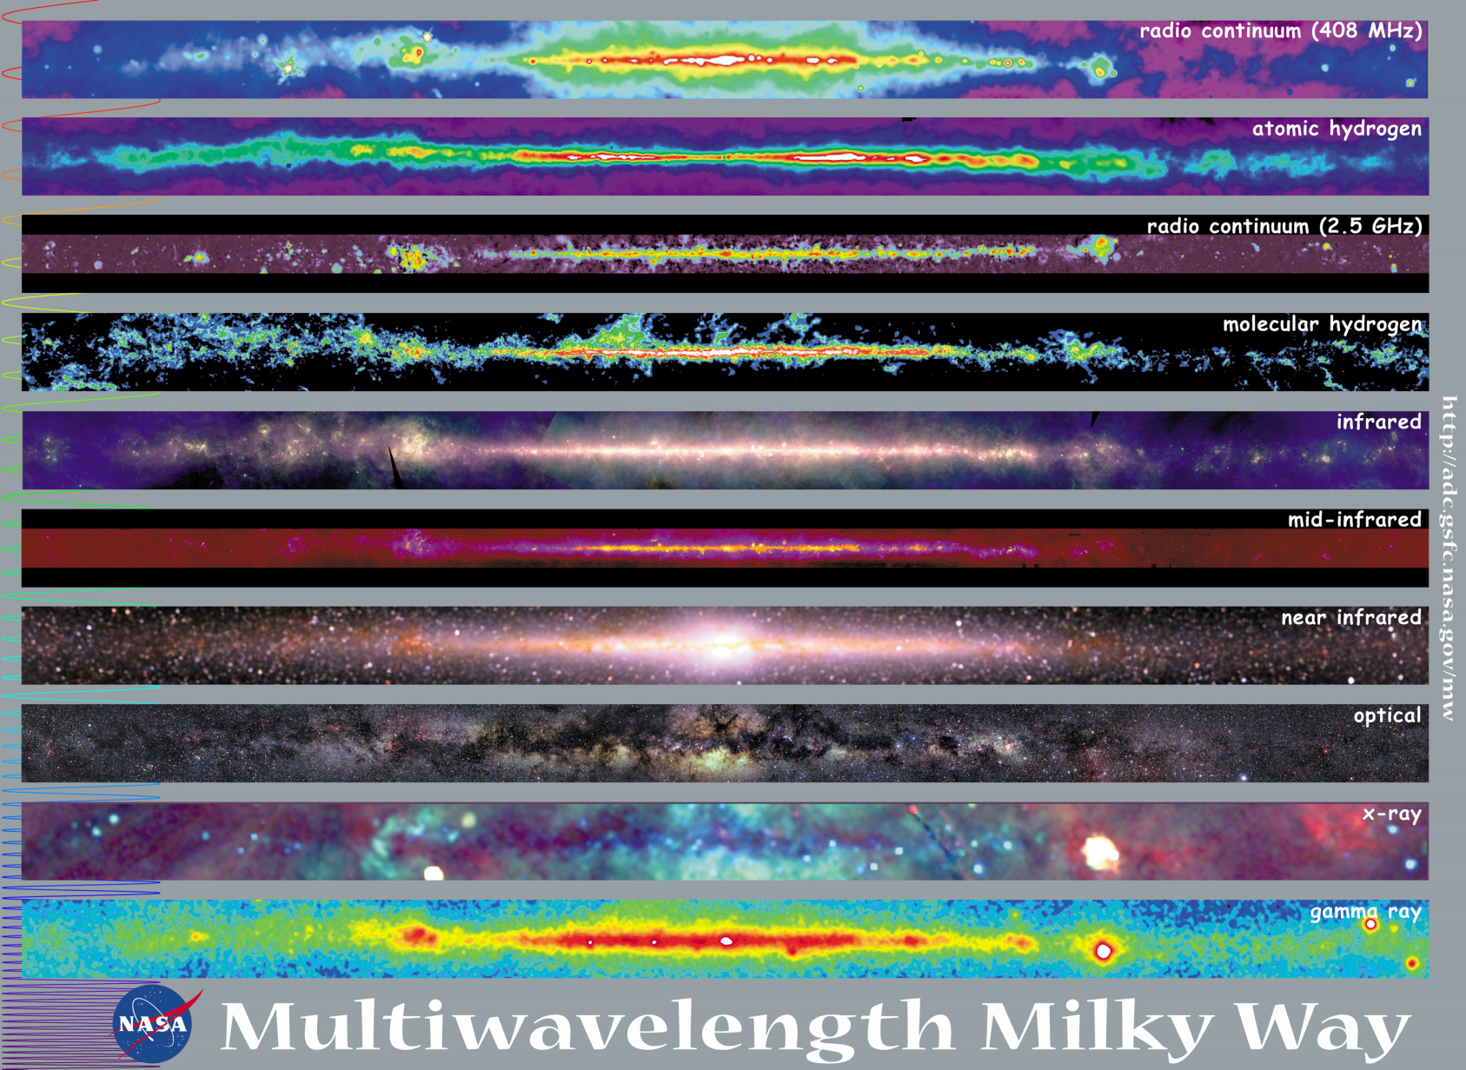
Observations with different probes allow us to learn different things!

Slide 45
Predictive power of pQCD
q(x₁)
Hard Scattering Process
X
g(x₂)
High-energy processes have predictable rates given:
    Partonic hard scattering rates (calculable in pQCD)
    Parton distribution functions (need experimental input)
    Fragmentation functions (need experimental input)
Universal non-perturbative factors

Slide 46
Factorization and universality in perturbative QCD
Need to systematically factorize short- and long-distance physics—observable physical QCD processes always involve at least one long-distance scale (confinement)!
Long-distance (i.e. non-perturbative) functions need to be universal in order to be portable across calculations for many processes (and to be meaningful in describing hadron structure!)
Measure observables sensitive to parton distribution functions (pdfs) and fragmentation functions (FFs) in many colliding systems over a wide kinematic range→constrain by performing
simultaneous fits to world data

Slide 47


PHENIX detector
Philosophy:
  High rate capability to measure rare probes,
  limited acceptance.
2 central spectrometers
  Track charged particles and detect electromagnetic processes
2 forward muon spectrometers
  Identify and track muons
2 forward calorimeters (as of 2007)
  Measure forward pions, etas
Relative Luminosity
  Beam-Beam Counter (BBC)
  Zero-Degree Calorimeter (ZDC)

Slide 48
Theory of strong interactions:
Quantum Chromodynamics
  Salient features of QCD not evident from Lagrangian!
    Color confinement – the color-charged quarks and gluons of QCD are always confined in color-neutral bound states
    Asymptotic freedom – when probed at high energies/short distances, the quarks and gluons inside a hadron behave as nearly free particles
  Gluons: mediator of the strong interactions
    Determine essential features of strong interactions
    Dominate structure of QCD vacuum (fluctuations in gluon fields)
    Responsible for > 98% of the visible mass in universe(!)
An elegant and by now well established field theory, yet with degrees of freedom that we can never observe directly in the laboratory!

Slide 49
The proton as a“laboratory” to study the strong force
Proton—simplest stable bound state in QCD!
?...
observation & models
fundamental theory
precision measurements
& more powerful theoretical tools
application?

Slide 50

Spin-momentum correlations and the proton as a QCD “laboratory”
“Transversity” pdf:
Correlates proton transverse spin and quark transverse spin
“Sivers” pdf:
Correlates proton transverse spin and quark transverse momentum
“Boer-Mulders” pdf:
Correlates quark transverse spin and quark transverse momentum
S_{p}-S_{q} coupling
S_{p}-L_{q} coupling
S_{q}-L_{q} coupling

Slide 51
Spin-momentum correlations in proton! A recent and rapidly developing area of QCD research
S•(p₁×p₂)
Collinear
Worm gear
Transversity
Measured non-zero!
Sivers
Boer-Mulders
Pretzelosity
Worm gear

Slide 52





Sivers
A flurry of new experimental results from deep-inelastic e+p scattering and e⁺e⁻ annihilation over last ~8 years!
Effects generally ~5-10%--large!!
e+p
μ+p
BELLE PRL96, 232002 (2006)
Collins
e⁺e⁻
Boer-Mulders
SPIN2008
e+p
BaBar: Released August 2011
Collins
e⁺e⁻
e+p
μ+p
Transversity x Collins

Slide 53

Transverse Single-Spin Asymmetries:
From Low to High Energies!
ANL
√s=4.9 GeV
BNL
√s=6.6 GeV
FNAL
√s=19.4 GeV
RHIC
√s=62.4 GeV
RHIC:
Up to √s=500 GeV!
π⁰
left
right

Slide 54


High-x_{F} asymmetries, but not valence quarks??
K
p
200 GeV
200 GeV
Negative kaons same as positive??
Large antiproton asymmetry?!
Pattern of pion species asymmetries in the forward direction
→ valence quark effect.
But this conclusion confounded by kaon and antiproton asymmetries from RHIC!
Lots of interesting effects to be explored!

Slide 55

My own physics focus on E906: Azimuthal dependence of unpolarized Drell-Yan cross section
cos2φ term sensitive to correlations between quark transverse spin and quark transverse momentum!
Large cos2φ dependence seen in pion-induced Drell-Yan
ν
NA10 dataa
194 GeV/c
π⁻+W
Q_{T} (GeV)
D. Boer, PRD60, 014012 (1999)

Slide 56


What about proton-induced Drell-Yan?
Significantly reduced cos2φ dependence in proton-induced Drell-Yan observed by E866
Suggests sea quark transverse spin-momentum correlations small?
Will be interesting to measure for higher-x sea quarks in E906!
E866, PRL 99, 082301
(2007)
Looking forward to forthcoming data!!
E866

