Slide 1
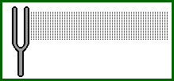
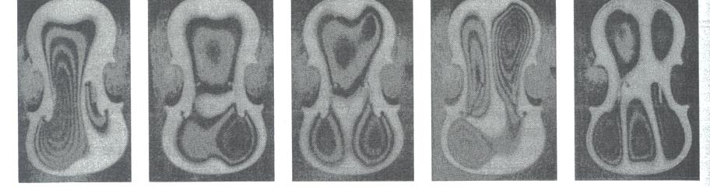
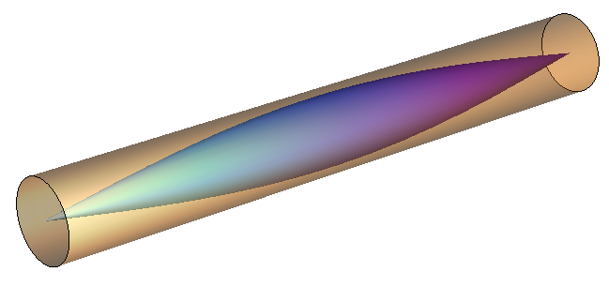
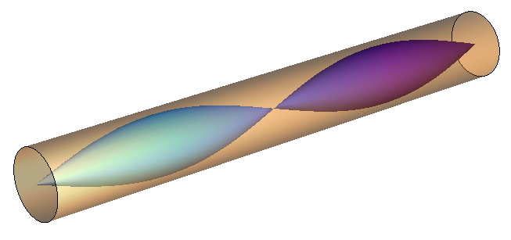
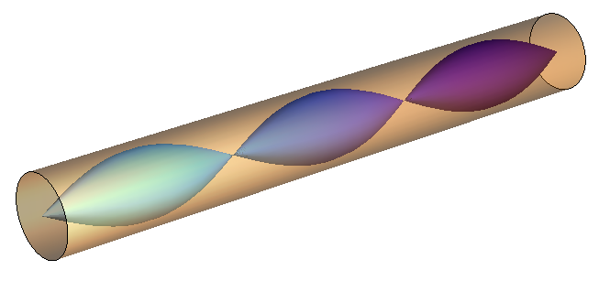
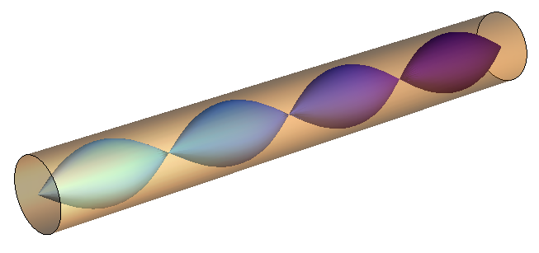
The Physics of Music
Christine A. Aidala
University of Michigan
Saturday Morning Physics
October 23, 2021

Slide 2
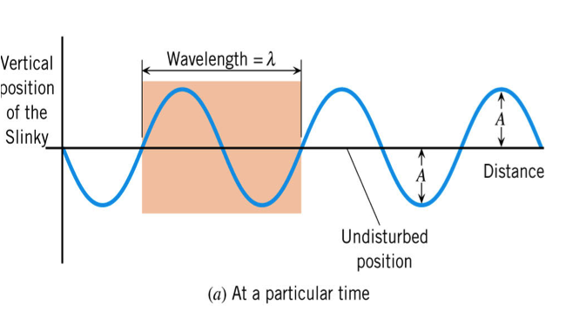
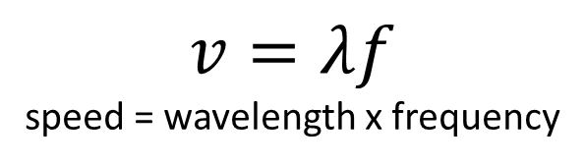
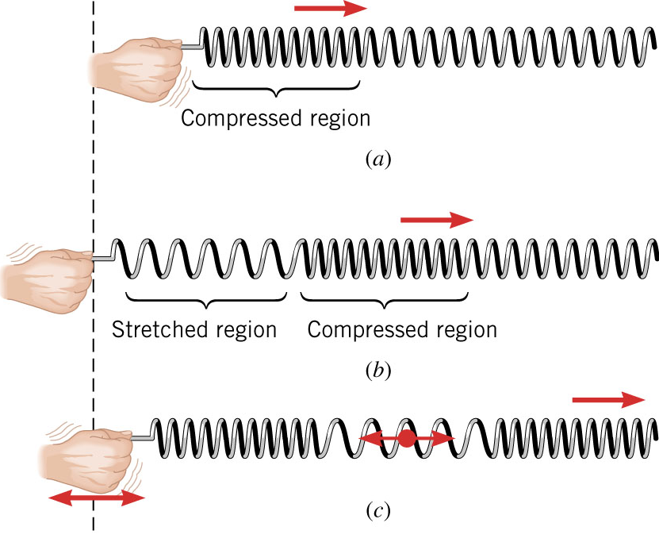
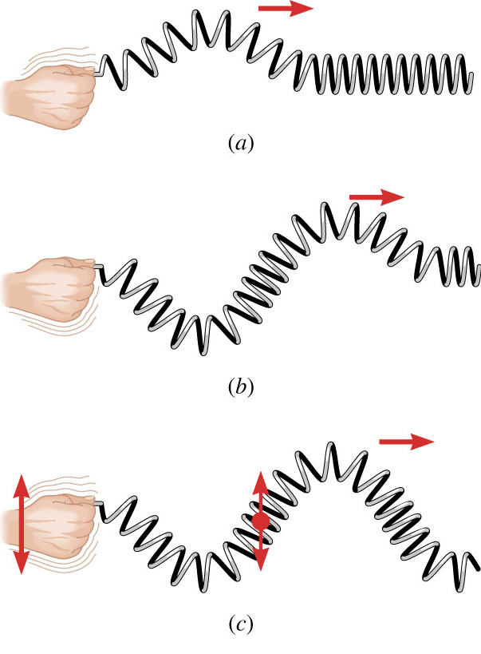
Waves
Amplitude = A
$$v=λf$$
speed = wavelength x frequency
Transverse waves
  A disturbance perpendicular to the
  direction of travel
  E.g. electromagnetic waves (radio, microwaves, visible light, x-rays, gamma rays)
Longitudinal waves
  A disturbance parallel to the
  direction of travel
  Sound waves are longitudinal air
  compression waves

Slide 3
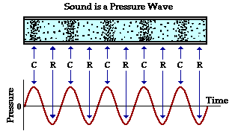
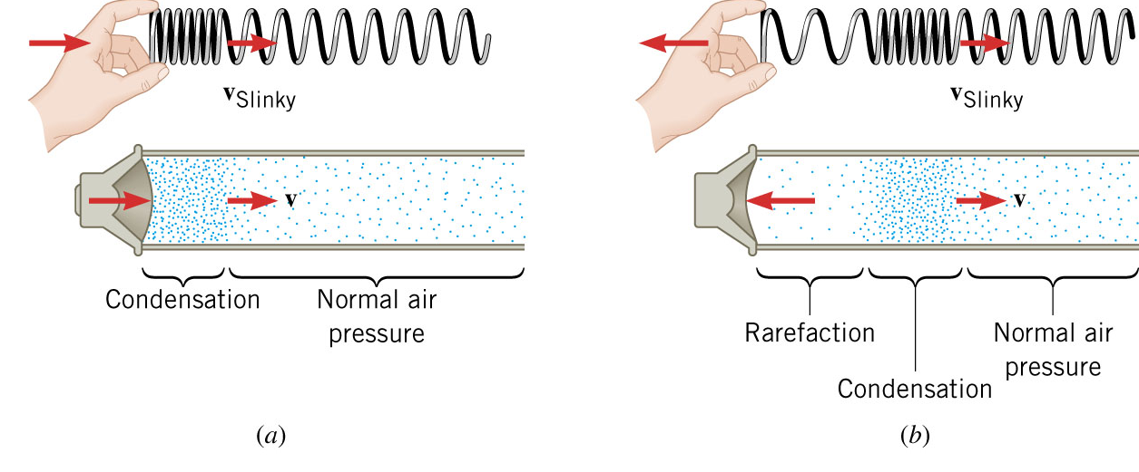
Sound is a Pressure Wave
(compression)

Slide 4
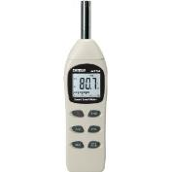


Characterizing Musical Tones
When we listen to a note, we can describe its
properties by loudness, pitch and timbre
We can physically measure intensity,
frequency and waveform
Perception of sound
Physical properties
Perception | Physical
Loudness | Intensity
how loud of soft a note sounds | measured W/m² or dB, proportional to amplitude²
Pitch | Frequency
high or low notes on a musical scale | cycles per second (Hz)
Timbre | Waveform
tone color or “quality” of the sound | measured shape of the wave

Slide 5
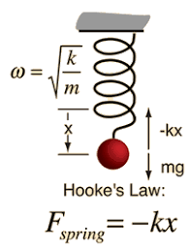
Describing Oscillatory Motion
Oscillations (vibrations) occur because of
  Restoring force: Acts to move the object back to its equilibrium position
  Inertia: Acts to maintain the motion in its current direction and speed
Frequency of oscillations depends on
strength of force and amount of inertia
  Stronger restoring force produces higher frequency (faster oscillation)
  More inertia gives lower frequency (slower oscillation)
f

Slide 6
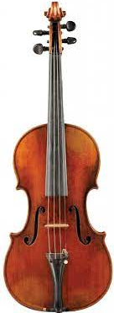
Vibrating Stretched String
Tuning pegs
adjust tension
Frequency depends on
  String tension T
  Mass per unit length μ
  Total length of string L
Properties
  Greater tension → higher frequency
  Greater mass → lower frequency
  Longer string → lower frequency
For same string stopped
at different lengths:
Press strings against fingerboard to shorten the length free to vibrate and play different notes on the same string
Thicker, heavier strings for lower notes, thin strings for high notes

Slide 7
Intervals and Ratios
Ancient Greeks: Tone intervals we hear depend on ratios of string lengths plucked
  Some intervals seem “natural” to us – “consonance”
L
“octave”
ratio: L/(L/2) = 2/1 or “2 to 1”
L/2
L
“perfect fifth”
ratio L/(2L/3) = 3/2 or “3 to 2”
2L/3
L
“perfect fourth”
ratio L/(3L/4) = 4/3 or “4 to 3”
3L/4

Slide 8
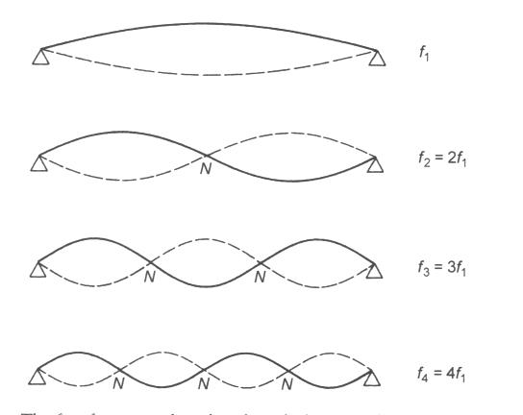
Natural Modes of Vibration of a String
Both ends are fixed: force “nodes” at the endpoints
  Nodes are points that stay at equilibrium
  Where nodes are depends on the mode (except ends)
Fit integer number of half-waves λ/2 into length L
Standing waves on string demo
L
L = λ/2 ⇒ λ₁ = 2L
λ/2
“modes of vibration”
L = λ ⇒ λ₂ = L
λ
L = (3/2)λ ⇒ λ₃ = (2/3)L
3λ/2
L = 2λ ⇒ λ₄ = (1/2)L
2λ
In general for n^{th} mode: λ_{n} = 2L / n n = 1, 2, 3,…
Notes:
Standing waves on string demo

Slide 9
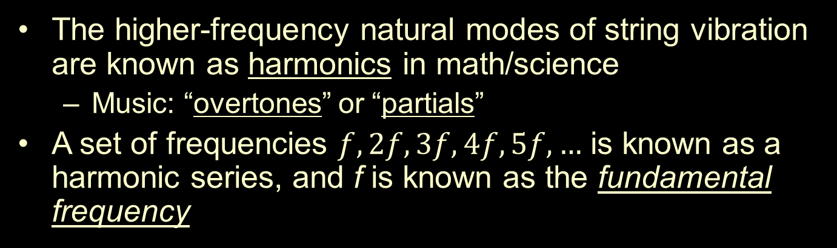
Harmonics and the Harmonic Series
The higher-frequency natural modes of string vibration are known as harmonics in math/science
  Music: “overtones” or “partials”
A set of frequencies $f, 2f, 3f, 4f, 5f, …$ is known as a harmonic series, and f is known as the fundamental frequency
f | 1st harmonic | fundamental | 1st partial
2f | 2nd harmonic | 1st overtone | 2nd partial
3f | 3rd harmonic | 2nd overtone | 3rd partial
4f | 4th harmonic | 3rd overtone | 4th partial

Slide 10
The Harmonic Series as Notes
A harmonic series can start at any fundamental frequency
  For example, start at A₂ = 110 Hz
f₁ | 110 Hz | A₂
f₂ | 220 Hz | A₃
f₃ | 330 Hz | E₄
f₄ | 440 Hz | A₄
f₅ | 550 Hz | C♯₅
f₆ | 660 Hz | E₅
f₇ | 770 Hz | ?
f₈ | 880 Hz | A₅
Octaves are based on powers of two (1, 2, 4, 8,…)
Most (but not all) frequencies match notes on the 12-tone chromatic scale
In between G♭₅ and G₅

Slide 11
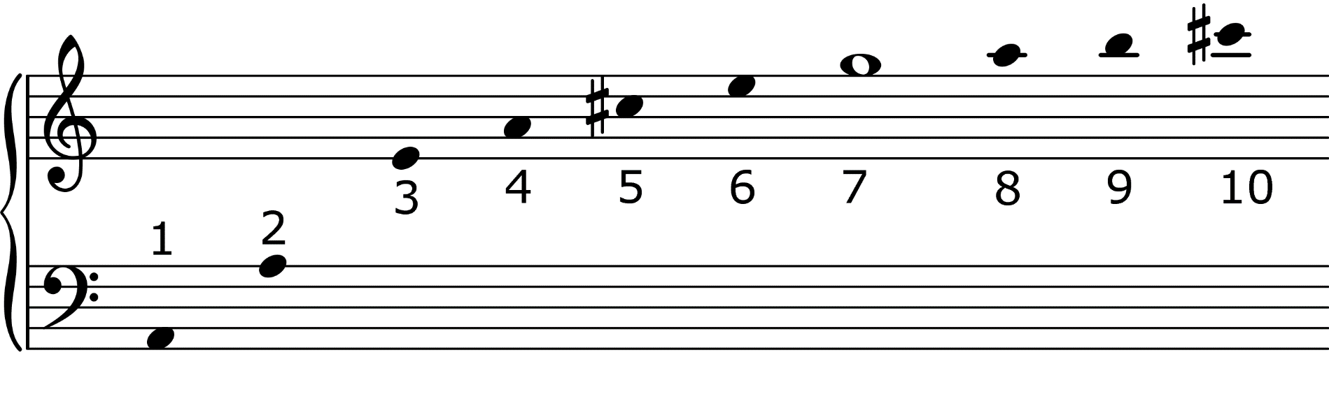
The Harmonic Series on A₂
The first few terms in the harmonic series starting on A₂
Musical harmony seems to be related to the harmonic series
  Consonant intervals are related to frequencies in a harmonic series
Minor
3rd 6:5
Perfect 4th 4:3
Major
3rd 5:4
Perfect 5th 3:2
Octave
2:1
A 7:6 ratio does not belong in the standard chromatic scale of tones and semitones

Slide 12
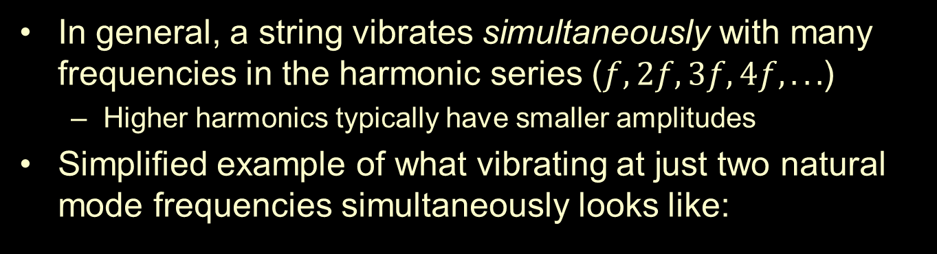
Strings Vibrate in Multiple Natural Modes Simultaneously!
In general, a string vibrates simultaneously with many frequencies in the harmonic series ($f, 2f, 3f, 4f, . . .$)
  Higher harmonics typically have smaller amplitudes
Simplified example of what vibrating at just two natural mode frequencies simultaneously looks like:
  f and 4f
Frequency f
Frequency 4f
Combined motion
“Ripples” of frequency 4f on top of a wave of frequency f

Slide 13
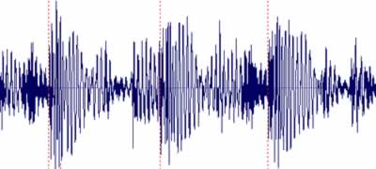
Timbre and Waveform
Different instruments sound different, even when playing the same note!
  Timbre: the “tone quality”
  Due to the relative strengths of the various harmonics
  Complex sound waveforms
Can understand complex waveforms by pulling them apart into simpler components

Slide 14
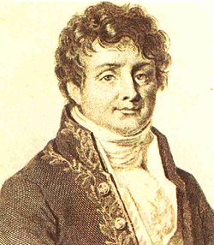

Complex Waveforms and Fourier Analysis
Any periodic waveform of fundamental frequency $f$ can be expressed as the sum of sine waves of frequencies $f, 2f, 3f, 4f, . . .$
  Terms in the harmonic series!
Need specific amplitudes for the various contributing frequencies to get a specific waveform
Fourier analysis forms much of the basis for analyzing musical tones:
Periodic waveform
Fundamental f
analyze →
← synthesize
Sum of sine waves
Frequencies f, 2f, 3f, 4f,…
The fundamental determines the pitch, and the relative strengths of the higher harmonics determine the timbre
Notes:
Relate directly to timbre!

Slide 15
Fourier Example: Building Square and Triangle Waves
We can build a square wave out of odd harmonics
The more harmonics we add, the closer we get to a true square wave
The triangle wave also has only odd harmonics, but with different amplitudes
The triangle wave is closer to a sine wave than a square wave
  Does not need as much “adjustment”
f
f
3f
3f
5f
5f
7f
Small amplitudes
7f

Slide 16
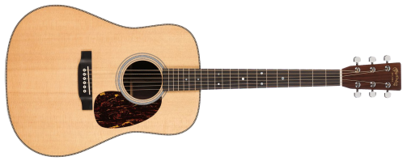
Sound from a Guitar
Acoustic guitar
The strings
themselves produce very little sound
  Ineffective at pushing air around
What we hear comes from the guitar body
Exciter
Vibrator
Radiator
Pluck the string
String
(+ Bridge and Body)
Body (top and bottom plates)
frets

Slide 17
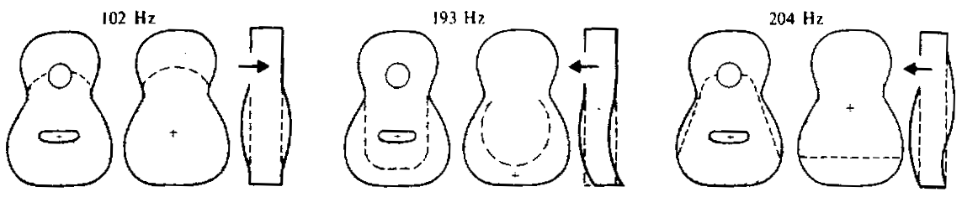
Body Resonances
The sound of an acoustic guitar is different from that of an electric guitar
  Or banjo, mandolin, plucked violin, viola, . . .
Important coupling between natural modes of the vibrating strings and modes of the body
Lowest three modes of a Martin D-28 folk guitar
Notes:
Note nodes and compare to string nodes

Slide 18
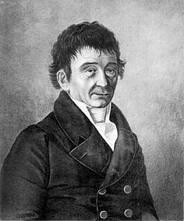
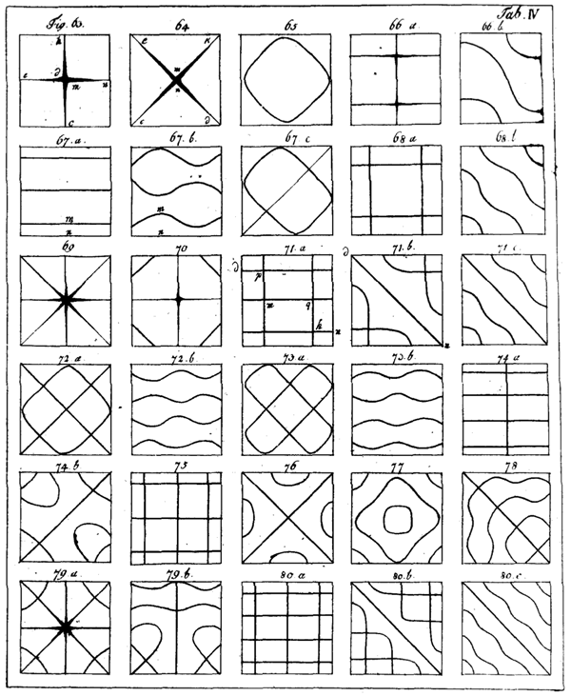
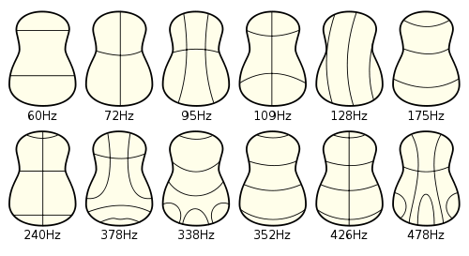
Natural Modes of Different Shaped Plates: Chladni Plates
Sprinkle powder on a plate and vibrate it
When the driving frequency matches a natural mode frequency (resonance!) the powder accumulates at nodal lines
  Recall: nodes stay at equilibrium
Can see resulting complex patterns of
two-dimensional modes
Used to study and design violin or
guitar plates
Chladni plate demo
Notes:
Chladni plate demo. Demonstrated at the French Academy of Sciences in 1808 and impressed emperor Napoleon

Slide 19
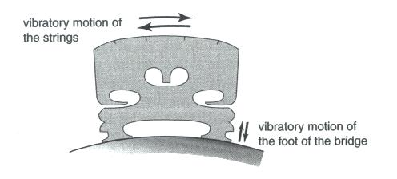
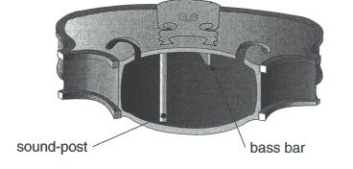
Violin Acoustics
Violin sound comes from:
  How the bow excites the string
  vibrations
  Coupling of the string vibrations
  to the body through the bridge
  Behavior of the body as a resonator – the top plate, back plate, body cavity, f-holes, etc.
The body has inside supports
- Makes the violin
asymmetrical!

Slide 20
Body Resonances
The pitch of a note is determined by the string – not by the natural modes of the body
Why do we care about the body modes?
  Because of resonance – if the frequency of the fundamental or an overtone matches the frequency of a natural mode of vibration of the body, that harmonic gets strengthened relative to the others
Different stringed instruments have different body modes
→ different timbres
Violin top plate vibrations at various frequencies – not very symmetric!

Slide 21
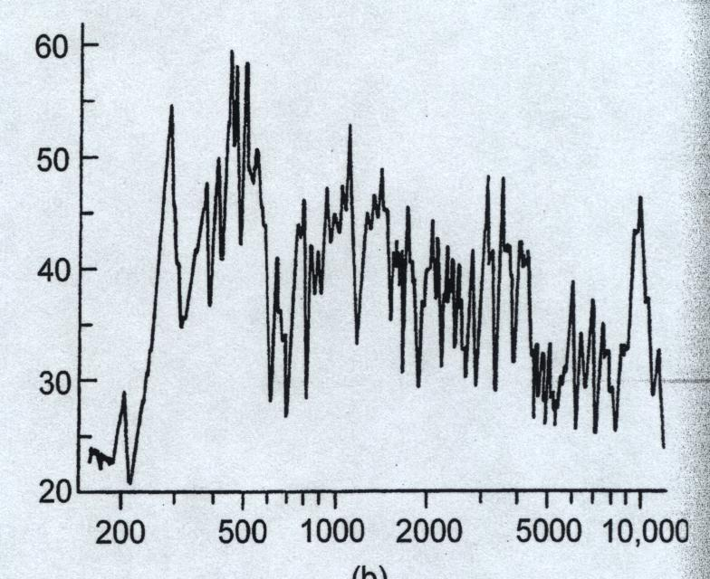
Violin Body Resonances
The violin body has two main bands of resonance
  Main wood resonance – near A₄
  Resonance of air in
  the body – near D₄
Frequency response curve for radiation from body
Donald Hall, Musical Acoustics
G₃
D₄
A₄
E₅
Frequency (Hz)

Slide 22
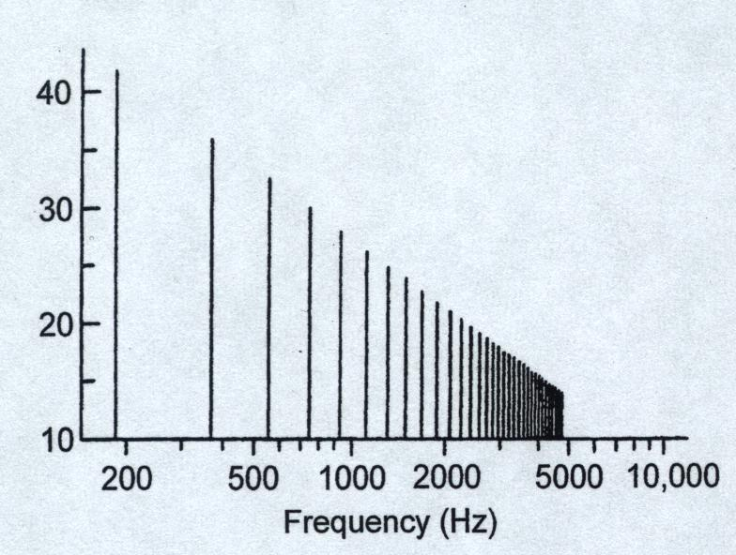
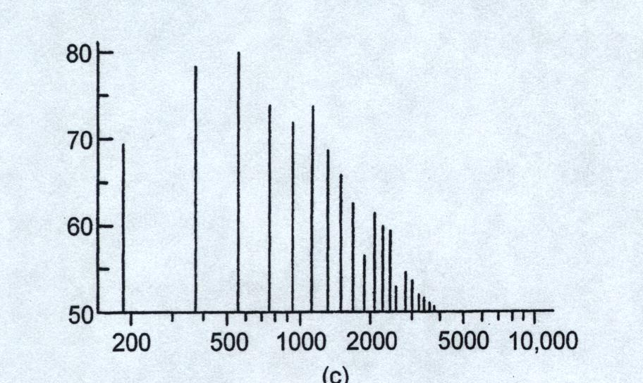
Radiated Violin Sound
The sound we hear from the violin is a combination of the vibration recipe of the string and the frequency response of the body
For the open G string
(196 Hz, lowest note on violin)
String
Donald Hall, Musical Acoustics
Body
Frequency (Hz)

Slide 23
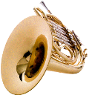

Winds
Blow into a pipe!
  Excite vibrations in a column of air
Classify wind instruments based on how the sound is excited
Produces sound of a definite pitch – related to the length of the tube
Air jets | Reeds | Brass

Slide 24
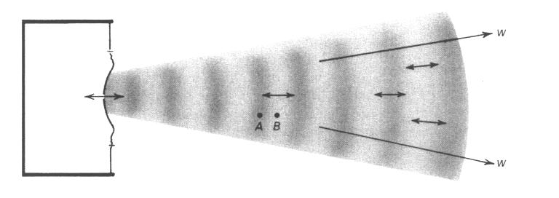
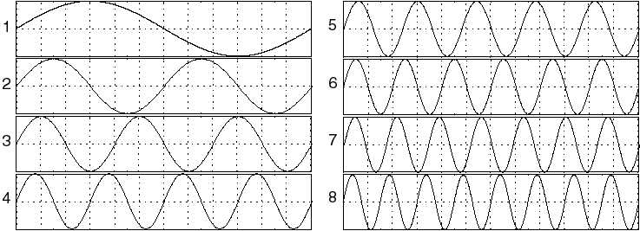
Air Pipe with Open Ends
Any open end of an air pipe must have a pressure node
  Because the pressure at the open end must be the same as the outside pressure
  This is always a node
Pressure nodes of an air column are just like displacement nodes of a string
Pressure graph
outside pressure
outside pressure
pressure max
pressure min
Notes:
Maybe add string node diagram again. Consider changing “displacement”

Slide 25
Natural Modes of Open Pipes
Open pipe modes form a harmonic series
n = 1
f₁
Fundamental
n = 2
f₂=2f₁
2nd harmonic
n = 3
f₃=3f₁
3nd harmonic
n = 4
f₄=4f₁
4th harmonic
Ruben’s tube demo
Notes:
Flute demo? Ruben’s tube.

Slide 26
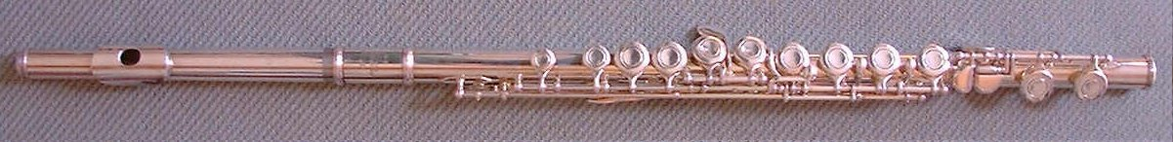

The Flute
Blowing across the mouthpiece excites the vibrations
Effective length of the pipe determines the pitch
  Pressure will equilibrate with atmospheric pressure at first open tone hole
12 tone holes for one octave of the chromatic scale
  Overblow to excite higher harmonics for the second and third octaves
The piccolo is essentially a half-size flute
  So it plays one octave up
Flute demo

Slide 27
Air Pipe with One Closed End
We can also excite air vibrations using a reed
  The vibrating reed acts like a valve to open and close the flow of air
At the closed end of an air column, pressure can build up
  Pressure at open end equilibrates with atmospheric pressure—a pressure node
This is called a “closed pipe”, even though one end is open

Slide 28
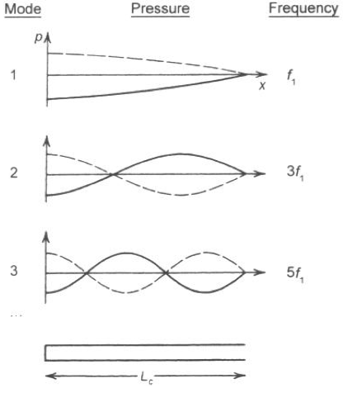
Closed Cylindrical Pipes - Clarinet
Because pressure can build up
at the closed end, closed cylinder
natural modes are different from
open pipes
The fundamental corresponds
to one quarter cycle of a wave,
rather than one half
Same length pipe will play an
octave lower than an open one
The clarinet overblows to
3f (octave + fifth) and 5f
(two octaves + major third)
  Only odd harmonics: accounts for
  the hollow timbre of the clarinet’s
  low notes
Donald Hall,
Musical Acoustics

Slide 29

Sound from a Clarinet
Clarinet (single reed instrument)
Exciter
Vibrator
Radiator
Reed
Body (cylindrical pipe)
Bell
Blow
Clarinet demo

Slide 30

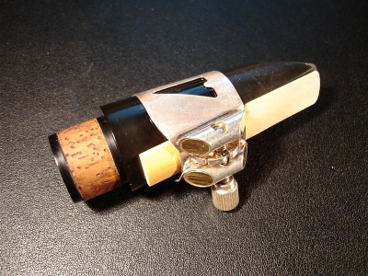
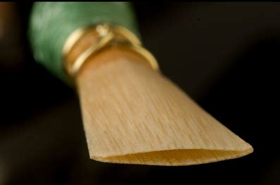
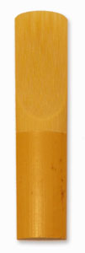
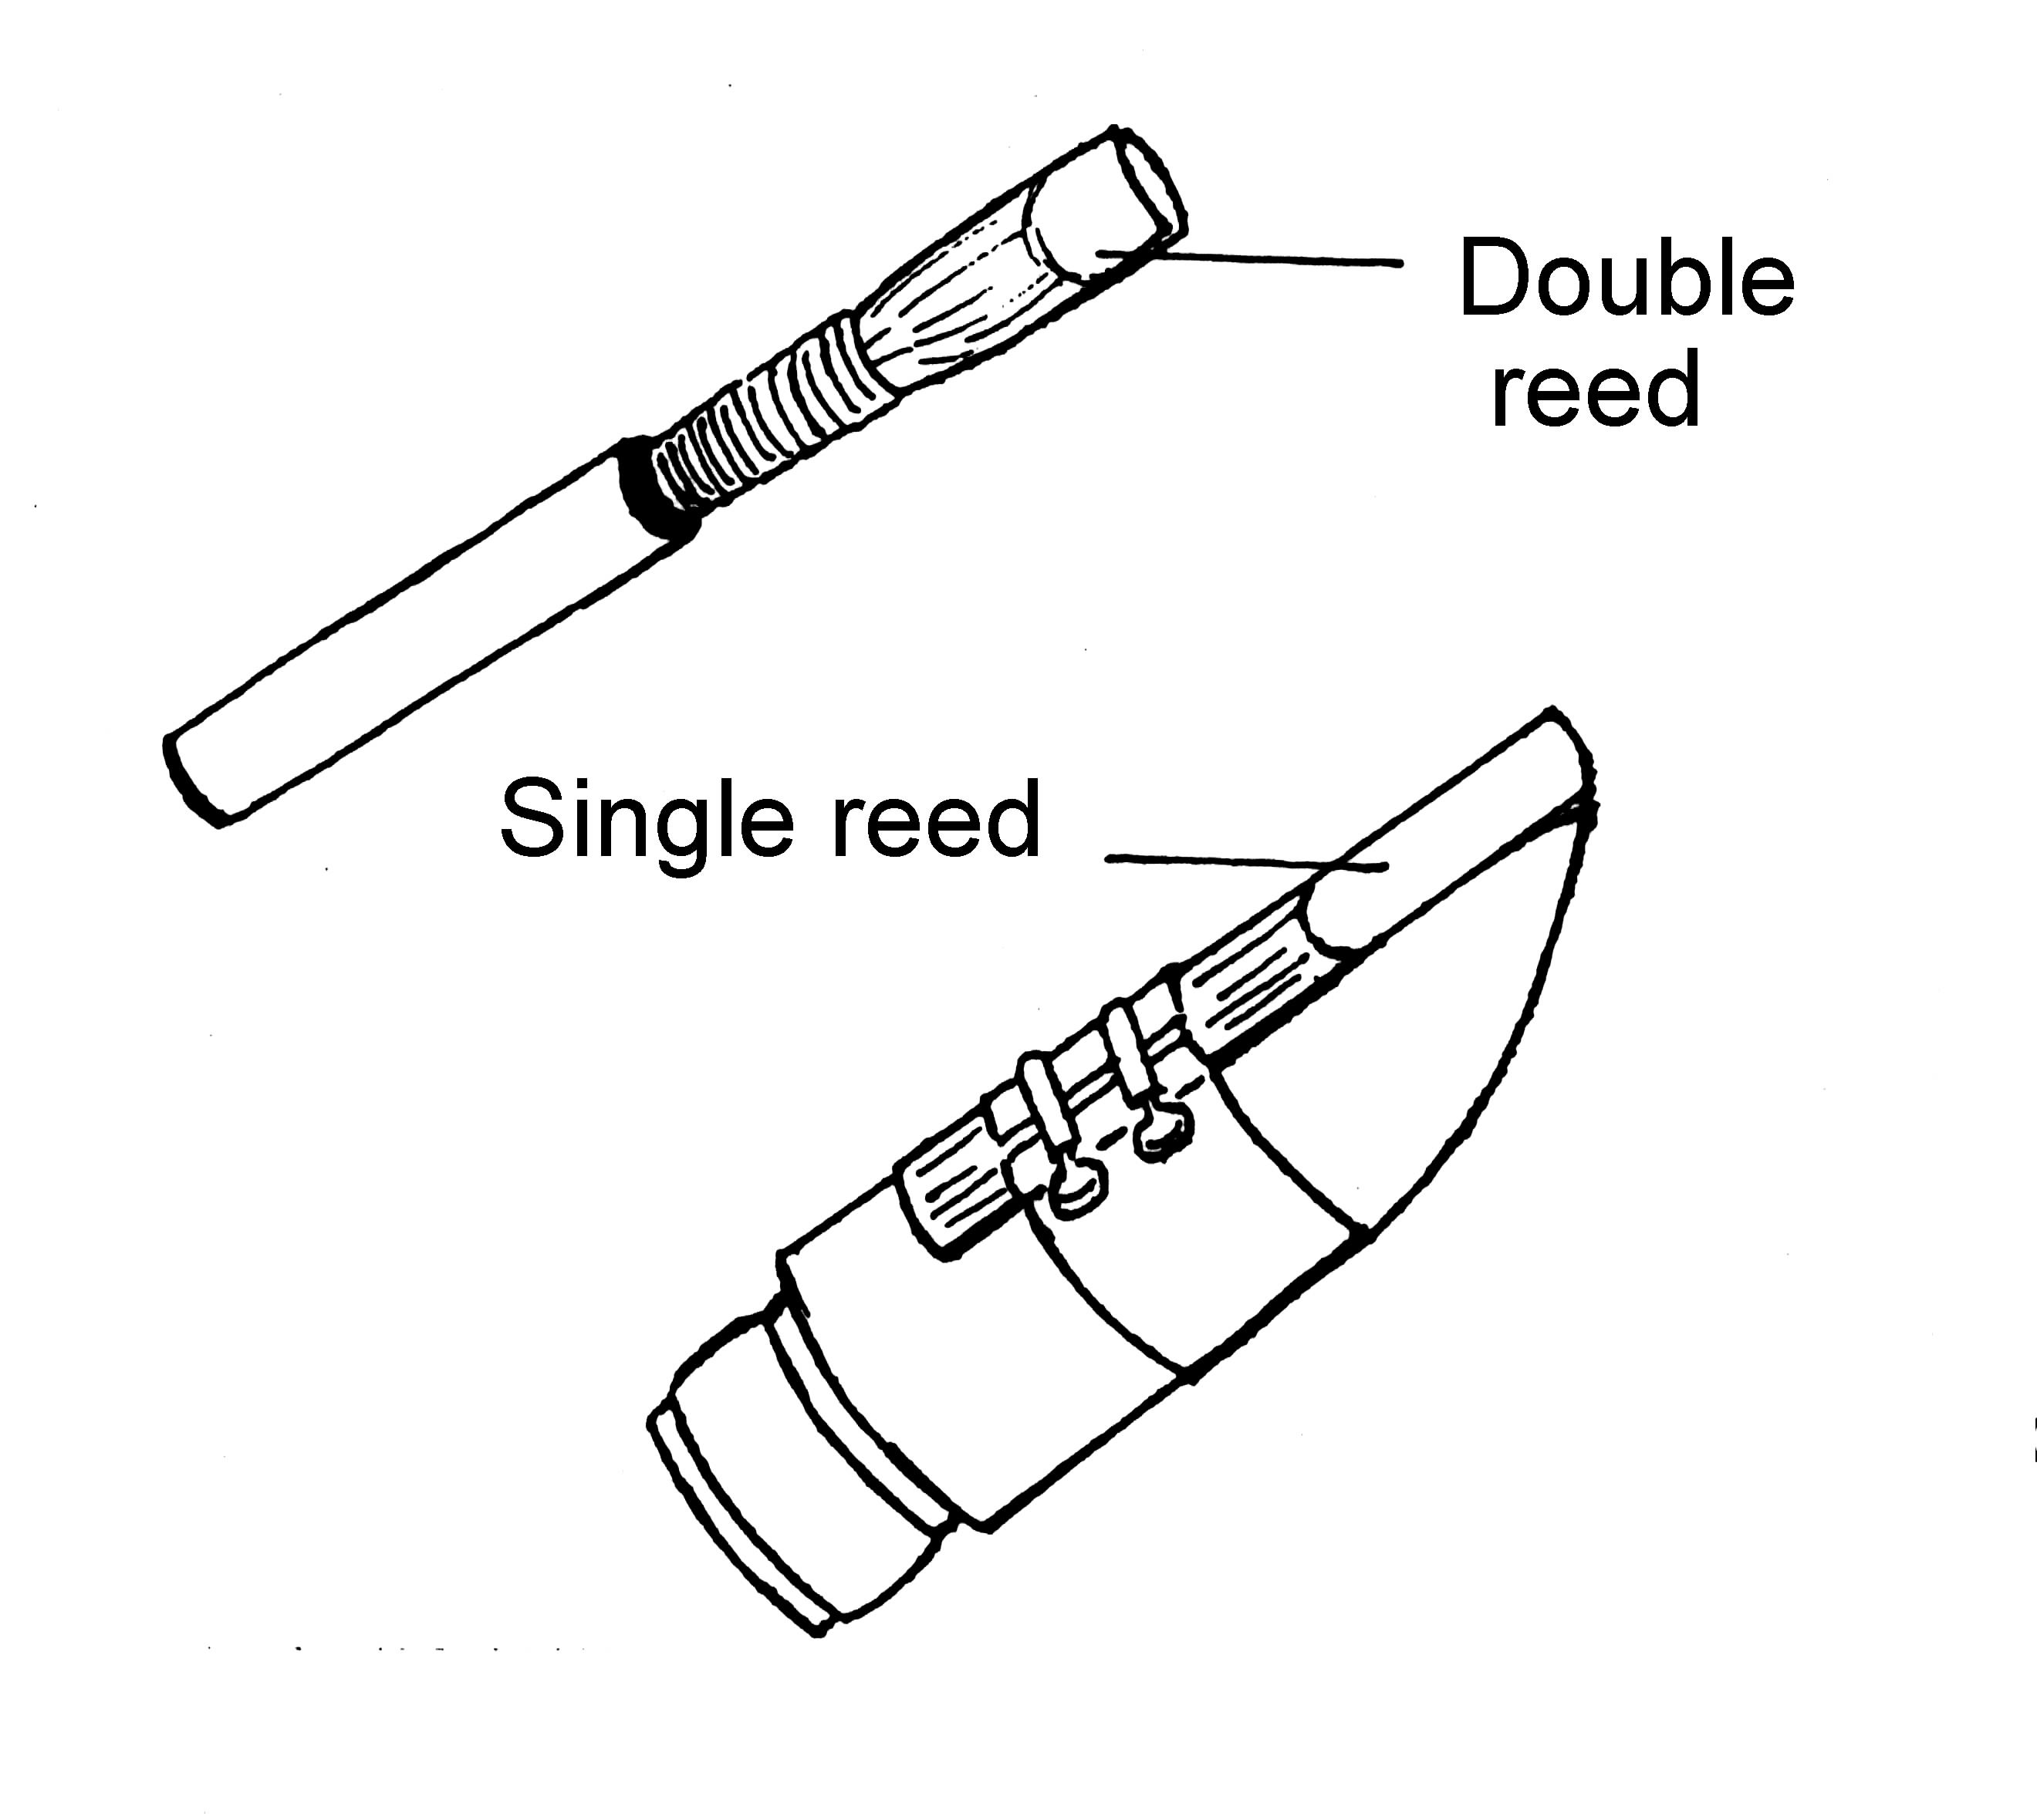
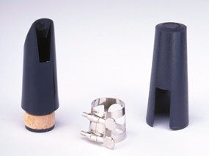
Single and Double Reeds
The reed woodwind instruments can have either single or double reed mouthpieces
  Acoustical properties not so different
What matters instead is a cylindrical vs. conical bore of the pipe!
  Cylindrical: Clarinet
  Conical: Saxophone, oboe, bassoon

Slide 31
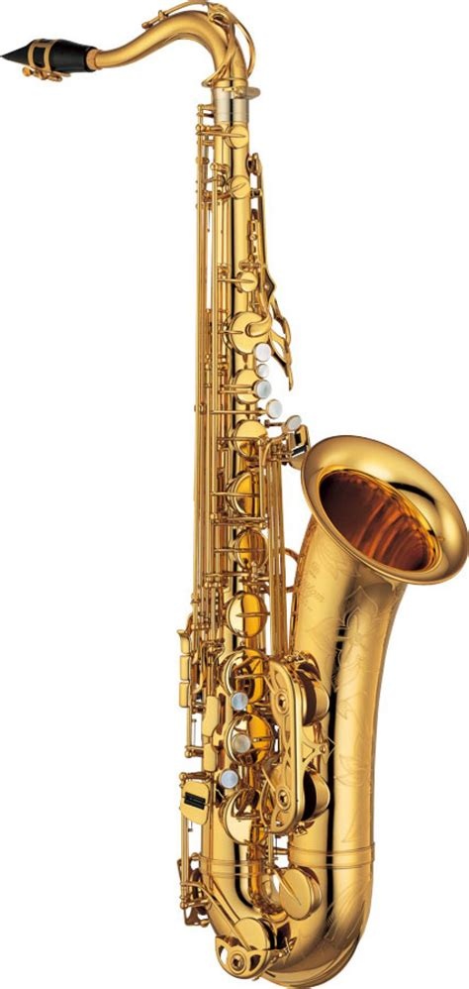
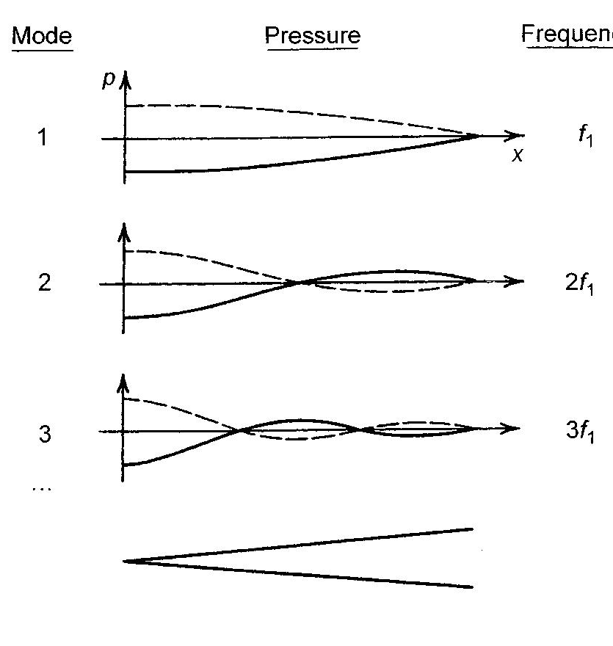
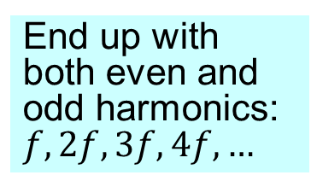
Natural Modes of Cones
The natural modes of a cone form a harmonic series
  Not like a cylindrical pipe with closed end
  Like an open pipe (on both ends), even though it has a reed on one end
As the cone gets wider, not as much pressure can build up in the standing wave, and the positions of the pressure nodes get shifted with respect to those of a cylindrical pipe
End up with both even and odd harmonics: $f, 2f, 3f, 4f,…$
Donald Hall,
Musical Acoustics

Slide 32
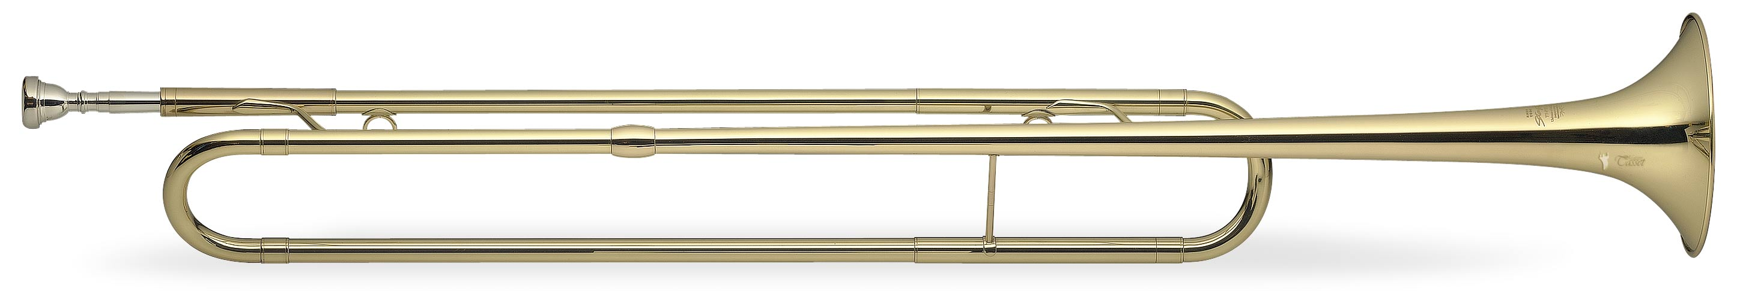
Brass Instruments
Lip buzzing (and mouthpiece buzzing) is what excites vibrations and sound waves
Lips and mouthpiece (exciter)
Tube (resonator)
Bell (radiator)
Brass mouthpiece demo

Slide 33
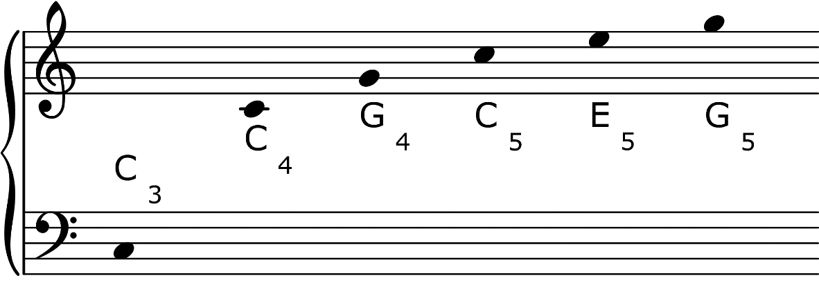
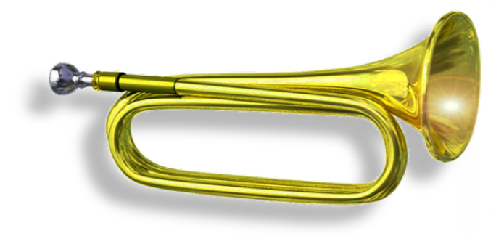
Harmonic Series for Brass
Example: Bugle notes
f 2f 3f 4f 5f 6f
Get a harmonic series with both even and odd harmonics for all brass --
but can be very hard to get the fundamental

Slide 34
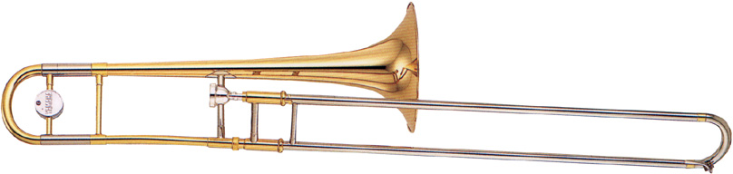
The Trombone
Play more than just bugle calls?
Need more notes!
  ⇒ Change the length of the pipe
The slide trombone does this in a clever manner
  Two ways to change the pitch:
  play higher harmonics or adjust the slide
Trombone demo

Slide 35
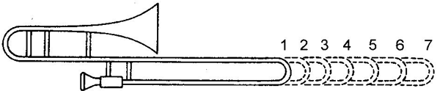
Trombone Slide
The closed position plays B♭₂
Use the trombone slide to decrease the pitch
  Go down from B♭₂
  Or down from higher mode notes
Each position → lower by a semitone (half step)
Each semitone shift is relative to the immediately preceding length, not the beginning length
⇒ Actual amount of length shift must steadily increase
Trombone “positions”
Notes:
V. Demo trombone mouthpiece and chromatic scale?

Slide 36





Brass Instruments with Valves
f 2f 3f 4f 5f 6f
If we want to fill in the notes
between G₄ and C₄, we
need to add six new pitches
This can be done using three valves
1
2
3
s²
s
s³
s = semitone
Euphonium demo
Notes:
M. Demo euphonium? Harmonic series and then chromatic scale? Pedal tone later?

Slide 37



Effect of Brass Instrument Bells
Mouthpiece
Tubing
Bell
Bell: changes cross-sectional area gently
Small λ: curvature seems gentle to the wave – pressure node near the open end of the bell
Large λ: curvature seems abrupt to the
wave – pressure node far from
the open end of the bell
So where the pressure
equilibrates depends on the
pitch!

Slide 38

Modification of Mode Frequencies
(a)
(b)
(c)
Adding a bell and mouthpiece modifies the natural modes of a closed pipe
  Cylindrical tube closed at one end
  Replace part of tube with bell
  Replace opposite end part with mouthpiece
Closed pipe
With bell
With mouthpiece
Donald Hall,
Musical Acoustics
Mouthpiece instead shifts high frequencies down
Odd harmonics
“New” harmonic series
Long wavelengths (low frequencies) effectively “see” a shorter pipe, so their natural mode frequencies get shifted up

Slide 39
Almost Get a New, Full
Harmonic Series
Closed pipe
With bell
With mouthpiece
Remember:
Sustained periodic wave must be built of components of a harmonic series:
nf, where n = 1, 2, 3, … (Fourier theorem)
Lowest mode frequency here is wrong for a harmonic series – too low
Makes fundamental very hard to play
Called a “pedal tone”
Odd harmonics
Frequency that would be the fundamental of all the higher modes: “pedal tone”
Pedal tone demo
Actual lowest natural mode frequency – doesn’t match the other natural modes!

Slide 40



Summary
Music is produced via natural modes
of vibration – of strings, air columns
  Also bars and membranes for percussion
The same note on different instruments sounds different because of the different relative strengths of the higher harmonics
  Affected by e.g. natural modes of the body for string instruments, how vibrations are excited, open vs. closed and cylindrical vs. conical pipes
I hope a greater understanding of the physics underlying music brings you a deeper appreciation of the musical arts!

Slide 41
Extra

Slide 42
The Speed of Sound
All waves have a speed associated with them
  The speed of sound is about 344 m/s (770 mph) at 20°C
  But depends on temperature
  This can mess up the pitch of organ pipes and wind instruments
For temperature T in Celsius:
speed (in m/s) = 344 + 0.6 x (T – 20)

Slide 43
Typical Sound Pressures
Typical sound waves have pressure amplitudes of about 0.01 N/m² (quiet) to
1 N/m² (loud)
This means the pressure changes for a loud sound correspond to about
  101,326 N/m² compressions
  101,324 N/m² rarefactions
A fractional change of 1 part in 10⁵
  Quiet sounds may have a fractional change of
  1 part in 10⁷ or more
Our ears are really remarkable in that we can detect such small pressure fluctuations

Slide 44
Typical Sound Power
Compared to a 100 W light bulb, sound power is very small
  Typically in the μW to mW range
Maximum sound power
Most instruments are at most a few percent efficient in converting input energy to sound energy
Instrument | Maximum sound power
Bass drum | 20 W
Trombone | 5 W
Trumpet | 300 mW
Flute | 50 mW

Slide 45

Typical Sound Wavelengths
We can calculate the wavelength of sound waves using v = λ f
  the speed of sound in dry air at 20°C is
  v = 344 m/s
Frequency | Wavelength
27.5 Hz (A₀) | 12.5 m
440 Hz (A₄ or concert A) | 78 cm
4186 Hz (C₈) | 8.2 cm
20 kHz | 1.7 cm
Human scale
The size of people, furniture, windows, etc. is important for sound propagation

Slide 46

Typical Sound Intensity Levels
Donald Hall, Musical Acoustics
Each 10 dB corresponds to a factor of 10 in intensity

Slide 47

Beats
The result of adding two waves of nearly equal
frequencies f₁ and f₂
  The resulting wave sounds like a pure tone with frequency
  The sound pulsates at the beat frequency
two waves
sum
“envelope” at f_{beat}
Wave with frequency f_{ave}

Slide 48



Resonance
Resonance occurs when we drive a system at one of its natural modes
If dissipation is small, the resonance can be very sharply peaked
Dissipated or radiated energy
Driving energy
Sharp
Broad

Slide 49



Fourier spectra for acoustic guitar
A₂ and E₂ strings
http://www.sillanumsoft.org/index.htm
A₂: 110 Hz
330
110
220
440
770
990
550
880
1100
247
165
E₂: 82.4 Hz
330
82
494
412
577

Slide 50


Radiated Violin Sound
A₄ (440 Hz)
The spectra of different
notes can be very
complicated
  The tone quality changes
  in the different registers of the violin
G₃ (196 Hz)
C₆ (1047 Hz)

Slide 51


Impedance and Wave Reflections
Impedance $Z$is a generalized form of resistance
Any time a wave encounters a boundary, some fraction $R$of it may get reflected
If Z₁ = Z₂ (matched impedances)
  Then $R$= 0 ⇒ no reflection
If Z₁ is much larger than Z₂ or vice versa (very different impedances)
  Then $R$≈ 1 ⇒ almost perfect reflection

Slide 52
Impedance of Air Pipes
The acoustic impedance is
Inversely proportional to the area of the pipe
  Wide pipes have a low impedance
  Skinny pipes have a high impedance
Cross-sectional area

Slide 53
Trapping Energy in a Pipe
Consider the impedance of a pipe open on both ends
Z₂ = 0 gives R = 1
So even open ended pipes will trap energy!
  Big area change at ends, so big impedance change
1
2
Area of 2 ≈ infinite
Z₂ ∝ 1/Area ≈ 0
Fraction of energy reflected ≈ 1!
Air columns with fixed lengths are like strings: they have standing waves

Slide 54




Air Jets and Edgetones
Under the right conditions, an air jet hitting an edge becomes unstable and starts oscillating
This excites a tone, and is half of what we need to make an instrument
The other half is a resonator to shape and “amplify” the sound
Donald Hall,
Musical Acoustics
Referee whistle, recorder, organ flue pipes, flute

Slide 55


Vibrating Reeds
Cane reeds on woodwinds are soft
Soft reeds do not vibrate much on their own
  Vibrational energy is almost immediately
  dissipated
  When coupled to an air pipe, soft reeds will vibrate at the natural frequencies determined by the pipe
One soft reed can be
used to make a
many-note instrument
Can vibrate at different
frequencies
Vibration response of a soft reed

Slide 56

Clarinet and Flute Tone Holes
The flute only needs to play one octave in its lowest register
The clarinet needs to play a twelfth in its lowest register
Tone holes in the right half
Tone holes in the lower two-thirds

Slide 57


Summary of Pipe Modes
Open cylinder | Closed cylinder | Cone
f₁ = v/2L | f₁ = v/4L | f₁ = v/2L
f₁, 2f₁, 3f₁, 4f_{1,…} | f₁, 3f₁, 5f₁, 7f_{1,…} | f₁, 2f₁, 3f₁, 4f_{1,…}
Notes:
Remove LANL!

Slide 58

Register Holes
Register holes are designed to kill the fundamental and allow one of the harmonics to survive
  Placed near the node of the harmonic
A register hole e.g. near the middle of an open pipe encourages the second harmonic
  Open pipe: 2nd mode is an octave
Improves the tone and makes overblowing more reliable
Location of the register hole is a compromise for playing a range of notes
pressure standing waves
Register hole closed
Register hole open
Notes:
Show on clarinet

Slide 59


Clarinet Register Holes
The clarinet uses a register key to kill the fundamental when playing in the clarion register
The location of the register hole is a
compromise for playing
a range of notes
  In this example, ideal
  for F₅, but not as good
  for lower and higher
  notes

Slide 60
Wavelength and Frequency
The wavelength is determined by the length and open or closed nature of the pipe
  How many wavelengths can we fit inside a pipe?
The frequency instead is determined by the speed of sound and the relation v = λf
Air pipe | Wavelength | Frequency | Harmonic series
f₁, 2f₁, 3f₁, 4f₁,…
f₁, 3f₁, 5f₁, 7f₁,…
Frequency will depend on temperature!
v = 344 m/s at room temperature

Slide 61

The Human Voice
Basic units of sound: phonemes
  Consonants: not periodic, no definite pitch
  Vowels: steady sounds with definite pitch
Vowels are produced by
  Exciter: the vocal folds (vocal cords) produce lots of harmonics
  Resonator: the vocal tract
  acts as a filter to enhance
  certain frequencies (formants)
Vowels can generally be
characterized by their first
two formants

Slide 62


Vocal Tract Resonances
After the sound is produced by the vocal folds, it is shaped by the vocal tract
Suppose we model the vocal tract as a 17 cm closed pipe
  Soft walls, so the resonances are
  very broad
These natural modes are known
as formants
L ≈ 17 cm ⇒ Resonances at ≈ 500 Hz, 1500 Hz, …

Slide 63

Formants
The formants act as filter frequencies
Spectrum from voice box
Vocal tract resonances
100 Hz from voice box
Intensity peaks around formant frequencies
200 Hz from voice box

Slide 64


Control of Formant Frequencies
Our vocal tract is not a perfect cylinder
  We can control format frequencies by changing the shape of our vocal tract
Strongest effect at pressure nodes
  Displacement antinodes
Second formant frequency controlled by lips and back of tongue
First formant frequency controlled by lips

Slide 65
Formant Chart
Front
Some variation in formants.
Also between men and women,
and different dialects
/i/
/ɪ/
/ɛ/
/æ/
Second formant frequency in Hz
/ɜr/
/ʌ/
/ʊ/
/ɒ/
/u/
/ɔ/
Back
Close
First formant frequency in Hz
Open

Slide 66

Example Waveforms and Spectra
ah at 150 Hz
ah at 90 Hz
More harmonics, but same formants
uh at 90 Hz

Slide 67
Percussion Natural Mode Frequencies
Since we hear frequencies, we would
like to have some idea how the natural mode frequencies are obtained
  Unfortunately no simple pattern, and depends on many factors
  Not a harmonic series!
General behavior for vibrations
f, 2f, 3f, 4f, 5f, 6f,…
For the n^{th} mode

Slide 68

Free Bar
Modes of a uniform bar which is free at both ends
  xylophone, marimba, metallophone (metal bars)
General pattern is similar to a clamped bar
  But different set of frequencies!
Still not a harmonic series
  Bending stiffness depends on the mode
f₁
2.76 f₁
5.40 f₁
8.93 f₁
Modification of bar to produce more musically helpful frequency ratios – greater thinning for xylophone and marimba bars

Slide 69
Membrane Mode Frequencies
The frequencies of vibration of a circular membrane can be mathematically determined
  The n^{th} zero of the m^{th} “Bessel function” J_{m}(z)
Fortunately, we don’t need the details
  The fundamental frequency f₁ is determined by properties of the drumhead
  The frequencies of the higher modes can be tabulated as multiples of f₁
Tension
Mass per unit area
The modes are non-harmonic – not due to stiffness (like for bars) but due to geometry of two dimensions

Slide 70

Membrane Mode Frequencies
We can tabulate the first 10 natural modes of an ideal stretched membrane (an ideal drumhead)
  Mode numbers labeled from lowest to highest frequency
  Note the mixed pattern of radial and circular nodes
(0,1)
(1,1)
(2,1)
(3,1)
(4,1)
(5,1)
Fundamental
(0,2)
(1,2)
(2,2)
mode 4 side view along diameter
(0,3)

