Slide 1
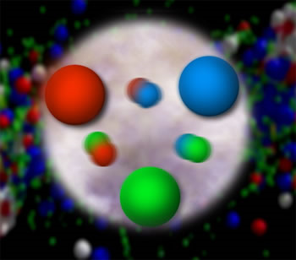
Smashing Protons for a Living
Christine A. Aidala
Notes:
All everyday matter is made of atoms, which are in turn made of electrons, protons, and neutrons. My research goes one step further to study what’s inside of protons of neutrons.

Slide 2
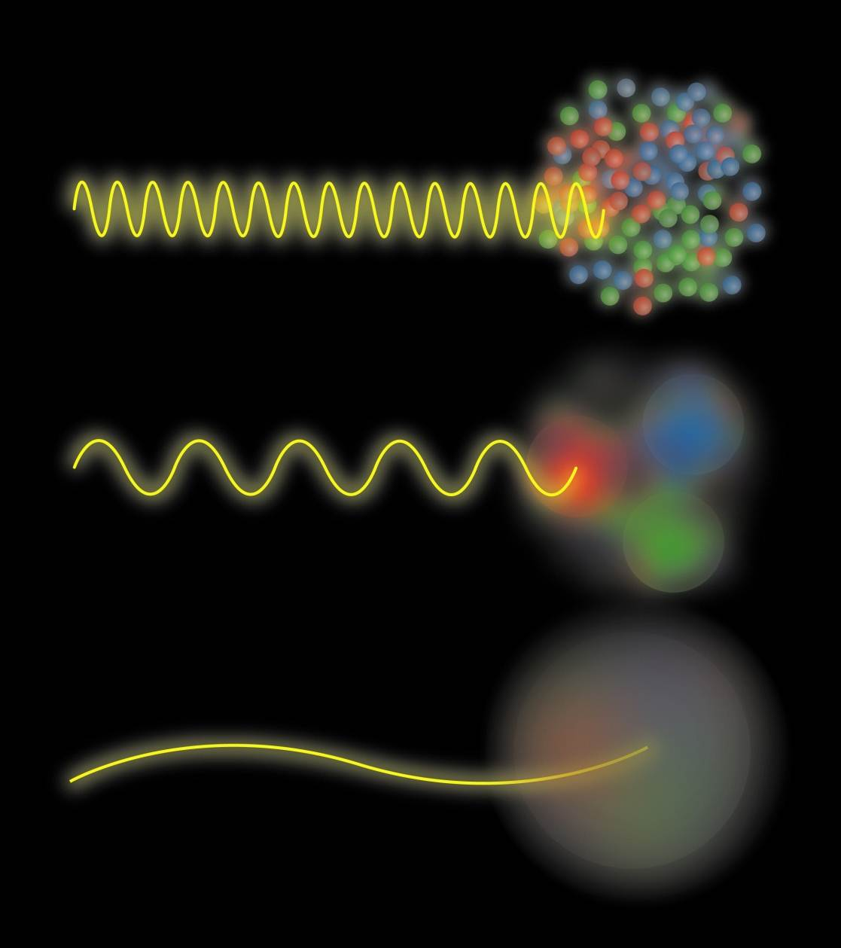
Josh Rubin
Notes:
What the inside of a proton “looks” like—what features you’re sensitive to--depends on the resolution with which you look at it. In general when you want to image or detect an object, you often use waves. They can be light waves, like we do with our own vision, other electromagnetic waves, like radar or the millimeter wave scanners that those of you who flew here probably had to pass through in airport security, sound waves, like bats using echolocation to hunt insects, or “particle waves,” due to wave-particle duality in quantum mechanics. The wavelength of the wave determines the size scale of what objects and features you can detect. So mm-wave scanners make more sense for the airport than technology sensitive only to objects bigger than 30 cm or as small as microns. And bats use ultrasound, sound waves at frequencies higher than humans can hear, because those frequencies have wavelengths that match the size of insects.
The proton is made of subnuclear particles called quarks held together by gluons—yes, gluons are named after glue! Due to quantum mechanics, the gluons can also fluctuate into quark-antiquark pairs. Yes, every atom of your body, and of everything, actually has antimatter continually blipping into existence and then annihilating again! If we go to small enough wavelengths we can detect this!

Slide 3
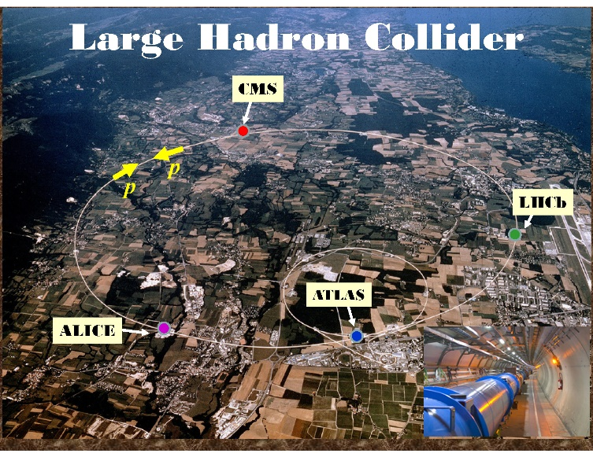
Notes:
The proton is about 10^-15 m in size, a million times smaller than “nanoscale” science. So we need extremely short wavelengths, which we can achieve through wave-particle duality by accelerating particles to very high energies. One of my experiments is at the Large Hadron Collider at the European Centre for Nuclear Research (CERN) near Geneva, Switzerland. Here’s the Geneva Airport, and Lac Leman, and the border with France is here. It’s a 27-km (~17-mile) ring about 100 m below ground, with four giant experiments.

Slide 4
100 m below the French countryside
Notes:
My experiment is called LHCb, or Large Hadron Collider Beauty experiment. It’s about 4 stories tall. High energy protons collide here, and through E=mc^2 produce sprays of new particles, from which we can learn about what was going on in the protons when they collided.

Slide 5
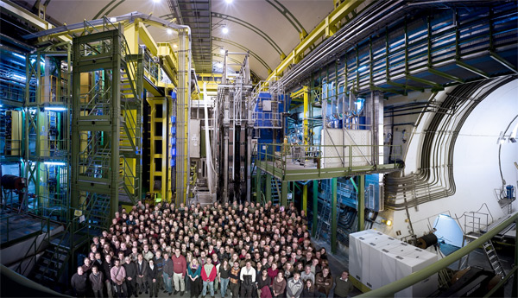
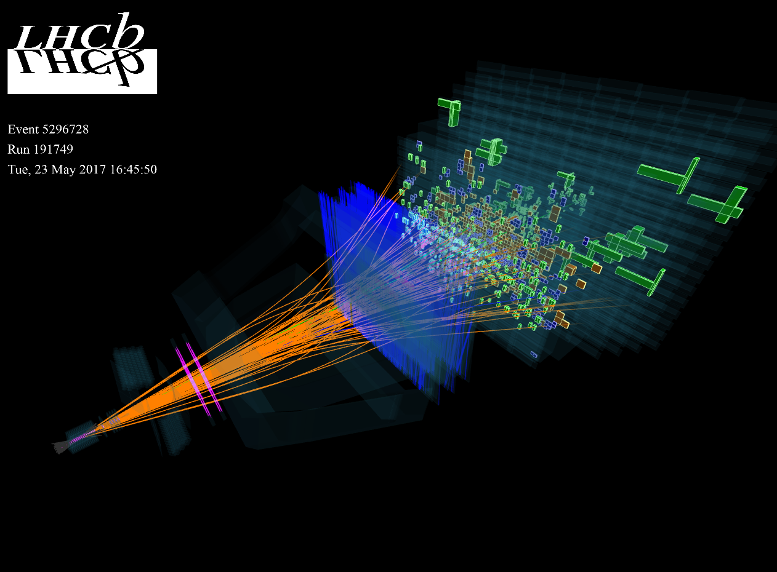
Notes:
Our collaboration is about ~850 scientists from 18 countries, supported by ~450 engineers and technicians.
Here’s a visualization of produced particles streaming out of an actual high-energy proton-proton collision and measured by our detector. We measure trillions of these collisions to collect a lot of statistics.

Slide 6
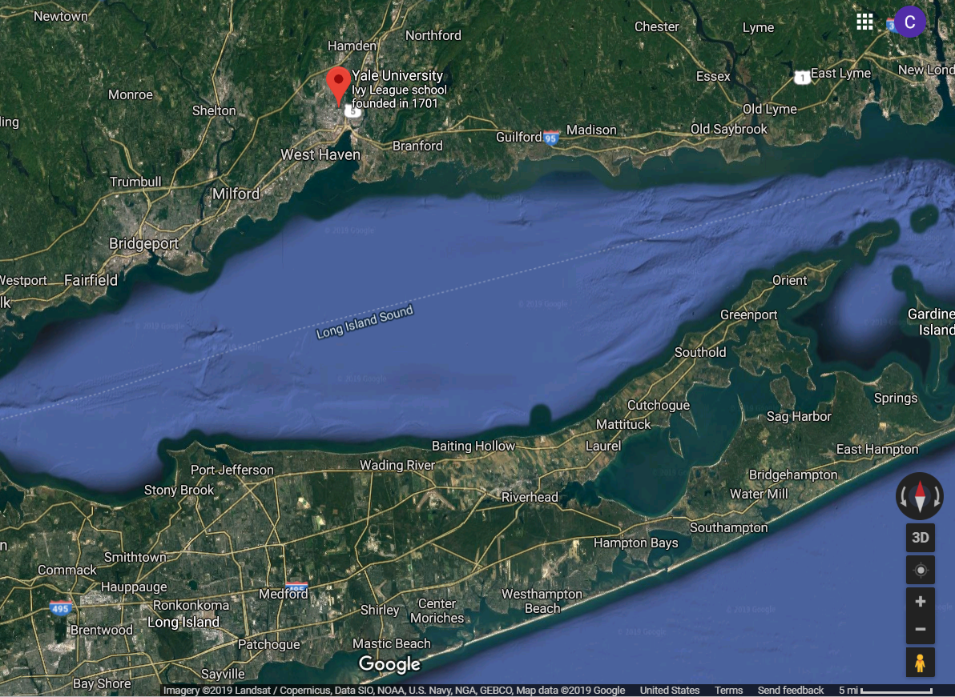
The Relativistic Heavy Ion Collider at Brookhaven National Lab – only collider in the U.S.
Notes:
The only collider in the U.S. right now is actually quite close, just south of here on Long Island. You can see the ring for the Relativistic Heavy Ion Collider on google maps—you’re actually seeing the ring access road, not the accelerator structure itself. Here I am inside part of the detector on the experiment I’ve been working on there since 2001.

Slide 7
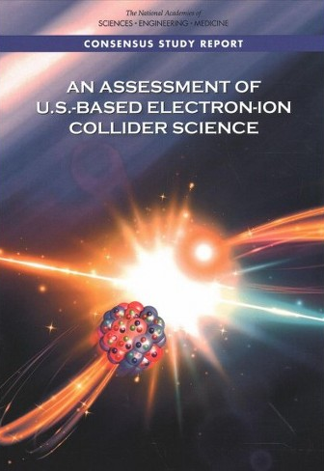
June 2019 issue!
Notes:
Brookhaven National Lab on Long Island is one of the two candidate host sites for the next collider expected to be built in the U.S., the Electron-Ion Collider. The Electron-Ion Collider is a proposed billion-dollar scale collider facility that would be like a giant (several-mile) electron microscope to study the inner structure of protons, neutrons, and nuclei in much more detail than we can now. I was part of a National Academy of Sciences committee that evaluated the science case for the facility in 2018, and there’s in fact a feature article on the Electron-Ion Collider in the latest issue of Scientific American!

Slide 8
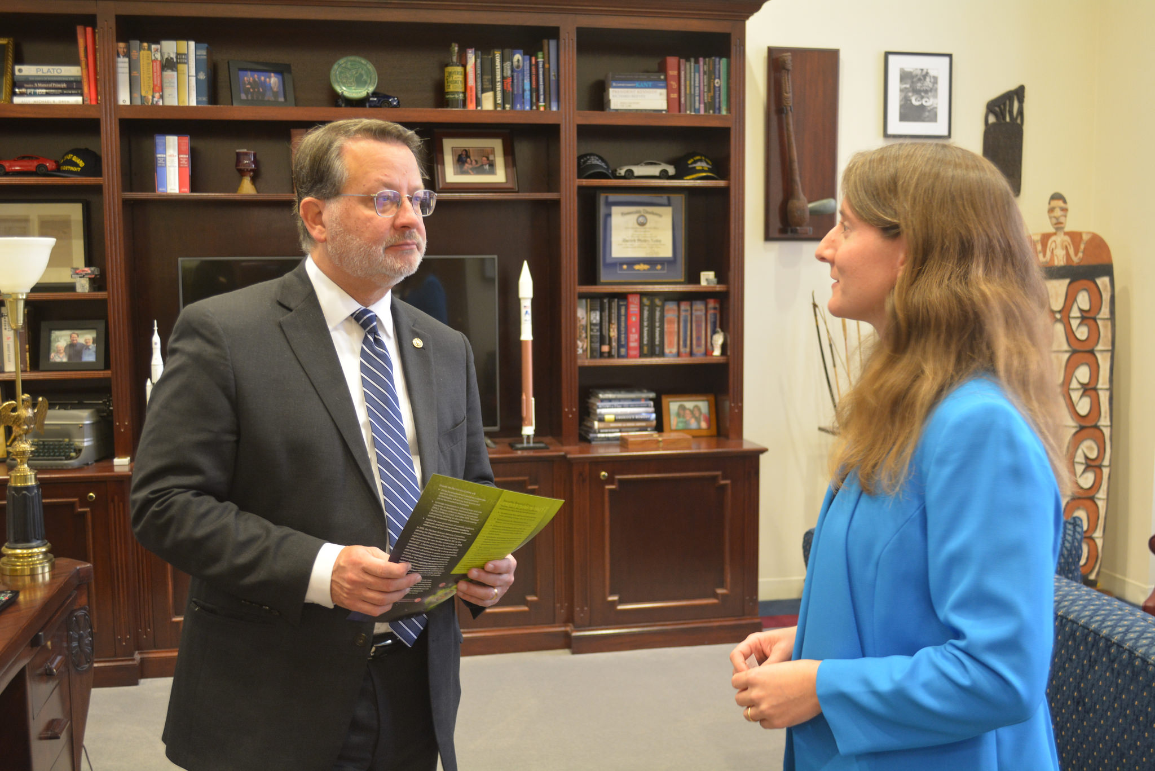
Notes:
If you want to build a new billion-dollar scale science facility you can’t spend all your time simply smashing protons—you’ve got to get out and convince Congress it’s worth building. Here I am on Capitol Hill in December telling Michigan Senator Gary Peters about the Electron-Ion Collider and how I lead a group of >850 scientists from 30 countries who would like to see this facility built in the U.S. We hope to get first data in 2030.

Slide 9
Some things you can talk to me about
I'm working on a new theory to refound the known branches of physics from a common, more fundamental starting point.
If you're interested in learning more about science and around in the summer, Brookhaven Lab on Long Island has “Summer Sunday” open houses.
https://www.bnl.gov/sundays/
I'll be on sabbatical in Milan for a year starting in July if anyone will be in the area and wants to get together!

