Slide 1
Parton Correlations
In and Across(!) Free Nucleons
Christine A. Aidala
University of Michigan
Gordon Conference on Photonuclear Reactions
Holderness, NH
August 10, 2014

Slide 2
Mapping out the partonic structure of the proton
What does the proton look like in terms of the quarks and gluons inside it?
Position
Momentum
Spin
Flavor
Color
Theoretical and experimental concepts to describe and access position only born in mid-1990s. Pioneering measurements over past decade.
Vast majority of past four decades focused on
1-dimensional momentum structure! Since 1990s starting to consider transverse components . . .
Polarized protons first studied in 1980s. How angular momentum of quarks and gluons add up still not well understood!
Early measurements of flavor distributions in valence region. Flavor structure at lower momentum fractions still yielding surprises!
Accounted for by theorists from beginning of QCD, but more detailed, potentially observable effects of color have come to forefront in last few years . . .

Slide 3
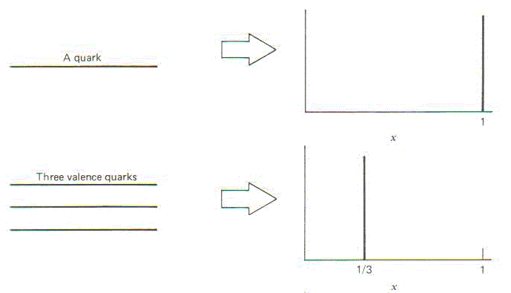
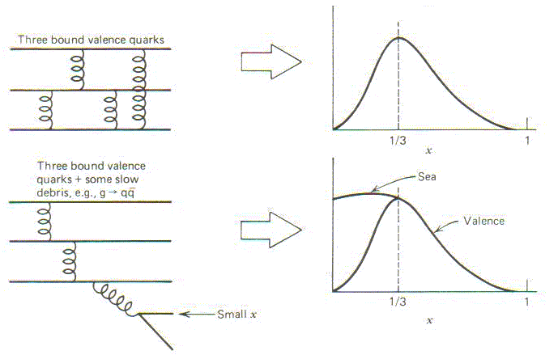
Parton distribution functions inside a nucleon:
The language we’ve developed (so far!)
What momentum fraction would the scattering particle carry
if the proton were made of …
3 bound valence quarks
A point particle
x_{Bjorken}
1
1/3
1
3 bound valence quarks + some
low-momentum sea quarks
x_{Bjorken}
Sea
3 valence quarks
Valence
Small x
1/3
1
x_{Bjorken}
1/3
x_{Bjorken}
1
Halzen and Martin, “Quarks and Leptons”, p. 201

Slide 4
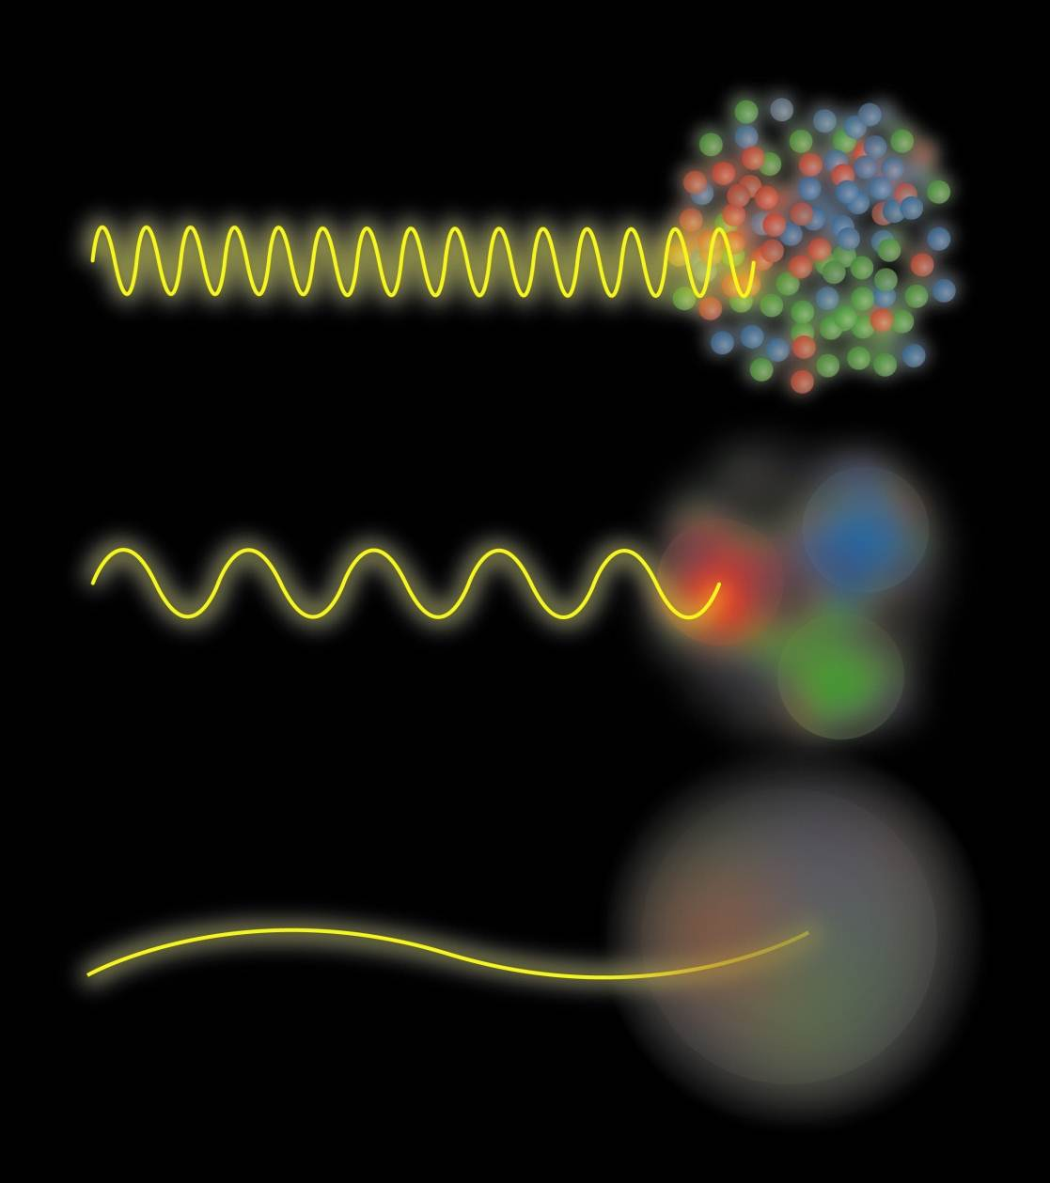
Partonic structure of the nucleon
Probing the proton at different energy scales offers information on different aspects of partonic structure
Graphic by Josh Rubin

Slide 5
Parton distribution functions in perturbative QCD calculations of observables
q(x₁)
Hard Scattering Process
X
g(x₂)
High-energy processes have predictable rates given:
    Partonic hard scattering rates (calculable in pQCD)
    Parton distribution functions (experiment or lattice)
    Fragmentation functions (experiment or lattice)
Universal non-perturbative factors

Slide 6
High-energy QCD: Thinking in terms of individual partons
Pdfs are single-parton functions in single nucleons
  Or in nuclei, but typically still think of partons in individual nucleons within nucleus
Can we go beyond this single-parton picture while staying in the hard (short-distance) limit of perturbative QCD?

Slide 7
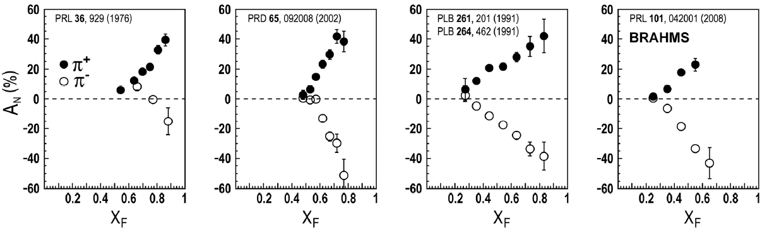
Historical detour:
Huge single-spin asymmetries in transversely polarized p+p collisions
ANL
√s=4.9 GeV
BNL
√s=6.6 GeV
FNAL
√s=19.4 GeV
RHIC
√s=62.4 GeV
left
right

Slide 8
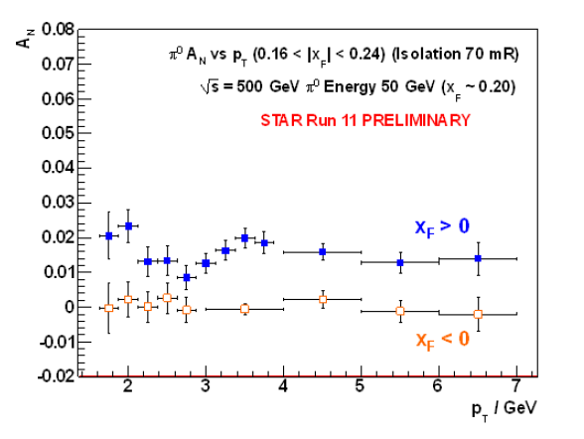
Single-spin asymmetries in transversely polarized p+p collisions
Similar effects across energies → Continuum between non-perturbative/non-partonic and perturbative/partonic descriptions of this non-perturbative structure??
Early single-spin asymmetry measurements couldn’t be explained by calculations with collinear, “leading-twist” pdfs
π⁰
Effects persist to kinematic regimes where perturbative QCD techniques clearly apply (p_{T} = 7 GeV → Q² ~ 49 GeV²!)

Slide 9
Transverse-momentum-dependent distributions and single-spin asymmetries
1989: The “Sivers mechanism” is proposed in an attempt to understand the observed asymmetries.
The Sivers distribution: first transverse-momentum-dependent (TMD) distribution to describe spin-momentum correlations
D.W. Sivers, PRD41, 83 (1990)
Departs from the traditional collinear factorization assumption in pQCD and proposes a correlation between the intrinsic transverse motion of the quarks and gluons and the proton’s spin
New frontier! Parton dynamics inside hadrons, and in the hadronization process
Spin and momenta can be of partons or hadrons

Slide 10
Parton distribution functions, including spin-spin and spin-momentum correlations
No (explicit) k_{T} dependence
Relevant measurements in simpler systems than p+p (semi-inclusive DIS, e+e- annihilation) only starting to be made over the last ~9 years, providing evidence that many of these correlations are non-zero in nature . . .
Transversity
k_{T} - dependent, T-even
k_{T} - dependent, T-odd
Sivers
Boer-Mulders
All at
“leading twist”

Slide 11
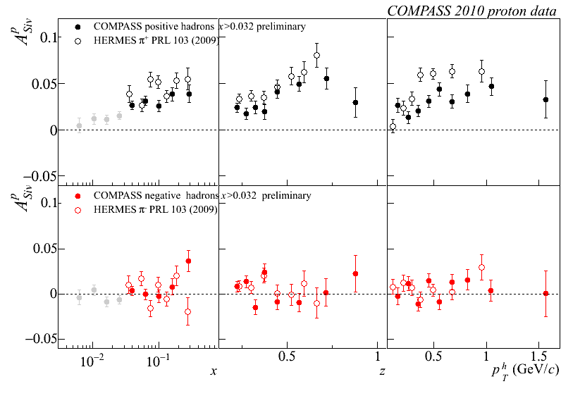
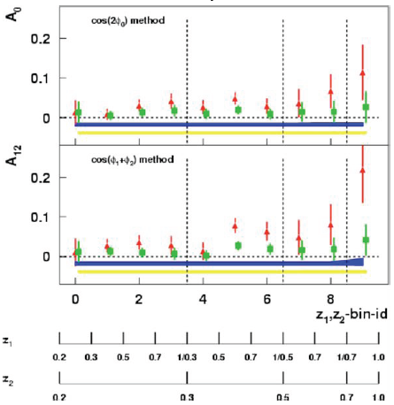
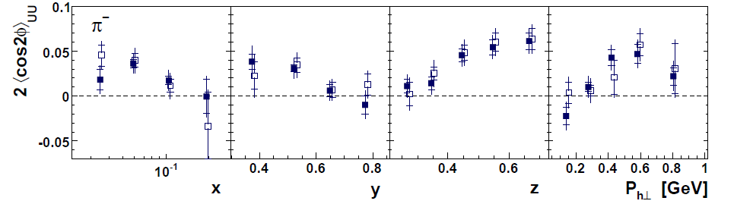
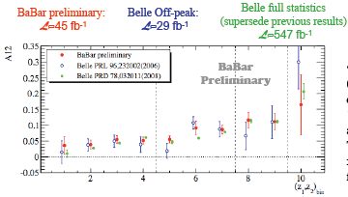
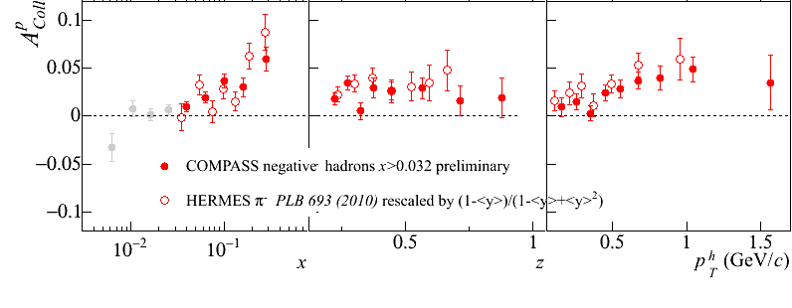
Sivers
e+p
μ+p
BELLE PRL96, 232002 (2006)
Collins x Collins
e⁺e⁻
Boer-Mulders x Collins
e+p
HERMES, PRD 87, 012010 (2013)
BaBar: Released August 2011
Collins x Collins
e⁺e⁻
e+p
μ+p
Transversity x Collins

Slide 12
An alternative approach to describing the large single-spin asymmetries:
Higher-twist multiparton correlations
Extend our ideas about (single-parton) pdfs to correlation functions that can’t be associated with a single parton
Non-perturbative structure → matrix elements involving the quantum mechanical interference between scattering off of a (quark+gluon) and scattering off of a single quark (of the same flavor and at the same x)
  Can also have interference between (gluon+gluon) and single gluon
  No explicit dependence on partonic transverse momentum
  Efremov+Teryaev 1981, 84; Qiu+Sterman 1991, 98

Slide 13
Beware: Two common usages of the term “twist”
Formal definition of twist: “mass dimension minus spin” of the operator in a matrix element within the Operator Product Expansion
  “Leading twist” is twist-2
  Twist-n matrix element carries a factor of 1/Q^{(n-2)}
But – observables with measurable contributions from terms suppressed by a factor of 1/Q^{(n-2)} often referred to as sensitive to “twist-n” contributions
  Never measure a matrix element, only matrix elements squared!
  To get 1/Q term describing an observable, need interference term in the square modulus:
    A = order 1 + order 1/Q + order 1/Q² + …
    |A|² = |order 1|² + |order 1/Q|² + (order 1)(order 1/Q)* + (order 1)*(order 1/Q) + …
  So twist-3 term in matrix element times twist-2 term gives 1/Q
  Square modulus of twist-3 term gives 1/Q², sometimes referred to as “twist-4”

Slide 14
Transverse single-spin asymmetries provide new information on hadron structure
Leading contribution to transverse single-spin asymmetries comes from either:
  Convolution of two twist-2 transverse-momentum-dependent parton distribution functions and/or fragmentation functions, or . . .
  Convolution of one twist-2 collinear pdf or fragmentation function and one twist-3 (collinear) multiparton correlation matrix element

Slide 15
Multiparton correlations in hadronization
Traditional fragmentation functions describe probability of single parton to hadronize into particular hadron, as function of momentum fraction (z) of parton carried by the final hadron
Can have matrix elements describing multiparton correlations in hadronization
  Interference between a (quark+gluon) hadronizing and only a quark
  Similarly, interference between (gluon+gluon) and only a single gluon
  Kanazawa+Koike, 2000

Slide 16
Transverse-momentum-dependent functions and twist-3 multiparton correlators
Twist-3 (collinear) multiparton correlators believed to be related to k_{T}-moments of (twist-2)TMD pdfs and fragmentation functions
  NPB667, 201 (2003); PRL97, 082002 (2006)
To directly constrain TMD functions with experimental data, need two scales
  Hard momentum
  Observable sensitive to parton intrinsic momentum
  Note: Original hadronic asymmetries only measured a single scale

Slide 17
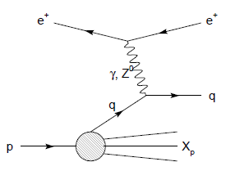
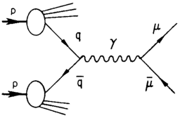
Modified universality of T-odd transverse-momentum-dependent distributions:
Color in action!
Deep-inelastic lepton-nucleon scattering:
Attractive final-state interactions
Quark-antiquark annihilation to leptons:
Repulsive initial-state interactions
Still waiting for a polarized quark-antiquark annihilation measurement to compare to existing lepton-nucleon scattering measurements . . .
As a result, get opposite sign for the Sivers transverse-momentum-dependent pdf when measure in semi-inclusive DIS versus Drell-Yan: process-dependent pdf! (Collins 2002)

Slide 18

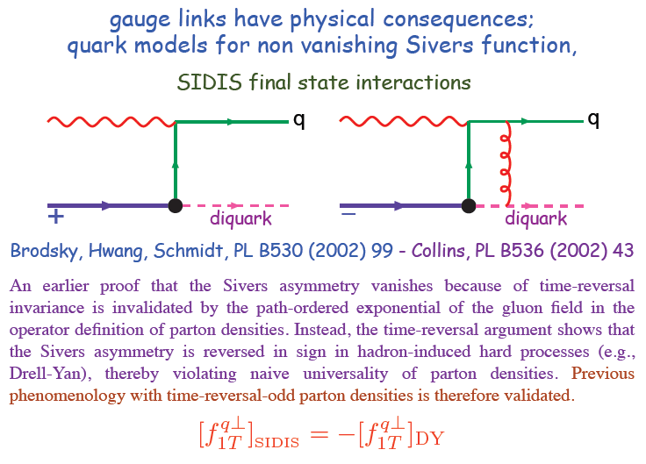
Modified universality requires full QCD:
Gauge-invariant quantum field theory
Collins, 1993
From M. Anselmino, Transversity 2014

Slide 19
Physical consequences of a gauge-invariant quantum theory:
Aharonov-Bohm (1959)
Wikipedia:
“The Aharonov–Bohm effect is important conceptually because it bears on three issues apparent in the recasting of (Maxwell's) classical electromagnetic theory as a gauge theory, which before the advent of quantum mechanics could be argued to be a mathematical reformulation with no physical consequences. The Aharonov–Bohm thought experiments and their experimental realization imply that the issues were not just philosophical.
The three issues are:
whether potentials are "physical" or just a convenient tool for calculating force fields;
whether action principles are fundamental;
the principle of locality.”

Slide 20
Physical consequences of a gauge-invariant quantum theory:
Aharonov-Bohm (1959)
Physics Today, September 2009 :
The Aharonov–Bohm effects: Variations on a subtle theme,
by Herman Batelaan and Akira Tonomura.
“Aharonov stresses that the arguments that led to the prediction of the various electromagnetic AB effects apply equally well to any other gauge-invariant quantum theory. In the standard model of particle physics, the strong and weak nuclear interactions are also described by gauge-invariant theories. So one may expect that particle-physics experimenters will be looking for new AB effects in new domains.”

Slide 21
Physical consequences of a gauge-invariant quantum theory:
Aharonov-Bohm effect in QCD!!
Deep-inelastic lepton-nucleon scattering:
Attractive final-state interactions
Quark-antiquark annihilation to leptons:
Repulsive initial-state interactions
Simplicity of these two processes:
Abelian vs. non-Abelian nature of the gauge group doesn’t play a major qualitative role.
BUT: In QCD expect additional, new effects due to specific non-Abelian nature of the gauge group
See e.g. Pijlman,
hep-ph/0604226
or Sivers,
arXiv:1109.2521
As a result:

Slide 22
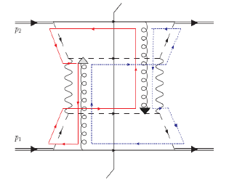
QCD Aharonov-Bohm effect:
Color entanglement
  2010: Rogers and Mulders predict color entanglement in processes involving p+p production of hadrons if quark transverse momentum taken into account
  Quarks become correlated across the two protons
  Consequence of QCD specifically as a non-Abelian gauge theory!
PRD 81:094006 (2010)
Color flow can’t be described as flow in the two gluons separately. Requires simultaneous presence of both.

Slide 23
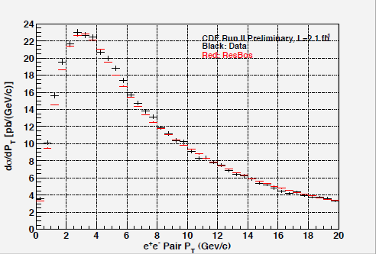
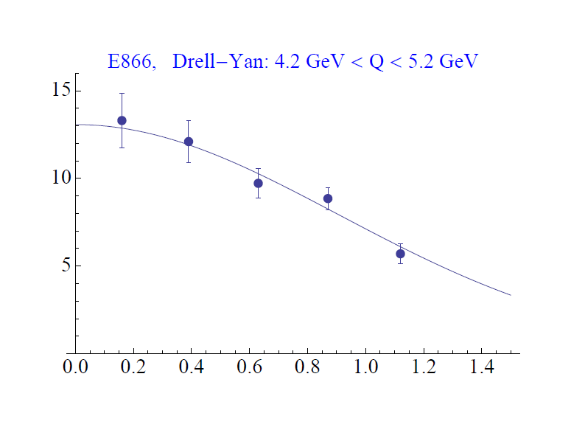
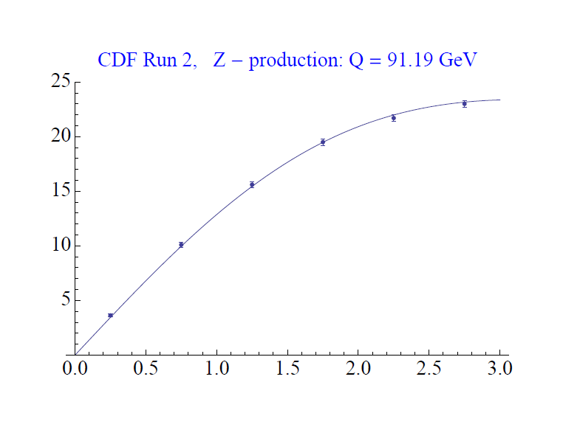
Testing the Aharonov-Bohm effect in QCD as a non-Abelian gauge theory
Look for contradiction with predictions for the case of no color entanglement
But first need to parameterize (unpolarized) transverse-momentum-dependent pdfs from world data
Z boson production,
Tevatron CDF
dσ/dp_{T}
CAA,
T.C. Rogers, in progress
dσ/dp_{T}
p+p → μ⁺+μ⁻+X
√s = 1.96 TeV
√s = 0.039 TeV
p_{T} (GeV/c)
p_{T} (GeV/c)

Slide 24
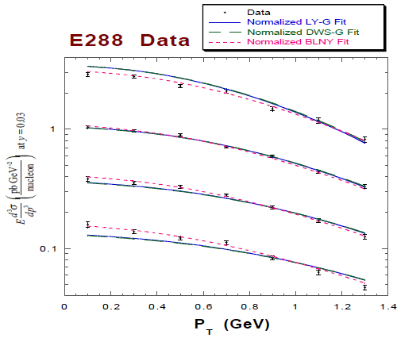
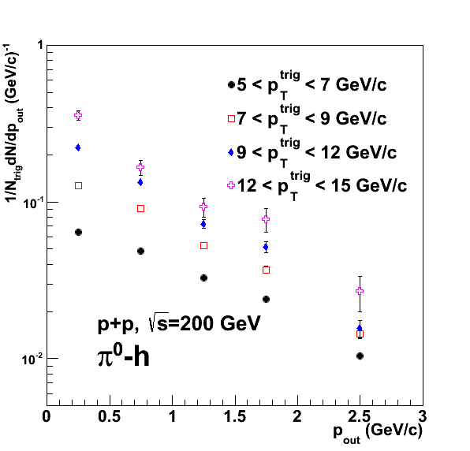

Testing the Aharonov-Bohm effect in QCD as a non-Abelian gauge theory
Landry et al., 2002
PRD82, 072001 (2010)
Drell-Yan lepton pair production
Hadron pair production
p+A → μ⁺+μ⁻+X
for different invariant masses:
No color entanglement expected
Get predictions from fits to data where no entanglement expected
Out-of-plane momentum component
Make predictions for processes where entanglement is expected; look for deviation

Slide 25
Summary
Spin-momentum correlations in proton scattering → New ideas about partonic structure and behavior
  Require full structure of QCD as a gauge-invariant quantum field theory
Importance of phases—Aharonov-Bohm effect in QCD!
Will be exciting to try to test in upcoming years . . .

Slide 26
Extra

Slide 27
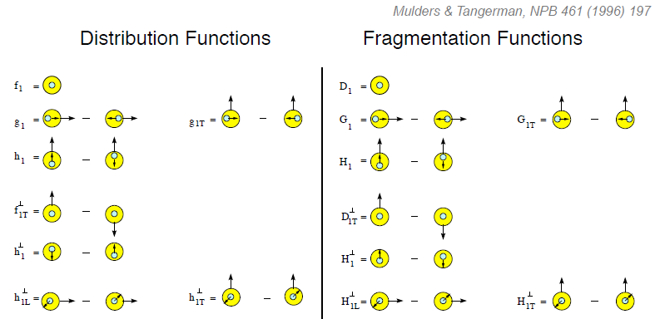
Example: Dropping the simplifying assumption of collinearity
Collinear
Worm gear
Collinear
Transversity
Sivers
Polarizing FF
Boer-Mulders
Pretzelosity
Collins
Worm gear
Many describe spin-momentum correlations: S•(p₁×p₂)

Slide 28
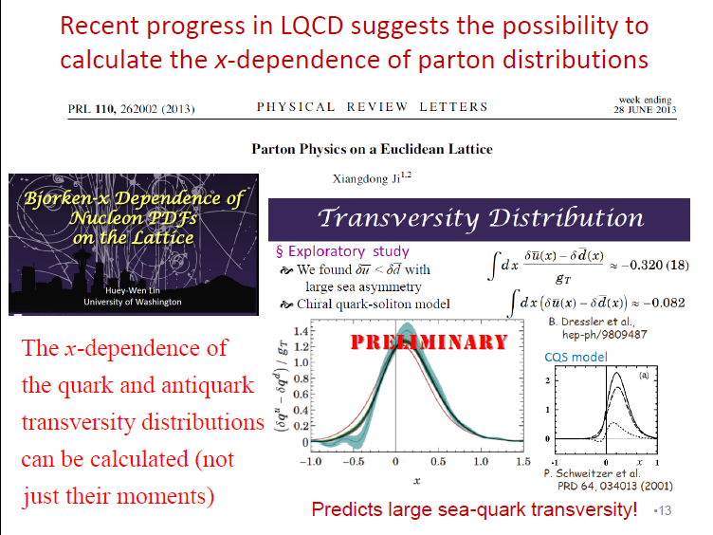
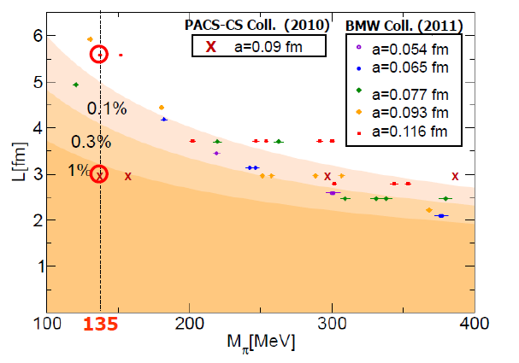
Example: Progress in lattice
Slide from J.-C. Peng
T. Hatsuda,
PANIC 2011
PACS-CS: PRD81, 074503 (2010)
BMW: PLB701, 265 (2011)

Slide 29
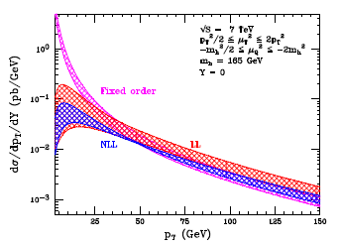
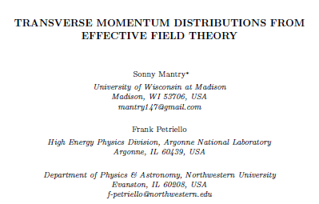
Example: Effective field theories
Soft Collinear Effective Theory
– p_{T} distribution for gg→Higgs
Higgs vs. p_{T}
arXiv:1108.3609
“Modern-day ‘testing’ of (perturbative) QCD is as much about pushing the boundaries of its applicability as about the verification that QCD is the correct theory of hadronic physics.”
– G. Salam, hep-ph/0207147 (DIS2002 proceedings)
Related talks by I. Scimemi, M. Echevarria, A. Idilbi

Slide 30
Experimental advances
More sophisticated observables
  E.g. angular distributions, spin dependence, multiparticle final states, . . .
  Often sensitive to parton dynamics
Multidifferential measurements
  E.g. simultaneously in x, Q², p_{T}
→ Demand more of theoretical calculations!

Slide 31
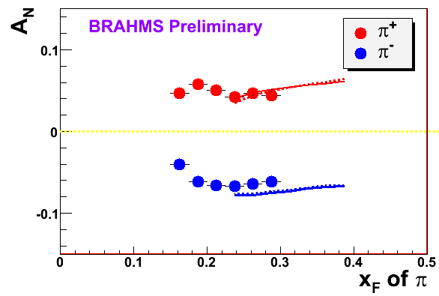
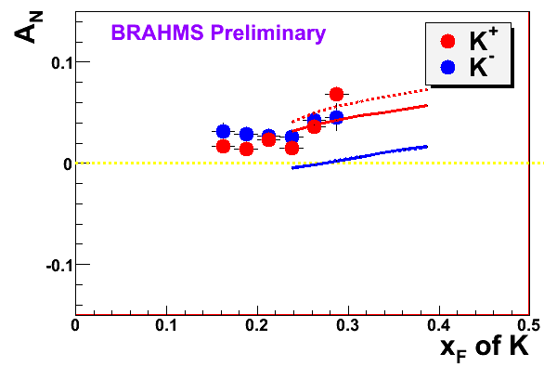

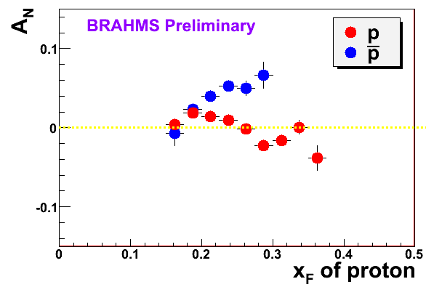
π
π
π, K, p
at 200 and 62.4 GeV
200 GeV
62.4 GeV
Note different scales
K
K
K- asymmetries
underpredicted
Pions suggest valence quark effect.
Kaons and (anti)protons don’t!
200 GeV
62.4 GeV
p
p
PRL 101, 042001 (2008)
Large antiproton asymmetry?? Unfortunately no 62.4
GeV measurement
200 GeV
62.4 GeV

Slide 32
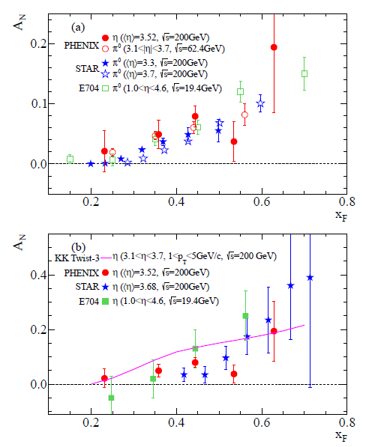
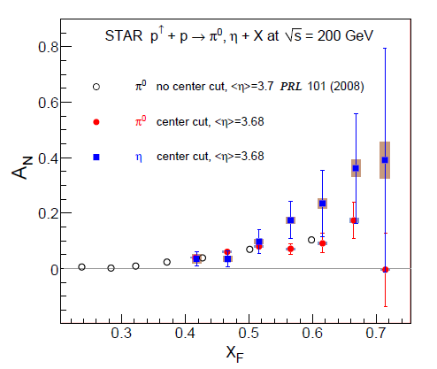
p+p η A_{N} larger than π⁰?? Same?
In addition to sea quarks, need to explore dynamics of gluons in more depth—talks by M. Echevarria, M. Schlegel, A.Szabelski, Y. Koike
arXiv:1406.3541
Related talks by L. Bland, D. Kleinjan,
A. Vossen, A. Ogawa, Y. Koike, D. Pitonyak, C. Pisano

Slide 33
Hadronization
Not as far along as nucleon structure—less of a focus in earlier years
Recent advances via
  TMD FFs
  Collinear twist-3 functions to describe hadronization
  Dihadron (interference) FF
  Hadronization from nuclei
Related talks by M. Radici, A. Kotzinian, I. Garzia, M. Grosse Perdekamp, F. Giordano, M. Contalbrigo, Y. Guan, O. Eyser, A. Vossen, + other p+p talks and all SIDIS talks . . .

Slide 34
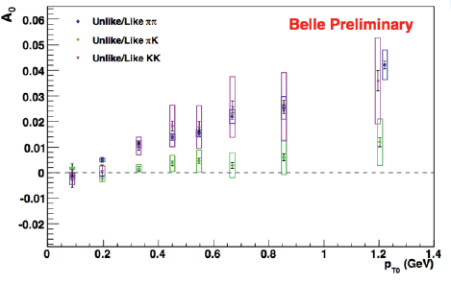
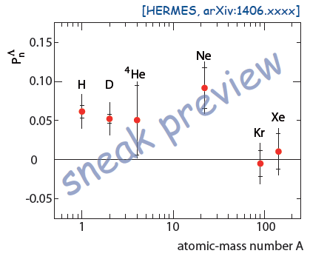
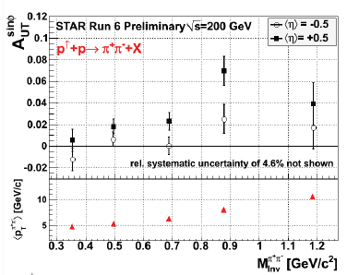
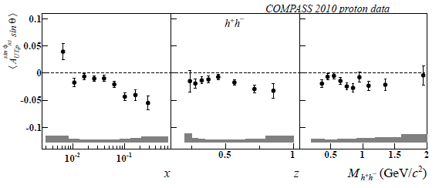
Now arXiv:1406.3236!
From talks by C. van Hulse, A. Vossen, C. Braun, F. Giordano

Slide 35
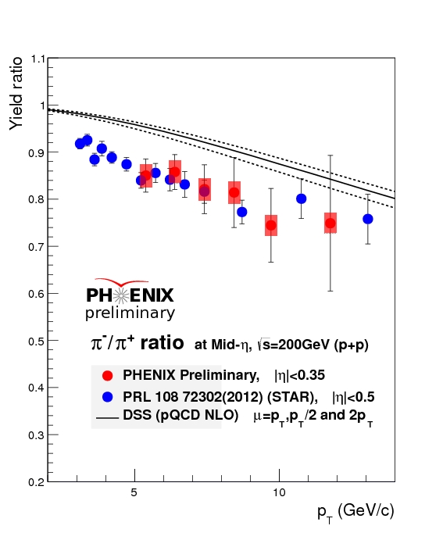
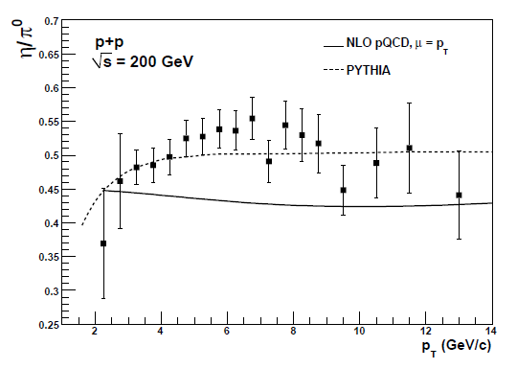
Identified hadron production: Ratios
Measured π-/π+ ratio significantly below NLO calculation in lower range of p_{T}
  Data: Normalization uncertainties cancel completely
  Calculation: Scale uncertainty greatly reduced
PHENIX ratio consistent with STAR points, which lie many sigma below NLO calculation out to ~10 GeV
More powerful to fit ratios directly in the future where available
pQCD uncertainties only from (FF) scale uncertainty
Similar issue for eta/pi0 ratio . . .
PRD83, 032001 (2011)

Slide 36
A cyclical process
Proliferation of observations and ideas
Synthesis

Slide 37
Transverse-momentum-dependent distributions and single-spin asymmetries
1989: The “Sivers mechanism” is proposed in an attempt to understand the low-energy hadronic asymmetries.
D.W. Sivers, PRD41, 83 (1990)
CERN

Slide 38
From Qiu-Sterman 1991 paper
Correlation between quark fields and gluonic field strength
Q-S ‘91: “new info on nucleon structure through the expectation value of a non-local operator that combines the quark fields with a single gluonic field strength . . . This matrix element describes the color singlet coupling of the quark density at fractional momentum x to an avergeed color field strength and the spin.” “off-diagonal contribution to a forward matrix element” “T(x, s_{T}) measures the overlap between states that differ by a single gluon with zero momentum fraction.” “transverse spin asym in DIS provides a measurement of the combination of structure functions g_1(x)+g_2(x), which is related to matrix elements of twist-3 operators.”
See Q-S ‘91 Eq. 5—H^0 x f_2 x f_2 + (1/Q)H^1 x f_2 x f_3 + O(1/Q^2), i.e. twist-3 matrix element is convoluted with twist-2 non-pert. function.

Slide 39
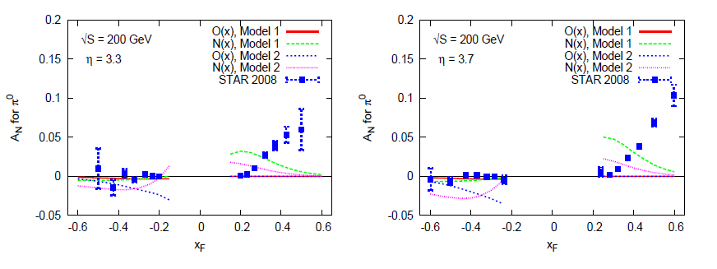
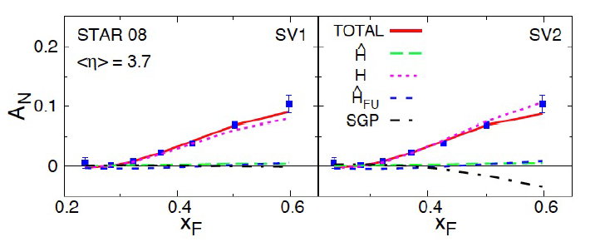
Twist-3 multiparton correlations to interpret inclusive A_{N} data from RHIC
Talks by Y. Koike, D. Pitonyak
Making progress!

Slide 40
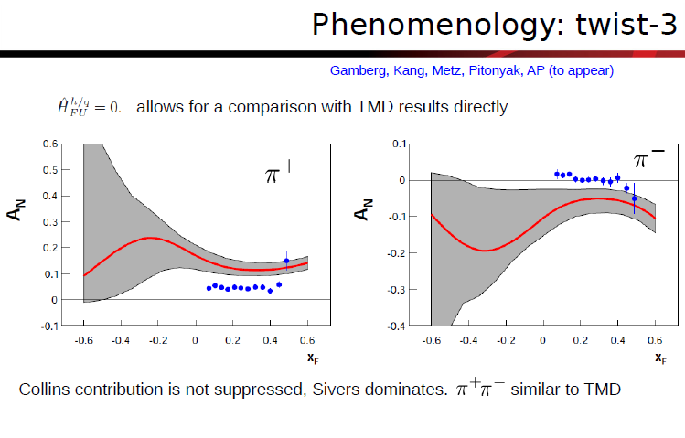
Inclusive hadron A_{N} in e+p
Talk by A. Prokudin

Slide 41
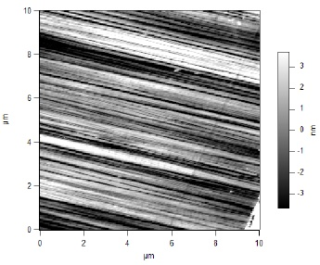
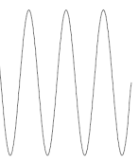
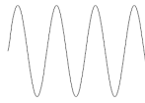
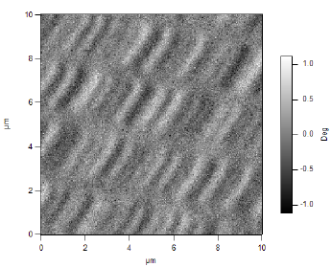
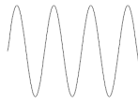
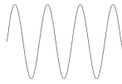
What things “look” like depends on how you “look”!
Slide courtesy of K. Aidala
Magnetic Force Microscopy
Computer Hard Drive
magnetic tip
Topography
Probe interacts with system being studied!
Lift height
Magnetism

