Slide 1
The Electron-Ion Collider:
Status and Prospects
EPJ A52, 268 (2016)
Christine A. Aidala
University of Michigan
EINN 2017
Paphos, Cyprus
November 4, 2017

Slide 2
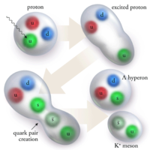
Theory of strong interactions:
Quantum Chromodynamics
  Fundamental field theory in hand since the early 1970s—BUT . . .
  Quark and gluon degrees of freedom in the theory cannot be observed or manipulated directly in experiment!
Color confinement—quarks and gluons are confined to color-neutral bound states
CLAS, PRL 113, 152004 (2014)
PRL Editor’s Choice Oct. 2014

Slide 3

QCD: How far have we come?
QCD is challenging!!
Three-decade period after initial birth of QCD dedicated to “discovery and development”
→ Symbolic closure: Nobel prize 2004 - Gross, Politzer, Wilczek for asymptotic freedom
Now early years of second phase:
quantitative QCD!

Slide 4
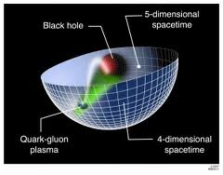
Advancing into the era of quantitative QCD: Theory has been forging ahead
In perturbative QCD, since 1990s starting to consider detailed internal dynamics that parts with traditional parton model ways of looking at hadrons—and perform phenomenological calculations using these new ideas/tools!
E.g.:
  Various resummation techniques
  Non-linear evolution at small momentum fractions
  Spin-spin and spin-momentum correlations in QCD bound states
  Techniques to handle target-mass and “higher-twist” corrections
  Spatial distributions of partons in QCD bound states
Nonperturbative methods:
  Lattice QCD less and less limited by computing resources—since 2010 starting to perform calculations at the physical pion mass (after 36 years!). Plus recent new ideas on how to calculate previously intractable quantities.
  AdS/CFT “gauge-string duality” an exciting recent development as first fundamentally new handle to try to tackle QCD in decades!

Slide 5
Effective field theories
QCD exhibits different behavior at different scales—effective field theories are useful approximations within these different regimes
  Color Glass Condensate – high energies, high densities
  Soft-Collinear Effective Theory – new insights into performing complicated perturbative calculations very quickly
  Heavy Quark Effective Theory, Non-Relativistic QCD, . . .
  Many effective theories for nonperturbative QCD – chiral symmetry breaking, . . .

Slide 6
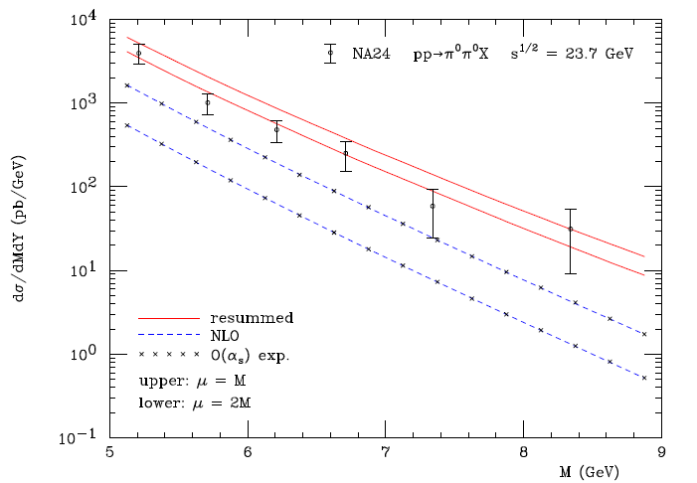
Example: “Threshold resummation” Extending perturbative calculations to lower energies
For observables with two different scales, sum logs of their ratio to all orders in the strong coupling constant
}
pp→π⁰π⁰X
}
Next-to-leading-order in α_{s} + resum.
Next-to-leading-order in α_{s}
M (GeV)
Almeida, Sterman, Vogelsang PRD80, 074016 (2009)

Slide 7
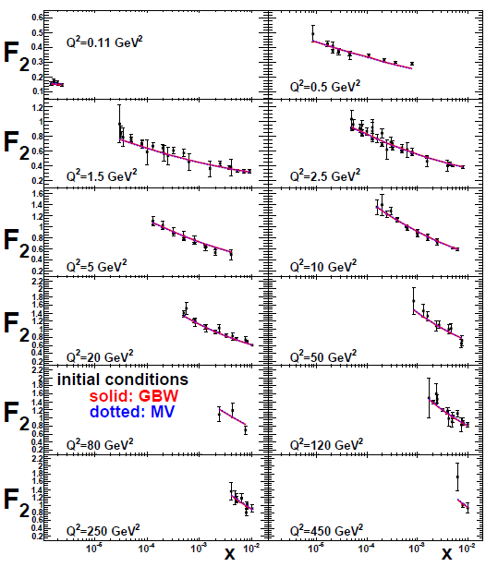
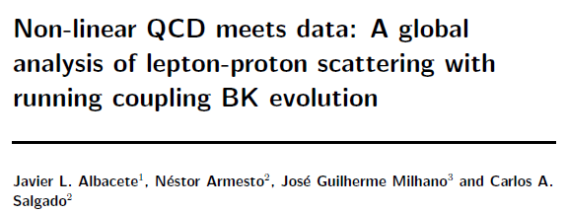
Example: Phenomenological applications of a non-linear gluon saturation regime
Phys. Rev. D80, 034031 (2009)
Basic framework for non-linear QCD, in which gluon densities are so high that there’s a non-negligible probability for two gluons to combine, developed ~1997-2001. But had to wait until “running coupling BK evolution” figured out in 2007 to compare directly to data!
Fits to proton structure function data at low parton momentum fraction x.

Slide 8
Example: Spin-spin and spin-momentum correlations in QCD bound states
Unpolarized
Spin-spin correlations
Spin-momentum correlations
S•(p₁×p₂)

Slide 9
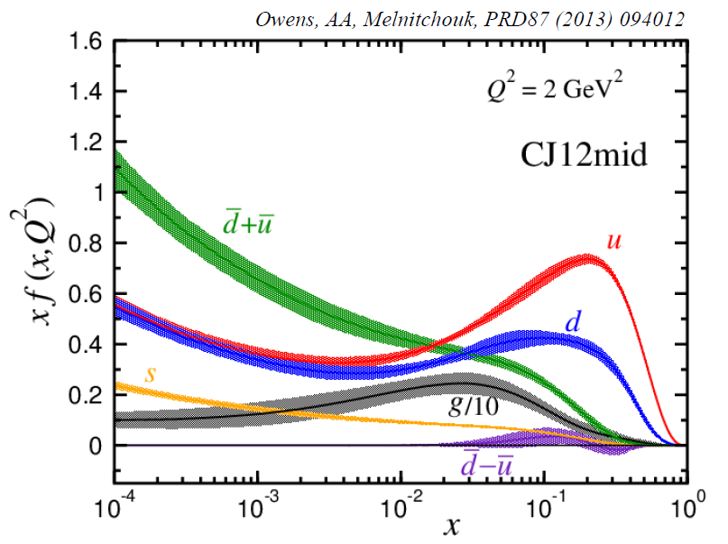
Example: Fits to quark and gluon distributions including much wider range of data
Incorporate corrections for target mass, “higher-twist,” and nuclear effects
Can in turn make predictions for future measurements in extended kinematic regions
Owens, Accardi, Melnitchouk, PRD87, 094012 (2013)
CTEQ-JLab collaboration
Collinear momentum fraction x

Slide 10
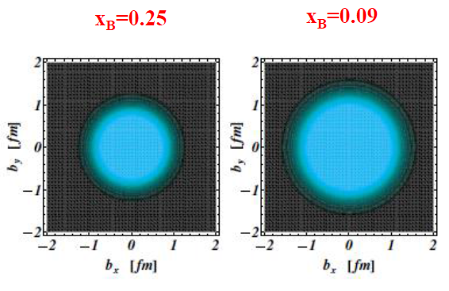
Example: Exploring spatial distributions
Guidal, Moutarde,
Vanderhaeghen,
Rept. Prog. Phys. 76 (2013) 066202
CLAS HERMES
Initial evidence that quarks carrying larger momentum fractions (25% vs. 9%) in the nucleon are distributed over a smaller volume in space
Spatial charge densities measured via deeply virtual Compton scattering

Slide 11
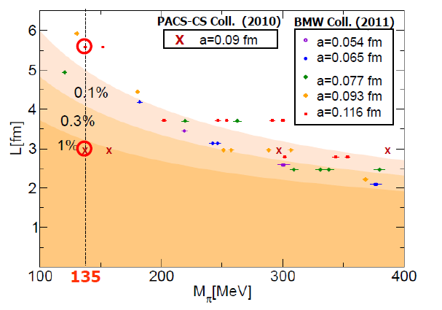
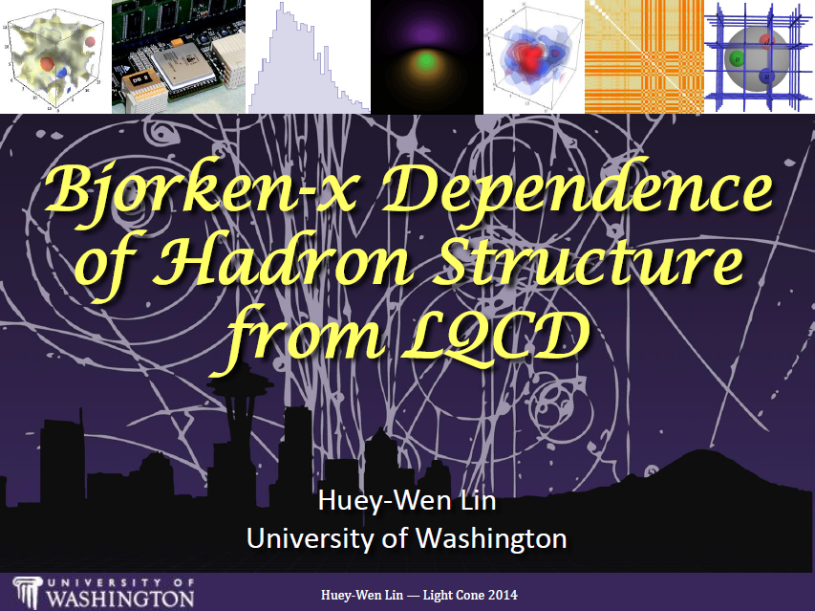
Example: Progress in lattice QCD
First calculations at physical pion mass 135 MeV
Figure from T. Hatsuda,
PANIC 2011
PACS-CS: PRD81, 074503 (2010)
BMW: PLB701, 265 (2011)
Since 2013, possibility to calculate x dependence of parton distribution functions
Slide from Huey-Wen Lin, Light Cone 2014

Slide 12
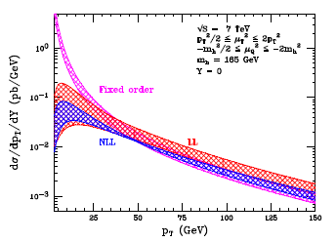
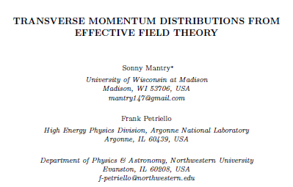
Example: Effective field theories
Higgs vs. p_{T}
arXiv:1108.3609
Soft Collinear Effective Theory
– Transverse momentum distribution for gluon+gluon→Higgs

Slide 13
Mapping out the partonic structure of the proton
What does the proton look like in terms of the quarks and gluons inside it?
Position
Momentum
Spin
Flavor
Color
Theoretical and experimental concepts to describe and access position only born in mid-1990s. Pioneering measurements over past decade.
Vast majority of past four decades focused on
1-dimensional momentum structure! Since 1990s starting to consider transverse components . . .
Polarized protons first studied in 1980s. How angular momentum of quarks and gluons add up still not well understood!
Measurements of flavor distributions in valence region. Flavor structure at lower momentum fractions still yielding surprises!
Accounted for theoretically from beginning of QCD, but more detailed, potentially observable effects of color have come to forefront in last few years . . .

Slide 14
A cyclical process
Proliferation of observations and ideas
Synthesis
The time is ripe for an Electron-Ion Collider!
Notes:
After lots of new observations and ideas over the course of the last 15-20 years, we’re now in a rewarding period of synthesis

Slide 15
Areas of study in QCD
Structure/properties of QCD matter
Formation of states of QCD matter
Interactions within QCD

Slide 16
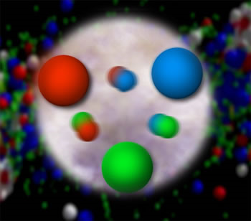
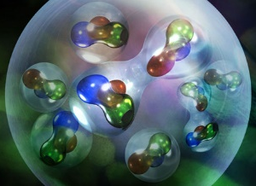

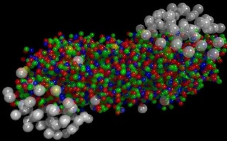
Structure/Properties of QCD matter
Bound states: Mesons and baryons
Bound states of bound states: Nuclei, neutron stars
Deconfined states: Quark-gluon plasma
EIC will address!
Nuclei aren’t just superpositions of free nucleons!

Slide 17
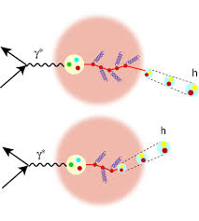
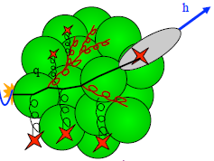
Formation of states of QCD matter
Hadronization mechanisms
Formation of bound states of bound states
Jet structure
Equilibration of QGP
Time scales of hadronization/equilibration
Modification of hadronization in different environments

Slide 18
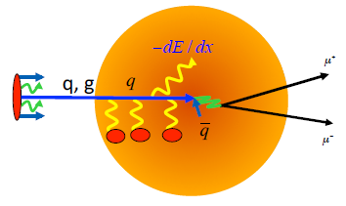
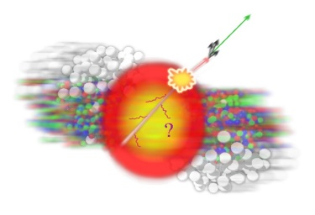
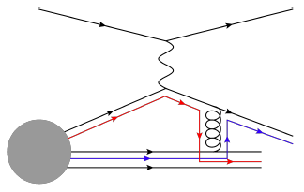
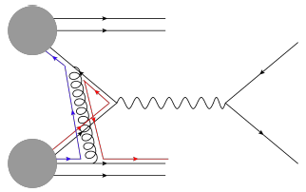
Interactions within QCD
Parton energy loss in cold and hot QCD matter
Flow of partons within quark-gluon plasma
Quantum interference and phase shifts
  E.g. quantum interference effects in hadronization
    One parton → multiple hadrons
    Multiple partons → one hadron
Color flow effects
  Process-dependent spin-momentum correlations in hadrons
  Quantum entanglement of partons across colliding hadrons
SIDIS
Drell-Yan

Slide 19
2015 U.S. Nuclear Physics
Long-Range Plan
EIC endorsed by U.S. nuclear community as highest priority facility for new construction after completion of Facility for Rare Isotope Beams (FRIB)
Lots going on since EINN 2015!

Slide 20
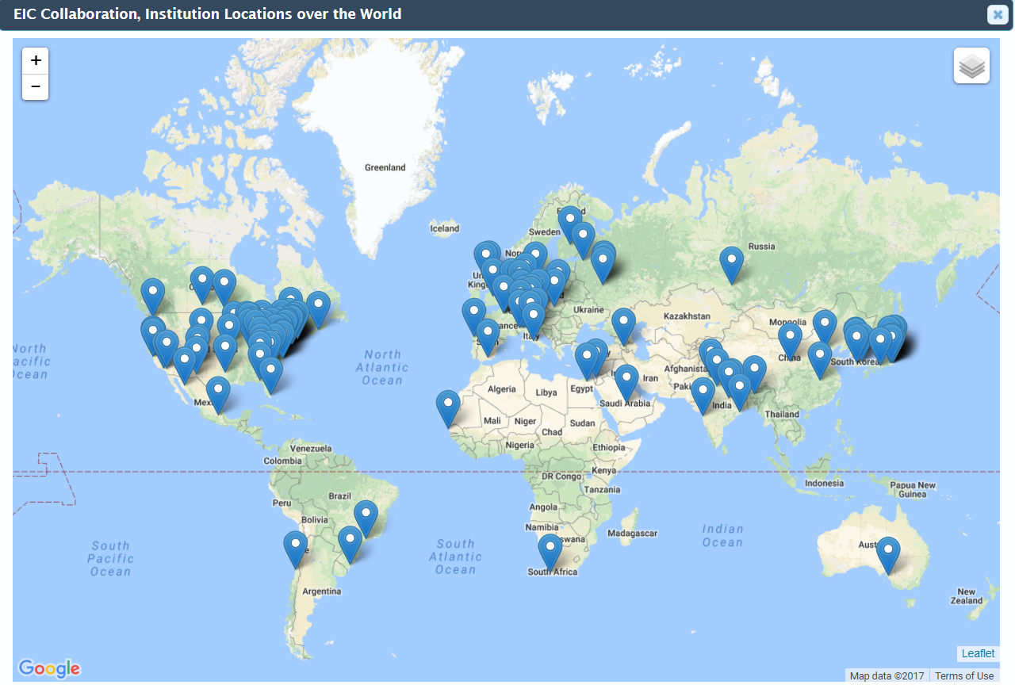
2016: Creation of EIC User Group
www.eicug.org
2015 Long-Range Plan prompted official formation of EIC User Group, consisting of interested members of the experimental, theoretical, and accelerator communities
Goal to give community a stronger and more visible role in the process leading to the realization of an EIC
Currently 719 members from 165 institutions in 29 countries
  Plan to add Ph.D. students in upcoming months
To join:
http://www.eicug.org/web/newmembers

Slide 21
EIC User Group
Organization laid out in EICUG Charter
Charter anticipates several phases of the EIC project (U.S. Dept. of Energy Critical Decision steps)
  Phase 1 (current) – The period until CD-0, formal recognition of scientific mission need
  Phase 2 – From CD-0 to CD-1
  Phase 3 – From CD-1 to CD-4, end of construction
  Phase 4 – EIC operation
Expect real experimental collaborations to form in phases 2-3

Slide 22
EICUG mission in Phase 1
Enhance and refine the science case beyond the White Paper written for the 2015 Long-Range Plan
Provide a forum for discussion and promote collaboration among the accelerator, experimental, and theoretical communities to enhance progress
Represent the interests of the EIC community in discussions with the laboratories and funding agencies

Slide 23
EIC User Group - Leadership
Steering Committee
  Bernd Surrow, Temple U. – Chair
  Charles Hyde, Old Dominion U. – Vice-Chair
  John Arrington, ANL
  Marco Radici, INFN Pavia/U. of Pavia
  Ernst Sichtermann, LBL
  Daniel Boer, Groningen – European representative
  Thomas Ullrich – BNL representative
  Rik Yoshida – JLab representative
Institutional Board
  Christine Aidala, U. of Michigan – Chair (and ex-officio member of Steering Committee)
Election & Nominating Committee
  Richard Milner, MIT - Chair
  Kawtar Hafidi, ANL
  Paul Newman, Birmingham
  Raju Venugopalan, BNL
  Christian Weiss, JLab

Slide 24
U.S. National Academy of Sciences review of EIC science
National Academy of Sciences: Established in 1863 by an Act of Congress, signed by President Lincoln, as a private, non-governmental institution to advise the nation on issues related to science and technology
In 2016, Dept. of Energy charged the National Academy of Sciences to assess the science case for a U.S.-based Electron-Ion Collider

Slide 25
U.S. National Academy of Sciences review of EIC science
Committee formed late 2016—mix of physicists from within and outside of the EIC community
Collected input from EICUG and various experts via solicited presentations at three in-person meetings
Will hold fourth and final in-person meeting end of November
Final report anticipated spring 2018
Charge: The committee will assess the scientific justification for a U.S. domestic electron ion collider facility, taking into account current international plans and existing domestic facility infrastructure. In preparing its report, the committee will address the role that such a facility could play in the future of nuclear physics, considering the field broadly, but placing emphasis on its potential scientific impact on quantum chromodynamics.

Slide 26
U.S. National Academy of Sciences review of EIC science: Charge questions
What is the merit and significance of the science that could be addressed by an electron ion collider facility and what is its importance in the overall context of research in nuclear physics and the physical sciences in general?
What are the capabilities of other facilities, existing and planned, domestic and abroad, to address the science opportunities afforded by an electron-ion collider? What unique scientific role could be played by a domestic electron ion collider facility that is complementary to existing and planned facilities at home and elsewhere?
What are the benefits to U.S. leadership in nuclear physics if a domestic electron ion collider were constructed?
What are the benefits to other fields of science and to society of establishing such a facility in the United States?

Slide 27
National Academy committee members
Ani Aprahamian, Notre Dame – Co-Chair
Gordon Baym, U. of Illinois Urbana-Champaign – Co-Chair
Christine Aidala, Michigan
Peter Braun-Munzinger, GSI
Haiyan Gao, Duke
Kawtar Hafidi, ANL
Wick Haxton, UC Berkeley
John Jowett, CERN
Larry McLerran, INT, U. of Washington
Lia Merminga, SLAC
Zein-Eddine Meziani, Temple
Richard Milner, MIT
Thomas Schaefer, North Carolina State U.
Ernst Sichtermann, LBL
Michael Turner, U. of Chicago
Assuming a positive outcome, final report in spring 2018 will set the stage to move to Dept. of Energy Critical Decision 0 . . .

Slide 28
In the meantime, plenty of other activities going on!
EIC User Group meetings
UC Berkeley, January 2016
Argonne National Lab, July 2016
Trieste, July 2017
Next: Catholic University of America in Washington, D.C., July 30 – August 3, 2018

Slide 29
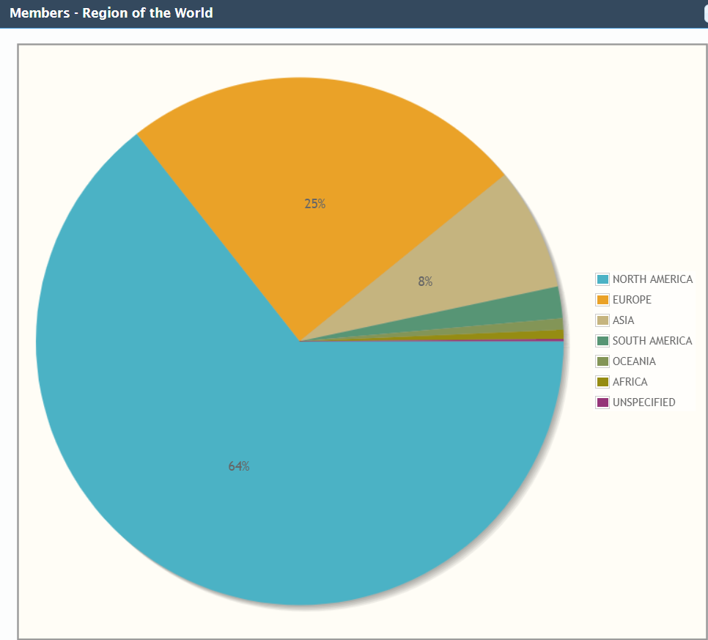
Strong EIC community within Europe
178 EICUG members from Europe, from 54 institutions
At Trieste EICUG meeting in July, talks by
Angela Bracco: The 2017 NuPECC Long-Range Plan
  “The science at EIC is highly recognized by NuPECC.”
Barbara Erazmus: EU Integrating Activity in Hadron Physics
  “EIC projects are welcome.”
Patrice Verdier: The IN2P3 visions and plans for nuclear and particle physics
  “We would be glad to help on EIC.”
Anne-Isabelle Etienvre: The CEA/IRFU visions and plans for nuclear and particle physics
  “Preparing the next generation with big expectations.”
Fernando Ferroni: The INFN vision and plans for nuclear and particle physics
  “A potential community of more than 110 experimental physicists. Some already contributing to the EIC physics case and to the Generic Detector R&D for an Electron Ion Collider.”
Europe:
25% of members

Slide 30
Generic Detector R&D program for an EIC ongoing since 2011
Goals:
  Enable successful design and timely implementation of an EIC experimental program
  Develop instrumentation solutions that meet realistic cost expectations
  Stimulate the formation of user collaborations to design and build experiments
Peer-reviewed program funded by Dept. of Energy and managed by BNL with $1.0-1.5M/year
  Coordinated by Thomas Ullrich, BNL
Support from standing EIC Detector Advisory Committee
  Marcel Demarteau (ANL), Carl Haber (LBL), Peter Krizan (Ljubljana), Ian Shipsey (Oxford), Rick van Berg (UPenn), Jerry Va’vra (SLAC), Glenn Young (JLab)
https://wiki.bnl.gov/conferences/index.php/EIC_R%25D

Slide 31
Latest facility concepts: JLEIC at JLab

Slide 32
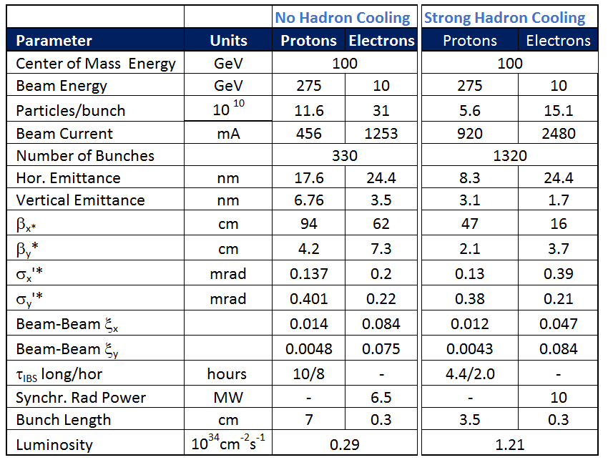
Latest facility concepts: eRHIC at BNL
Ring-ring design
Community Review of EIC Accelerator R&D recently performed for the Dept. of Energy
EIC Accelerator Collaboration meeting Oct 10-12, 2017

Slide 33
Many recent EIC-related meetings!

Slide 34
Upcoming EIC-related meetings
EICUG Detector Discussion meeting – Nov 30 – Dec 1, 2017, Temple U.
POETIC 8, March 19-22, 2018, Regensburg U.
  Physics Opportunities at an ElecTron Ion Collider
DIS 2018, April 16-20, 2018 in Kobe, Japan
EICUG meeting, July 30 – Aug 3, 2018, CUA, Washington, D.C.
INT workshop INT-18-3: Probing Nucleons and Nuclei in High-Energy Collisions – Oct 1 – Nov 18, 2018, U. of Washington
https://indico.bnl.gov/conferenceDisplay.py?confId=3737

Slide 35
Summary
Early years of rewarding new era of quantitative basic research in QCD!
An Electron-Ion Collider with
  polarized electrons
  a range of unpolarized nuclear species
  polarized protons and polarized light nuclei
  center-of-mass energies from ~30 to ~100 GeV
  luminosities >10³³ cm⁻² s⁻¹
will be the facility to bring this new era to maturity!
The EIC recently entered a new phase with a lot going on since the 2015 Long-Range Plan—all are welcome to join!
http://www.eicug.org/web/newmembers

Slide 36
Extra

Slide 37
Hadronization
Not as far along as nucleon structure—less of a focus in earlier years
Recent advances via
  TMD FFs
  Collinear twist-3 functions to describe hadronization
  Dihadron (interference) FF
  Hadronization from nuclei

Slide 38
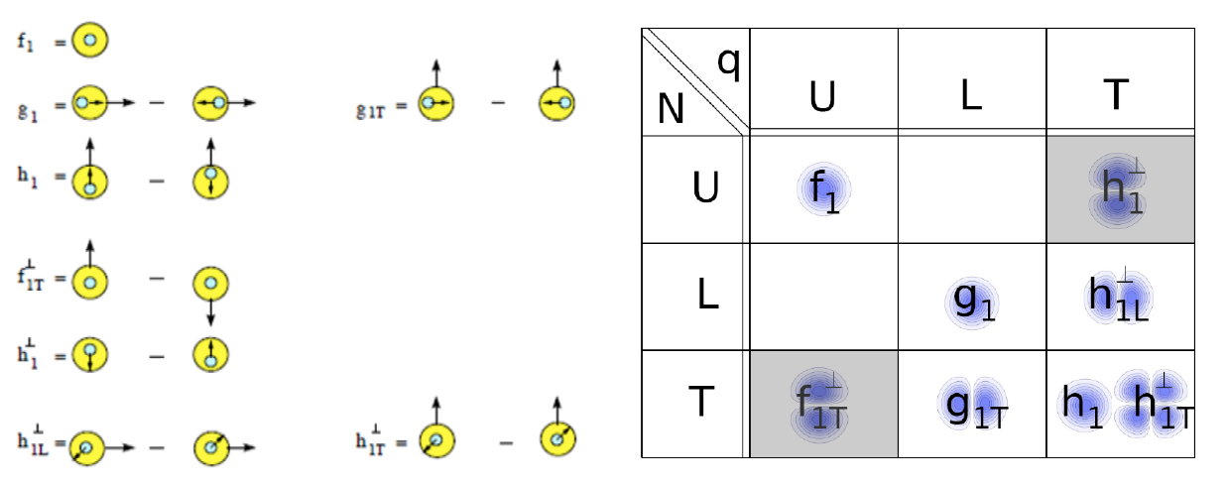
Spin-spin and spin-momentum correlations in QCD bound states
U = unpolarized L = longitudinally polarized T = transversely polarized
N = nucleon q = quark

Slide 39
High-energy QCD: Thinking in terms of individual partons
Pdfs are single-parton functions in single nucleons
  Or in nuclei, but typically still think of partons in individual nucleons within nucleus
Can we go beyond this single-parton picture while staying in the hard (short-distance) limit of perturbative QCD?

Slide 40
An alternative approach to describing the large single-spin asymmetries:
Higher-twist multiparton correlations
Extend our ideas about (single-parton) pdfs to correlation functions that can’t be associated with a single parton
Non-perturbative structure → matrix elements involving the quantum mechanical interference between scattering off of a (quark+gluon) and scattering off of a single quark (of the same flavor and at the same x)
  Can also have interference between (gluon+gluon) and single gluon
  No explicit dependence on partonic transverse momentum
  Efremov+Teryaev 1981, 84; Qiu+Sterman 1991, 98

Slide 41
Beware: Two common usages of the term “twist”
Formal definition of twist: “mass dimension minus spin” of the operator in a matrix element within the Operator Product Expansion
  “Leading twist” is twist-2
  Twist-n matrix element carries a factor of 1/Q^{(n-2)}
But – observables with measurable contributions from terms suppressed by a factor of 1/Q^{(n-2)} often referred to as sensitive to “twist-n” contributions
  Never measure a matrix element, only matrix elements squared!
  To get 1/Q term describing an observable, need interference term in the square modulus:
    A = order 1 + order 1/Q + order 1/Q² + …
    |A|² = |order 1|² + |order 1/Q|² + (order 1)(order 1/Q)* + (order 1)*(order 1/Q) + …
  So twist-3 term in matrix element times twist-2 term gives 1/Q
  Square modulus of twist-3 term gives 1/Q², sometimes referred to as “twist-4”

Slide 42
Transverse single-spin asymmetries provide new information on hadron structure
Leading contribution to transverse single-spin asymmetries comes from either:
  Convolution of two twist-2 transverse-momentum-dependent parton distribution functions and/or fragmentation functions, or . . .
  Convolution of one twist-2 collinear pdf or fragmentation function and one twist-3 (collinear) multiparton correlation matrix element

Slide 43
Multiparton correlations in hadronization
Traditional fragmentation functions describe probability of single parton to hadronize into particular hadron, as function of momentum fraction (z) of parton carried by the final hadron
Can have matrix elements describing multiparton correlations in hadronization
  Interference between a (quark+gluon) hadronizing and only a quark
  Similarly, interference between (gluon+gluon) and only a single gluon
  Kanazawa+Koike, 2000

