Slide 1
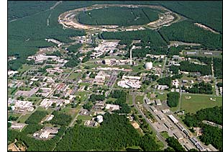
Probing QCD in Hadrons Through TMDs at RHIC
Or
Why Use Messy p+p Collisions
to Study What’s Happening
Inside the Nucleon??
Christine Aidala
Los Alamos National Lab
INT
November 4, 2010
Notes:
I feel that the overarching question that those of us working on the proton structure program at RHIC would like to contribute to answering is . . .

Slide 2
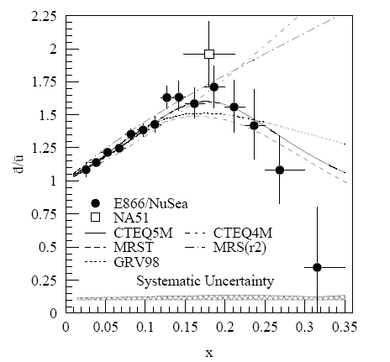
Can We Learn Anything New About Nucleon Structure from Hadronic Collisions When We’ve Got DIS?
Fermilab Experiment 866 used proton-hydrogen and proton-deuterium collisions to probe nucleon structure via the Drell-Yan process
Anti-up/anti-down asymmetry in the quark sea, with an unexpected x behavior!
E906 will follow up with more precise measurement at high x—data starting next year!
Hadronic collisions play a complementary role to DIS and have let us continue to find surprises in the rich linear momentum structure of the proton, even after 40 years of DIS!
Hadronic collisions offer unique handles on
antiquarks – Drell-Yan, W physics
gluons
. . .
PRD64, 052002 (2001)

Slide 3
Reliance on Input from Simpler Systems
Disadvantage of hadronic collisions: generally much “messier” than DIS! → Rely on input from simpler systems
The more we know from simpler systems such as DIS and e+e- annihilation, the more we can in turn learn from hadronic collisions!
Relevant quantities for TMDs only started to be measured in simpler systems over the last ~5-8 years

Slide 4
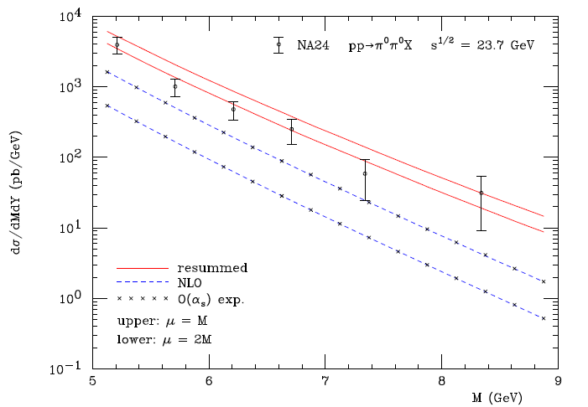
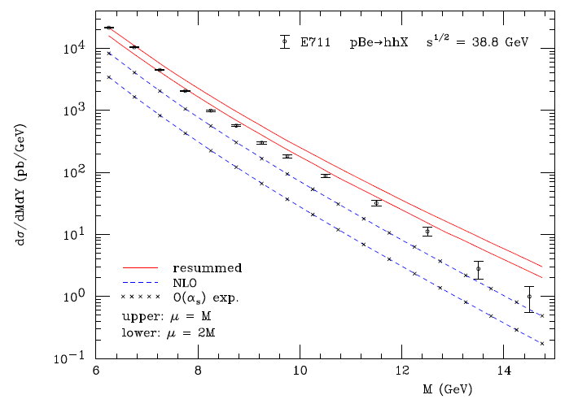
Progress in pQCD calculational techniques
23.7 GeV!
38.8 GeV!
pQCD an ever-more-powerful tool.
Interpretation of p+p results—over a wider range of energies—getting easier!
“Modern-day ‘testing’ of (perturbative) QCD is as much about pushing the boundaries of its applicability as about the verification that QCD is the correct theory of hadronic physics.”
– G. Salam, hep-ph/0207147 (DIS2002 proceedings)
One recent example:
Almeida, Sterman, Vogelsang, PRD80, 074016 (2009)
Cross section for di-hadron production vs. invariant mass using threshold resummation (rigorous method for implementing p_{T} and rapidity cuts on hadrons to match experiment)
4
Notes:
4

Slide 5


Transverse Single-Spin Asymmetries:
From Low to High Energies!
ANL
√s=4.9 GeV
BNL
√s=6.6 GeV
FNAL
√s=19.4 GeV
RHIC
√s=62.4 GeV
RHIC
√s=200 GeV
Effects persist to RHIC energies
→ Can probe this non-perturbative structure of nucleon in a calculable regime!
π⁰
left
STAR
right

Slide 6
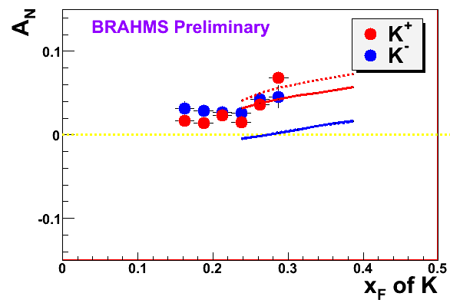
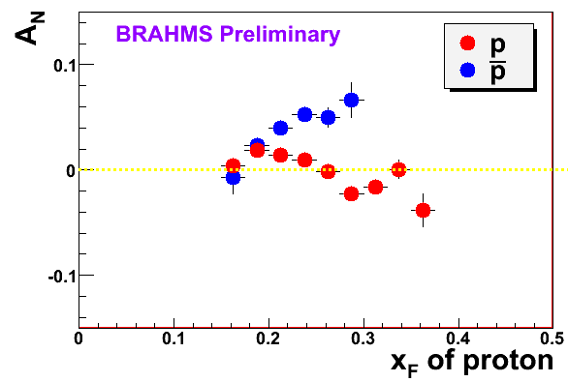
High-x_{F} Asymmetries,
But Not Valence Quarks??
Pattern of pion species asymmetries in the forward direction
→ valence quark effect.
But this conclusion confounded by kaon and antiproton asymmetries!
Note different scales
K
K
K- asymmetries
underpredicted
200 GeV
62.4 GeV
p
p
Large antiproton asymmetry?!
(No one has attempted predictions . . .)
200 GeV
62.4 GeV

Slide 7
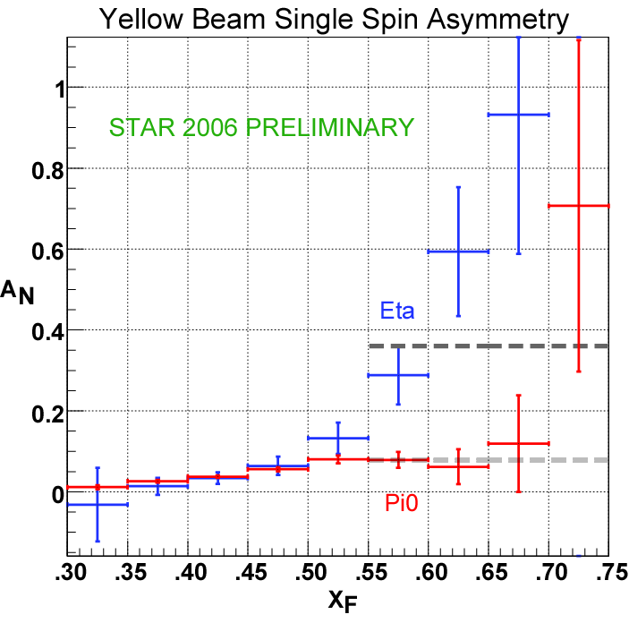
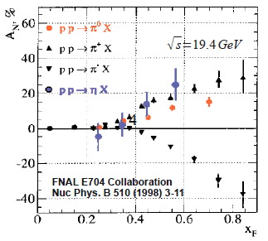
Another Surprise: Transverse Single-Spin Asymmetry in Eta Meson Production
Further evidence against a valence quark effect!
Note earlier E704 data consistent . . .
Larger than the neutral pion!
STAR

Slide 8
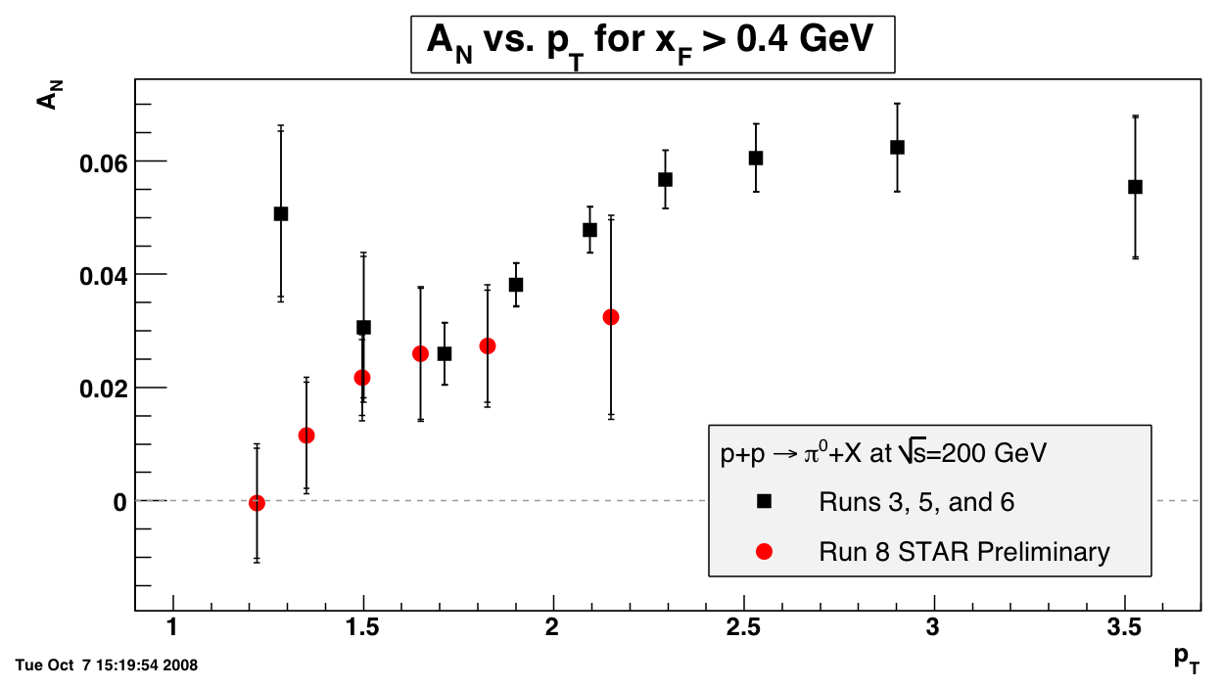
What About p_{T} Dependence?
Decrease at low p_{T} now observed, but evidence for turn-over at “high” p_{T} unclear . . .
Black points: Phys. Rev. Lett. 101, 222001 (2008)

Slide 9
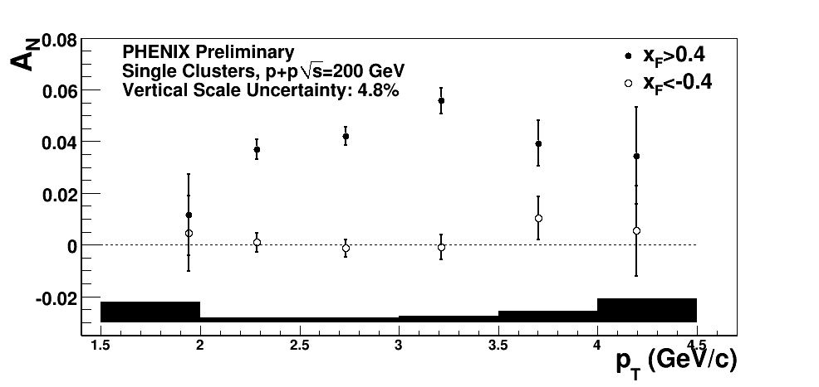
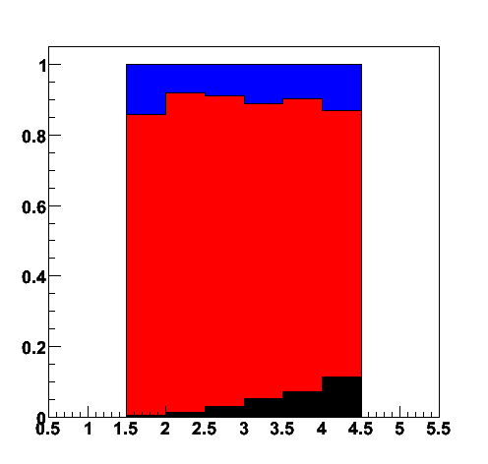
p_{T} Dependence of PHENIX Data Similar
Starts to drop after p_{T} ~ 3 GeV/c??
Decay photon
π⁰
Direct photon
Fraction of clusters
p_{T}

Slide 10
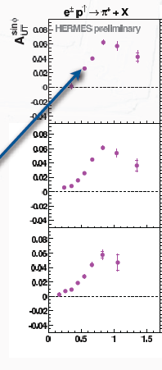
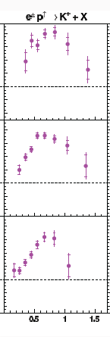

p_{T} Dependence of HERMES Inclusive(!) Hadron Data
Clear rise from low p_{T} and turn-over at ~0.8 GeV/c, for both pions and kaons
π⁺
Κ⁺
0.2 < x_{F} < 1
0.2 < x_{F} < 1
0.08 < x_{F} < 0.2
0.08 < x_{F} < 0.2
Non-zero asymmetries
at x_{F} ~ 0 . . .
-0.1 < x_{F} < 0.08
-0.1 < x_{F} < 0.08
p_{T} (GeV/c)

Slide 11
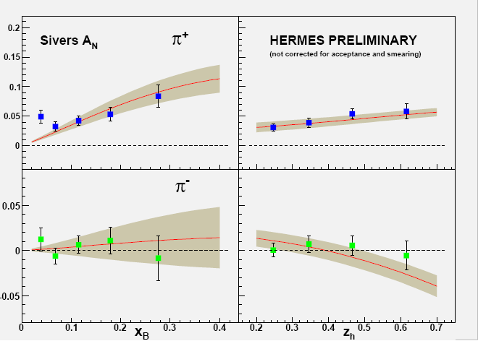

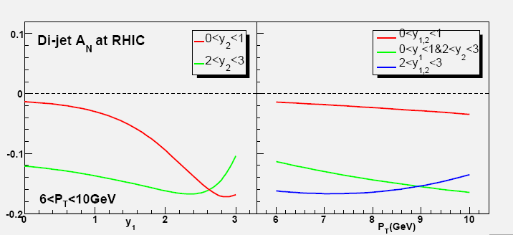
Probing the Sivers Function via Dijets:
An Illustrative History
Sivers effect in p+p ⇒ spin-dependent sideways boost to dijets, suggested by Boer & Vogelsang (PRD 69, 094025 (2004))
2005: Prediction by Vogelsang and Yuan for p+p, based on preliminary Sivers moments from HERMES
proton spin
y
parton k_{T}^{x}
x
z
Colliding beams
W. Vogelsang and F. Yuan, PRD 72, 054028 (2005).
Notes:
I’d like to close this section of my talk with what I feel is a nice story of the stimulating interplay these years between theory and experiment in transverse spin physics.

Slide 12
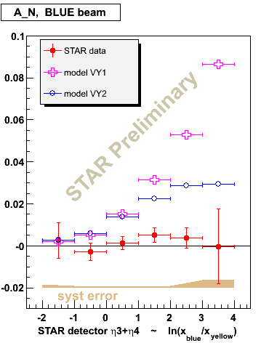
Measured Sivers A_{N} for Dijets
STAR
Measured A_{N} consistent with zero ⇒ both quark and gluon Sivers effects much smaller in p+p → dijets than in HERMES SIDIS??

Slide 13
Calculations for p+p revisited!
Bomhof, Mulders, Vogelsang, Yuan: PRD75, 074019 (2007)
Prediction for dijet SSA if Sivers contributions were same as for SIDIS (FSI)
Conclusion: Asymmetries observed at STAR not inconsistent with SIDIS results
Initial- and final-state cancellations in p+p → jet+jet found to reduce expected dijet asymmetry at RHIC.
Complex p+p data pushes theorists to think harder (and think again)!
Interplay between theory and experiment, between DIS and p+p.
STAR
Prediction for dijet SSA if Sivers contributions were same as for Drell-Yan (ISI)
PRL99, 14003 (2007)

Slide 14
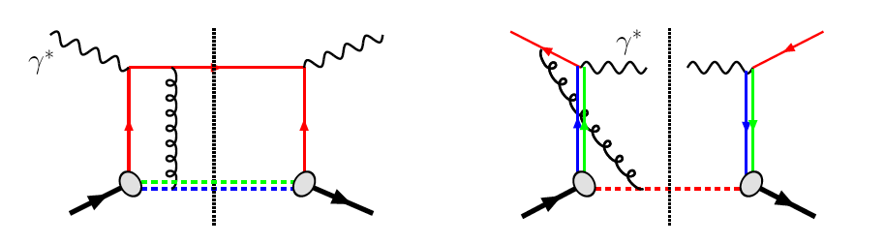
TMDs and Universality:
Modified Universality of T-Odd TMDs
DIS: attractive FSI
Drell-Yan: repulsive ISI
Measurements in semi-inclusive DIS already exist. A p+p measurement will be a crucial test of our understanding of QCD!
But Drell-Yan in p+p requires large integrated luminosity—small, dedicated experiment currently being set up at RHIC to take transversely polarized data during 500 GeV running (longitudinal polarization at PHENIX and STAR for W sea helicity program).
As a result:

Slide 15
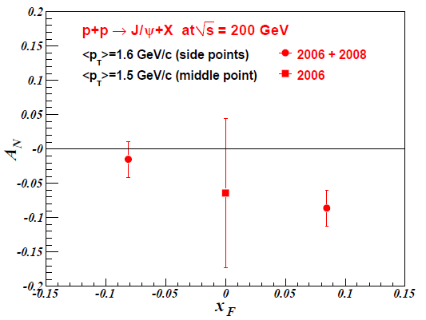
J/Psi A_{N} and Gluon Correlations with the (Transverse) Spin of the Proton
Other consequences of non-universality of Sivers TMD (and other T-odd TMDs and their collinear, twist-3 cousins) starting to be realized!
  PRD 78, 014024 (2008)—F. Yuan predicts that J/Psi transverse single-spin asymmetry sensitive to J/Psi production mechanism, with different expectations for p+p vs. SIDIS
No SIDIS measurement yet, but PHENIX recently submitted results for publication
3.3σ negative asymmetry at (slightly) forward rapidity observed.
J/Psi at RHIC produced via
gg interactions.
Suggests possible non-zero (collinear, twist-3) trigluon correlation functions in transversely polarized proton.
Will need more data to confirm!
arXiv:1009.4864 [hep-ex]

Slide 16
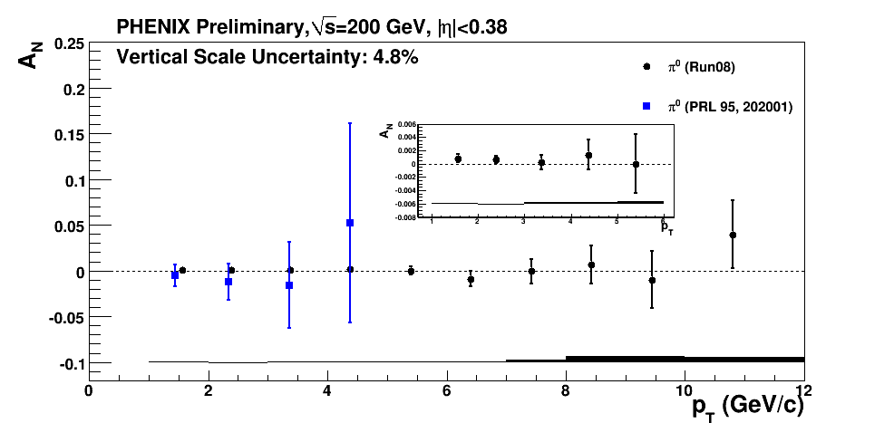
Gluons Look Different for Pions at Midrapidity??
Not necessarily a contradiction! Importance of color interactions starting to be realized in these processes sensitive to parton dynamics within hadrons . . .
Midrapidity pion production at 200 GeV dominated by gg scattering up to p_{T}~5 GeV/c, with similar x_{gluon} to forward J/Psi, but transverse single-spin asymmetry measured to be 10⁻³ or less . . . Contradicts J/Psi result??
Notes:
Color code

Slide 17
Factorization, Color, and Hadronic Collisions
  Earlier this year—work by T. Rogers, P. Mulders (PRD 81:094006, 2010) claiming pQCD factorization broken in processes involving more than two hadrons total if parton k_{T} taken into account (TMD pdfs and/or FFs)
  “Color entanglement”
  To understand further, useful to be able to compare measurements with 2, 3, and 4 hadrons in different combinations of initial and final state
    SIDIS, Drell-Yan, p+p → single inclusive hadrons, direct photons, photon-hadron and hadron-hadron correlations, . . .
TMDs an exciting sub-field—lots of recent experimental activity, and theoretical questions probing deep issues of both universality and factorization in (perturbative) QCD!

Slide 18
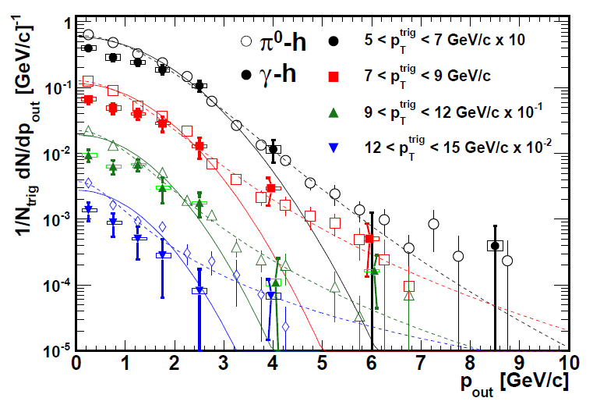
Testing TMD Factorization Breaking with Unpolarized p+p Collisions?
PHENIX, PRD82, 072001 (2010)
Discussion after Ted Rogers’ talk at Trento—implications for observables describable using Collins-Soper-Sterman (“Q_{T}”) resummation formalism
Would like to test using photon-hadron and dihadron correlation measurements in unpolarized p+p collisions at RHIC
Lots of expertise on such measurements within PHENIX, driven by heavy ion program!

Slide 19
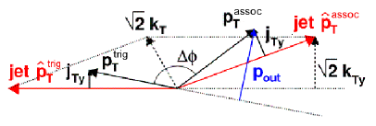
Testing TMD Factorization Breaking with Unpolarized p+p Collisions?
Rogers working with Mert Aybat to produce calculations of p_{out} distributions assuming factorization works
Take CSS soft factor from parameterizations of Drell-Yan and Z boson measurements
Take (preliminary) TMD FFs from Anselmino et al. for π⁰ – charged hadron case
Will show different shape than data??
Difference between factorized calculation and data will vary for 3-hadron vs. 4-hadron processes??
PHENIX, PRD82, 072001 (2010)
(Curves shown here just empirical parameterizations from PHENIX paper)

Slide 20
Looking toward the future . . .

Slide 21
Near-Term Future at RHIC Relevant to TMDs
(next 5 years)
Improved heavy flavor measurements
  See also Ming Liu’s talk this Friday
  PHENIX silicon vertex detectors
    VTX— |η|<1.0, take data starting 2011
    FVTX—1.2<|η|<2.2 (same as muon arms), data starting 2012
  STAR Heavy Flavor Tracker (HFT)
    Midrapidity, data starting 2014
Lower-energy data, motivated by heavy ion comparison running: 62.4 GeV, possibly 39 and/or 18 GeV (note 18 GeV ~ 19.4 GeV at FNAL E704)
  Easier to reach higher x_{F}

Slide 22
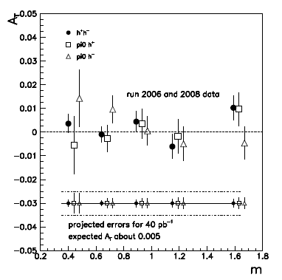
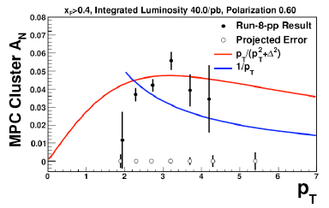
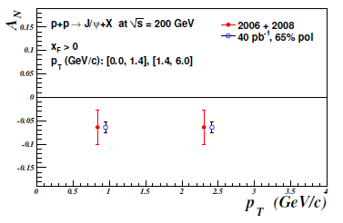
A Few Projections
p_{T} dependence of EM cluster (π⁰) A_{N}
A_{T} for IFF vs. m
p_{T} dependence of J/Psi A_{N}

Slide 23
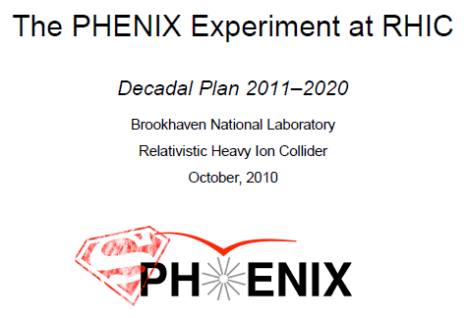
Planning for the Longer-Term Future
This fall PHENIX and STAR handing in (independent) “Decadal Plans” to BNL management
  Talks by Barbara Jacak and Ernst Sichtermann in September
Expect joint discussions among BNL management and the two collaborations to begin in the upcoming months
Long-term future at RHIC (past ~2018) clearly affected by what happens with EIC!
(STAR Decadal Plan still to be handed in)

Slide 24
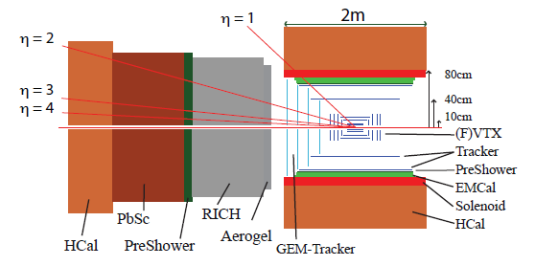
Improved Forward Detection Capabilities
PHENIX discussing major overhaul of detector beyond ~2016
STAR discussing much more modest upgrades
But details aside, can generally assume good full jet reconstruction would be possible at RHIC in the future, at both mid- and forward rapidities, and strong forward Drell-Yan capabilities as well
sPHENIX (SPHINX?) detector in PHENIX Decadal Plan

Slide 25
Long-Term Accelerator Prospects
Could go up to energies as high as sqrt(s)=650 GeV with new DX magnets
  Should know much more about prospects for polarization with higher beam energies after upcoming long 500 GeV run in 2011
Polarized He³ beams foreseen for EIC—could run He³ in hadron-hadron mode at RHIC as well
  R&D for polarized He³ source starting now

Slide 26
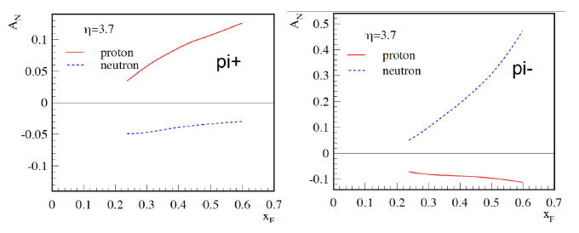
One Example: Flavor Separation of Transverse Spin Observables
Zhongbo
Kang
With polarized He³ as well as proton beams at RHIC, new handles on flavor separation of various transverse spin observables possible
  What will the status of the (non-)valence quark puzzle be by then??

Slide 27
So . . .Why Use Hadronic Collisions to Study QCD in Hadrons?
Complementary information can be learned from hadronic collisions vs. DIS, and there’s an interplay between the two—would be good to have continued ability to study (polarized) p+p collisions for at least part of EIC era!
Unique handles on antiquarks – Drell-Yan, W production
Unique handles on gluons
Different color interactions compared to DIS!!
  Going beyond collinear, leading-twist pdfs has been probing deep issues of universality , factorization, and color interactions in (perturbative) QCD
And hadronic collisions will be increasingly tractable through upcoming years
  As more is learned from the simpler systems of DIS and e+e-
  As the limits of applicability of pQCD are pushed ever further
If you can’t understand p+p collisions, your work isn’t done yet in understanding QCD in hadrons!

Slide 28
Additional Material

Slide 29

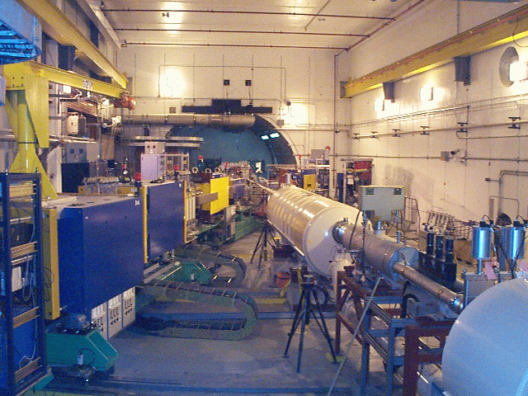
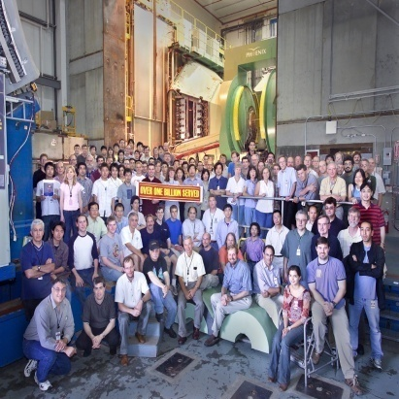
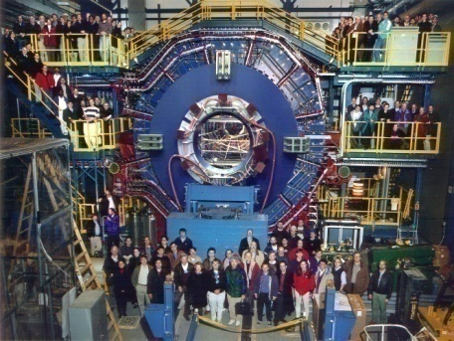


RHIC Spin Physics Experiments
Three experiments: STAR, PHENIX, BRAHMS
Future running only with STAR and PHENIX
Transverse spin only
(No rotators)
Longitudinal or transverse spin
Longitudinal or transverse spin
Accelerator performance:
Avg. pol ~57% at 200 GeV (design 70%).
Achieved 5.0x10³¹ cm⁻² s⁻¹ lumi (design ~4x this).

Slide 30
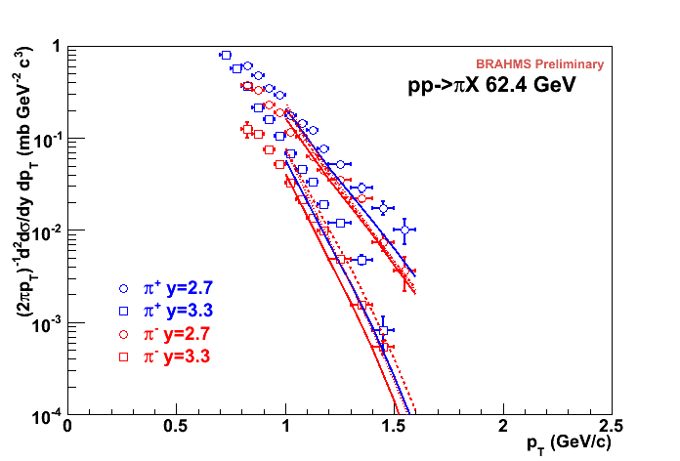
√s=62.4 GeV
Forward pions
Comparison of NLO pQCD calculations with BRAHMS π data at high rapidity. The calculations are for a scale factor of μ=p_{T}, KKP (solid) and DSS (dashed) with CTEQ5 and CTEQ6.5.
Surprisingly good description of data, in apparent disagreement with earlier analysis of ISR π⁰ data at 53 GeV.
Still not so bad!

Slide 31
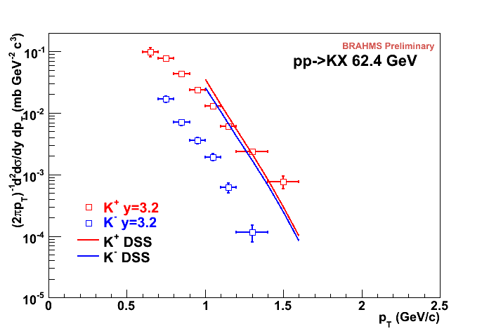
√s=62.4 GeV
Forward kaons
K⁻ data suppressed ~order of magnitude (valence quark effect).
NLO pQCD using recent DSS FF’s gives ~same yield for both charges(??).
Related to FF’s? PDF’s??
K⁺: Not bad!
K⁻: Hmm…
Notes:
Authero of DSS knows about this.

Slide 32
Prokudin et al. at Ferrara

Slide 33
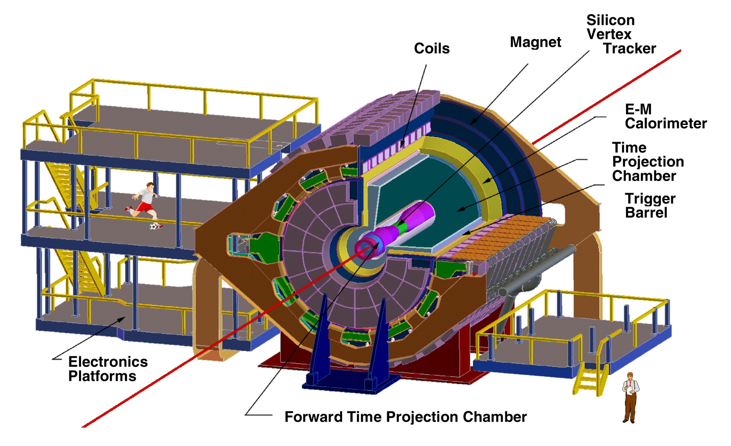
The STAR Detector at RHIC
STAR

Slide 34
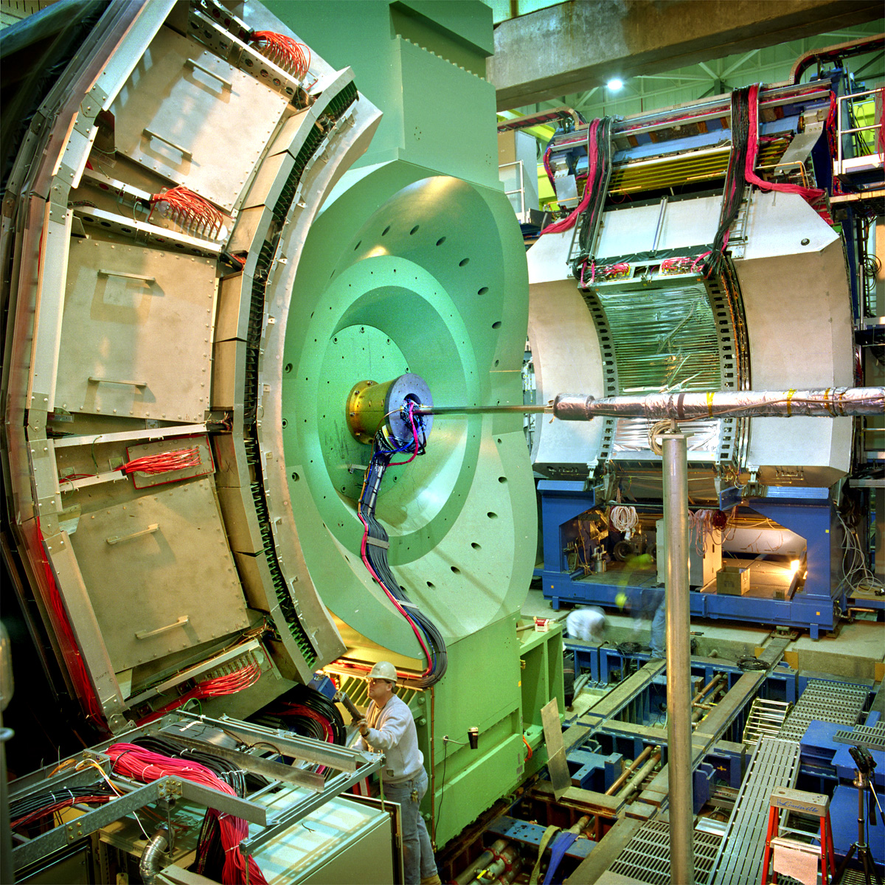

PHENIX Detector
Philosophy:
  High rate capability to measure rare probes,
  but limited acceptance.
2 central
spectrometers
Track charged particles and detect electromagnetic processes
azimuth
2 forward
spectrometers
- Identify and track muons

Slide 35
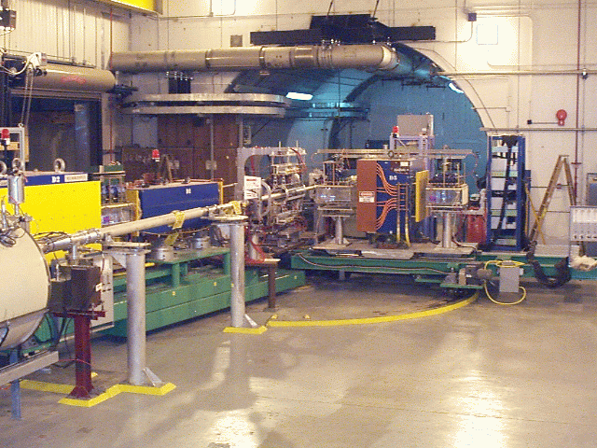
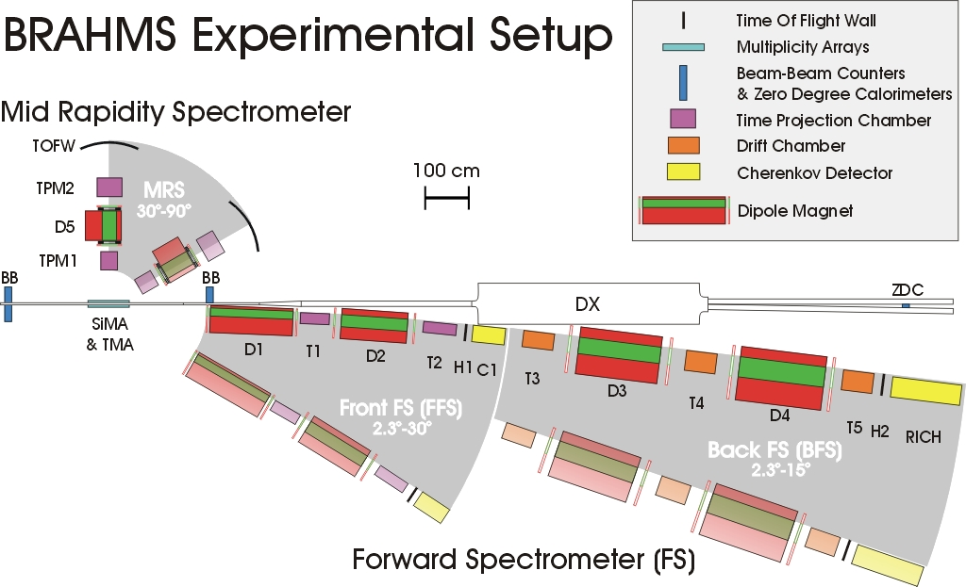
BRAHMS detector
Philosophy:
  Small acceptance spectrometer arms
  designed with good charged particle ID.

Slide 36
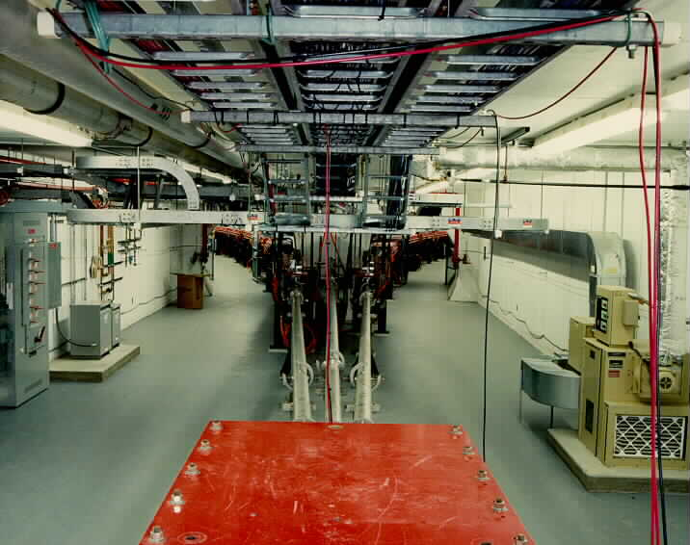
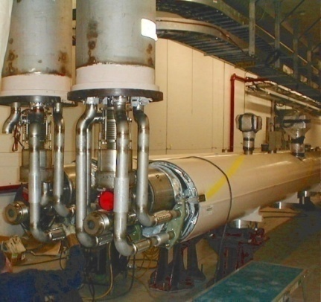
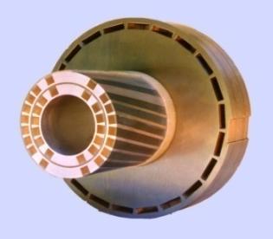
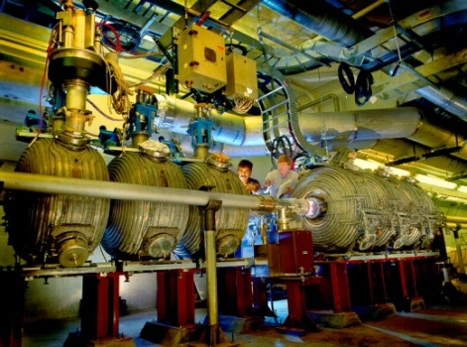
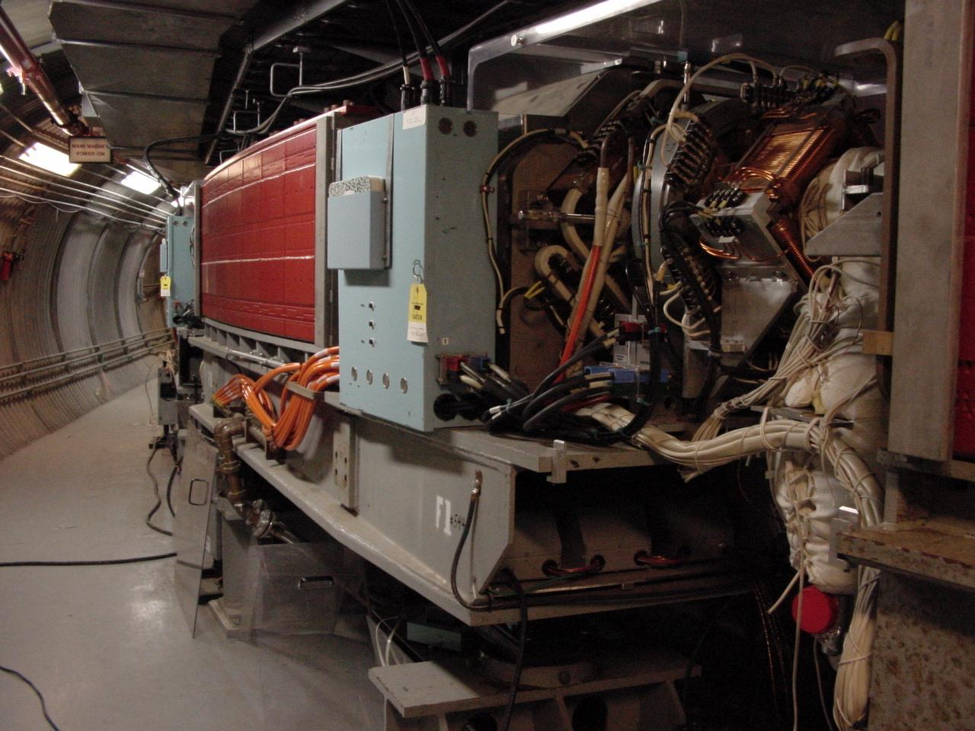
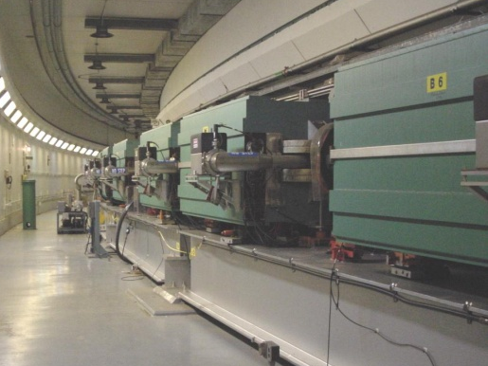
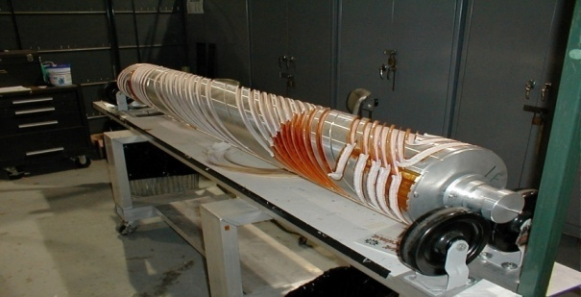
RHIC as a Polarized p+p Collider
Absolute Polarimeter (H jet)
RHIC pC Polarimeters
Siberian Snakes
PHOBOS
BRAHMS & PP2PP
Siberian Snakes
PHENIX
Spin Flipper
STAR
Spin Rotators
Various equipment to maintain and measure beam polarization through acceleration and storage
Partial Snake
Helical Partial
Snake
Polarized Source
Strong Snake
LINAC
AGS
200 MeV Polarimeter
BOOSTER
Rf Dipole
AGS Internal Polarimeter
AGS pC Polarimeter
Notes:
RHIC, as a high-energy polarized proton collider, really represents an outstanding achievement in accelerator physics. . . . [equipment].

Slide 37
Proton Spin Structure at RHIC
Transversity
Transverse-momentum-
dependent distributions
, Jets
Prompt Photons
Single-Spin Asymmetries
Back-to-Back Correlations
Advantages of a polarized proton-proton collider:
Hadronic collisions → Leading-order access to gluons
High energies → Applicability of perturbative QCD
High energies → Production of new probes: W bosons

Slide 38
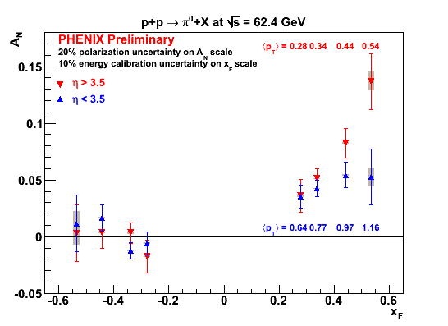
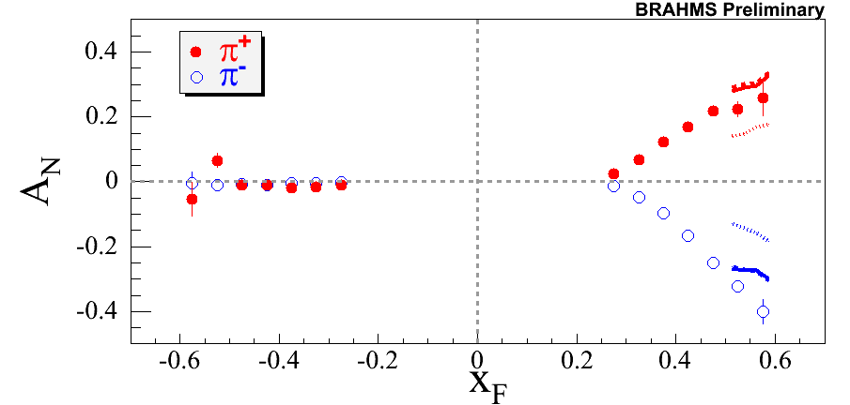

Transverse SSA’s Persist up to RHIC Energies!
√s = 62.4 GeV
PRL101, 042001 (2008)
π⁰

Slide 39
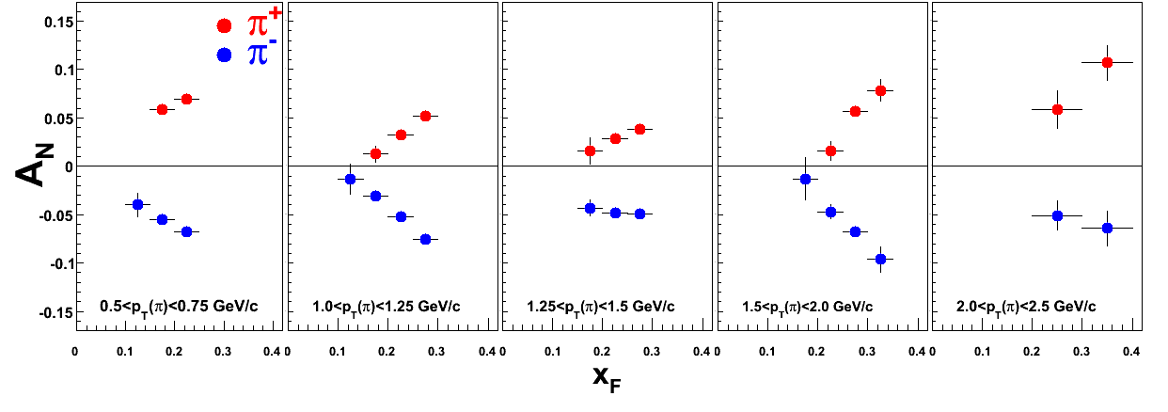
Transverse SSA’s at √s = 200 GeV at RHIC
π⁰
BRAHMS Preliminary
PRL101, 222001 (2008)
STAR

Slide 40
Forward π⁰ A_{N} at 200 GeV: p_{T} dependence
arXiv:0801.2990
Accepted by PRL
STAR

Slide 41
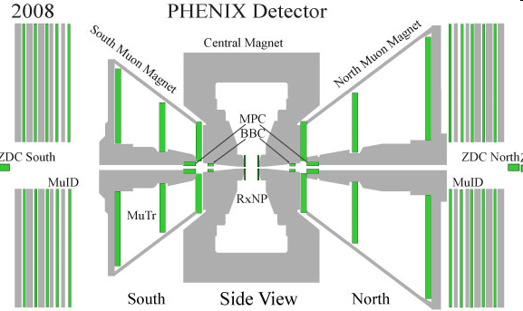
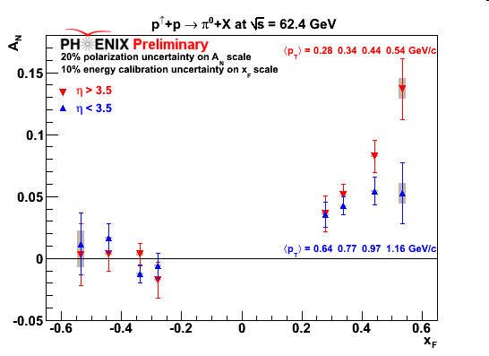
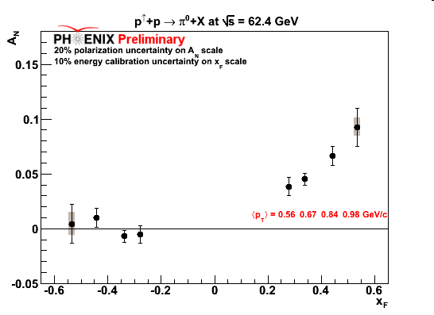
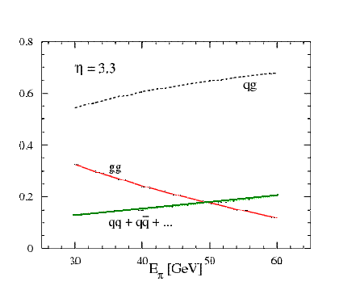
Forward A_{N} pi0 in MPC 62.4 GeV
η > 3.5
η < 3.5
3.1 < η < 3.7
PHENIX π⁰ results available for √s=62 GeV
Production dominated by quark-gluon
Similar x_{F} scaling to higher and lower center of masses
Asymmetries could enter a global analysis on transverse spin asymmetries
Process contribution to π⁰, η=3.3, √s=200 GeV
PLB 603,173 (2004)

Slide 42


Forward A_{N} Cluster in MPC at 200 GeV
Decay photon
π⁰
Direct photon
Fraction of clusters
p_{T} (GeV/c)

Slide 43


Forward SSA A_{N} Cluster in MPC at 200 GeV
GeV/c
GeV/c
η<3.3 η<3.3
Fraction of clusters
Eta>3.3
Decay photon
π⁰
Direct photon
x_{F}
x_{F}

Slide 44

Interference Fragmentation Function to Probe Transversity
Added statistics from 2008 running. No significant asymmetries seen at mid-rapidity.

Slide 45

Forward neutrons at √s=200 GeV at PHENIX
Large negative SSA observed for x_{F}>0, enhanced by requiring concidence with forward charged particles (“MinBias” trigger).
No x_{F} dependence seen.
Mean p_{T}
(Estimated by simulation assuming ISR p_{T} dist.)
0.4<|x_{F}|<0.6 0.088 GeV/c
0.6<|x_{F}|<0.8 0.118 GeV/c
0.8<|x_{F}|<1.0 0.144 GeV/c
preliminary | A_{N}
Without MinBias | -6.6 ±0.6 %
With MinBias | -8.3 ±0.4 %
charged
particles
neutron
neutron

Slide 46
Forward neutrons at other energies
Significant forward neutron asymmetries observed down to 62.4 and up to 410 GeV!
√s=62.4 GeV
√s=410 GeV

