Slide 1
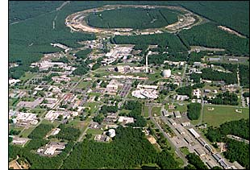
Advancing QCD by Studying the Partonic Bound States of Everyday Matter at RHIC
Christine A. Aidala
University of Michigan
DNP 2013, RHIC Users Open Forum
October 24, 2013

Slide 2
How do we understand the visible matter in our universe in terms of the fundamental quarks and gluons of quantum chromodynamics?
How can studying the partonic structure of protons and nuclei teach us more about fundamental aspects of QCD?
Notes:
An essential tool of the trade if this is a question you’re interested in tackling is . . .

Slide 3
The proton as a QCD “laboratory”
Proton—simplest stable bound state in QCD!
?...
observation & models
fundamental theory
precision measurements
& more powerful theoretical tools
application?

Slide 4
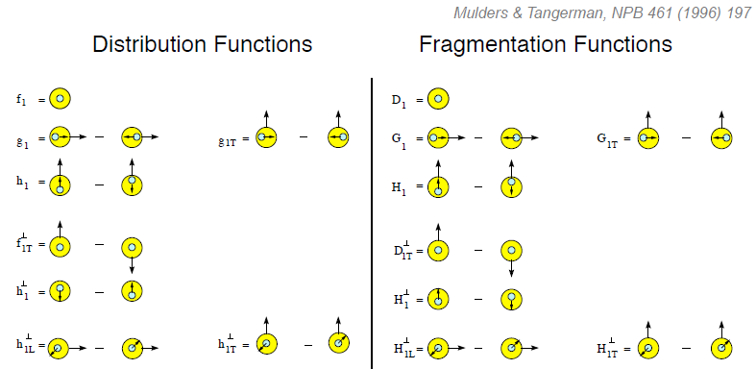
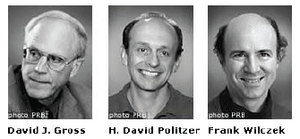
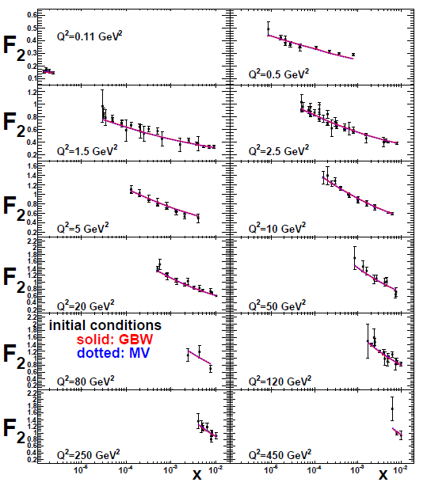
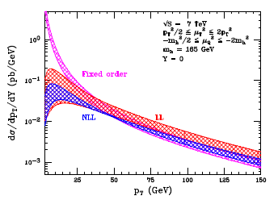
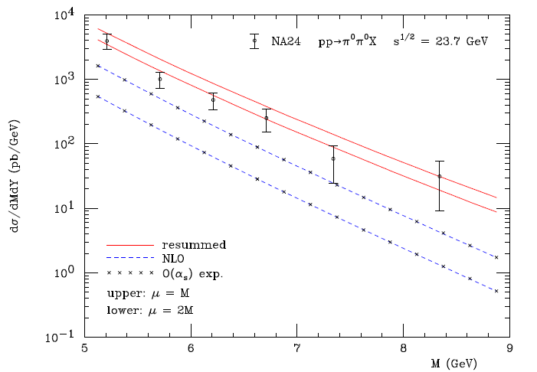
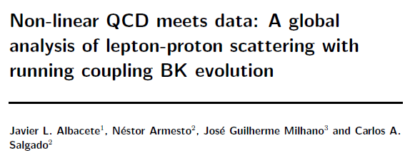
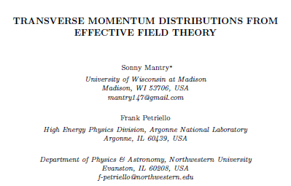
Entering a new era: Quantitative QCD!
Transverse-Momentum-Dependent
QCD: Discovery and development
  1973 → ~2004
Since 1990s starting to consider detailed internal QCD dynamics that parts with traditional parton model ways of looking at hadrons—and perform phenomenological calculations using these new ideas/tools!
  Various resummation techniques
  Non-collinearity of partons with parent hadron
  Various effective field theories, e.g. Soft-Collinear Eff. Th.
  Non-linear evolution at small momentum fractions
Higgs vs. pT
Mulders & Tangerman, NPB 461, 197 (1996)
Collinear
Worm gear
arXiv:1108.3609
Almeida, Sterman, Vogelsang
PRD80, 074016 (2009)
Transversity
PRD80, 034031 (2009)
pp→π⁰π⁰X
Sivers
Boer-Mulders
M (GeV)
Pretzelosity
Worm gear

Slide 5
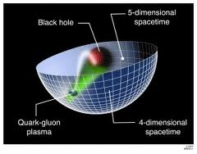
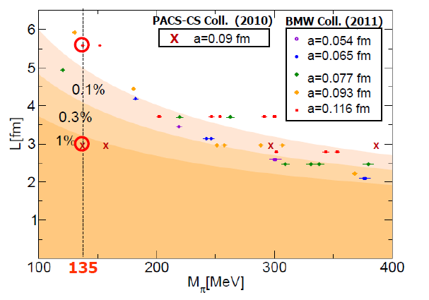
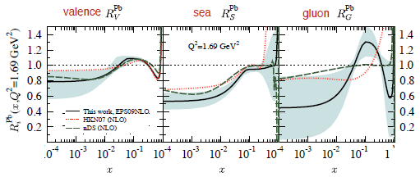
Additional recent theoretical progress in QCD
Renaissance in nuclear pdfs
  EPS09 283 citations!
Progress in non-perturbative methods:
  Lattice QCD just starting to perform calculations at physical point!
  AdS/CFT “gauge-string duality” an exciting recent development as first fundamentally new handle to try to tackle QCD in decades!
PACS-CS: PRD81, 074503 (2010)
BMW: PLB701, 265 (2011)
“Modern-day ‘testing’ of (perturbative) QCD is as much about pushing the boundaries of its applicability as about the verification that QCD is the correct theory of hadronic physics.”
– G. Salam, hep-ph/0207147 (DIS2002 proceedings)
T. Hatsuda,
PANIC 2011
JHEP 0904, 065 (2009)
Notes:
Lattice calcs at pion mass: hadron spectrum, quark masses, pseudoscalar meson decay constants. Also frameworks to describe jet structure, e.g. “1-jettiness”.

Slide 6
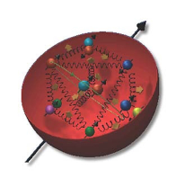
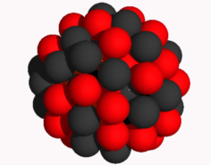
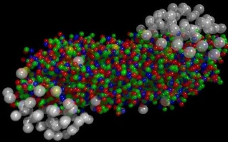
RHIC
A great place to be to study QCD!
An accelerator-based program, but not designed to be at the energy (or intensity) frontier. More closely analogous to many areas of condensed matter research—create a system and study its properties!
What systems are we studying?
  “Simple” QCD bound states—the proton is the simplest stable bound state in QCD (and conveniently, nature has already created it for us!)
  Collections of QCD bound states (nuclei, also available out of the box!)
  QCD deconfined! (quark-gluon plasma, some assembly required!)
Understand more complex QCD systems within
the context of simpler ones
RHIC was designed from the start as a single facility capable of nucleus-nucleus, proton-nucleus, and proton-proton collisions
e+p, e+A collisions: Even simpler systems to further contextualize the more complex ones

Slide 7
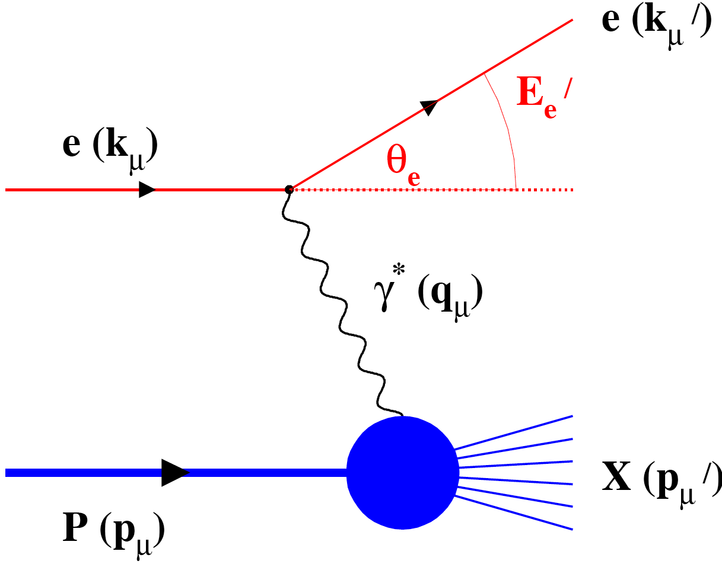
EIC: The facility to bring this new era of quantitative QCD to maturity!
Electroweak probe
  “Clean” processes to interpret (QED)
  Measurement of scattered electron → full kinematic information on partonic scattering
Collider mode → Higher energies
  Quarks and gluons relevant d.o.f.
  Perturbative QCD applicable
  Heavier probes accessible (e.g. charm, bottom, W boson exchange)

Slide 8
Quarks and gluons: The d.o.f. in our fundamental field theory
Future emphasis on jets and more hermetic detectors→Try to access parton kinematics
  Jets and dijets, direct photons are the handles available in hadronic collisions
In e+p/A collisions, access parton kinematics by measuring energy and angle of scattered electron
To continue advancing in QCD, critical to perform experimental work where quarks and gluons are relevant d.o.f. in the processes studied!
High enough energies
Detectors capable of measuring observables sensitive to parton kinematics (in the collision system being studied)
Notes:
Starting to drop simplifying assumptions and approximations,
[deeper levels of understanding],. . .
Compare, contrast, provide different handles

Slide 9
Mapping out the proton
What does the proton look like in terms of the quarks and gluons inside it?
Position
Momentum
Spin
Flavor
Color
Theoretical and experimental concepts to describe and access position only born in mid-1990s. Pioneering measurements over past decade.
Vast majority of past four decades focused on
1-dimensional momentum structure! Since 1990s starting to consider other directions . . .
Polarized protons first studied in 1980s. How angular momentum of quarks and gluons add up still not well understood!
Good measurements of flavor distributions in valence region. Flavor structure at lower momentum fractions still yielding surprises!
Accounted for by theorists from beginning of QCD, but more detailed, potentially observable effects of color have come to forefront in last couple years . . .

Slide 10
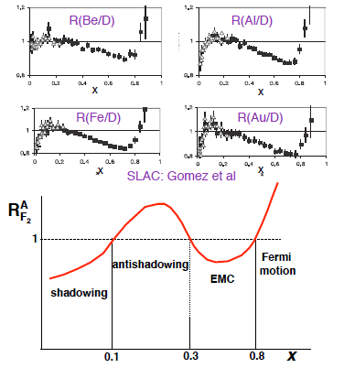

Nuclei: Not simple superpositions of nucleons!
Rich and intriguing differences compared to free nucleons, which vary with the linear momentum fraction probed (and likely transverse momentum, impact parameter, . . .).
Understanding the nucleon in terms of the quark and gluon d.o.f. of QCD does NOT allow us to understand nuclei in terms of the colored constituents inside them! New, collective effects present . . .

Slide 11
The EIC: A powerhouse to study the structure of protons and nuclei
Exquisite flexibility and control (polarization direction, system size, √s)
Tremendous statistical power
For many observables, can make multidifferential measurements to the full extent quantum mechanics will allow!
(x, Q², p_{T}, z, b, ...)

Slide 12
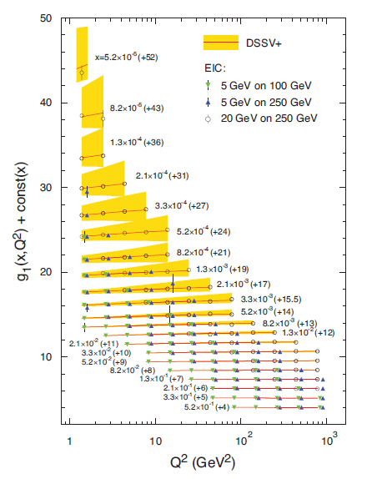
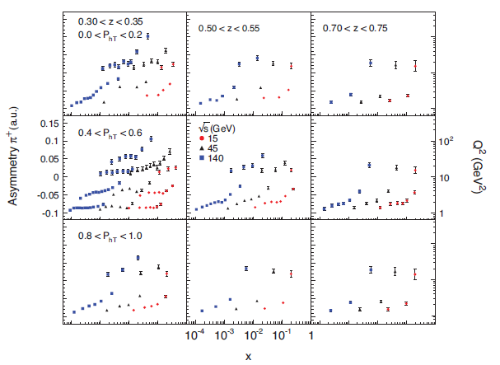
Sivers as a function of
x, Q², p_{T}, z, √s!!

Slide 13
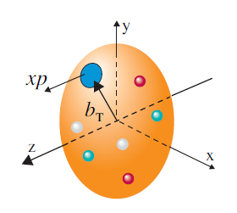
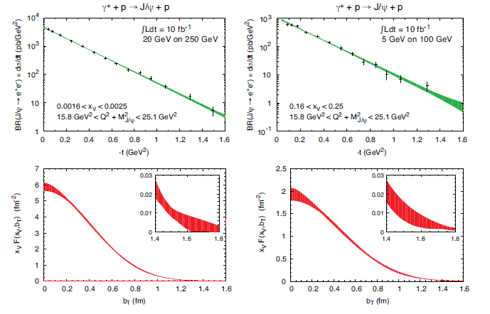
Impact parameter distributions for different x, different nuclei, quarks versus gluons, flavor-tagged quarks, . . . (not all shown here)

Slide 14
But is there anything we can learn from p+p, p+A collisions that we can’t learn from e+p, e+A??

Slide 15
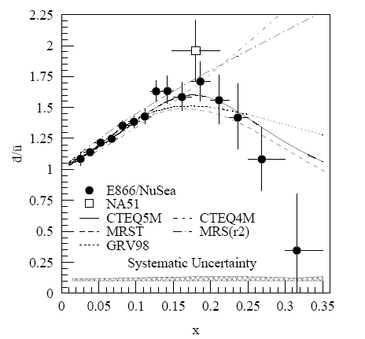
Complementarity of DIS and hadronic collisions: A (relatively) recent surprise
Fermilab Experiment 866 used proton-hydrogen and proton-deuterium collisions to probe nucleon structure via the Drell-Yan process
Anti-up/anti-down asymmetry in the quark sea, with an unexpected x behavior!
Indicates “primordial” sea quarks, in addition to those dynamically generated by gluon splitting!
Hadronic collisions play a complementary role to DIS and have let us continue to find surprises in the rich linear momentum structure of the proton, even after > 40 years!
PRD64, 052002 (2001)

Slide 16
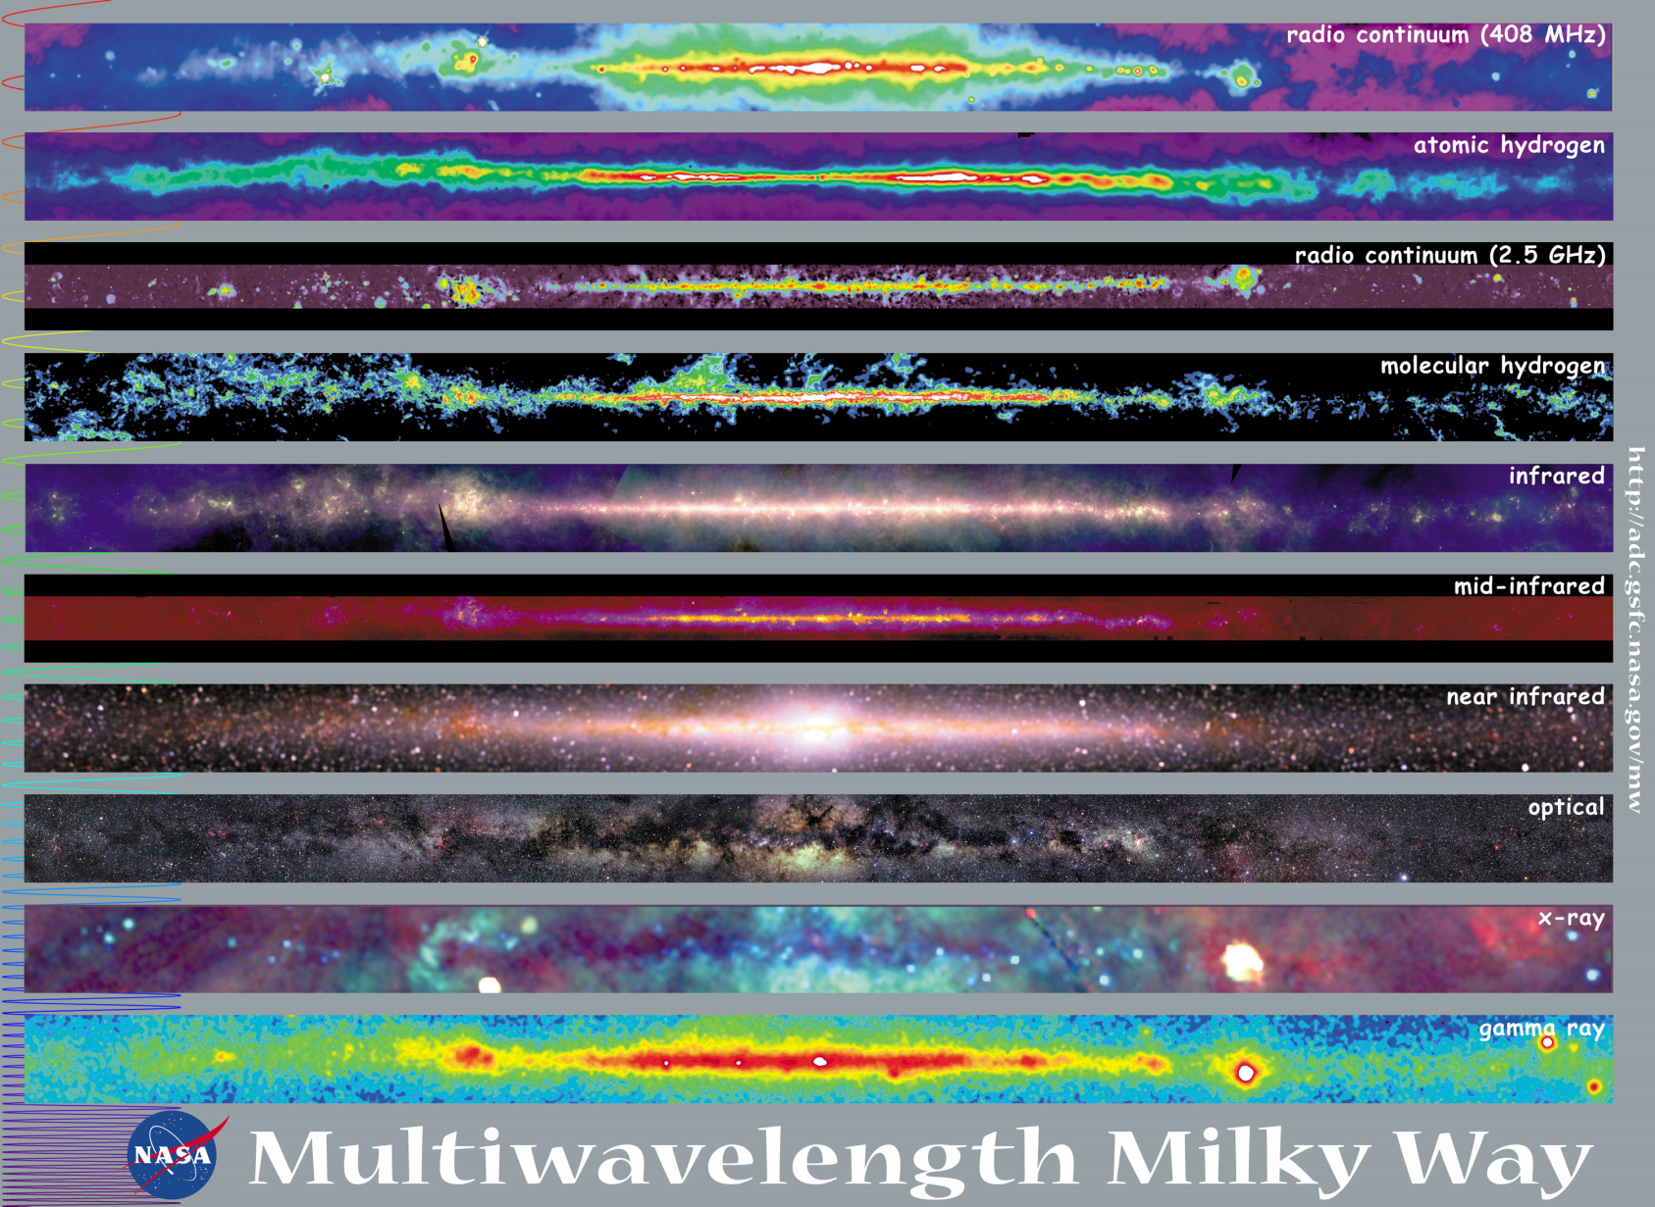
Observations with different probes allow us to learn different things!

Slide 17
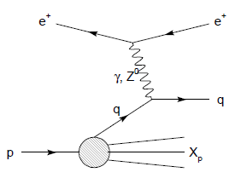
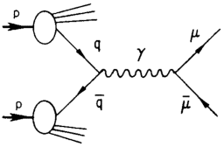
Modified universality of Sivers transverse-momentum-dependent distribution:
Color in action!
Semi-inclusive DIS: attractive final-state
interaction
Drell-Yan:
repulsive initial-state
interaction
As a result:

Slide 18
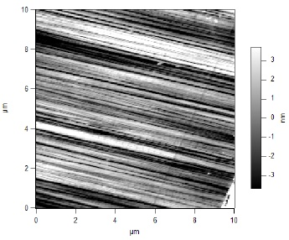
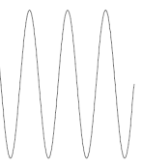
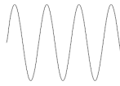
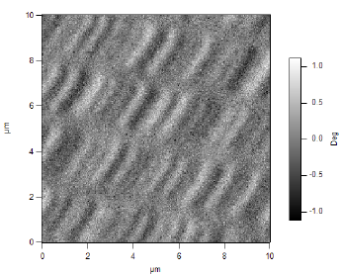
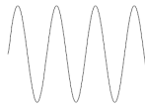
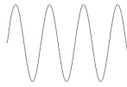
What things “look” like depends on how you “look”!
Slide courtesy of K. Aidala
Magnetic Force Microscopy
Computer Hard Drive
magnetic tip
Topography
Probe interacts with system being studied!
Lift height
Magnetism

Slide 19

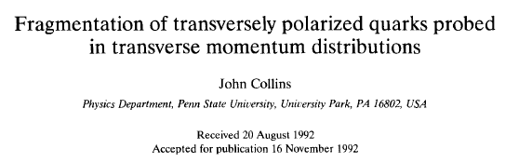
Progress in understanding QCD and color interactions
1989: Dennis Sivers proposes a transverse-momentum-dependent (TMD) pdf in an attempt to explain the large transverse single-spin asymmetries seen in hadronic collisions in the 1970s and 1980s
1992: John Collins argues that Sivers function must be zero based on naïve view of TMD pdfs—Wilson lines that arise naturally in gauge theories assumed to be purely formal and not to matter for physics. (Collins also proposes an alternative possible explanation for the observed asymmetries, a TMD FF)

Slide 20
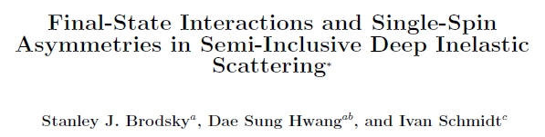
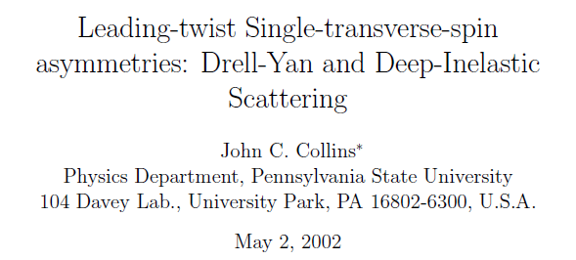
Progress in understanding QCD and color interactions
1999-2001: SMC and HERMES measure significant transverse single-spin asymmetries in semi-inclusive DIS, reminiscent of what’s been observed in p+p.
2002: Brodsky, Hwang, and Schmidt find a leading-power Sivers effect in a model calculation—it requires final-state interactions between the proton remnant and the produced hadron in semi-inclusive DIS
2002: Collins realizes that his 1992 assumption that the nature of QCD as a gauge theory has no physical consequences was incorrect! Leads to prediction of Sivers function sign change when probed in SIDIS versus Drell-Yan

Slide 21
Physical consequences of a gauge-invariant quantum theory:
Aharonov-Bohm (1959)
Wikipedia:
“The Aharonov–Bohm effect is important conceptually because it bears on three issues apparent in the recasting of (Maxwell's) classical electromagnetic theory as a gauge theory, which before the advent of quantum mechanics could be argued to be a mathematical reformulation with no physical consequences. The Aharonov–Bohm thought experiments and their experimental realization imply that the issues were not just philosophical.
The three issues are:
whether potentials are "physical" or just a convenient tool for calculating force fields;
whether action principles are fundamental;
the principle of locality.”
Physics Today, September 2009 :
The Aharonov–Bohm effects: Variations on a subtle theme,
by Herman Batelaan and Akira Tonomura.
“Aharonov stresses that the arguments that led to the prediction of the various electromagnetic AB effects apply equally well to any other gauge-invariant quantum theory. In the standard model of particle physics, the strong and weak nuclear interactions are also described by gauge-invariant theories. So one may expect that particle-physics experimenters will be looking for new AB effects in new domains.”

Slide 22
Physical consequences of a gauge-invariant quantum theory:
Aharonov-Bohm effect in QCD!!
See e.g. Pijlman,
hep-ph/0604226 or
Sivers,
arXiv:1109.2521
Semi-inclusive DIS: attractive final-state
interaction
Drell-Yan:
repulsive initial-state
interaction
BUT: In QCD it can get even richer!!
→Expect additional, new effects due to specific non-Abelian nature of the gauge group!
Simplicity of semi-inclusive DIS and Drell-Yan:
Abelian vs. non-Abelian nature of the gauge group doesn’t play a major qualitative role.
As a result:

Slide 23
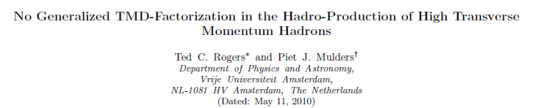
Consequences of QCD as a non-Abelian gauge theory
2004, 2006: Mulders et al. generalize SIDIS/DY sign flip prediction to production of hadrons in hadronic collisions by including more complicated Wilson lines.
2007: Collins and Qiu show that observations of Mulders et al. correspond to breakdown of the normal steps in the derivation of factorization. So factorization breaking identified, but the possibility for some kind of generalized factorization remains open.
(Some years of debate here. One point that emerges is that the factorization breaking will exist for the unpolarized case just as it does for the original spin-dependent case when TMD distributions are used.)
2010: Rogers and Mulders put the nail in the coffin on generalized factorization and predict color entanglement, as a consequence of QCD specifically as a non-Abelian gauge theory.

Slide 24
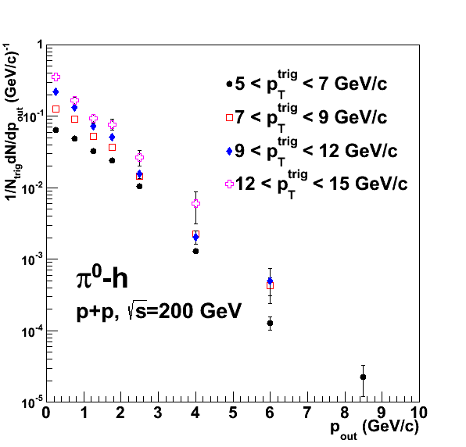
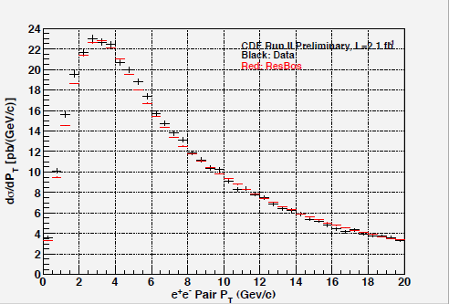
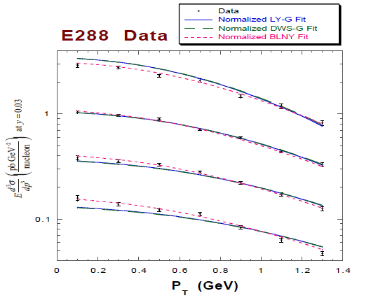
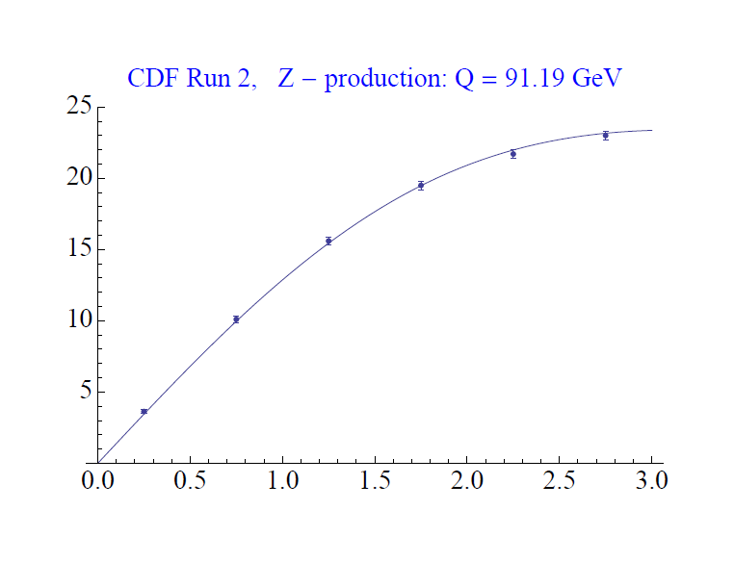

Consequeces of QCD as a non-Abelian gauge theory:
New predictions emerging
Will predictions based on unpolarized TMD distributions from fits to Drell-Yan and Z data, where factorization should hold, disagree with data from p+p to hadrons sensitive to intrinsic k_{T}??
PRD82, 072001 (2010)
Z boson production,
CDF
dσ/dp_{T}
Out-of-plane momentum component
√s = 1.96 TeV
Landry et al., 2002
p_{T} (GeV/c)

Slide 25
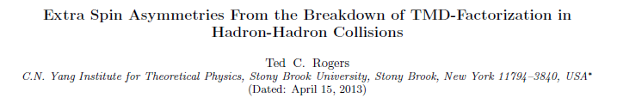
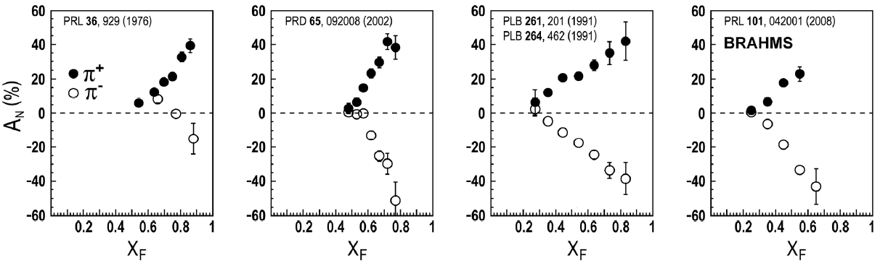
Consequeces of QCD as a non-Abelian gauge theory:
New predictions emerging
2013: Ted Rogers predicts “extra spin asymmetries from the breakdown of TMD-factorization in hadron-hadron collisions”
No phenomenology yet, but 37 years after the discovery of huge transverse single-spin asymmetries and spontaneous hyperon polarization in hadronic collisions (p+A in both cases, in fact), I’m hopeful that we may finally be on the right track!!

Slide 26
Final remarks
We’re currently in the early years of the era of quantitative QCD
The EIC will be the facility to bring this era to maturity
  Theory and phenomenology have advanced enough in the last 10-15 years that we’ll be able to reap great physics rewards from precision QCD measurements in the 2020s
Studying the partonic structure of protons and nuclei is leading us to deeper understanding of QCD as the fundamental theory of the strong force
Studying the production of hadrons specifically in hadronic collisions provides unique means to explore the physical consequences of QCD as a non-Abelian gauge theory
  Several exciting new ideas have emerged recently that need to be explored further and tested!
It’s an exciting time to be in QCD!

Slide 27
Extra

Slide 28
Recall the ‘C’ in ‘QCD’ . . .
While electrons offer several advantages (interactions easy to calculate, reconstruct kinematics exactly), you can’t learn everything about a hadron or nucleus by probing it with an electron!!

Slide 29
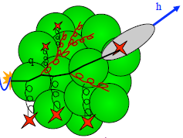
eRHIC
A facility to bring this new era of quantitative QCD to maturity!
How can QCD matter be described in terms of the quark and gluon d.o.f. in the field theory?
How does a colored quark or gluon become a colorless object?
Study in detail
  “Simple” QCD bound states: Nucleons
  Collections of QCD bound states: Nuclei
  Hadronization
Collider energies: Focus on
sea quarks and gluons

Slide 30
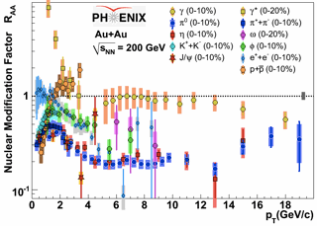
Calibration using different collision systems, different probes
Electroweak probes of the hot, dense matter in the A+A final state already exploited
  Direct photons, internal conversions of thermal photons, Z bosons
Learn by comparing to a variety of strongly interacting probes
  Light mesons as proxies for light quarks—various potential means of in-medium energy loss
  Charm and bottom mesons as proxies for heavy quarks—less affected by radiative energy loss
d+A allows us instead to use strong probes of the initial state
e+A will enable electroweak probes of the initial state for the first time!

Slide 31
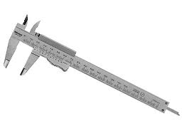
The future of RHIC:
Precision measurements
With RHIC’s unprecedented flexibility extended further, even more comparisons and complementarities to learn from!
  e+p↑, p↑+p↑, p↑+a↑, e+a↑, e+A, p/d+A, a+a, a+A, A+A
  All with higher luminosities than currently available at RHIC or earlier facilities
Electroweak and colored probes available in both the initial and final states!
Control over parton kinematics
  e+A, e+p, fully reconstructed jets, more hermetic detectors
Controlled experiments in hadronization
Notes:
Starting to drop simplifying assumptions and approximations,
[deeper levels of understanding],. . .
Compare, contrast, provide different handles

Slide 32
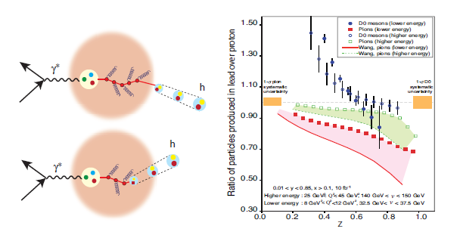
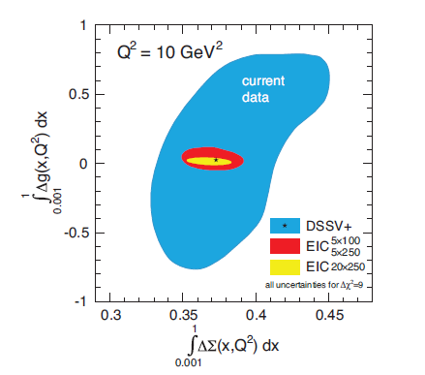
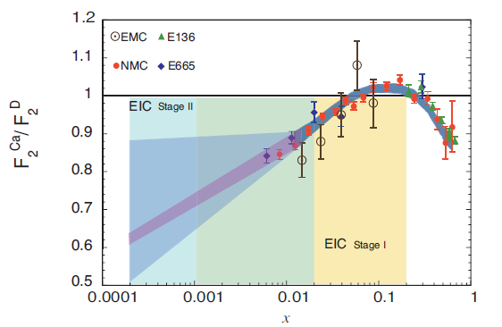

Slide 33
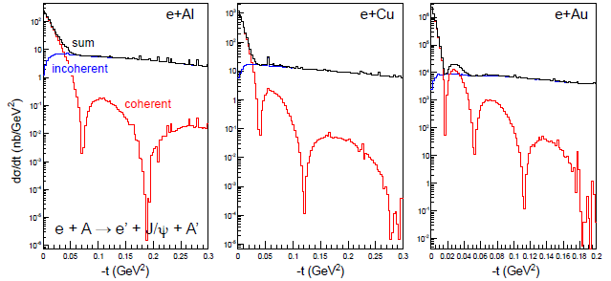
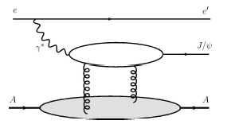
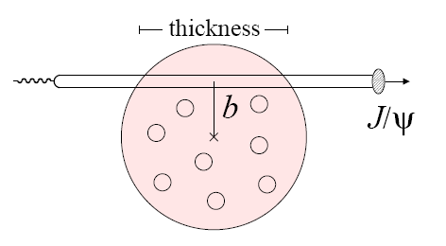

Impact-parameter-dependent nuclear gluon density via exclusive J/Ψ production in e+A
Assume Woods-Saxon gluon density
Coherent diffraction pattern extremely sensitive to details of gluon density in nuclei!

Slide 34
Hadronization: A lot to learn, from a variety of collision systems
What are the ways in which partons can turn into hadrons?
Spin-momentum correlations in hadronization?
  Correlations now measured definitively in e+e-! (BELLE, BABAR)
Gluons vs. quarks?
  Gluon vs. quark jets a hot topic in the LHC p+p program right now
  Go back to clean e+e- with new jet analysis techniques in hand?
In “vacuum” vs. cold nuclear matter vs. hot + dense QCD matter?
  Use path lengths through nuclei to benchmark hadronization times → e+A
Hadronization via “fragmentation” (what does that really mean?), “freeze-out,” “recombination,” . . .?
  Soft hadron production from thermalized quark-gluon plasma—different mechanism than hadronization from hard-scattered q or g?
Light atomic nuclei and antinuclei also produced in heavy ion collisions at RHIC!
  How are such “compound” QCD systems formed from partons? Cosmological implications??
…
In my opinion, hadronization has been a largely neglected area over the past decades of QCD—lots of progress to look forward to in upcoming years, with e+A, p+p, and A+A all playing a role along with e⁺e⁻!
Notes:
Baryon anomaly

Slide 35
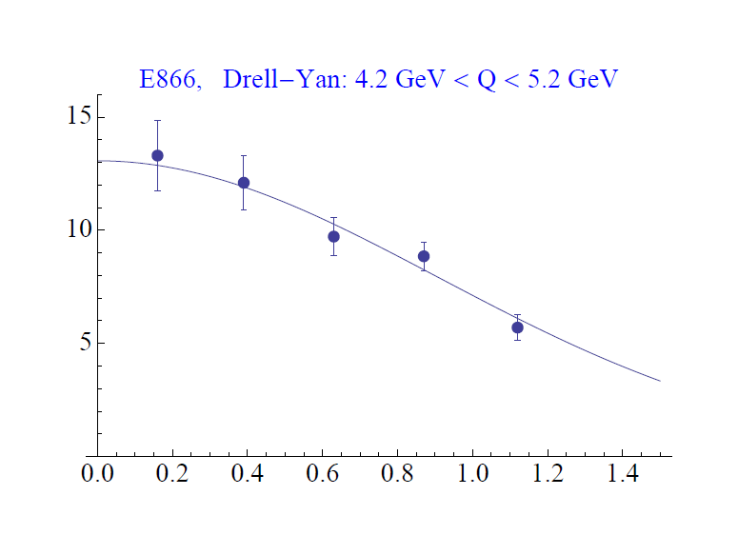
Testing factorization/factorization breaking with (unpolarized) p+p collisions
Testing factorization in transverse-momentum-dependent case
  Important for broad range of pQCD calculations
Can we parametrize transverse-momentum-dependent distributions that simultaneously describe many measurements?
  So far yes for Drell-Yan and Z boson data, including recent Z measurements from Tevatron and LHC!
Z boson production,
Tevatron CDF
dσ/dp_{T}
dσ/dp_{T}
C.A. Aidala,
T.C. Rogers
√s = 0.039 TeV
√s = 1.96 TeV
p_{T} (GeV/c)
p_{T} (GeV/c)

Slide 36



High-x_{F} Asymmetries,
But Not Valence Quarks??
Pattern of pion species asymmetries in the forward direction
→ valence quark effect.
But this conclusion confounded by kaon and antiproton asymmetries!
Note different scales
K
K
K- asymmetries
underpredicted
200 GeV
62.4 GeV
p
p
Large antiproton asymmetry?!
(No one has attempted predictions . . .)
200 GeV
62.4 GeV

