Slide 1
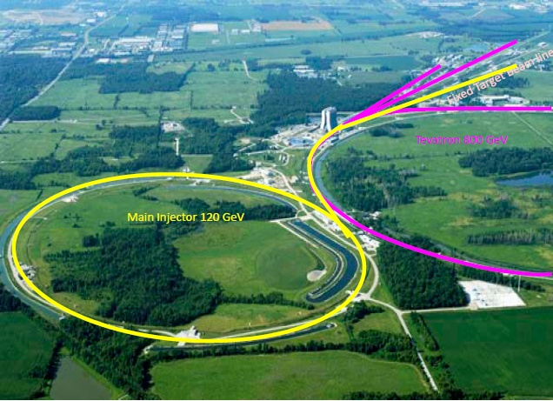
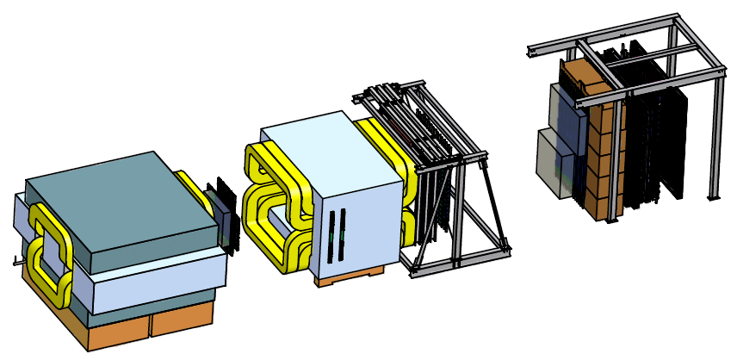
Investigation of Angular Distributions of Drell-Yan Dimuons in p+p and p+d Interactions with the E906/SeaQuest Experiment
Christine A. Aidala
Los Alamos National Lab
DNP Meeting
Michigan State University
October 29, 2011

Slide 2
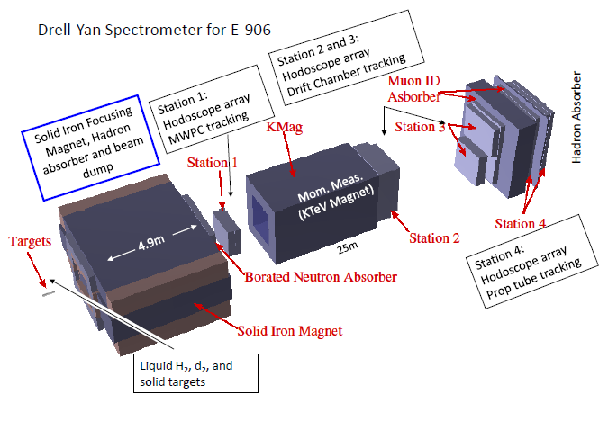
Fermilab E906/SeaQuest: A dedicated fixed-target Drell-Yan experiment
Physics programs:
Nucleon structure
Cold nuclear matter
120 GeV/c proton beam from Fermilab Main Injector
Liquid hydrogen and deuterium, nuclear (C, Ca, W) targets
Commissioning to start in December, data-taking through ~2015

Slide 3
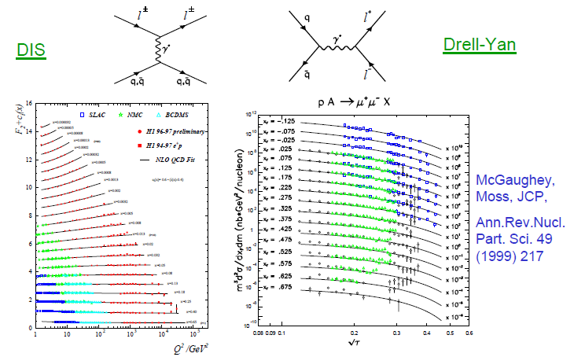
Complementarity of Drell-Yan and DIS
Both Drell-Yan and deep-inelastic scattering are tools to probe the quark and antiquark structure of hadrons!

Slide 4
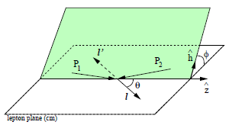
Drell-Yan decay angular distributions
θ and φ are the decay polar and azimuthal angles of the μ⁺ in the dilepton rest frame: Collins-Soper frame
A general expression for Drell-Yan decay angular distributions
Lam-Tung relation: 1- λ = 2ν
Reflects the spin-1/2 nature of (anti)quarks
Analog of the Callan-Gross relation in deep-inelastic scattering

Slide 5
Lam-Tung relation
Lam and Tung, PRD18, 2447 (1978)
Theoretically robust
Unaffected by NLO [O(α_{s})] corrections
NNLO [O(α_{s}²)] corrections small
Mirkes and Ohnemus, PRD 51, 4891 (1995)
Preserved under resummation of soft gluons
Berger, Qiu, and Rodrigues-Pedraza, arXiv:0707.3150 and PRD 76, 074006 (2007)
What do the data show?

Slide 6
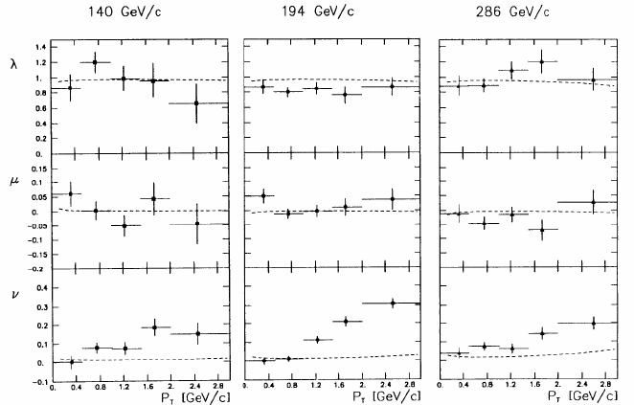
Measured angular dependences
CERN NA10
π⁻ + W
Z. Phys. 37, 545
(1988)
Dashed curves
from pQCD
calculations
ν non-zero, increases with p_{T}

Slide 7
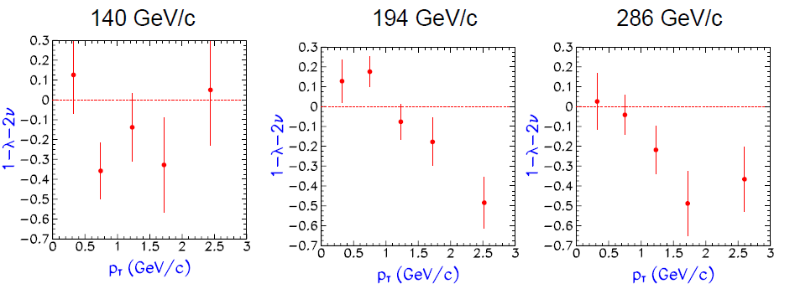
Lam-Tung relation violated!
NA10, Z. Phys. 37, 545 (1988)
Violation of the Lam-Tung relation suggests new mechanisms with non-perturbative origin!

Slide 8
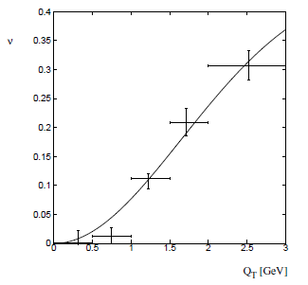
Azimuthal dependence of unpolarized Drell-Yan cross section
cos2φ term sensitive to correlations between quark transverse spin and quark transverse momentum! → Boer-Mulders transverse-momentum-dependent parton distribution function
Evidence for such correlations also in semi-inclusive DIS data
Large cos2φ dependence seen in pion-induced Drell-Yan from multiple experiments
ν
NA10 data
194 GeV/c
π⁻+W
Q_{T} (GeV)
D. Boer, PRD60, 014012 (1999)

Slide 9
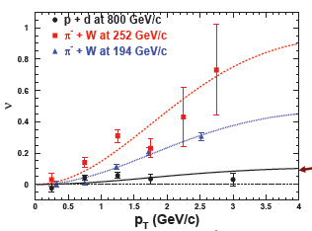
What about proton-induced Drell-Yan?
E866, PRL 99, 082301 (2007);
PRL 102, 182001 (2009)
Significantly reduced cos2φ dependence in proton-induced D-Y
Suggests sea quark transverse spin-momentum correlations small?
What about higher-x sea quarks in E906??
E866

Slide 10
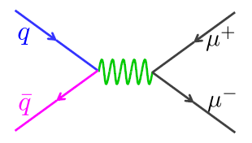
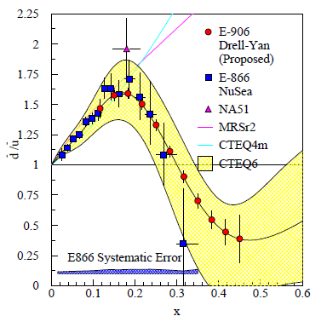
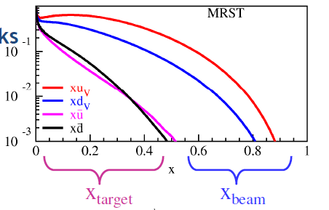
E906/SeaQuest: Probing high-x antiquarks
Follow-up experiment to FNAL E866 - main goal to extend measurements to higher x
E866 found a strong flavor asymmetry in the proton’s sea quarks, with a striking x dependence
Sea quarks generated perturbatively via gluon splitting should be flavor symmetric!
“Intrinsic” antiquarks?
120 GeV proton beam from FNAL Main Injector (E866: 800 GeV)
Reach higher x values
Also improved statistics: D-Y cross section ~1/s
E906
E866
Talk by Chiranjib Dutta, JC7 (Friday)

Slide 11
E906/SeaQuest timeline
Fermilab Stage II approval in December 2008
Expect first beam in December 2011 (for 2 years of data collection)
Expt. Funded
Experiment
Construction
Exp. Experiment
Runs Runs
Shutdown
2009
2010
2011
2012
2013
2014
2015
Beam: low intensity
high intensity
Oct 2011
Apparatus available for future programs at e.g. Fermilab, (J-PARC or RHIC)
significant interest from collaboration for continued program:
Polarized beam in Main Injector
Polarized target

Slide 12
Summary
Drell-Yan process a means to probe the quark and antiquark distributions in hadrons
Data from earlier Drell-Yan experiments show interesting angular dependences
Suggest correlations between transverse spin and momentum of quarks inside unpolarized hadrons
Parton dynamics within hadrons: a rich area of QCD that we’re only just starting to explore!
E906/SeaQuest at Fermilab will perform precision proton-induced Drell-Yan measurements on hydrogen, deuterium, and a variety of nuclear targets for antiquark x ~0.1-0.45
Data-taking will start in the upcoming months—stay tuned!

Slide 13
See also . . .
Talk JC7, Chiranjib Dutta – Light antiquark asymmetry in E906 Drell-Yan and prospects of polarized Drell-Yan at the Fermilab Main Injector
CEU poster, Mandi Crowder – Exploring the EMC effect and anti-shadowing at Fermilab E906/SeaQuest
CEU poster, Tyler Hague – Reconstructing Drell-Yan data at SeaQuest
CEU poster, Kristin Holz – Studying the light antiquark asymmetry in the nucleon sea with FNAL E906/SeaQuest
CEU poster, Andrew Miller – Gain matching and efficiency tests on double- and single-ended hodoscope arrays

Slide 14
Fermilab E906/Drell-Yan Collaboration
Abilene Christian University
Donald Isenhower, Tyler Hague
Rusty Towell, Shon Watson
Academia Sinica
Wen-Chen Chang, Yen-Chu Chen
Shiu Shiuan-Hal, Da-Shung Su
Argonne National Laboratory
John Arrington, Don Geesaman*
Kawtar Hafidi, Roy Holt, Harold Jackson
David Potterveld, Paul E. Reimer*
Josh Rubin
University of Colorado
Ed Kinney, J. Katich, Po-Ju Lin
Fermi National Accelerator Laboratory
Chuck Brown, David Christian
University of Illinois
Bryan Dannowitz, Markus Diefenthaler Dan Jumper, Bryan Kerns, Naomi C.R Makins, R. Evan McClellan, Jen-Chieh Peng
KEK
Shinya Sawada
Ling-Tung University
Ting-Hua Chang
Los Alamos National Laboratory
Christine Aidala, Gerry Garvey, Lei Guo, Xiaodong Jiang, Mike Leitch, Han Liu, Kun Liu, Ming Liu, Pat McGaughey, Joel Moss, Andrew Puckett
University of Maryland
Betsy Beise, Kaz Nakahara
University of Michigan
Chiranjib Dutta,
Wolfgang Lorenzon, Uttam Paudel, Richard Raymond Qu Zhongming
*Co-Spokespersons
National Kaohsiung Normal University
Rurngsheng Guo, Su-Yin Wang
University of New Mexico
Imran Younus
RIKEN
Yoshinori Fukao, Yuji Goto, Atsushi Taketani, Manabu Togawa
Rutgers University
Lamiaa El Fassi, Ron Gilman, Ron Ransome, Brian Tice, Ryan Thorpe Yawei Zhang
Tokyo Institute of Technology
Shou Miyasaka, Ken-ichi Nakano Florian Saftl, Toshi-Aki Shibata
Yamagata University
Yoshiyuki Miyachi
Collaboration contains many of the E866/NuSea groups and several new groups (total 17 groups as of October 2011)
14

Slide 15
Extra material

Slide 16
Dilepton pair production

Slide 17
E906 Drell-Yan spectrometer
Station 3
(Hodoscope array, drift chamber track.)
25m long
Station 1
(hodoscope array,
MWPC track.)
4.9m
Iron Wall
(Hadron absorber)
Station 4
(hodoscope array, prop tube track.)
KTeV Magnet
(Mom. Meas.)
Solid Iron Magnet
(focusing magnet, hadron absorber and beam dump)
Station 2
(hodoscope array, drift chamber track.)
Targets
(liquid H₂, D₂, and solid targets)

Slide 18
E906 Drell-Yan spectrometer: Reduce, Reuse, Recycle!
St. 4 Prob Tubes: Homeland Security via Los Alamos
St. 3 & 4 Hodo PMTs: E866, HERMES, KTeV
St. 1 & 2 Hodoscopes: HERMES
St. 2 Support Structure: KTeV
St. 2 & 3 tracking: E866
Target Flasks: E866
Cables: KTeV
Hadron Absorber: FNAL
Shielding blocks: FNAL old beamline
2nd Magnet: KTeV mom analysis magnet
Solid Fe Magnet Coils: E866 SM3 Magnet
Solid Fe Magnet FLUX Return Iron: E866 SM12 Magnet

Slide 19
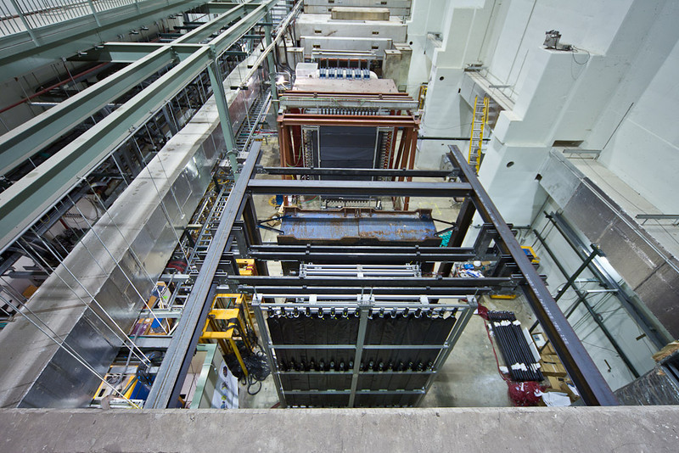
E906 hall from above

Slide 20
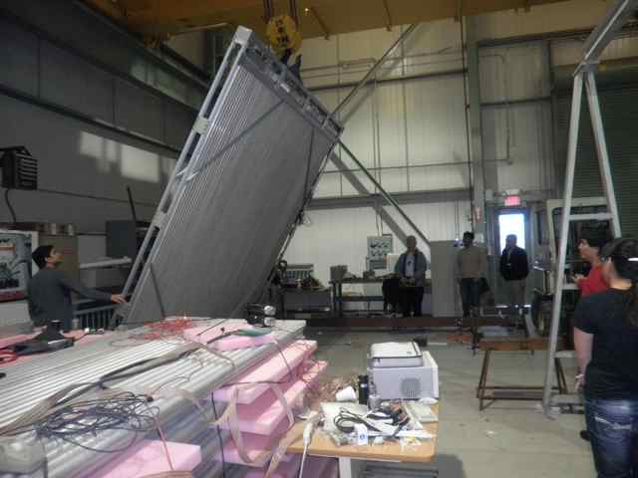
LANL: Station 4 tracking plane
Assembled from old proportional tubes scavenged from LANL threat reduction experiments!

Slide 21
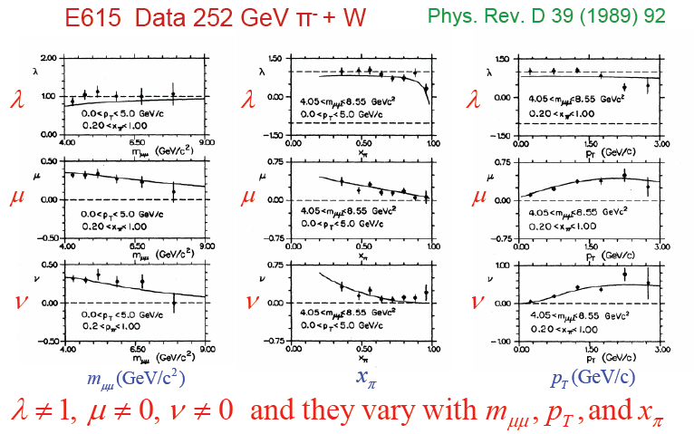
Angular dependences for pion-induced D-Y from E615

Slide 22
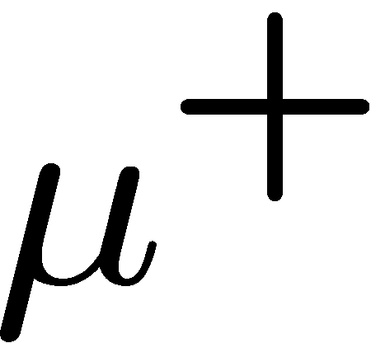
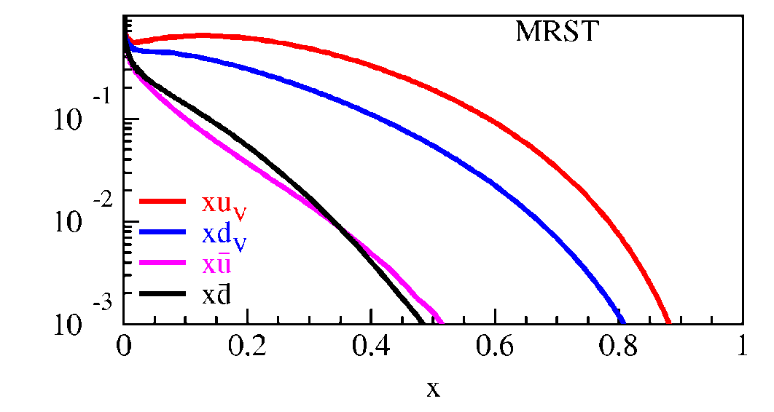
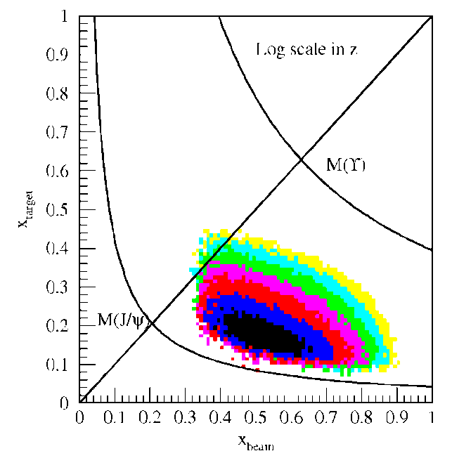
Fixed-target Drell-Yan: What we really measure
Measure yields of μ⁺μ⁻ pairs from different targets
Reconstruct p_{γ} , M²_{γ}= x_{b}x_{t}s
Determine x_{b}, x_{t}
Measure differential cross section
Fixed target kinematics and detector acceptance give x_{b} > x_{t}
x_{F} = 2p||^{γ}/s^{1/2} ≈ x_{b} – x_{t}
Beam valence quarks probed at high x
Target sea quarks probed at low/intermediate x
x_{target}
x_{beam}
E906 Spect.
Monte Carlo
Notes:
Determine mass and momentum of virtual photon
Determine momentum fraction x_b and x_t of partons in beam and target
Measure absolute differential cross section
Sensitivity of D-Y process to anti-quark distribution of target or beam clear from examining diff. cross section
At large x, parton distributions are dominated by valence distributions, at small x by sea distributions
So in limit of large x_b and small x_t, cross section is dominated by first term -> providing direct sensitivity to antiquark sea of target nuclei
So if we just have to design the right experiment: This is E906.

Slide 23
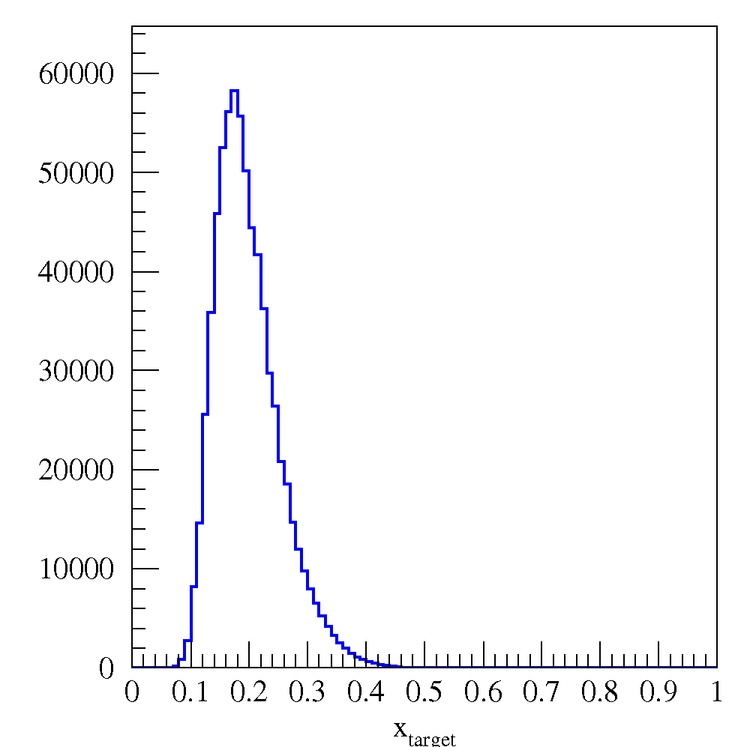
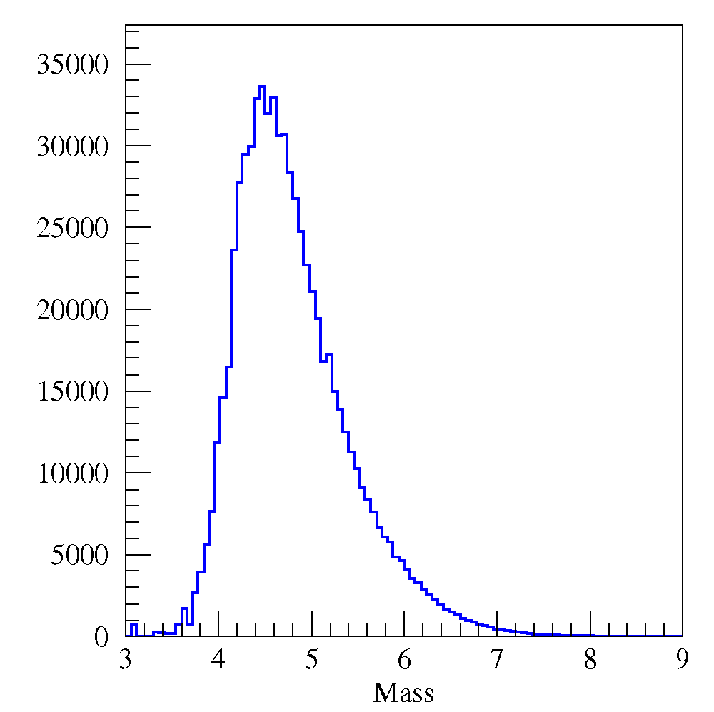
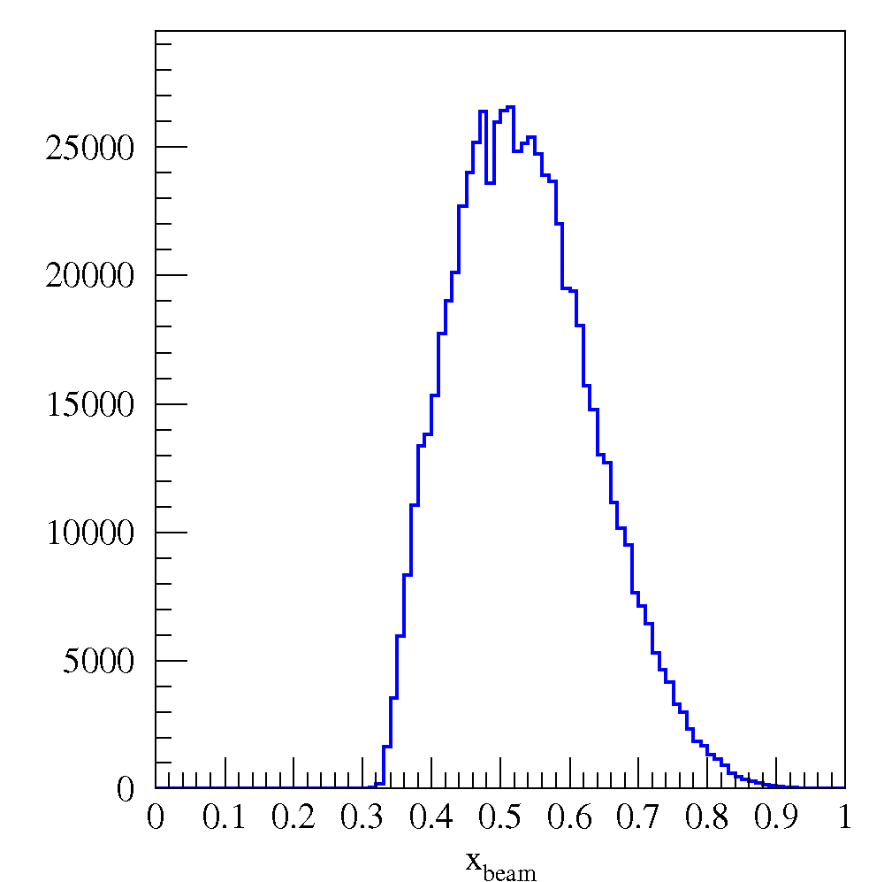
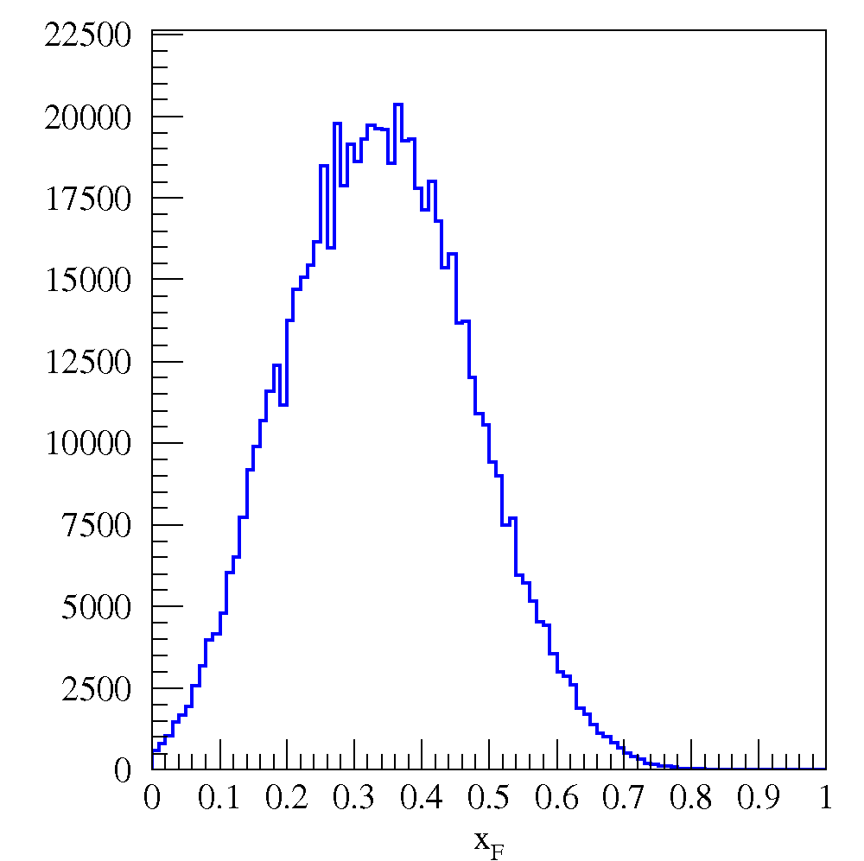
SeaQuest: Drell-Yan acceptance
Programmable trigger removes likely J/ψ events
Transverse momentum acceptance to above 2 GeV
Spectrometer could also be used for J/ψ studies
x_{target}
x_{beam}
x_{F}
Mass

Slide 24
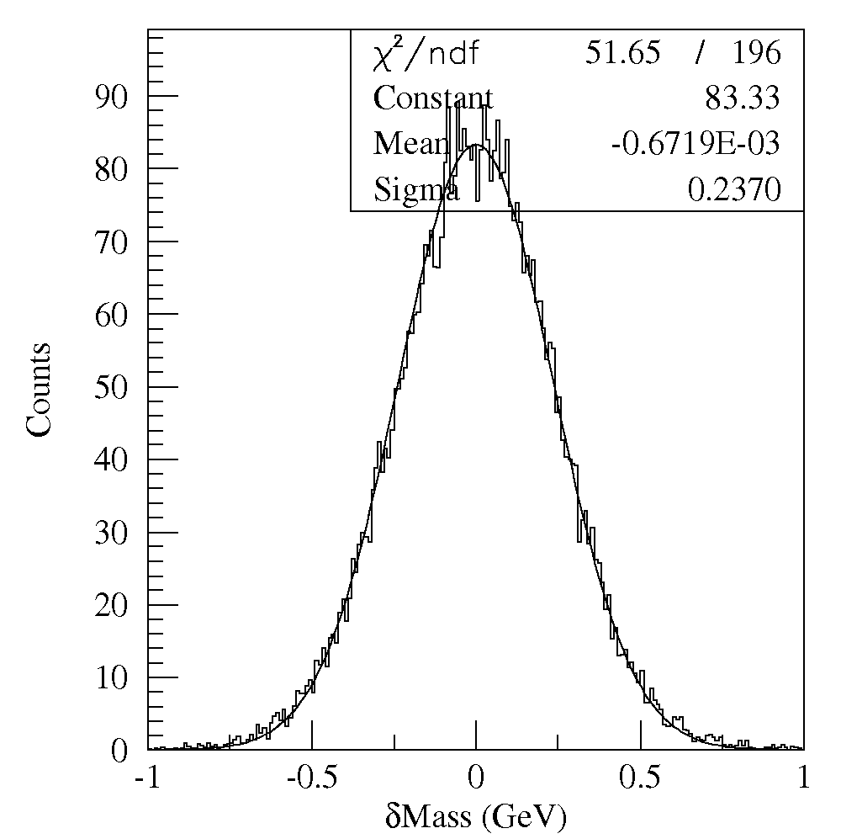
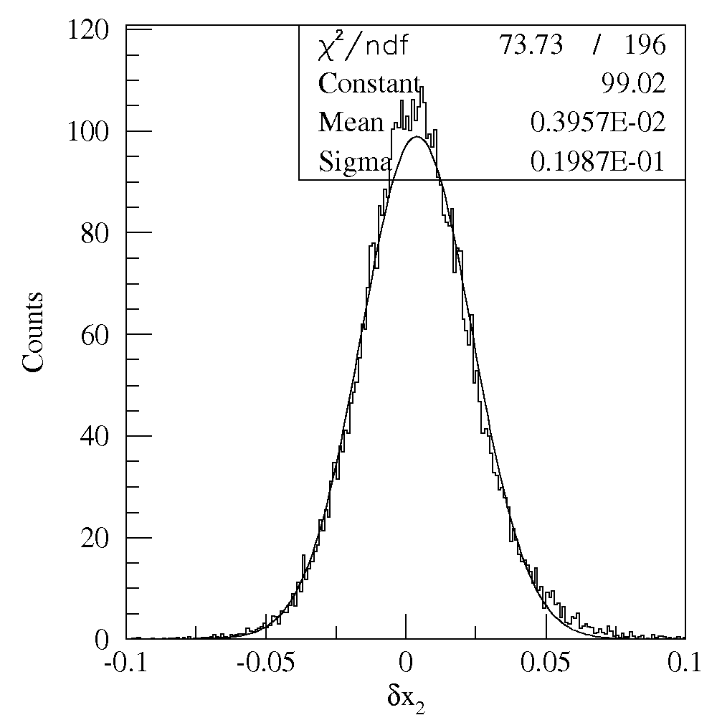
Detector resolution
240 MeV
Mass Res.
0.04 x₂ Res.
Triggered Drell-Yan events

Slide 25
Azimuthal dependence of Drell-Yan cross section in terms of transverse-momentum-dependent distributions
Arnold, Metz, Schlegel, PRD79, 034005 (2009)

Slide 26
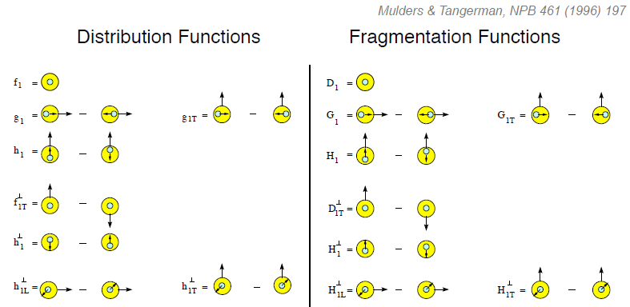
Evidence for variety of spin-momentum correlations in proton, and in process of hadronization!
Collinear
Worm gear
Collinear
Transversity
Measured non-zero!
Sivers
Polarizing FF
Boer-Mulders
Pretzelosity
Collins
Worm gear

Slide 27
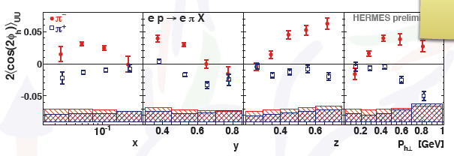
Cos2φ dependences in semi-inclusive DIS
Sensitive to Boer-Mulders TMD pdf x Collins TMD FF
Difference for positive and negative pions indicates that
higher-twist QCD effects don’t play a large role

Slide 28
Boer-Mulders fits to NA10 data

Slide 29
Other explanations of cos2φ dependence: Higher-twist effects in pion not large enough

Slide 30
Other explanations of cos2φ dependence: QCD vacuum effect would be for valence and sea

Slide 31
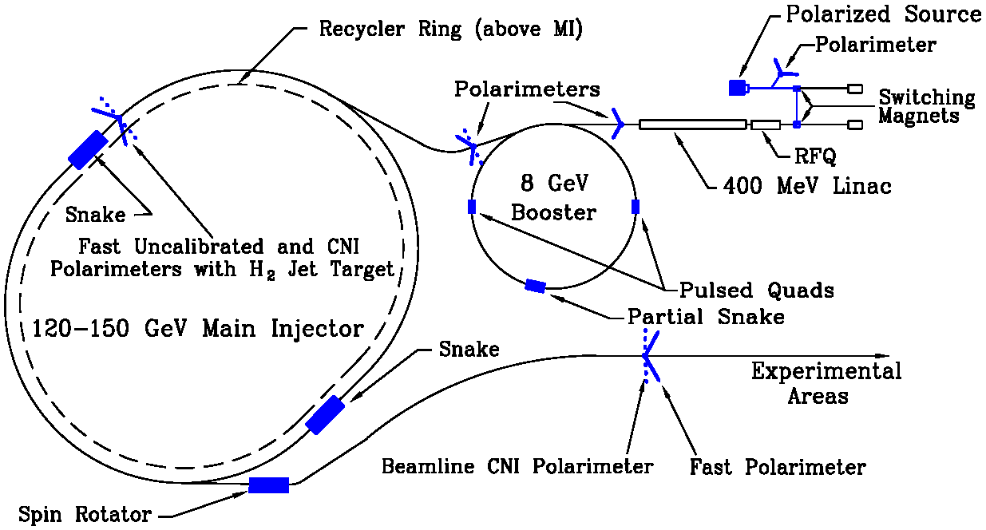
Polarized Drell-Yan at Fermilab Main Injector
Polarize beam in Main Injector – Proposal submitted to Fermilab management September 2011
Use SeaQuest dimuon spectrometer
fixed target experiment
luminosity: L_{av} = 3.4 x 10³⁵ /cm²/s
I_{av} = 1.6 x 10¹¹ p/s (=26 nA)
N_{p}= 2.1 x 10²⁴ /cm²
approved for 2-3 years of running: 3.4 x 10¹⁸ pot
by 2015: fully understood, optimized for Drell-Yan, and ready to take pol. beam
arXiv:1110.3042

Slide 32
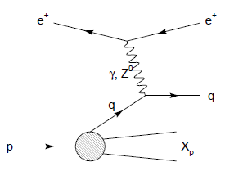
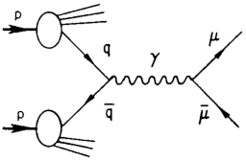
Modified universality of T-odd transverse-momentum-dependent distributions: Color in action!
DIS: attractive final-state int.
Drell-Yan: repulsive initial-state int.
Some DIS measurements already exist. A polarized Drell-Yan measurement will be a crucial test of our understanding of QCD!
As a result:

