Slide 1
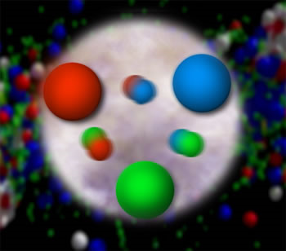
From Quarks and Gluons to the World Around Us:
Advancing Quantum Chromodynamics by Probing Nucleon Structure
Christine A. Aidala
Los Alamos National Lab
UConn
January 20, 2012

Slide 2
Theory of strong interactions:
Quantum Chromodynamics
  Salient features of QCD not evident from Lagrangian!
    Color confinement
    Asymptotic freedom
  Gluons: mediator of the strong interactions
    Determine essential features of strong interactions
    Dominate structure of QCD vacuum (fluctuations in gluon fields)
    Responsible for > 98% of the visible mass in universe(!)
An elegant and by now well established field theory, yet with degrees of freedom that we can never observe directly in the laboratory!

Slide 3
How do we understand the visible matter in our universe in terms of the fundamental quarks and gluons of QCD?

Slide 4
The proton as a QCD “laboratory”
Proton—simplest stable bound state in QCD!
?...
observation & models
fundamental theory
precision measurements
& more powerful theoretical tools
application?

Slide 5
Nucleon structure: The early years
1933: Estermann and Stern measure the proton’s anomalous magnetic moment → indicates proton not a pointlike particle!
1960s: Quark structure of the nucleon
  SLAC inelastic electron-nucleon scattering experiments by Friedman, Kendall, Taylor → Nobel Prize
  Theoretical development by Gell-Mann → Nobel Prize
1970s: Formulation of QCD . . .

Slide 6
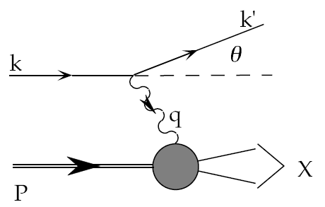
Deep-inelastic lepton-nucleon scattering:
A tool of the trade
Probe nucleon with an electron or muon beam
Interacts electromagnetically with (charged) quarks and antiquarks
“Clean” process theoretically—quantum electrodynamics well understood and easy to calculate!

Slide 7
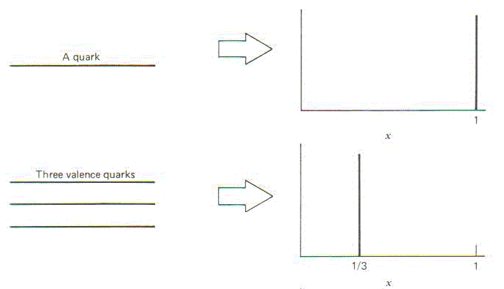
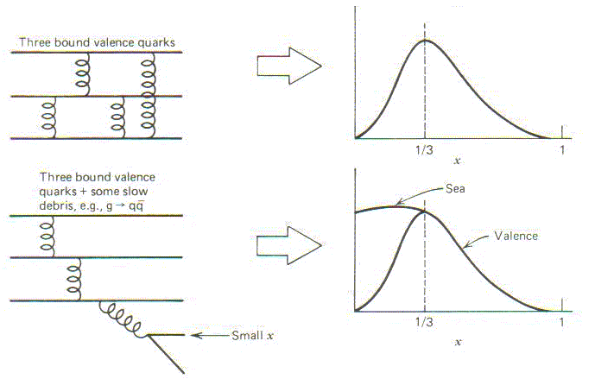
Parton distribution functions inside a nucleon:
The language we’ve developed (so far!)
What momentum fraction would the scattering particle carry
if the proton were made of …
3 bound valence quarks
A point particle
x_{Bjorken}
1
1/3
1
3 bound valence quarks + some
low-momentum sea quarks
x_{Bjorken}
Sea
3 valence quarks
Valence
Small x
1/3
1
x_{Bjorken}
1/3
x_{Bjorken}
1
Halzen and Martin, “Quarks and Leptons”, p. 201

Slide 8
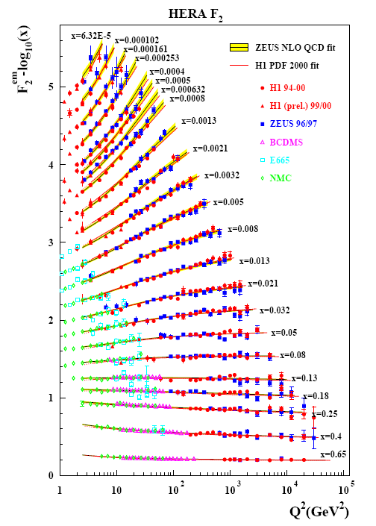
Decades of DIS data: What have we learned?
Wealth of data largely thanks to proton-electron collider, HERA, in Hamburg, which shut down in July 2007
Rich structure at low x
Half proton’s linear momentum carried by gluons!
PRD67, 012007 (2003)

Slide 9
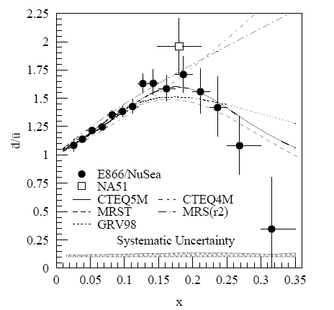
And a (relatively) recent surprise from p+p, p+d collisions
Fermilab Experiment 866 used proton-hydrogen and proton-deuterium collisions to probe nucleon structure via the Drell-Yan process
Anti-up/anti-down asymmetry in the quark sea, with an unexpected x behavior!
Indicates “primordial” sea quarks, in addition to those dynamically generated by gluon splitting!
Hadronic collisions play a complementary role to DIS and have let us continue to find surprises in the rich linear momentum structure of the proton, even after > 40 years!
PRD64, 052002 (2001)

Slide 10
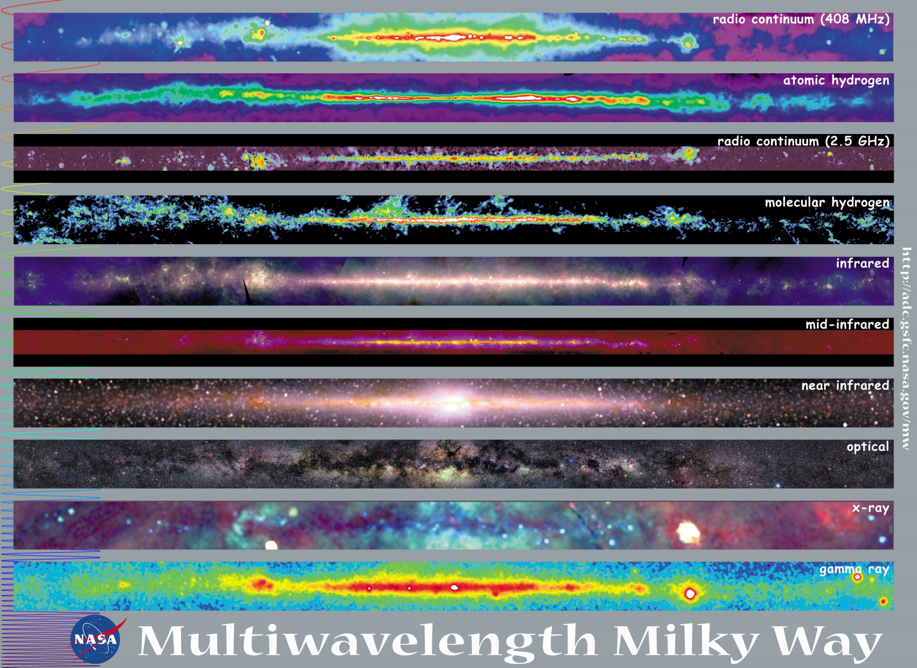
Observations with different probes allow us to learn different things!

Slide 11
Mapping out the proton
What does the proton look like in terms of the quarks and gluons inside it?
Position
Momentum
Spin
Flavor
Color
Theoretical and experimental concepts to describe and access position only born in mid-1990s. Pioneering measurements over past decade.
Vast majority of past four decades focused on
1-dimensional momentum structure! Since 1990s starting to consider other directions . . .
Polarized protons first studied in 1980s. How angular momentum of quarks and gluons add up still not well understood!
Early measurements of flavor distributions in valence region. Flavor structure at lower momentum fractions still yielding surprises!
Accounted for by theorists from beginning of QCD, but more detailed, potentially observable effects of color have come to forefront in last couple years . . .

Slide 12
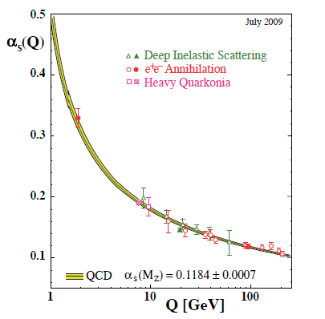
Perturbative QCD
Take advantage of running of the strong coupling constant with energy (asymptotic freedom)—weak coupling at high energies (short distances)
Perturbative expansion as in quantum electrodynamics (but many more diagrams due to gluon self-coupling!!)
Most importantly: pQCD provides a rigorous way of relating the fundamental field theory to a variety of physical observables!
Notes:
Scattering energy

Slide 13
Predictive power of pQCD
q(x₁)
Hard Scattering Process
X
g(x₂)
“Hard” (high-energy) probes have predictable rates given:
    Partonic hard scattering rates (calculable in pQCD)
    Parton distribution functions (need experimental input)
    Fragmentation functions (need experimental input)
Universal non-perturbative factors

Slide 14
Factorization and universality in perturbative QCD
Need to systematically factorize short- and long-distance physics—observable physical QCD processes always involve at least one long-distance scale (confinement)!
Long-distance (i.e. non-perturbative) functions need to be universal in order to be portable across calculations for many processes
Measure non-perturbative parton distribution functions (pdfs) and fragmentation functions (FFs) in many colliding systems over a wide kinematic range→constrain by performing
simultaneous fits to world data

Slide 15
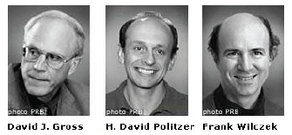
QCD: How far have we come?
QCD challenging!!
Three-decade period after initial birth of QCD dedicated to “discovery and development”
→ Symbolic closure: Nobel prize 2004 - Gross, Politzer, Wilczek for asymptotic freedom
Now very early stages of second phase:
quantitative QCD!
Notes:
[While some a generation or so ahead of me have enjoyed very exciting careers [centered on][based around] the discovery and development of QCD, …]

Slide 16
Advancing into the era of quantitative QCD: Theory already forging ahead!
In perturbative QCD, since 1990s starting to consider detailed internal QCD dynamics that parts with traditional parton model ways of looking at hadrons—and perform phenomenological calculations using these new ideas/tools!
  Non-collinearity of partons with parent hadron
  Non-linear evolution at small momentum fractions
  Various resummation techniques
Non-perturbative methods:
  Lattice QCD less and less limited by computing resources—now starting to perform calculations at the physical pion mass!
  AdS/CFT “gauge-string duality” an exciting recent development as first fundamentally new handle to try to tackle QCD in decades!

Slide 17
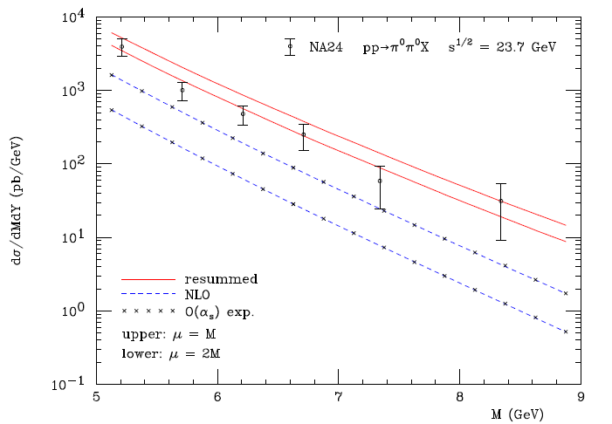
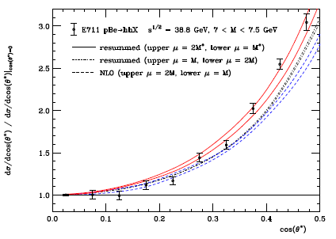
Example: Threshold resummation to extend pQCD to lower energies
pBe→hhX
pp→π⁰π⁰X
M (GeV)
cos θ*
Almeida, Sterman, Vogelsang PRD80, 074016 (2009) .
Much improved agreement compared to next-to-leading-order (NLO) calculations in a simple α_{s} expansion!

Slide 18
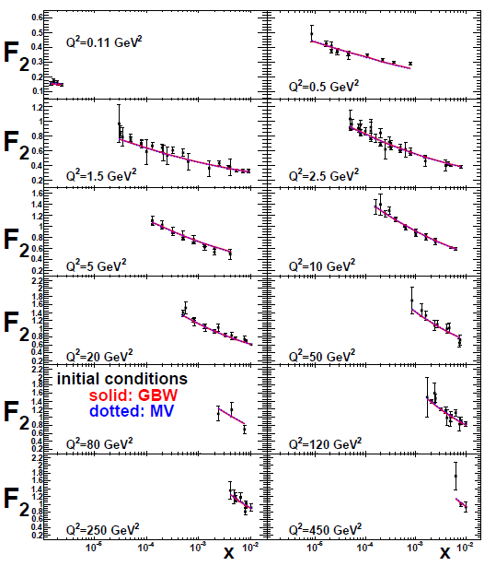
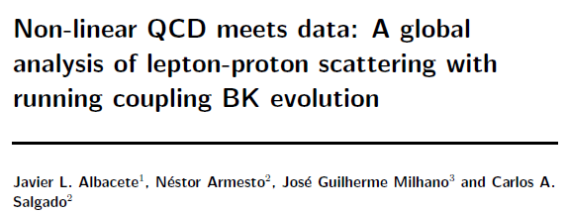
Example: Phenomenological applications of a non-linear gluon saturation regime at low x
Phys. Rev. D80, 034031 (2009)
Basic framework for non-linear QCD, in which gluon densities are so high that there’s a non-negligible probability for two gluons to combine, developed ~1997-2001 (by A. Kovner et al.!). But had to wait until “running coupling BK evolution” figured out in 2007 to compare rigorously to data!!
Fits to proton structure function data at low parton momentum fraction x.

Slide 19
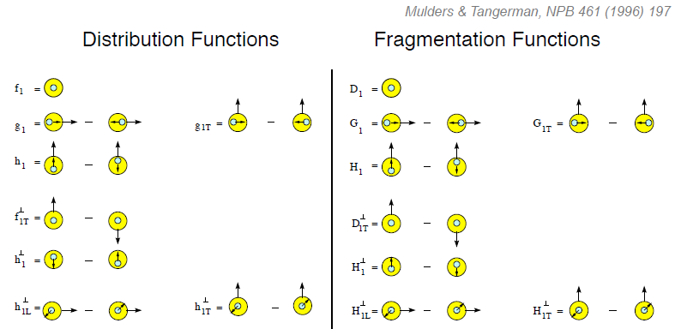
Dropping the simplifying assumption of collinearity: Transverse-momentum-dependent distributions (TMDs)
Collinear
Worm gear
“Modern-day ‘testing’ of (perturbative) QCD is as much about pushing the boundaries of its applicability as about the verification that QCD is the correct theory of hadronic physics.”
– G. Salam, hep-ph/0207147 (DIS2002 proceedings)
Collinear
Transversity
Sivers
Polarizing FF
Boer-Mulders
Pretzelosity
Collins
Worm gear

Slide 20
Critical to perform experimental work where quarks and gluons are relevant d.o.f. in the processes studied!

Slide 21
Evidence for variety of spin-momentum correlations in proton, and in process of hadronization!
Collinear
Worm gear
Collinear
Transversity
Measured non-zero!
Sivers
Polarizing FF
Boer-Mulders
Pretzelosity
Collins
Worm gear

Slide 22
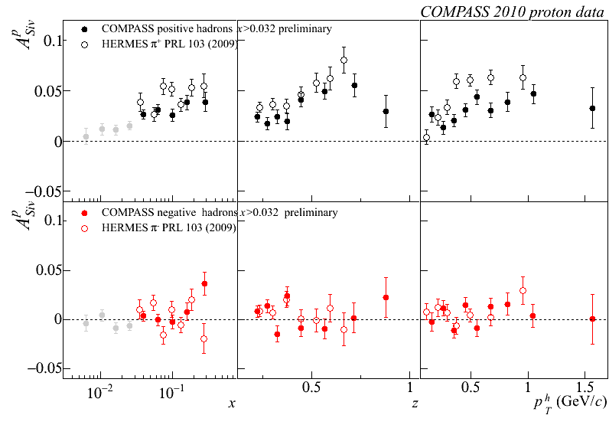
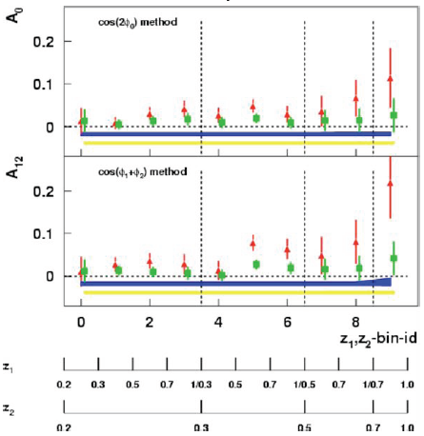
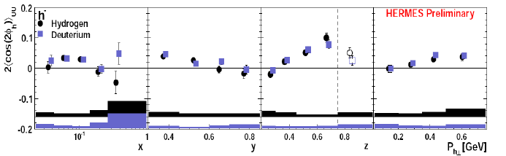
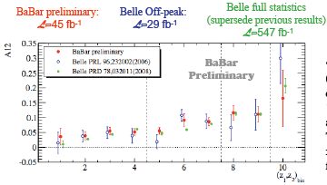
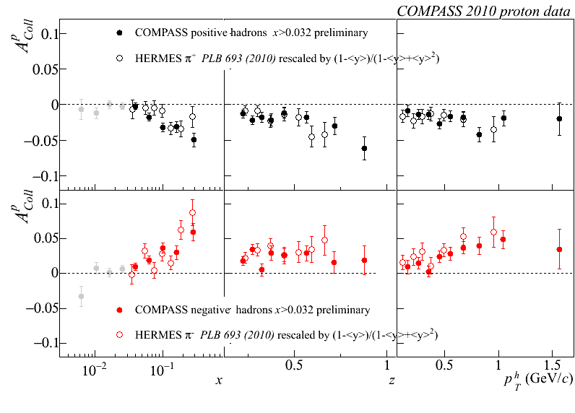
A flurry of new experimental results from semi-inclusive deep-inelastic scattering and e+e- annihilation over last ~8 years!
Sivers
BELLE Collins: PRL96, 232002 (2006)
Boer-Mulders
SPIN2008
Transversity x Collins
BaBar Collins: Released August 2011

Slide 23
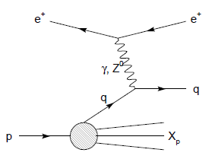
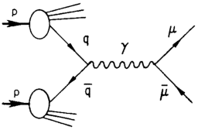
Modified universality of T-odd transverse-momentum-dependent distributions:
Color in action!
DIS: attractive final-state int.
Drell-Yan: repulsive initial-state int.
Some DIS measurements already exist. A polarized Drell-Yan measurement will be a crucial test of our understanding of QCD!
As a result:

Slide 24
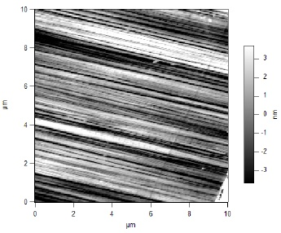
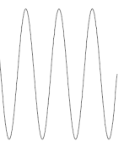
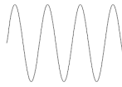
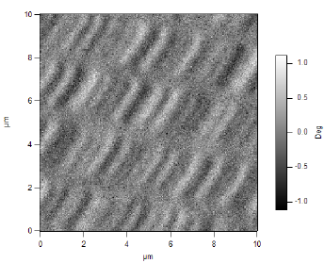
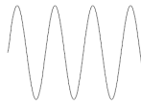
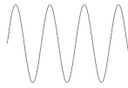
What things “look” like depends on how you “look”!
Slide courtesy of K. Aidala
Magnetic Force Microscopy
Computer Hard Drive
magnetic tip
Topography
Probe interacts with system being studied!
Lift height
Magnetism

Slide 25
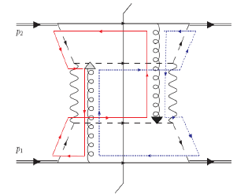
Factorization, color, and hadronic collisions
  In 2010, theoretical work by T.C. Rogers, P.J. Mulders claimed pQCD factorization broken in processes involving hadro-production of hadrons if parton transverse momentum taken into account (TMD pdfs and/or FFs)
  “Color entanglement”
PRD 81:094006 (2010)
Non-collinear pQCD an exciting subfield—lots of recent experimental activity, and theoretical questions probing deep issues of both universality and factorization in pQCD!
Color flow can’t be described as flow in the two gluons separately. Requires simultaneous presence of both!

Slide 26
How to keep pushing forward experimentally?
Need continued measurements where quarks and gluons are relevant degrees of freedom
  Need “high enough” collision energies
Need to study different collision systems and processes!!
  Electroweak probes of QCD systems (DIS): Allow study of many aspects of QCD in hadrons while being easy to calculate
  Strong probes of QCD systems (hadronic collisions): The real test of our understanding! Access color . . .
My own work—
Hadronic collisions
  Drell-Yan → Fermilab E906
  Variety of electroweak and hadronic final states → PHENIX experiment at the Relativistic Heavy Ion Collider (RHIC)
Deep-inelastic scattering
  Working toward Electron-Ion Collider as a next-generation facility
If you can’t understand p+p collisions, your work isn’t done yet in understanding QCD in hadrons!

Slide 27


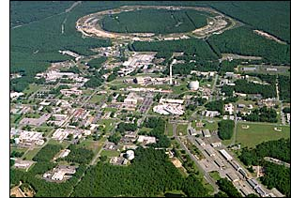
The Relativistic Heavy Ion Collider at Brookhaven National Laboratory
New York City
27

Slide 28
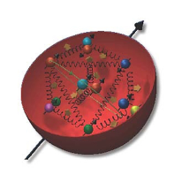
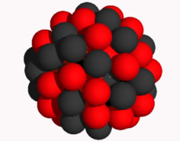
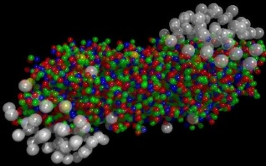
Why did we build RHIC?
To study QCD!
An accelerator-based program, but not designed to be at the energy (or intensity) frontier. More closely analogous to many areas of condensed matter research—create a system and study its properties!
What systems are we studying?
  “Simple” QCD bound states—the proton is the simplest stable bound state in QCD (and conveniently, nature has already created it for us!)
  Collections of QCD bound states (nuclei, also available out of the box!)
  QCD deconfined! (quark-gluon plasma, some assembly required!)
Understand more complex QCD systems within
the context of simpler ones
RHIC was designed from the start as a single facility capable of nucleus-nucleus, proton-nucleus, and proton-proton collisions

Slide 29
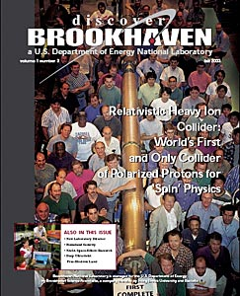
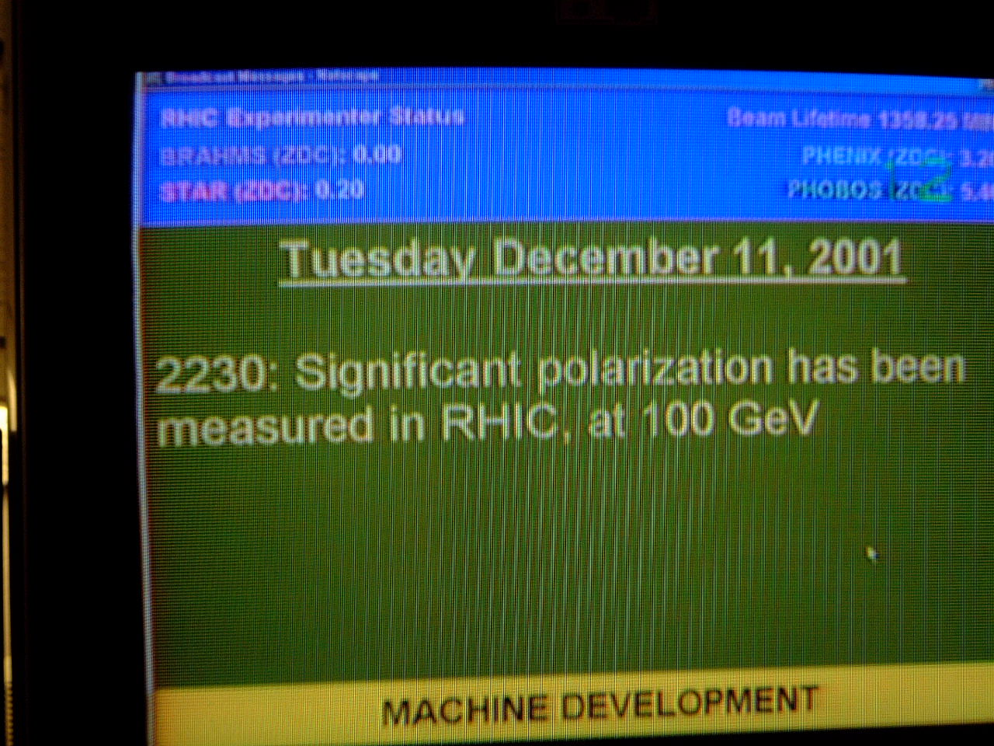
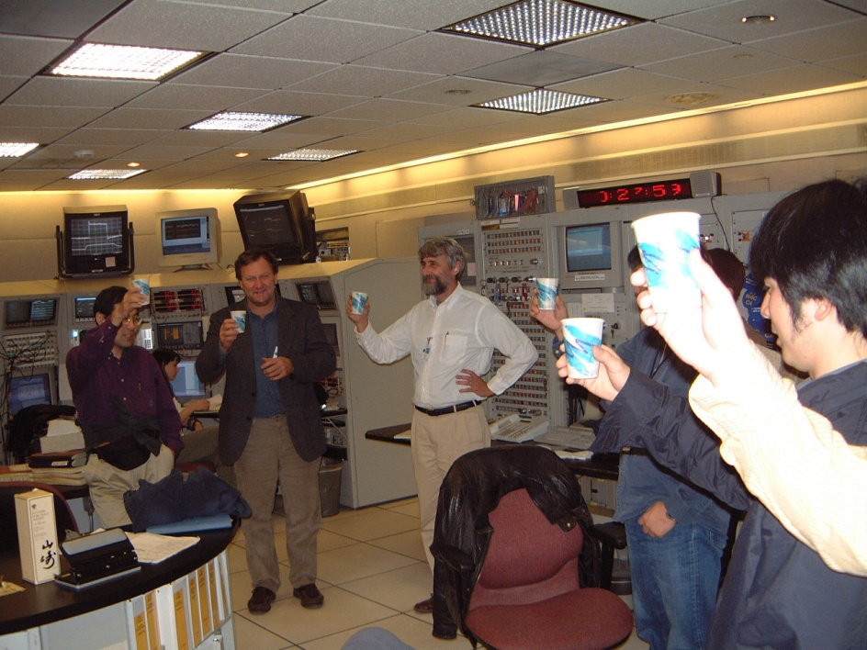
First and only polarized proton collider
29

Slide 30
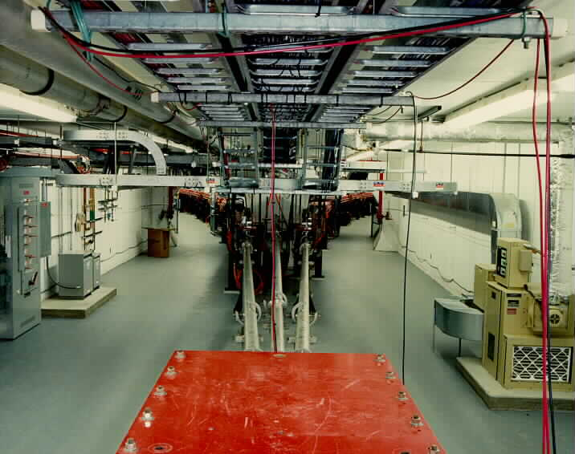
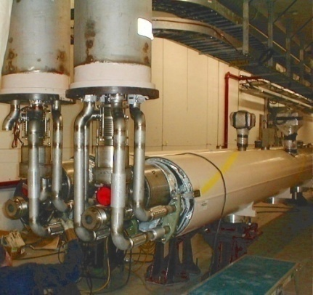
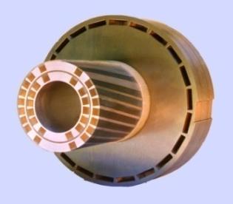
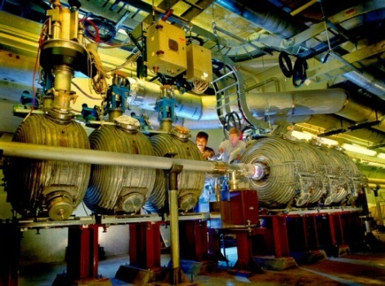
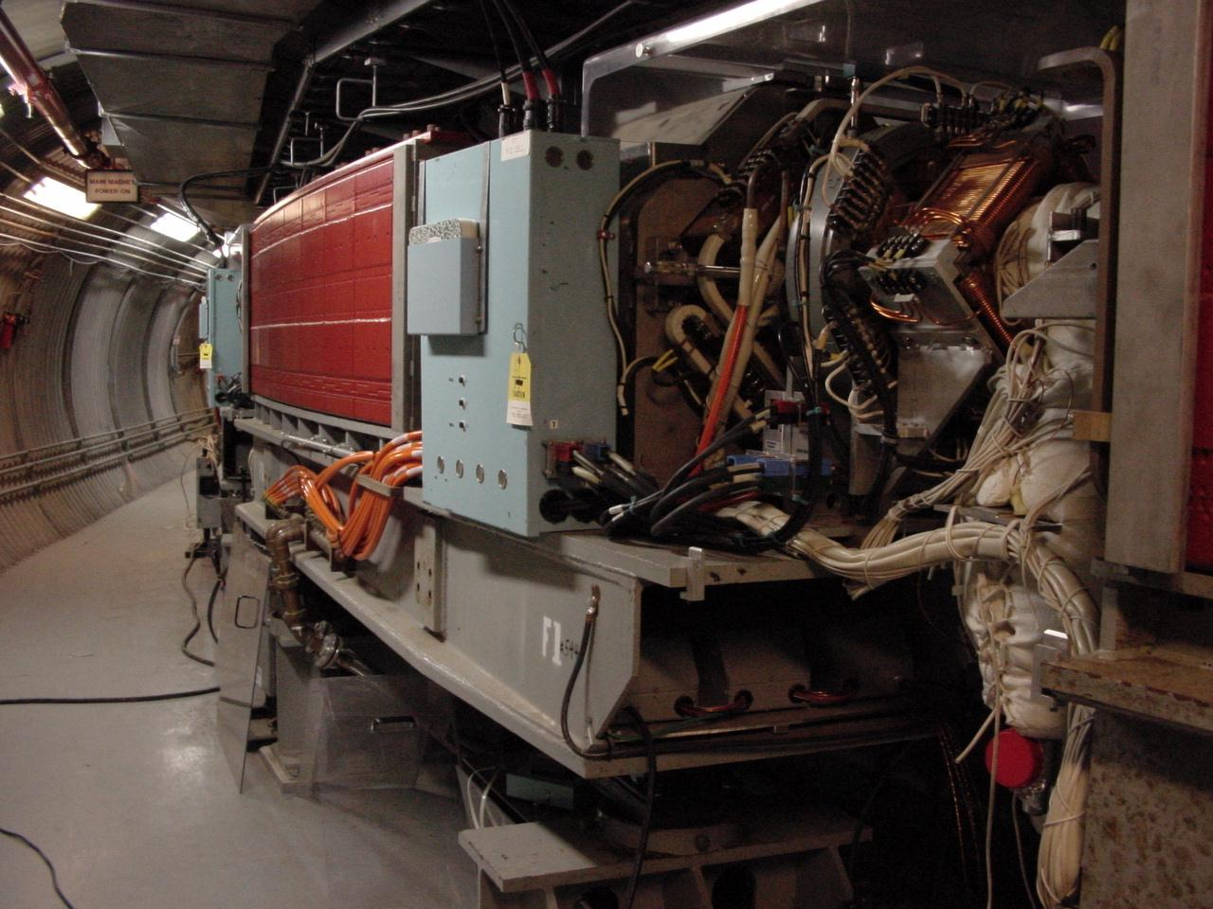
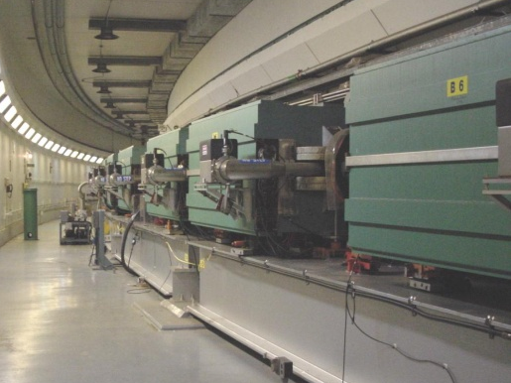
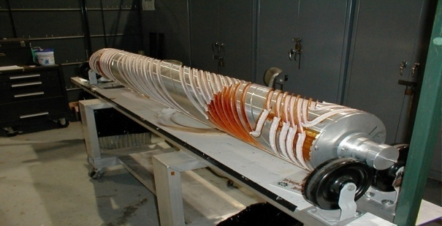
RHIC as a polarized p+p collider
Absolute Polarimeter (H jet)
RHIC pC Polarimeters
Siberian Snakes
BRAHMS & PP2PP
Siberian Snakes
PHENIX
Spin Flipper
STAR
Spin Rotators
Various equipment to maintain and measure beam polarization through acceleration and storage
Partial Snake
Helical Partial
Snake
Polarized Source
Strong Snake
LINAC
AGS
200 MeV Polarimeter
BOOSTER
Rf Dipole
AGS Internal Polarimeter
AGS pC Polarimeter
30

Slide 31


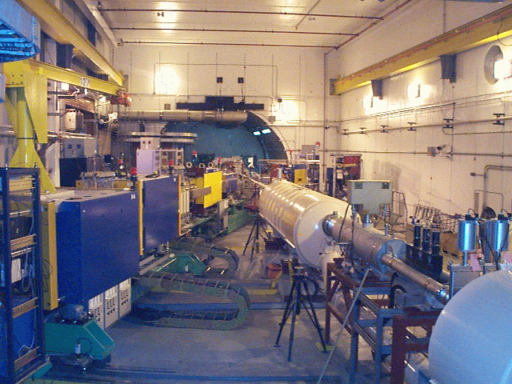
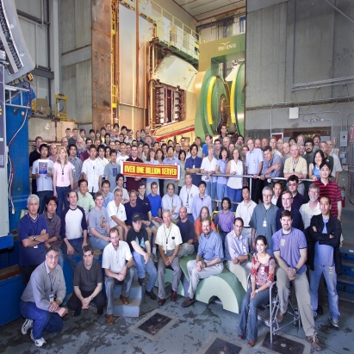
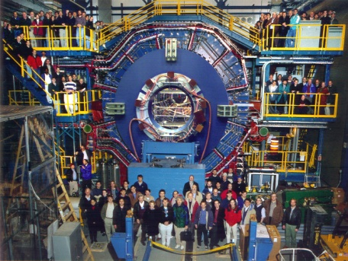


Spin physics at RHIC
Polarized protons at RHIC 2002-present
Mainly √s = 200 GeV, also 62.4 GeV in 2006, started 500 GeV program in 2009
Two large multipurpose detectors: STAR and PHENIX
  Longitudinal or transverse polarization
One small spectrometer until 2006: BRAHMS
  Transverse polarization only
Transverse spin only
(No rotators)
Longitudinal or transverse spin
Longitudinal or transverse spin

Slide 32
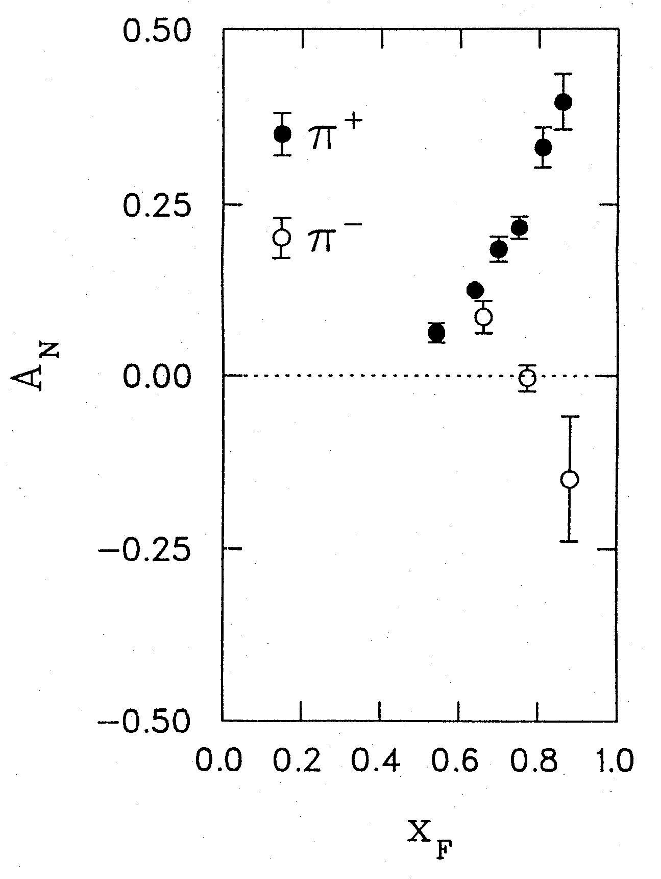
Transversely polarized hadronic collisions: A discovery ground
Argonne ZGS, p_{beam} = 12 GeV/c
left
right
What’s the origin of such striking asymmetries?? We’ll need to wait more than a decade for the birth of a new subfield in order to explore the possibilities . . .
W.H. Dragoset et al., PRL36, 929 (1976)

Slide 33
Transverse-momentum-dependent distributions and single-spin asymmetries
1989: “Sivers mechanism” proposed
Take into account the transverse momentum (k_{T}) of quarks within the proton, and postulate a correlation between quark k_{T} and proton spin!
Single-spin asymmetries ~ S•(p₁×p₂)
D.W. Sivers, PRD41, 83 (1990)

Slide 34

Transverse single-spin asymmetries:
From low to high energies!
ANL
√s=4.9 GeV
BNL
√s=6.6 GeV
FNAL
√s=19.4 GeV
RHIC
√s=62.4 GeV
RHIC
√s=200 GeV
Effects persist to RHIC energies
→ Can probe this non-perturbative structure of nucleon in a calculable regime!
π⁰
left
STAR
right

Slide 35
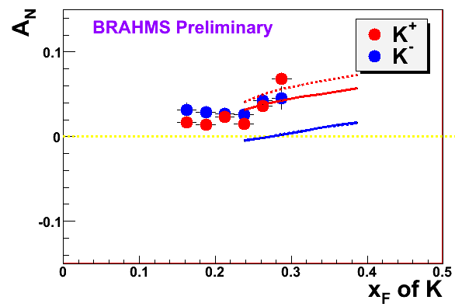
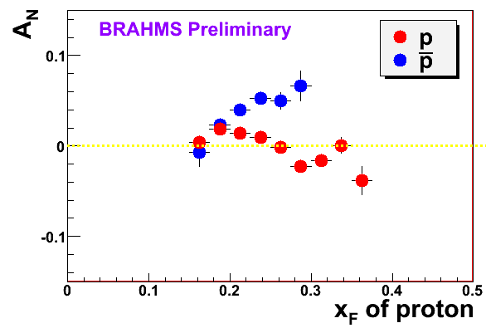
High-x_{F} asymmetries, but not valence quarks??
Pattern of pion species asymmetries in the forward direction→ valence quark effect.
But this conclusion confounded by kaon and antiproton asymmetries from RHIC!
Note different scales
PRL 101, 042001 (2008)
K
K
K⁻ asymmetries
underpredicted
200 GeV
62.4 GeV
p
p
Large antiproton asymmetry?!
(No one has attempted calculations yet . . .)
200 GeV
62.4 GeV

Slide 36
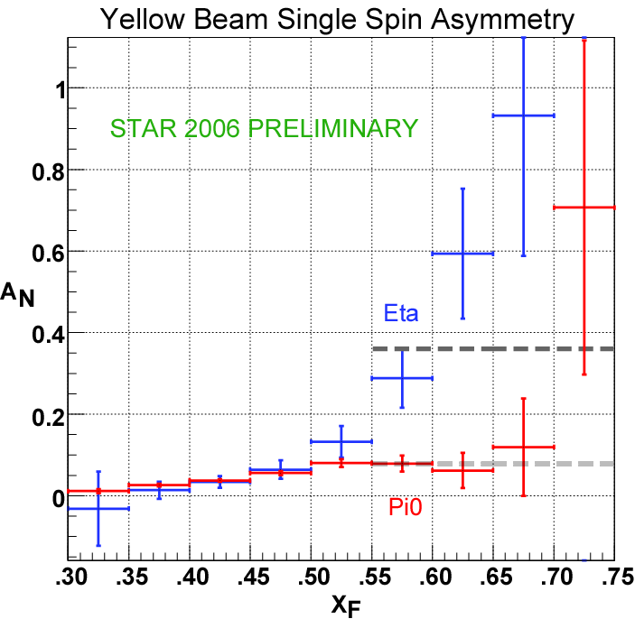
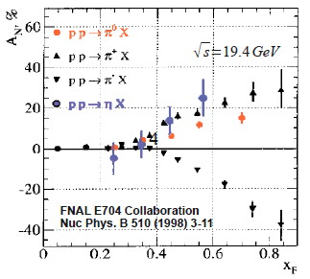
Another surprise: Transverse single-spin asymmetry in eta meson production
Further evidence against a valence quark effect!
Larger than the neutral pion!
STAR
Note earlier Fermilab E704 data consistent . . .

Slide 37



Recent PHENIX etas show no sharp increase for x_{F} > 0.5!
But still suggests larger asymmetry for etas than for neutral pions!
Will need to wait for final results from both collaborations . . .

Slide 38



pQCD calculations for η mesons recently enabled by first-ever fragmentation function parametrization
Simultaneous fit to world e+e- and p+p data
  e+e- annihilation to hadrons simplest colliding system to study FFs
  Technique to include semi-inclusive deep-inelastic scattering and p+p data in addition to e+e only developed in 2007!
  Included PHENIX p+p cross section in eta FF parametrization
CAA, F. Ellinghaus, R. Sassot, J.P. Seele, M. Stratmann,
PRD83, 034002 (2011)

Slide 39


First eta transverse single-spin asymmetry theory calculation
Using new eta FF parametrization, first theory calculation now published (STAR kinematics)
Obtain larger asymmetry for eta than for neutral pion over entire x_{F} range, not nearly as large as STAR result
Due to strangeness contribution!
Cyclical process of refinement—the more non-perturbative functions are constrained, the more we can learn from additional measurements
Kanazawa + Koike, PRD83, 114024 (2011)

Slide 40


Testing TMD-factorization breaking with (unpolarized) p+p collisions
PHENIX experiment, PRD82, 072001 (2010)
PRD 81:094006 (2010)
Want to test prediction using photon-hadron and dihadron correlation measurements in unpolarized p+p collisions
  Lots of expertise on such measurements within PHENIX, driven by heavy ion program!
Calculate observable assuming factorization works
Will show different shapes than data??
BUT—first need reduced uncertainties on the transverse-momentum-dependent distributions as input to the calculations
  Working w/T. Rogers to parametrize using Drell-Yan and Z boson data, including recent Z measurements from the Fermilab Tevatron and CERN LHC!
Z boson production
CDF experiment,
Tevatron
(Curves shown here just empirical parameterizations from experimental paper)

Slide 41
Single-spin asymmetries and the proton as a QCD “laboratory”
Transversity pdf:
Correlates proton transverse spin and quark transverse spin
Sivers pdf:
Correlates proton transverse spin and quark transverse momentum
Boer-Mulders pdf:
Correlates quark transverse spin and quark transverse momentum
S_{p}-S_{q} coupling??
S_{p}-L_{q} coupling??
S_{q}-L_{q} coupling??

Slide 42
Summary and outlook
We still have a ways to go from the quarks and gluons of QCD to full descriptions of the protons and nuclei of the world around us!
The proton as the simplest QCD bound state provides a QCD “laboratory” analogous to the atom’s role in the development of QED
After an initial “discovery and development” period lasting ~30 years, we’re now taking the first steps into an exciting new era of quantitative QCD!

Slide 43
Afterword:
QCD “versus” nucleon structure?
A personal perspective

Slide 44
We shall not cease from exploration
And the end of all our exploring
Will be to arrive where we started
And know the place for the first time.
T.S. Eliot

Slide 45
Extra

Slide 46

Drell-Yan complementary to DIS

Slide 47




Fermilab E906/Seaquest: A dedicated Drell-Yan experiment
Follow-up experiment to FNAL E866 with main goal of extending measurements to higher x
120 GeV proton beam from FNAL Main Injector (E866: 800 GeV)
  D-Y cross section ~1/s – improved statistics
E906
E866

Slide 48


Fermilab E906
Targets: Hydrogen and deuterium (liquid), C, Ca, W nuclei
  Also cold nuclear matter program
Commissioning starts in March, data-taking through ~2013

Slide 49

E906 Station 4 plane for tracking and muon identification
Assembled from old proportional tubes scavenged from LANL “threat reduction” experiments!

Slide 50

Azimuthal dependence of unpolarized Drell-Yan cross section
cos2φ term sensitive to correlations between quark transverse spin and quark transverse momentum! → Boer-Mulders TMD
Large cos2φ dependence seen in pion-induced Drell-Yan
ν
NA10 dataa
194 GeV/c
π⁻+W
Q_{T} (GeV)
D. Boer, PRD60, 014012 (1999)

Slide 51

Azimuthal dependence of Drell-Yan cross section in terms of TMDs
Arnold, Metz, Schlegel, PRD79, 034005 (2009)

Slide 52


What about proton-induced Drell-Yan?
Significantly reduced cos2φ dependence in proton-induced D-Y
Suggests sea quark transverse spin-momentum correlations small?
Will be interesting to measure for higher-x sea quarks in E906!
E866, PRL 99, 082301
(2007)
E866

Slide 53

The Electron-Ion Collider
A facility to bring this new era of quantitative QCD to maturity!
How can QCD matter be described in terms of the quark and gluon d.o.f. in the field theory?
How does a colored quark or gluon become a colorless object?
Study in detail
  “Simple” QCD bound states: Nucleons
  Collections of QCD bound states: Nuclei
  Hadronization
Collider energies: Focus on
sea quarks and gluons

Slide 54

Why an Electron-Ion Collider?
Electroweak probe
  “Clean” processes to interpret (QED)
  Measurement of scattered electron → full kinematic information on partonic scattering
Collider mode → Higher energies
  Quarks and gluons relevant d.o.f.
  Perturbative QCD applicable
  Heavier probes accessible (e.g. charm, bottom, W boson exchange)

Slide 55




Accelerator concepts
Polarized beams of p, ³He
  Previously only fixed-target polarized experiments!
Beams of light → heavy ions
  Previously only fixed-target e+A experiments!
Luminosity 100-1000x that of HERA e+p collider
Two concepts: Add electron facility to RHIC at BNL or ion facility to CEBAF at JLab
EIC
EIC (20x100) GeV
EIC (10x100) GeV
Notes:
Add sqrt(s) ranges?

Slide 56

PHENIX detector
Philosophy:
  High rate capability to measure rare probes,
  limited acceptance.
2 central spectrometers
  Track charged particles and detect electromagnetic processes
2 forward muon spectrometers
  Identify and track muons
2 forward calorimeters (as of 2007)
  Measure forward pions, etas
Relative Luminosity
  Beam-Beam Counter (BBC)
  Zero-Degree Calorimeter (ZDC)

Slide 57


Upgrading the PHENIX detector:
Thinking big . . . Or, well, small
Conceptual design for detector to be installed between ~2017 and ~2021
Current PHENIX detector

Slide 58


sPHENIX detector concept
PHENIX discussing major overhaul of detector beyond ~2016
Being designed such that it could take advantage of initial electron-proton, electron-ion collisions
SPHNX??

Slide 59

Testing factorization breaking with p+p comparison measurements for heavy ion physics:
Unanticipated synergy between programs!
PHENIX, PRD82, 072001 (2010)
Implications for observables describable using Collins-Soper-Sterman (“Q_{T}”) resummation formalism
Try to test using photon-hadron and dihadron correlation measurements in unpolarized p+p collisions at RHIC
Lots of expertise on such measurements within PHENIX, driven by heavy ion program!
(Curves shown here just empirical parameterizations from PHENIX paper)

