Slide 1
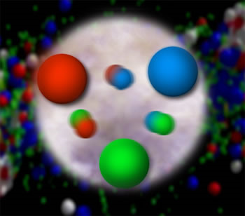
From hadrons to hidden assumptions:
My recent work in quantum chromodynamics and foundations of physics
Christine A. Aidala
University of Michigan
University of Michigan
September 11, 2019

Slide 2





Acknowledgments
University of Michigan
Associate Professor Support Fund

Slide 3
Acknowledgments:
Group members 2016-present
Undergraduates
Ezra Lesser
Ruby Araj
Nick Kamp
Ashley Cavanagh
Jessen Jia
Hayden Hansen
Nikhil Shankar
Jem Guhit
Athira K V
Waleed El Rawi
Erik Loyd
Anna Cooleybeck
Yuxi Xie
Jessie Guo
Micah Johnson
Julie Rakas
Luc Le Pottier
Postdocs
Mike Skoby
Joe Osborn
Sookhyun Lee
Visiting Postdoc
Trambak Bhattacharyya
Visiting Scholars
Dylan Manna
Duraid Asha
Post-Bachelor’s
Tyler Ulrich
Daniel Zile
High School Student
Benjamin Kovacs
Ph.D. Students
Bryan Ramson
Joe Osborn
Catherine Ayuso
Nicole Lewis
Enrique Gamez
Kara Mattioli
William Dean
Jordan Roth
Cynthia Nunez
Desmond Shangase
Dillon Fitzgerald
Chami Amarasinghe
Ceren Dag

Slide 4
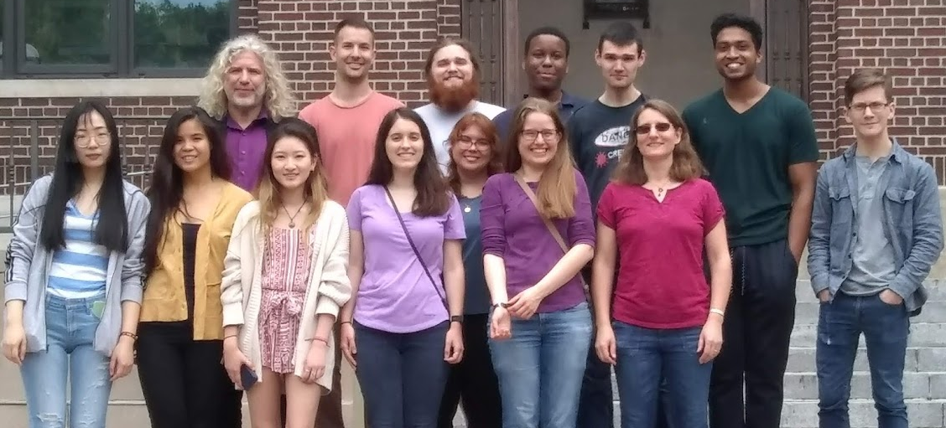
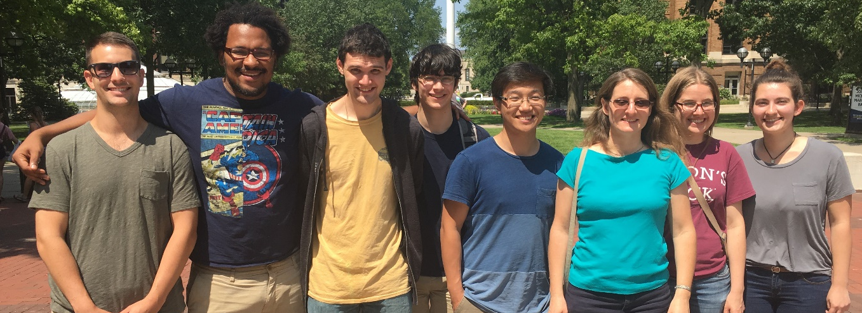


Acknowledgments:
Group members 2016-present
Undergraduates
Ezra Lesser
Ruby Araj
Nick Kamp
Ashley Cavanagh
Jessen Jia
Hayden Hansen
Nikhil Shankar
Jem Guhit
Athira K V
Waleed El Rawi
Erik Loyd
Anna Cooleybeck
Yuxi Xie
Micah Johnson
Julie Rakas
Luc Le Pottier
Postdocs
Mike Skoby
Joe Osborn
Sookhyun Lee
Visiting Postdoc
Trambak Bhattacharyya
Visiting Scholars
Dylan Manna
Duraid Asha
Post-Bachelor’s
Tyler Ulrich
Daniel Zile
High School Students
Benjamin Kovacs
Ph.D. Students
Bryan Ramson
Joe Osborn
Catherine Ayuso
Nicole Lewis
Enrique Gamez
Kara Mattioli
William Dean
Jordan Roth
Cynthia Nunez
Desmond Shangase
Dillon Fitzgerald
Chami Amarasinghe

Slide 5
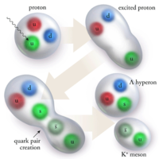
Quantum Chromodynamics:
Theory of strong interactions
  Fundamental field theory in hand since the early 1970s—BUT . . .
  Quark and gluon degrees of freedom in the theory cannot be observed or manipulated directly in experiment!
Color confinement—quarks and gluons are confined to color-neutral bound states
CLAS Collaboration
PRL 113, 152004 (2014)
Notes:
Beams of protons common—lightest stable bound state along w/antiprotons and much more readily available (hydrogen bottle). Also beams of long-lived unstable QCD bound states: neutrons (but tricky to steer and manipulate w/o electrical charge); pions, kaons travel up to tens of meters. Can _produce and measure_, without further manipulating as you typically want to for a beam, dozens of other unstable bound states.

Slide 6
How do we understand the visible matter in our universe in terms of the quark and gluon degrees of freedom of quantum chromodynamics?
How can studying QCD systems teach us more about fundamental aspects of QCD as a theory?
Notes:
Goals of all of QCD research

Slide 7
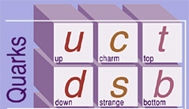
My areas of focus within QCD
Proton structure, specifically spin-spin and spin-momentum correlations, analogous to spin-spin and spin-orbit couplings in atoms
Observables sensitive to non-Abelian aspects of the theory, due to the fact that gluons couple to each other
New focus: formation of color-neutral bound states, “hadrons,” from colored quarks and gluons
  “Hadronization”

Slide 8
Hadron structure vs. hadron formation
Both relate the quark and gluon degrees of freedom of QCD to particles/states we can work with in the lab/nature
However, hadron formation inherently dynamic—a process
  In contrast to studying the dynamics of quarks and gluons within hadrons, e.g. via spin-momentum correlations, where really studying average dynamics
  Thus hadronization much less developed and more open a subfield than hadron structure. . .

Slide 9
Jets and jet hadronization
When a quark or gluon gets scattered out of a bound state (e.g. proton) at high energies, a series of gluon radiation and quark-antiquark pair production processes occurs
Never see free quarks or gluons! Everything becomes part of new bound states. Get a spray of particles in your detector, a “jet”
Developments in the last 11 years allowing robust comparison between experiment and theory have made jets powerful tools at collider facilities

Slide 10
Jets and jet hadronization
When a quark or gluon gets scattered out of a bound state (e.g. proton) at high energies, a series of gluon radiation and quark-antiquark pair production processes occurs
Never see free quarks or gluons! Everything becomes part of new bound states. Get a spray of particles in your detector, a “jet”
Developments in the last 11 years allowing robust comparison between experiment and theory have made jets powerful tools at collider facilities
So a jet as a whole can provide kinematic information about the gluon or quark scattered out of a proton or produced in a decay
  E.g. Higgs decaying to a beauty-antibeauty quark pair, observed as a jet pair

Slide 11
Jets and jet hadronization
When a quark or gluon gets scattered out of a bound state (e.g. proton) at high energies, a series of gluon radiation and quark-antiquark pair production processes occurs
Never see free quarks or gluons! Everything becomes part of new bound states. Get a spray of particles in your detector, a “jet”
Developments in the last 11 years allowing robust comparison between experiment and theory have made jets powerful tools at collider facilities
But jets also provide an environment to study how QCD bound states form
So a jet as a whole can provide kinematic information about the gluon or quark scattered out of a proton or produced in a decay
  E.g. Higgs decaying to a beauty-antibeauty quark pair, observed as a jet pair

Slide 12
Understanding hadronization:
A wish list
Courtesy Joe Osborn
jet
A way to connect the outgoing quark or gluon to the final-state hadrons
  - Jets
Complete information on the flavor of the outgoing quark and the types of produced particles
quark
or gluon

Slide 13
Understanding hadronization:
A wish list
Courtesy Joe Osborn
jet
A way to connect the outgoing quark or gluon to the final-state hadrons
  - Jets
Complete information on the flavor of the outgoing quark and the types of produced particles
π⁺
n
Λ⁰
η
up
parton

Slide 14
Understanding hadronization:
A wish list
Courtesy Joe Osborn
jet
A way to connect the outgoing quark or gluon to the final-state hadrons
  - Jets
Complete information on the flavor of the outgoing quark and the types of produced particles
π⁺
n
Λ⁰
η
up
parton
Baryon vs. meson
Correlations (e.g. strangeness, heavy flavor)
Resonance production (φ, J/ψ, Υ)
…

Slide 15
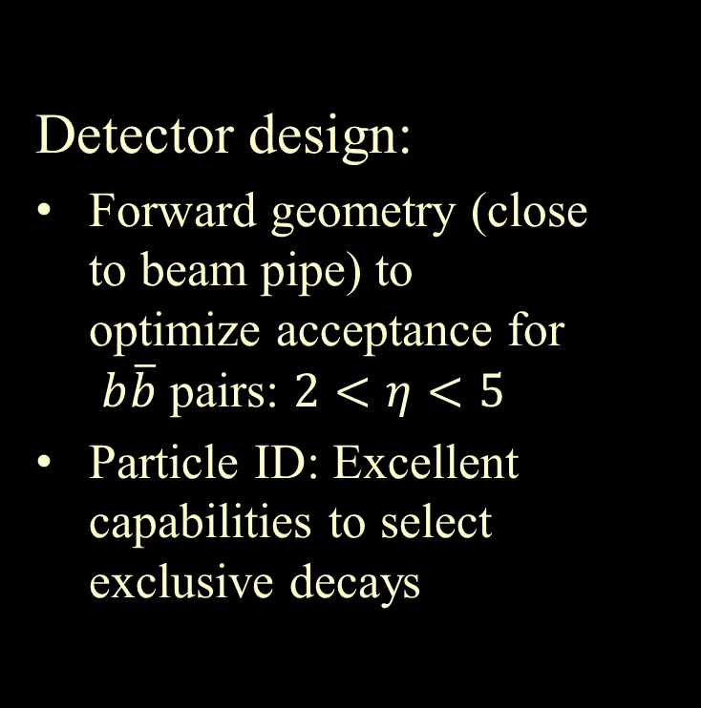
The Large Hadron Collider beauty experiment
Detector design:
Forward geometry (close
to beam pipe) to
optimize acceptance for
$b\overline{b}$ pairs: $2<η<5$
Particle ID: Excellent capabilities to select
exclusive decays
LHCb is the experiment devoted to heavy flavor at the LHC

Slide 16
The Large Hadron Collider beauty experiment
Detector design:
Forward geometry (close
to beam pipe) to
optimize acceptance for
$b\overline{b}$ pairs: $2<η<5$
Particle ID: Excellent capabilities to select
exclusive decays
LHCb is the experiment devoted to heavy flavor at the LHC
Some features specifically attractive for hadronization:
Full jet reconstruction with tracking, ECAL, HCAL
  Identification of jets from charm and beauty quarks
Charged hadron identification from 2 < p < 100 GeV
Can study identified particle distributions within jets!

Slide 17
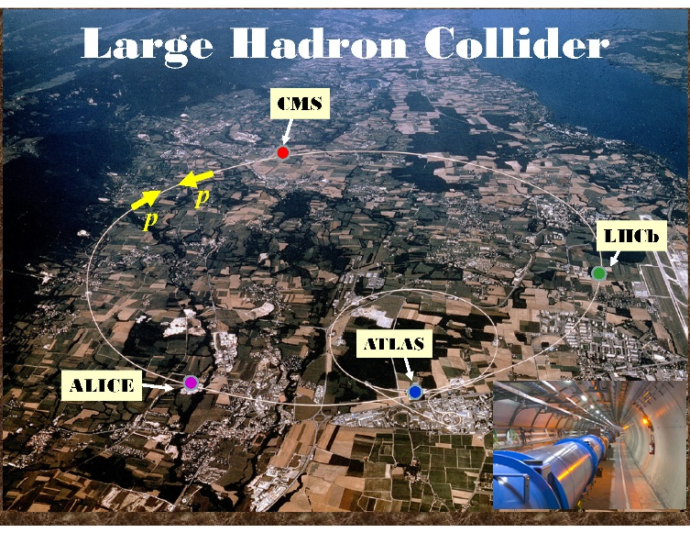
Notes:
The proton is about 10^-15 m in size, a million times smaller than “nanoscale” science. So we need extremely short wavelengths, which we can achieve through wave-particle duality by accelerating particles to very high energies. One of my experiments is at the Large Hadron Collider at the European Centre for Nuclear Research (CERN) near Geneva, Switzerland. Here’s the Geneva Airport, and Lac Leman, and the border with France is here. It’s a 27-km (~17-mile) ring about 100 m below ground, with four giant experiments.

Slide 18
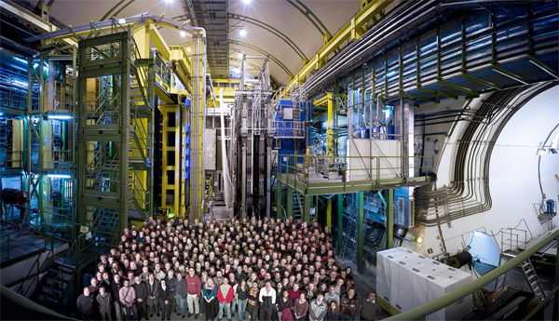
LHCb Collaboration
~850 scientists from 79 institutions in 18 countries
  The “small” LHC experiment!
U-M officially admitted as new collaborating institution Sep 2017
  First nuclear-funded group in U.S. for LHCb (NSF)

Slide 19
Studying hadronization in jets: Forward Z boson+jet
q
Z
q
Z
Z boson+jet is predominantly sensitive to quark jets
Forward kinematics further increases fraction of light quark jets, in particular up and down flavored quarks
q
g
g
q

Slide 20
Studying hadronization in jets: Forward Z boson+jet
LHCb previously measured the forward Z+jet cross section
  JHEP 05, 131 (2016)
Now have measured charged hadron distributions within the jet, in the same data set
  arXiv:1904.08878
First measurement at the LHC of charged hadrons within Z-tagged jets
First measurement at the LHC of charged hadrons-in-jets at forward rapidity

Slide 21
Charged hadrons in jets: Observables
Longitudinal momentum fraction z
  Historically, this has typically been the only observable considered
Transverse momentum with respect to jet axis j_{T}
Radial profile r
Lays the foundation for a broader hadronization program at LHCb utilizing
Full particle identification!
  Unprecedented within jets produced at a hadron collider
Heavy flavor jet tagging
Resonance production within jets
Multiparticle correlations within a jet
Hadron distributions in correlated jet pairs

Slide 22
Charged hadrons in jets: Observables
Longitudinal momentum fraction z
  Historically, this has typically been the only observable considered
Transverse momentum with respect to jet axis j_{T}
Radial profile r
Lays the foundation for a broader hadronization program at LHCb utilizing
Full particle identification!
  Unprecedented within jets produced at a hadron collider
Charm- and beauty-initiated jets
Resonance production within jets
Multiparticle correlations within a jet
Hadron distributions in correlated jet pairs

Slide 23
Analysis
Work by former PD Joe Osborn
arXiv:1904.08878
LHCb-PAPER-2019-012
Follow similar analysis strategy to previous ATLAS and LHCb papers
  ATLAS: EPJC 71, 1795 (2011), NPA 978, 65 (2018)
  LHCb: PRL 118, 192001 (2017)

Slide 24
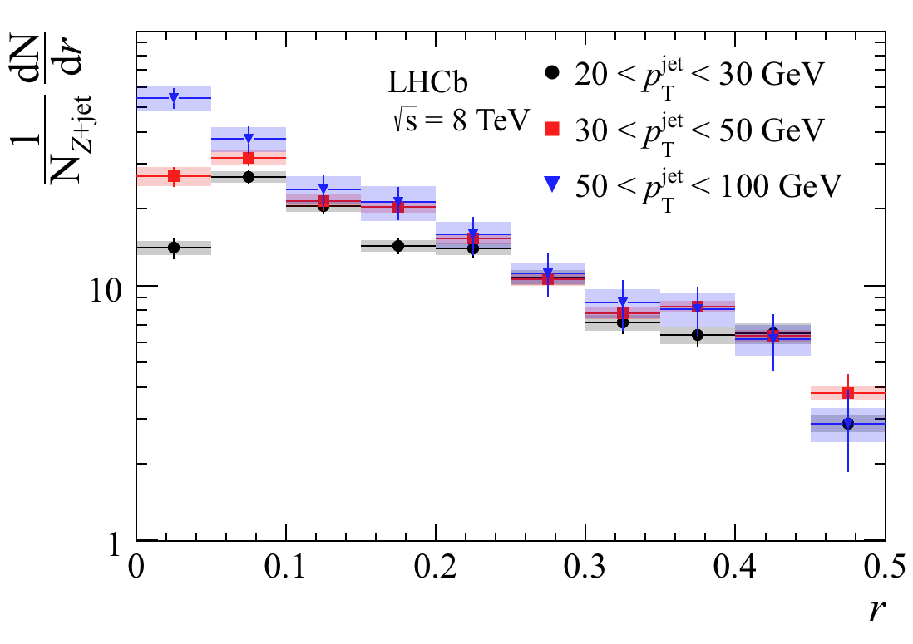
Results: Radial profiles
Observe that the greater energy available in higher transverse momentum jets leads to more hadrons produced (logical)
New: ~All of the additional particles are produced close to the jet axis, and go from a depletion close to the axis to an excess
arXiv:1904.08878
LHCb-PAPER-2019-012
Notes:
Explain why look at pT of the jets – any momentum transverse to the original beam axis indicates a [violent] interaction, a [large] momentum transfer to/between constituents.

Slide 25
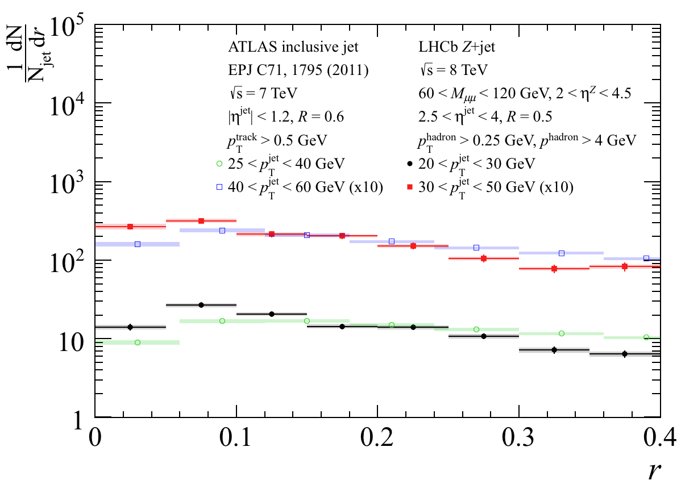
Differences between quark- and gluon-dominated jet samples: Radial profile
Quark-dominated jets more collimated than gluon-dominated jets measured by ATLAS
  I.e. more charged hadrons at small radii, fewer at large radii
  Qualitatively agrees with conventional expectations, but this shows clear and quantitative evidence from data
arXiv:1904.08878
LHCb-PAPER-2019-012
Notes:
If anything, effect would be enhanced if jet pT bins were exactly matched

Slide 26
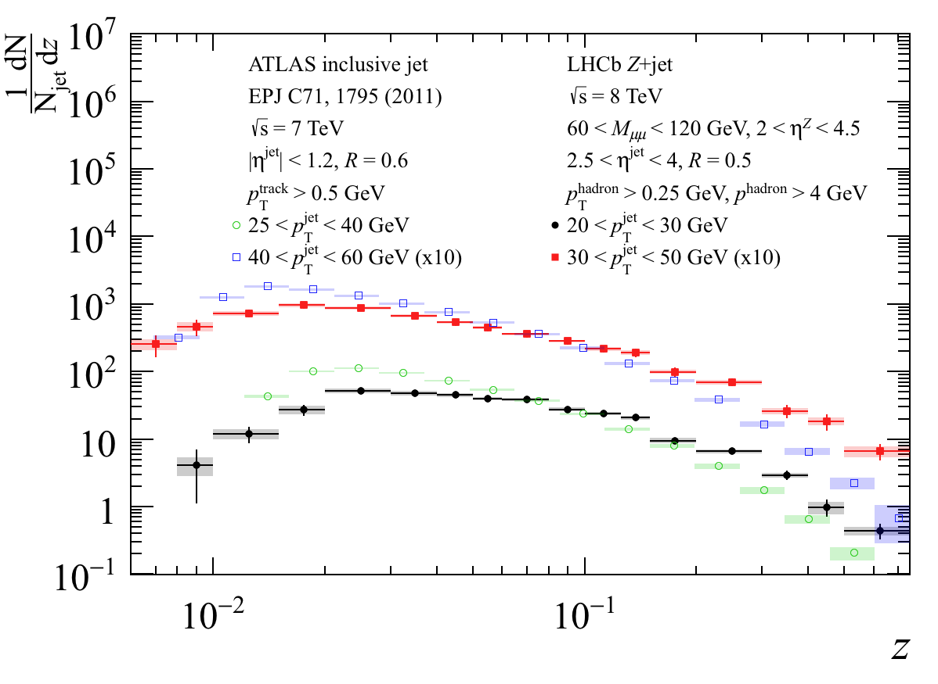
Differences between quark- and gluon-dominated jet samples: Longitudinal profile
Quark-dominated jets have relatively more hadrons produced at higher longitudinal momentum fractions than gluon-dominated jets
arXiv:1904.08878
LHCb-PAPER-2019-012
  Will be interesting to follow up with an identified particle measurement. Do the hadrons produced at large momentum fractions in quark-dominated jets tend to contain a quark of the same flavor as the one that initiated the jet?

Slide 27
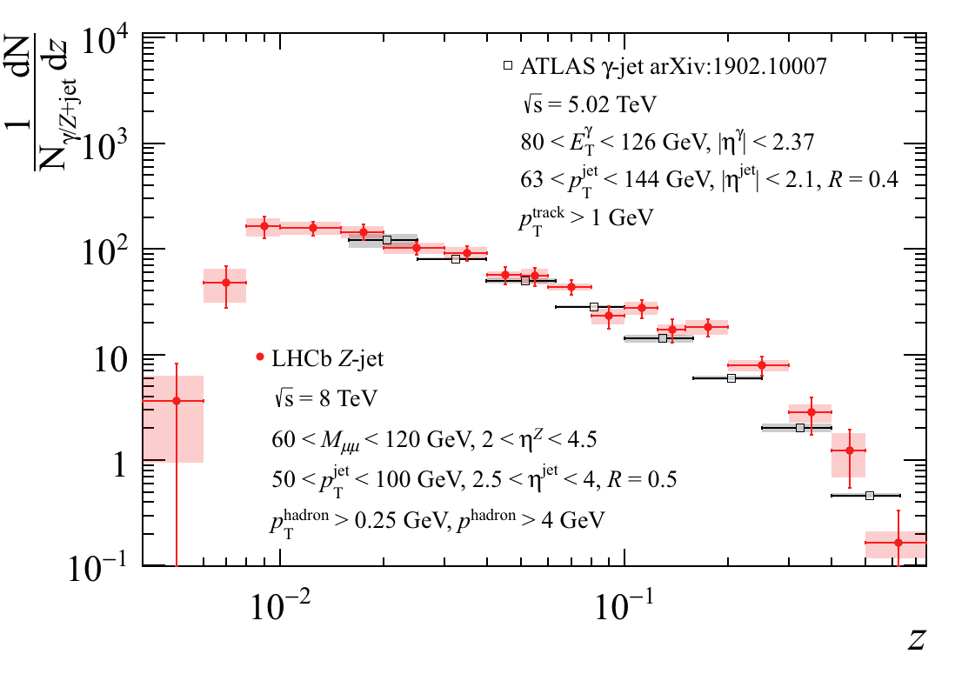
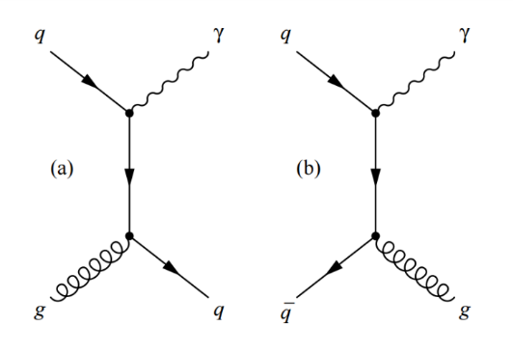
Differences between quark- and gluon-dominated jet samples: Longitudinal profile
ATLAS midrapidity γ+jet and LHCb Z+jet longitudinal momentum distributions are more similar
  γ+jet, like Z+jet, enhances quark jet fraction
  Further evidence that differences observed between LHCb results and ATLAS gluon-dominated results are due to differences in quark and gluon hadronization
arXiv:1904.08878
LHCb-PAPER-2019-012

Slide 28

Ongoing work on LHCb
Hadron distributions in jets initiated by a charm or beauty quark (GS Kara Mattioli)
  Unlike lighter flavors, can explicitly identify charm and beauty jets
Heavy and lighter quarkonia in jets
  Υ ($b\overline{b}$ bound state) (UG Jessie Guo, PD Sookhyun Lee)
  φ ($s\overline{s}$ bound state) (GS Desmond Shangase)
  polarization of J/ψ ($c\overline{c}$ bound state) (PD Sookhyun Lee)
Measurement of spontaneous polarization of forward Λ hyperons ($uds$ bound state—a “heavy proton” with a strange quark)
(GS Cynthia Nunez)
  A striking unexplained effect since 1976 discovery (in which U-M was involved!) . . .
Z boson + jet pairs to search for predicted color entanglement of quarks across colliding protons (GS Jordan Roth)
Notes:
Feel like a kid in a candy shop! Mention ATLAS lambda polarization measurement verbally, and Homer Neal’s interest.

Slide 29

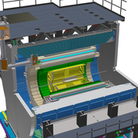
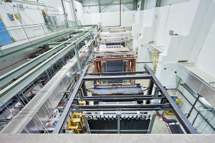
Other recent and ongoing work in QCD
PHENIX experiment at the Relativistic Heavy Ion Collider, Brookhaven National Lab (took data 2000-2016)
First-ever experimental searches for predicted color entangled quarks across
high-energy colliding protons—thus far inconclusive! (Former GS Joe Osborn)
  Phys. Rev. D95, 072002 (2017)
  Phys. Rev. D98, 072004 (2018)
  Phys. Rev. C99, 044912 (2019)
Measurement of spin-momentum correlations in the production of direct photons, eta mesons, and charmed mesons in transversely polarized proton-proton collisions
(GS Nicole Lewis, Enrique Gamez, Dillon Fitzgerald)
sPHENIX at RHIC, BNL (start data taking 2023)
Test beam studies for calorimeter prototypes – IEEE Trans. Nucl. Sci. 65, 2901 (2018)
Silicon photomultiplier quality testing here on campus
E906/SeaQuest experiment at Fermilab (took data 2014-2017)
Nucl. Inst. Meth.A930, 49 (2019)
Measurement of enhancement of antidown quarks with respect to antiup quarks in the proton
(GS Catherine Ayuso)
Measurement of modification of J/ψ (charm-anticharm bound state) production
from nuclear vs. proton targets (GS Catherine Ayuso)
Notes:
Mention Nicole showing preliminary results at conferences

Slide 30
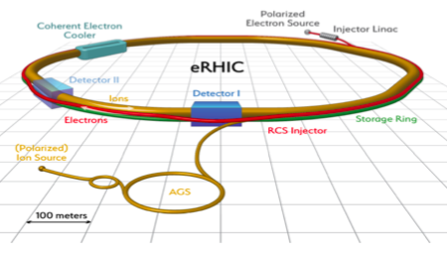
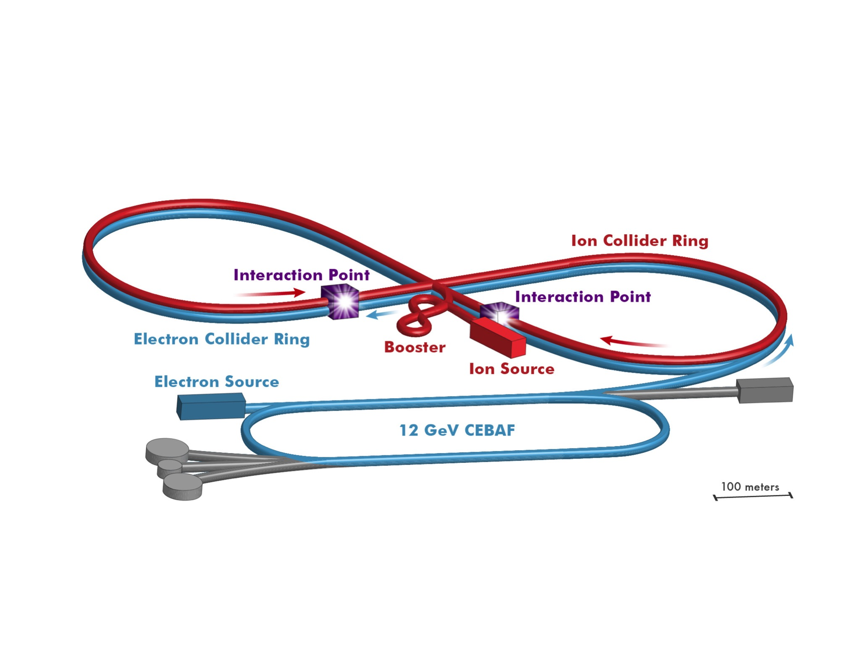
Next-generation QCD facility:
The Electron-Ion Collider
Key science questions:
How does a nucleon acquire mass?
How does the spin of the nucleon arise from its elementary quark and gluon constituents?
What are the emergent properties of dense systems of gluons?
Two candidate sites: Brookhaven National Lab and Jefferson Lab
BNL
JLab

Slide 31
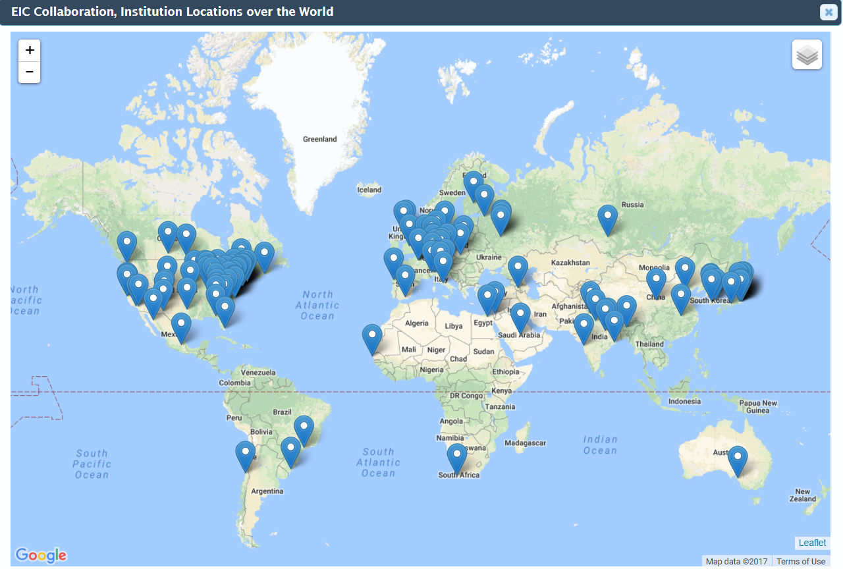
Next-generation QCD facility:
The Electron-Ion Collider
Key science questions:
How does a nucleon acquire mass?
How does the spin of the nucleon arise from its elementary quark and gluon constituents?
What are the emergent properties of dense systems of gluons?
Two candidate sites: Brookhaven National Lab and Jefferson Lab
BNL
JLab
Electron-Ion Collider User Group: Currently 889 members from 190 institutions in 30 countries
www.eicug.org

Slide 32

July 2018 National Academy Consensus Report found that the science that can be addressed by an EIC is “compelling, fundamental, and timely”
Notes:
Brookhaven National Lab on Long Island is one of the two candidate host sites for the next collider expected to be built in the U.S., the Electron-Ion Collider. The Electron-Ion Collider is a proposed billion-dollar scale collider facility that would be like a giant (several-mile) electron microscope to study the inner structure of protons, neutrons, and nuclei in much more detail than we can now. I was part of a National Academy of Sciences committee that evaluated the science case for the facility in 2018, and there’s in fact a feature article on the Electron-Ion Collider in the latest issue of Scientific American!

Slide 33
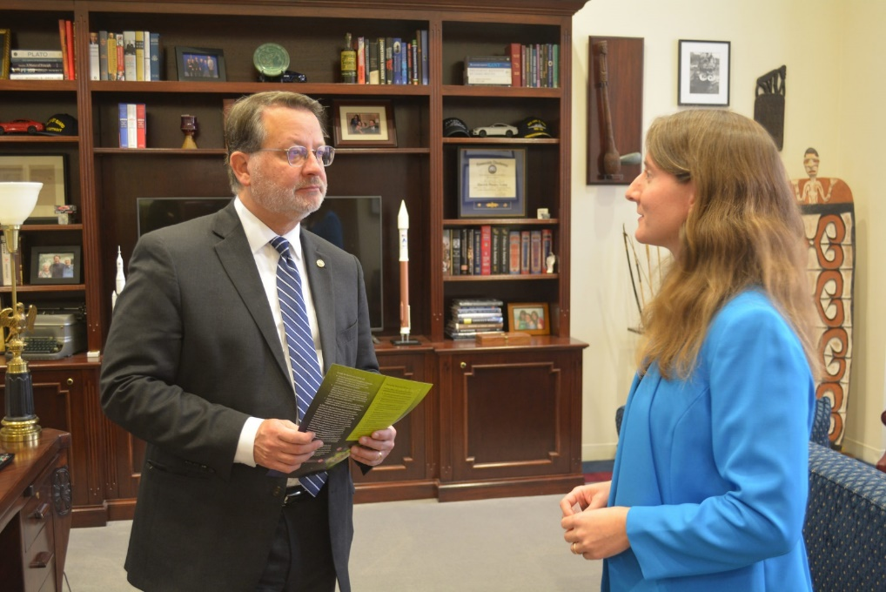
July 2018 National Academy Consensus Report found that the science that can be addressed by an EIC is “compelling, fundamental, and timely”
Notes:
Brookhaven National Lab on Long Island is one of the two candidate host sites for the next collider expected to be built in the U.S., the Electron-Ion Collider. The Electron-Ion Collider is a proposed billion-dollar scale collider facility that would be like a giant (several-mile) electron microscope to study the inner structure of protons, neutrons, and nuclei in much more detail than we can now. I was part of a National Academy of Sciences committee that evaluated the science case for the facility in 2018, and there’s in fact a feature article on the Electron-Ion Collider in the latest issue of Scientific American!

Slide 34

July 2018 National Academy Consensus Report found that the science that can be addressed by an EIC is “compelling, fundamental, and timely”
Notes:
Brookhaven National Lab on Long Island is one of the two candidate host sites for the next collider expected to be built in the U.S., the Electron-Ion Collider. The Electron-Ion Collider is a proposed billion-dollar scale collider facility that would be like a giant (several-mile) electron microscope to study the inner structure of protons, neutrons, and nuclei in much more detail than we can now. I was part of a National Academy of Sciences committee that evaluated the science case for the facility in 2018, and there’s in fact a feature article on the Electron-Ion Collider in the latest issue of Scientific American!

Slide 35
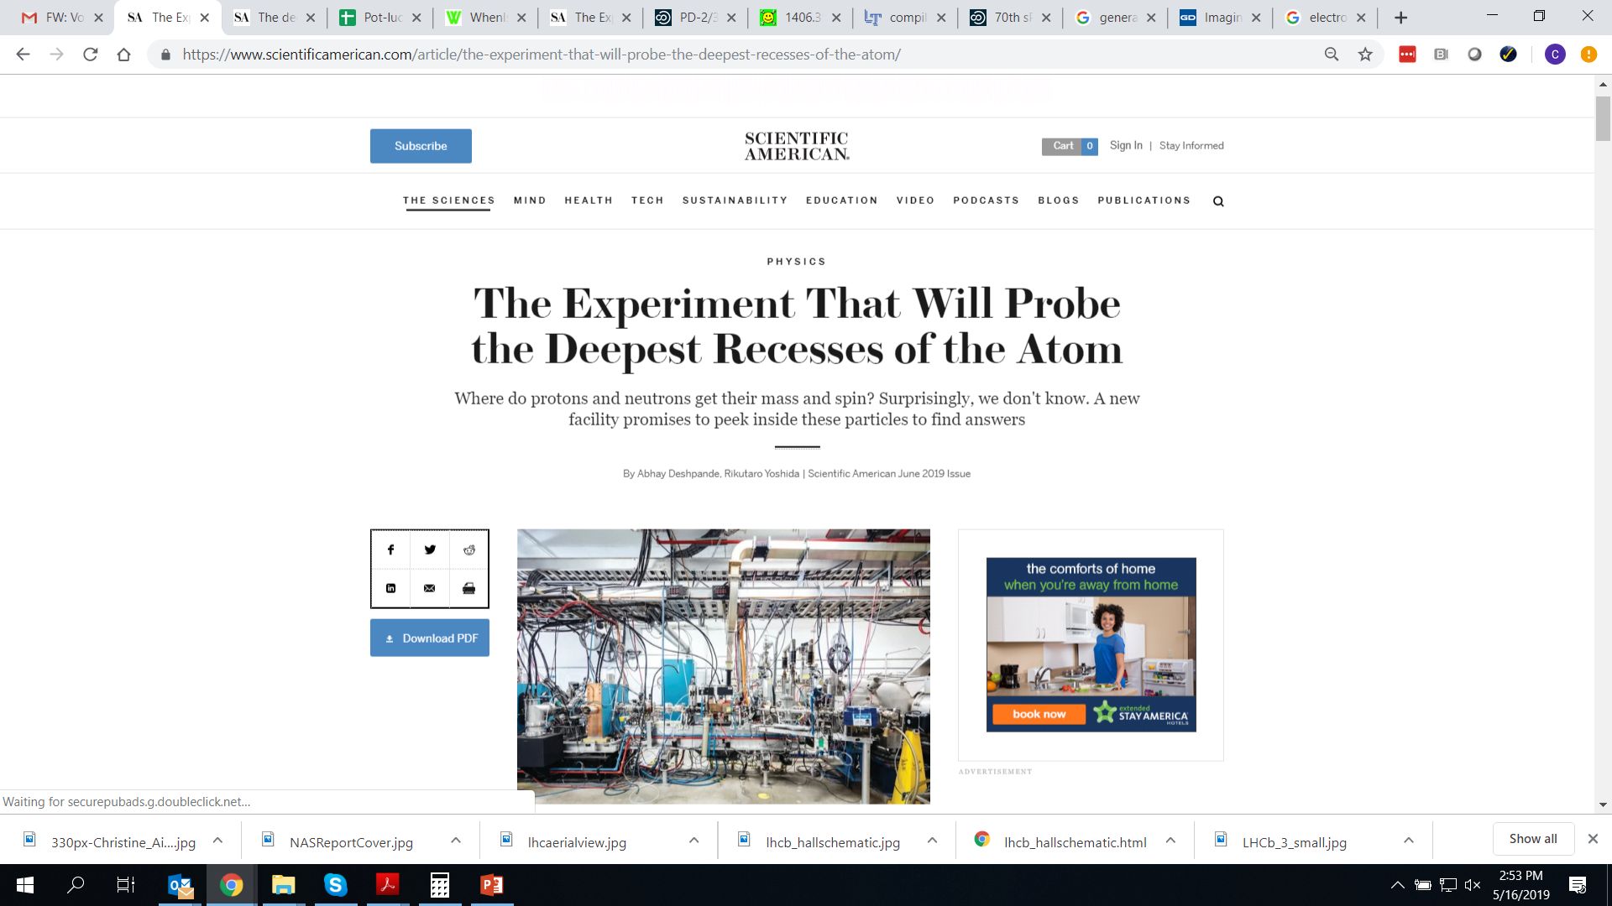
Scientific American
June 2019 issue!
Notes:
Brookhaven National Lab on Long Island is one of the two candidate host sites for the next collider expected to be built in the U.S., the Electron-Ion Collider. The Electron-Ion Collider is a proposed billion-dollar scale collider facility that would be like a giant (several-mile) electron microscope to study the inner structure of protons, neutrons, and nuclei in much more detail than we can now. I was part of a National Academy of Sciences committee that evaluated the science case for the facility in 2018, and there’s in fact a feature article on the Electron-Ion Collider in the latest issue of Scientific American!

Slide 36
Scientific American
June 2019 issue!
Current status: “Critical Decision-0” expected from DOE this month. Panel for site recommendation formed. Early money already in FY2020 President’s budget request and House markup.
Hope for first data 2030.
Notes:
Brookhaven National Lab on Long Island is one of the two candidate host sites for the next collider expected to be built in the U.S., the Electron-Ion Collider. The Electron-Ion Collider is a proposed billion-dollar scale collider facility that would be like a giant (several-mile) electron microscope to study the inner structure of protons, neutrons, and nuclei in much more detail than we can now. I was part of a National Academy of Sciences committee that evaluated the science case for the facility in 2018, and there’s in fact a feature article on the Electron-Ion Collider in the latest issue of Scientific American!

Slide 37


Assumptions of Physics project with Gabriele Carcassi
The aim of the project is to find a handful of physical principles and assumptions from which the basic laws of physics can be derived
To do that we want to develop a general mathematical theory of experimental science: the theory that studies scientific theories
  A formal framework that forces us to clarify our assumptions
  From those assumptions the mathematical objects are derived
  Each mathematical object has a clear physical meaning and no object is unphysical
  Gives us concepts and tools that span across different disciplines
  Allows us to explore what happens when the assumptions fail, possibly leading to new physics ideas
http://assumptionsofphysics.org/

Slide 38
General mathematical theory of experimental science
To do any kind of science, we need a set of experimentally verifiable assertions → Logic of verifiable statements
  G. Carcassi, CAA, “Towards a general mathematical theory of experimental science.” arXiv:1807.07896; also first three chapters of draft book
Not closed under negation, because negation of a verifiable statement not necessarily verifiable
Only closed under finite conjunction (AND), because require verification in finite time
  Similar to finite resources already considered in theoretical computer science
Closed under countable disjunction (OR), because can’t complete more than countable number of tests in finite time
http://assumptionsofphysics.org/book

Slide 39

General mathematical theory of experimental science
Set of experimentally distinguishable objects, cases, etc. → topological space
Implies particular topology
  CAA, G. Carcassi, M.J. Greenfield, “Topology and experimental distinguishability.” Top. Proc. 54, 271 (2019).
If X is a set of physically distinguishable cases (e.g. the possible states a system can be in), it will have a natural topology that keeps track of the statements that are verifiable (e.g. corresponding to finite precision measurement)
  Topology is the foundation for manifolds, differential geometry (i.e. geometrical vectors, integration over curves), symplectic geometry (i.e. classical Hamiltonian mechanics), Riemmanian geometry (i.e. special and general relativity)
It will also have a natural $σ$-algebra that keeps track of the theoretical statements we can use for predictions
  $σ$-algebras are the foundation for measure theory and probability theory
Notes:
Topologies are there to capture experimental verifiability. Note that we don’t have any quantities yet! No numbers.

Slide 40
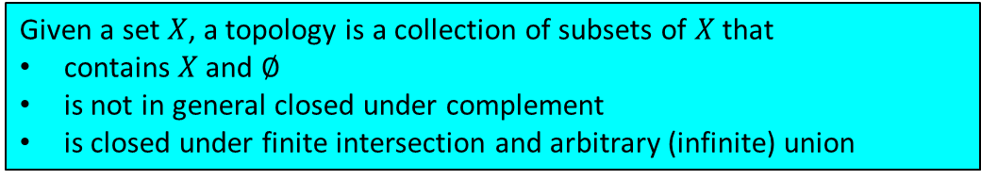
General mathematical theory of experimental science
Set of experimentally distinguishable objects, cases, etc. → topological space
Implies particular topology
  CAA, G. Carcassi, M.J. Greenfield, “Topology and experimental distinguishability.” Top. Proc. 54, 271 (2019).
If X is a set of physically distinguishable cases (e.g. the possible states a system can be in), it will have a natural topology that keeps track of the statements that are verifiable (e.g. corresponding to finite precision measurement)
  Topology is the foundation for manifolds, differential geometry (i.e. geometrical vectors, integration over curves), symplectic geometry (i.e. classical Hamiltonian mechanics), Riemmanian geometry (i.e. special and general relativity)
It will also have a natural $σ$-algebra that keeps track of the theoretical statements we can use for predictions
  $σ$-algebras are the foundation for measure theory and probability theory
Given a set $X$, a topology is a collection of subsets of $X$ that
contains $X$ and $∅$
is not in general closed under complement
is closed under finite intersection and arbitrary (infinite) union
Notes:
Topologies are there to capture experimental verifiability. Note that we don’t have any quantities yet! No numbers.

Slide 41

General mathematical theory of experimental science
Set of experimentally distinguishable objects, cases, etc. → topological space
Implies particular topology
  CAA, G. Carcassi, M.J. Greenfield, “Topology and experimental distinguishability.” Top. Proc. 54, 271 (2019).
If X is a set of physically distinguishable cases, it will have a natural topology that keeps track of the statements that are verifiable (e.g. corresponding to finite precision measurement)
  Topology is the foundation for manifolds, differential geometry (i.e. geometrical vectors, integration over curves), symplectic geometry (i.e. classical Hamiltonian mechanics), Riemmanian geometry (i.e. special and general relativity)
It will also have a natural $σ$-algebra that keeps track of the theoretical statements we can use for predictions
  $σ$-algebras are the foundation for measure theory and probability theory
Given a set $X$, a topology is a collection of subsets of $X$ that
contains $X$ and $∅$
is not in general closed under complement
is closed under finite intersection and arbitrary (infinite) union
Notes:
Topologies are there to capture experimental verifiability. Note that we don’t have any quantities yet! No numbers.

Slide 42
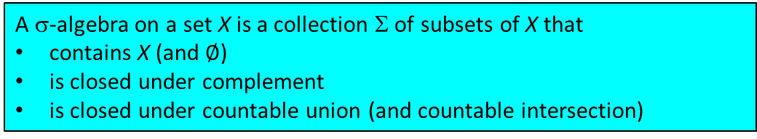
General mathematical theory of experimental science
Set of experimentally distinguishable objects, cases, etc. → topological space
Implies particular topology
  CAA, G. Carcassi, M.J. Greenfield, “Topology and experimental distinguishability.” Top. Proc. 54, 271 (2019).
If X is a set of physically distinguishable cases, it will have a natural topology that keeps track of the statements that are verifiable (e.g. corresponding to finite precision measurement)
  Topology is the foundation for manifolds, differential geometry (i.e. geometrical vectors, integration over curves), symplectic geometry (i.e. classical Hamiltonian mechanics), Riemmanian geometry (i.e. special and general relativity)
It will also have a natural $σ$-algebra that keeps track of the theoretical statements we can use for predictions
  $σ$-algebras are the foundation for measure theory and probability theory
Given a set $X$, a topology is a collection of subsets of $X$ that
contains $X$ and $∅$
is not in general closed under complement
is closed under finite intersection and arbitrary (infinite) union
A σ-algebra on a set X is a collection Σ of subsets of X that
contains X (and $∅$)
is closed under complement
is closed under countable union (and countable intersection)
Notes:
Topologies are there to capture experimental verifiability. Note that we don’t have any quantities yet! No numbers.

Slide 43
Takeaway
Specifying a scientific theory means specifying a (countable) set of verifiable statements and their logical relationships. The role of mathematical structures in physics is to formalize the logical relationships between verifiable statements.
The mere requirement of experimental verification (i.e. the algebra of verifiable statements) already provides a link to two fundamental mathematical structures (topologies and σ-algebras), which therefore we can always use in any physical theory
The idea is that we can rebuild the other mathematical structures piece by piece so that we spell out the physical assumptions implicit in the most primitive objects, like quantities represented by integers and real numbers
  E.g. measuring distance with a ruler can be broken down into verifiable statements like “the object is after the 5 cm mark”, “the object is before the 5.3 cm mark”

Slide 44
Deriving classical Hamiltonian particle mechanics under scalar and vector potential forces
Found only two physical assumptions needed to rederive classical Hamiltonian particle mechanics
  1. Deterministic and reversible evolution
  2a. Specifying the state of the whole is equivalent to specifying the state of the parts (infinitesimal reducibility)
Determinism and reversibility is more than a one-to-one map: it has to preserve the nature of the system and the type of description
  Mathematically it will be an isomorphism in the category used to capture states, the associated verifiable statements, and their logical structure
Symplectic manifold (phase space) a necessary consequence of requiring coordinate-invariant distributions
  Conjugate variables (q, k)
Add a third assumption to get Euler-Lagrange equations, i.e. classical Lagrangian mechanics
  3. Equivalence between evolution of states (dynamics) and trajectories (kinematics)
G. Carcassi, CAA, D.J. Baker, L. Bieri
J. Phys. Commun. 2, 045026 (2018)

Slide 45



Deterministic
A process like this is deterministic (you can predict the future)
$$t−Δt$$
$$t$$
$$t+Δt$$

Slide 46
Reversible
A process like this is reversible (you can reconstruct the past)
$$t−Δt$$
$$t$$
$$t+Δt$$

Slide 47
Deterministic and reversible
A process like this is deterministic and reversible
$$t−Δt$$
$$t$$
$$t+Δt$$

Slide 48
Deriving classical Hamiltonian particle mechanics under scalar and vector potential forces
Found only two physical assumptions needed to rederive classical Hamiltonian particle mechanics
  1. Deterministic and reversible evolution
  2a. Specifying the state of the whole is equivalent to specifying the state of the parts (infinitesimal reducibility)
Determinism and reversibility is more than a one-to-one map: it has to preserve the nature of the system and the type of description
  Mathematically it will be an isomorphism in the category used to capture states, the associated verifiable statements, and their logical structure
Symplectic manifold (phase space) a necessary consequence of requiring coordinate-invariant distributions
  Conjugate variables (q, k)
Add a third assumption to get Euler-Lagrange equations, i.e. classical Lagrangian mechanics
  3. Equivalence between evolution of states (dynamics) and trajectories (kinematics)
G. Carcassi, CAA, D.J. Baker, L. Bieri
J. Phys. Commun. 2, 045026 (2018)

Slide 49
Assumption of infinitesimal reducibility
The system is reducible to its parts: giving the state of the whole is equivalent to giving the state of the parts. The system can be subdivided indefinitely.
time

Slide 50
Deriving classical Hamiltonian particle mechanics under scalar and vector potential forces
Found only two physical assumptions needed to rederive classical Hamiltonian particle mechanics
  1. Deterministic and reversible evolution
  2a. Specifying the state of the whole is equivalent to specifying the state of the parts (infinitesimal reducibility)
Determinism and reversibility is more than a one-to-one map: it has to preserve the nature of the system and the type of description
  Mathematically it will be an isomorphism in the category used to capture states, the associated verifiable statements, and their logical structure
Symplectic manifold (phase space) a necessary consequence of requiring coordinate-invariant distributions
  Conjugate variables (q, k)
Add a third assumption to get Euler-Lagrange equations, i.e. classical Lagrangian mechanics
  3. Equivalence between evolution of states (dynamics) and trajectories (kinematics)
G. Carcassi, CAA, D.J. Baker, L. Bieri
J. Phys. Commun. 2, 045026 (2018)

Slide 51
Deriving classical Hamiltonian particle mechanics under scalar and vector potential forces
Found only two physical assumptions needed to rederive classical Hamiltonian particle mechanics
  1. Deterministic and reversible evolution
  2a. Specifying the state of the whole is equivalent to specifying the state of the parts (infinitesimal reducibility)
Determinism and reversibility is more than a one-to-one map: it has to preserve the nature of the system and the type of description
  Mathematically it will be an isomorphism in the category used to capture states, the associated verifiable statements, and their logical structure
Symplectic manifold (phase space) a necessary consequence of requiring coordinate-invariant distributions
  Conjugate variables (q, k)
Add a third assumption to get Euler-Lagrange equations, i.e. classical Lagrangian mechanics
  3. Equivalence between evolution of states (dynamics) and trajectories (kinematics)
G. Carcassi, CAA, D.J. Baker, L. Bieri
J. Phys. Commun. 2, 045026 (2018)

Slide 52
Deriving classical Hamiltonian particle mechanics under scalar and vector potential forces
Found only two physical assumptions needed to rederive classical Hamiltonian particle mechanics
  1. Deterministic and reversible evolution
  2a. Specifying the state of the whole is equivalent to specifying the state of the parts (infinitesimal reducibility)
Determinism and reversibility is more than a one-to-one map: it has to preserve the nature of the system and the type of description
  Mathematically it will be an isomorphism in the category used to capture states, the associated verifiable statements, and their logical structure
Symplectic manifold (phase space) a necessary consequence of requiring coordinate-invariant distributions
  Conjugate variables (q, k)
Add a third assumption to get Euler-Lagrange equations, i.e. classical Lagrangian mechanics
  3. Equivalence between evolution of states (dynamics) and trajectories (kinematics)
G. Carcassi, CAA, D.J. Baker, L. Bieri
J. Phys. Commun. 2, 045026 (2018)

Slide 53
Change assumption of infinitesimal reducibility → Quantum mechanics
To get quantum particle mechanics (Schrodinger equation), modify assumption 2
  1. Deterministic and reversible evolution (same)
  2b. Specifying the state of the whole tells you nothing about the state of the parts (irreducibility)
?
time
G. Carcassi, CAA, D.J. Baker, L. Bieri
J. Phys. Commun. 2, 045026 (2018)

Slide 54
Other neat things that come out
Uncertainty principle and “antiparticles” come naturally from the deterministic evolution of distributions of parts
  Classical “uncertainty principle” – information entropy conserved during Hamiltonian evolution. Minimum spread in phase space is Gaussian distribution.
  Everything done in terms of relativistically invariant Hamiltonian—evolution in affine parameter (proper time) different from evolution in t. Get distinct states for which affine parameter and t have same direction vs. opposite.
G. Carcassi, CAA, D.J. Baker, L. Bieri
J. Phys. Commun. 2, 045026 (2018)

Slide 55



General mathematical theory
of experimental science
Experimental verifiability
leads to topological spaces, sigma-algebras, …
State-level assumptions
Infinitesimal reducibility
leads to classical phase space
Irreducibility
leads to quantum state space
Process-level assumptions
Hamilton’s equations
$\frac{d}{dt}\left(q, p\right)=\left(\frac{∂H}{∂p},−\frac{∂H}{∂q}\right)$
Deterministic and reversible evolution
leads to isomorphism on state space
Schroedinger equation
$$ıℏ\frac{∂}{∂t}ψ=Hψ$$
Non-reversible evolution
Thermodynamics
Euler-Lagrange equations
$δ∫L\left(q, \dot{q},t\right)=0$
…
Kinematic equivalence
leads to massive particles
http://assumptionsofphysics.org/

Slide 56

Current work: Entropy, thermodynamics, and statistical mechanics
MCubed project with Kai Sun (Physics) + Dave Baker (Philosophy)
Generalized entropy in terms of set mappings (state evolutions)
Require clear relation to thermodynamic, Gibbs, Boltzmann, von Neumann, and Shannon entropies

Slide 57
Deterministic but irreversible
A deterministic but irreversible process concentrates evolutions (number of evolutions per state can only increase)
$$t−Δt$$
$$t$$
$$t+Δt$$

Slide 58
Equilibria
An equilibrium does not change during the evolution (number of evolutions are maximum at equilibrium)
$$t−Δt$$
$$t$$
$$t+Δt$$

Slide 59
Long-term goals of the project
Ultimate goal to build up and rederive all established branches of physics within a common context/framework
  Want everything in the math to correspond to something physical
Believe that being able to identify and articulate our physical assumptions for various systems/cases—and their necessary mathematical implications—will point us toward new directions, exploring alternative assumptions
Potential implications for physics education as well
Need area experts—collaborators and consultants welcome!

Slide 60
Long-term goals of the project
Ultimate goal to build up and rederive all established branches of physics within a common context/framework
  Want everything in the math to correspond to something physical
Believe that being able to identify and articulate our physical assumptions for various systems/cases—and their necessary mathematical implications—will point us toward new directions, exploring alternative assumptions
Potential implications for physics education as well
Need area experts—collaborators and consultants welcome!

Slide 61
Long-term goals of the project
Ultimate goal to build up and rederive all established branches of physics within a common context/framework
  Want everything in the math to correspond to something physical
Believe that being able to identify and articulate our physical assumptions for various systems/cases—and their necessary mathematical implications—will point us toward new directions, exploring alternative assumptions
Potential implications for physics education as well
Need area experts—collaborators and consultants welcome!

Slide 62
Summary
time
?
time
The formation of QCD bound states has been vastly underexplored over prior decades compared to structure
The LHCb experiment at CERN offers unprecedented opportunities to study hadronization. Our recent results measuring production of charged hadrons in light quark jets are the first in a longer-term program.
Careful consideration of physical assumptions and their mathematical implications leads to more constrained mathematical structures than one might naively expect
Articulation of underlying assumptions and their implications can lead to better understanding of existing theories and point toward ideas for new ones

Slide 63
Summary
time
?
time
The formation of QCD bound states has been vastly underexplored over prior decades compared to structure
The LHCb experiment at CERN offers unprecedented opportunities to study hadronization. Our recent results measuring production of charged hadrons in light quark jets are the first in a longer-term program.
Careful consideration of physical assumptions and their mathematical implications leads to more constrained mathematical structures than one might naively expect
Articulation of underlying assumptions and their implications can lead to better understanding of existing theories and point toward ideas for new ones

Slide 64
Summary
time
?
time
The formation of QCD bound states has been vastly underexplored over prior decades compared to structure
The LHCb experiment at CERN offers unprecedented opportunities to study hadronization. Our recent results measuring production of charged hadrons in light quark jets are the first in a longer-term program.
Careful consideration of physical assumptions and their mathematical implications leads to more constrained mathematical structures than one might naively expect
Articulation of underlying assumptions and their implications can lead to better understanding of existing theories and point toward ideas for new ones
I’ve had a lot of fun embarking upon new research directions over the past few years!

Slide 65
Extra

Slide 66
Principle of
Scientific Objectivity
Science is:
universal (same for everybody)
non-contradictory (logically consistent)
evidence-based (experimentally verifiable)

Slide 67
Verifiable statements
The principle of scientific objectivity tells us that science deals with assertions that are:
  either true or false (non-contradictory)
  for everybody (universal)
  and experimentally verifiable (evidence-based)
We call such assertions verifiable statements
  The first two requirements are the same as in classical logic.
  The third means we have an experimental test that we can run and, if the statement is true, it completes successfully in finite time

Slide 68

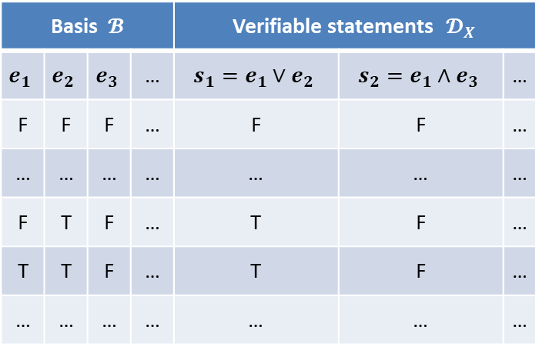

Basis $𝓑$ |  |  |  | Verifiable statements $𝓓_{X}$
$$e_{1}$$ | $$e_{2}$$ | $$e_{3}$$ | … | $$s_{1}=e_{1}∨e_{2}$$ | $$s_{2}=e_{1}∧e_{3}$$ | …
F | F | F | … | F | F | …
… | … | … | … | … | … | …
F | T | F | … | T | F | …
T | T | F | … | T | F | …
… | … | … | … | … | … | …
Start with a countable set of verifiable statements (the most we can test experimentally). We call this a basis.
Possibilities $X$
Construct all verifiable statements that can be verified from the basis (close under finite conjunction and countable disjunction). We call this an experimental domain
Consider all truth assignments: it is sufficient to assign the basis
Remove truth assignments that are impossible (e.g. the distance is more than 5 and less than 3)
The experimental domain $𝓓_{X}$ induces a natural topology on the set of possibilities $X$
We call the remaining lines the set of possibilities for the experimental domain (what can be found experimentally)
The role of logic (and math) in science is to capture
what is consistent (i.e. the possibilities) and what is
verifiable (i.e. the verifiable statements)
Each verifiable statement corresponds to a set of possibilities in which the statement is true.

Slide 69

States and trajectories
The kinematic assumption means that we need to be able to relate state variables (i.e. variables that identify states) with kinematic variables (i.e. variables that identify trajectories)
That is, we need a one-to-one map between $(q^{i},p_{i})$, position and momentum, and $(x^{i}, v^{i})$, position and velocity. But this is not enough: we need to be able to express the density in terms of the kinematic variables. Therefore the relationships between the differentials have to be linear.
For position we choose $q^{i}=x^{i}$ and $dq^{i}=dx^{i}$
For momentum at constant $q^{i}$ we must have something of the form
$dp_{i}=mg_{ij}{dv}^{j}$ where $g_{ij}$ is a linear transformation and $m$ is a constant of proportionality

Slide 70

Massive particles under conservative forces
If we integrate $dp_{i}=mg_{ij}{dv}^{j}$ we have $p_{i}=mg_{ij}v^{j}+𝓆A_{i}$ where $𝓆A_{i}$ is a set of arbitrary functions of position
We also have $d_{t}q^{i}=d_{t}x^{i}=v^{i}=∂_{p_{i}}H=\frac{g^{ij}}{m}\left(p_{j}−𝓆A_{j}\right)$. If we integrate $H=\frac{1}{2m}\left(p_{i}−𝓆A_{i}\right)g^{ij}\left(p_{j}−𝓆A_{j}\right)+𝓆V$ where $𝓆V$ is an arbitrary function of position
We recognize the Hamiltonian for a massive particle under scalar and vector potential forces

Slide 71

Mathematical structure for space-time
Geometry (lengths and angles) starts here: most fundamental structures are not geometrical
Riemannian manifold
Differentiable manifold + inner product
Topological manifold + differentiable structure
Ordered topological space + locally $ℝ^{n}$
Topological space + order topology
If we want to understand why (i.e. under what conditions) space-time has the structure it has, we first need to understand why (i.e. under what conditions) it is a topological space, it has an order topology, …

Slide 72
Kinematic coverage affects mix of scattering quarks and gluons
LHCb also has unique kinematic coverage in terms of scattered quark or gluon momentum fraction x and four-momentum-transfer-squared Q²
  Enhanced light quark jet fraction in forward region

Slide 73
J/Ψ production in jets at LHCb
First LHCb jet substructure measurement was J/ψ-in-jet production
  J/ψ from b decay well described by PYTHIA
  Prompt J/ψ-in-jet not! Can shed light on prompt J/ψ production mechanism(s). How is a prompt J/ψ produced within a jet??

Slide 74
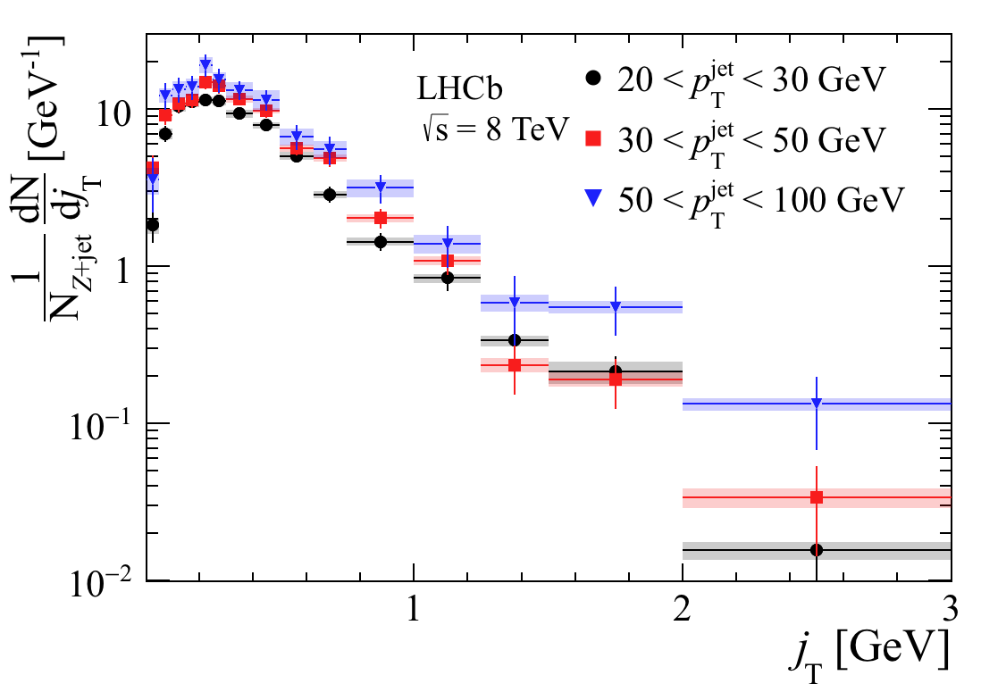
Results: Transverse momentum distributions
Transverse momentum of hadron with respect to jet axis shows turnover from “soft” (strong coupling: not perturbatively calculable) hadron production at low jT to “hard” (weaker coupling: perturbatively calculable) hadron production due to e.g. gluon emission at larger jT
Shapes similar as function of p_{T}^{jet}
Comparison to ATLAS gluon-dominated jets shows smaller mean transverse momentum in quark-dominated Z+jet than gluon-dominated jets [animate plot?]
  No ATLAS quark-enhanced results available, unfortunately
arXiv:1904.08878
LHCb-PAPER-2019-012

Slide 75
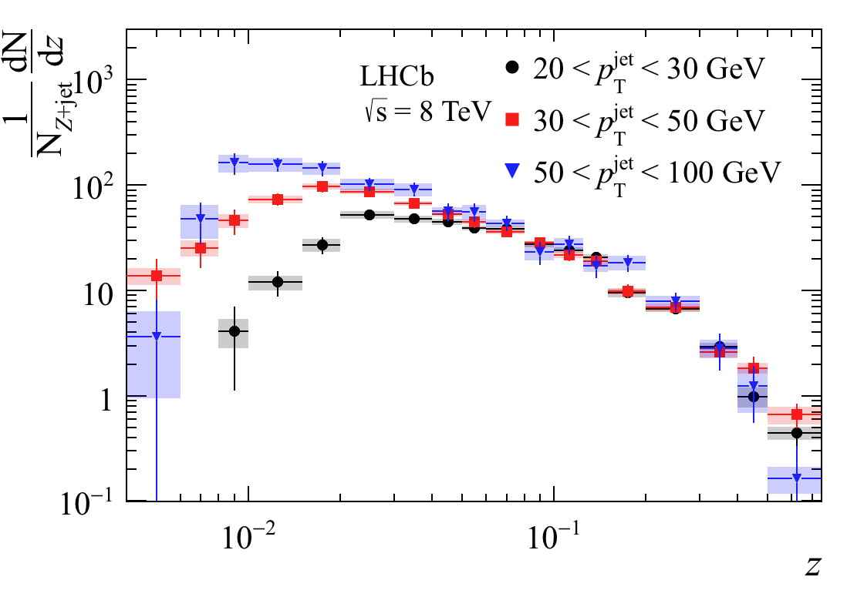
Results: Longitudinal momentum distributions
Measurements in three jet transverse momentum (p_{T}^{jet}) bins, integrated over Z boson kinematics
Longitudinal hadron-in-jet distributions independent of jet p_{T} at high longitudinal momentum fraction z
Distributions diverge at low z simply due to kinematic phase space available
arXiv:1904.08878
LHCb-PAPER-2019-012

Slide 76
Longitudinal momentum distributions: Comparison to gluon-dominated jets from ATLAS
Quark-dominated jets have relatively more hadrons produced at higher longitudinal momentum fractions than gluon-dominated jets
  Will be interesting to follow up with an identified particle measurement. Do the hadrons produced at large momentum fractions in quark-dominated jets tend to contain a quark of the same flavor as the one that initiated the jet??
arXiv:1904.08878
LHCb-PAPER-2019-012
Notes:
Measure K+/K- ratio as a function of z in forward, quark-dominated jets to test if “excess” hadrons at high z compared to gluon jets have same flavor as quark that initiated jet.

Slide 77
Longitudinal momentum distributions: Comparison to quark-enhanced jets from ATLAS (γ+jet)
ATLAS midrapidity γ+jet and LHCb Z+jet longitudinal distributions are instead very similar in the comparable jet p_{T} bin
  γ+jet, like Z+jet, enhances quark jet fraction
  Further evidence that differences observed between LHCb results and ATLAS gluon-dominated results are due to differences in quark and gluon hadronization
arXiv:1904.08878
LHCb-PAPER-2019-012

Slide 78
Results: Radial profiles
Radial profiles largely independent of jet p_{T} away from the jet axis
Multiplicity of hadrons along jet axis rises sharply with jet p_{T}
  More “violent” scattering produces more particles (intuitive), most of which are close to the jet axis (not obvious)
arXiv:1904.08878
LHCb-PAPER-2019-012

Slide 79
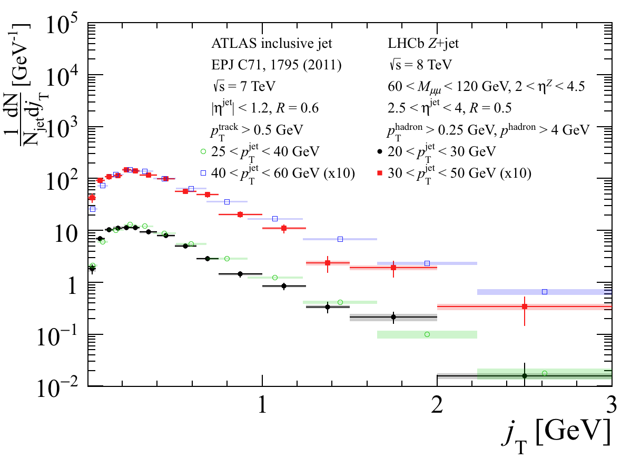
Transverse momentum distributions:
Comparison to ATLAS inclusive jets
Transverse momentum distributions show smaller <j_{T}> in Z+jet vs. inclusive jet at small j_{T}
arXiv:1904.08878
LHCb-PAPER-2019-012

Slide 80

Analysis details
Work by former PD Joe Osborn
arXiv:1904.08878
LHCb-PAPER-2019-012
Follow similar analysis strategy to previous ATLAS and LHCb papers
  ATLAS: EPJC 71, 1795 (2011), NPA 978, 65 (2018)
  LHCb: PRL 118, 192001 (2017)
$Z→μ^{+}μ^{−}$ with $60<M_{μμ}<120$ GeV, $2<η<4.5$
Anti-k_{T} jets with $R=0.5, p_{T}^{jet}>20$ GeV, $2<η<4.5$
|Δφ_{Z+jet}| > 7π/8 selects 2→2 event topology
Charged hadrons selected with p_{T} > 0.25 GeV, p > 4 GeV, ΔR < 0.5

Slide 81
Hyperon polarization from unpolarized collisions
PRL36, 1113 (1976)
1976 lambda polarization discovery: p+Be, 300 GeV beam
Polarization transverse to production plane up to ~20% for forward-angle lambda production; Polarizing TMD FF?
Confirmed 1977 at CERN, p+Pt, 24 GeV beam (and by various proton-nucleus and proton-proton experiments afterwards . . .)

Slide 82
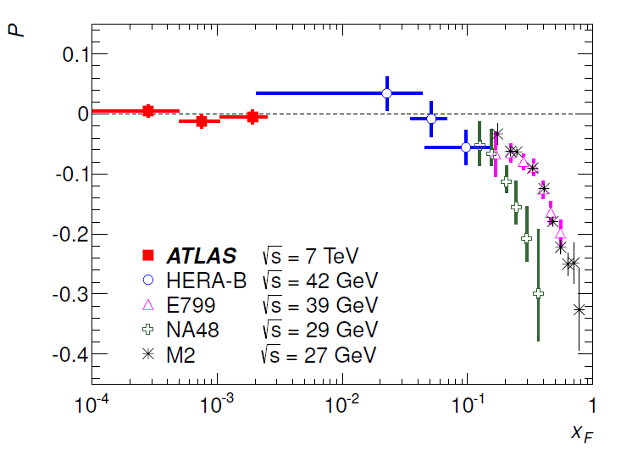
x_{F} dependence of lambda polarization in hadronic collisions
Same sign and general x_{F} dependence for neutron beams
But for K- and Σ- beams, positive polarization at positive x_{F}
And for π- beam, positive polarization but at negative x_{F}!
Consistent with zero for π+ and K+ beams
Proton beams
PRD91, 032004 (2015)

Slide 83
Ch. 2: Basic science to be explored
How does a nucleon acquire mass? --almost 100 times greater than the sum of its valence quark masses. Cannot be understood via Higgs mechanism
How does the spin (internal angular momentum) of the nucleon arise from its elementary quark and gluon constituents? Proton spin is the basis of magnetic resonance imaging (MRI).
What are the emergent properties of dense systems of gluons? How are they distributed in both position and momentum in nucleons and nuclei and how are they correlated among themselves and with the quarks and antiquarks present? What are their quantum states? Are there new forms of matter made of dense gluons?

Slide 84
It takes a while to realize billion-dollar-scale science facilities . . .
Slide from Tim Hallman, DOE
Notes:
Mention I was Tim’s undergraduate summer student at BNL in 1997?

Slide 85
Slide from Tim Hallman, DOE Office of Science Associate Director for
Nuclear Physics, at July meeting in Paris

Slide 86
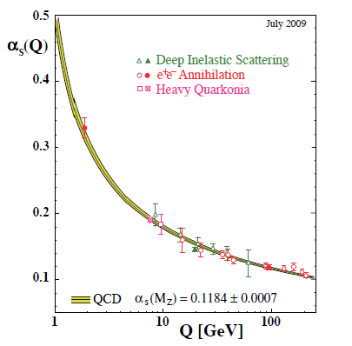
Perturbative QCD
Running of strong coupling constant with energy (asymptotic freedom)—weak coupling at high energies (short distances)
Perturbative expansions as in QED (but many more diagrams due to gluon self-coupling!!)
Stronger coupling
Higher resolution
Higher resolution
Notes:
Scattering energy

Slide 87
Predictive power of perturbative QCD
q(x₁)
Hard Scattering Process
X
g(x₂)
High-energy processes have predictable rates given:
    Partonic hard scattering rates (calculable in pQCD)
    Parton distribution functions (need experimental input)
    Fragmentation functions (need experimental input)
Universal non-perturbative factors

Slide 88
Relativistic Heavy Ion Collider (RHIC)
Ion collisions from 6 GeV-200 GeV
  Energy scan to map out QCD phase diagram
  Au+Au, d+Au, ³He+Au, Cu+Au, Cu+Cu, p↑+Au, p↑+Al, U+U—control system size and geometry (e.g. Au, Cu spherical, ³He “triangular”, U ellipsoidal)
Polarized proton-proton collisions ranging in center-of-mass energy 62-510 GeV, >50% polarization

Slide 89
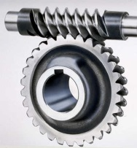

Spin-spin and spin-momentum correlations in QCD bound states
Worm-gear
(Kotzinian-Mulders)
Unpolarized
Spin-spin correlations
Helicity
Transversity
Sivers
Spin-momentum correlations
Boer-Mulders
S•(p₁×p₂)
Pretzelosity
Worm-gear
Review of spin-spin and spin-momentum correlations in the proton:
Aidala, Bass, Hasch, Mallot – Rev. Mod. Phys. 85, 655-691 (2013)

