Slide 1
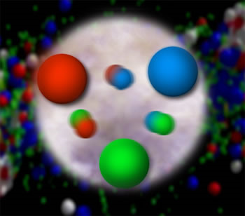
Frontiers in
Quantum Chromodynamics
Christine A. Aidala
University of Michigan
University of Michigan
October 14, 2015

Slide 2
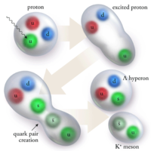
Quantum Chromodynamics:
Theory of strong interactions
  Fundamental field theory in hand since the early 1970s—BUT . . .
  Quark and gluon degrees of freedom in the theory cannot be observed or manipulated directly in experiment!
Color confinement—quarks and gluons are confined to color-neutral bound states
CLAS, PRL 113, 152004 (2014)

Slide 3
How do we understand the visible matter in our universe in terms of the quark and gluon degrees of freedom of quantum chromodynamics?
How can studying QCD systems teach us more about fundamental aspects of QCD as a theory?
Notes:
Goals of all of QCD research

Slide 4
Acknowledgments
Josh Rubin, Vera Loggins, Vincent Andrieux – postdocs
Ron Belmont – visiting postdoc
Bryan Ramson, Joe Osborn, Catherine Ayuso – Ph.D. students
Anshika Upadhyay – EE Master’s student
Bardia Nadim, Matt Wood – post-Bachelor’s
Aaron White, Catherine Culkin, Matt Wood, Robert Cernak, Emily Cizmas, McKenzie Barber, Isaac Mooney, Tyler Read, Ezra Lesser, Emily Camras – undergrads
Shantanu Deshmukh, Swapnil Akunuri – high school students

Slide 5





Acknowledgments

Slide 6
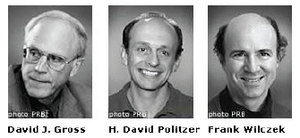
QCD: How far have we come?
QCD is challenging!!
Three-decade period after initial birth of QCD dedicated to “discovery and development”
→ Symbolic closure: Nobel prize 2004 - Gross, Politzer, Wilczek for asymptotic freedom
Now early years of second phase:
quantitative QCD!
Various frontiers opened up since late 1990s, early 2000s . . .

Slide 7
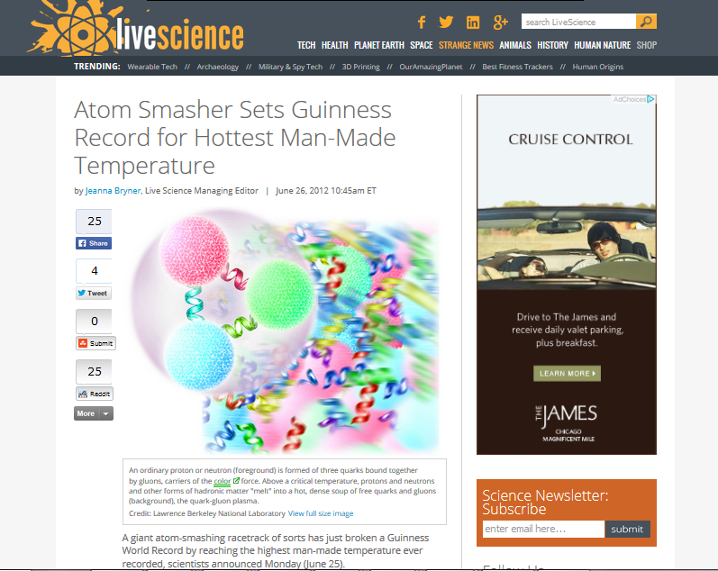
Phases of QCD matter:
Quark-gluon plasma—Hot!
~4x10¹² K
(250,000x hotter than core of Sun)

Slide 8
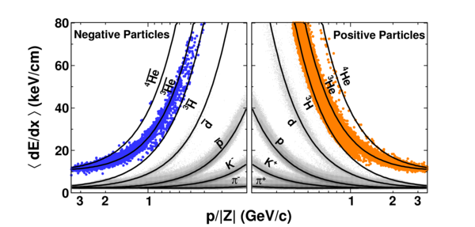
Creating antinuclei from quark-gluon plasma
  “Little Bang Nucleosynthesis”
  Cosmological implications??
STAR
Nature 473, 353 (2011)

Slide 9
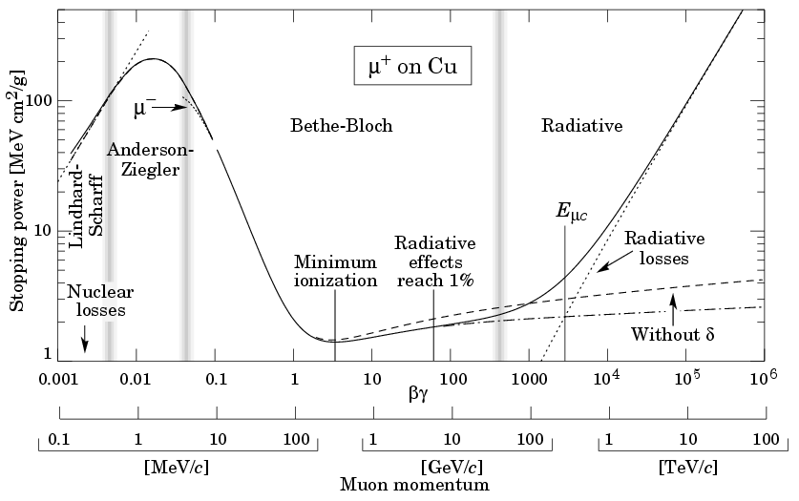
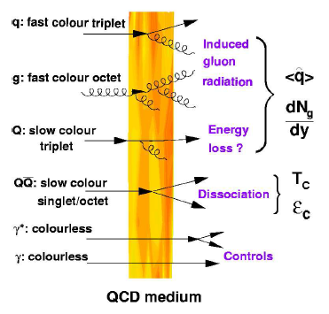
Quark energy loss in QCD matter
D. D’Enterria
QED energy loss: Stopping power –dE/dx of positive muons in copper
Just starting to explore loss mechanisms and analog of Bethe-Bloch curve for QCD

Slide 10
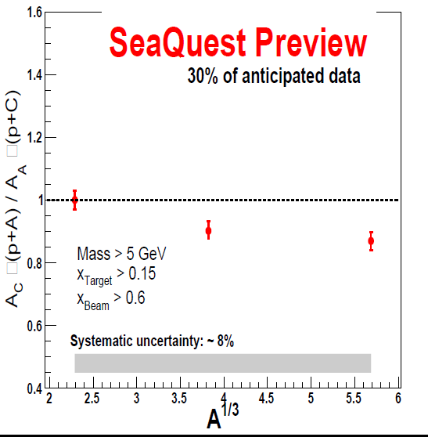
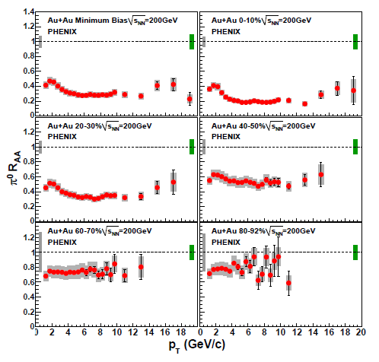

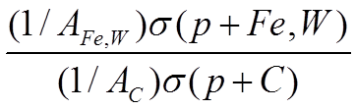

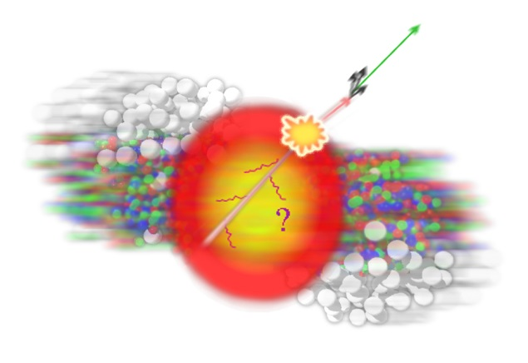
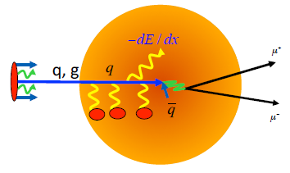
Quark energy loss in QCD matter
“Cold” (normal) nuclear matter
Hot quark-gluon plasma
C
Fe
W
PRL 101, 232301 (2008)

Slide 11

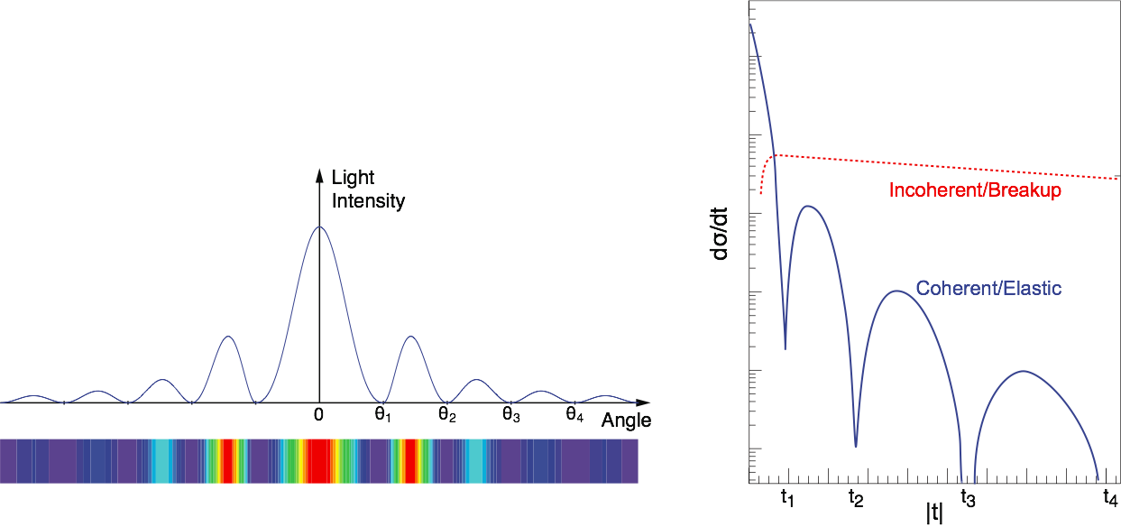
Gamma-ray diffraction to probe spatial structure of nuclei
Diffraction pattern from monochromatic plane wave incident on a circular screen of fixed radius

Slide 12
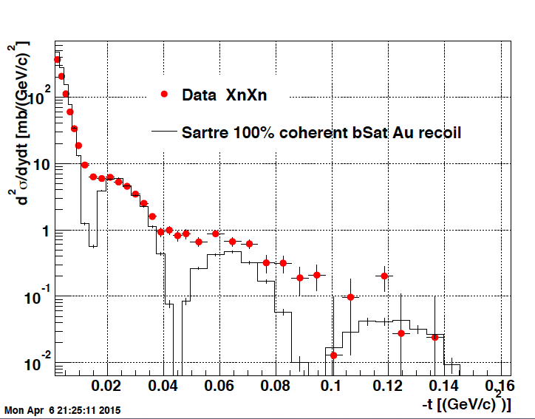
Gamma-ray diffraction to probe spatial structure of nuclei
Expected diffraction pattern from gamma ray incident on ~spherical nucleus
Diffractive J/ψ production
Au+Au ultraperipheral collisions
√s_{NN} = 200 GeV
2 nuclear beams. The probed nucleus in one beam. Gamma emitted by Coulomb-excited nucleus passing nearby in second beam.
STAR
Preliminary

Slide 13
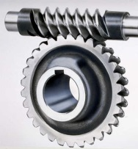

Spin-spin and spin-momentum correlations in QCD bound states
Worm-gear
(Kotzinian-Mulders)
Unpolarized
Spin-spin correlations
Helicity
Transversity
Sivers
Spin-momentum correlations
Boer-Mulders
S•(p₁×p₂)
Pretzelosity
Worm-gear
Review of spin-spin and spin-momentum correlations in the proton:
Aidala, Bass, Hasch, Mallot – Rev. Mod. Phys. 85, 655-691 (2013)

Slide 14
A cyclical process
Proliferation of observations and ideas
Synthesis

Slide 15
Critical to perform experimental work where quarks and gluons are relevant d.o.f. in the processes studied!
→ High (enough) energies

Slide 16
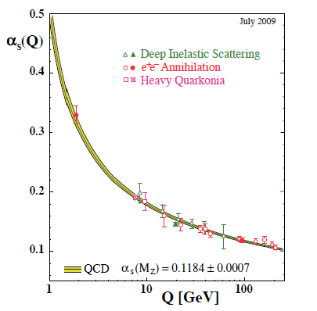
Perturbative QCD
Running of strong coupling constant with energy (asymptotic freedom)—weak coupling at high energies (short distances)
Perturbative expansions as in QED (but many more diagrams due to gluon self-coupling!!)
Stronger coupling
Most importantly: perturbative QCD provides a rigorous way of relating the fundamental field theory to a variety of physical observables
Higher resolution
Higher resolution
Notes:
Scattering energy

Slide 17
Factorization and universality in perturbative QCD
Can systematically factorize short- and long-distance physics—observable physical QCD processes always involve at least one “long-distance” (~10⁻¹⁵ m) scale (confinement)!
Long-distance (i.e. non-perturbative) functions need to be universal in order to be portable across calculations for many processes (and to be meaningful in describing bound state structure!)

Slide 18
Predictive power of perturbative QCD
q(x₁)
Hard Scattering Process
X
g(x₂)
High-energy processes have predictable rates given:
    Partonic hard scattering rates (calculable in pQCD)
    Parton distribution functions (need experimental input)
    Fragmentation functions (need experimental input)
Universal non-perturbative factors

Slide 19
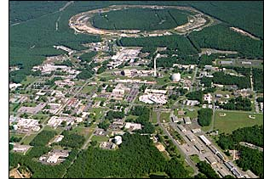
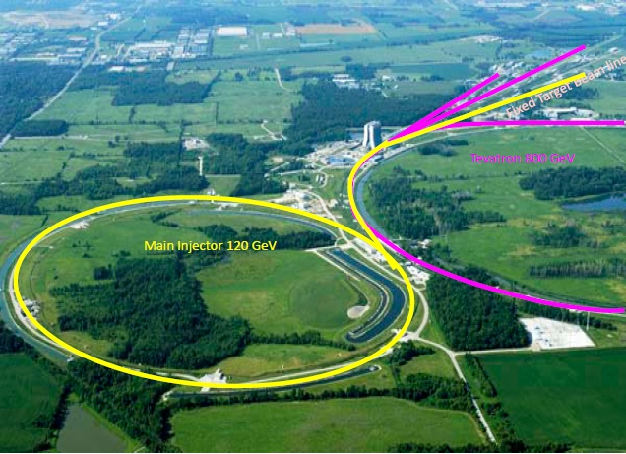
My experiments
The PHENIX experiment at the Relativistic Heavy Ion Collider at Brookhaven National Lab (BNL) on Long Island, NY
The SeaQuest experiment at Fermi National Accelerator Laboratory outside Chicago

Slide 20
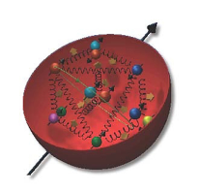
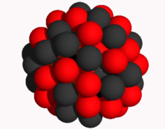
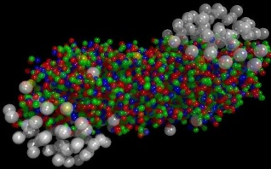
The Relativistic Heavy Ion Collider at Brookhaven National Laboratory
Extremely versatile QCD facility
Accelerator-based program, but not designed to be at the energy (or intensity) frontier. More closely analogous to many areas of condensed matter research—create a system and study its properties!
What systems are we studying?
  “Simple” QCD bound states—the proton is the simplest stable bound state in QCD (and conveniently, nature has already created it for us!)
  Collections of QCD bound states (nuclei, also available out of the box!)
  QCD deconfined! (quark-gluon plasma, some assembly required!)

Slide 21
Relativistic Heavy Ion Collider (RHIC)
Ion collisions from 6 GeV-200 GeV
  Energy scan to map out QCD phase diagram
  Au+Au, d+Au, ³He+Au, Cu+Au, Cu+Cu, p↑+Au, p↑+Al, U+U—control system size and geometry (e.g. Au, Cu spherical, ³He “triangular”, U ellipsoidal)
Polarized proton-proton collisions ranging in center-of-mass energy 62-510 GeV, >50% polarization

Slide 22

PHENIX experiment
Large, multipurpose detector taking data since 2000
~500 collaborators from 75 institutions in 15 countries

Slide 23
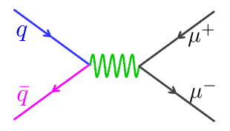
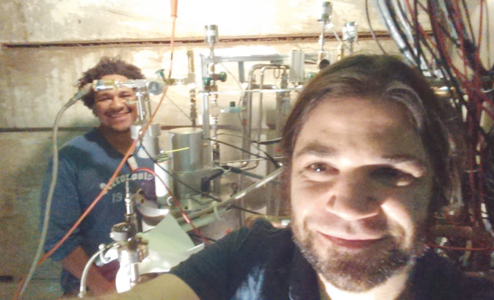
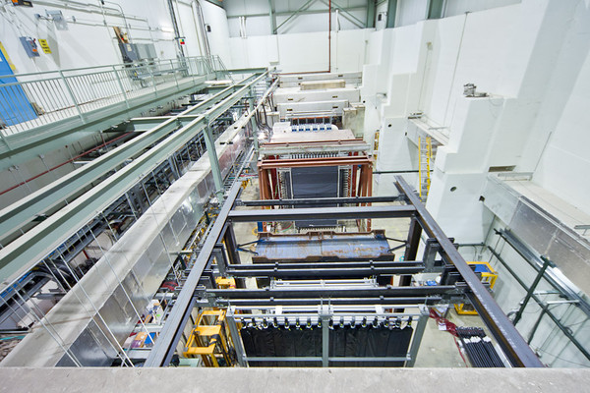
Fermilab E906/SeaQuest: Dedicated quark-antiquark annihilation experiment
120 GeV proton beam from Fermilab Main Injector with liquid hydrogen, deuterium, solid C, Fe, W targets
Study flavor-dependent antiquarks in nucleon; cold nuclear matter

Slide 24
Spin-spin and spin-momentum correlations in QCD

Slide 25

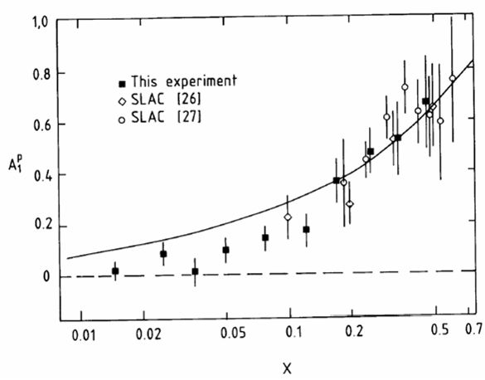
Proton “spin crisis”
SLAC: 0.10 < x <0.7
CERN: 0.01 < x <0.5
Quark-Parton Model
expectation!
A₁(x)
0.1 < x_{SLAC} < 0.7
E130, Phys.Rev.Lett.51:1135 (1983)
480 citations
These haven’t been easy to measure!
EMC (CERN), Phys.Lett.B206:364 (1988)
1810 citations!
0.01 < x_{CERN} < 0.5
“Proton Spin Crisis”
x-Bjorken
Notes:
SLAC – up by 20 in 2 years, EMC – 130 in 2 years

Slide 26
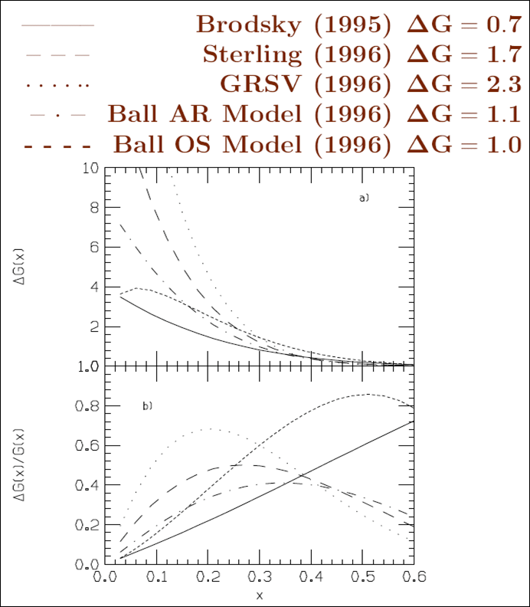
Quest for ΔG, gluon spin contribution to spin of proton
In mid-1990s predictions for the integrated gluon spin contribution to proton spin ranged from 0.7 – 2.3!
  Many models hypothesized large gluon spin contributions to screen the quark spin, but these would then require large orbital angular momentum in the opposite direction

Slide 27
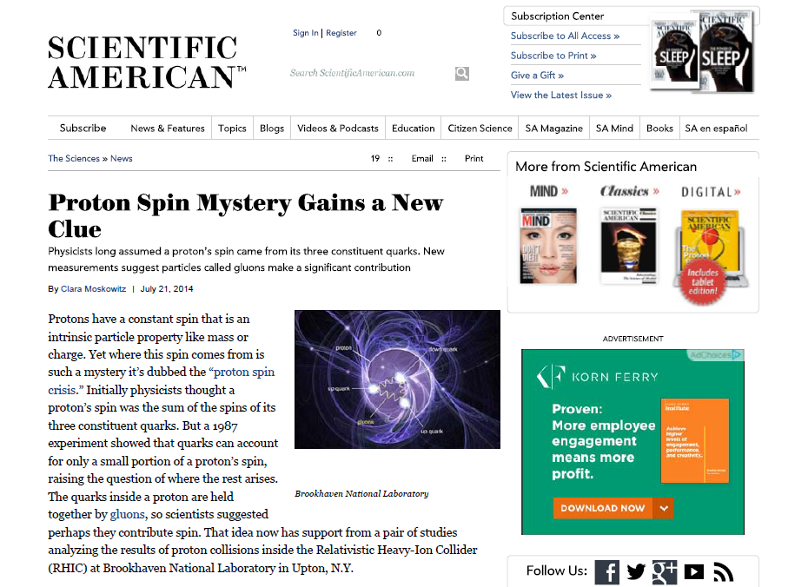
July 2014

Slide 28
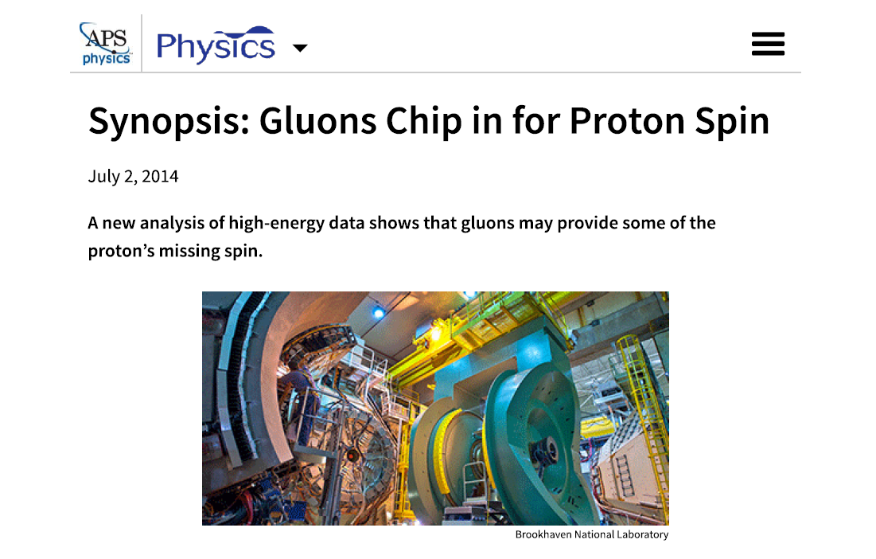

Slide 29
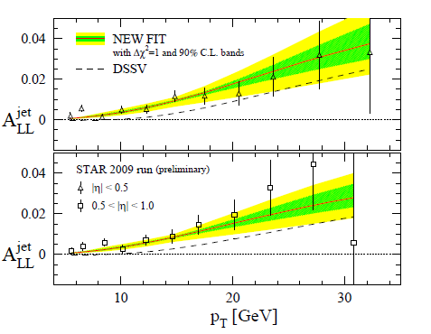
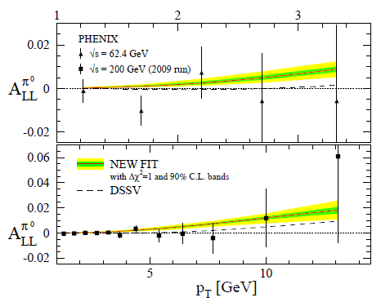
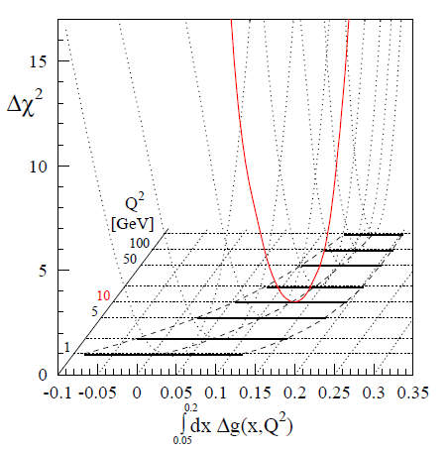
First evidence for nonzero gluon polarization in proton
Suite of RHIC measurements sensitive to gluon spin, using different final-state observables
  Neutral pions – PHENIX, PRD90, 012007
  Charged pions – PHENIX, PRD91, 032001
  Eta mesons – PHENIX, PRD83, 032001
    Interpretable due to first-ever eta meson fragmentation function parameterization: Aidala, Ellinghaus, Sassot, Seele, Stratmann, PRD83, 034002
  Jets – STAR, PRD86, 032006; PRL 115, 092002
But quark spin + (nonzero but small) gluon spin contributions still only add up to
~50% of proton spin
→ Orbital angular momentum important!
de Florian, Sassot, Stratmann, Vogelsang, PRL 113, 012001

Slide 30
Spin-momentum correlations and quark dynamics
Lots of evidence from deep-inelastic lepton-nucleon scattering experiments over past ~10 years that many of these spin-momentum correlations are nonzero in nature!
(Relating them rigorously to orbital angular momentum is a trickier business . . .)
Worm-gear
(Kotzinian-Mulders)
Unpolarized
Spin-spin correlations
Helicity
Transversity
Sivers
Spin-momentum correlations
Boer-Mulders
S•(p₁×p₂)
Pretzelosity
Worm-gear

Slide 31
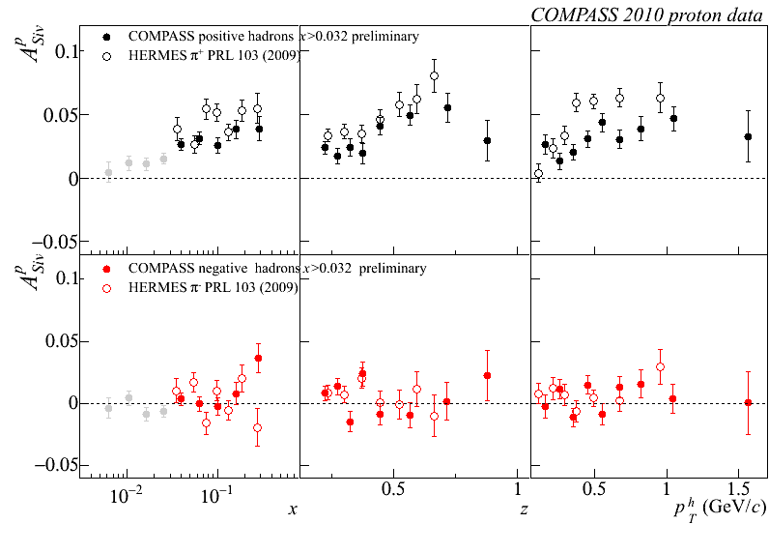
Sivers
e+p
μ+p

Slide 32
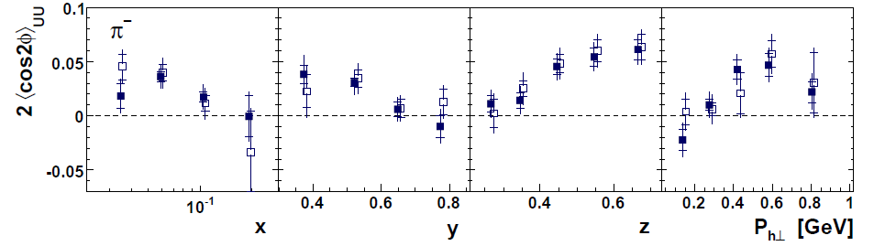
Sivers
e+p
μ+p
Boer-Mulders x Collins
e+p
HERMES, PRD 87, 012010 (2013)

Slide 33
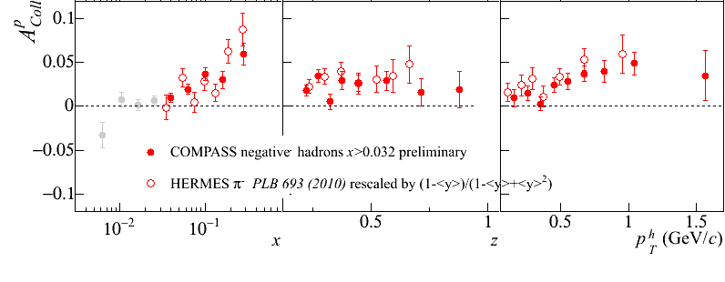
Sivers
e+p
μ+p
Boer-Mulders x Collins
e+p
HERMES, PRD 87, 012010 (2013)
e+p
μ+p
Transversity x Collins

Slide 34
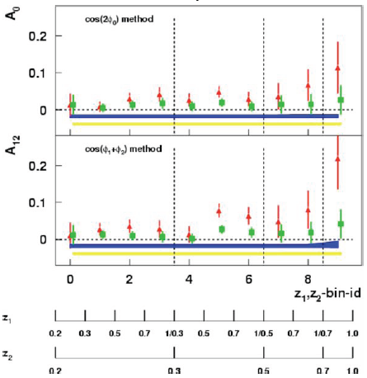
Sivers
e+p
μ+p
BELLE PRL96, 232002 (2006)
Collins x Collins
e⁺e⁻
Boer-Mulders x Collins
e+p
HERMES, PRD 87, 012010 (2013)
e+p
μ+p
Transversity x Collins

Slide 35
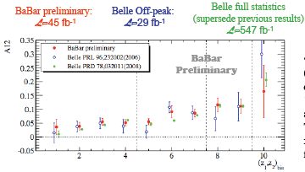
Sivers
e+p
μ+p
BELLE PRL96, 232002 (2006)
Collins x Collins
e⁺e⁻
Boer-Mulders x Collins
e+p
HERMES, PRD 87, 012010 (2013)
BaBar published ref. PRD90, 052003 (2014)
Collins x Collins
e⁺e⁻
e+p
μ+p
Transversity x Collins

Slide 36
“Naïve-T-odd” spin-momentum correlations require phase interference
Some spin-momentum correlation functions odd under “naïve-time-reversal” (actually a PT transformation)
1990 – Proposed by D.W. Sivers
1993 – Claimed forbidden by J.C. Collins
2002 – Demonstrated nonvanishing by Brodsky, Hwang, Schmidt if phase interference effects due to color interactions present

Slide 37
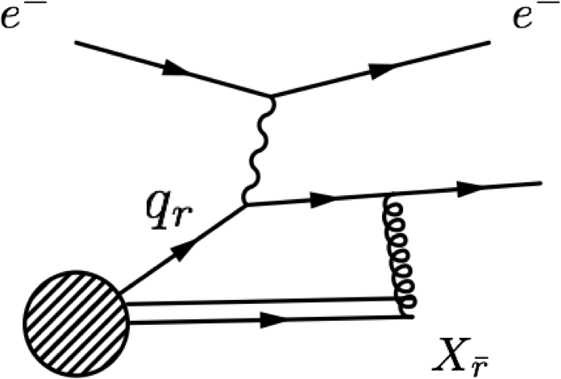
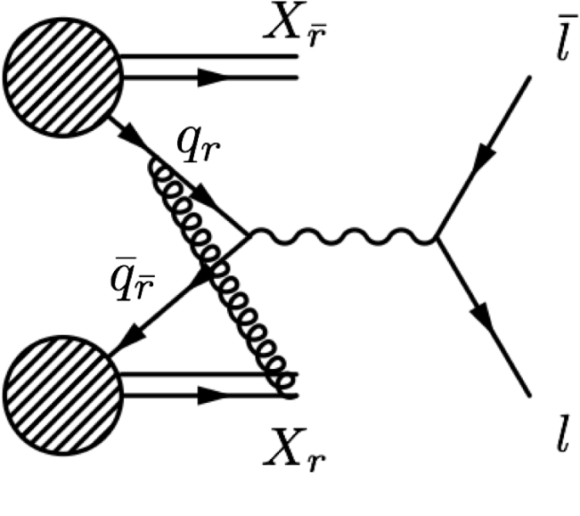
Color in action! Modified universality of certain transverse-momentum-dependent distributions
Deep-inelastic lepton-nucleon scattering:
Attractive final-state interactions
Quark-antiquark annihilation to leptons:
Repulsive initial-state interactions
Get opposite sign for Sivers transverse-momentum-dependent pdf in semi-inclusive DIS versus Drell-Yan:
process-dependent pdf! (Collins 2002)
Figures by J.D. Osborn

Slide 38
Color in action! Modified universality of certain transverse-momentum-dependent distributions
Deep-inelastic lepton-nucleon scattering:
Attractive final-state interactions
Quark-antiquark annihilation to leptons:
Repulsive initial-state interactions
Get opposite sign for Sivers transverse-momentum-dependent pdf in semi-inclusive DIS versus Drell-Yan:
process-dependent pdf! (Collins 2002)
Still waiting for a polarized quark-antiquark annihilation measurement to compare to existing lepton-nucleon scattering measurements . . .
Figures by J.D. Osborn

Slide 39


Huge spin-momentum correlations seen in p↑+p→ charged pions
ANL
√s=4.9 GeV
BNL
√s=6.6 GeV
FNAL
√s=19.4 GeV
RHIC
√s=62.4 GeV
Color exchange and phase interference possible in both initial and final state—more complicated! Huge correlations not yet understood . . .
left
right

Slide 40
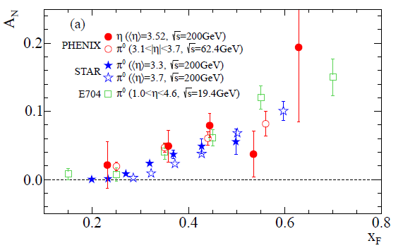
Slightly smaller correlations in p↑+p→ neutral pions and eta mesons
Partial cancellation between up and down quarks orbiting in opposite directions in polarized proton?
Antiquarks and strange quarks don’t matter?
PHENIX, PRD90, 072008 (2014)

Slide 41
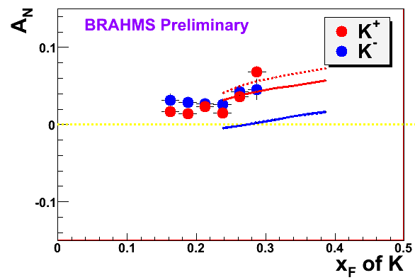
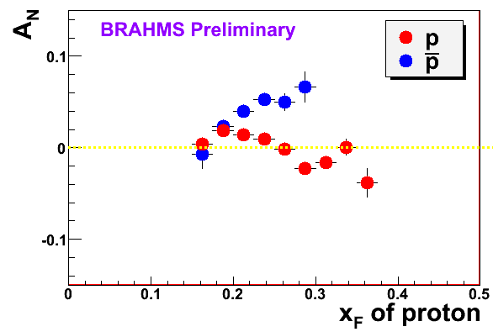
But antiquarks do matter!
What’s generating these large effects in p+p??
K
p
200 GeV
200 GeV
Negative kaons same as positive??
Large antiproton asymmetry?!

Slide 42
Color entanglement—origin of huge spin-momentum correlations in p+p??
  2010: Prediction of color entanglement in processes involving p+p production of hadrons if quark transverse momentum taken into account
  Quarks become correlated across the two protons!
  Novel consequence of QCD specifically as a non-Abelian gauge theory (gluons couple to other gluons)
Rogers + Mulders, PRD 81, 094006

Slide 43
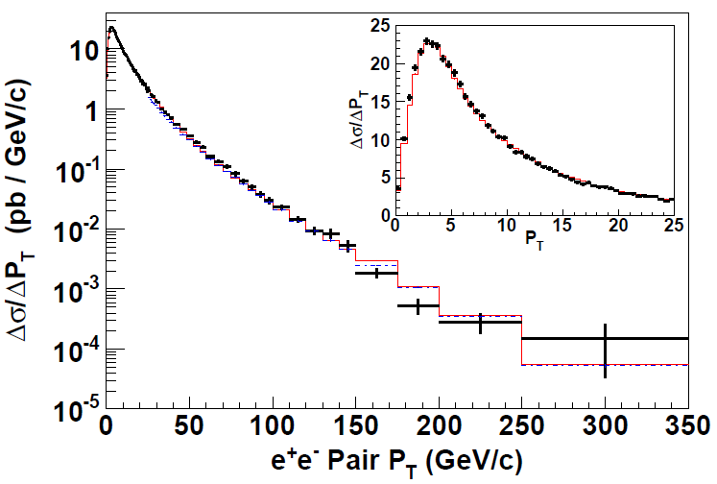
Searching for color entanglement
First improve knowledge of cases with no color entanglement—can be polarized or unpolarized processes sensitive to quark intrinsic transverse momentum
Quark-antiquark scattering to electroweak particles—no entanglement expected
See how Gaussian width evolves with four-momentum transfer
CDF Z production
PRD86, 052010 (2012)

Slide 44
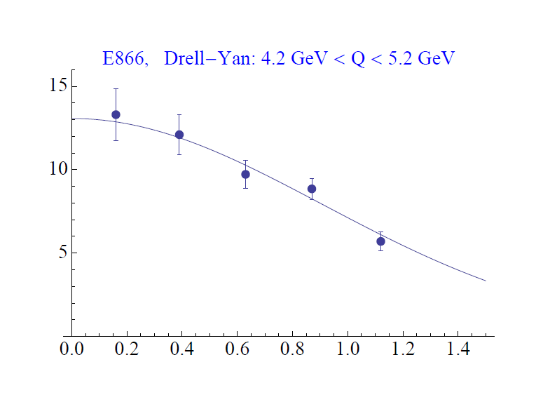
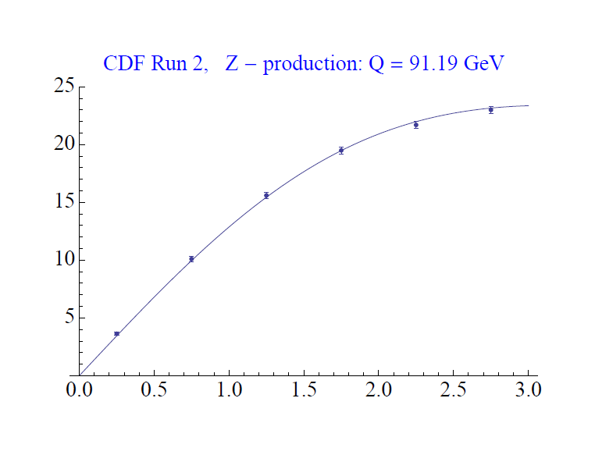
Searching for color entanglement
First improve knowledge of cases with no color entanglement—can be polarized or unpolarized processes sensitive to quark intrinsic transverse momentum
Quark-antiquark scattering to electroweak particles—no entanglement expected
See how Gaussian width evolves with four-momentum transfer
CDF Z production
PRD86, 052010 (2012)
dσ/dp_{T}
Aidala,
Rogers
dσ/dp_{T}
p+p → μ⁺+μ⁻+X
√s = 1.96 TeV
√s = 0.039 TeV
p_{T} (GeV/c)
p_{T} (GeV/c)

Slide 45
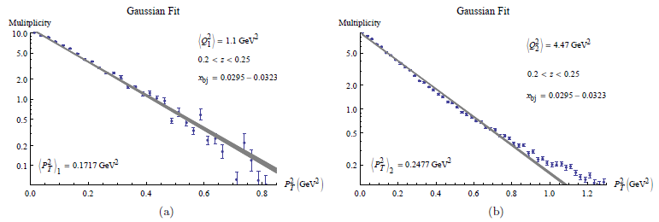
Searching for color entanglement
Hadron produced by deep-inelastic muon-nucleus scattering—no entanglement expected
Gaussian distribution at low transverse momentum of produced particle
Again want to see how Gaussian width evolves with 4-momentum transfer of reaction—should be same rate across all non-entangled processes
<Q>=1.05 GeV/c
<Q>=2.11GeV/c
μ+⁶LiD→h+X
Aidala, Field, Gamberg, Rogers, PRD89, 094002 (2014)
Data from COMPASS, EPJC73, 2531 (2013)

Slide 46
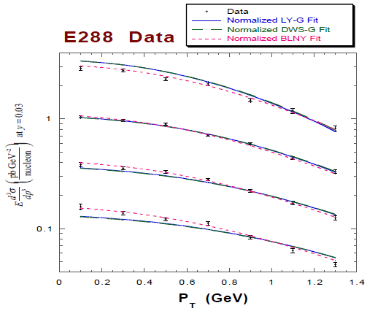
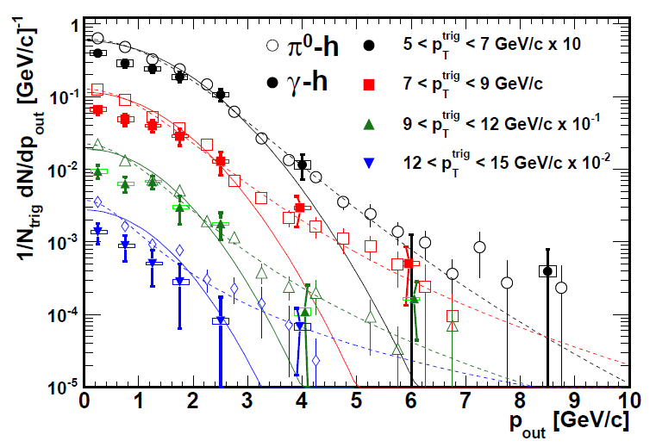
Testing TMD-factorization breaking/ color entanglement: p+p → hadrons
PRD 67, 073016 (2003)
PRD82, 072001 (2010)
Quark-antiquark annihilation to lepton pairs
Out-of-plane momentum component
Drell-Yan p_{T} for different 4-momentum transfers: no entanglement expected
π⁰-charged hadron and γ-charged hadron correlations for different 4-momentum transfers: entanglement expected. Gaussian shape at low p_{out}
Look for different rate of change of Gaussian widths as function of 4-momentum transfer. . . In progress!

Slide 47
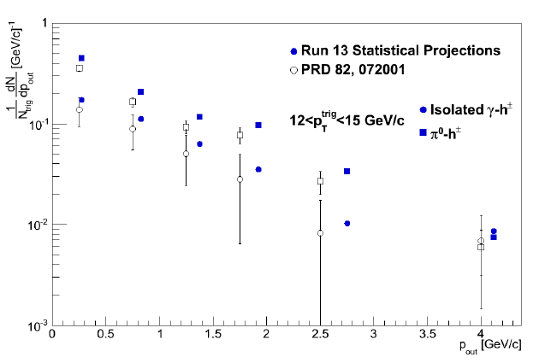
Much higher statistics coming soon from recent 510 GeV proton-proton data
Entangled QCD systems completely new territory!! Still understanding how best to extract the physics from the data. Our new results will at least stimulate further discussion within the community…
J.D. Osborn
Out-of-plane momentum component

Slide 48
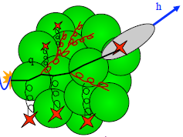
Summary
Early years of rewarding new era of quantitative basic research in QCD!
Gradually shifting to think about QCD systems in new ways, focusing on topics/ideas/concepts long familiar to the world of condensed matter physics
  Different phases of matter and phase transitions
  All sorts of correlations within systems
  Quantum mechanical phase interference effects
  Quantum entangled systems
Lots of fertile ground ready to be explored in the upcoming years

Slide 49
Extra

Slide 50
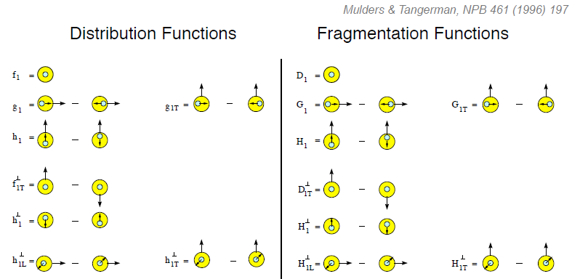
Spin-momentum correlations and the proton as a QCD “laboratory”
“Transversity” pdf:
Correlates proton transverse spin and quark transverse spin
“Sivers” pdf:
Correlates proton transverse spin and quark transverse momentum
“Boer-Mulders” pdf:
Correlates quark transverse spin and quark transverse momentum
S_{p}-S_{q} coupling
S_{p}-L_{q} coupling
S_{q}-L_{q} coupling

Slide 51

p+p → γ+h or π⁰+h azimuthal correlations for different hard scales

Slide 52


Parametrizing transverse-momentum-dependent parton distribution functions
Can successfully simultaneously describe data from fixed-target energies to LHC energies! With better knowledge of the quark and gluon distributions inside the proton, will be able to improve predictions for transverse momentum dependence of particle production at LHC.
C.A. Aidala,
T.C. Rogers
dσ/dp_{T}
dσ/dp_{T}
√s = 1.96 TeV
√s = 7.0 TeV
p_{T} (GeV/c)
p_{T} (GeV/c)

Slide 53

Deep-inelastic lepton-nucleon scattering:
A tool of the trade
Probe nucleon with an electron or muon beam
Interacts electromagnetically with (charged) quarks and antiquarks
“Clean” process theoretically—quantum electrodynamics well understood and easy to calculate!

Slide 54


Parton distribution functions inside a nucleon:
The language we’ve developed (so far!)
What momentum fraction would the scattering particle carry
if the proton were made of …
3 bound valence quarks
A point particle
x_{Bjorken}
1
1/3
1
3 bound valence quarks + some
low-momentum sea quarks
x_{Bjorken}
Sea
3 valence quarks
Valence
Small x
1/3
1
x_{Bjorken}
1/3
x_{Bjorken}
1
Halzen and Martin, “Quarks and Leptons”, p. 201

Slide 55

Decades of DIS data: What have we learned?
F₂(x,Q²)
Wealth of data largely thanks to proton-electron collider, HERA, in Hamburg (1992-2007)
Rich structure at low x
Half proton’s momentum carried by gluons!
parton distribution function
momentum fraction
PRD67, 012007 (2003)

Slide 56

What have we learned in terms of this picture by now?
Wealth of data largely thanks to proton-electron collider, HERA, in Hamburg (1992-2007)
Half proton’s momentum carried by gluons!

Slide 57

Drell-Yan complementary to DIS

Slide 58









RHIC as a polarized p+p collider
Absolute Polarimeter (H jet)
RHIC pC Polarimeters
Siberian Snakes
BRAHMS & PP2PP
Siberian Snakes
PHENIX
Spin Flipper
STAR
Spin Rotators
Various equipment to maintain and measure beam polarization through acceleration and storage
Partial Snake
Helical Partial
Snake
Polarized Source
Strong Snake
LINAC
AGS
200 MeV Polarimeter
BOOSTER
Rf Dipole
AGS Internal Polarimeter
AGS pC Polarimeter
58

Slide 59

PHENIX detector
Philosophy:
  High rate capability to measure rare probes,
  limited acceptance.
2 central spectrometers
  Track charged particles and detect electromagnetic processes
2 forward muon spectrometers
  Identify and track muons
2 forward calorimeters (as of 2007)
  Measure forward pions, etas
Relative Luminosity
  Beam-Beam Counter (BBC)
  Zero-Degree Calorimeter (ZDC)

Slide 60





The era of quantitative QCD!
Transverse-Momentum-Dependent
QCD: Discovery and development
  1973 → ~2004
Since 1990s starting to consider detailed internal QCD dynamics, going beyond traditional parton model ways of looking at hadrons—and perform phenomenological calculations using these new ideas/tools!
  Various resummation techniques
  Non-collinearity of partons with parent hadron
  Various effective field theories, e.g. Soft-Collinear Eff. Th.
  Non-linear evolution at small momentum fractions
Higgs vs. pT
Mulders & Tangerman, NPB 461, 197 (1996)
Collinear
Worm gear
arXiv:1108.3609
Almeida, Sterman, Vogelsang
PRD80, 074016 (2009)
Transversity
PRD80, 034031 (2009)
pp→π⁰π⁰X
Sivers
Boer-Mulders
M (GeV)
Pretzelosity
Worm gear

Slide 61


Additional recent theoretical progress in QCD
Progress in non-perturbative methods:
  Lattice QCD just starting to perform calculations at physical pion mass!
  AdS/CFT “gauge-string duality” an exciting recent development as first fundamentally new handle to try to tackle QCD in decades!
PACS-CS: PRD81, 074503 (2010)
BMW: PLB701, 265 (2011)
“Modern-day ‘testing’ of (perturbative) QCD is as much about pushing the boundaries of its applicability as about the verification that QCD is the correct theory of hadronic physics.”
– G. Salam, hep-ph/0207147 (DIS2002 proceedings)
T. Hatsuda,
PANIC 2011
Notes:
Hadron spectrum, quark masses, pseudoscalar meson decay constants

Slide 62

How Perfect is “Perfect”
All “realistic” hydrodynamic calculations for RHIC fluids to date have assumed zero viscosity
  η = 0  “perfect fluid”
  But there is a (conjectured) quantum limit:
  Where do
  “ordinary”
  fluids sit wrt
  this limit?
  RHIC “fluid” might
  be at ~2-3 on this
  scale (!)
T=10¹² K

Slide 63


Quark energy loss in QCD matter
“Cold” (normal) nuclear matter
Hot quark-gluon plasma

Slide 64






Spin physics at RHIC
Polarized protons at RHIC 2002-present
Mainly √s = 200 GeV, also 62.4 GeV in 2006, started 500 GeV program in 2009
Two large multipurpose detectors: STAR and PHENIX
  Longitudinal or transverse polarization
One small spectrometer until 2006: BRAHMS
  Transverse polarization only
Transverse spin only
(No rotators)
Longitudinal or transverse spin
Longitudinal or transverse spin

Slide 65
Mapping out the proton
What does the proton look like in terms of the quarks and gluons inside it?
Position
Momentum
Spin
Flavor
Color
Theoretical and experimental concepts to describe and access position only born in mid-1990s. Pioneering measurements over past decade.
Vast majority of past four decades focused on
1-dimensional momentum structure! Since 1990s starting to consider other directions . . .
Polarized protons first studied in 1980s. How angular momentum of quarks and gluons add up still not well understood!
Good measurements of flavor distributions in valence region. Flavor structure at lower momentum fractions still yielding surprises!
Accounted for by theorists from beginning of QCD, but more detailed, potentially observable effects of color have come to forefront in last couple years . . .

Slide 66

Fermilab E906
Targets: Liquid hydrogen and deuterium (W. Lorenzon), and C, Ca, W nuclei
  Also cold nuclear matter program

Slide 67

Azimuthal dependence of Drell-Yan cross section
In terms of transverse-momentum-dependent parton distribution functions
Arnold, Metz, Schlegel, PRD79, 034005 (2009)
Contributions if you have unpolarized (U), longitudinally polarized (L), or transversely polarized (T) beam and target

Slide 68

Azimuthal dependence of unpolarized Drell-Yan cross section
cos2φ term sensitive to correlations between quark transverse spin and quark transverse momentum!
Large cos2φ dependence seen in pion-induced Drell-Yan
ν
NA10 dataa
194 GeV/c
π⁻+W
Q_{T} (GeV)
D. Boer, PRD60, 014012 (1999)

Slide 69


What about proton-induced Drell-Yan?
Significantly reduced cos2φ dependence in proton-induced Drell-Yan observed by E866
Suggests sea quark transverse spin-momentum correlations small?
Will be interesting to measure for higher-x sea quarks in E906!
E866, PRL 99, 082301
(2007)
Looking forward to forthcoming data!!
E866

Slide 70


pQCD calculations for η mesons recently enabled by first-ever fragmentation function parametrization
Simultaneous fit to world e⁺e⁻ and p+p data
  e⁺e⁻ annihilation to hadrons simplest colliding system to study FFs
  Technique to include deep-inelastic scattering and p+p data in addition to e⁺e⁻ only developed in 2007!
  Included PHENIX p+p cross section in η FF parametrization
C.A. Aidala, F. Ellinghaus, R. Sassot, J.P. Seele, M. Stratmann,
PRD83, 034002 (2011)

Slide 71

Neural network techniques for fitting parton helicity distributions
Reduce/eliminate bias from choice of functional forms
NNPDF Collaboration, Nocera et al., Nucl. Phys. B887, 276 (2014)

Slide 72

Sea quarks—many hints of interesting behavior already!
p+W: (Valence) quark from p, (sea) antiquark from W
pbar+W: (Valence) quark from W, (valence) antiquark from pbar
(Valence x sea) spectrum harder → Larger mean k_{T} for sea than valence quarks?
  Agrees with chiral soliton model predictions (e.g. Schweitzer, Strikman, Weiss 2013)
  Consistent with work by Bacchetta et al.
Plot from CAA, Field, Gamberg, Rogers, PRD89, 094002 (2014)
Data from E537 (pbar+W): PRD38, 1377 (1988)
E439: (p+W): AIP Conf. Proc. 45, 93 (1978)

Slide 73

First results! Light sea flavor ratio
Only 5% of anticipated data
Systematic uncertainty dominated by target-dependent variation in collection efficiency with beam intensity—expected to drop to ~1% after corrections
Already comparable high-x_{target} statistics to E866 result
Suggests ratio does not drop off sharply
Installation of new Station 1 chamber will enhance high-x_{target} acceptance

Slide 74

Effects persist up to transverse momenta of 7 GeV/c!
Can use tools of perturbative QCD to try to interpret!!

Slide 75


Looking to the future
Module prototyping for a new tungsten-powder – scintillating fiber electromagnetic calorimeter at RHIC
Electromagnetic calorimeter light guide design

Slide 76
Searching for color entanglement
Quark-antiquark annihilation to lepton pairs
p+A → μ⁺+μ⁻+X
for different invariant masses:
No color entanglement expected
Landry, Brock, Nadolsky, Yuan, PRD 67, 073016 (2003)
Get predictions from fits to data where no entanglement expected

Slide 77

Searching for color entanglement
PRD82, 072001 (2010)
Quark-antiquark annihilation to lepton pairs
p+A → μ⁺+μ⁻+X
for different invariant masses:
No color entanglement expected
Landry, Brock, Nadolsky, Yuan, PRD 67, 073016 (2003)
Get predictions from fits to data where no entanglement expected
Out-of-plane momentum component
In progress . . .!
Make predictions for processes where entanglement is expected; look for deviation

Slide 78


Slide 79


Slide 80


