Slide 1
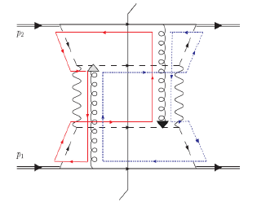

Spin-Momentum Correlations, Aharonov-Bohm, and
Color Entanglement in Quantum Chromodynamics
Christine A. Aidala
University of Michigan
left
right
MIT LNS Colloquium
November 28, 2016

Slide 2
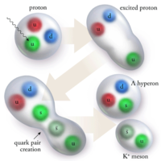
Theory of strong interactions:
Quantum Chromodynamics
  Fundamental field theory in hand since the early 1970s—BUT . . .
  Quark and gluon degrees of freedom in the theory cannot be observed or manipulated directly in experiment!
Color confinement—quarks and gluons are confined to color-neutral bound states
CLAS, PRL 113, 152004 (2014)
PRL Editor’s Choice Oct. 2014

Slide 3
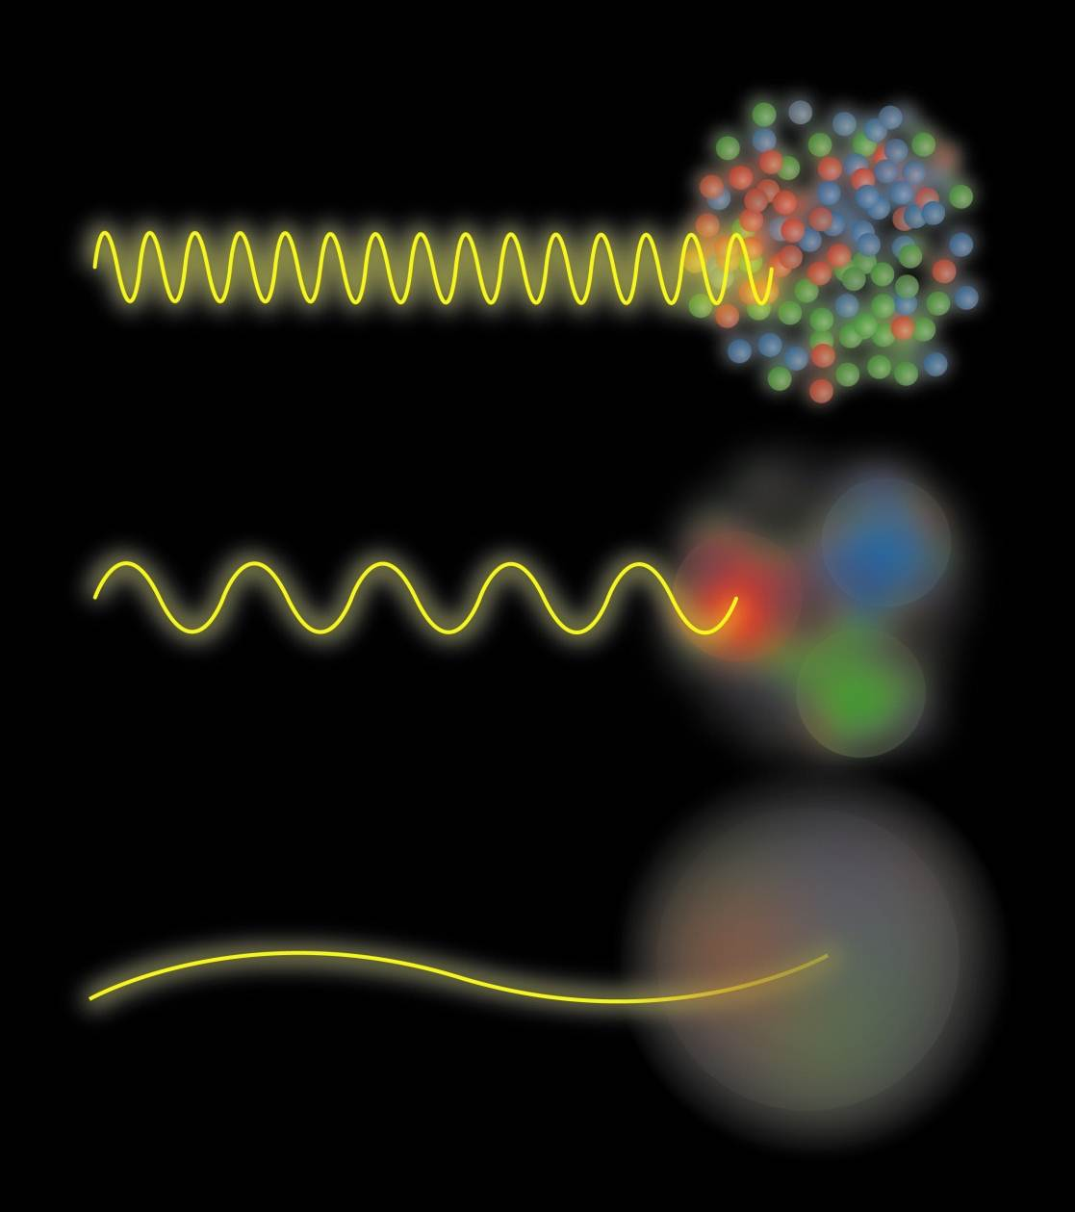
Quark and gluon structure of the nucleon
Probing the proton at different energy scales offers information on different aspects of its internal structure
Josh Rubin

Slide 4
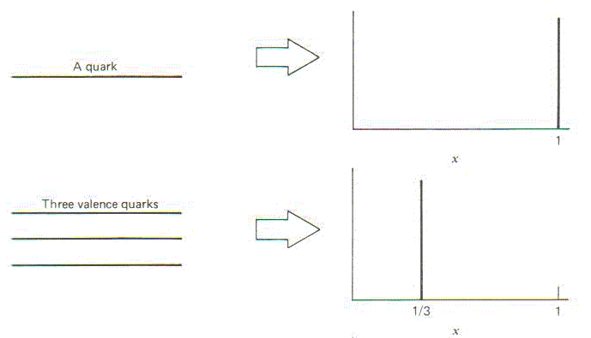
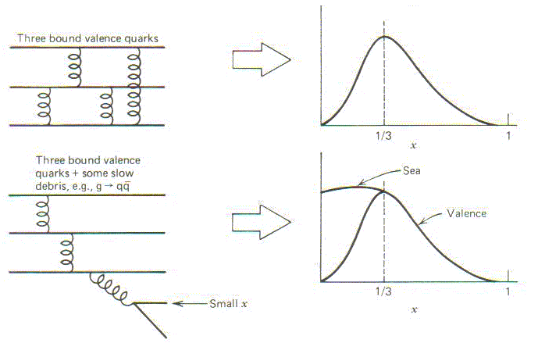
Parton distribution functions inside a nucleon:
The language we’ve developed (so far!)
What momentum fraction would the scattering particle carry
if the proton were made of …
3 bound valence quarks
A point particle
x_{Bjorken}
1
1/3
1
3 bound valence quarks + some
low-momentum sea quarks
x_{Bjorken}
Sea
3 valence quarks
Valence
Small x
1/3
1
x_{Bjorken}
1/3
x_{Bjorken}
1
Halzen and Martin, “Quarks and Leptons”, p. 201

Slide 5
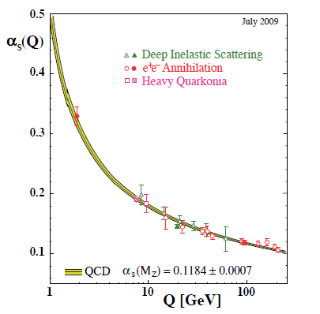
Perturbative QCD
Take advantage of running of the strong coupling constant with energy (asymptotic freedom)—weak coupling at high energies (short distances)
Perturbative expansion as in quantum electrodynamics (but many more diagrams due to gluon self-coupling!!)
Provides one rigorous way of relating the fundamental field theory to a variety of physical observables!
Notes:
Scattering energy

Slide 6
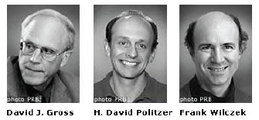
QCD: How far have we come?
QCD is challenging!!
Three-decade period after initial birth of QCD dedicated to “discovery and development”
→ Symbolic closure: Nobel prize 2004 - Gross, Politzer, Wilczek for asymptotic freedom
Now early years of second phase:
quantitative QCD!

Slide 7
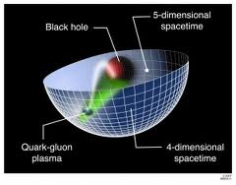
Advancing into the era of quantitative QCD: Theory has been forging ahead
In perturbative QCD, since 1990s starting to consider detailed internal dynamics that parts with traditional parton model ways of looking at hadrons—and perform phenomenological calculations using these new ideas/tools!
E.g.:
  Various resummation techniques
  Non-linear evolution at small momentum fractions
  Spin-spin and spin-momentum correlations in QCD bound states
  Spatial distributions of partons in QCD bound states
Nonperturbative methods:
  Lattice QCD less and less limited by computing resources—since 2010 starting to perform calculations at the physical pion mass (after 36 years!). Plus recent new ideas on how to calculate previously intractable quantities.
  AdS/CFT “gauge-string duality” an exciting recent development as first fundamentally new handle to try to tackle QCD in decades!

Slide 8
Effective field theories
QCD exhibits different behavior at different scales—effective field theories are useful approximations within these different regimes
  Color Glass Condensate – high energies, high densities
  Soft-Collinear Effective Theory – new insights into performing complicated perturbative calculations very quickly
  Chiral Effective Theory, Heavy Quark Effective Theory, Non-Relativistic QCD, . . .
  Many effective theories for nonperturbative QCD – chiral symmetry breaking, . . .

Slide 9
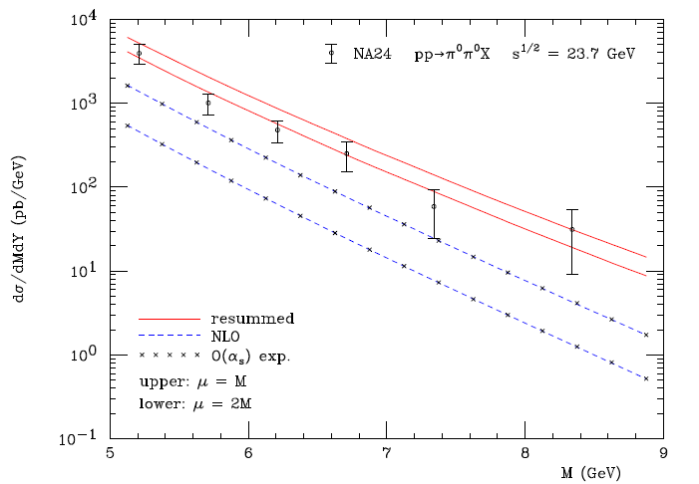
Example: “Threshold resummation” Extending perturbative calculations to lower energies
For observables with two different scales, sum logs of their ratio to all orders in the strong coupling constant
}
pp→π⁰π⁰X
}
Next-to-leading-order in α_{s} + resum.
Next-to-leading-order in α_{s}
M (GeV)
Almeida, Sterman, Vogelsang PRD80, 074016 (2009)

Slide 10
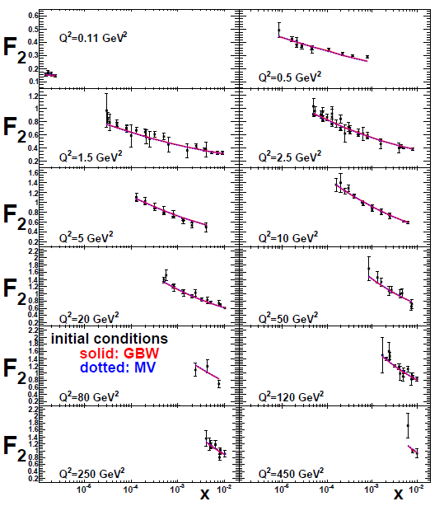
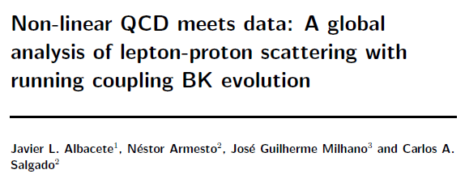
Example: Phenomenological applications of a non-linear gluon saturation regime
Phys. Rev. D80, 034031 (2009)
Basic framework for non-linear QCD, in which gluon densities are so high that there’s a non-negligible probability for two gluons to combine, developed ~1997-2001. But had to wait until “running coupling BK evolution” figured out in 2007 to compare directly to data!
Fits to proton structure function data at low parton momentum fraction x.

Slide 11
Example: Spin-spin and spin-momentum correlations in QCD bound states
Unpolarized
Spin-spin correlations
Spin-momentum correlations
S•(p₁×p₂)

Slide 12
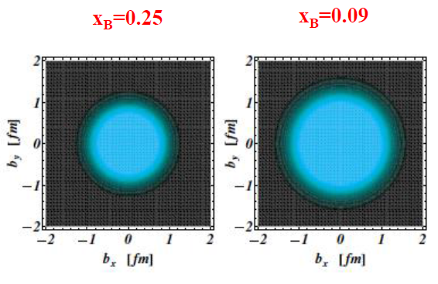
Example: Exploring spatial distributions
Guidal, Moutarde,
Vanderhaeghen,
Rept. Prog. Phys. 76 (2013) 066202
CLAS HERMES
Initial evidence that quarks carrying larger momentum fractions (25% vs. 9%) in the nucleon are distributed over a smaller volume in space
Spatial charge densities measured via deeply virtual Compton scattering

Slide 13
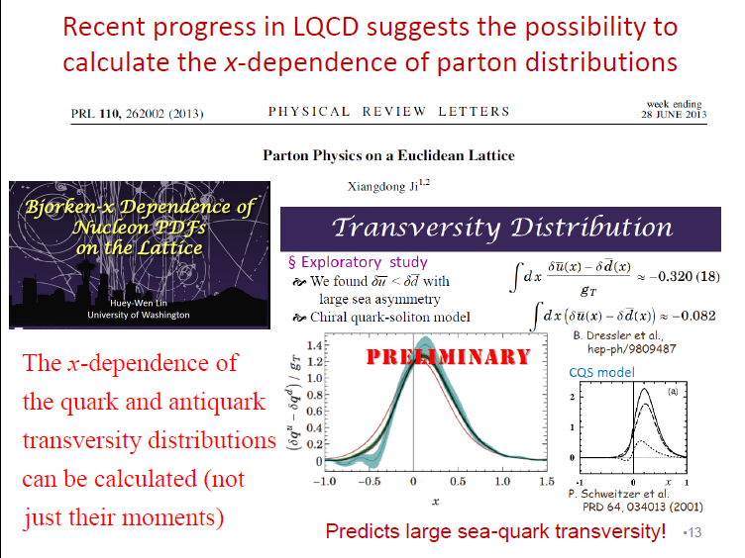
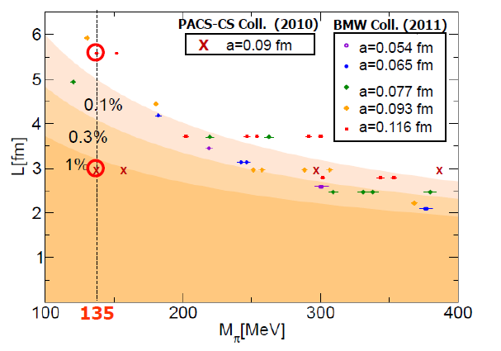
Example: Progress in lattice QCD
Slide from J.-C. Peng, Transversity 2014
First calculations at physical pion mass 135 MeV
Figure from T. Hatsuda,
PANIC 2011
PACS-CS: PRD81, 074503 (2010)
BMW: PLB701, 265 (2011)

Slide 14
Example: Effective field theories
Higgs production vs. p_{T}
D. Neill, I. Rothstein, V. Vaidya
JHEP 1512, 097 (2015)
Soft Collinear Effective Theory
– Transverse momentum distribution for gluon+gluon→Higgs

Slide 15
Mapping out the partonic structure of the proton
What does the proton look like in terms of the quarks and gluons inside it?
Position
Momentum
Spin
Flavor
Color
Theoretical and experimental concepts to describe and access position only born in mid-1990s. Pioneering measurements over past decade.
Vast majority of past four decades focused on
1-dimensional momentum structure! Since 1990s starting to consider transverse components . . .
Polarized protons first studied in 1980s. How angular momentum of quarks and gluons add up still not well understood!
Good measurements of flavor distributions in valence region. Flavor structure at lower momentum fractions still yielding surprises!
Accounted for theoretically from beginning of QCD, but more detailed, potentially observable effects of color flow have come to forefront in last few years . . .

Slide 16
A cyclical process
Proliferation of observations and ideas
Synthesis
Notes:
After lots of new observations and ideas over the course of the last 15-20 years, we’re now in a rewarding period of synthesis

Slide 17
Factorization and universality in perturbative QCD
Need to systematically factorize short- and long-distance physics—observable physical QCD processes always involve at least one long-distance scale (confinement)!
Long-distance (i.e. not perturbatively calculable) functions need to be universal in order to be portable across calculations for many processes
Measure nonperturbative parton distribution functions (pdfs) and fragmentation functions in many colliding systems over a wide kinematic range→constrain by performing
simultaneous fits to world data

Slide 18
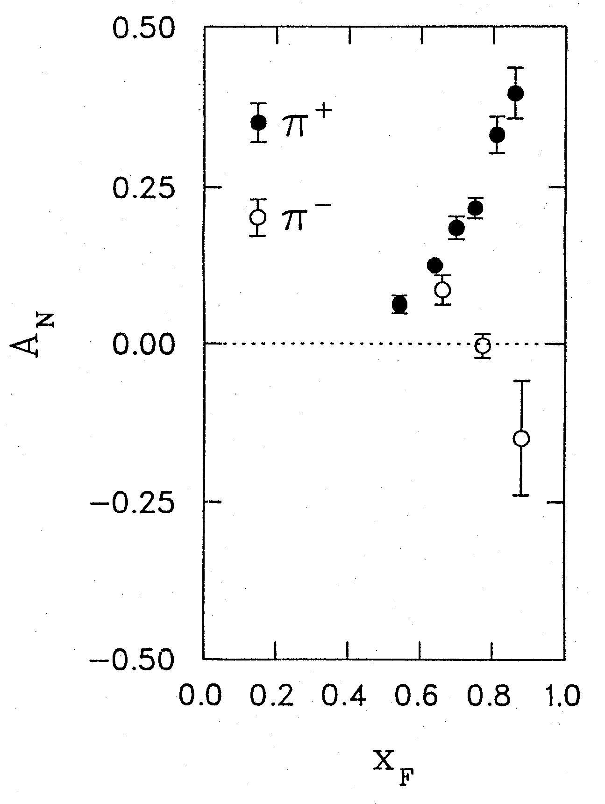
Spin-momentum correlations:
1976 discovery in p+p collisions
Argonne √s=4.9 GeV
Charged pions produced preferentially on one or the other side with respect to the transversely polarized beam direction—by up to 40%!!
Had to wait more than a decade for the birth of a new subfield in order to explore the possibilities . . .
left
right
W.H. Dragoset et al., PRL36, 929 (1976)

Slide 19
Transverse-momentum-dependent distributions and single-spin asymmetries
1990: “Sivers mechanism” proposed in attempt to understand observed asymmetries
Departs from traditional collinear factorization assumption in pQCD and proposes correlation between the intrinsic transverse motion of the quarks and gluons and the proton’s spin
Sivers distribution: first transverse-momentum-dependent parton distribution function describing a spin-momentum correlation
New frontier! Parton dynamics inside hadrons, and in the hadronization process
D.W. Sivers
PRD41, 83 (1990)
Spin and momenta of partons and/or hadrons
Notes:
Dennis Sivers motivated by forthcoming E704 data

Slide 20


Spin-spin and spin-momentum correlations in QCD bound states
Worm-gear
(Kotzinian-Mulders)
Unpolarized
Spin-spin correlations
Helicity
Lots of evidence from deep-inelastic lepton-nucleon scattering experiments over past ~10 years that many of these correlations are nonzero in nature!
Transversity
Sivers
Spin-momentum correlations
Boer-Mulders
S•(p₁×p₂)
Pretzelosity
Worm-gear

Slide 21
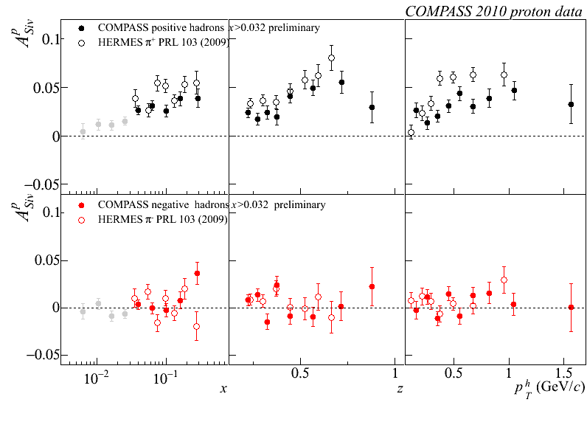
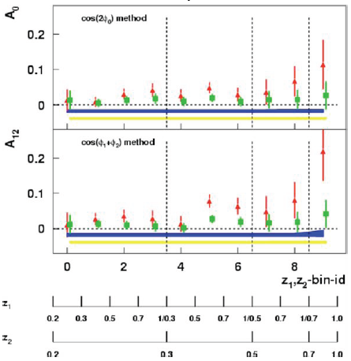
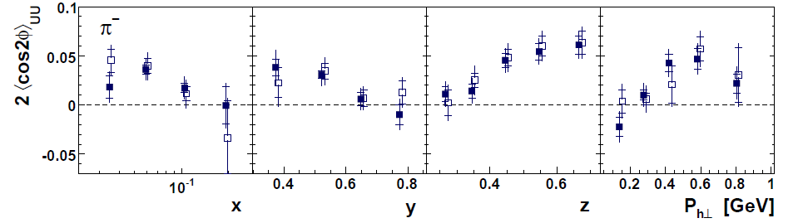
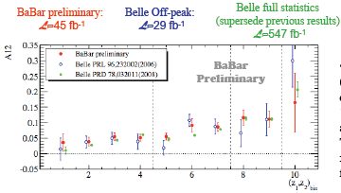
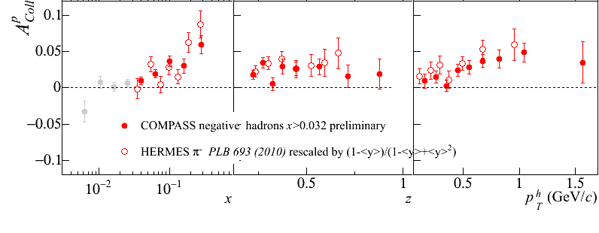
Sivers
e+p
μ+p
BELLE PRL96, 232002 (2006)
Collins x Collins
e⁺e⁻
Boer-Mulders x Collins
e+p
HERMES, PRD 87, 012010 (2013)
BaBar published ref. PRD90, 052003 (2014)
Collins x Collins
e⁺e⁻
e+p
μ+p
Transversity x Collins

Slide 22

But what about proton-proton collisions?
ANL
√s=4.9 GeV
BNL
√s=6.6 GeV
FNAL
√s=19.4 GeV
RHIC
√s=62.4 GeV
left
Strikingly similar effects across energies!
→ Continuum between nonperturbative/nonpartonic and perturbative/partonic descriptions of this nonperturbative structure?
right

Slide 23
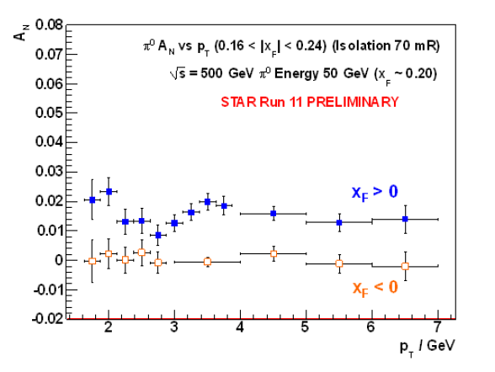
Single-spin asymmetries in transversely polarized p+p collisions
Effects persist to kinematic regimes where perturbative QCD techniques clearly apply
p_{T} = 7 GeV
→ Q² ~ 49 GeV²!
π⁰
STAR
(forward)
(backward)

Slide 24
p+p → hadron + X:
Challenging to interpret
Always huge effects!
But in p+p → pion +X don’t have enough information to separate initial-state (proton structure) from final-state (hadronization) effects

Slide 25
Properties of naïve-T-odd spin-momentum correlation functions
Sivers transverse-momentum-dependent parton distribution function is odd under “naïve-time-reversal” (actually a PT transformation)
  As is Boer-Mulders spin-momentum correlation
In 1993, after original 1990 paper by D.W. Sivers, J.C. Collins claimed such functions must vanish
Only realized in 2002 by Brodsky, Hwang, and Schmidt that could be nonvanishing if phase interference effects due to color interactions present

Slide 26
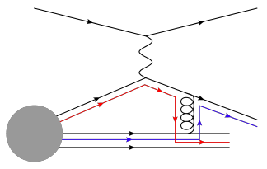
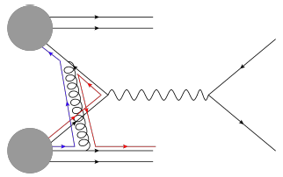
Modified universality of certain transverse-momentum-dependent distributions:
Color in action!
Deep-inelastic lepton-nucleon scattering: Final-state color exchange
Quark-antiquark annihilation to leptons: Initial-state color exchange
incoming
electron
scattered
electron
incoming proton
proton remnant
produced
positron
scattering
antiquark
scattering
quark
scattered
quark
scattering
quark
proton remnant
proton remnant
produced
electron
incoming proton
incoming proton
As a result, get opposite sign for the Sivers transverse-momentum-dependent pdf when measure in semi-inclusive DIS versus Drell-Yan: process-dependent pdf! (Collins 2002)
Figures by J.D. Osborn

Slide 27
Modified universality: Experimental indications
STAR
PRL 116, 132301 (2016)
W boson measurement from STAR suggestive of sign change, but not yet conclusive. Will take more data in 2017.
COMPASS experiment at CERN will also perform a measurement in next couple years.

Slide 28

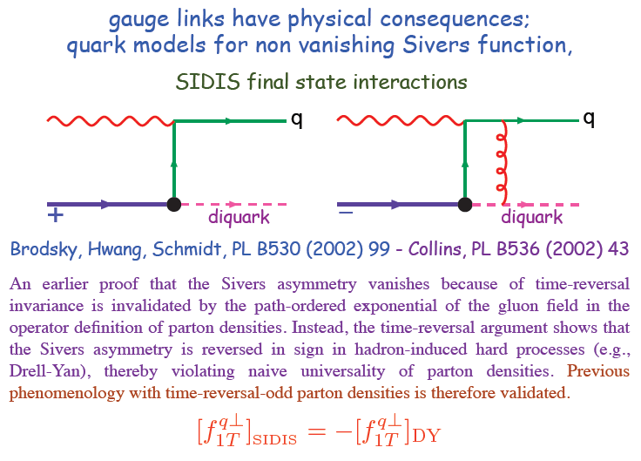
Modified universality requires full QCD:
Gauge-invariant quantum field theory
From 1993 claim by J.C. Collins that such processes must vanish
Slide from M. Anselmino, Transversity 2014

Slide 29
Physical consequences of a gauge-invariant quantum theory:
Aharonov-Bohm (1959)
Wikipedia:
“The Aharonov–Bohm effect is important conceptually because it bears on three issues apparent in the recasting of (Maxwell's) classical electromagnetic theory as a gauge theory, which before the advent of quantum mechanics could be argued to be a mathematical reformulation with no physical consequences. The Aharonov–Bohm thought experiments and their experimental realization imply that the issues were not just philosophical.
The three issues are:
whether potentials are "physical" or just a convenient tool for calculating force fields;
whether action principles are fundamental;
the principle of locality.”

Slide 30
Physical consequences of a gauge-invariant quantum theory:
Aharonov-Bohm (1959)
Physics Today, September 2009 :
The Aharonov–Bohm effects: Variations on a subtle theme,
by Herman Batelaan and Akira Tonomura.
“Aharonov stresses that the arguments that led to the prediction of the various electromagnetic AB effects apply equally well to any other gauge-invariant quantum theory. In the standard model of particle physics, the strong and weak nuclear interactions are also described by gauge-invariant theories. So one may expect that particle-physics experimenters will be looking for new AB effects in new domains.”

Slide 31
Physical consequences of a gauge-invariant quantum theory:
Aharonov-Bohm effect in QCD!!
Deep-inelastic lepton-nucleon scattering: Final-state color exchange
Quark-antiquark annihilation to leptons: Initial-state color exchange
Simplicity of these two processes:
Abelian vs. non-Abelian nature of the gauge group doesn’t play a major qualitative role.
BUT: In QCD expect additional, new effects due to specific non-Abelian nature of the gauge group
incoming
electron
scattered
electron
incoming proton
proton remnant
produced
positron
scattering
antiquark
scattering
quark
scattered
quark
scattering
quark
proton remnant
proton remnant
produced
electron
incoming proton
incoming proton
See e.g. Pijlman, hep-ph/0604226
or Sivers, arXiv:1109.2521

Slide 32
QCD Aharonov-Bohm effect:
Color entanglement
  2010: Rogers and Mulders predict color entanglement in processes involving p+p production of hadrons if quark transverse momentum taken into account
  Quarks become correlated across the two colliding protons
  Consequence of QCD specifically as a non-Abelian gauge theory!
PRD 81, 094006 (2010)
Color flow can’t be described as flow in the two gluons separately. Requires simultaneous presence of both.
Huge transverse spin asymmetries in p+p a color entanglement effect??

Slide 33
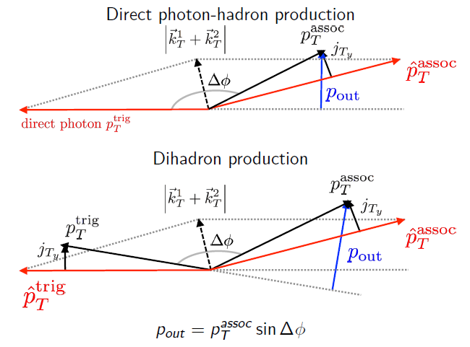
Searching for evidence of color entanglement at RHIC
Need observable sensitive to a nonperturbative momentum scale
  Nearly back-to-back particle production
Need 2 initial-state hadrons
  color exchange between a scattering parton and remnant of other proton
And at least 1 final-state hadron
  exchange between scattered parton and either remnant
→ In p+p collisions, measure out-of-plane momentum component in nearly back-to-back photon-hadron and hadron-hadron production

Slide 34
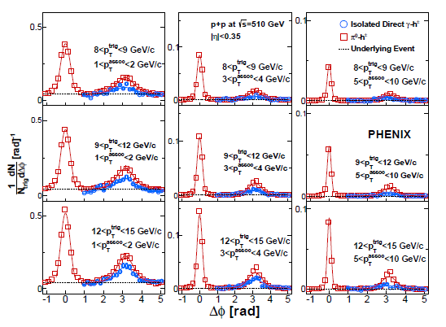
Two-particle correlation distributions show expected jet-like structure

Slide 35
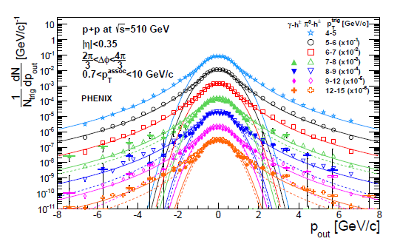
Out-of-plane momentum component distributions
Clear two-component distribution
  Gaussian near 0— nonperturbative transverse momentum
  Power-law at large p_{out}—kicks from hard (perturbative) gluon radiation
Different colors → different bins in hard interaction scale
Curves are fits to Gaussian and Kaplan functions, not calculations!

Slide 36
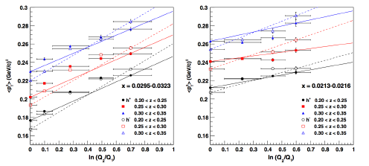
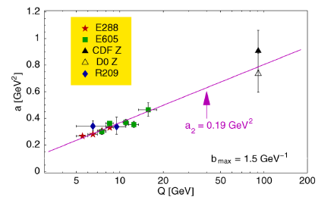
Look at evolution of nonperturbative transverse momentum widths with hard scale (Q²)
Theoretical proof of factorization for transverse-momentum-dependent parton distribution functions directly predicts that nonpertubative transverse momentum widths increase as a function of the hard scattering energy scale
  Increased phase space for gluon radiation
Confirmed experimentally in semi-inclusive deep-inelastic lepton-nucleon scattering (left) and quark-antiquark annihilation to leptons (right)
Aidala, Field, Gamberg, Rogers, Phys. Rev. D89, 094002 (2014)
Konychev + Nadolsky, Phys. Lett. B633, 710 (2006)

Slide 37
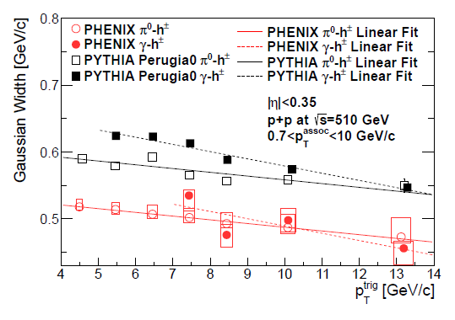
Nonperturbative momentum widths decrease in processes where entanglement predicted
Suggestive of quantum-correlated partons across colliding protons!
However, have not yet completely ruled out a “trivial” nonperturbative correlation between partonic longitudinal momentum fraction x and partonic transverse momentum k_{T}
Slope of decrease for both photon-hadron and dihadron correlations reproduced ~exactly in PYTHIA p+p event generator—could this effect be in PYTHIA??
  Effectively yes! Unlike analytic pQCD calculations, PYTHIA forces entire event including remnants to color neutralize, implemented via something they call “color reconnection”
Discussions ongoing, and follow-up studies underway . . .
PHENIX Collab., arXiv:1609.04769,
Submitted to PRD

Slide 38
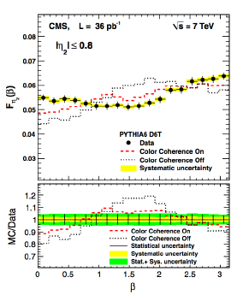
Possible links to “color coherence” at Tevatron and LHC?
D0, CDF, CMS have all published evidence for “color coherence effects”
  CMS: EPJ C74, 2901 (2014)
  CDF: PRD50, 5562 (1994)
  D0: PLB414, 419 (1997)
Few citations—relatively little-known work thus far. Need to get different communities talking to explore detailed color effects more in upcoming years!

Slide 39
Summary
Early years of rewarding new era of quantitative basic research in QCD!
Gradually shifting to think about QCD systems in new ways, focusing on topics/ideas/concepts that have long been familiar to the world of condensed matter and AMO physics
  All sorts of correlations within systems
  Quantum mechanical phase interference effects
  Quantum entangled systems
Will be exciting to continue testing and exploring these ideas and phenomena in upcoming years . . .

Slide 40
Extra

Slide 41
Partonic process contributions for direct photon production
PHENIX data region
Quark-gluon Compton scattering still dominates at NLO -
PLB140, 87 (1984)
PHENIX Collab., arXiv:1609.04769,
Submitted to PRD.
Calculation by T. Kaufmann

Slide 42
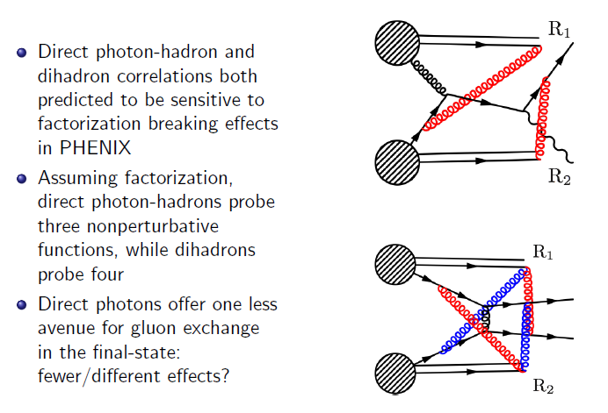
p+p → γ+h+X vs. p+p → h+h+X

Slide 43
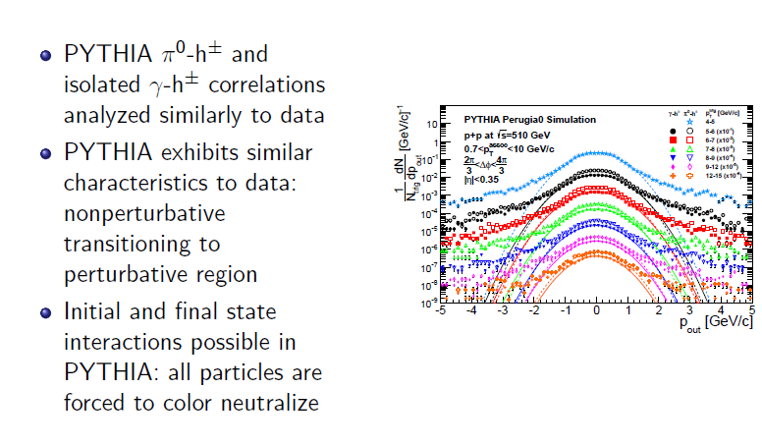
PYTHIA p_{out} distributions

Slide 44
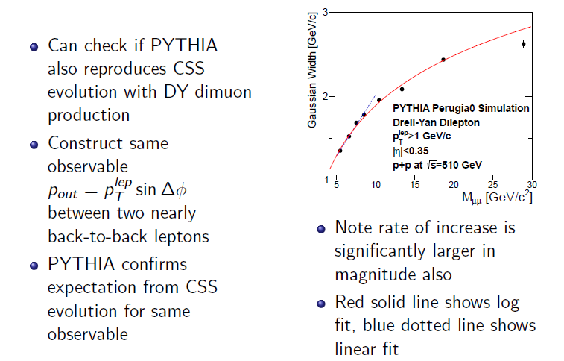
PYTHIA Drell-Yan

Slide 45
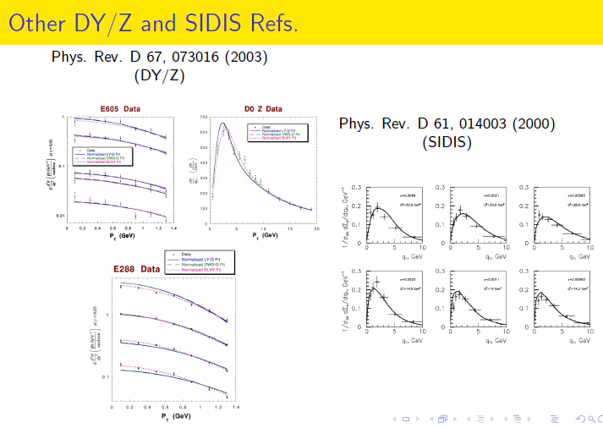
Nonperturbative momentum measurements in Drell-Yan and Z production

Slide 46
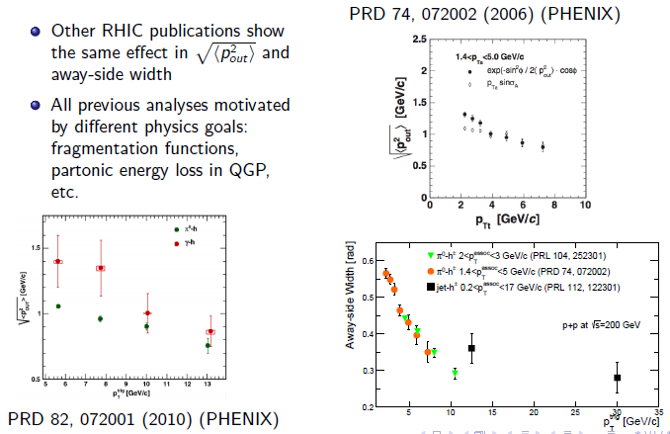
Other measurements showing decreasing nonperturbative momentum widths
STAR and PHENIX

Slide 47
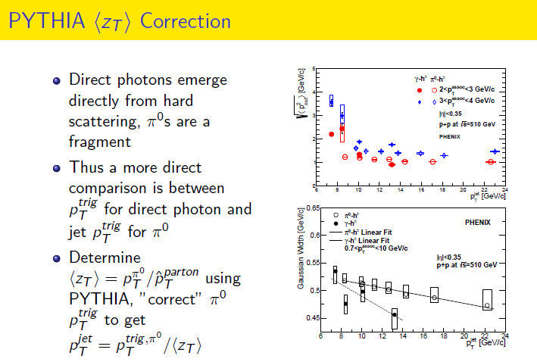

Slide 48
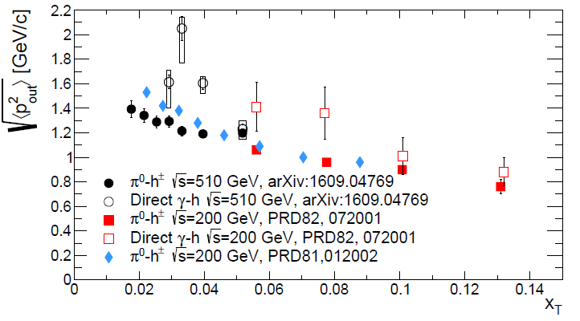
RMS p_{out} vs. x_{T}

Slide 49
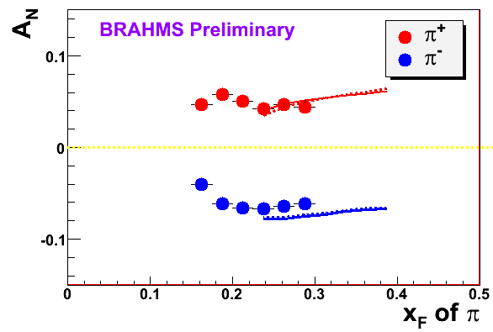
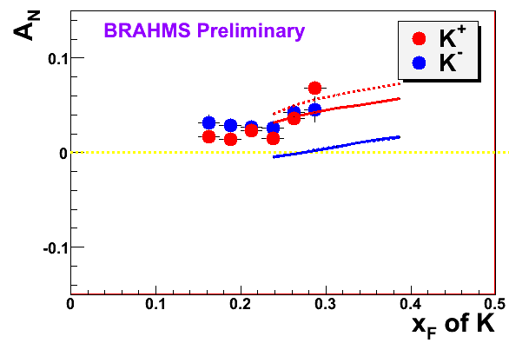

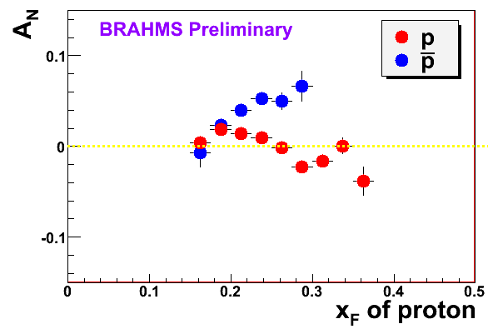
π
π
π, K, p
at 200 and 62.4 GeV
200 GeV
62.4 GeV
Note different scales
K
K
K- asymmetries
underpredicted
Pions suggest valence quark effect.
Kaons and (anti)protons don’t!
200 GeV
62.4 GeV
p
p
PRL 101, 042001 (2008)
Large antiproton asymmetry?? Unfortunately no 62.4
GeV measurement
200 GeV
62.4 GeV

Slide 50
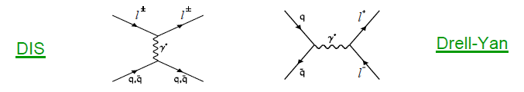
Complementarity of Drell-Yan and DIS
Both deep-inelastic lepton-nucleon scattering (DIS) and quark-antiquark annihilation to leptons (Drell-Yan process) are tools to probe the quark and antiquark structure of hadrons

Slide 51
Parton distribution functions in perturbative QCD calculations of observables
q(x₁)
Hard Scattering Process
X
g(x₂)
High-energy processes have predictable rates given:
    Partonic hard scattering rates (calculable in pQCD)
    Parton distribution functions (experiment or lattice)
    Fragmentation functions (experiment or lattice)
Universal non-perturbative factors

Slide 52
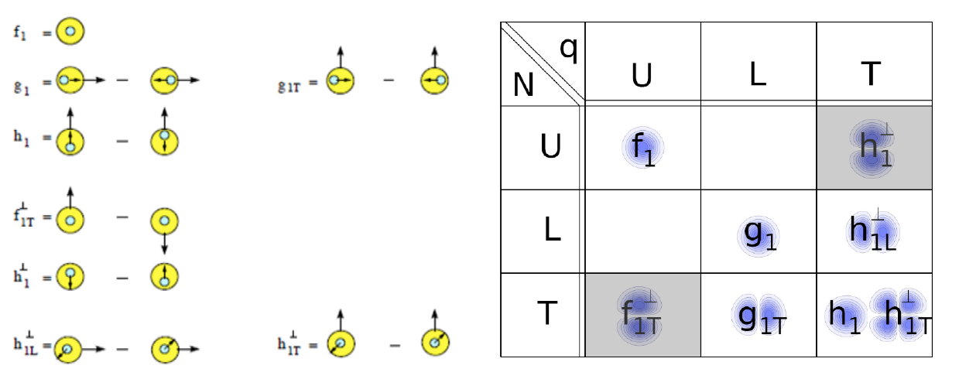
Spin-spin and spin-momentum correlations in QCD bound states
U = unpolarized L = longitudinally polarized T = transversely polarized
N = nucleon q = quark

Slide 53
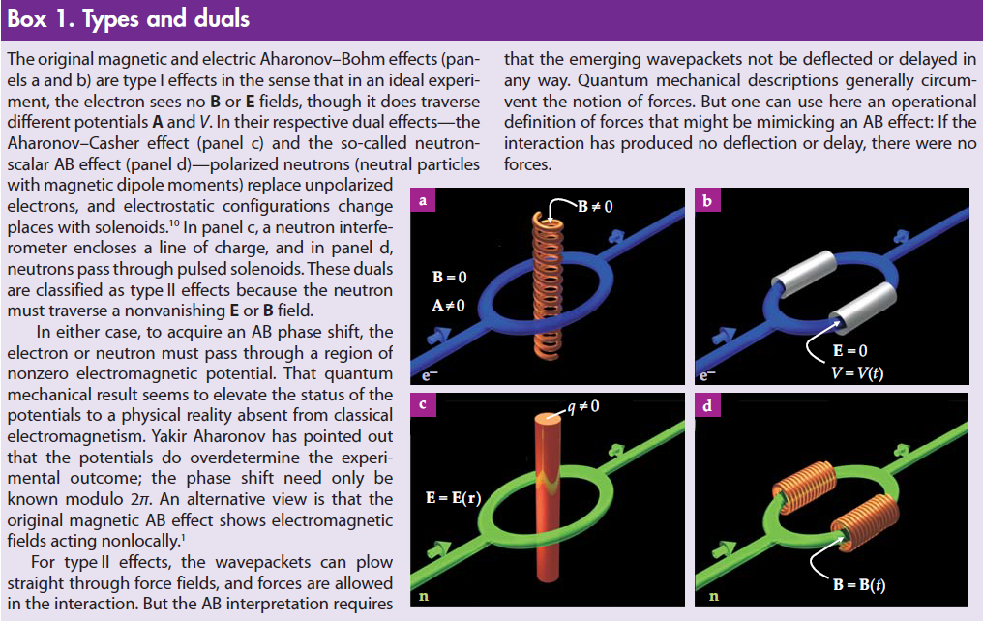
Magnetic and electric A-B effects;
Type-I and Type-II A-B effects
Physics Today, September 2009

Slide 54
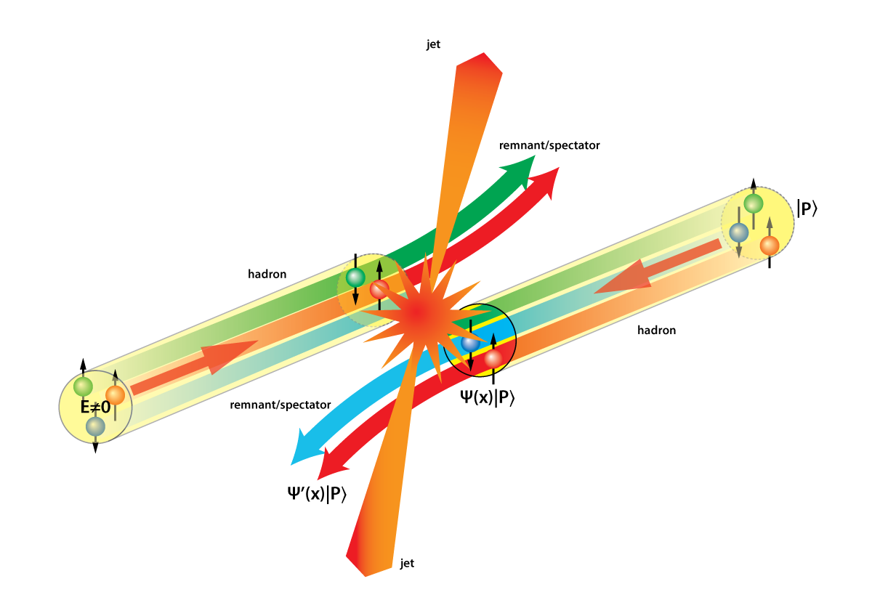
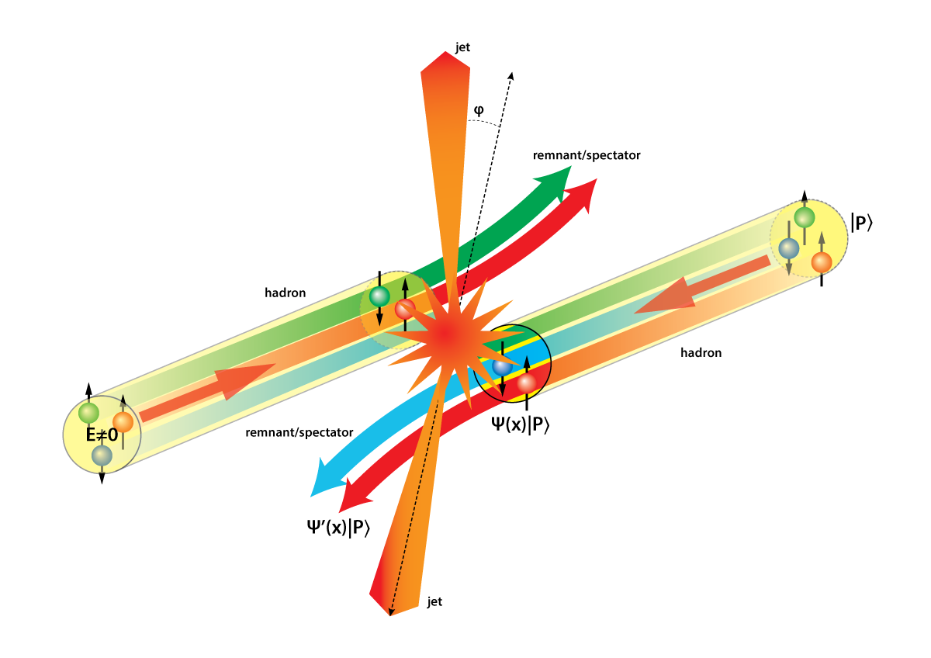
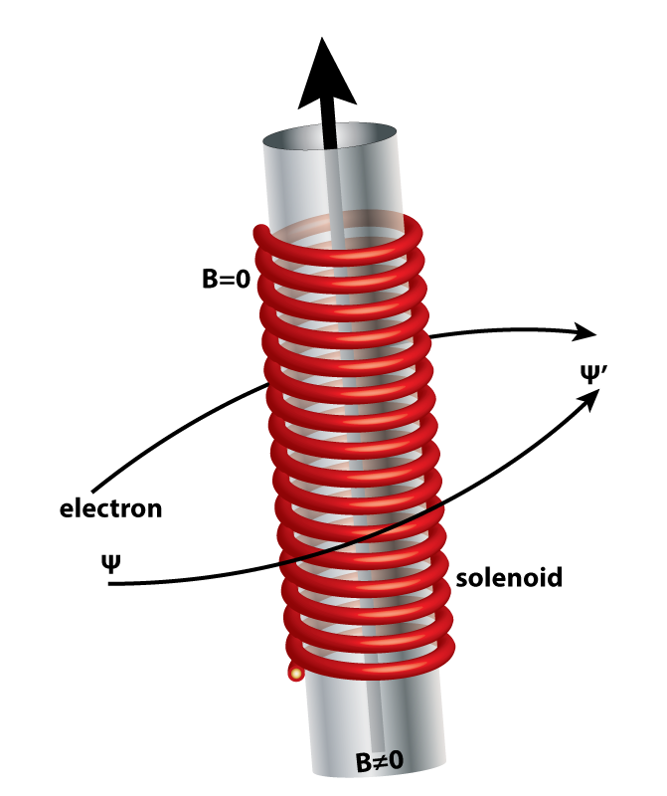
Opportunities to see color-induced phases in QCD
Slide from P. Mulders
Figures by Kees Huyser

Slide 55
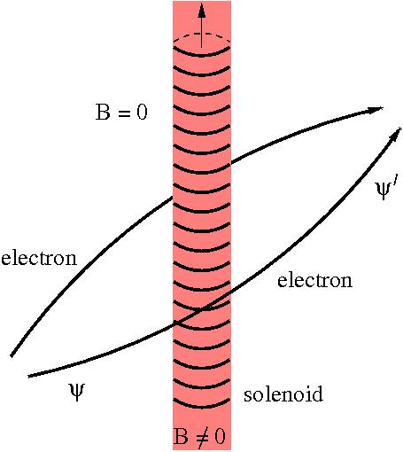
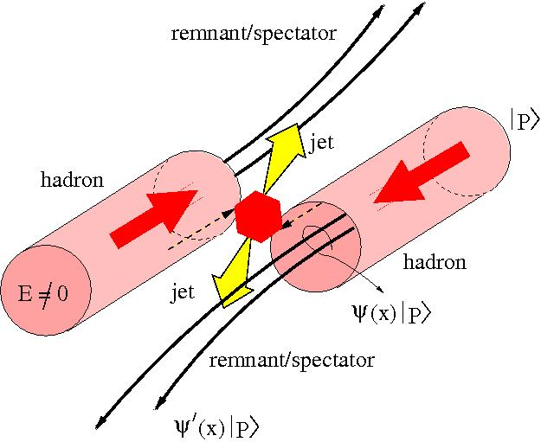
Featuring: phases in gauge theories
Slide from P. Mulders

Slide 56
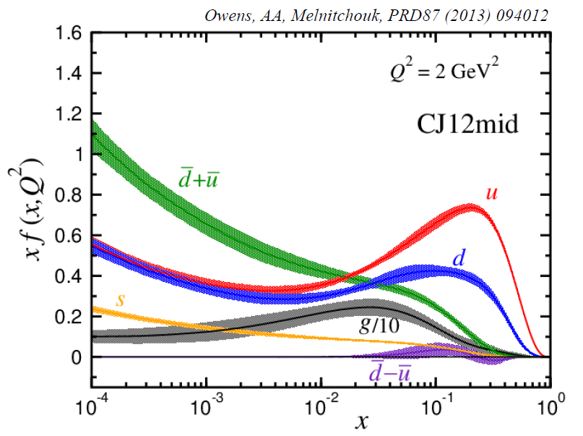
Example: Fits to quark and gluon distributions including much wider range of data
Incorporate corrections for target mass, “higher-twist,” and nuclear effects
Can in turn make predictions for future measurements in extended kinematic regions
Owens, Accardi, Melnitchouk, PRD87, 094012 (2013)
CTEQ-JLab collaboration
Collinear momentum fraction x

