Slide 1
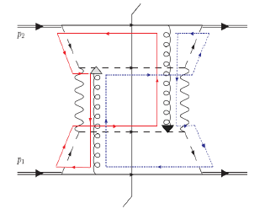

Spin-Momentum Correlations, Aharonov-Bohm, and
Color Entanglement in Quantum Chromodynamics
Christine A. Aidala
University of Michigan
left
right
University of Kansas
March 30, 2015

Slide 2
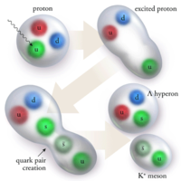
Theory of strong interactions:
Quantum Chromodynamics
  Fundamental field theory in hand since the early 1970s—BUT . . .
  Quark and gluon degrees of freedom in the theory cannot be observed or manipulated directly in experiment!
Color confinement—quarks and gluons are confined to color-neutral bound states
CLAS, PRL 113, 152004 (2014)
PRL Editor’s Choice Oct. 2014

Slide 3
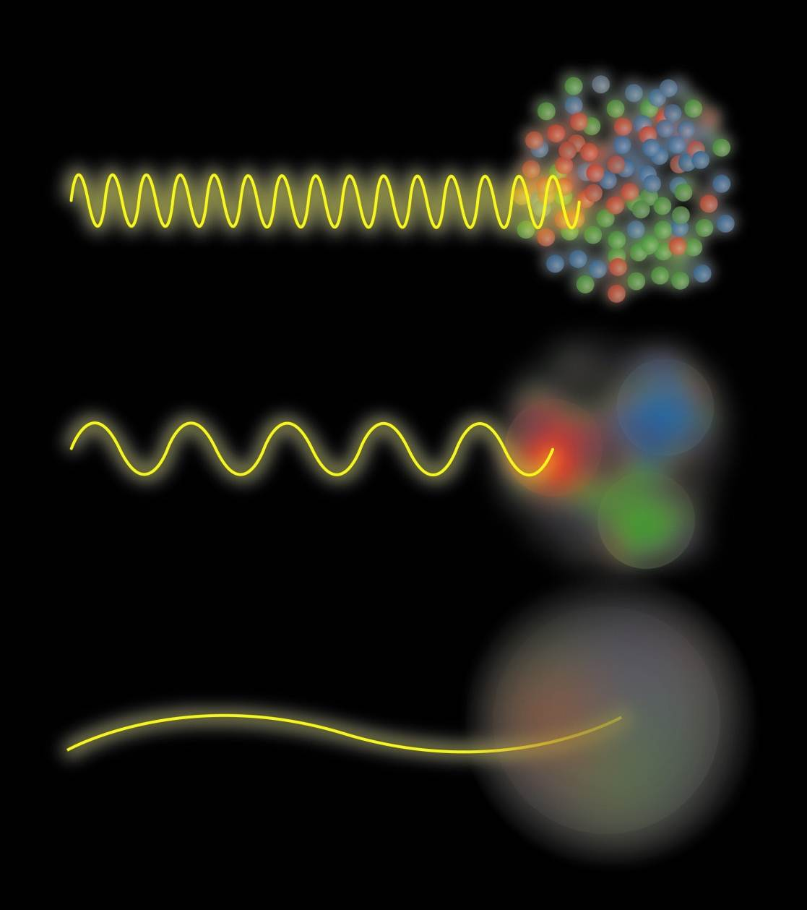
Quark and gluon structure of the nucleon
Probing the proton at different energy scales offers information on different aspects of its internal structure
Graphic by Josh Rubin

Slide 4
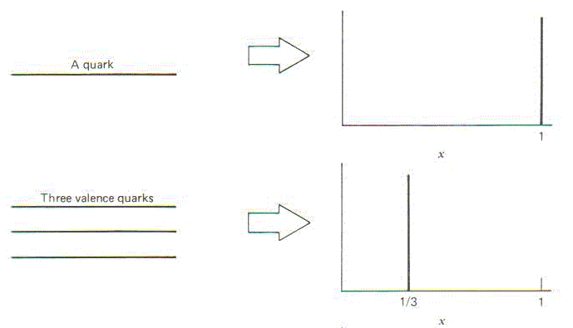
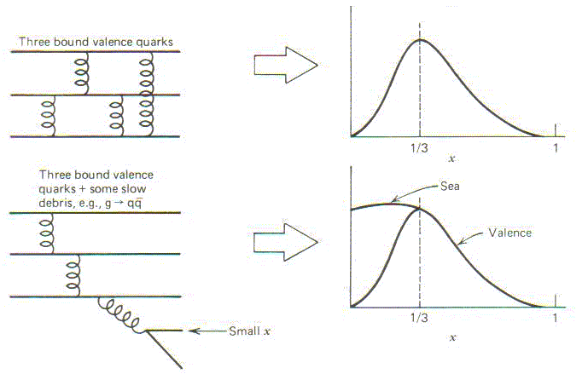
Parton distribution functions inside a nucleon:
The language we’ve developed (so far!)
What momentum fraction would the scattering particle carry
if the proton were made of …
3 bound valence quarks
A point particle
x_{Bjorken}
1
1/3
1
3 bound valence quarks + some
low-momentum sea quarks
x_{Bjorken}
Sea
3 valence quarks
Valence
Small x
1/3
1
x_{Bjorken}
1/3
x_{Bjorken}
1
Halzen and Martin, “Quarks and Leptons”, p. 201

Slide 5
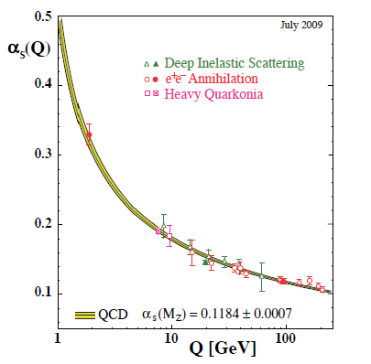
Perturbative QCD
Take advantage of running of the strong coupling constant with energy (asymptotic freedom)—weak coupling at high energies (short distances)
Perturbative expansion as in quantum electrodynamics (but many more diagrams due to gluon self-coupling!!)
Provides a rigorous way of relating the fundamental field theory to a variety of physical observables!
Notes:
Scattering energy

Slide 6
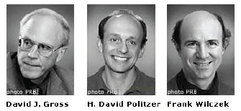
QCD: How far have we come?
QCD is challenging!!
Three-decade period after initial birth of QCD dedicated to “discovery and development”
→ Symbolic closure: Nobel prize 2004 - Gross, Politzer, Wilczek for asymptotic freedom
Now early years of second phase:
quantitative QCD!

Slide 7
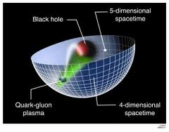
Advancing into the era of quantitative QCD: Theory has been forging ahead
In perturbative QCD, since 1990s starting to consider detailed internal dynamics that parts with traditional parton model ways of looking at hadrons—and perform phenomenological calculations using these new ideas/tools!
E.g.:
  Various resummation techniques
  Non-linear evolution at small momentum fractions
  Spin-spin and spin-momentum correlations in QCD bound states
  Spatial distributions of partons in QCD bound states
Nonperturbative methods:
  Lattice QCD less and less limited by computing resources—since 2010 starting to perform calculations at the physical pion mass (after 36 years!). Plus recent new ideas on how to calculate previously intractable quantities.
  AdS/CFT “gauge-string duality” an exciting recent development as first fundamentally new handle to try to tackle QCD in decades!

Slide 8
Effective field theories
QCD exhibits different behavior at different scales—effective field theories are useful approximations within these different regimes
  Color Glass Condensate – high energies, high densities
  Soft-Collinear Effective Theory – new insights into performing complicated perturbative calculations very quickly
  Heavy Quark Effective Theory, Non-Relativistic QCD, . . .
  Many effective theories for nonperturbative QCD – chiral symmetry breaking, . . .

Slide 9
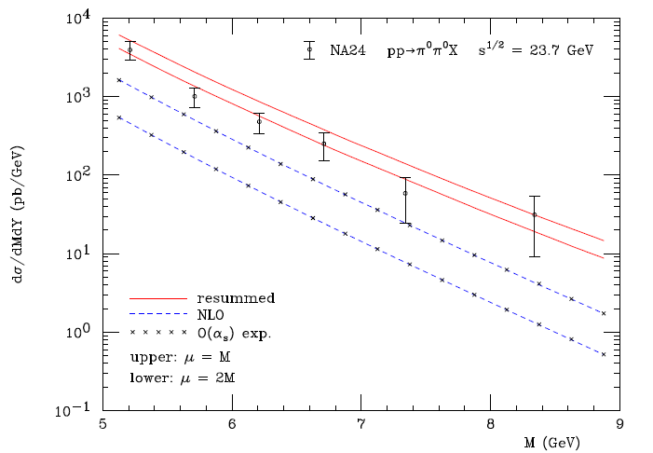
Example: “Threshold resummation” Extending perturbative calculations to lower energies
For observables with two different scales, sum logs of their ratio to all orders in the strong coupling constant
}
pp→π⁰π⁰X
}
Next-to-leading-order in α_{s} + resum.
Next-to-leading-order in α_{s}
M (GeV)
Almeida, Sterman, Vogelsang PRD80, 074016 (2009)

Slide 10
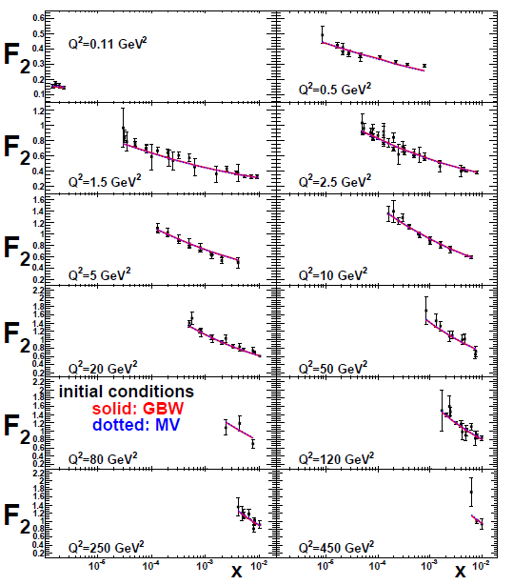
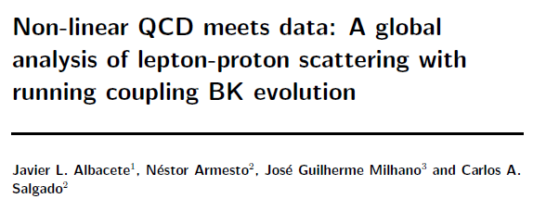
Example: Phenomenological applications of a non-linear gluon saturation regime
Phys. Rev. D80, 034031 (2009)
Basic framework for non-linear QCD, in which gluon densities are so high that there’s a non-negligible probability for two gluons to combine, developed ~1997-2001. But had to wait until “running coupling BK evolution” figured out in 2007 to compare directly to data!
Fits to proton structure function data at low parton momentum fraction x.

Slide 11
Example: Spin-spin and spin-momentum correlations in QCD bound states
Unpolarized
Spin-spin correlations
Ralston and Soper,
Nucl. Phys. B152, 109 (1979)
Spin-momentum correlations
S•(p₁×p₂)

Slide 12
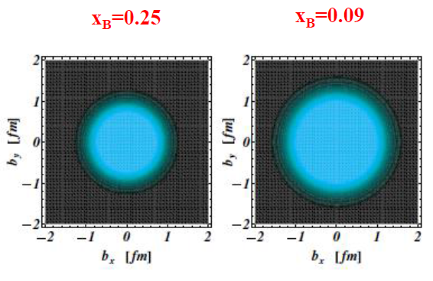
Example: Exploring spatial distributions
Guidal, Moutarde,
Vanderhaeghen,
Rept. Prog. Phys. 76 (2013) 066202
CLAS HERMES
Initial evidence that quarks carrying larger momentum fractions (25% vs. 9%) in the nucleon are distributed over a smaller volume in space
Spatial charge densities measured via deeply virtual Compton scattering
Similarly, exclusive J/Psi meson production in ultraperipheral nuclear collisions—sensitive to spatial distribution of gluons in the nucleus
-M. Murray, D. Tapia Takaki

Slide 13
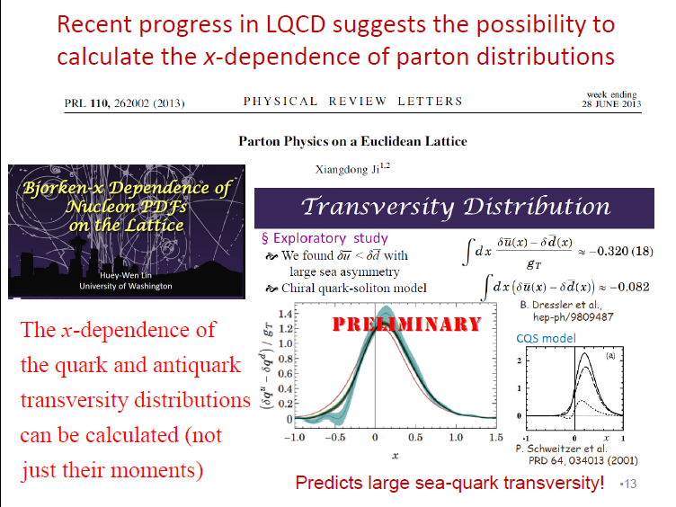
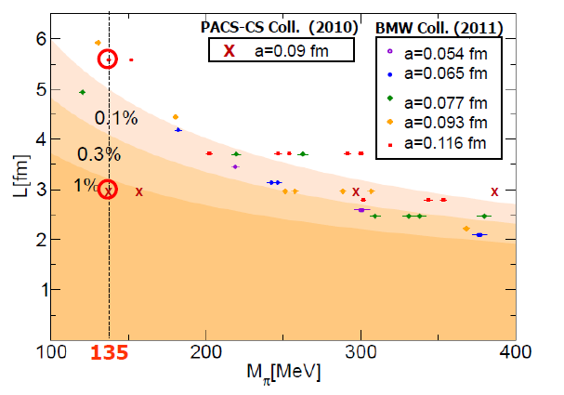
Example: Progress in lattice QCD
Slide from J.-C. Peng, Transversity 2014
First calculations at physical pion mass 135 MeV
Figure from T. Hatsuda,
PANIC 2011
PACS-CS: PRD81, 074503 (2010)
BMW: PLB701, 265 (2011)

Slide 14
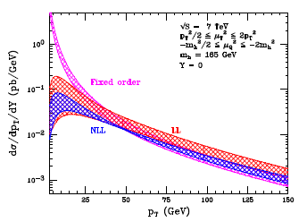
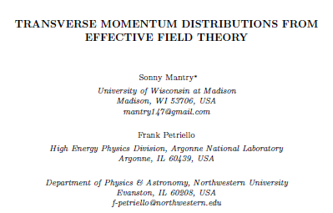
Example: Effective field theories
Higgs vs. p_{T}
arXiv:1108.3609
Soft Collinear Effective Theory
– Transverse momentum distribution for gluon+gluon→Higgs

Slide 15
Mapping out the partonic structure of the proton
What does the proton look like in terms of the quarks and gluons inside it?
Position
Momentum
Spin
Flavor
Color
Theoretical and experimental concepts to describe and access position only born in mid-1990s. Pioneering measurements over past decade.
Vast majority of past four decades focused on
1-dimensional momentum structure! Since 1990s starting to consider transverse components . . .
Polarized protons first studied in 1980s. How angular momentum of quarks and gluons add up still not well understood!
Good measurements of flavor distributions in valence region. Flavor structure at lower momentum fractions still yielding surprises!
Accounted for theoretically from beginning of QCD, but more detailed, potentially observable effects of color have come to forefront in last few years . . .

Slide 16
A cyclical process
Proliferation of observations and ideas
Synthesis
Notes:
After lots of new observations and ideas over the course of the last 15-20 years, we’re now in a rewarding period of synthesis

Slide 17
Factorization and universality in perturbative QCD
Need to systematically factorize short- and long-distance physics—observable physical QCD processes always involve at least one long-distance scale (confinement)!
Long-distance (i.e. not perturbatively calculable) functions need to be universal in order to be portable across calculations for many processes
Measure nonperturbative parton distribution functions (pdfs) and fragmentation functions in many colliding systems over a wide kinematic range→constrain by performing
simultaneous fits to world data

Slide 18
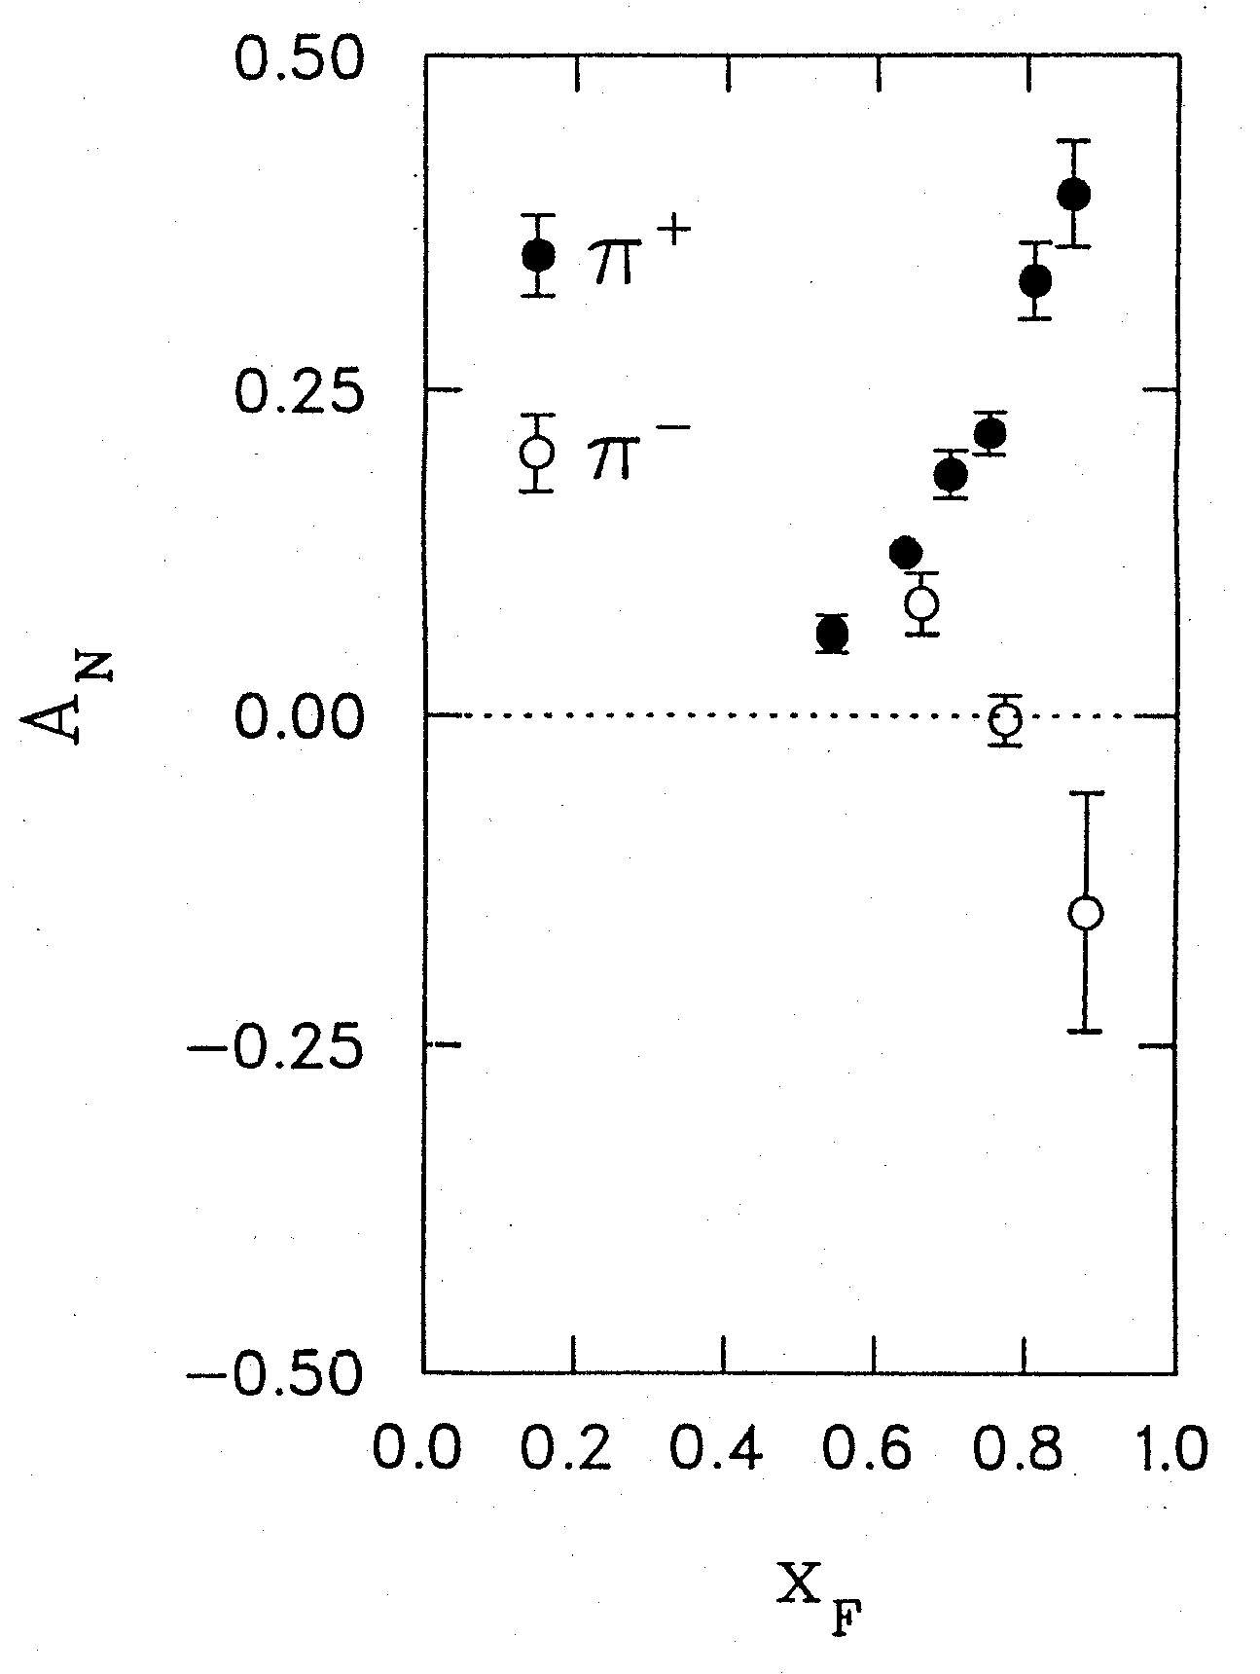
Spin-momentum correlations:
1976 discovery in p+p collisions
Argonne √s=4.9 GeV
Charged pions produced preferentially on one or the other side with respect to the transversely polarized beam direction—by up to 40%!!
Had to wait more than a decade for the birth of a new subfield in order to explore the possibilities . . .
left
right
W.H. Dragoset et al., PRL36, 929 (1976)

Slide 19
Transverse-momentum-dependent distributions and single-spin asymmetries
1990: “Sivers mechanism” proposed in attempt to understand observed asymmetries
Departs from traditional collinear factorization assumption in pQCD and proposes correlation between the intrinsic transverse motion of the quarks and gluons and the proton’s spin
Sivers distribution: first transverse-momentum-dependent parton distribution function describing a spin-momentum correlation
New frontier! Parton dynamics inside hadrons, and in the hadronization process
D.W. Sivers
PRD41, 83 (1990)
Spin and momenta of partons and/or hadrons
Notes:
Dennis Sivers motivated by forthcoming E704 data

Slide 20
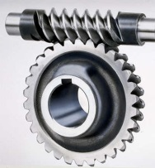

Spin-spin and spin-momentum correlations in QCD bound states
Worm-gear
(Kotzinian-Mulders)
Unpolarized
Spin-spin correlations
Helicity
Lots of evidence from deep-inelastic lepton-nucleon scattering experiments over past ~10 years that many of these correlations are nonzero in nature!
Transversity
Sivers
Spin-momentum correlations
Boer-Mulders
S•(p₁×p₂)
Pretzelosity
Worm-gear

Slide 21
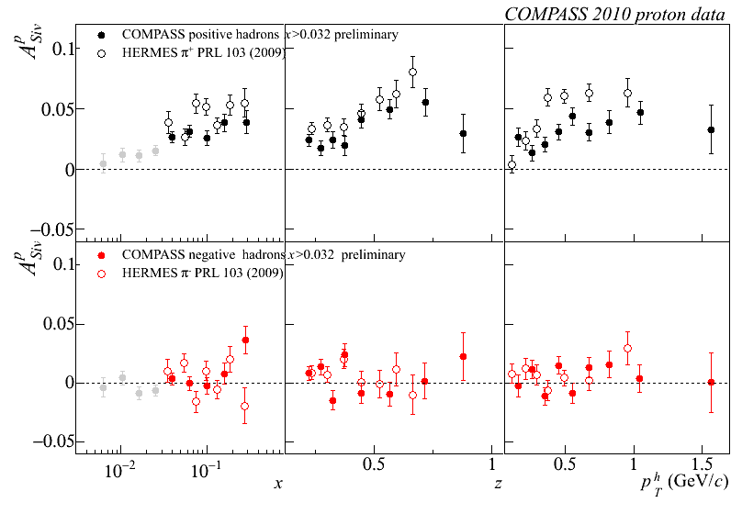
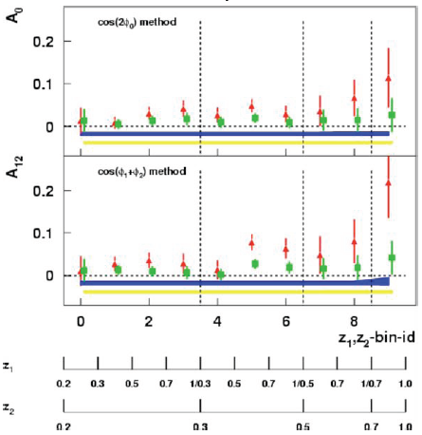
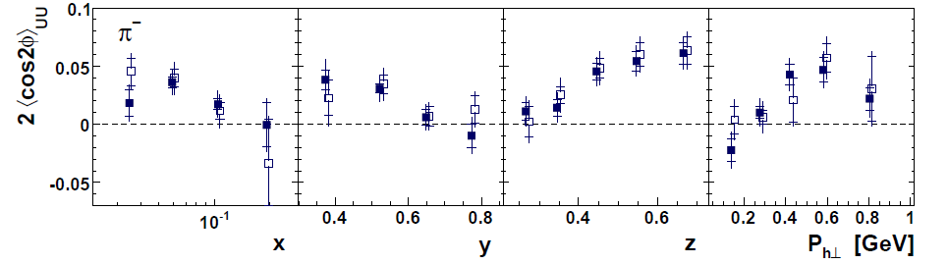
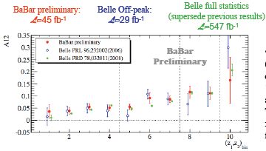
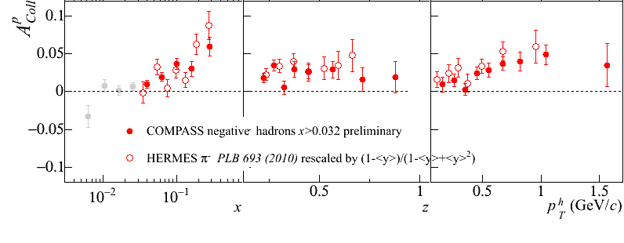
Sivers
e+p
μ+p
BELLE PRL96, 232002 (2006)
Collins x Collins
e⁺e⁻
Boer-Mulders x Collins
e+p
HERMES, PRD 87, 012010 (2013)
BaBar published ref. PRD90, 052003 (2014)
Collins x Collins
e⁺e⁻
e+p
μ+p
Transversity x Collins

Slide 22

But what about proton-proton collisions?
ANL
√s=4.9 GeV
BNL
√s=6.6 GeV
FNAL
√s=19.4 GeV
RHIC
√s=62.4 GeV
left
Strikingly similar effects across energies!
→ Continuum between nonperturbative/nonpartonic and perturbative/partonic descriptions of this nonperturbative structure?
right

Slide 23
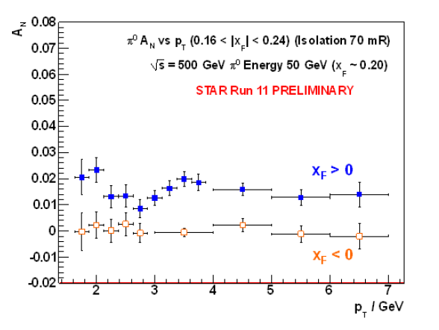
Single-spin asymmetries in transversely polarized p+p collisions
Effects persist to kinematic regimes where perturbative QCD techniques clearly apply
p_{T} = 7 GeV
→ Q² ~ 49 GeV²!
π⁰
(forward)
(backward)

Slide 24
p+p → hadron + X:
Challenging to interpret
Always huge effects!
But in p+p → pion +X don’t have enough information to separate initial-state (proton structure) from final-state (hadronization) effects

Slide 25
Properties of naïve-T-odd spin-momentum correlation functions
Sivers transverse-momentum-dependent parton distribution function is odd under “naïve-time-reversal” (actually a PT transformation)
  As is Boer-Mulders spin-momentum correlation
In 1993, after original 1990 paper by D.W. Sivers, J.C. Collins claimed such functions must vanish
Only realized in 2002 by Brodsky, Hwang, and Schmidt that could be nonvanishing if phase interference effects due to color interactions present

Slide 26
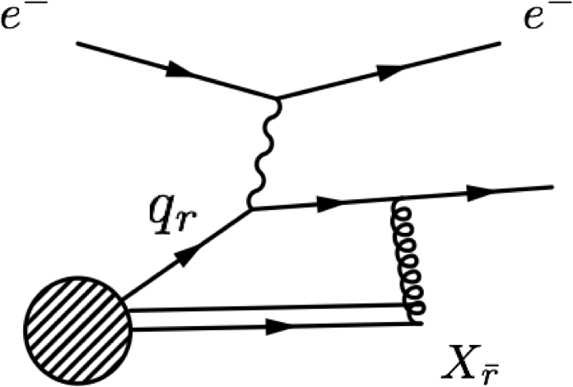
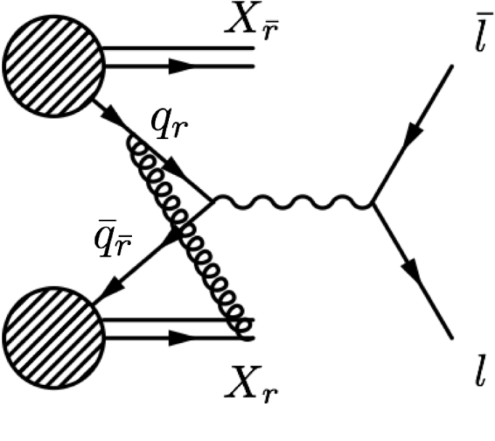
Modified universality of certain transverse-momentum-dependent distributions:
Color in action!
Deep-inelastic lepton-nucleon scattering:
Attractive final-state interactions
Quark-antiquark annihilation to leptons:
Repulsive initial-state interactions
As a result, get opposite sign for the Sivers transverse-momentum-dependent pdf when measure in semi-inclusive DIS versus Drell-Yan: process-dependent pdf! (Collins 2002)
Still waiting for a polarized quark-antiquark annihilation measurement to compare to existing lepton-nucleon scattering measurements . . .
Figures by J.D. Osborn

Slide 27

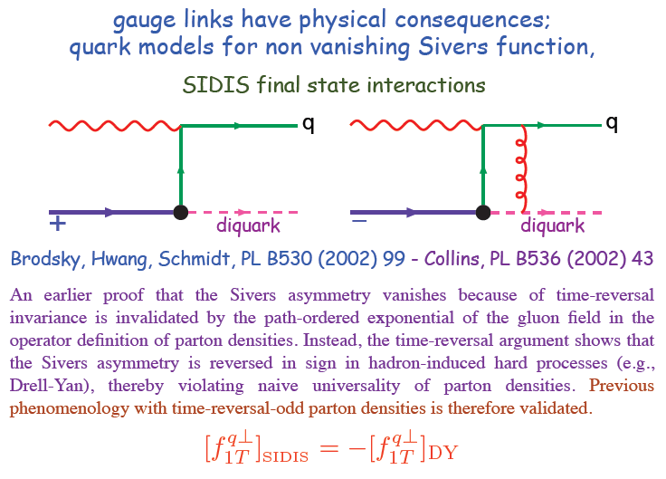
Modified universality requires full QCD:
Gauge-invariant quantum field theory
1993 claim by J.C. Collins that such processes must vanish
Slide from M. Anselmino, Transversity 2014

Slide 28
Physical consequences of a gauge-invariant quantum theory:
Aharonov-Bohm (1959)
Wikipedia:
“The Aharonov–Bohm effect is important conceptually because it bears on three issues apparent in the recasting of (Maxwell's) classical electromagnetic theory as a gauge theory, which before the advent of quantum mechanics could be argued to be a mathematical reformulation with no physical consequences. The Aharonov–Bohm thought experiments and their experimental realization imply that the issues were not just philosophical.
The three issues are:
whether potentials are "physical" or just a convenient tool for calculating force fields;
whether action principles are fundamental;
the principle of locality.”

Slide 29
Physical consequences of a gauge-invariant quantum theory:
Aharonov-Bohm (1959)
Physics Today, September 2009 :
The Aharonov–Bohm effects: Variations on a subtle theme,
by Herman Batelaan and Akira Tonomura.
“Aharonov stresses that the arguments that led to the prediction of the various electromagnetic AB effects apply equally well to any other gauge-invariant quantum theory. In the standard model of particle physics, the strong and weak nuclear interactions are also described by gauge-invariant theories. So one may expect that particle-physics experimenters will be looking for new AB effects in new domains.”

Slide 30
Physical consequences of a gauge-invariant quantum theory:
Aharonov-Bohm effect in QCD!!
Deep-inelastic lepton-nucleon scattering:
Attractive final-state interactions
Quark-antiquark annihilation to leptons:
Repulsive initial-state interactions
Simplicity of these two processes:
Abelian vs. non-Abelian nature of the gauge group doesn’t play a major qualitative role.
BUT: In QCD expect additional, new effects due to specific non-Abelian nature of the gauge group
See e.g. Pijlman, hep-ph/0604226
or Sivers, arXiv:1109.2521
Figures by J.D. Osborn

Slide 31
QCD Aharonov-Bohm effect:
Color entanglement
  2010: Rogers and Mulders predict color entanglement in processes involving p+p production of hadrons if quark transverse momentum taken into account
  Quarks become correlated across the two protons
  Consequence of QCD specifically as a non-Abelian gauge theory!
PRD 81, 094006 (2010)
Color flow can’t be described as flow in the two gluons separately. Requires simultaneous presence of both.
Huge transverse spin asymmetries in p+p a color entanglement effect??

Slide 32
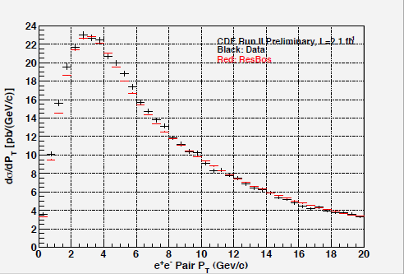
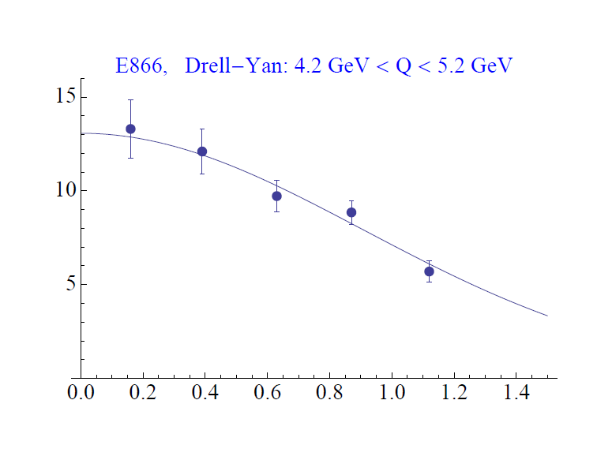
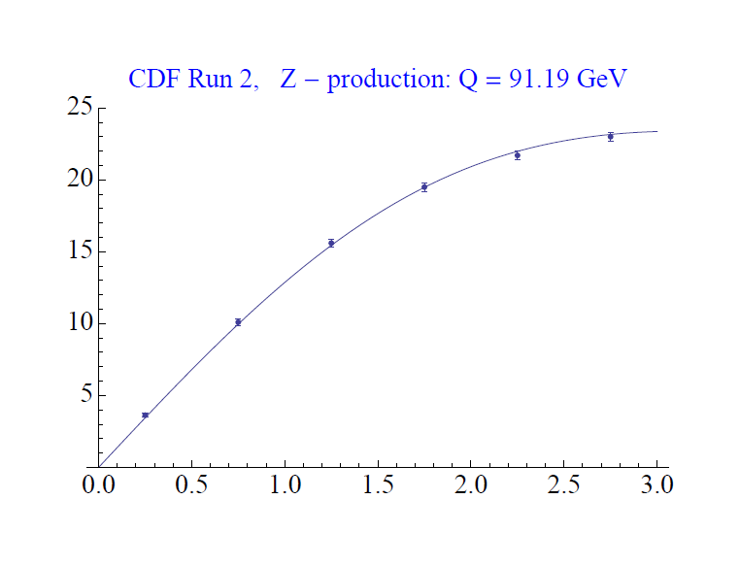
Testing the Aharonov-Bohm effect in QCD as a non-Abelian gauge theory
Look for contradiction with predictions for the case of no color entanglement
But first need to parameterize (unpolarized) transverse-momentum-dependent pdfs from world data
  Can put better constraints on unpolarized predictions because of more available data
Z boson production,
Tevatron CDF
dσ/dp_{T}
CAA,
T.C. Rogers, in progress
dσ/dp_{T}
p+p → μ⁺+μ⁻+X
√s = 1.96 TeV
√s = 0.039 TeV
p_{T} (GeV/c)
p_{T} (GeV/c)

Slide 33
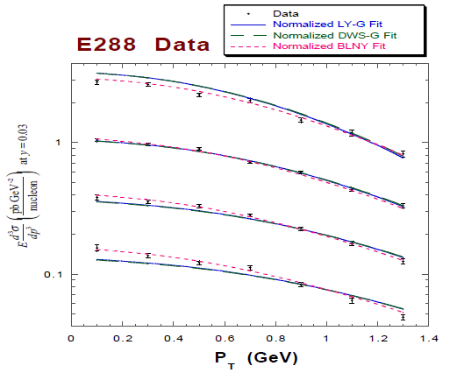
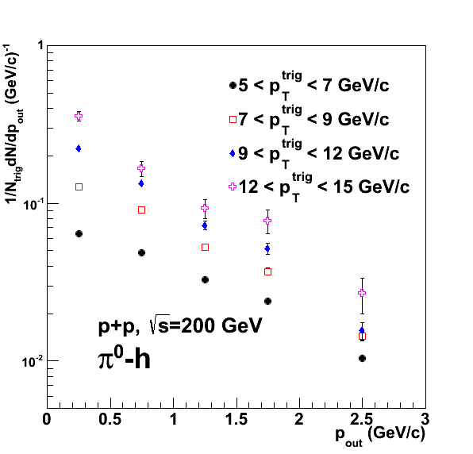

Testing the Aharonov-Bohm effect in QCD as a non-Abelian gauge theory
Landry et al., 2002
PRD82, 072001 (2010)
Quark-antiquark annihilation to lepton pairs
Hadron pair production
p+A → μ⁺+μ⁻+X
for different invariant masses:
No color entanglement expected
Get predictions from fits to data where no entanglement expected
Out-of-plane momentum component
Make predictions for processes where entanglement is expected; look for deviation

Slide 34
Summary
Early years of rewarding new era of quantitative basic research in QCD!
Gradually shifting to think about QCD systems in new ways, focusing on topics/ideas/concepts that have long been familiar to the world of condensed matter physics
  All sorts of correlations within systems
  Quantum mechanical phase interference effects
  Quantum entangled systems
Will be exciting to continue testing and exploring these ideas and phenomena in upcoming years . . .

Slide 35
Extra

Slide 36
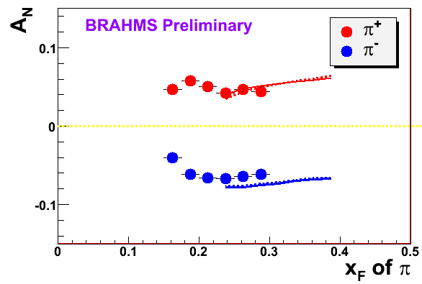
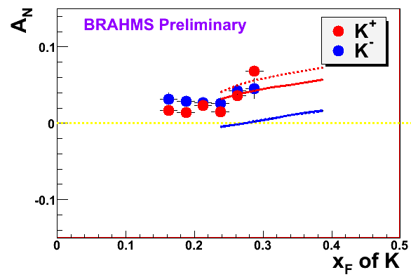

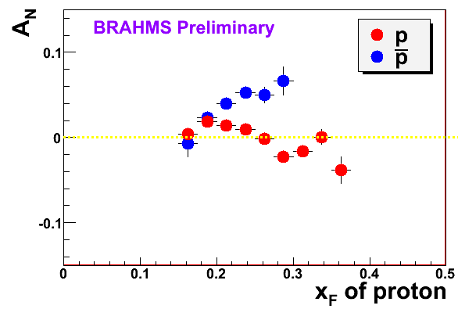
π
π
π, K, p
at 200 and 62.4 GeV
200 GeV
62.4 GeV
Note different scales
K
K
K- asymmetries
underpredicted
Pions suggest valence quark effect.
Kaons and (anti)protons don’t!
200 GeV
62.4 GeV
p
p
PRL 101, 042001 (2008)
Large antiproton asymmetry?? Unfortunately no 62.4
GeV measurement
200 GeV
62.4 GeV

Slide 37
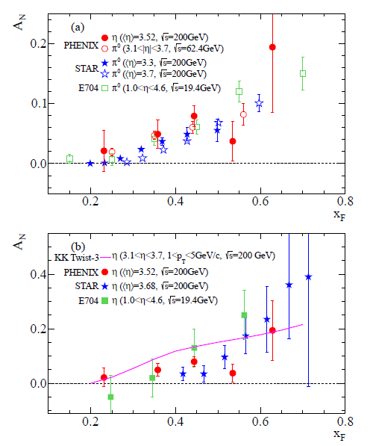
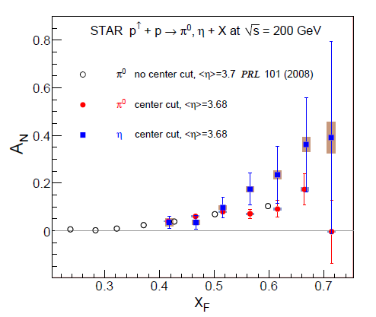
p+p η A_{N} larger than π⁰?? Same?
In addition to sea quarks, need to explore dynamics of gluons in more depth—talks by M. Echevarria, M. Schlegel, A.Szabelski, Y. Koike
arXiv:1406.3541
Related talks by L. Bland, D. Kleinjan,
A. Vossen, A. Ogawa, Y. Koike, D. Pitonyak, C. Pisano

Slide 38
Hadronization
Not as far along as nucleon structure—less of a focus in earlier years
Recent advances via
  TMD FFs
  Collinear twist-3 functions to describe hadronization
  Dihadron (interference) FF
  Hadronization from nuclei
Related talks by M. Radici, A. Kotzinian, I. Garzia, M. Grosse Perdekamp, F. Giordano, M. Contalbrigo, Y. Guan, O. Eyser, A. Vossen, + other p+p talks and all SIDIS talks . . .

Slide 39
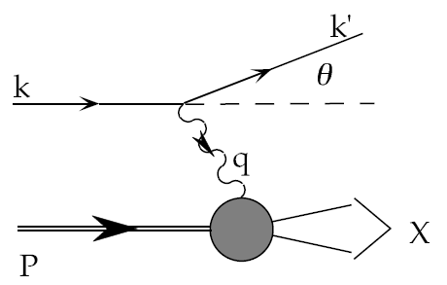
Deep-inelastic lepton-nucleon scattering:
A tool of the trade
Probe nucleon with an electron or muon beam
Interacts electromagnetically with (charged) quarks and antiquarks
“Clean” process theoretically—quantum electrodynamics well understood and easy to calculate!

Slide 40
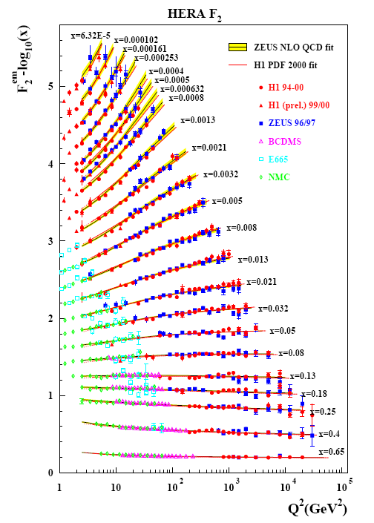
Decades of deep-inelastic lepton-nucleon scattering data: What have we learned?
Wealth of data largely thanks to proton-electron collider, HERA, in Hamburg, which run 1992-2007
Rich structure at low x
Half proton’s linear momentum carried by gluons!
PRD67, 012007 (2003)

Slide 41
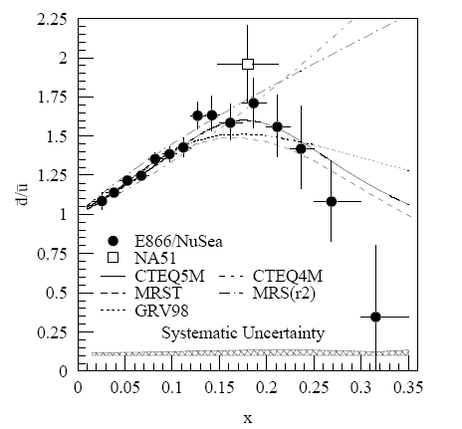
And a (relatively) recent surprise from p+hydrogen, p+deuterium collisions
Fermilab Experiment 866 used proton-hydrogen and proton-deuterium collisions to probe nucleon structure via the Drell-Yan process
Would expect anti-up/anti-down ratio of 1 if sea quarks are only generated dynamically by gluon splitting into quark-antiquark pairs
Measured flavor asymmetry in the quark sea, with striking x behavior
Indicates some kind of “primordial” sea quarks!
Hadronic collisions play a complementary role to electron-nucleon scattering and have let us continue to find surprises in the rich linear momentum structure of the proton, even after > 40 years!
PRD64, 052002 (2001)

Slide 42
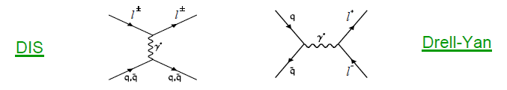
Complementarity of Drell-Yan and DIS
Both deep-inelastic lepton-nucleon scattering (DIS) and quark-antiquark annihilation to leptons (Drell-Yan process) are tools to probe the quark and antiquark structure of hadrons

Slide 43
Parton distribution functions in perturbative QCD calculations of observables
q(x₁)
Hard Scattering Process
X
g(x₂)
High-energy processes have predictable rates given:
    Partonic hard scattering rates (calculable in pQCD)
    Parton distribution functions (experiment or lattice)
    Fragmentation functions (experiment or lattice)
Universal non-perturbative factors

Slide 44
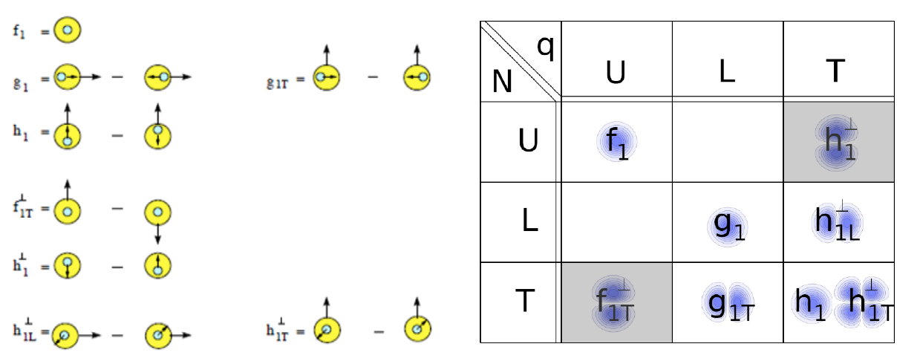
Spin-spin and spin-momentum correlations in QCD bound states
U = unpolarized L = longitudinally polarized T = transversely polarized
N = nucleon q = quark

Slide 45
High-energy QCD: Thinking in terms of individual partons
Pdfs are single-parton functions in single nucleons
  Or in nuclei, but typically still think of partons in individual nucleons within nucleus
Can we go beyond this single-parton picture while staying in the hard (short-distance) limit of perturbative QCD?

Slide 46
An alternative approach to describing the large single-spin asymmetries:
Higher-twist multiparton correlations
Extend our ideas about (single-parton) pdfs to correlation functions that can’t be associated with a single parton
Non-perturbative structure → matrix elements involving the quantum mechanical interference between scattering off of a (quark+gluon) and scattering off of a single quark (of the same flavor and at the same x)
  Can also have interference between (gluon+gluon) and single gluon
  No explicit dependence on partonic transverse momentum
  Efremov+Teryaev 1981, 84; Qiu+Sterman 1991, 98

Slide 47
Beware: Two common usages of the term “twist”
Formal definition of twist: “mass dimension minus spin” of the operator in a matrix element within the Operator Product Expansion
  “Leading twist” is twist-2
  Twist-n matrix element carries a factor of 1/Q^{(n-2)}
But – observables with measurable contributions from terms suppressed by a factor of 1/Q^{(n-2)} often referred to as sensitive to “twist-n” contributions
  Never measure a matrix element, only matrix elements squared!
  To get 1/Q term describing an observable, need interference term in the square modulus:
    A = order 1 + order 1/Q + order 1/Q² + …
    |A|² = |order 1|² + |order 1/Q|² + (order 1)(order 1/Q)* + (order 1)*(order 1/Q) + …
  So twist-3 term in matrix element times twist-2 term gives 1/Q
  Square modulus of twist-3 term gives 1/Q², sometimes referred to as “twist-4”

Slide 48
Transverse single-spin asymmetries provide new information on hadron structure
Leading contribution to transverse single-spin asymmetries comes from either:
  Convolution of two twist-2 transverse-momentum-dependent parton distribution functions and/or fragmentation functions, or . . .
  Convolution of one twist-2 collinear pdf or fragmentation function and one twist-3 (collinear) multiparton correlation matrix element

Slide 49
Multiparton correlations in hadronization
Traditional fragmentation functions describe probability of single parton to hadronize into particular hadron, as function of momentum fraction (z) of parton carried by the final hadron
Can have matrix elements describing multiparton correlations in hadronization
  Interference between a (quark+gluon) hadronizing and only a quark
  Similarly, interference between (gluon+gluon) and only a single gluon
  Kanazawa+Koike, 2000

Slide 50
Transverse-momentum-dependent functions and twist-3 multiparton correlators
Twist-3 (collinear) multiparton correlators believed to be related to k_{T}-moments of (twist-2)TMD pdfs and fragmentation functions
  NPB667, 201 (2003); PRL97, 082002 (2006)
To directly constrain TMD functions with experimental data, need two scales
  Hard momentum
  Observable sensitive to parton intrinsic momentum
  Note: Original hadronic asymmetries only measured a single scale

Slide 51
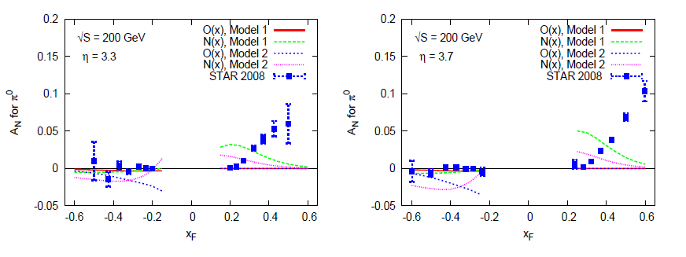
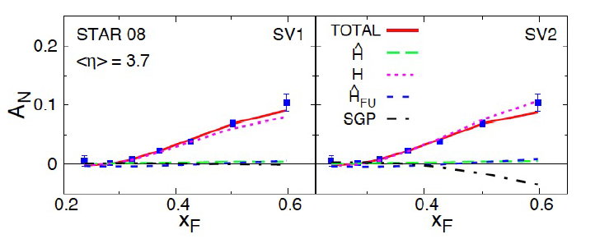
Twist-3 multiparton correlations to interpret inclusive A_{N} data from RHIC
Making progress!

Slide 52
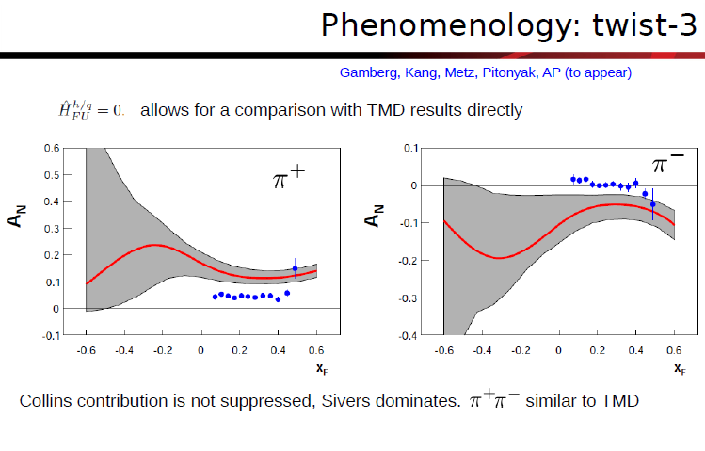
Inclusive hadron A_{N} in e+p

Slide 53
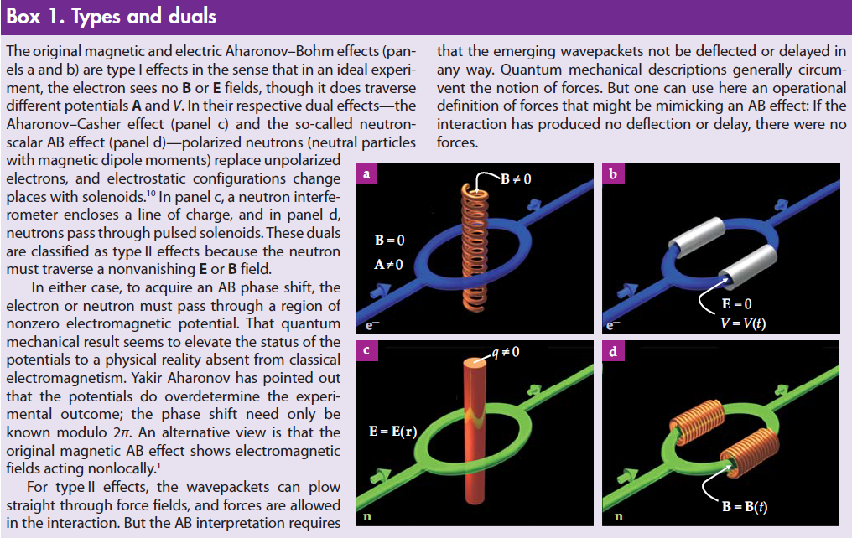
Magnetic and electric A-B effects;
Type-I and Type-II A-B effects
Physics Today, September 2009

Slide 54
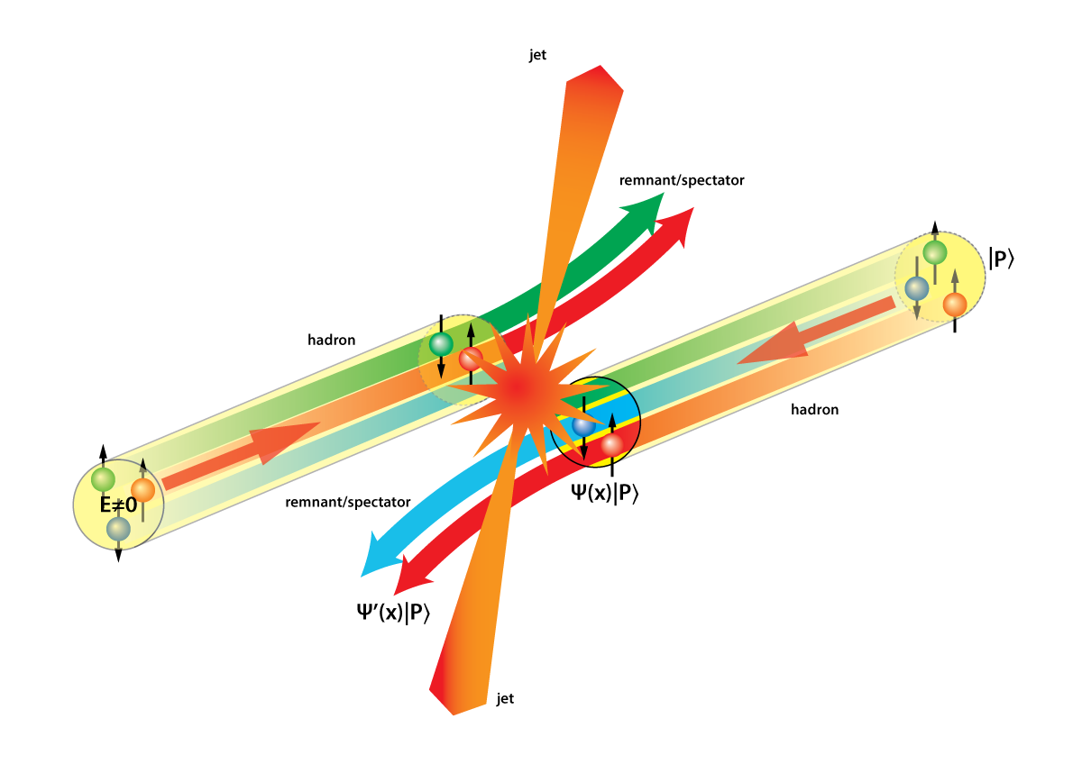
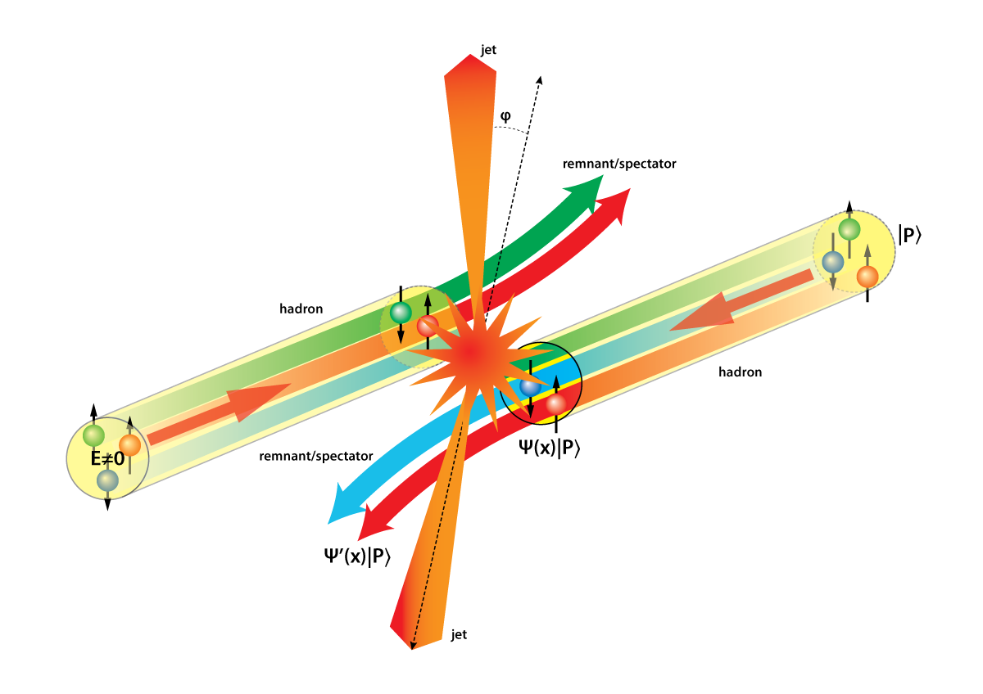
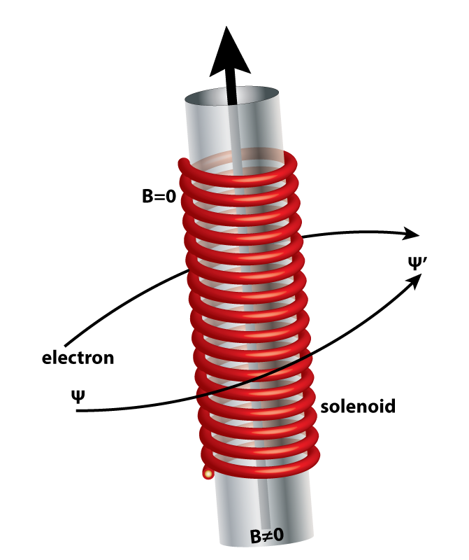
Opportunities to see color-induced phases in QCD
Slide from P. Mulders
Figures by Kees Huyser

Slide 55
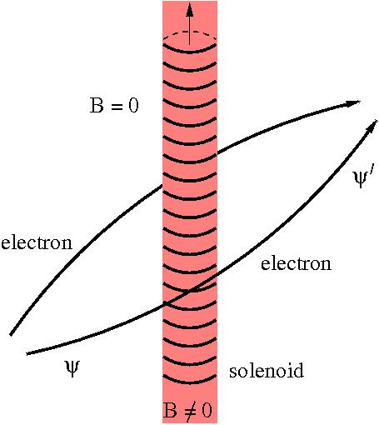

Featuring: phases in gauge theories
Slide from P. Mulders

Slide 56

Example: Fits to quark and gluon distributions including much wider range of data
Incorporate corrections for target mass, “higher-twist,” and nuclear effects
Can in turn make predictions for future measurements in extended kinematic regions
Owens, Accardi, Melnitchouk, PRD87, 094012 (2013)
CTEQ-JLab collaboration
Collinear momentum fraction x

