Slide 1
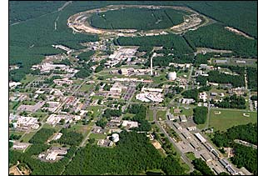
Getting Protons to Study Themselves:
Investigating the Proton Structure at the Relativistic Heavy Ion Collider
Christine Aidala
Los Alamos National Lab
Catholic University of America
December 9, 2009
Notes:
I feel that the overarching question that those of us working on the proton structure program at RHIC would like to contribute to answering is . . .

Slide 2
Nucleon Structure: The Early Years
1933: Estermann and Stern measure the proton’s anomalous magnetic moment → indicates proton not a pointlike particle!
1960’s: Quark structure of the nucleon
  SLAC inelastic electron-nucleon scattering experiments by Friedman, Kendall, Taylor → Nobel Prize
  Theoretical development by Gell-Mann → Nobel Prize

Slide 3
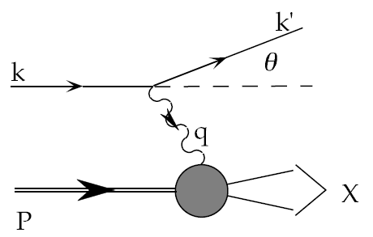
Deep-Inelastic Scattering:
A Tool of the Trade
Probe nucleon with an electron or muon beam
Interacts electromagnetically with (charged) quarks and antiquarks
“Clean” process theoretically—quantum electrodynamics well understood and easy to calculate
Technique that originally discovered the parton structure of the nucleon in the 1960’s!

Slide 4
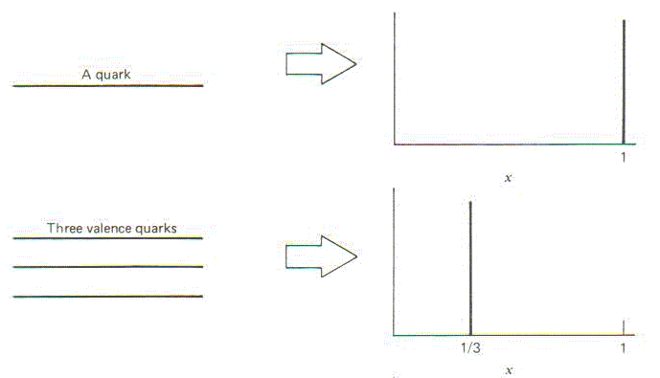
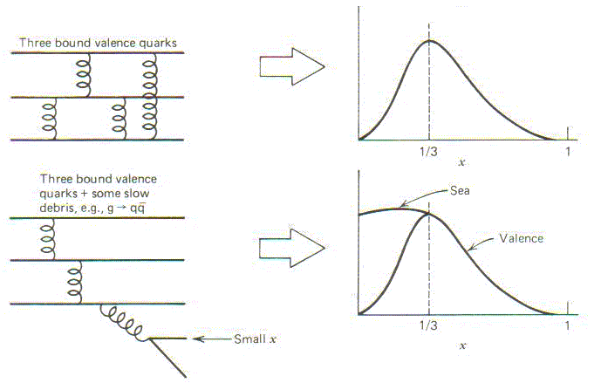
Proton Structure and
“Bjorken-x”
What momentum fraction would the scattering particle carry
if the proton were made of …
3 bound valence quarks
A point particle
x_{Bjorken}
1
1/3
1
3 bound valence quarks
and some slow sea quarks
x_{Bjorken}
Sea
3 valence quarks
Valence
Small x
1/3
1
x_{Bjorken}
1/3
x_{Bjorken}
1
Halzen and Martin, “Quarks and Leptons”, p. 201

Slide 5
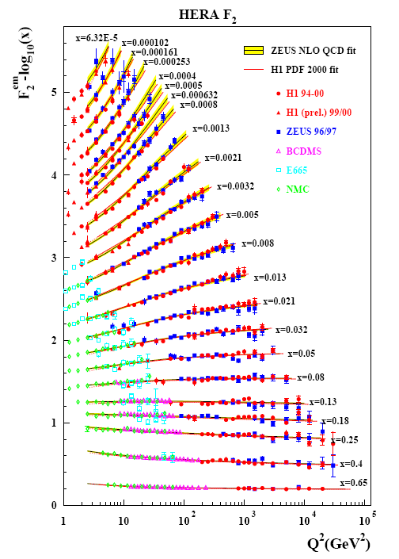
Decades of DIS Data: What Have We Learned?
Wealth of data largely thanks to proton-electron collider, HERA, in Hamburg, which shut down in 2007
Rich structure at low x
Half proton’s linear momentum carried by gluons!
PRD67, 012007 (2003)
Notes:
There are a number of useful ways to look at and describe nucleon structure. For example in addition to the structure functions such as F2 shown here, which, if you will, lets you “see” the asymptotic freedom of QCD, you can also describe the proton in terms of parton distribution functions, . . . In any case, we’ve learned quite a lot from decades of DIS data on the linear momentum structure of the proton, but even in the age of HERA, . . .

Slide 6
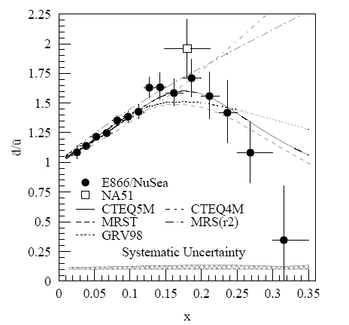
And a (Relatively) Recent Surprise From p+p, p+d Collisions
Fermilab Experiment 866 used proton-hydrogen and proton-deuterium collisions to probe nucleon structure via the Drell-Yan process
Anti-up/anti-down asymmetry in the quark sea, with an unexpected x behavior!
Hadronic collisions play a complementary role to DIS and have let us continue to find surprises in the rich linear momentum structure of the proton, even after 40 years!
PRD64, 052002 (2001)

Slide 7
What about the angular momentum structure of the proton?

Slide 8

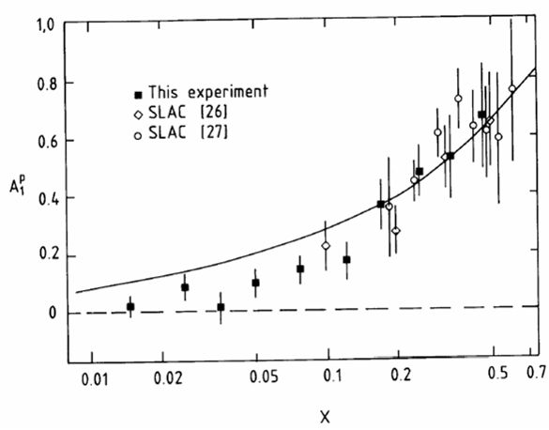
The Proton “Spin Crisis”
SLAC: 0.10 < x <0.7
CERN: 0.01 < x <0.5
Quark-Parton Model
expectation!
A₁(x)
0.1 < x_{SLAC} < 0.7
E130, Phys.Rev.Lett.51:1135 (1983)
425 citations
These haven’t been easy to measure!
EMC (CERN), Phys.Lett.B206:364 (1988)
1464 citations!
0.01 < x_{CERN} < 0.5
“Proton Spin Crisis”
x-Bjorken

Slide 9
Decades of Polarized DIS
HERMES
Quark Spin – Gluon Spin – Transverse Spin – GPDs – L_{z}
SLAC E80-E155
CERN EMC,SMC COMPASS
DESY HERMES
JLAB Halls A, B, C
No polarized electron-proton collider to date, but we did end up with a polarized proton-proton collider . . .
→2000
ongoing
→2007
ongoing
PRL92, 012005 (2004)
Notes:
These have all been fixed-target experiments. By the 1990’s, the technology existed to accelerate polarized proton beams to high energies. In fact I got into this business in the 1990’s working on studies in support of polarizing the proton beam at HERA. Polarized HERA was never realized, but while discussions for polarized HERA were going on in the ‘90’s, plans were already being implemented to polarize the proton beams they would have at RHIC.

Slide 10
A Polarized Proton Collider:
Opportunities . . .
Proton-proton collisions → Direct access to the gluons via gluon-quark, gluon-gluon scattering
High energy provided by a collider allows production of new probes
  W bosons
High energy allows use of convenient theoretical tools
  Factorized perturbative quantum chromodynamics (pQCD) (more on this later!)
up quarks
gluon
sea quarks
down quarks

Slide 11


The Relativistic Heavy Ion Collider at Brookhaven National Laboratory
Notes:
RHIC is (was) visible from space and is located on Eastern Long Island

Slide 12
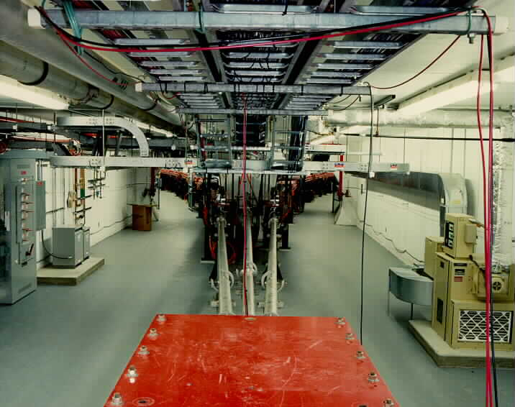
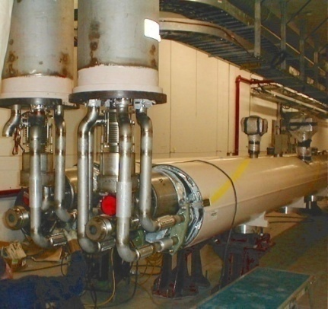
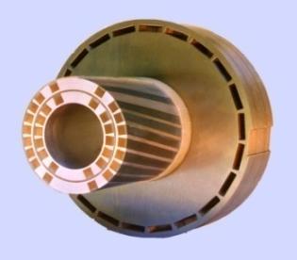
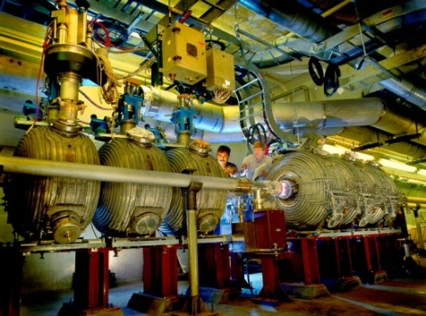
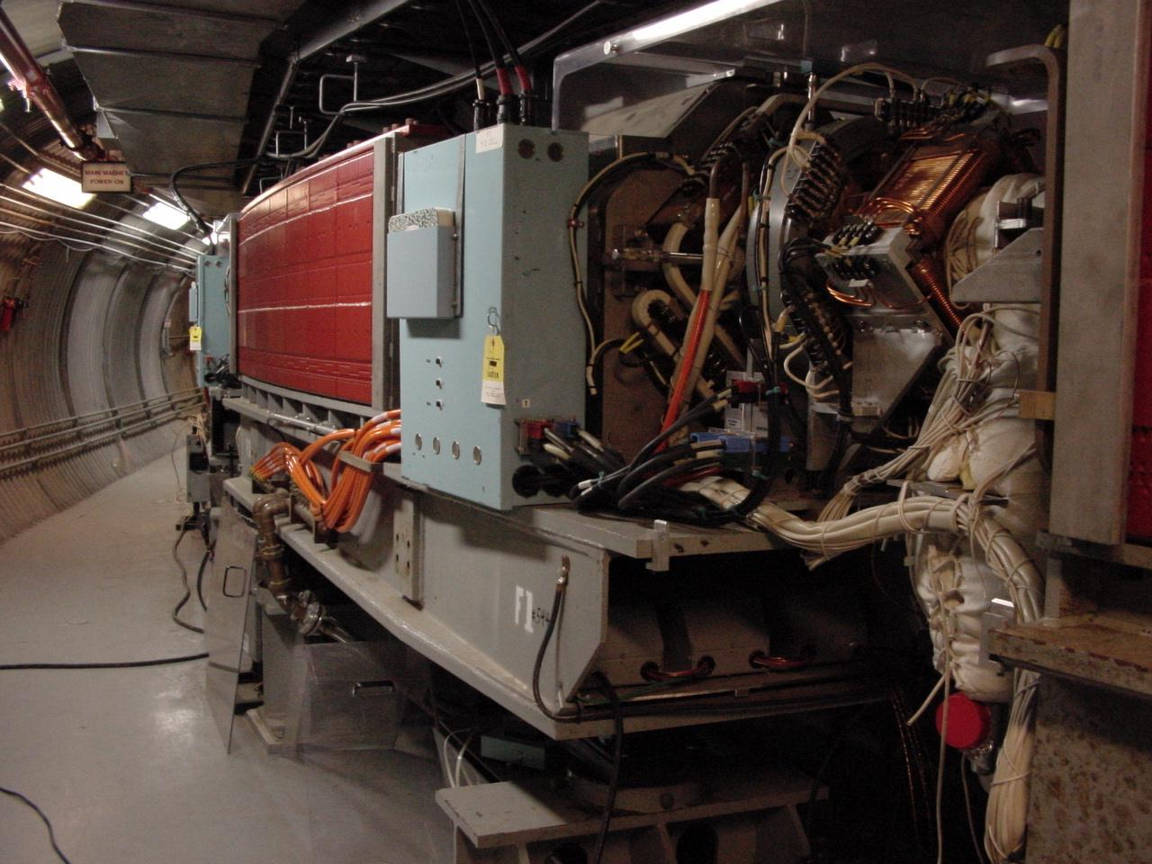
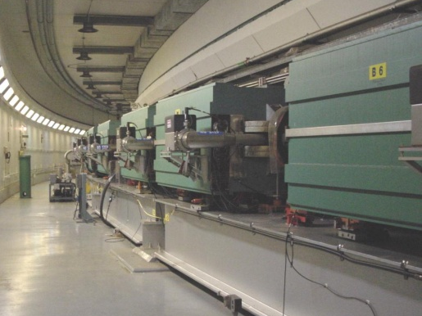
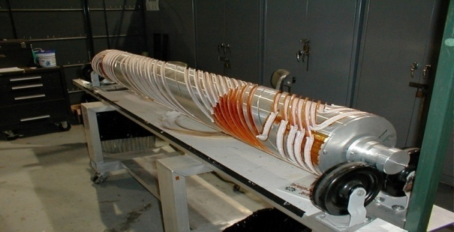
RHIC as a Polarized p+p Collider
Absolute Polarimeter (H jet)
RHIC pC Polarimeters
Siberian Snakes
PHOBOS
BRAHMS & PP2PP
Siberian Snakes
PHENIX
Spin Flipper
STAR
Spin Rotators
Various equipment to maintain and measure beam polarization through acceleration and storage
Partial Snake
Helical Partial
Snake
Polarized Source
Strong Snake
LINAC
AGS
200 MeV Polarimeter
BOOSTER
Rf Dipole
AGS Internal Polarimeter
AGS pC Polarimeter
Notes:
RHIC, as a high-energy polarized proton collider, really represents an outstanding achievement in accelerator physics. . . . [equipment].

Slide 13
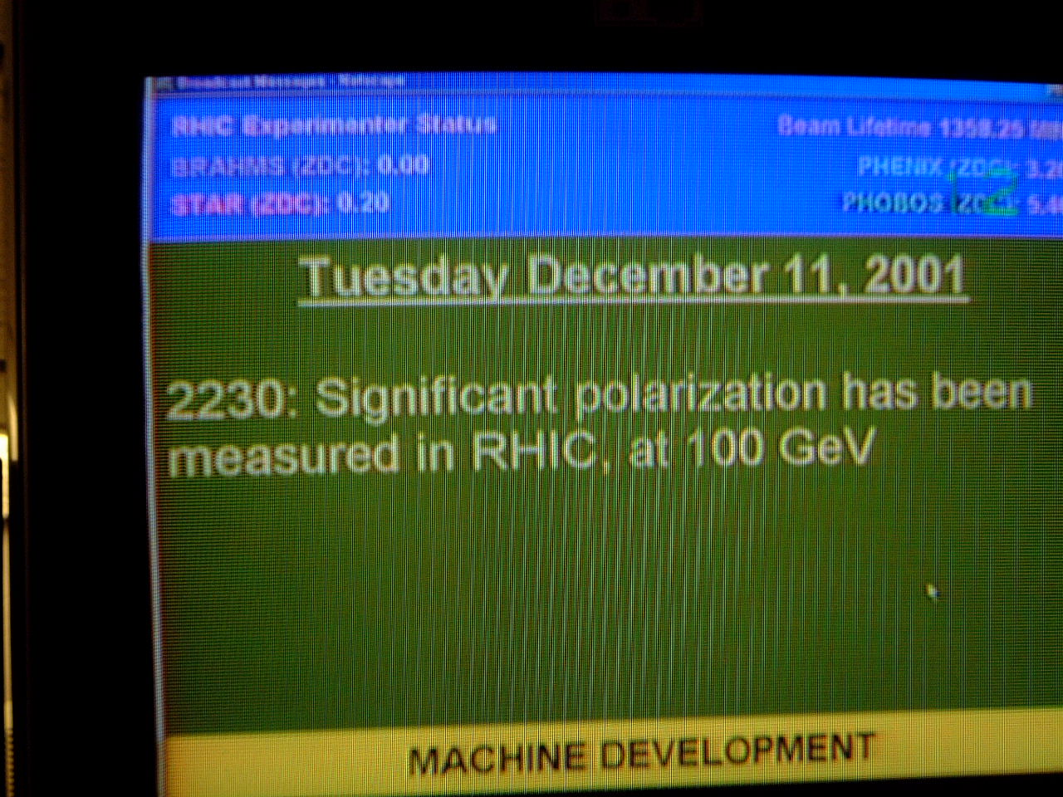
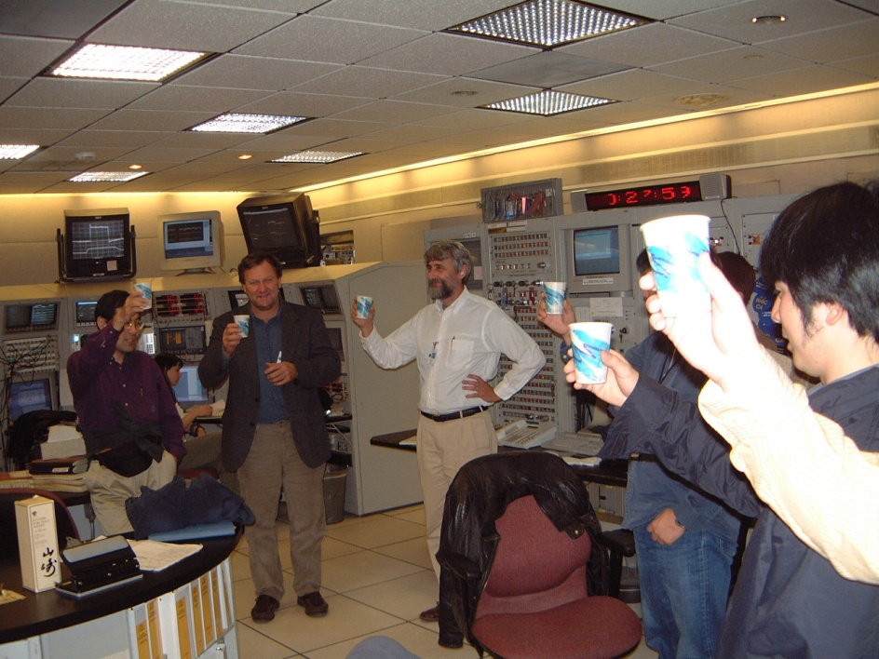
December 2001: News to Celebrate

Slide 14
RHIC Physics
Broadest possible study of QCD in nucleus-nucleus, proton-nucleus, proton-proton collisions
Heavy ion physics
  Investigate nuclear matter under extreme conditions
  Examine systematic variations with species and energy
Proton spin structure
  Gluon polarization (ΔG)
  Sea-quark polarization
  Transverse spin structure
Most versatile hadronic collider in the world!
Nearly any species can be collided with any other, thanks
to separate rings with independent steering magnets.

Slide 15


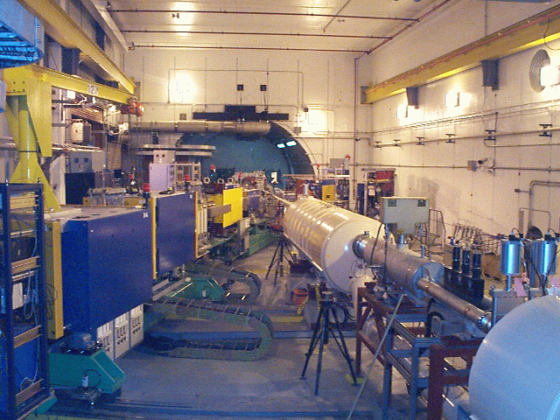
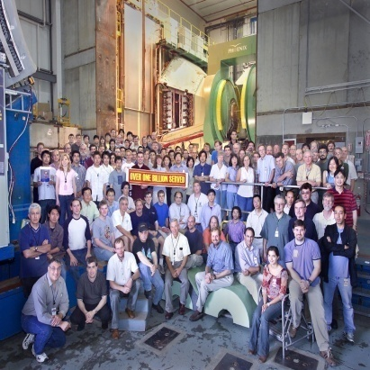
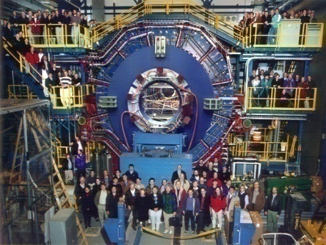


RHIC Spin Physics Experiments
Three experiments: STAR, PHENIX, BRAHMS
Future running only with STAR and PHENIX
Transverse spin only
(No rotators)
Longitudinal or transverse spin
Longitudinal or transverse spin
Accelerator performance:
Avg. pol ~60% at 200 GeV (design 70%).
Achieved 3.5x10³¹ cm⁻² s⁻¹ lumi (design ~5x this).

Slide 16
Proton Spin Structure at RHIC
Transversity
Transverse-momentum-
dependent distributions
, Jets
Prompt Photons
Single-Spin Asymmetries
Back-to-Back Correlations
Advantages of a polarized proton-proton collider:
Hadronic collisions → Leading-order access to gluons
High energies → Applicability of perturbative QCD
High energies → Production of new probes: W bosons

Slide 17
A Polarized Proton Collider:
Opportunities . . . and Challenges
Proton-proton collisions → Direct access to the gluons via gluon-quark, gluon-gluon scattering
High energy provided by a collider allows production of new probes
  W bosons
High energy allows use of convenient theoretical tools
  Factorized perturbative quantum chromodynamics (pQCD)
Challenge: No longer dealing with the “clean” processes of QED!

Slide 18
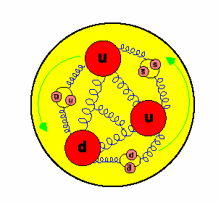
Getting Protons to Study Themselves: Studying Proton Structure with Quark and Gluon Probes
At ultra-relativistic energies
the proton represents a jet
of quark and gluon probes
Need QCD now, not QED!
Notes:
R

Slide 19
Reliance on Input from Simpler Systems
Disadvantage of hadronic collisions: much “messier” than DIS! → Rely on input from simpler systems
The more we know from simpler systems such as DIS and e+e- annihilation, the more we can in turn learn from hadronic collisions!

Slide 20
Factorization and Universality in Perturbative QCD
q(x₁)
Hard Scattering Process
X
g(x₂)
“Hard” probes have predictable rates given:
    Parton distribution functions (need experimental input)
    Partonic hard scattering rates (calculable in pQCD)
    Fragmentation functions (need experimental input)
Universality
(Process
independence)

Slide 21
Proton Spin Structure at RHIC
Transversity
Transverse-momentum-
dependent distributions
, Jets
Prompt Photons
Single-Spin Asymmetries
Back-to-Back Correlations

Slide 22
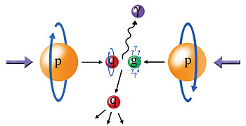
Probing the Helicity Structure of the Nucleon with p+p Collisions
Study difference in particle production rates for same-helicity vs. opposite-helicity proton collisions
DIS
?
pQCD
e+e-
Leading-order access to gluons → ΔG
Notes:
Let me now show you some highlights from the helicity program at RHIC.

Slide 23
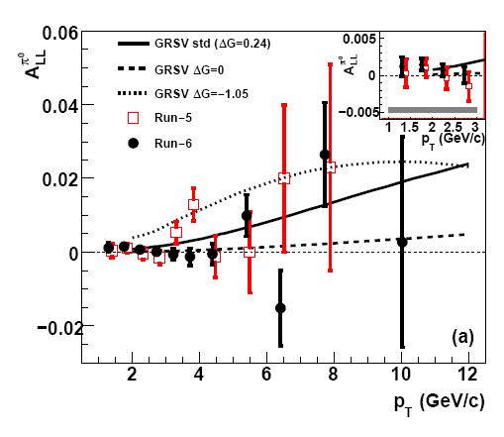
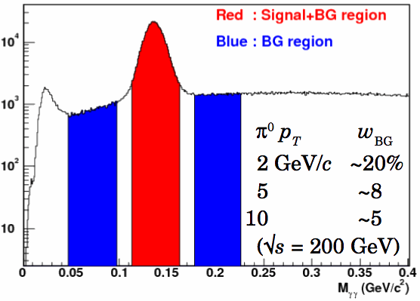

Inclusive Neutral Pion Asymmetry at √s=200 GeV
PRL103, 012003 (2009)
PHENIX: Limited acceptance and fast EMCal trigger → Neutral pions have been primary probe
- Subject to fragmentation function uncertainties, but easy to reconstruct
Helicity asymmetry measurement
Notes:
“Quality of data fits versus gluon spin in measured region”
How do we know that we can trust pqcd in extracting gluon spin?
“pQCD works well at RHIC energies”

Slide 24
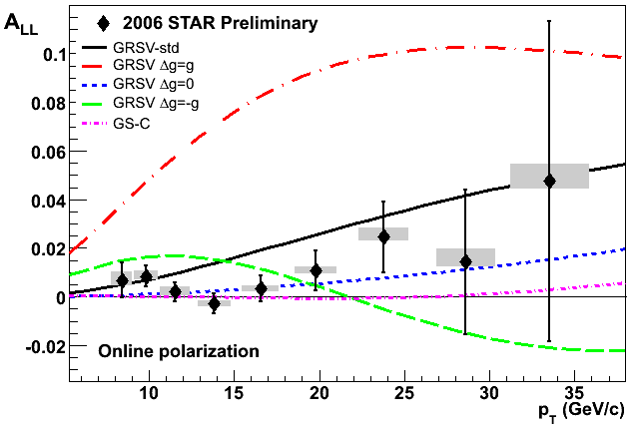

Inclusive Jet Asymmetry at √s=200 GeV
A_{LL} systematics | (x 10 ⁻³)
Reconstruction + Trigger Bias | [-1,+3] (p_{T} dep)
Non-longitudinal Polarization | ~ 0.03 (p_{T} dep)
Relative Luminosity | 0.94
Backgrounds | 1st bin ~ 0.5 Else ~ 0.1
STAR: Large acceptance
→ Jets have been primary probe
Not subject to uncertainties on fragmentation functions, but need to handle complexities of jet reconstruction
π⁺
e⁺
π⁰
π⁻
Κ⁰
p_{T} systematic | ±6.7%
Helicity asymmetry measurement
GRSV curves and data with cone radius R= 0.7 and -0.7 < η < 0.9
STAR
24
Notes:
24

Slide 25
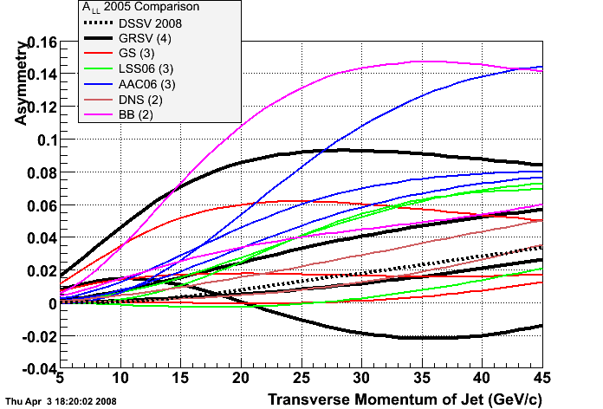
Gradually Honing In . . .
Many predictions for Δg(x) which can be translated into predictions for jet, pion, etc. helicity asymmetries and compared with RHIC data.
NOT a matter of simply distinguishing among a few discrete predictions!
(But note: Same true for DIS, also for extracting unpolarized pdf’s)
Notes:
25

Slide 26
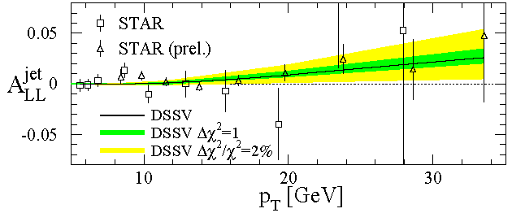
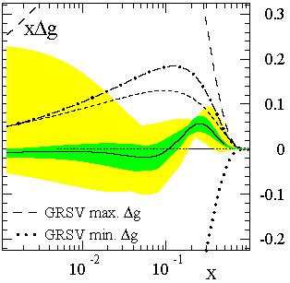
Present Status of Δg(x): Global pdf Analyses
de Florian et al., PRL101, 072001 (2008)
Still a long road ahead! Need to perform measurements with higher precision and covering a greater range in gluon momentum fraction. Data taken earlier this year will push program forward.
The first global next-to-leading-order (NLO) pQCD analysis to include inclusive DIS, semi-inclusive DIS, and RHIC p+p data on an equal footing
Truncated moment of Δg(x) at moderate x found to be small
Best fit finds node in gluon distribution near x ~ 0.1
  Not prohibited, but not so intuitive . . .
x range covered by current RHIC measurements at 200 GeV
Notes:
If you consider the thousands of points going into standard global fits of unpolarized pdf’s, we’ve still got a long way to go!

Slide 27
The Future of ΔG Measurements at RHIC
Extend x coverage
  Run at different center-of-mass energies
    Already results for neutral pions at 62.4 GeV, now first data at 500 GeV
  Extend measurements to forward particle production
    Forward calorimetry recently enhanced in both PHENIX and STAR
Go beyond inclusive measurements—i.e. measure the final state more completely—to better reconstruct the kinematics and thus the x values probed.
  Jet-jet and direct photon – jet measurements – But need higher statistics!
Additional inclusive measurements of particles sensitive to different combinations of quark and gluon scattering

Slide 28
Proton Spin Structure at RHIC
Transversity
Transverse-momentum-
dependent distributions
, Jets
Prompt Photons
Single-Spin Asymmetries
Back-to-Back Correlations

Slide 29
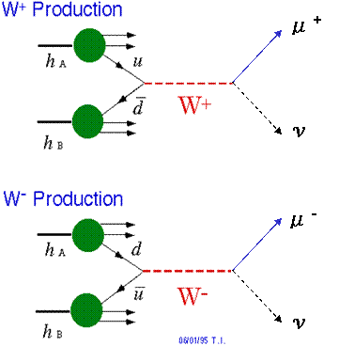
Flavor-Separated Sea Quark Polarizations Through W Production
Flavor separation of the polarized sea quarks with no reliance on FF’s!
Complementary to semi-inclusive DIS measurements.
Parity violation of the weak
interaction in combination with
control over the proton spin
orientation gives access to the
flavor spin structure in the proton!

Slide 30
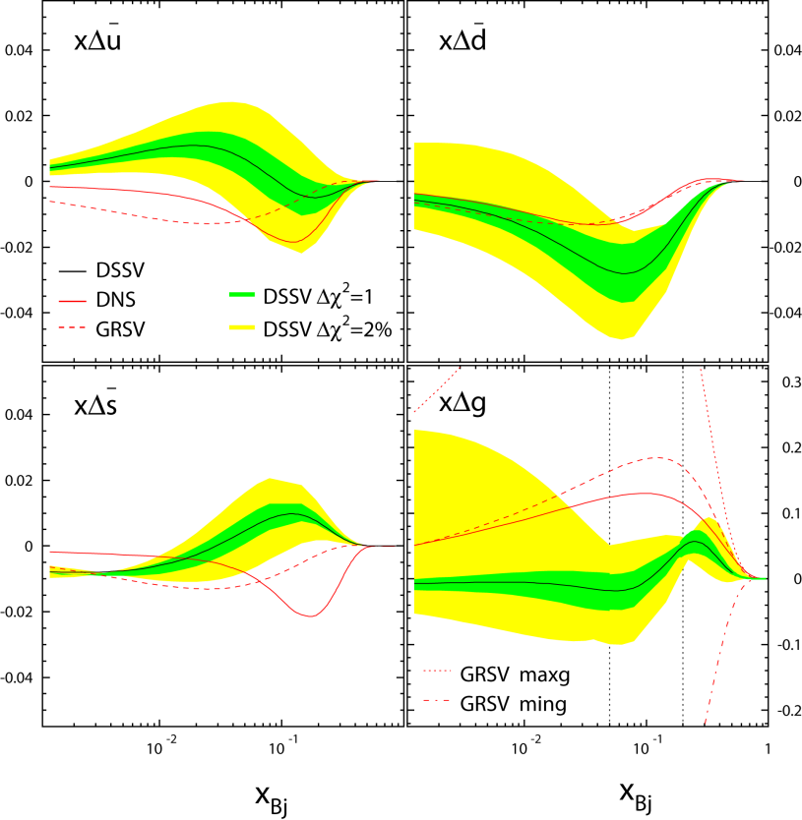
Flavor-Separated Sea Quark Polarizations Through W Production
Latest global fit to helicity distributions: Still relatively large uncertainties on helicity distributions of anti-up and anti-down quarks!
DSSV, PRL101, 072001 (2008)

Slide 31
First 500 GeV Data Recorded!
First 500 GeV run took place in February and March this year
Largely a commissioning run for the accelerator, the polarimeters, and the detectors
  Polarization ~35% so far—many additional depolarizing resonances compared to 200 GeV
  Both STAR and PHENIX will finish installing detector/trigger upgrades to be able to make full use of the next 500 GeV run in 2011
  But W → e already possible with current data!

Slide 32
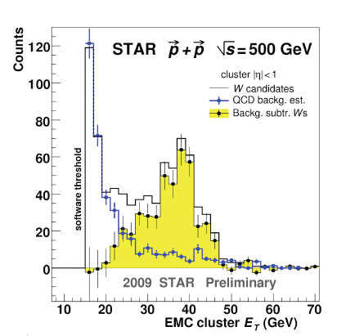
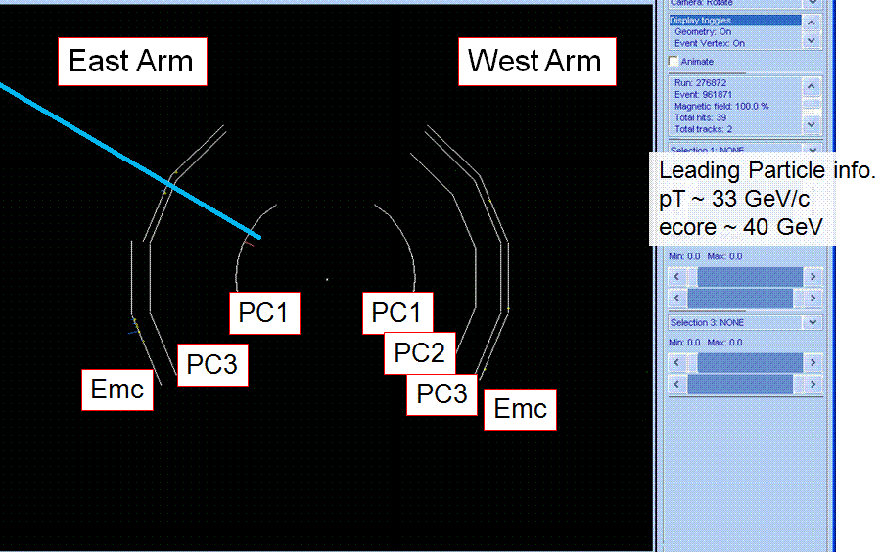
The Hunt for W’s at RHIC has Begun!
Stay tuned . . .!
Clear Jacobian peak seen
Event display of a candidate W event
STAR

Slide 33
Proton Spin Structure at RHIC
Transversity
Transverse-momentum-
dependent distributions
, Jets
Prompt Photons
Single-Spin Asymmetries
Back-to-Back Correlations

Slide 34
Longitudinal (Helicity) vs. Transverse Spin Structure
Transverse spin structure of the proton cannot be deduced from longitudinal (helicity) structure
  Spatial rotations and Lorentz boosts don’t commute!
  Only the same in the non-relativistic limit
Transverse structure linked to intrinsic parton transverse momentum (k_{T}) and orbital angular momentum!

Slide 35
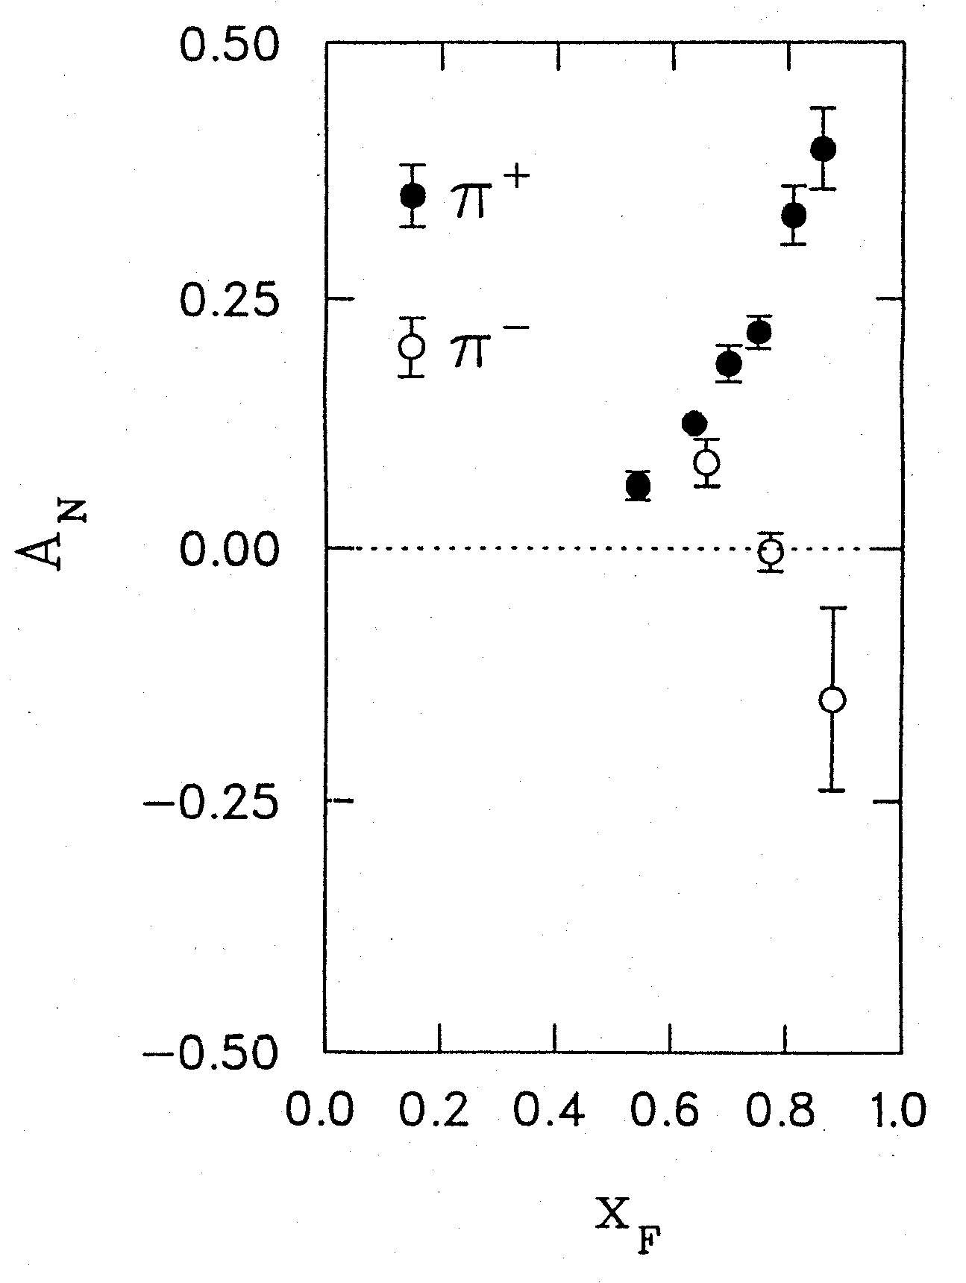
1976: Discovery in p+p Collisions!
Large Transverse Single-Spin Asymmetries
Argonne √s=4.9 GeV
Charged pions produced preferentially on one or the other side with respect to the transversely polarized beam direction!
left
We’ll need to wait more than a decade for the birth of a new subfield in order to start getting a handle on these surprising effects . . .
right
W.H. Dragoset et al., PRL36, 929 (1976)

Slide 36
Transverse-Momentum-Dependent Distributions and Single-Spin Asymmetries
1989: The “Sivers mechanism” is proposed in an attempt to understand the observed asymmetries.
D.W. Sivers, PRD41, 83 (1990)
Transverse Single-Spin Asymmetries ~ S•(p₁×p₂)
→ Access dynamics of quarks and gluons within the proton!
Departs from the traditional collinear factorization assumption in pQCD and proposes a correlation between the intrinsic transverse motion of the quarks and gluons and the proton’s spin

Slide 37
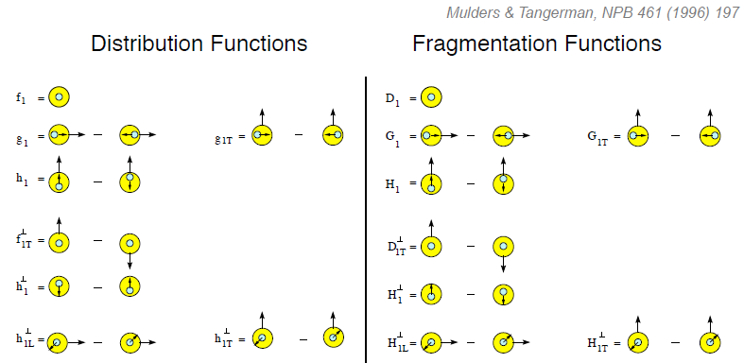
Quark Distribution and Fragmentation Functions (No Collinearity Assumption)
Relevant measurements in simpler systems (DIS, e+e-) only starting to be made over the last ~5 years! Rapidly advancing field both experimentally and theoretically!
Transversity
Measured non-zero
Sivers
Polarizing FF
Boer-Mulders
Pretzelosity
Collins

Slide 38
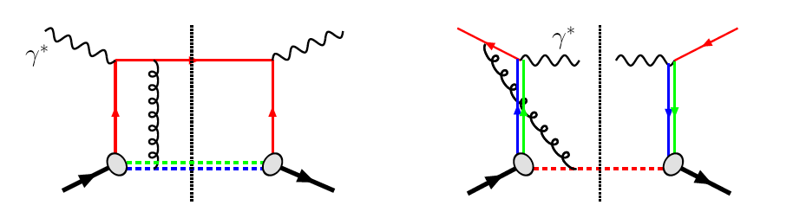
Transverse-Momentum-Dependent pdf’s
and Universality:
Modified Universality of Sivers Asymmetries
DIS: attractive final-state interactions
Drell-Yan: repulsive initial-state interactions
Field has been raising deep questions regarding our understanding of QCD. “Process-dependent” proton structure??
Relevant measurements in semi-inclusive DIS already exist. A p+p measurement will be a crucial test!
As a result:

Slide 39

Transverse Single-Spin Asymmetries:
Strikingly Similar From Low to High Energies!
ANL
√s=4.9 GeV
BNL
√s=6.6 GeV
FNAL
√s=19.4 GeV
RHIC
√s=62.4 GeV
RHIC
√s=200 GeV!
Effects persist to RHIC energies
→ Can probe this non-perturbative structure of nucleon in a calculable regime!
π⁰
left
STAR
right

Slide 40
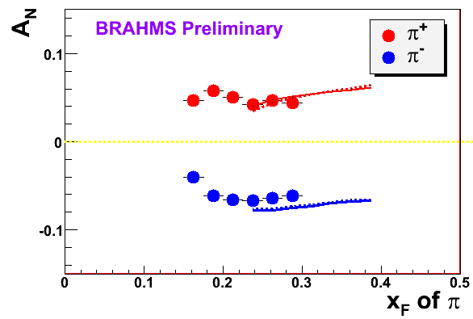
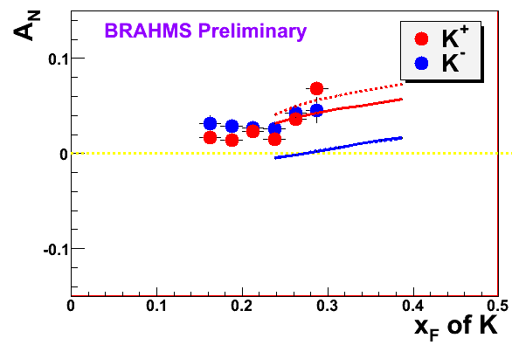
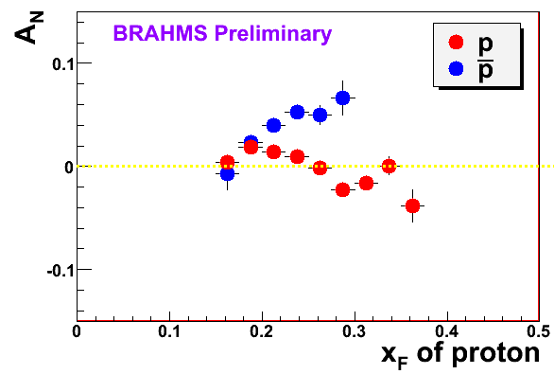
π
π
π, K, p
at 200 and 62.4 GeV
Pattern of pion species asymmetries in the forward direction
→ valence quark effect.
But this conclusion confounded by kaon and antiproton asymmetries!
200 GeV
62.4 GeV
Note different scales
K
K
K- asymmetries
underpredicted
200 GeV
62.4 GeV
p
p
Large antiproton asymmetry?? Unfortunately no 62.4 GeV measurement
200 GeV
62.4 GeV

Slide 41
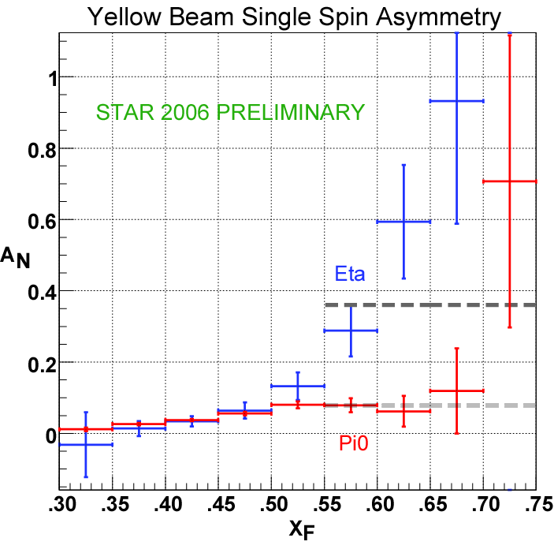
Another Surprise: Transverse Single-Spin Asymmetry in Eta Meson Production
Further evidence against a valence quark effect!
Larger than the neutral pion!
STAR

Slide 42
Correlations Among Spins and Momenta of Quarks and Nucleon
Recall: Single-Spin-Asymmetries ~ S•(p₁×p₂)
Transversity : correlation between transverse proton spin and quark spin
Sivers : correlation between transverse proton spin and quark transverse momentum
Boer-Mulders: correlation between transverse quark spin and quark transverse momentum
S_{p}– S_{q} – coupling?
Long-term goal: Description of the nucleon in terms of the quark and gluon wavefunctions!
S_{p}-- L_{q}– coupling???
S_{q}-- L_{q}– coupling???

Slide 43
QED vs. QCD
observation & models
precision measurements
& fundamental theory

Slide 44

Glancing Into the Future:
The Electron-Ion Collider
Design and build a new facility with the capability of colliding a beam of electrons with a wide variety of nuclei as well as polarized protons and light ions: the Electron-Ion Collider

Slide 45
The EIC: Communities Coming Together
At RHIC, heavy ions and nucleon spin structure already meet, but in some sense by “chance”
  Genuinely different physics
  Communities come from different backgrounds
  Bound by an accelerator that has capabilities relevant to both
Proposed EIC a facility where heavy ion and nucleon structure communities truly come together, peering into various forms of hadronic matter to continue to uncover the secrets and subtleties of QCD . . .

Slide 46
Conclusions and Prospects
After 40 years of studying the internal structure of the nucleon and nuclei, we remain far from the ultimate goal of being able to describe nuclear matter in terms of its quark and gluon degrees of freedom!
You can use protons to study protons!
  Data from RHIC has already improved constraints on the gluon spin contribution to the spin of the proton
  Further data will improve those constraints, teach us about the quark flavor decomposition of the proton’s spin, and continue to push forward knowledge of quark and gluon correlations and dynamics within the proton.
The EIC promises to usher in a new era of precision measurements that will probe the behavior of quarks and gluons in nucleons as well as nuclei, bringing us to a new phase in understanding the rich complexities of QCD in matter.
There’s a large and diverse community of people—at RHIC and complementary facilities—driven to continue coaxing the secrets out of one of the most fundamental building blocks of the world around us.

Slide 47
Additional Material

Slide 48
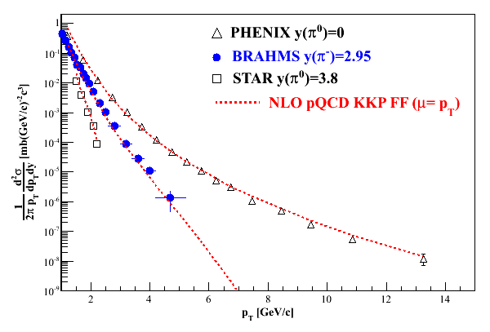
Polarization-averaged cross sections at √s=200 GeV
Good description at 200 GeV over all rapidities down to p_{T} of 1-2 GeV/c.

Slide 49
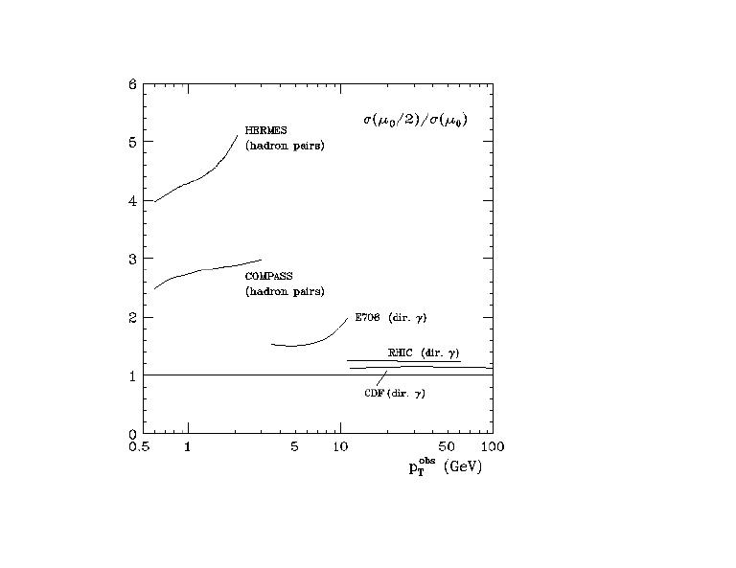
pQCD Scale Dependence at RHIC vs. Spin-Dependent DIS
Scale dependence
benchmark:
Tevatron ~ 1.2
RHIC ~ 1.3
COMPASS ~ 2.5 – 3
HERMES ~ 4 – 5
Scale dependence
at RHIC is significantly
reduced compared to
fixed-target polarized
DIS.
HERMES
(hadron pairs)
Change in pQCD calculation of
cross section if factorization scale
change by factor 2
COMPASS
(hadron pairs)
RHIC
(direct photon)
E708
(direct photon)
CDF
(direct photon)

Slide 50
Sampling the Integral of ΔG: π⁰ p_{T} vs. x_{gluon}
Inclusive asymmetry measurements in p+p collisions sample from wide bins in x—sensitive to (truncated) integral of ΔG, not to functional form vs. x.
Not a clean measurement of x as in DIS!
Based on simulation using NLO pQCD as input
PRL103, 012003 (2009)

Slide 51
π⁰ A_{LL}: Agreement with different parametrizations
For each parametrization, vary ΔG^{[0,1]} at the input scale while fixing Δq(x) and the shape of Δg(x), i.e. no refit to DIS data.
For range of shapes studied, current data relatively insensitive to shape in x region covered.
Need to extend x range!
PRL103, 012003 (2009)

Slide 52
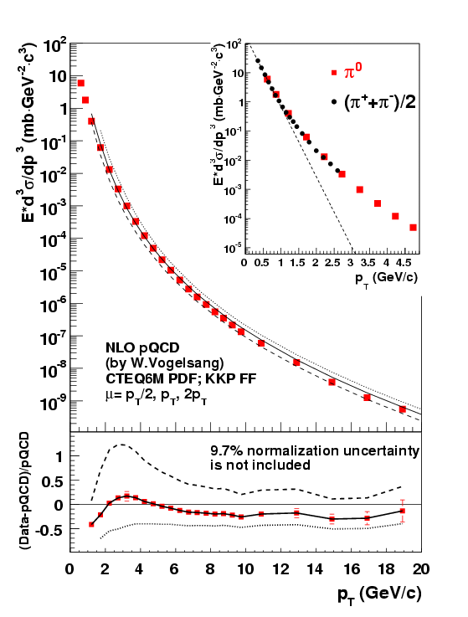
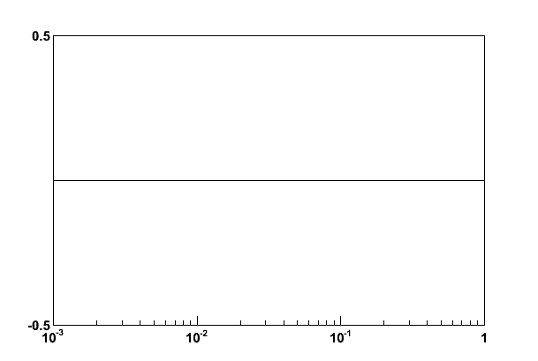
Extending x Coverage
PRD79, 012003 (2009)
Measure in different kinematic regions
  e.g. forward vs. central
Change center-of-mass energy
  Most data so far at 200 GeV
  Brief run in 2006 at 62.4 GeV
  First 500 GeV data-taking to start next month!
62.4 GeV
Extend to lower x at √s = 500 GeV
Extend to higher x at √s = 62.4 GeV
200 GeV
present
x-range
√s = 200 GeV
Notes:
Get rid of!

Slide 53
Neutral Pion A_{LL} at 62.4 GeV
Converting to x_{T}, can see significance of 62.4 GeV measurement (0.08 pb⁻¹) compared to published data from 2005 at 200 GeV (3.4 pb⁻¹).
PRD79, 012003 (2009)

Slide 54
The Pion Isospin Triplet, A_{LL} and ΔG
At transverse momenta > ~5 GeV/c, midrapidity pions dominantly produced via qg scattering
Tendency of π⁺ to fragment from an up quark and π⁻ from a down quark and fact that Δu and Δd have opposite signs make A_{LL} of π⁺ and π⁻ differ measurably
Order of asymmetries of pion species can provide information on the sign of ΔG, which remains unknown!
Fraction pions produced

Slide 55
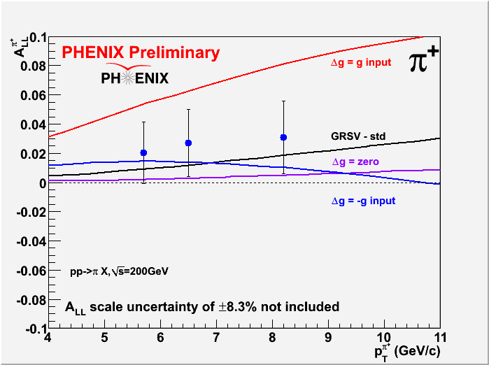
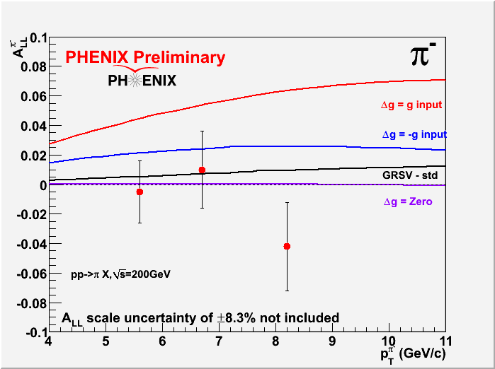
Charged pion A_{LL} at 200 GeV
So far statistics-limited, but will become more significant measurement using data from 200 GeV run earlier this year!

Slide 56
Prokudin et al. at Ferrara

Slide 57
Prokudin et al. at Ferrara

Slide 58
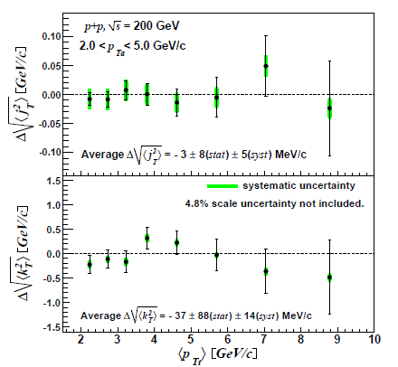
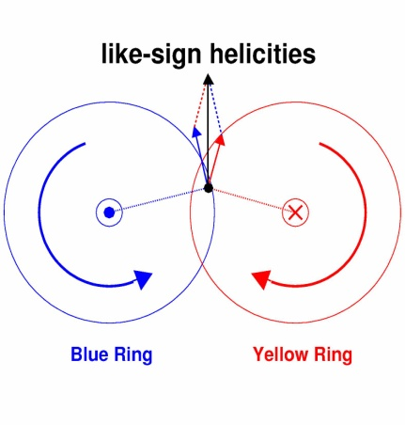
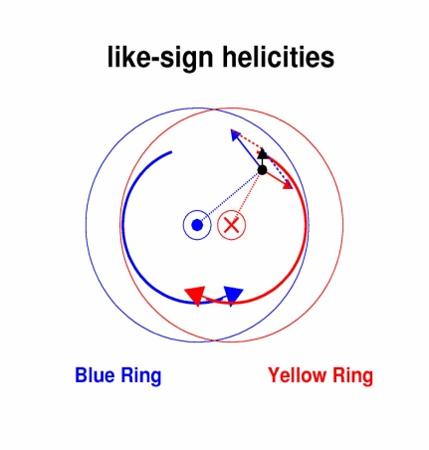
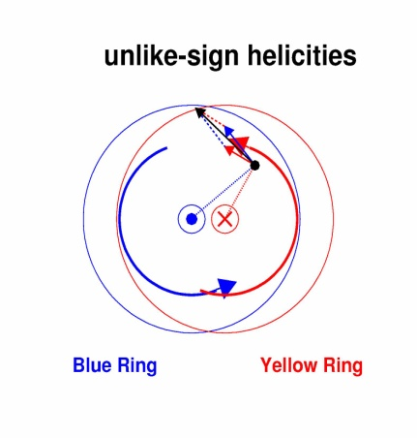
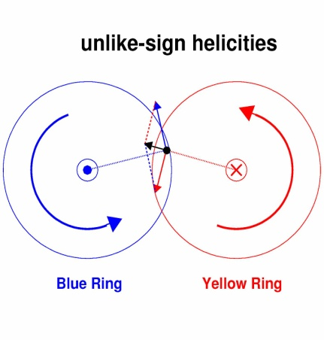
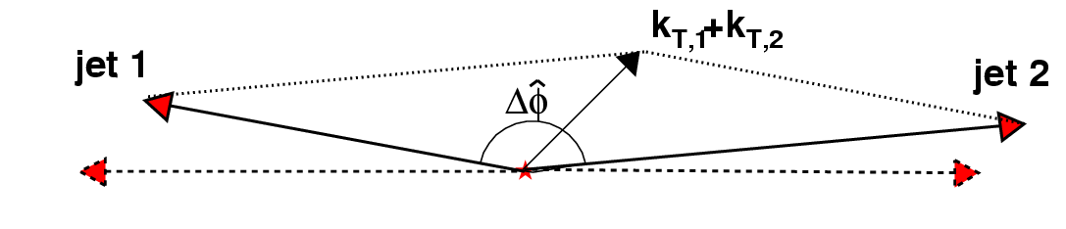
Attempting to Probe k_{T} from
Orbital Motion
k_{T} larger
k_{T} smaller
Spin-correlated transverse momentum (orbital angular momentum) may contribute to jet k_{T}. (Meng Ta-chung et al., Phys. Rev. D40, 1989)
Possible helicity dependence
Would depend on (unmeasured) impact parameter, but may observe net effect after averaging over impact parameter
Same
helicity
Opposite
helicity
arXiv:0910.1029, submitted to PRD

Slide 59

PRL103, 172001 (2009)

Slide 60


Slide 61

Forward neutrons at √s=200 GeV at PHENIX
Large negative SSA observed for x_{F}>0, enhanced by requiring concidence with forward charged particles (“MinBias” trigger).
No x_{F} dependence seen.
Mean p_{T}
(Estimated by simulation assuming ISR p_{T} dist.)
0.4<|x_{F}|<0.6 0.088 GeV/c
0.6<|x_{F}|<0.8 0.118 GeV/c
0.8<|x_{F}|<1.0 0.144 GeV/c
preliminary | A_{N}
Without MinBias | -6.6 ±0.6 %
With MinBias | -8.3 ±0.4 %
charged
particles
neutron
neutron

Slide 62
Forward neutrons at other energies
Significant forward neutron asymmetries observed down to 62.4 and up to 410 GeV!
√s=62.4 GeV
√s=410 GeV

Slide 63






Single-Spin Asymmetries for Local Polarimetry:
Confirmation of Longitudinal Polarization
A_{N}
Spin Rotators OFF
Vertical polarization
Blue
φ
Yellow
Spin Rotators ON
Current Reversed!
Radial polarization
Blue
Yellow
Spin Rotators ON
Correct Current
Longitudinal polarization!
Blue
Yellow

Slide 64

Hydrogen-Jet Polarimeter for Beams at Full Energy
(polarized)
proton beam
scattered
proton
Use transversely polarized hydrogen target and take advantage of transverse single-spin asymmetry in elastic proton-proton scattering
Only consider single polarization at a time. Symmetric process!
  Know polarization of your target
  Measure analyzing power in scattering
  Then use analyzing power to measure polarization of beam
polarized
proton target
recoil proton

Slide 65

First Observation of the Collins Effect
in Polarized Deep Inelastic Electron-Proton Scattering
HERMES
Collins Asymmetries in semi-
inclusive deep inelastic scattering
e+p → e + π + X
~ Transversity (x) x Collins(z)
A_{UT} sin(φ+φ_{s})

Slide 66
The Collins Effect Must be Present
in e⁺e⁻ Annihilation into Quarks!
electron
q₁
q₂
quark-1
spin
quark-2
spin
Collins effect in e+e-
Quark fragmentation
will lead to effects
in di-hadron correlation
measurements!
positron

Slide 67


Observation of the Collins Effect in e⁺e⁻
Annihilation with Belle
Belle (UIUC/RBRC) group
Collins Asymmetries in e⁺e⁻
annihilation into hadrons
e⁺+e⁻ → π⁺ + π⁻ + X
~ Collins(z₁) x Collins (z₂)
PRELIMINARY
ϕ₂−π
Θ
e⁻
ϕ₁
e⁺
A₁₂ cos(φ₁+φ₂)

Slide 68




Sivers Asymmetries at HERMES
and COMPASS
implies non-zero L_{q}
π^{+/−}
Κ^{+/−}

Slide 69

The STAR Detector at RHIC
STAR

Slide 70


PHENIX Detector
Philosophy:
  High rate capability to measure rare probes,
  but limited acceptance.
2 central
spectrometers
Track charged particles and detect electromagnetic processes
azimuth
2 forward
spectrometers
- Identify and track muons

Slide 71


BRAHMS detector
Philosophy:
  Small acceptance spectrometer arms
  designed with good charged particle ID.

