Slide 1

MEIC at JLab: Machine Design Status
Andrew Hutton
Jefferson Lab
For the JLab EIC Study Group
EIC Collaboration Meeting, Stony Brook University, Jan. 10-12, 2010

Slide 2
Outline
Introduction & Highlights
Machine Design Status
  Design, luminosity, key enabling technologies
Design Details
Critical R&D
  Assessment, state-of-art, program and progress
Path forward
Summary

Slide 3
ELIC: The Primary Future for JLab World Class Nuclear Science Program
JLab has been developing a preliminary design of an EIC based on the CEBAF recirculating SRF linac for nearly a decade.
Based on the requirements of the future nuclear science program, design efforts have focused on achieving:
    ultra high luminosity (up to 10³⁵) in multiple detectors
    very high polarization (>80%) for both electron & light ions
We have made significant progress on design optimization
    Primary focus on a Medium-energy Electron Ion Collider (MEIC) as the best compromise between science, technology and project cost
      Energy range is up to 60 GeV ions and 11 GeV electrons
    A well-defined upgrade capability is maintained
    High luminosity & high polarization continue to be the design drivers

Slide 4
MEIC Enabling Technologies
Pushing the limits of present accelerator theory
  Issues associated with short ion bunches (e.g.. cooling)
  Issues associated with small β* at collision points
    Focus on chromatic compensation
  Beam-beam effects
Development of new advanced concepts
  Dispersive crabbing
  Beam-based fast kicker for circulator electron cooler

Slide 5
Outline
Introduction & Highlights
Machine Design Status
  Design, luminosity, key enabling technologies
Design Details
Critical R&D
  Assessment, state-of-art, program and progress
Path forward
Summary

Slide 6
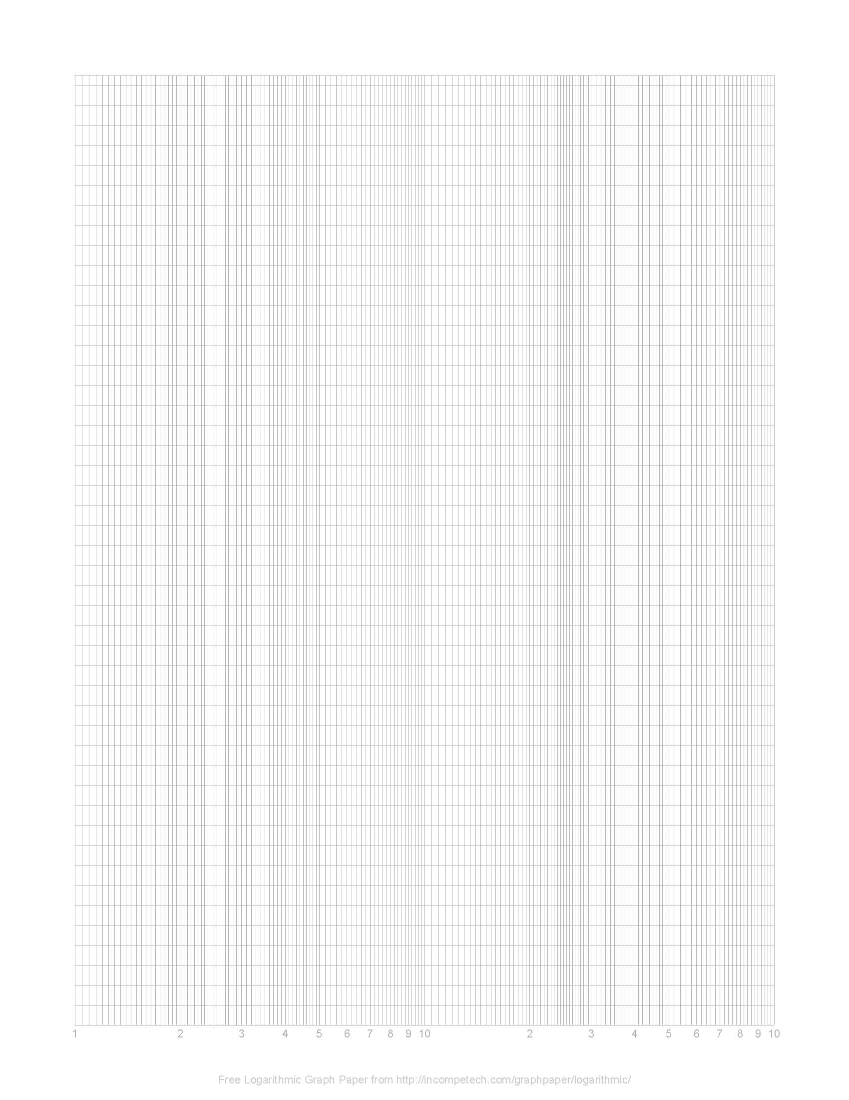
MEIC Science Drivers
Key issues in nucleon structure & nuclear physics
Sea quark and gluon imaging of nucleon with GPDs (x >~ 0.01)
Orbital angular momentum, transverse spin, and TMDs
QCD vacuum in hadron structure and fragmentation
Nuclei in QCD: Binding from EMC effect, quark/gluon radii from coherent processes, transparency
Machine/detector requirements
High luminosity > 10³⁴: Low rates, differential measurements
CM energy s~1000 GeV²: Reach in Q², x
Detectability: Angular coverage, particle ID, energy resolution
E_{CM} (GeV)
120
50 fb⁻¹
x_{min} ~ 10⁻⁴
100
gluon saturation
DIS
nucleon
structure
exclusive, electroweak
processes
80
quarks, gluons in nuclei
60
MEIC
MEIC
40
x_{min} ~ 10⁻³
sin²θ_{W}
20
x_{min} ~ 10⁻²
  favors lower & more
  symmetric energies
0
1
10
100
∫L dt (fb⁻¹)
R. Ent

Slide 7
ELIC Design Goals
Energy
  Wide CM energy range between 10 GeV and 100 GeV
  Low energy: 3 to 10 GeV e on 3 to 12 GeV/c p (and ion)
  Medium energy: up to 11 GeV e on 60 GeV p or 30 GeV/n ion
  and for future upgrade
  High energy: up to 10 GeV e on 250 GeV p or 100 GeV/n ion
Luminosity
  10³³ up to 10³⁵ cm⁻² s⁻¹ per collision point
  Multiple interaction points
Ion Species
  Polarized H, D, ³He, possibly Li
  Up to heavy ion A = 208, all stripped
Polarization
  Longitudinal at the IP for both beams, transverse of ions
  Spin-flip of both beams
  All polarizations >70% desirable
Positron Beam desirable

Slide 8
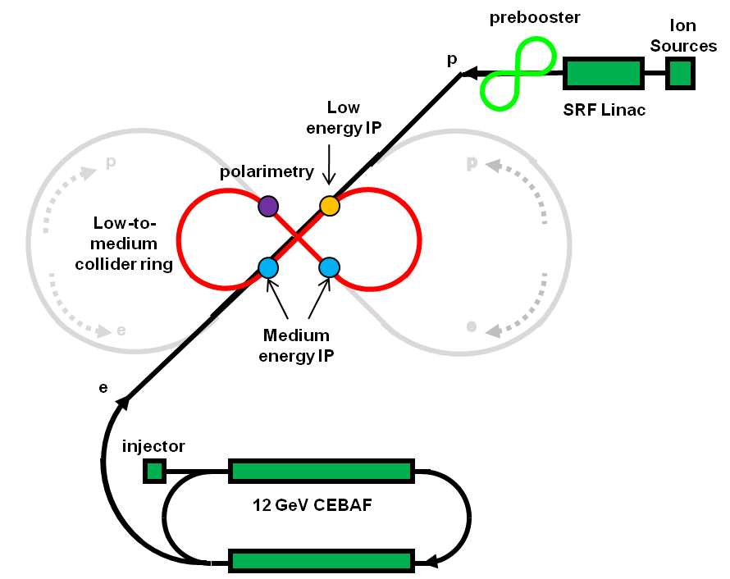
MEIC: Low and Medium Energy
Three compact rings:
3 to 11 GeV electron
Up to 12 GeV/c proton (warm)
Up to 60 GeV/c proton (cold)

Slide 9
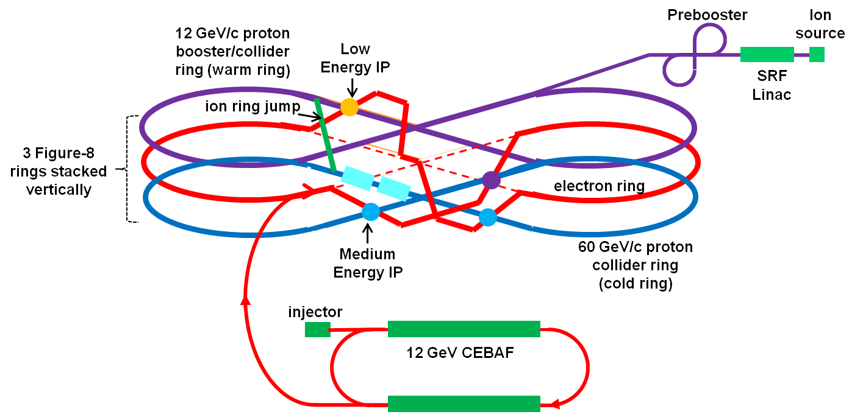
MEIC: Detailed Layout
polarimetry

Slide 10
ELIC: High Energy & Staging
Serves as a large booster to the full energy collider ring
Circumference | m | 1800
Radius | m | 140
Width | m | 280
Length | m | 695
Straight | m | 306
p
prebooster
SRF Linac
Ion Sources
p
p
ELIC collider ring
MEIC collider ring
electron ring
Interaction Point
e
e
e
injector
Ion ring
Vertical crossing
12 GeV CEBAF
Stage |  | Max. Energy (GeV/c) |  | Ring Size (m) |  | Ring Type |  | IP#
 |  | p | e | p | e | p | e
 | Low | 12 | 5 (11) | 630 |  | Warm | Warm | 1
 | Medium | 60 | 5 (11) | 630 |  | Cold | Warm | 2
 | High | 250 | 10 | 1800 |  | Cold | Warm | 4

Slide 11
ELIC Main Parameters
Beam Energy | GeV | 250/10 | 150/7 | 60/5 | 60/3 |  | 12/3
Collision freq. | MHz |  |  | 499
Particles/bunch | 10¹⁰ | 1.1/3.1 | 0.5/3.25 | 0.74/2.9 | 1.1/6 |  | 0.47/2.3
Beam current | A | 0.9/2.5 | 0.4/2.6 | 0.59/2.3 | 0.86/4.8 |  | 0.37/2.7
Energy spread | 10⁻⁴ | ~ 3
RMS bunch length | mm | 5 | 5 | 5 | 5 |  | 50
Horiz.. emit., norm. | μm | 0.7/51 | 0.5/43 | 0.56/85 | 0.8/75 |  | 0.18/80
Vert. emit. Norm. | μm | 0.03/2 | 0.03/2.87 | 0.11/17 | 0.8/75 |  | 0.18/80
Horizontal beta-star | mm | 125 | 75 | 25 | 25 |  | 5
Vertical beta-star | mm | 5
Vert. b-b tune shift/IP |  | 0.01/0.1 | 0.015/.05 | 0.01/0.03 | .015/.08 |  | .015/.013
Laslett tune shift | p-beam | 0.1 | 0.1 | 0.1 | 0.054 |  | 0.1
Peak Lumi/IP, 10³⁴ | cm⁻²s⁻¹ | 11 | 4.1 | 1.9 | 4.0 |  | 0.59
High energy
Medium energy
Low energy

Slide 12
Achieving High Luminosity
MEIC design luminosity
L~ 4x10³⁴ cm⁻² s⁻¹ for medium energy (60 GeV x 3 GeV)
Luminosity Concepts
  High bunch collision frequency (0.5 GHz, can be up to 1.5 GHz)
  Very small bunch charge (<3x10¹⁰ particles per bunch)
  Very small beam spot size at collision points (β*_{y} ~ 5 mm)
  Short ion bunches (σ_{z} ~ 5 mm)
  Keys to implementing these concepts
  Making very short ion bunches with small emittance
  SRF ion linac and (staged) electron cooling
  Need crab crossing for colliding beams
  Additional ideas/concepts
  Relative long bunch (comparing to beta*) for very low ion energy
  Large synchrotron tunes to suppress synchrotron-betatron resonances
  Equal (fractional) phase advance between IPs

Slide 13
MEIC Ring-Ring Design Features
Ultra high luminosity
Polarized electrons and polarized light ions
Up to three IPs (detectors) for high science productivity
“Figure-8” ion and lepton storage rings
  Ensures spin preservation and ease of spin manipulation
  Avoids energy-dependent spin sensitivity for all species
Present CEBAF injector meets MEIC requirements
  12 GeV CEBAF can serve as a full energy injector
    Simultaneous operation of collider & CEBAF fixed target program if required
Experiments with polarized positron beam would be possible

Slide 14
Outline
Introduction & Highlights
Machine Design Status
  Design, luminosity, key enabling technologies
Design Details
Critical R&D
  Assessment, state-of-art, program and progress
Path forward
Summary

Slide 15
Design Choice - Figure-8 Ion Rings
Figure-8 optimum for polarized ion beams
  Simple solution to preserve full ion polarization by avoiding spin resonances during acceleration
  Energy independence of spin tune
  g-2 is small for deuterons; a figure-8 ring is the only practical way to arrange for longitudinal spin polarization at interaction point
  Allows multiple interactions in the same straight – can help with chromatic correction
  Only possible disadvantage is small cost increase
  There are no technical disadvantages

Slide 16
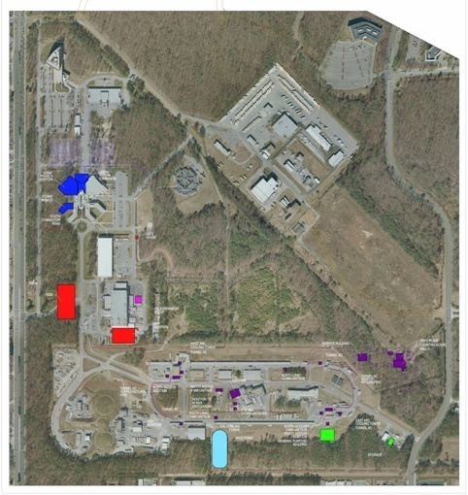
Figure-8 Ring Footprint
Ring circumference is a compromise
  Synchrotron radiation power of e-beam
  ➔ prefers large arc length
  Space charge effect of ion beams
  ➔ prefers small circumference
Multiple IPs require long straights
Straights also hold service elements
(cooling, injection and ejections, etc.)
City of NN
WM
State
City of NN
MEIC Footprint (~600m)
SURA
ELIC Footprint (~1800m)
CEBAF
Medium Energy IP
Arc | 157 m
Figure-8 straight | 150 m
Insertion | 10 m
Circumference | 660 m
Snake Insertion
60°
Low Energy IP

Slide 17
Figure-8 Electron Ring
L = 150 m
C = 180 m
60⁰
total ring circumference: 660 m
Q_{x}=32.096 Q_{y}=29.113
Arc outward
Straight + 2 IR
Arc inward
Straight disp.

Slide 18
Electron Ring Tune Diagram
Two Ring ‘tunes’ are being studied:
Working point above the integer:
Q_{x}=32.096 Q_{y}=29.113
Working point a la KEKB:
Q_{x}=32.506 Q_{y}=29.531

Slide 19
Figure-8 Ion Ring
L = 150 m
C = 180 m
60⁰
total ring circumference: 660 m
FODO lattice
Arc inward
Straight
Arc outward

Slide 20
Straight Section Layout
Minimizing crossing angle reduces crab cavity challenges
y
straight section
z
spin rotator
vertical bend
vertical bend
spin rotator
e
e
collision point
collision point
arc dipoles
~0.5 m
arc bend
i
~0.5 m
i
vertical bend
spin rotators
vertical bend
Vertical crossing angle (~30 mrad)
Optional 2nd detector
Interaction Region
~ 60 m
IP
FODO
Crab cavity
Chrom
Matching quads
FF
FF
Matching quad
Chrom
Crab cavity
FODO
Detector space

Slide 21
Low Beta Focusing
vertical focusing first
IP
IP
FF triplet : Q3 Q2 Q1
l * = 6m
Q1 G[kG/cm] = -3.4
Q2 G[kG/cm] = 2.1
Q3 G[kG/cm] = -4.1
l * = 6m
Natural Chromaticity: ζ_{x} = -278 ζ_{y} = -473

Slide 22
Forming a High-Intensity Ion Beam
cooling
Stacking proton beam in ACR
low energy ring
SRF Linac
Circumference | m | 100
Energy/u | GeV | 0.2 -0.4
Cooling electron current | A | 1
Cooling time for protons | ms | 10
Stacked ion current | A | 1
Norm. emit. After stacking | µm | 16
source
pre-booster-Accumulator ring
Medium energy collider ring
 | Energy (GeV/c) | Cooling | Process
Source/SRF linac | 0.2 |  | Full stripping
Prebooster/Accumulator-Ring | 3 | DC electron | Stacking/accumulating
Low energy ring (booster) | 12 | Electron | RF bunching (for collision)
Medium energy ring | 60 | Electron | RF bunching (for collision)
Stacking/accumulation process
Multi-turn (~20) pulse injection from SRF linac into the prebooster
Damping/cooling of injected beam
Accumulation of 1 A coasted beam at space charge limited emittance
Fill prebooster/large booster, then acceleration
Switch to collider ring for booster, RF bunching & staged cooling

Slide 23
Electron Polarization
Producing/matching
CEBAF polarized electron source
Injected into Figure-8 ring with vertical polarization
Turn to longitudinal direction at IPs using vertical crossing bends and solenoid spin rotators
Maintaining in the ring
electron self-polarization
SC solenoids at IRs removes spin resonances & energy sensitivity.
spin rotator
180º spin rotator
spin rotator
collision point
collision point
spin rotator
180º spin rotator
spin rotator
Energy independent spin rotation - vertical to longitudinal
Solenoid spin rotator
Vertical bending dipole
Vertical bending dipole
Solenoid spin rotator
spin
spin tune solenoid
Spin tune solenoid
e
e
i
Arc bending dipoles
90º
90º
Arc bending dipoles
i
spin tune solenoid
spin tune solenoid
Vertical bending dipole
Spin rotators
Vertical bending dipole

Slide 24
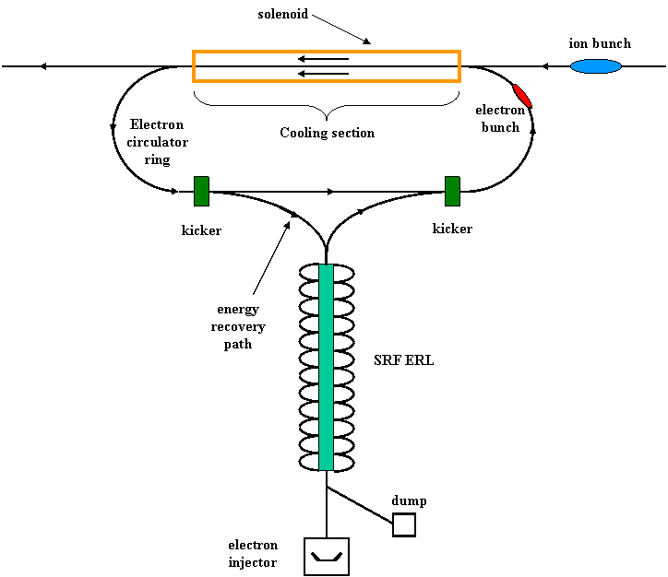
ERL Circulator Cooler
Design goal
Up to 33 MeV electron energy
Up to 3 A CW unpolarized beam
(~nC bunch charge @ 499 MHz)
Up to 100 MW beam power!
Solution: ERL Circulator Cooler
ERL provides high average current CW beam with minimum RF power
Circulator ring for reducing average current from source and in ERL
(# of circulating turns reduces ERL current by same factor)
Technologies
High intensity electron source/injector
Energy Recovery Linac (ERL)
Fast kicker
Electron circulator ring

Slide 25
Positrons in CEBAF/MEIC
10 MeV
converter
Unpolarized positrons generated from the modified electron injector by a converter
Self-polarization in the lepton storage ring
5 MeV
e+
Longitudinal emitt. filter
Transverse emitt. filter
Polarized source
e-
15 MeV
e-
e
-
e-
e+
dipole
115 MeV
dipole
dipole
15 MeV
e+
During positron production:
- Polarized source is off
- Dipoles are turned on
Position-ion collisions should reach same luminosity as electron-ion collisions
Unpolarized source
Positron source development at JLab
“CEPBAF”, S. Golge (Ph. D thesis)
Polarized e+ Source, J. Dumas (PhD thesis)
Joint JLab/Idaho Univ. Positron Program
International Workshop on Positrons at Jefferson Lab
March 25-27, 2009
(M. Poelker)

Slide 26
Technology Under Consideration:
Crab Waist
Proposed for Super-B factory for luminosity enhancement (Raimondi)
Deals with large Piwinski angle and low vertical beta-star
Super-B design calls for 0.2 mm β* while bunch length is 6 mm
Recent proof-of-principle experiment at DAΦNE very positive
x
β
Y
e+
e
-
2
σ
x
/
θ
θ
2
σ
z
*
θ
z
2
σ
z
2
σ
x
Crabbed waist can be realized with a sextupole in with IP in x and at π/2 in y

Slide 27
Technology Under Consideration: Traveling Final Focusing
Space charge effect dominates in a very low energy ion beam
Laslett tune-shift limits total charge that can be loaded into a bunch
Long ion bunch can hold more charge with same charge density, therefore increasing luminosity
Hour glass effect can kill luminosity if the bunch length is much large than β*
“Traveling final focusing” has been proposed to mitigate hour glass effect (Brinkmann/Dohlus), originally using RF cavity
New realization scheme: crab crossing with sextupoles
slice 1
sextupole
F₁
slice 2
slice 2
Crab cavity
slice 1
F₂

Slide 28
Outline
Introduction & Highlights
Machine Design Status
  Design, luminosity, key enabling technologies
Design Details
Critical R&D
Path forward
Summary

Slide 29
MEIC Critical Accelerator R&D
  We have identified the following critical R&D for MEIC at JLab
    Interaction Region design with chromatic compensation
    Electron cooling
    Crab crossing and crab cavity
    Forming high intensity low energy ion beam
    Beam-beam effect
    Beam polarization and tracking
    Traveling focusing for very low energy ion beam
Level of R&D | Low-to-Medium Energy (12x3 GeV/c) & (60x5 GeV/c) | High Energy (up to 250x10 GeV)
Challenging
Semi Challenging | IR design/chromaticity Electron cooling Traveling focusing (for very low ion energy) | IR design/chromaticity Electron cooling
Likely | Crab crossing/crab cavity High intensity low energy ion beam | Crab crossing/crab cavity High intensity low energy ion beam
Know-how | Spin tracking Beam-Beam | Spin tracking Beam-beam

Slide 30
Outline
Introduction & Highlights
Machine Design Status
  Design, luminosity, key enabling technologies
Design Details
Critical R&D
  Assessment, state-of-art, program and progress
Path forward
Summary

Slide 31
Future Accelerator R&D
We will concentrate R&D efforts on the most critical tasks
Focal Point 1: Complete Electron and Ion Ring designs
sub tasks: Finalize chromaticity correction of electron ring and complete particle tracking
Insert interaction region optics in ion ring
Start chromaticity correction of ion ring, followed by particle tracking
Led by Slava Derbenev and Alex Bogacz (JLab)
Focal Point 2: IR design and feasibility studies of advanced IR schemes
sub tasks: Develop a complete IR design
Beam dynamics with crab crossing
Traveling final focusing and/or crab waist?
Led by Mike Sullivan (SLAC)

Slide 32
Future Accelerator R&D
Focal Point 3: Forming high-intensity short-bunch ion beams & cooling
sub tasks: Ion bunch dynamics and space charge effects (simulations)
Electron cooling dynamics (simulations)
Dynamics of cooling electron bunch in ERL circulator ring
Led by Peter Ostroumov (ANL)
Focal Point 4: Beam-beam interaction
sub tasks: Include crab crossing and/or space charge
Include multiple bunches and Interaction Points
Led by Yuhong Zhang and Balsa Terzic (JLab)
Additional design and R&D studies
Electron spin tracking, ion source development
Transfer line design

Slide 33
Collaborations Established
Interaction region design M. Sullivan (SLAC)
ELIC ion complex front end P. Ostroumov (ANL)
(From source up to injection into collider ring)
  Ion source V. Dudnikov, R. Johnson (Muons, Inc)
  V. Danilov (ORNL)
  SRF Linac P. Ostroumov (ANL), B. Erdelyi (NIU)
Chromatic compensation A. Netepenko (Fermilab)
Beam-beam simulation J. Qiang (LBNL)
Electron cooling simulation D. Bruhwiler (Tech X)
Electron spin tracking D. Barber (DESY)

Slide 34
Summary
MEIC is optimized to collide a wide variety of polarized light ions and unpolarized heavy ions with polarized electrons (or positrons)
MEIC covers an energy range matched to the science program proposed by the JLab nuclear physics community (~1000 GeV²) with luminosity up to 4x10³⁴ cm⁻²s⁻¹
An Upgrade path to higher energies (250x10 GeV²), has been developed which should provide luminosity of 1x10³⁵ cm⁻²s⁻¹
The design is based on a Figure-8 ring for optimum polarization, and an ion beam with high repetition rate, small emittance and short bunch length
Electron cooling is absolutely essential for cooling and bunching ion beams
We have identified the critical accelerator R&D topics for MEIC
EIC is the future of Nuclear Physics at JLab

Slide 35
ELIC Study Group
A. Afanasev, A. Bogacz, J. Benesch, P. Brindza, A. Bruell, L. Cardman, Y. Chao, S. Chattopadhyay, E. Chudakov, P. Degtiarenko, J. Delayen, Ya. Derbenev, R. Ent, P. Evtushenko, A. Freyberger, D. Gaskell, J. Grames, L. Harwood, T. Horn, A. Hutton, C. Hyde, R. Kazimi, F. Klein, G. A. Krafft, R. Li, L. Merminga, J. Musson, A. Nadel-Turonski, M. Poelker, R. Rimmer, C. Tengsirivattana, A. Thomas, M. Tiefenback, H. Wang, C. Weiss, B. Wojtsekhowski, B. Yunn, Y. Zhang - Jefferson Laboratory staffs and users
W. Fischer, C. Montag - Brookhaven National Laboratory
D. Barber - DESY
V. Danilov - Oak Ridge National Laboratory
V. Dudnikov - Brookhaven Technology Group
P. Ostroumov - Argonne National Laboratory
V. Derenchuk - Indiana University Cyclotron Facility
A. Belov - Institute of Nuclear Research, Moscow, Russia
V. Shemelin - Cornell University

